Slide 1
R-Seminar Win 2022
EEMB 595R
2022
Leander Anderegg & Eleanor Caves
landeregg@ucsb.edu eleanor_caves@ucsb.edu

Slide 2
Introductions
Us:
Lee Anderegg – landeregg@ucsb.edu, @leanderegg
Eleanor Caves – Eleanor_caves@ucsb.edu, @

Slide 3
What is R-Seminar?

Slide 4
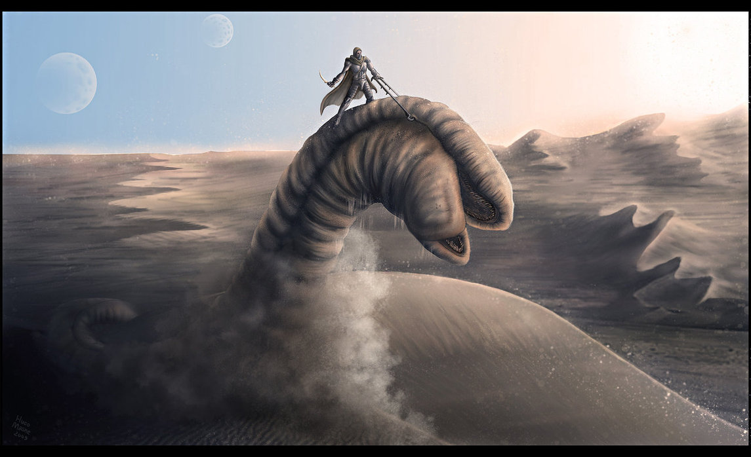
What is R-Seminar?

Slide 5

What is R-Seminar?

Slide 6
Seminar Logistics
Keeping track of the Schedule – https://docs.google.com/spreadsheets/d/1qT8d15lUdDRsCYuoDvtLiX6k0yRfYSody_3x51BYPI8/edit?usp=sharing
Sharing / Collaborating on Files – GitHub Organization:
https://github.com/UCSB-RSeminar-Win22
Listserv – rstats@eemb.ucsb.edu
Subscribe: (anyone know if people can auto-subscribe to Google Groups???)
Sign up in the ‘email’ column of the schedule
Email landeregg@ucsb.edu and I’ll add you
Zoom: https://ucsb.zoom.us/j/89987313659?pwd=TTF3V2RnYWs3Y05Hc1JDOHpKbTFHZz09
Meeting ID: 899 8731 3659
Passcode: 024436

Slide 7
Topics
Learn | Teach

Slide 8
Guidelines for Presenters
Move Slow—You know your code, data and approach better than your audience.
Make it Interactive—Include a simple exercise to give people a chance to play with the code.
Upload scripts and data at least 24hr in advance—Allows folks to install packages, work out any platform-specific kinks.
Ground in Science—We are scientists, not programmers.

Slide 9
Guidelines for Participants
Fork the repository in GitHub—This way we won’t have to worry about folks changing the original version of the code.
Try the code before the seminar—This will give you a chance to install packages and iron out any issues with file paths, etc.
Learn by doing—Follow along with the presenter by running the code yourself.

Slide 10

GitHub Demo

Slide 11

Your own version control
Github repo
‘main’ branch
Clone to local machine
(or ‘pull’ most recent version)
‘local’
‘push’ commits to the main version in the cloud
Edit project, commit changes

Slide 12
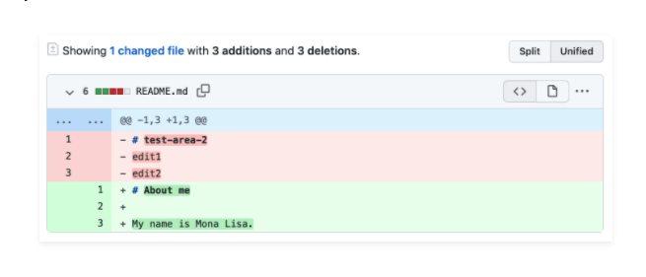
Your own version control
Github repo
‘main’ branch
Clone to local machine
(or ‘pull’ most recent version)
‘local’
‘push’ commits to the main version in the cloud
Edit project, commit changes

Slide 13
Collaborating
Github repo
‘main’ branch
Merge your branch with the master branch for official update using a ‘pull request’
‘fork’ main branch to your github account
Clone/pull to local machine
‘push’ commits to your branch
Edit project, commit changes

Slide 14
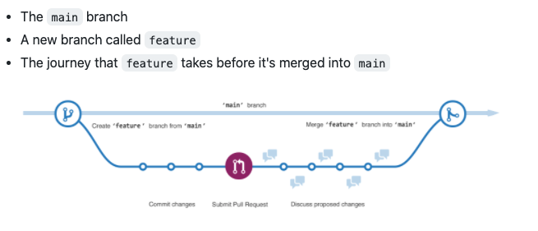
Collaborating

Slide 15
Prep for Next Week
Update to latest versions of R and Rstudio.
Install Git on the laptop you will bring to seminar.
Test the connection between GitHub and Rstudio.
See the great tutorial here:
https://cfss.uchicago.edu/setup/
https://rfortherestofus.com/2021/02/how-to-use-git-github-with-r/

Slide 16
Special Session: Intro to R

