Slide 1
REINFORCE
by Ao Li

Slide 2
Background Knowledge
Monte Carlo tree search
SGD(Stochastic Gradient Descent)

Slide 3
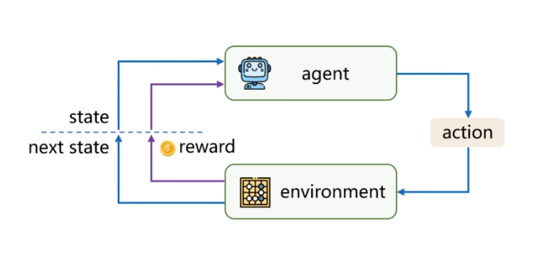
What is Reinforce Learning

Slide 4
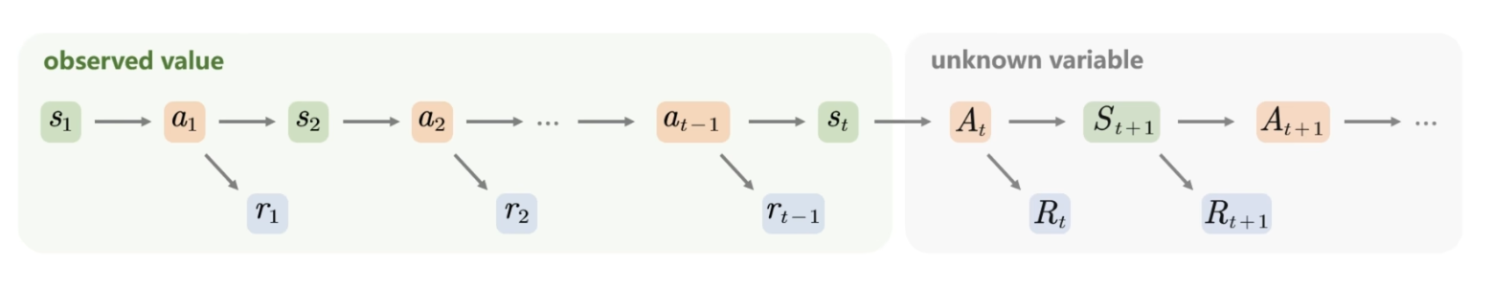
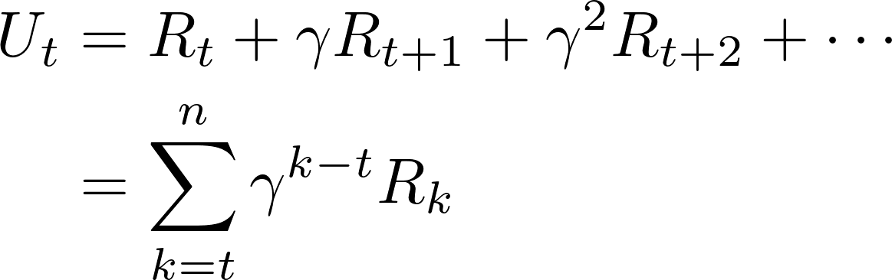
Markov Decision Process

Slide 5

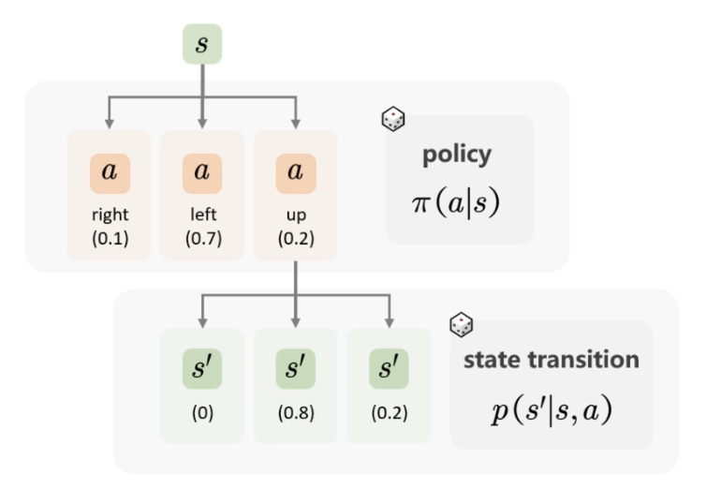
Policy
decision-making function
action-value function

Slide 6
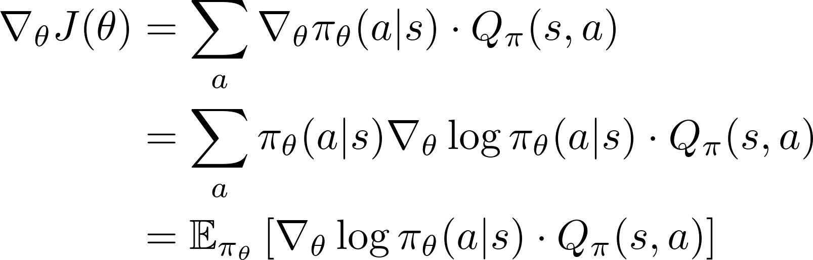
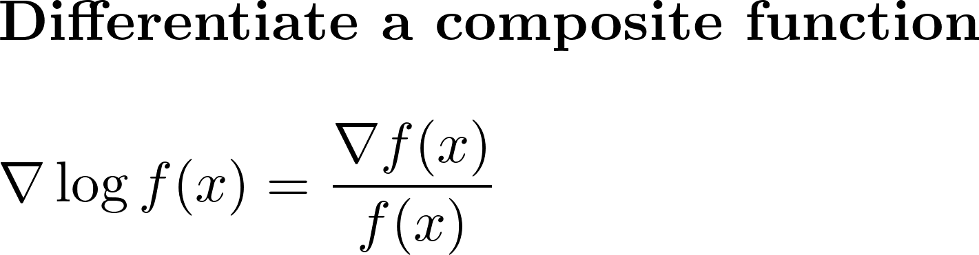
Maximize the return

Slide 7
SGA(Stochastic Gradient Ascent)

Slide 8
Training Code
Environment: Mac, PyTorch

