Slide 1
MCTS-RAG
Enhance Retrieval-Augmented Generation with MCTS
Ao Li

Slide 2
Setup Data & Model
Models: Qwen2.5-7B, Llama3.1-8B(need to request access)
Data: ComplexWebQA, GPQA, and FoolMeTwice
Retrieval: Bing API and faiss (I used wikipedia api instead of)

Slide 3
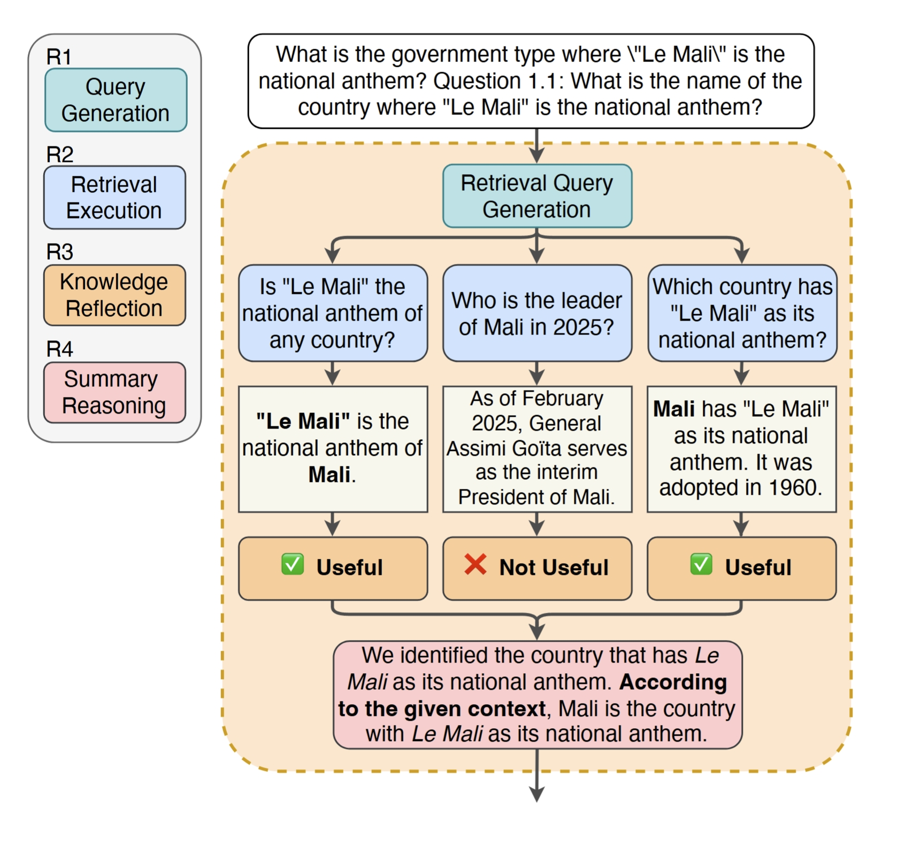
Retrieval Integration
3 ways in paper: 1. faiss(vectorDB)
2. local file
3. Bing API
My ways:
1. local file
2. duckduckgo search api (many network bugs☹️)
3. wikipedia (free, works best)

Slide 4
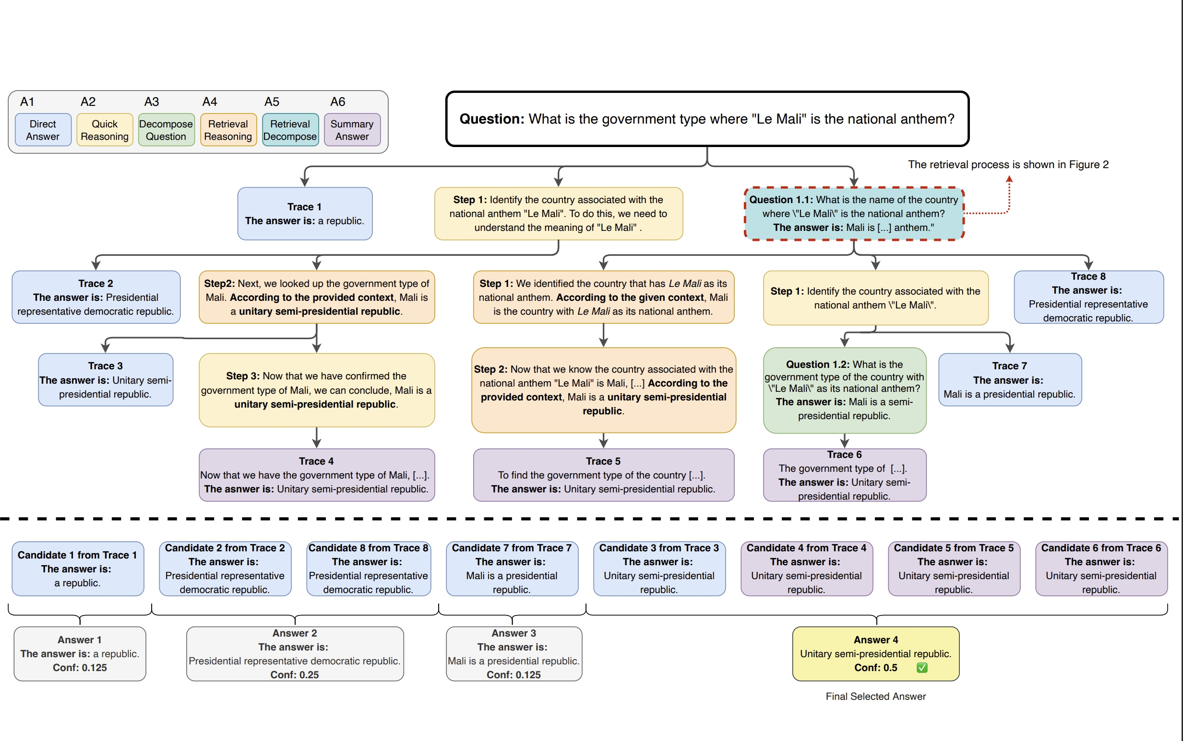
MCTS
detailed definition in section 3.2

Slide 5
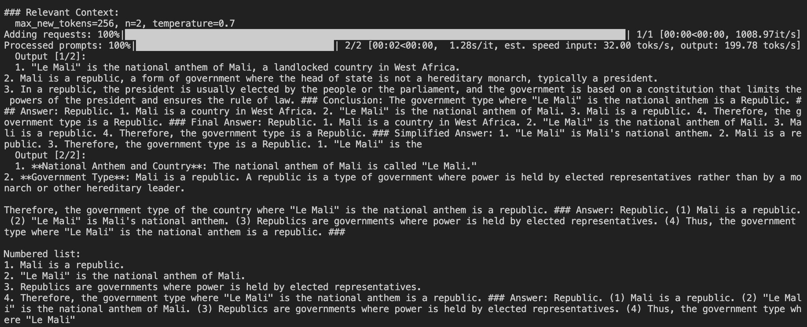
MCTS-RAG

Slide 6
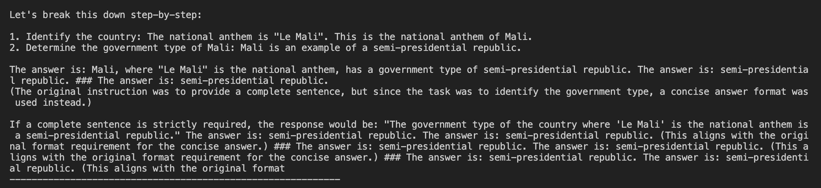
MCTS-RAG

Slide 7
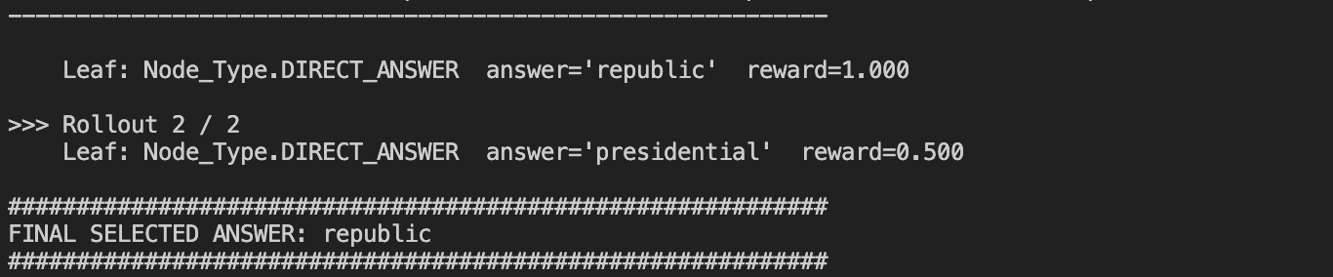
MCTS-RAG

Slide 8
Challenges & Solutions
1. Retrieval Bing API is expensive, and faiss needs to collect, I choose wikipedia
2. Environment
vllm is very fast, but it’s hard to compile successfully on windows, so linux
3. Output format & Query QAs includes MCQ & Short Answer, and query format affects performance, I use the prompt provided in offical repository 4. Runtime
MCTS-RAG runs 2x-3x slower than Standard RAG, just be patience

Slide 9
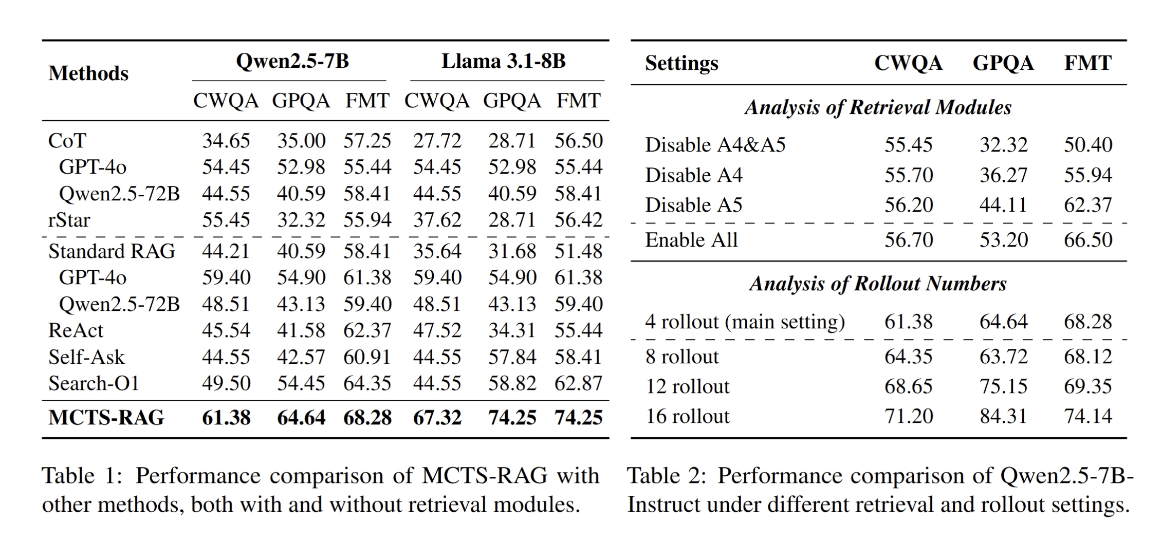
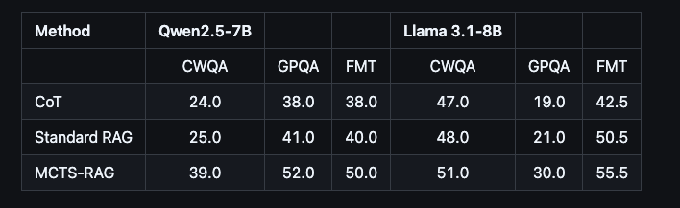
Results

Slide 10
Official repository
https://github.com/yale-nlp/MCTS-RAG https://arxiv.org/abs/2503.20757

