Slide 1
Algorithm Design and Analysis (H)
CS216
Prof. Shiqi Yu (于仕琪)
yusq@sustech.edu.cn
http://faculty.sustech.edu.cn/yusq/

Slide 2

Dynamic Programming
Slides by Kevin Wayne. Copyright © 2005 Pearson-Addison Wesley. All rights reserved.

Slide 3
5. Sequence Alignment
Notes:
1-24,26-37

Slide 4


Correct Typos Automatically

Slide 5


It can do more …
Gmail

Slide 6
String Similarity
How similar are two strings?
ocurrance
occurrence
o
c
u
r
r
a
n
c
e
-
o
c
c
u
r
r
e
n
c
e
6 mismatches, 1 gap
o
c
-
u
r
r
a
n
c
e
o
c
c
u
r
r
e
n
c
e
1 mismatch, 1 gap
o
c
-
u
r
r
-
a
n
c
e
o
c
c
u
r
r
e
-
n
c
e
0 mismatches, 3 gaps

Slide 7
Edit Distance
Applications.
Basis for Unix diff.
Speech recognition.
Computational biology.
Edit distance. [Levenshtein 1966, Needleman-Wunsch 1970]
Gap penalty δ; mismatch penalty α_{pq}.
Cost = sum of gap and mismatch penalties.
C
T
G
A
C
C
T
A
C
C
T
-
C
T
G
A
C
C
T
A
C
C
T
C
C
T
G
A
C
T
A
C
A
T
C
C
T
G
A
C
-
T
A
C
A
T
α_{TC} + α_{GT} + α_{AG}+ 2α_{CA}
2δ + α_{CA}
Notes:
Levenshtein introduced concept of edit-distance; Needleman-Wunsch first applied it to aligning biological sequences; our algorithm is closest in spirit to Smith-Waterman (but their algorithm is for local alignment)
Presumably alpha_pp = 0, but assumption not needed (could be a profit instead of penalty)
bonus application: spam filter - compare message with known spam messages

Slide 8
Sequence Alignment
Goal: Given two strings X = x₁ x₂ . . . x_{m} and Y = y₁ y₂ . . . y_{n} find alignment of minimum cost.
Def. An alignment M is a set of ordered pairs x_{i}-y_{j} such that each item occurs in at most one pair and no crossings.
Def. The pair x_{i}-y_{j} and x_{i'}-y_{j'} cross if i < i', but j > j'.
Ex: CTACCG vs. TACATG. Sol: M = x₂-y₁, x₃-y₂, x₄-y₃, x₅-y₄, x₆-y₆.
x₁
x₂
x₃
x₄
x₅
x₆
C
T
A
C
C
-
G
-
T
A
C
A
T
G
y₁
y₂
y₃
y₄
y₅
y₆

Slide 9
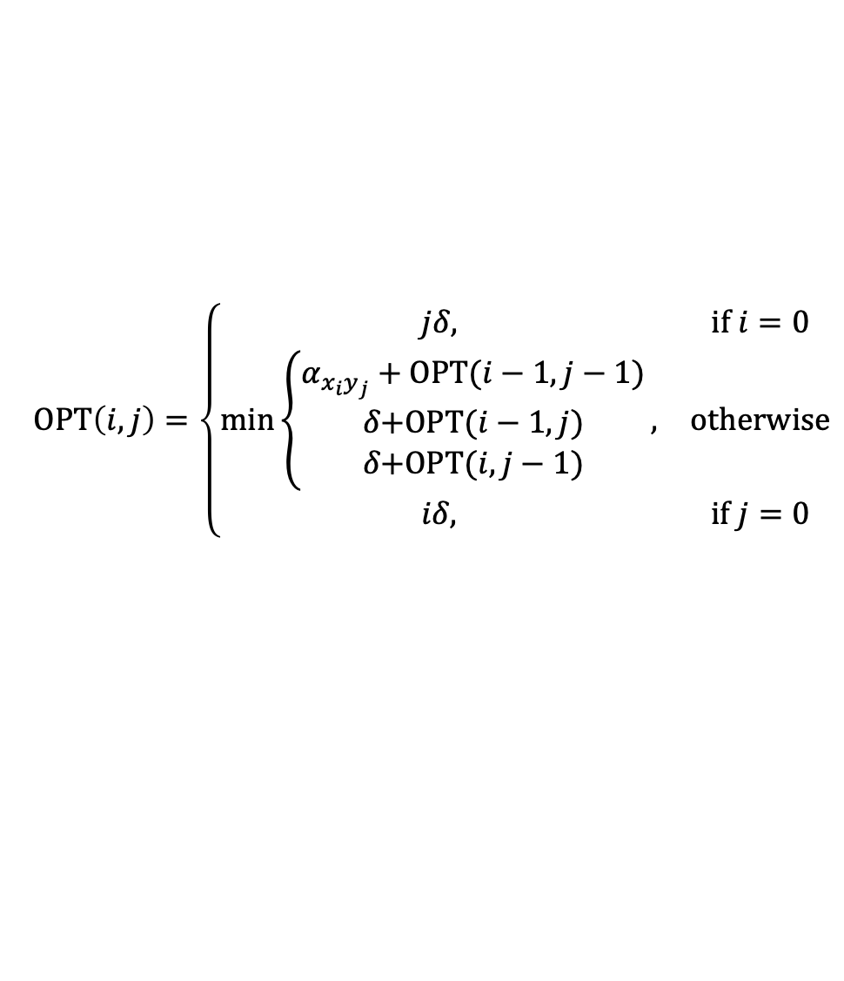
Sequence Alignment: Problem Structure
Def. OPT(i, j) = min cost of aligning strings x₁ x₂ . . . x_{i} and y₁ y₂ . . . y_{j}.
Case 1: OPT matches x_{i}-y_{j}.
pay mismatch for x_{i}-y_{j} + min cost of aligning two strings x₁ x₂ . . . x_{i-1} and y₁ y₂ . . . y_{j-1}
Case 2a: OPT leaves x_{i} unmatched.
pay gap for x_{i} and min cost of aligning x₁ x₂ . . . x_{i-1} and y₁ y₂ . . . y_{j}
Case 2b: OPT leaves y_{j} unmatched.
pay gap for y_{j} and min cost of aligning x₁ x₂ . . . x_{i} and y₁ y₂ . . . y_{j-1}
$$OPT\left(i,j\right)=\left\{\begin{matrix}jδ, & \text{if} i=0 \\ \min_{}\left\{\begin{matrix}α_{x_{i}y_{j}}+\text{O}\text{PT}(i−1,j−1) \\ δ\text{+}\text{OPT}(i−1,j) \\ δ\text{+}\text{OPT}(i,j−1)\end{matrix}\right., & \text{otherwise} \\ iδ, & \text{if} j=0\end{matrix}\right.$$

Slide 10
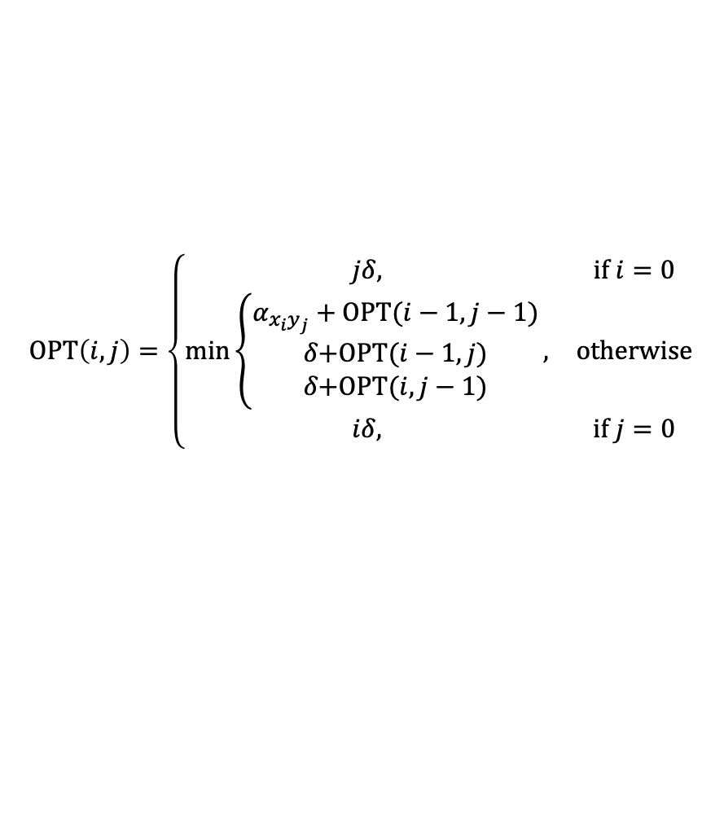
Sequence Alignment: Algorithm
Sequence-Alignment(m, n, x₁x₂...x_{m}, y₁y₂...y_{n}, δ, α) {
for i = 0 to m
M[i, 0] = iδ
for j = 0 to n
M[0, j] = jδ
for i = 1 to m
for j = 1 to n
M[i, j] = min(α[x_{i,} y_{j}] + M[i-1, j-1],
δ + M[i-1, j],
δ + M[i, j-1])
return M[m, n]
}
$$OPT\left(i,j\right)=\left\{\begin{matrix}jδ, & \text{if} i=0 \\ \min_{}\left\{\begin{matrix}α_{x_{i}y_{j}}+\text{O}\text{PT}(i−1,j−1) \\ δ\text{+}\text{OPT}(i−1,j) \\ δ\text{+}\text{OPT}(i,j−1)\end{matrix}\right., & \text{otherwise} \\ iδ, & \text{if} j=0\end{matrix}\right.$$
Analysis. Θ(mn) time and space.
English words or sentences: m, n ≤ 10.
Computational biology: m = n = 100,000. 10 billions ops OK, but 10GB array?

Slide 11
6. Shortest Paths

Slide 12
Shortest Paths
Shortest path problem. Given a directed graph G = (V, E), with edge weights c_{vw}, find shortest path from node s to node t.
Ex. Nodes represent agents in a financial setting and c_{vw} is cost of transaction in which we buy from agent v and sell immediately to w.
allow negative weights
2
10
3
s
9
6
18
-16
6
6
30
11
4
19
15
5
-8
6
20
16
7
44
t

Slide 13
Shortest Paths: Failed Attempts
Dijkstra. Can fail if negative edge costs.
Re-weighting. Adding a constant to every edge weight can fail.
u
2
3
s
v
1
-6
t
5
5
2
2
s
6
t
6
3
0
3
-3

Slide 14
Shortest Paths: Negative Cost Cycles
Negative cost cycle.
Observation. If some path from s to t contains a negative cost cycle, there does not exist a shortest s-t path; otherwise, there exists one that is simple.
-6
-4
7
s
t
W
c(W) < 0

Slide 15
Shortest Paths: Dynamic Programming
Def. OPT(i, v) = length of shortest v-t path P using at most i edges.
Case 1: P uses at most i-1 edges.
OPT(i, v) = OPT(i-1, v)
Case 2: P uses exactly i edges.
if (v, w) is first edge, then OPT uses (v, w), and then selects best w-t path using at most i-1 edges
Remark. By previous observation, if no negative cycles, then OPT(n-1, v) = length of shortest v-t path.
$$OPT\left(i,v\right)=min⁡(OPT\left(i−1,v\right), \min_{w∈V}{(OPT\left(i−1,w\right)+C_{vw})})$$

Slide 16
Shortest Paths: Implementation
Analysis. Θ(mn) time, Θ(n²) space.
Finding the shortest paths. Maintain a "successor" for each table entry.
Shortest-Path(G, t) {
foreach node v ∈ V
M[0, v] ← ∞
M[0, t] ← 0
for i = 1 to n-1
foreach node v ∈ V
M[i, v] ← M[i-1, v]
foreach edge (v, w) ∈ E
M[i, v] ← min { M[i, v], M[i-1, w] + c_{vw} }
}
Notes:
Alternative to maintaining predecessor indices: compute optimal distances, then consider only zero reduced cost edges.

Slide 17
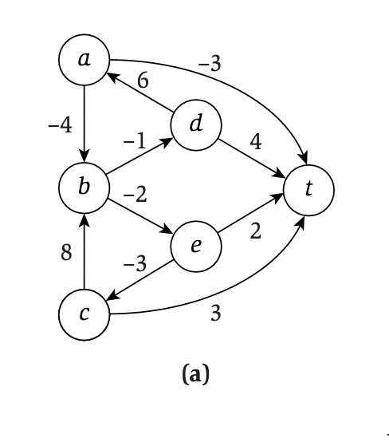
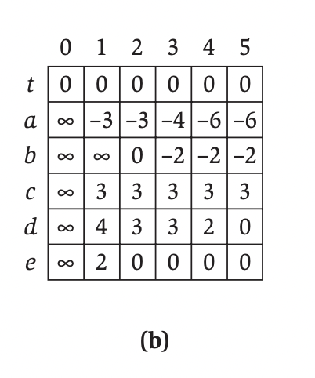
Shortest Paths: Example
$$OPT\left(i,v\right)=min⁡(OPT\left(i−1,v\right), \min_{w∈V}{(OPT\left(i−1,w\right)+C_{vw})})$$

Slide 18
Shortest Paths: Practical Improvements
Practical improvements.
Maintain only one array M[v] = shortest v-t path that we have found so far.
No need to check edges of the form (v, w) unless M[w] changed in previous iteration.
Theorem. Throughout the algorithm, M[v] is length of some v-t path, and after i rounds of updates, the value M[v] is no larger than the length of shortest v-t path using ≤ i edges.
Overall impact.
Memory: O(m + n).
Running time: O(mn) worst case, but substantially faster in practice.

Slide 19
Bellman-Ford: Efficient Implementation
Push-Based-Shortest-Path(G, s, t) {
foreach node v ∈ V {
M[v] ← ∞
successor[v] ← φ
}
M[t] = 0
for i = 1 to n-1 {
foreach node w ∈ V {
if (M[w] has been updated in previous iteration) {
foreach node v such that (v, w) ∈ E {
if (M[v] > M[w] + c_{vw}) {
M[v] ← M[w] + c_{vw}
successor[v] ← w
}
}
}
If no M[w] value changed in iteration i, stop.
}
}

Slide 20
7. Distance Vector Protocol

Slide 21
Distance Vector Protocol
Communication network.
Node ≈ router.
Edge ≈ direct communication link.
Cost of edge ≈ delay on link.
Dijkstra's algorithm. Requires global information of network.
Bellman-Ford. Uses only local knowledge of neighboring nodes.
Synchronization. We don't expect routers to run in lockstep. The order in which each foreach loop executes is not important. Moreover, algorithm still converges even if updates are asynchronous.
naturally nonnegative, but Bellman-Ford used anyway!

Slide 22
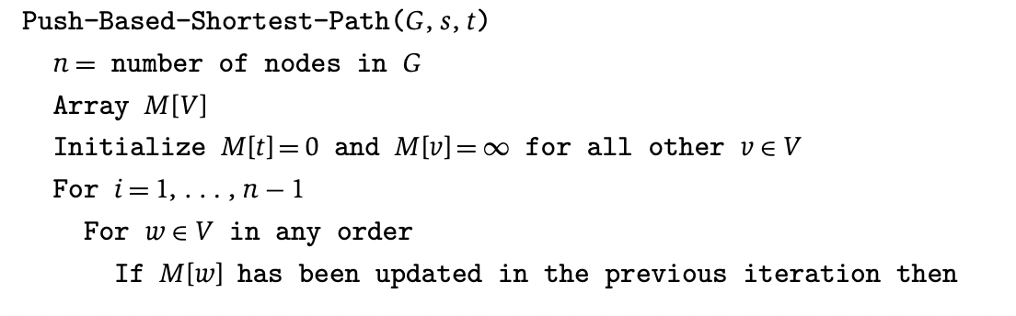
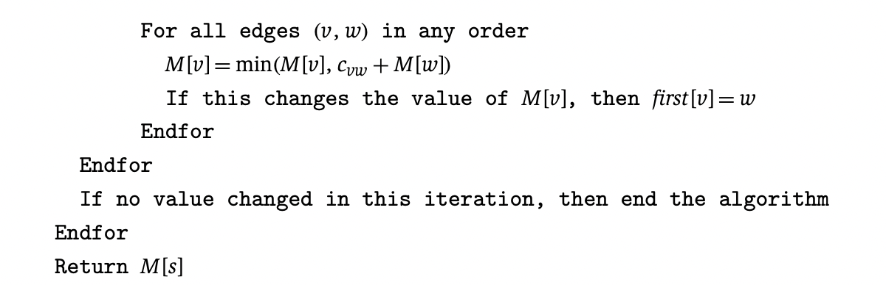
Push-based shortest path

Slide 23
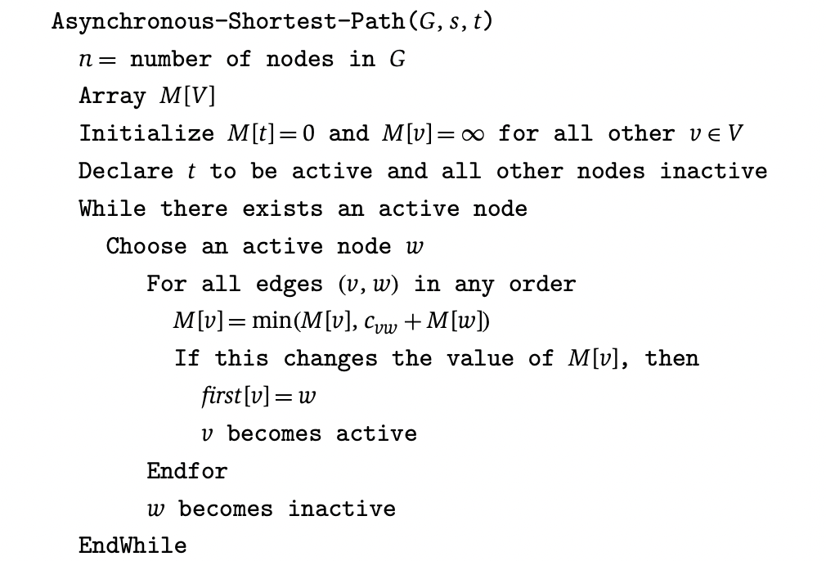
Asynchronous shortest path

Slide 24
Distance Vector Protocol
Distance vector protocol.
Each router maintains a vector of shortest path lengths to every other node (distances) and the first hop on each path (directions).
Algorithm: each router performs n separate computations, one for each potential destination node.
"Routing by rumor."
Ex. RIP, Xerox XNS RIP, Novell's IPX RIP, Cisco's IGRP, DEC's DNA Phase IV, AppleTalk's RTMP.
Caveat. Edge costs may change during algorithm (or fail completely).
1
s
1
v
1
t
"counting to infinity"
2
1
deleted
Notes:
in some protocols, length = hop count
since each node determines is values based on its neighbors, protocol sometimes facetiously reffered to as routing by rumor
route invalidation timer: v flags path to t as invalid if v doesn't hear from t for a while
RIP fix for counting to infinity: maintain max hop count = 16

Slide 25
Path Vector Protocols
Link state routing.
Each router also stores the entire path.
Based on Dijkstra's algorithm.
Avoids "counting-to-infinity" problem and related difficulties.
Requires significantly more storage.
Ex. Border Gateway Protocol (BGP), Open Shortest Path First (OSPF).
not just the distance and first hop
Notes:
each router stores whole network topology

