Slide 1
Algorithm Design and Analysis (H)
CS216
Prof. Shiqi Yu (于仕琪)
yusq@sustech.edu.cn
http://faculty.sustech.edu.cn/yusq/

Slide 2

1. Network Flow
Slides by Kevin Wayne. Copyright © 2005 Pearson-Addison Wesley. All rights reserved.

Slide 3
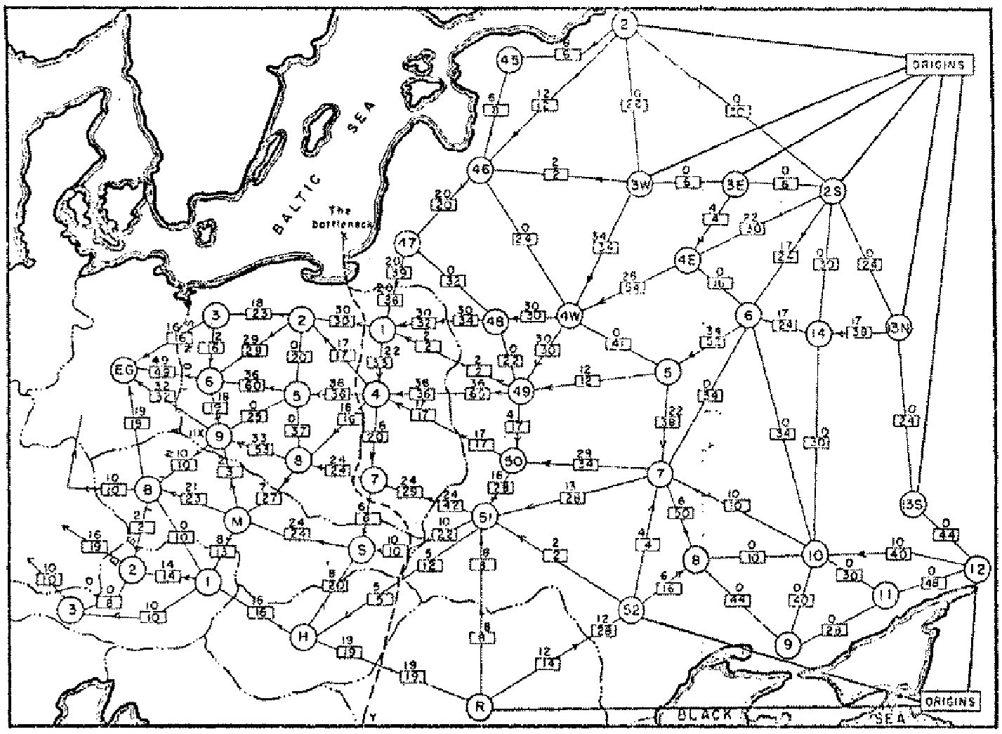
Soviet Rail Network, 1955
Reference: On the history of the transportation and maximum flow problems. Alexander Schrijver in Math Programming, 91: 3, 2002.
Slides by Kevin Wayne. Copyright © 2005 Pearson-Addison Wesley. All rights reserved.
Notes:
Russian scientist A. N. Tolstoi investigated soviet rail network. Wanted to optimize amount of cargo that could be shipped from origins in Soviet Union (right) to destination satellite counties (Poland, Czechoslovakia, Austria, Eastern Germany) (left). American scientists Harris and Ross were also interested in Soviet rail system but from a different perspective. In a secret report (declassified at Schrijver's request in 1999), Harris and Ross calculated a "minimum interdiction" of 163,000 tons.
after aggregation, 44 vertices, 105 edges

Slide 4
Maximum Flow and Minimum Cut
Max flow and min cut.
Two very rich algorithmic problems.
Cornerstone problems in combinatorial optimization.
Beautiful mathematical duality.
Nontrivial applications / reductions.
Data mining.
Open-pit mining.
Project selection.
Airline scheduling.
Bipartite matching.
Baseball elimination.
Image segmentation.
Network connectivity.
Network reliability.
Distributed computing.
Egalitarian stable matching.
Security of statistical data.
Network intrusion detection.
Multi-camera scene reconstruction.
Many many more …
Slides by Kevin Wayne. Copyright © 2005 Pearson-Addison Wesley. All rights reserved.
Notes:
Network intrusion detection: http://www.ieee-infocom.org/2003/papers/46_02.PDF

Slide 5
Minimum Cut Problem
Flow network.
Abstraction for material flowing through the edges.
G = (V, E) = directed graph, no parallel edges.
Two distinguished nodes: s = source, t = sink.
c(e) = capacity of edge e.
2
9
5
10
4
15
15
10
source
s
5
3
8
6
10
t
sink
4
6
15
10
capacity
15
4
30
7
Slides by Kevin Wayne. Copyright © 2005 Pearson-Addison Wesley. All rights reserved.
Notes:
source = where material originates, sink = where material goes.
We use cut to mean s-t cut.

Slide 6
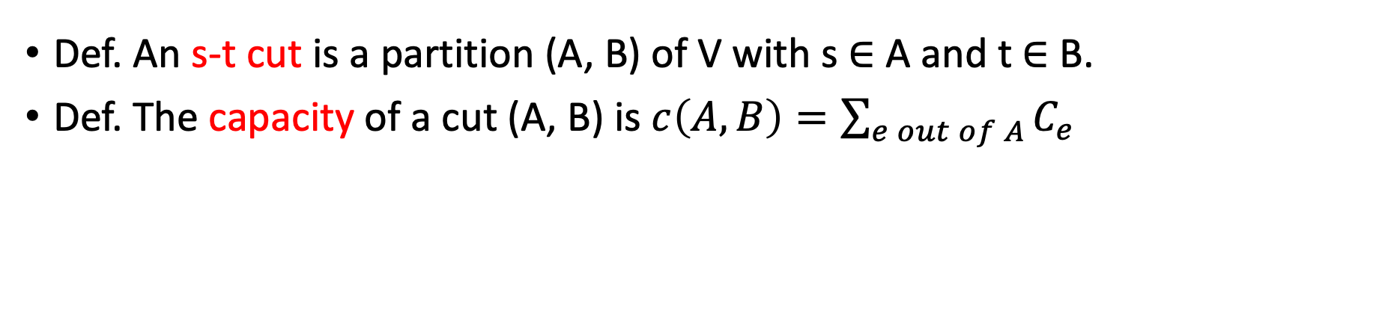
Cuts
Def. An s-t cut is a partition (A, B) of V with s ∈ A and t ∈ B.
Def. The capacity of a cut (A, B) is $c\left(A,B\right)=\sum_{e out of A}{C_{e}}$
2
9
5
10
4
15
15
10
s
5
3
8
6
10
t
A
4
6
15
10
15
Capacity = 10 + 5 + 15 = 30
4
30
7
Slides by Kevin Wayne. Copyright © 2005 Pearson-Addison Wesley. All rights reserved.

Slide 7
Cuts
Def. An s-t cut is a partition (A, B) of V with s ∈ A and t ∈ B.
Def. The capacity of a cut (A, B) is $c\left(A,B\right)=\sum_{e out of A}{C_{e}}$
2
9
5
10
4
15
15
10
s
5
3
8
6
10
t
A
4
15
15
6
10
Capacity = 9 + 15 + 8 + 30 = 62
4
30
7
Slides by Kevin Wayne. Copyright © 2005 Pearson-Addison Wesley. All rights reserved.
Notes:
7->3 not counted

Slide 8
Minimum Cut Problem
Min s-t cut problem. Find an s-t cut of minimum capacity.
2
9
5
10
4
15
15
10
s
5
3
8
6
10
t
A
4
6
15
10
15
Capacity = 10 + 8 + 10 = 28
4
30
7
Slides by Kevin Wayne. Copyright © 2005 Pearson-Addison Wesley. All rights reserved.

Slide 9
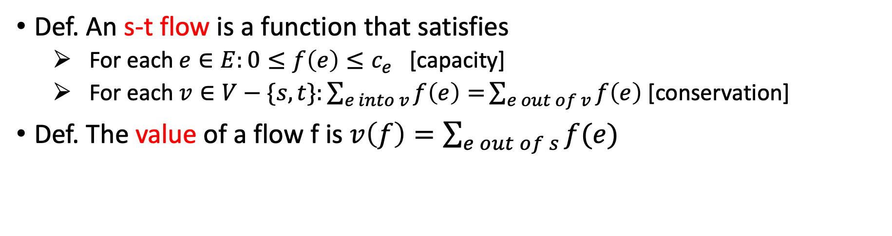
Flows
Def. An s-t flow is a function that satisfies
For each $e∈E:0≤f\left(e\right)≤c_{e}$ [capacity]
For each $v∈V−\{s,t\}:\sum_{e into v}{f\left(e\right)=}\sum_{e out of v}{f\left(e\right)}$ [conservation]
Def. The value of a flow f is $v\left(f\right)=\sum_{e out of s}{f(e)}$
0
2
9
5
4
0
0
10
4
4
15
15
0
10
0
4
4
s
5
3
8
6
10
t
0
0
capacity
4
0
6
15
0
10
15
flow
0
0
Value = 4
4
30
7
Slides by Kevin Wayne. Copyright © 2005 Pearson-Addison Wesley. All rights reserved.
Notes:
source = where material originates, sink = where material goes
flow conservation = otherwise warehouse overfills or oil pipe bursts
flow conservation is analogous to Kirchoff's law
* flow: abstract entity generated at source, transmitted across edges, absorbed at sink
* assume no arcs enter s or leave t (makes a little cleaner, no loss of generality)

Slide 10
Flows
Def. An s-t flow is a function that satisfies
For each $e∈E:0≤f\left(e\right)≤c_{e}$ [capacity]
For each $v∈V−\{s,t\}:\sum_{e into v}{f\left(e\right)=}\sum_{e out of v}{f\left(e\right)}$ [conservation]
Def. The value of a flow f is $v\left(f\right)=\sum_{e out of s}{f(e)}$
6
2
9
5
10
0
6
10
4
4
15
15
0
10
3
8
8
s
5
3
8
6
10
t
1
10
capacity
4
0
6
15
0
10
15
flow
11
11
Value = 24
4
30
7
Slides by Kevin Wayne. Copyright © 2005 Pearson-Addison Wesley. All rights reserved.

Slide 11
Maximum Flow Problem
Max flow problem. Find s-t flow of maximum value.
9
2
9
5
10
1
9
10
4
0
15
15
0
10
4
8
9
s
5
3
8
6
10
t
4
10
capacity
4
0
6
15
0
10
15
flow
14
14
Value = 28
4
30
7
Slides by Kevin Wayne. Copyright © 2005 Pearson-Addison Wesley. All rights reserved.
Notes:
Equalize inflow and outflow at every intermediate node.
Maximize flow sent from s to t.

Slide 12

Flows and Cuts
Flow value lemma. Let f be any flow, and let (A, B) be any s-t cut. Then, the net flow sent across the cut is equal to the amount leaving s.
$$v\left(f\right)= f^{out}\left(A\right)−f^{in}\left(A\right)$$
6
2
9
5
10
0
6
10
4
4
15
15
0
10
3
8
8
s
5
3
8
6
10
t
A
1
10
4
0
6
15
0
10
15
11
11
Value = 24
4
30
7
Slides by Kevin Wayne. Copyright © 2005 Pearson-Addison Wesley. All rights reserved.

Slide 13
Flows and Cuts
Flow value lemma. Let f be any flow, and let (A, B) be any s-t cut. Then, the net flow sent across the cut is equal to the amount leaving s.
$$v\left(f\right)= f^{out}\left(A\right)−f^{in}\left(A\right)$$
6
2
9
5
10
0
6
10
4
4
15
15
0
10
3
8
8
s
5
3
8
6
10
t
A
1
10
4
0
6
15
0
10
15
11
11
Value = 6 + 0 + 8 - 1 + 11 = 24
4
30
7
Slides by Kevin Wayne. Copyright © 2005 Pearson-Addison Wesley. All rights reserved.
Notes:
total amount of flow that leaves S minus amount flow that "swirls" back

Slide 14
Flows and Cuts
Flow value lemma. Let f be any flow, and let (A, B) be any s-t cut. Then, the net flow sent across the cut is equal to the amount leaving s.
$$v\left(f\right)= f^{out}\left(A\right)−f^{in}\left(A\right)$$
6
2
9
5
10
0
6
10
4
4
15
15
0
10
3
8
8
s
5
3
8
6
10
t
A
1
10
4
0
6
15
0
10
15
11
11
Value = 10 - 4 + 8 - 0 + 10 = 24
4
30
7
Slides by Kevin Wayne. Copyright © 2005 Pearson-Addison Wesley. All rights reserved.

Slide 15

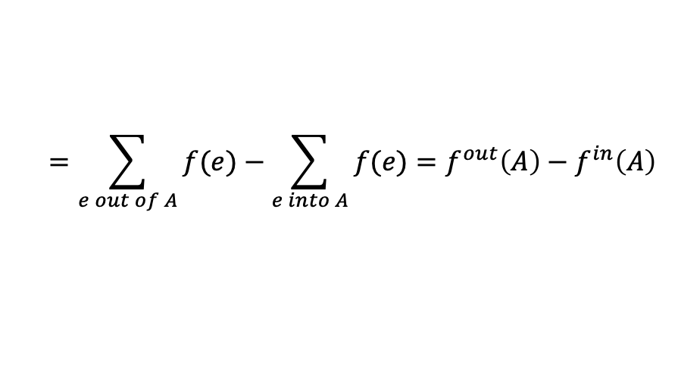
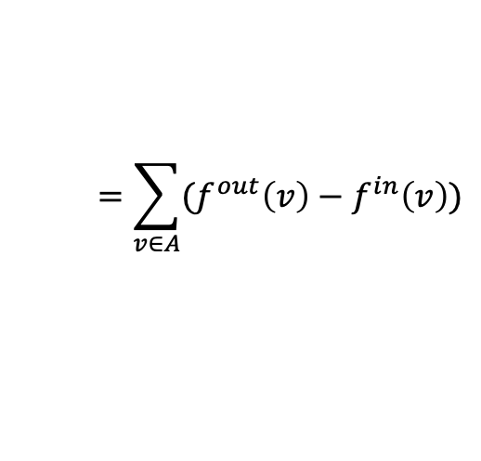

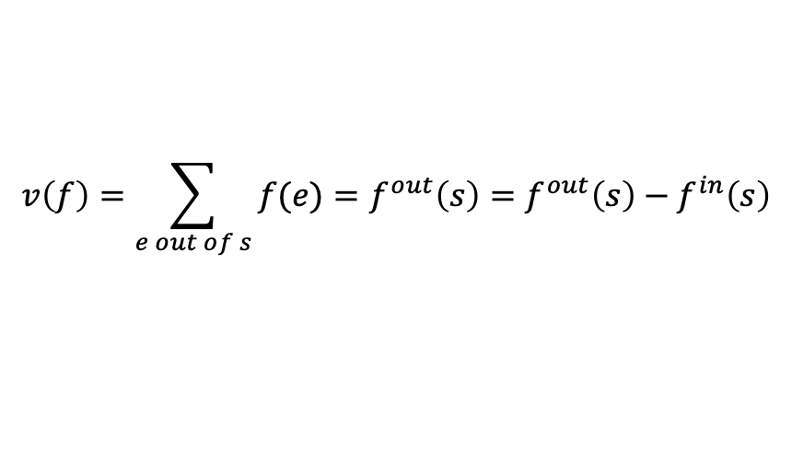
Flows and Cuts
Flow value lemma. Let f be any flow, and let (A, B) be any s-t cut. Then, the net flow sent across the cut is equal to the amount leaving s.
$$v\left(f\right)= f^{out}\left(A\right)−f^{in}\left(A\right)$$
Pf.
$f^{in}\left(s\right)$=0
$$v\left(f\right)=\sum_{e out of s}{f(e)}=f^{out}\left(s\right)=f^{out}\left(s\right)−f^{in}\left(s\right)$$
$f^{out}\left(v\right)−f^{in}\left(v\right)$=0
$$=\sum_{v∈A}{(f^{out}\left(v\right)−f^{in}\left(v\right))}$$
$$=\sum_{e out of A}{f(e)}−\sum_{e into A}{f(e)}=f^{out}\left(A\right)−f^{in}\left(A\right)$$
Slides by Kevin Wayne. Copyright © 2005 Pearson-Addison Wesley. All rights reserved.

Slide 16

Flows and Cuts
Flow value lemma. Let f be any flow, and let (A, B) be any s-t cut. Then, the net flow sent across the cut is equal to the amount leaving s.
$$v\left(f\right)= f^{out}\left(A\right)−f^{in}\left(A\right)$$
$$v\left(f\right)= f^{in}\left(B\right)−f^{out}\left(B\right)$$
Pf.
$$v\left(f\right)=\sum_{e out of s}{f(e)}=f^{out}\left(s\right)=f^{out}\left(s\right)−f^{in}\left(s\right)$$
$$=\sum_{v∈A}{(f^{out}\left(v\right)−f^{in}\left(v\right))}$$
$$=\sum_{e out of A}{f(e)}−\sum_{e into A}{f(e)}=f^{out}\left(A\right)−f^{in}\left(A\right)$$
Slides by Kevin Wayne. Copyright © 2005 Pearson-Addison Wesley. All rights reserved.

Slide 17
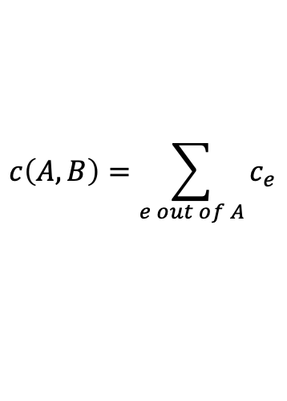
Flows and Cuts
Weak duality. Let f be any flow, and let (A, B) be any s-t cut. Then the value of the flow is at most the capacity of the cut:
$$c\left(A,B\right)=\sum_{e out of A}{c_{e}}$$
Cut capacity = 30 ⇒ Flow value ≤ 30
2
9
5
10
4
15
15
10
s
5
3
8
6
10
t
A
4
6
15
10
15
Capacity = 30
4
30
7
Slides by Kevin Wayne. Copyright © 2005 Pearson-Addison Wesley. All rights reserved.

Slide 18
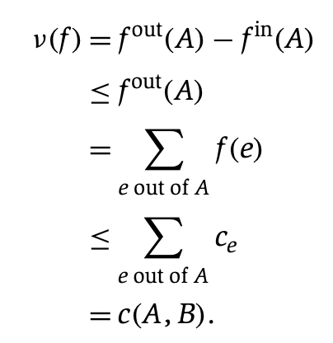
Flows and Cuts
Weak duality. Let f be any flow. Then, for any s-t cut (A, B) we have v(f) ≤ c(A, B).
Pf.
▪
A
B
4
8
t
s
7
6
Slides by Kevin Wayne. Copyright © 2005 Pearson-Addison Wesley. All rights reserved.

Slide 19
Certificate of Optimality
Corollary. Let f be any flow, and let (A, B) be any cut. If v(f) = c(A, B), then f is a max flow and (A, B) is a min cut.
Value of flow = 28 Cut capacity = 28 ⇒ Flow value ≤ 28
every flow is upper bounded by every cut!
9
2
9
5
10
1
9
10
4
0
15
15
0
10
4
8
9
s
5
3
8
6
10
t
4
10
A
4
0
6
15
0
10
15
14
14
4
30
7
Slides by Kevin Wayne. Copyright © 2005 Pearson-Addison Wesley. All rights reserved.

Slide 20
Towards a Max Flow Algorithm
Greedy algorithm.
Start with f(e) = 0 for all edge e ∈ E.
Find an s-t path P where each edge has f(e) < c(e).
Augment flow along path P.
Repeat until you get stuck.
1
0
0
20
10
s
30
0
t
10
20
0
0
2
Flow value = 0
Slides by Kevin Wayne. Copyright © 2005 Pearson-Addison Wesley. All rights reserved.

Slide 21
Towards a Max Flow Algorithm
Greedy algorithm.
Start with f(e) = 0 for all edge e ∈ E.
Find an s-t path P where each edge has f(e) < c(e).
Augment flow along path P.
Repeat until you get stuck.
1
20
0
0
X
20
10
30
0
20
t
s
X
10
20
0
0
20
X
2
Flow value = 20
Slides by Kevin Wayne. Copyright © 2005 Pearson-Addison Wesley. All rights reserved.

Slide 22
Towards a Max Flow Algorithm
Greedy algorithm.
Start with f(e) = 0 for all edge e ∈ E.
Find an s-t path P where each edge has f(e) < c(e).
Augment flow along path P.
Repeat until you get stuck.
locally optimality ⇒ global optimality
1
1
20
0
20
10
20
10
20
10
s
30
20
t
s
30
10
t
10
20
10
20
0
20
10
20
greedy = 20
2
opt = 30
2
Slides by Kevin Wayne. Copyright © 2005 Pearson-Addison Wesley. All rights reserved.

Slide 23
Residual Graph
capacity
u
17
v
Original edge: e=(u,v) ∈ E.
Flow f(e), capacity c(e)
Residual edge.
"Undo" flow sent
e=(u,v) and e^{R}=(v,u)
Residual capacity:
Forward edge: c(e)-f(e)
Backward edge: f(e)
Residual graph: G_{f}=(V,E_{f}).
Residual edges with positive residual capacity
E_{f}={e:f(e)<c(e)} ∪ {e^{R}:f(e)>0}.
6
flow
residual capacity
u
11
v
6
residual capacity
Slides by Kevin Wayne. Copyright © 2005 Pearson-Addison Wesley. All rights reserved.

Slide 24
Augmenting Path Algorithm
Augment(f, c, P) {
b ← bottleneck(P)
foreach e ∈ P {
if (e ∈ E) f(e) ← f(e) + b
else f(e^{R})← f(e^{R}) - b
}
return f
}
forward edge
reverse edge
P: simple s-t path in G^{f}
bottleneck(P): min residual capacity of any edge on P
Augmenting path: any s-t path in the residual graph
Slides by Kevin Wayne. Copyright © 2005 Pearson-Addison Wesley. All rights reserved.

Slide 25
Augmenting Path Algorithm
Ford-Fulkerson(G, s, t, c) {
foreach e ∈ E f(e) ← 0
G^{f} ← residual graph
while (there exists augmenting path P) {
f ← Augment(f, c, P)
update G^{f}
}
return f
}
Slides by Kevin Wayne. Copyright © 2005 Pearson-Addison Wesley. All rights reserved.

Slide 26
Ford-Fulkerson Algorithm
2
4
4
capacity
G:
10
2
8
6
10
s
10
3
9
5
10
t
Slides by Kevin Wayne. Copyright © 2005 Pearson-Addison Wesley. All rights reserved.

Slide 27
Max-Flow Min-Cut Theorem
Augmenting path theorem. Flow f is a max flow iff there are no augmenting paths.
Max-flow min-cut theorem. [Elias-Feinstein-Shannon 1956, Ford-Fulkerson 1956] The value of the max flow is equal to the value of the min cut.
Pf. We prove both simultaneously by showing TFAE:
(i) There exists a cut (A, B) such that v(f) = c(A, B).
(ii) Flow f is a max flow.
(iii) There is no augmenting path relative to f.
(i) ⇒ (ii) This was the corollary to weak duality lemma.
(ii) ⇒ (iii) We show contrapositive.
Let f be a flow. If there exists an augmenting path, then we can improve f by sending flow along path.
Slides by Kevin Wayne. Copyright © 2005 Pearson-Addison Wesley. All rights reserved.

Slide 28
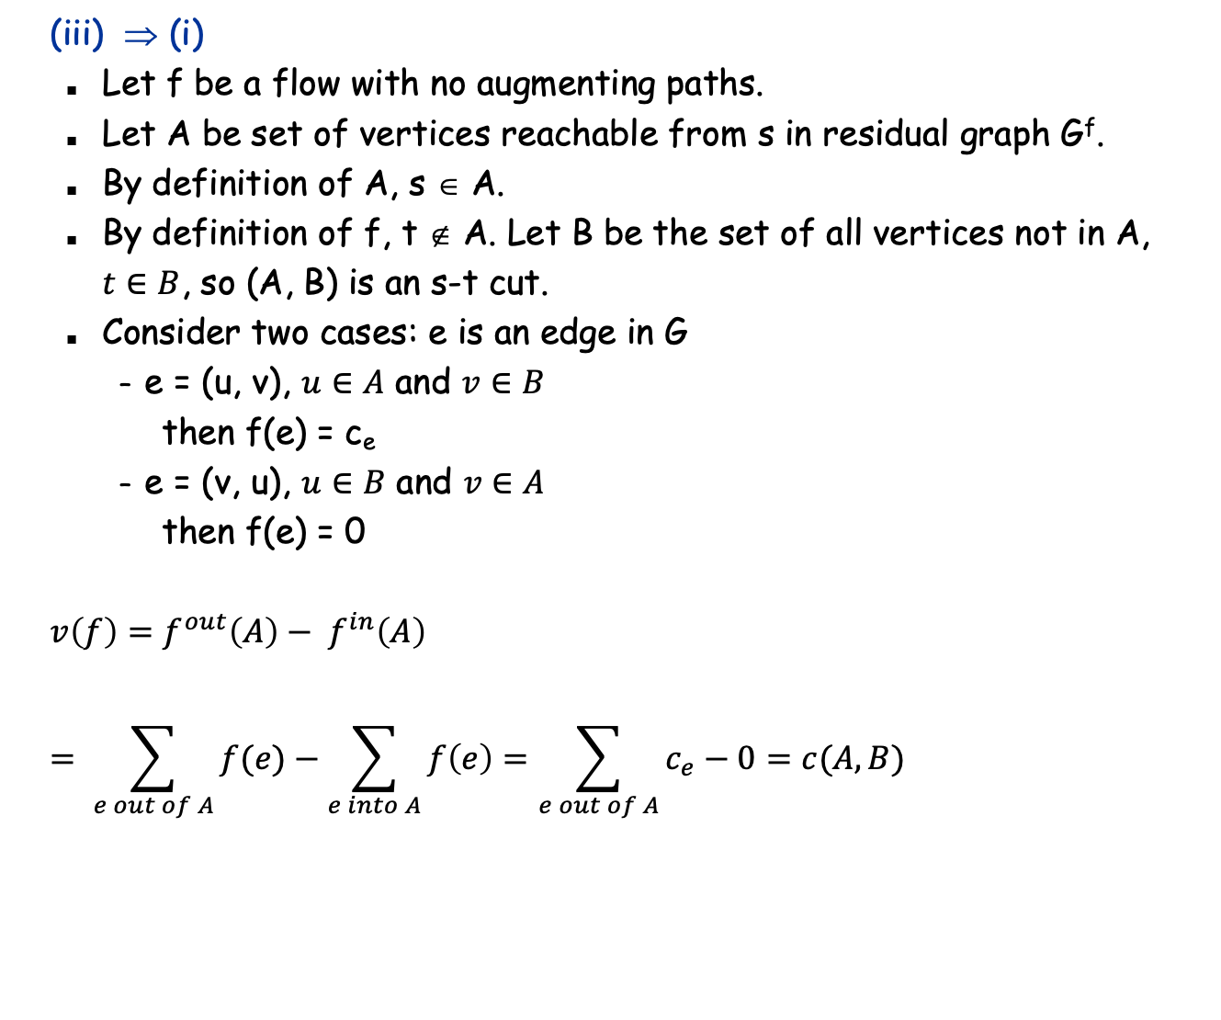
Proof of Max-Flow Min-Cut Theorem
original network
A
B
t
s
Slides by Kevin Wayne. Copyright © 2005 Pearson-Addison Wesley. All rights reserved.

Slide 29
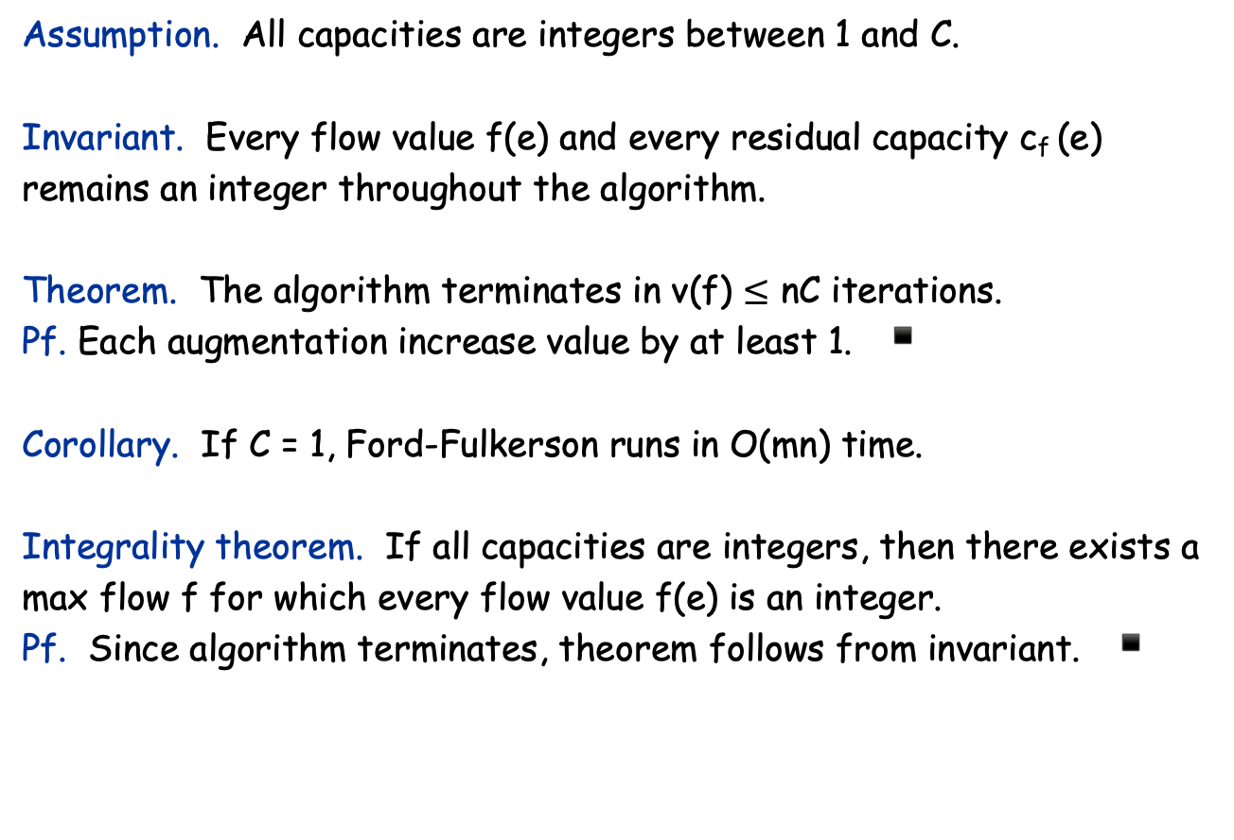
Running Time
Slides by Kevin Wayne. Copyright © 2005 Pearson-Addison Wesley. All rights reserved.

