Slide 1
Algorithm Design and Analysis (H)
CS216
Prof. Shiqi Yu (于仕琪)
yusq@sustech.edu.cn
http://faculty.sustech.edu.cn/yusq/

Slide 2

2. Choosing Good Augmenting Paths
Slides by Kevin Wayne. Copyright © 2005 Pearson-Addison Wesley. All rights reserved.

Slide 3
Ford-Fulkerson: Exponential Number of Augmentations
Q. Is generic Ford-Fulkerson algorithm polynomial in input size?
A. No. If max capacity is C, then algorithm can take C iterations.
m, n
1
1
1
0
0
1
0
0
X
X
X
1
C
C
C
C
1
0
t
1
0
1
0
t
s
X
1
s
X
X
C
C
C
C
0
0
1
0
0
1
X
1
X
X
2
2
Slides by Kevin Wayne. Copyright © 2005 Pearson-Addison Wesley. All rights reserved.

Slide 4
Choosing Good Augmenting Paths
Use care when selecting augmenting paths.
Some choices lead to exponential algorithms.
Clever choices lead to polynomial algorithms.
If capacities are irrational, algorithm not guaranteed to terminate!
Goal: choose augmenting paths so that:
Can find augmenting paths efficiently.
Few iterations.
Choose augmenting paths with: [Edmonds-Karp 1972, Dinitz 1970]
Max bottleneck capacity.
Sufficiently large bottleneck capacity.
Fewest number of edges.
Slides by Kevin Wayne. Copyright © 2005 Pearson-Addison Wesley. All rights reserved.

Slide 5
Capacity Scaling
Intuition. Choosing path with highest bottleneck capacity increases flow by max possible amount.
Don't worry about finding exact highest bottleneck path.
Maintain scaling parameter Δ.
Let G_{f} (Δ) be the subgraph of the residual graph consisting of only arcs with capacity at least Δ.
4
4
110
102
110
102
s
1
t
s
t
122
170
122
170
2
2
G_{f}
G_{f} (100)
Slides by Kevin Wayne. Copyright © 2005 Pearson-Addison Wesley. All rights reserved.

Slide 6
Capacity Scaling
Scaling-Max-Flow(G, s, t, c) {
foreach e ∈ E f(e) ← 0
Δ ← smallest power of 2 greater than or equal to C
G_{f} ← residual graph
while (Δ ≥ 1) {
G_{f}(Δ) ← Δ-residual graph
while (there exists augmenting path P in G_{f}(Δ)) {
f ← augment(f, c, P)
update G_{f}(Δ)
}
Δ ← Δ / 2
}
return f
}
Slides by Kevin Wayne. Copyright © 2005 Pearson-Addison Wesley. All rights reserved.

Slide 7
Capacity Scaling: Correctness
Assumption. All edge capacities are integers between 1 and C.
Integrality invariant. All flow and residual capacity values are integral.
Correctness. If the algorithm terminates, then f is a max flow.
Pf.
By integrality invariant, when Δ = 1 ⇒ G_{f}(Δ) = G_{f}.
Upon termination of Δ = 1 phase, there are no augmenting paths. ▪
Slides by Kevin Wayne. Copyright © 2005 Pearson-Addison Wesley. All rights reserved.

Slide 8
Capacity Scaling: Running Time
Lemma 1. The outer while loop repeats 1 + ⎡log₂ C⎤ times.
Pf. Initially C ≤ Δ < 2C. Δ decreases by a factor of 2 each iteration. ▪
Lemma 2. Let f be the flow at the end of a Δ-scaling phase. Then the value of the maximum flow is at most v(f) + m Δ.
Lemma 3. There are at most 2m augmentations per scaling phase.
Let f be the flow at the end of the previous scaling phase Δ’
Let f* be the maximum flow.
Lemma 2 ⇒ v(f*) ≤ v(f) + m Δ’ = v(f) + m(2Δ).
Each augmentation in a Δ-phase increases v(f) by at least Δ. ▪
Theorem. The scaling max-flow algorithm finds a max flow in O(m log C) augmentations. It can be implemented to run in O(m² log C) time. ▪
proof on next slide
Slides by Kevin Wayne. Copyright © 2005 Pearson-Addison Wesley. All rights reserved.

Slide 9
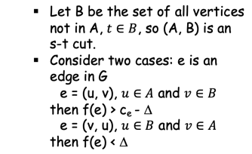
Capacity Scaling: Running Time
Lemma 2. Let f be the flow at the end of a Δ-scaling phase. Then value of the maximum flow is at most v(f) + m Δ.
Pf. (almost identical to proof of max-flow min-cut theorem)
We show that at the end of a Δ-phase, there exists a cut (A, B) such that c(A, B) ≤ v(f) + m Δ.
Choose A to be the set of nodes reachable from s in G_{f}(Δ).
By definition of A, s ∈ A.
By definition of f, t ∉ A.
A
B
t
s
original network
Slides by Kevin Wayne. Copyright © 2005 Pearson-Addison Wesley. All rights reserved.
Notes:
intuition: f is max flow in G_{f}(Δ). Adding back arc with capacity less than Δ can only increase capacity of cut by at most mΔ.

Slide 10
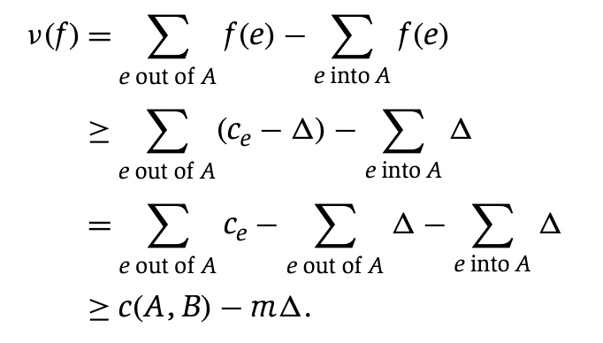
Capacity Scaling: Running Time
Lemma 2. Let f be the flow at the end of a Δ-scaling phase. Then value of the maximum flow is at most v(f) + m Δ.
Pf. (almost identical to proof of max-flow min-cut theorem)
We show that at the end of a Δ-phase, there exists a cut (A, B) such that c(A, B) ≤ v(f) + m Δ.
Choose A to be the set of nodes reachable from s in G_{f}(Δ).
By definition of A, s ∈ A.
By definition of f, t ∉ A.
Slides by Kevin Wayne. Copyright © 2005 Pearson-Addison Wesley. All rights reserved.
Notes:
intuition: f is max flow in G_{f}(Δ). Adding back arc with capacity less than Δ can only increase capacity of cut by at most mΔ.

Slide 11
3. Bipartite Matching
Slides by Kevin Wayne. Copyright © 2005 Pearson-Addison Wesley. All rights reserved.

Slide 12
Matching
Matching.
Input: undirected graph G = (V, E).
M ⊆ E is a matching if each node appears in at most one edge in M.
Max matching: find a max cardinality matching.
Slides by Kevin Wayne. Copyright © 2005 Pearson-Addison Wesley. All rights reserved.

Slide 13
Bipartite Matching
Bipartite matching.
Input: undirected, bipartite graph G = (L ∪ R, E).
M ⊆ E is a matching if each node appears in at most one edge in M.
Max matching: find a max cardinality matching.
1
1'
2
2'
matching
1-2', 3-1', 4-5'
3
3'
4
4'
L
5
5'
R
Slides by Kevin Wayne. Copyright © 2005 Pearson-Addison Wesley. All rights reserved.

Slide 14
Bipartite Matching
Bipartite matching.
Input: undirected, bipartite graph G = (L ∪ R, E).
M ⊆ E is a matching if each node appears in at most one edge in M.
Max matching: find a max cardinality matching.
1
1'
2
2'
max matching
1-1', 2-2', 3-3’, 5-5'
3
3'
4
4'
L
5
5'
R
Slides by Kevin Wayne. Copyright © 2005 Pearson-Addison Wesley. All rights reserved.

Slide 15
Bipartite Matching
Max flow formulation.
Create digraph G' = (L ∪ R ∪ {s, t}, E' ).
Direct all edges from L to R, and assign infinite (or unit) capacity.
Add source s, and unit capacity edges from s to each node in L.
Add sink t, and unit capacity edges from each node in R to t.
G'
1
∞
1'
1
2
2'
1
s
3
3'
t
4
4'
L
5
5'
R
Slides by Kevin Wayne. Copyright © 2005 Pearson-Addison Wesley. All rights reserved.

Slide 16
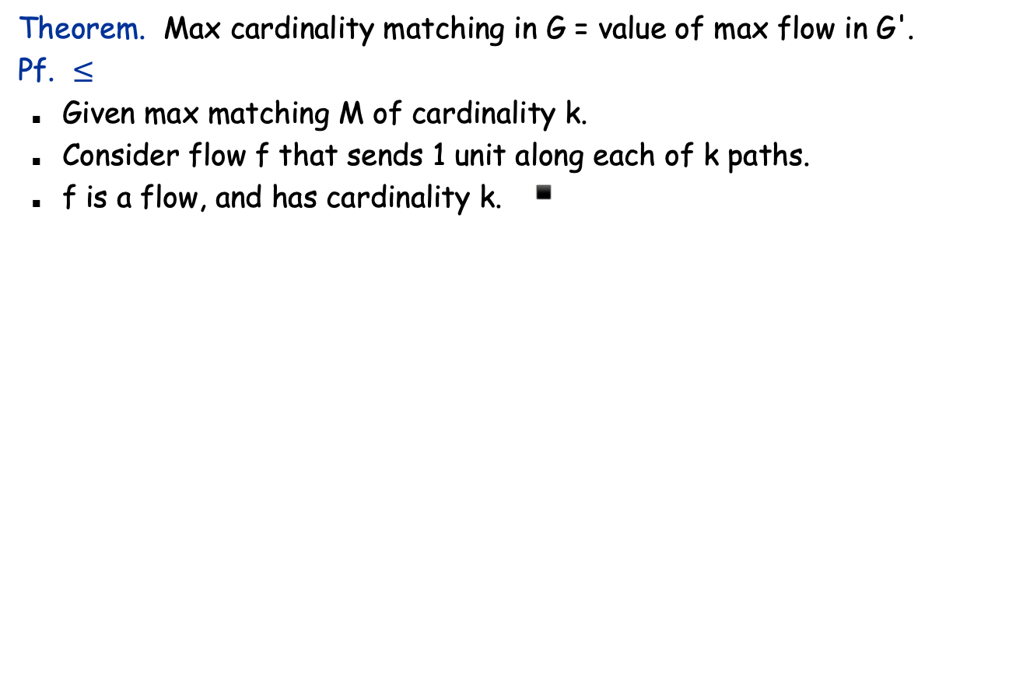
Bipartite Matching: Proof of Correctness
1
1'
1
∞
1'
2
2'
1
2
2'
1
3
3'
s
3
3'
t
4
4'
4
4'
G
G'
5
5'
5
5'
Slides by Kevin Wayne. Copyright © 2005 Pearson-Addison Wesley. All rights reserved.

Slide 17
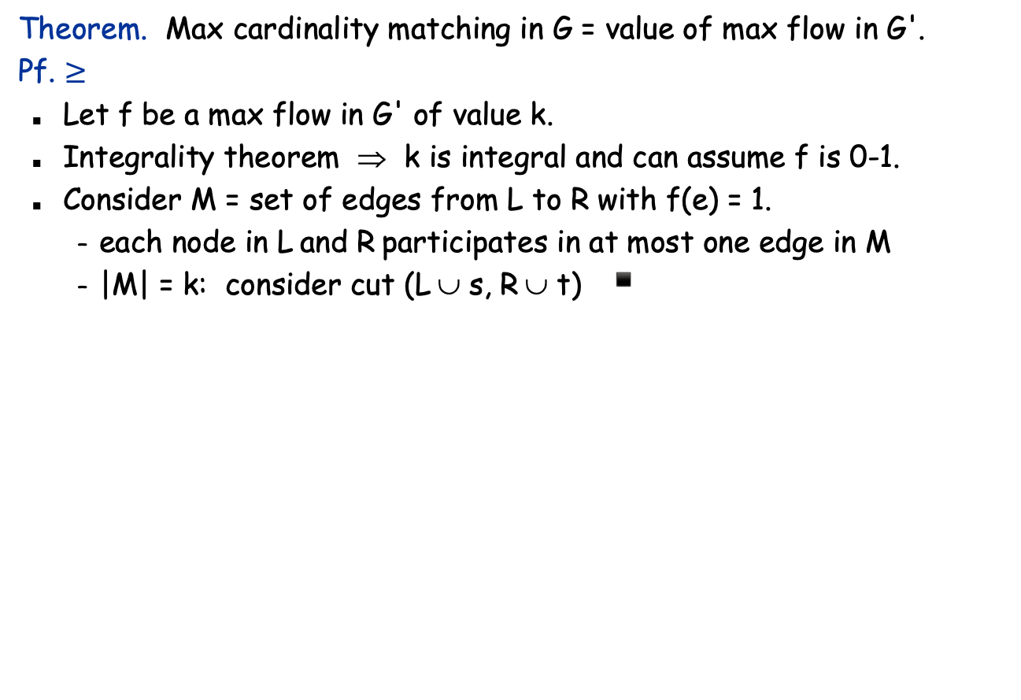
Bipartite Matching: Proof of Correctness
1
∞
1'
1
1'
1
2
2'
1
2
2'
s
3
3'
t
3
3'
4
4'
4
4'
G'
G
5
5'
5
5'
Slides by Kevin Wayne. Copyright © 2005 Pearson-Addison Wesley. All rights reserved.
Notes:
flow across cut (L ∪ s, R ∪ t) = flow entering t = k

Slide 18
Perfect Matching
Def. A matching M ⊆ E is perfect if each node appears in exactly one edge in M.
Q. When does a bipartite graph have a perfect matching?
Structure of bipartite graphs with perfect matchings.
Clearly we must have |L| = |R|.
What other conditions are necessary?
What conditions are sufficient?
Slides by Kevin Wayne. Copyright © 2005 Pearson-Addison Wesley. All rights reserved.

Slide 19
Perfect Matching
Notation. Let S be a subset of nodes, and let N(S) be the set of nodes adjacent to nodes in S.
Observation. If a bipartite graph G = (L ∪ R, E), has a perfect matching, then |N(S)| ≥ |S| for all subsets S ⊆ L.
Pf. Each node in S has to be matched to a different node in N(S).
1
1'
2
2'
No perfect matching:
S = { 2, 4, 5 }
N(S) = { 2', 5' }.
3
3'
4
4'
L
5
5'
R
Slides by Kevin Wayne. Copyright © 2005 Pearson-Addison Wesley. All rights reserved.

Slide 20
Marriage Theorem
Marriage Theorem. [Frobenius 1917, Hall 1935] Let G = (L ∪ R, E) be a bipartite graph with |L| = |R|. Then, G has a perfect matching iff |N(S)| ≥ |S| for all subsets S ⊆ L.
Pf. ⇒ This was the previous observation.
1
1'
2
2'
No perfect matching:
S = { 2, 4, 5 }
N(S) = { 2', 5' }.
3
3'
4
4'
L
5
5'
R
Slides by Kevin Wayne. Copyright © 2005 Pearson-Addison Wesley. All rights reserved.

Slide 21
Proof of Marriage Theorem
Pf. ⇐ Suppose G does not have a perfect matching.
Formulate as a max flow problem and let (A, B) be min cut in G'.
By max-flow min-cut, c(A, B) < | L |.
Define L_{A} = L ∩ A, L_{B} = L ∩ B , R_{A} = R ∩ A.
c(A, B) = | L_{B} | + | R_{A} |.
Min cut : N(L_{A}) ⊆ R_{A} because c(A,B) not increased if so
|N(L_{A} )| ≤ | R_{A} | = c(A, B) - | L_{B} | < | L | - | L_{B} | = | L_{A} |.
Choose S = L_{A} . ▪
G' = (L ∪ R ∪ {s, t}, E' )
1
∞
∞
G'
1
A
1'
2'
L_{A} = {2, 4, 5} L_{B} = {1, 3} R_{A} = {2', 5'} N(L_{A}) = {2', 5'}
2
∞
1
s
1
3'
4
3
4'
t
5
1
5'
Slides by Kevin Wayne. Copyright © 2005 Pearson-Addison Wesley. All rights reserved.

Slide 22
Bipartite Matching: Running Time
Which max flow algorithm to use for bipartite matching?
Generic augmenting path: O(m val(f*) ) = O(mn).
Capacity scaling: O(m² log C ) = O(m²).
Shortest augmenting path: O(m n^{1/2}).
Non-bipartite matching.
Structure of non-bipartite graphs is more complicated, but well-understood. [Tutte-Berge, Edmonds-Galai]
Blossom algorithm: O(n⁴). [Edmonds 1965]
Best known: O(m n^{1/2}). [Micali-Vazirani 1980]
Slides by Kevin Wayne. Copyright © 2005 Pearson-Addison Wesley. All rights reserved.

Slide 23
4. Disjoint Paths
Slides by Kevin Wayne. Copyright © 2005 Pearson-Addison Wesley. All rights reserved.

Slide 24
Edge Disjoint Paths
Disjoint path problem. Given a digraph G = (V, E) and two nodes s and t, find the max number of edge-disjoint s-t paths.
Def. Two paths are edge-disjoint if they have no edge in common.
2
5
s
3
6
t
4
7
Slides by Kevin Wayne. Copyright © 2005 Pearson-Addison Wesley. All rights reserved.

Slide 25
Edge Disjoint Paths
Disjoint path problem. Given a digraph G = (V, E) and two nodes s and t, find the max number of edge-disjoint s-t paths.
Def. Two paths are edge-disjoint if they have no edge in common.
2
5
s
3
6
t
4
7
Slides by Kevin Wayne. Copyright © 2005 Pearson-Addison Wesley. All rights reserved.

Slide 26
Edge Disjoint Paths
Max flow formulation: assign unit capacity to every edge.
Theorem. Max number edge-disjoint s-t paths equals max flow value.
Pf. ≤
Suppose there are k edge-disjoint paths P₁, . . . , P_{k}.
Set f(e) = 1 if e participates in some path P_{i} ; else set f(e) = 0.
Since paths are edge-disjoint, f is a flow of value k. ▪
1
1
1
1
1
1
s
1
1
t
1
1
1
1
1
1
Slides by Kevin Wayne. Copyright © 2005 Pearson-Addison Wesley. All rights reserved.

Slide 27
Edge Disjoint Paths
Max flow formulation: assign unit capacity to every edge.
Theorem. Max number edge-disjoint s-t paths equals max flow value.
Pf. ≥
Suppose max flow value is k.
Integrality theorem ⇒ there exists 0-1 flow f of value k.
Consider edge (s, u) with f(s, u) = 1.
by conservation, there exists an edge (u, v) with f(u, v) = 1
continue until reach t, always choosing a new edge
Produces k (not necessarily simple) edge-disjoint paths. ▪
1
1
1
1
1
1
s
1
1
t
1
1
1
1
1
1
Slides by Kevin Wayne. Copyright © 2005 Pearson-Addison Wesley. All rights reserved.
can eliminate cycles to get simple paths if desired

Slide 28
Network Connectivity
Network connectivity. Given a digraph G = (V, E) and two nodes s and t, find min number of edges whose removal disconnects t from s.
Def. A set of edges F ⊆ E disconnects t from s if every s-t path uses at least one edge in F.
2
5
s
3
6
t
4
7
Slides by Kevin Wayne. Copyright © 2005 Pearson-Addison Wesley. All rights reserved.

Slide 29
Edge Disjoint Paths and Network Connectivity
Theorem. [Menger 1927] The max number of edge-disjoint s-t paths is equal to the min number of edges whose removal disconnects t from s.
Pf. ≤
Suppose the removal of F ⊆ E disconnects t from s, and |F| = k.
Every s-t path uses at least one edge in F. Hence, the number of edge-disjoint paths is at most k. ▪
2
5
2
5
s
3
6
t
s
3
6
t
4
7
4
7
Slides by Kevin Wayne. Copyright © 2005 Pearson-Addison Wesley. All rights reserved.

Slide 30
Disjoint Paths and Network Connectivity
Theorem. [Menger 1927] The max number of edge-disjoint s-t paths is equal to the min number of edges whose removal disconnects t from s.
Pf. ≥
Suppose max number of edge-disjoint paths is k.
Then max flow value is k.
Max-flow min-cut ⇒ exist cut (A, B) of capacity k.
Let F be set of edges going from A to B.
|F| = k and disconnects t from s. ▪
A
2
5
2
5
s
3
6
t
s
3
6
t
4
7
4
7
Slides by Kevin Wayne. Copyright © 2005 Pearson-Addison Wesley. All rights reserved.

Slide 31
5. Extensions to Max Flow
Slides by Kevin Wayne. Copyright © 2005 Pearson-Addison Wesley. All rights reserved.

Slide 32
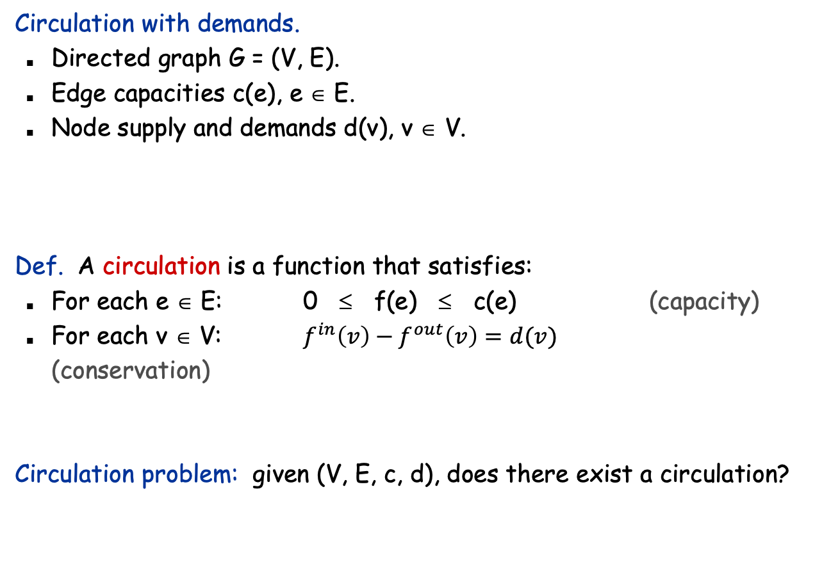
Circulation with Demands
demand if d(v) > 0; supply if d(v) < 0; transshipment if d(v) = 0
Slides by Kevin Wayne. Copyright © 2005 Pearson-Addison Wesley. All rights reserved.

Slide 33
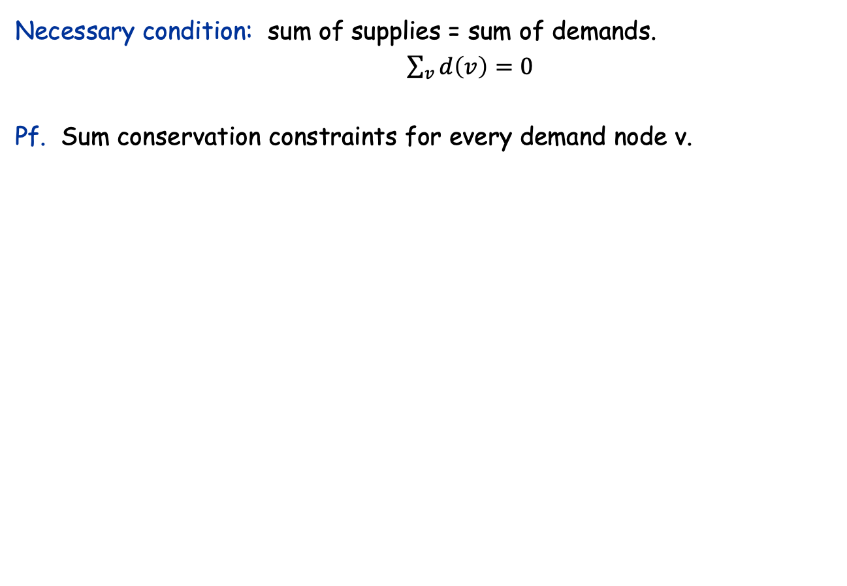
Circulation with Demands
-8
-6
supply
6
1
4
7
7
7
10
6
6
4
2
9
-7
3
3
4
11
10
0
4
capacity
demand
flow
Slides by Kevin Wayne. Copyright © 2005 Pearson-Addison Wesley. All rights reserved.
Notes:
note: only one type of flow (indistinguishable whether it is received from one source or another)
more general problem: multicommodity flow, where each sink must receive flow from one particular source

Slide 34
Circulation with Demands
Max flow formulation.
-8
-6
supply
G:
7
7
10
6
4
9
-7
3
4
11
10
0
demand
Slides by Kevin Wayne. Copyright © 2005 Pearson-Addison Wesley. All rights reserved.

Slide 35
Circulation with Demands
Max flow formulation.
Add new source s and sink t.
For each v with d(v) < 0, add edge (s, v) with capacity -d(v).
For each v with d(v) > 0, add edge (v, t) with capacity d(v).
Claim: G has circulation iff G' has max flow of value D.
saturates all edges leaving s and entering t
s
7
8
6
supply
G':
7
7
10
6
4
9
3
4
0
10
11
demand
t
Slides by Kevin Wayne. Copyright © 2005 Pearson-Addison Wesley. All rights reserved.

Slide 36
Circulation with Demands
Integrality theorem. If all capacities and demands are integers, and there exists a circulation, then there exists one that is integer-valued.
Pf. Follows from max flow formulation and integrality theorem for max flow.
Characterization. Given (V, E, c, d), there does not exist a circulation iff there exists a node partition (A, B) such that Σ_{v∈B} d_{v} > cap(A, B)
Pf idea. Look at min cut in G'.
demand by nodes in B exceeds supply of nodes in B plus max capacity of edges going from A to B
Slides by Kevin Wayne. Copyright © 2005 Pearson-Addison Wesley. All rights reserved.

Slide 37
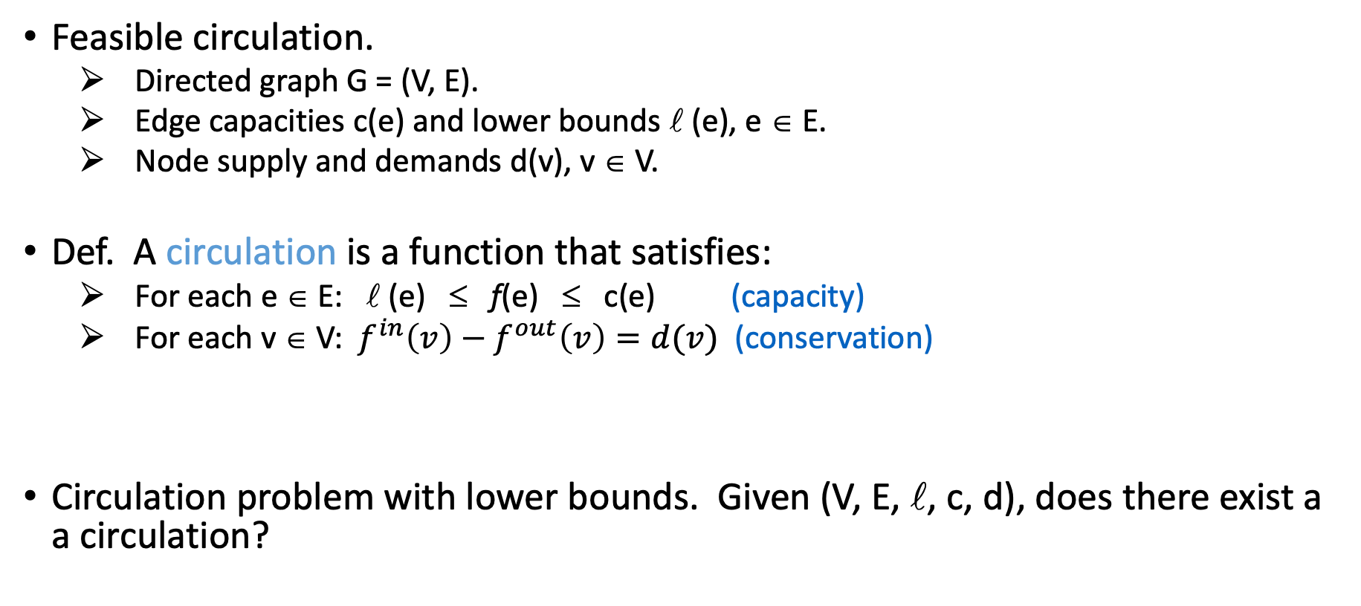
Circulation with Demands and Lower Bounds
Feasible circulation.
Directed graph G = (V, E).
Edge capacities c(e) and lower bounds  (e), e ∈ E.
Node supply and demands d(v), v ∈ V.
Def. A circulation is a function that satisfies:
For each e ∈ E:  (e) ≤ f(e) ≤ c(e) (capacity)
For each v ∈ V: $f^{in}\left(v\right)−f^{out}\left(v\right)=d(v)$ (conservation)
Circulation problem with lower bounds. Given (V, E, , c, d), does there exist a a circulation?
Slides by Kevin Wayne. Copyright © 2005 Pearson-Addison Wesley. All rights reserved.

Slide 38
Circulation with Demands and Lower Bounds
Idea. Model lower bounds with demands.
Send (e) units of flow along edge e.
Update demands of both endpoints.
Theorem. There exists a circulation in G iff there exists a circulation in G'. If all demands, capacities, and lower bounds in G are integers, then there is a circulation in G that is integer-valued.
Pf sketch. f(e) is a circulation in G iff f'(e) = f(e) - (e) is a circulation in G'.
lower bound
upper bound
capacity
v
[2, 9]
w
v
7
w
d(v)
G
d(w)
d(v) + 2
d(w) - 2
G'
Slides by Kevin Wayne. Copyright © 2005 Pearson-Addison Wesley. All rights reserved.

Slide 39
6. Survey Design
Slides by Kevin Wayne. Copyright © 2005 Pearson-Addison Wesley. All rights reserved.

Slide 40
Survey Design
one survey question per product
Survey design.
Design survey asking n₁ consumers about n₂ products.
Can only survey consumer i about product j if they own it.
Ask consumer i between c_{i} and c_{i}' questions.
Ask between p_{j} and p_{j}' consumers about product j.
Goal. Design a survey that meets these specs, if possible.
Bipartite perfect matching. Special case when c_{i} = c_{i}' = p_{i} = p_{i}' = 1.
Slides by Kevin Wayne. Copyright © 2005 Pearson-Addison Wesley. All rights reserved.

Slide 41
Survey Design
Algorithm. Formulate as a circulation problem with lower bounds.
Include an edge (i, j) if consumer j owns product i.
Integer circulation ⇔ feasible survey design.
[0, ∞]
1
[0, 1]
1'
[c₁, c₁']
[p₁, p₁']
2
2'
s
3
3'
t
4
4'
consumers
5
5'
products
Slides by Kevin Wayne. Copyright © 2005 Pearson-Addison Wesley. All rights reserved.

Slide 42
7. Image Segmentation
Slides by Kevin Wayne. Copyright © 2005 Pearson-Addison Wesley. All rights reserved.

Slide 43
Image Segmentation
Image segmentation.
Central problem in image processing.
Divide image into coherent regions.
Ex: Three people standing in front of complex background scene. Identify each person as a coherent object.
Slides by Kevin Wayne. Copyright © 2005 Pearson-Addison Wesley. All rights reserved.

Slide 44
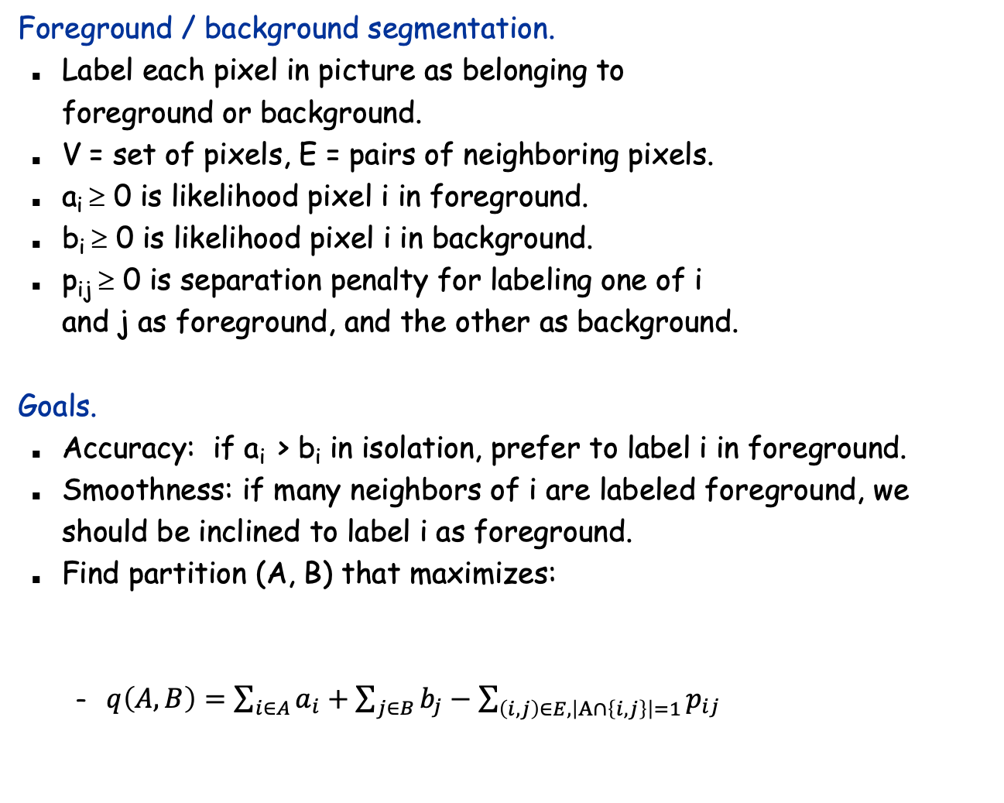
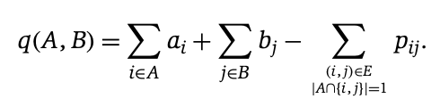
Image Segmentation
foreground
background
Slides by Kevin Wayne. Copyright © 2005 Pearson-Addison Wesley. All rights reserved.

Slide 45
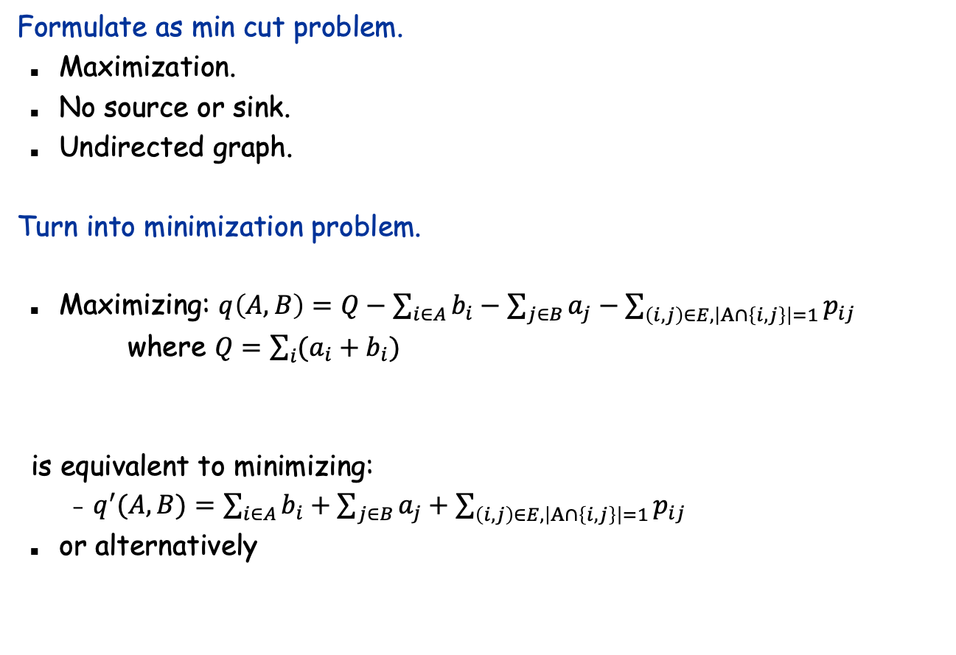
Image Segmentation
Slides by Kevin Wayne. Copyright © 2005 Pearson-Addison Wesley. All rights reserved.

Slide 46
Image Segmentation
p_{ij}
Formulate as min cut problem.
G' = (V', E').
Add source to correspond to foreground; add sink to correspond to background
Use two anti-parallel edges instead of undirected edge.
p_{ij}
p_{ij}
a_{j}
s
i
p_{ij}
j
t
b_{i}
G'
Slides by Kevin Wayne. Copyright © 2005 Pearson-Addison Wesley. All rights reserved.

Slide 47
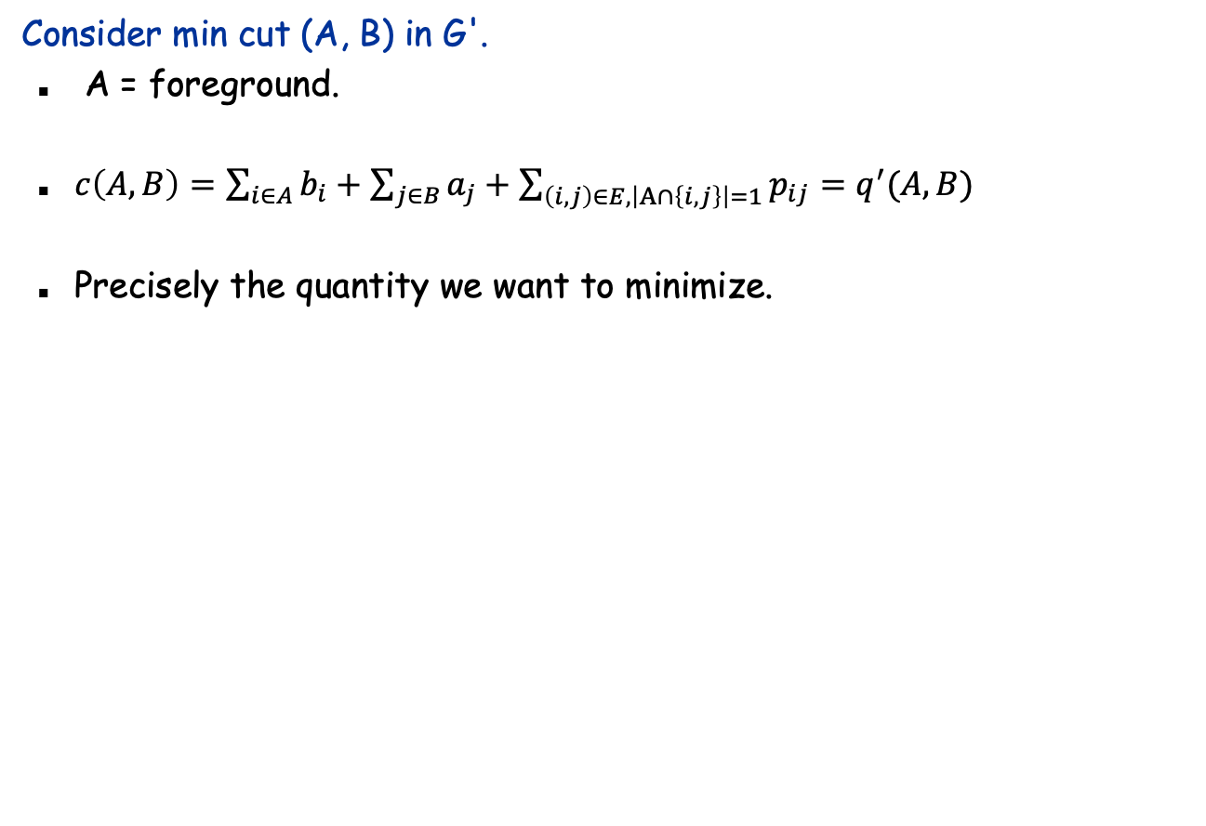
Image Segmentation
if i and j on different sides,
p_{ij} counted exactly once
a_{j}
s
i
p_{ij}
j
t
b_{i}
A
G'
Slides by Kevin Wayne. Copyright © 2005 Pearson-Addison Wesley. All rights reserved.

