Slide 1

Algorithm Design and Analysis (H)
CS216
Prof. Shiqi Yu (于仕琪)
yusq@sustech.edu.cn
http://faculty.sustech.edu.cn/yusq/
Slides by Kevin Wayne. Copyright © 2005 Pearson-Addison Wesley. All rights reserved.

Slide 2
Greedy Algorithms

Slide 3
4. Optimal Caching
Slides by Kevin Wayne. Copyright © 2005 Pearson-Addison Wesley. All rights reserved.

Slide 4
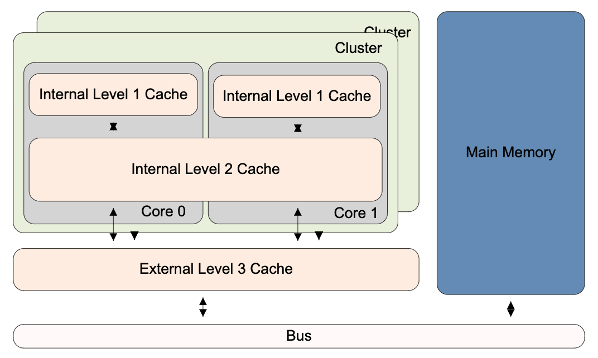
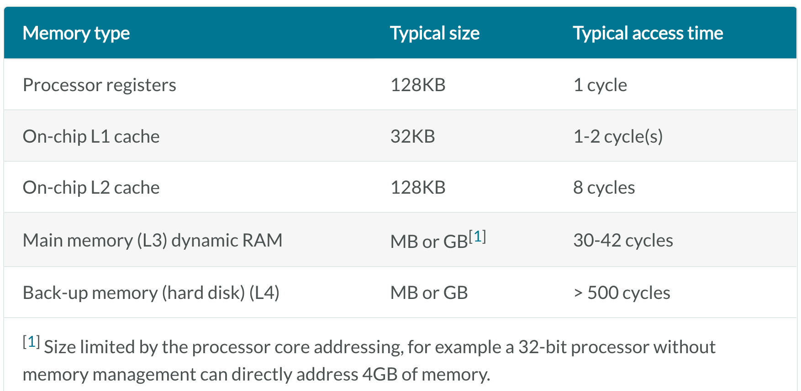
Caching
HD->memory->cache
https://developer.arm.com/documentation/den0024/a/Caches

Slide 5
Optimal Offline Caching
Caching.
Cache with capacity to store k items.
Sequence of m item requests d₁, d₂, …, d_{m}.
Cache hit: item already in cache when requested.
Cache miss: item not already in cache when requested: must bring requested item into cache, and evict some existing item, if full.
Goal. Eviction schedule that minimizes number of cache misses.
Ex: k = 2, initial cache = ab, requests: a, b, c, b, c, a, a, b.
Optimal eviction schedule: 2 cache misses.
Slides by Kevin Wayne. Copyright © 2005 Pearson-Addison Wesley. All rights reserved.

Slide 6
Optimal Offline Caching: Farthest-In-Future
Farthest-in-future. Evict item in the cache that is not requested until farthest in the future.
Theorem. [Bellady, 1960s] FF is optimal eviction schedule.
Pf. Algorithm and theorem are intuitive; proof is subtle.
current cache:
a
b
c
d
e
f
future queries:
g a b c e d a b b a c d e a f a d e f g h ...
cache miss
eject this one
Slides by Kevin Wayne. Copyright © 2005 Pearson-Addison Wesley. All rights reserved.

Slide 7
Reduced Eviction Schedules
Def. A reduced schedule is a schedule that only inserts an item into the cache in a step in which that item is requested.
Intuition. Can transform an unreduced schedule into a reduced one with no more cache misses.
a
a
b
c
a
a
b
c
a
a
x
c
a
a
b
c
c
a
d
c
c
a
b
c
d
a
d
b
d
a
d
c
a
a
c
b
a
a
d
c
b
a
x
b
b
a
d
b
c
a
c
b
c
a
c
b
a
a
b
c
a
a
c
b
a
a
b
c
a
a
c
b
an unreduced schedule
a reduced schedule
Slides by Kevin Wayne. Copyright © 2005 Pearson-Addison Wesley. All rights reserved.

Slide 8
Reduced Eviction Schedules
Claim. Given any unreduced schedule S, can transform it into a reduced schedule S' with no more cache misses.
Pf. (by induction on number of unreduced items)
Suppose S brings d into the cache at time t, without a request.
Let c be the item S evicts when it brings d into the cache.
Case 1: d evicted at time t', before next request for d.
Case 2: d requested at time t' before d is evicted. ▪
doesn't enter cache at requested time
S
S'
S
S'
c
c
c
c
t
t
t
t
d
d
t'
t'
t'
t'
e
d evicted at time t', before next request
e
d requested at time t'
d
Case 1
Case 2
Slides by Kevin Wayne. Copyright © 2005 Pearson-Addison Wesley. All rights reserved.
Notes:
Note: can't assume a priori that events in unreduced schedule occur solely at request times

Slide 9
Farthest-In-Future: Analysis
Theorem. FF is optimal eviction algorithm.
Pf. (by induction on number or requests j)
Let S be reduced schedule that satisfies invariant through j requests. We produce S' that satisfies invariant after j+1 requests.
Consider (j+1)^{st} request d = d_{j+1}.
Since S and S_{FF} have agreed up until now, they have the same cache contents before request j+1.
Case 1: (d is already in the cache). S' = S satisfies invariant.
Case 2: (d is not in the cache and S and S_{FF} evict the same element). S' = S satisfies invariant.
Invariant: There exists an optimal reduced schedule S that makes the same eviction schedule as S_{FF} through the first j+1 requests.
Slides by Kevin Wayne. Copyright © 2005 Pearson-Addison Wesley. All rights reserved.

Slide 10
Farthest-In-Future: Analysis
Pf. (continued)
Case 3: (d is not in the cache; S_{FF} evicts e; S evicts f ≠ e).
begin construction of S' from S by evicting e instead of f
now S' agrees with S_{FF} on first j+1 requests; we show that having element f in cache is no worse than having element e
j
same
e
f
same
e
f
S
S'
j+1
same
e
d
same
d
f
j
S
S'
Slides by Kevin Wayne. Copyright © 2005 Pearson-Addison Wesley. All rights reserved.

Slide 11
Farthest-In-Future: Analysis
Let j' be the first time after j+1 that S and S' take a different action, and let g be item requested at time j'.
must involve e or f (or both)
j'
same
e
same
f
S
S'
Case 3a: g = e. Can't happen with Farthest-In-Future since there must be a request for f before e.
Case 3b: g = f. Element f can't be in cache of S, so let e' be the element that S evicts.
if e' = e, S' accesses f from cache; now S and S' have same cache
if e' ≠ e, S' evicts e' and brings e into the cache; now S and S' have the same cache
Note: S' is no longer reduced, but can be transformed into a reduced schedule that agrees with S_{FF} through step j+1
Slides by Kevin Wayne. Copyright © 2005 Pearson-Addison Wesley. All rights reserved.

Slide 12
Farthest-In-Future: Analysis
Let j' be the first time after j+1 that S and S' take a different action, and let g be item requested at time j'.
must involve e or f (or both)
j'
same
e
same
f
S
S'
otherwise S' would take the same action
Case 3c: g ≠ e, f. S must evict e. Make S' evict f; now S and S' have the same cache. ▪
j'
same
g
same
g
S
S'
Slides by Kevin Wayne. Copyright © 2005 Pearson-Addison Wesley. All rights reserved.

Slide 13
Caching Perspective
Online vs. offline algorithms.
Offline: full sequence of requests is known a priori.
Online (reality): requests are not known in advance.
Caching is among most fundamental online problems in CS.
LIFO. Evict page brought in most recently.
LRU. Evict page whose most recent access was earliest.
Theorem. FF is optimal offline eviction algorithm.
Provides basis for understanding and analyzing online algorithms.
LRU is k-competitive. [Section 13.8]
LIFO is arbitrarily bad.
FF with direction of time reversed!
Slides by Kevin Wayne. Copyright © 2005 Pearson-Addison Wesley. All rights reserved.

Slide 14
5. Shortest Paths in a Graph
Slides by Kevin Wayne. Copyright © 2005 Pearson-Addison Wesley. All rights reserved.
Notes:
map from Microsoft Streets and Trips

Slide 15
Shortest Path Problem
Shortest path network.
Directed graph G = (V, E).
Source s, destination t.
Length _{e} = length of edge e.
Shortest path problem: find shortest directed path from s to t.
cost of path = sum of edge costs in path
2
23
3
Cost of path s-2-3-5-t = 9 + 23 + 2 + 16 = 50.
9
s
18
14
2
6
6
30
11
4
19
15
5
5
20
16
6
7
44
t
Slides by Kevin Wayne. Copyright © 2005 Pearson-Addison Wesley. All rights reserved.

Slide 16
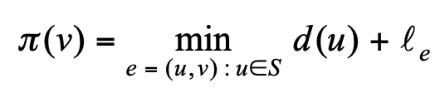
Dijkstra's Algorithm
Dijkstra's algorithm.
Maintain a set of explored nodes S for which we have determined the shortest path distance d(u) from s to u.
Initialize S = { s }, d(s) = 0.
Repeatedly choose unexplored node v which minimizes add v to S, and set d(v) = π(v).
shortest path to some u in explored part, followed by a single edge (u, v)
_{e}
v
d(u)
u
S
s
Slides by Kevin Wayne. Copyright © 2005 Pearson-Addison Wesley. All rights reserved.

Slide 17
Dijkstra's Algorithm
Dijkstra's algorithm.
Maintain a set of explored nodes S for which we have determined the shortest path distance d(u) from s to u.
Initialize S = { s }, d(s) = 0.
Repeatedly choose unexplored node v which minimizes add v to S, and set d(v) = π(v).
shortest path to some u in explored part, followed by a single edge (u, v)
_{e}
v
d(u)
u
S
s
Slides by Kevin Wayne. Copyright © 2005 Pearson-Addison Wesley. All rights reserved.
Notes:
S is only needed for the proof of correctness, not the algorithm itself

Slide 18
Dijkstra's Algorithm: Proof of Correctness
Invariant. For each node u ∈ S, d(u) is the length of the shortest s-u path.
Pf. (by induction on |S|)
Base case: |S| = 1 is trivial.
Inductive hypothesis: Assume true for |S| = k ≥ 1.
Let v be next node added to S, and let u-v be the chosen edge.
The shortest s-u path plus (u, v) is an s-v path of length π(v).
Consider any s-v path P. We'll see that it's no shorter than π(v).
Let x-y be the first edge in P that leaves S, and let P' be the subpath to x.
P is already too long as soon as it leaves S.
P
P'
x
y
s
S
u
v
● (P) ≥  (P') +  (x,y) ≥ d(x) +  (x, y) ≥ π(y) ≥ π(v)
nonnegative weights
inductive hypothesis
defn of π(y)
Dijkstra chose v instead of y
Slides by Kevin Wayne. Copyright © 2005 Pearson-Addison Wesley. All rights reserved.
Notes:
Consider any path P from s to v. It is already at least as long as π(v) by the time it leaves S.

Slide 19
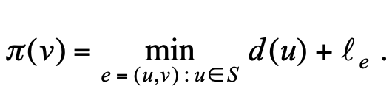
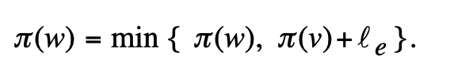
Dijkstra's Algorithm: Implementation
For each unexplored node, explicitly maintain
Next node to explore = node with minimum π(v).
When exploring v, for each incident edge e = (v, w), update
Efficient implementation. Maintain a priority queue of unexplored nodes, prioritized by π(v).
PQ Operation
Dijkstra
Array
Binary heap
d-way Heap
Fib heap †
Insert
n
n
log n
d log _{d} n
1
ExtractMin
n
n
log n
d log _{d} n
log n
ChangeKey
m
1
log n
log _{d} n
1
IsEmpty
n
1
1
1
1
Total
n²
m log n
m log _{m/n} n
m + n log n
† Individual ops are amortized bounds

Slide 20
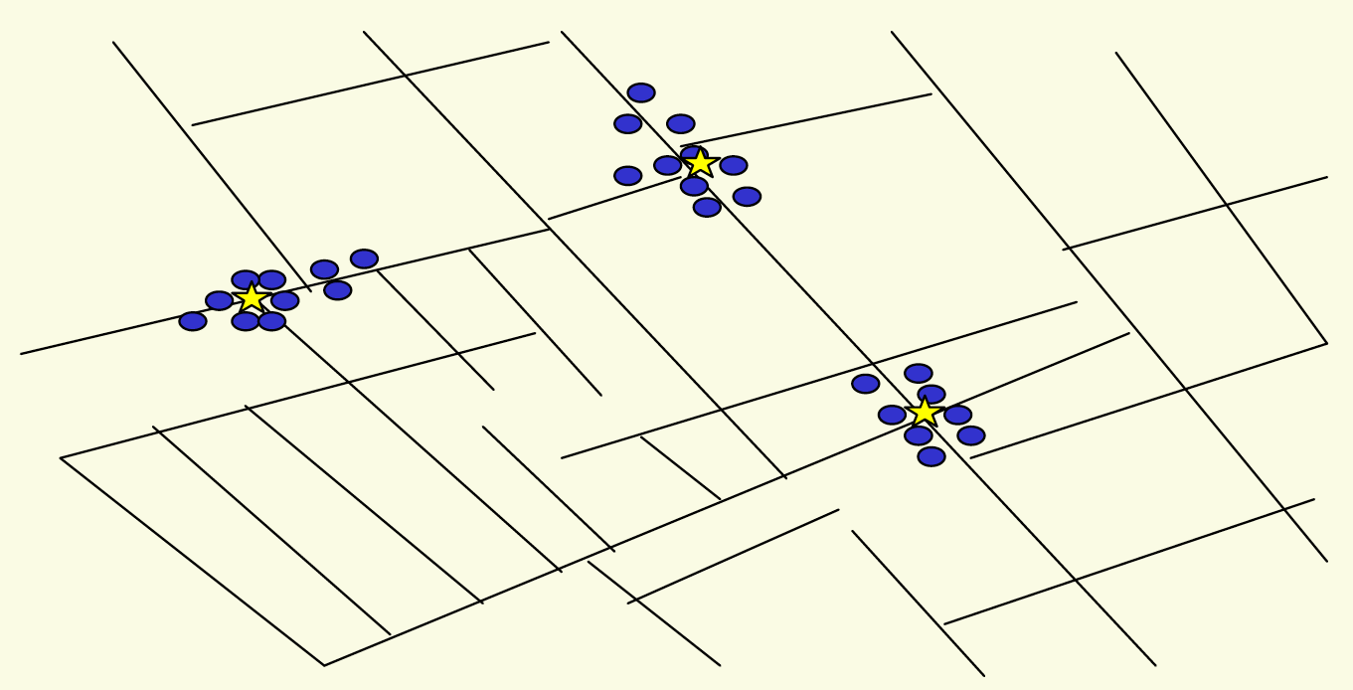
6. Clustering
Outbreak of cholera deaths in London in 1850s. Reference: Nina Mishra, HP Labs
Notes:
History: London physicist John Snow plotted outbreak of cholera deaths on map in 1850s
location indicated that clusters were around certain intersections with polluted wells; this exposed the problem and solution!

Slide 21
Clustering
Clustering. Given a set U of n objects labeled p₁, …, p_{n}, classify into coherent groups.
Distance function. Numeric value specifying "closeness" of two objects.
Fundamental problem. Divide into clusters so that points in different clusters are far apart.
Routing in mobile ad hoc networks.
Identify patterns in gene expression.
Document categorization for web search.
Similarity searching in medical image databases
Skycat: cluster 10⁹ sky objects into stars, quasars, galaxies.
photos, documents. micro-organisms
number of corresponding pixels whose
intensities differ by some threshold
Notes:
skycat: 7 dimensional vectors, each coordinate represents radiation in some band of the spectrum
Sloan Sky Survey: cluster entire visible universe

Slide 22
Clustering of Maximum Spacing
k-clustering. Divide objects into k non-empty groups.
Distance function. Assume it satisfies several natural properties.
d(p_{i}, p_{j}) = 0 iff p_{i} = p_{j} (identity of indiscernibles)
d(p_{i}, p_{j}) ≥ 0 (nonnegativity)
d(p_{i}, p_{j}) = d(p_{j}, p_{i}) (symmetry)
Spacing. Min distance between any pair of points in different clusters.
Clustering of maximum spacing. Given an integer k, find a k-clustering of maximum spacing.
spacing
k = 4
Notes:
semimetric: not necessarily a metric space (no triangle inequality)
Ex: assumes Euclidean distance function

Slide 23
Greedy Clustering Algorithm
Single-link k-clustering algorithm.
Form a graph on the vertex set U, corresponding to n clusters.
Find the closest pair of objects such that each object is in a different cluster, and add an edge between them.
Repeat n-k times until there are exactly k clusters.
Key observation. This procedure is precisely Kruskal's algorithm (except we stop when there are k connected components).
Remark. Equivalent to finding an MST and deleting the k-1 most expensive edges.
Notes:
Agglomerative clustering. Build tree bottom up.
Divisive clustering. Build tree top down.

Slide 24
Greedy Clustering Algorithm: Analysis
Theorem. Let C* denote the clustering C*₁, …, C*_{k} formed by deleting the k-1 most expensive edges of a MST. C* is a k-clustering of max spacing.
Pf. Let C denote some other clustering C₁, …, C_{k}.
The spacing of C* is the length d* of the (k-1)^{st} most expensive edge.
Let p_{i}, p_{j} be in the same cluster in C*, say C*_{r}, but different clusters in C, say C_{s} and C_{t}.
Some edge (p, q) on p_{i}-p_{j} path in C*_{r} spans two different clusters in C.
All edges on p_{i}-p_{j} path have length ≤ d* since Kruskal chose them.
Spacing of C is ≤ d* since p and q are in different clusters. ▪
C_{s}
C_{t}
C*_{r}
p_{i}
p
q
p_{j}

Slide 25
Extra Slides
Slides by Kevin Wayne. Copyright © 2005 Pearson-Addison Wesley. All rights reserved.

Slide 26
Coin Changing
Slides by Kevin Wayne. Copyright © 2005 Pearson-Addison Wesley. All rights reserved.
Notes:
"michael douglas played gordon gecko in iconic movie of the 1980's that embodied Reagan era"
also starring charlie and martin sheen, directed by Oliver Stone

Slide 27







Coin Changing
Goal. Given currency denominations: 1, 5, 10, 25, 100, devise a method to pay amount to customer using fewest number of coins.
Ex: 34¢.
Cashier's algorithm. At each iteration, add coin of the largest value that does not take us past the amount to be paid.
Ex: $2.89.
Slides by Kevin Wayne. Copyright © 2005 Pearson-Addison Wesley. All rights reserved.
Notes:
most of us solve this kind of problem every day without thinking twice, unconsciously using an obvious greedy algorithm
http://www.frbatlanta.org/publica/brochure/fundfac/html/coinfaces.html

Slide 28
Coin-Changing: Greedy Algorithm
Cashier's algorithm. At each iteration, add coin of the largest value that does not take us past the amount to be paid.
Q. Is cashier's algorithm optimal?
Sort coins denominations by value: c₁ < c₂ < … < c_{n}.
S ← φ
while (x ≠ 0) {
let k be largest integer such that c_{k} ≤ x
if (k = 0)
return "no solution found"
x ← x - c_{k}
S ← S ∪ {k}
}
return S
coins selected
Slides by Kevin Wayne. Copyright © 2005 Pearson-Addison Wesley. All rights reserved.
Notes:
takes O(n log n) + |S| where S is the number of coins taken by greedy
Note: can be sped up somewhat by using integer division

Slide 29
Coin-Changing: Analysis of Greedy Algorithm
Theorem. Greed is optimal for U.S. coinage: 1, 5, 10, 25, 100.
Pf. (by induction on x)
Consider optimal way to change c_{k} ≤ x < c_{k+1} : greedy takes coin k.
We claim that any optimal solution must also take coin k.
if not, it needs enough coins of type c₁, …, c_{k-1} to add up to x
table below indicates no optimal solution can do this
Problem reduces to coin-changing x - c_{k} cents, which, by induction, is optimally solved by greedy algorithm. ▪
k
c_{k}
All optimal solutions must satisfy
Max value of coins 1, 2, …, k-1 in any OPT
1
1
P ≤ 4
-
2
5
N ≤ 1
4
3
10
N + D ≤ 2
4 + 5 = 9
4
25
Q ≤ 3
20 + 4 = 24
5
100
no limit
75 + 24 = 99
Slides by Kevin Wayne. Copyright © 2005 Pearson-Addison Wesley. All rights reserved.
Notes:
P = pennies, N = nickels, D = dimes, Q = quarters

Slide 30
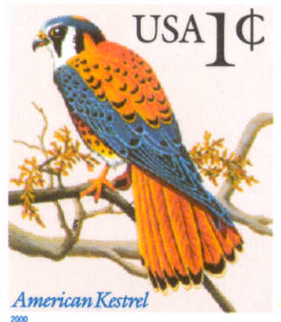
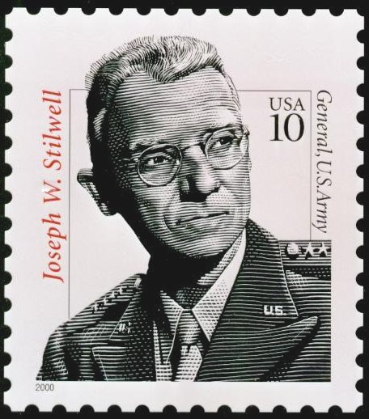
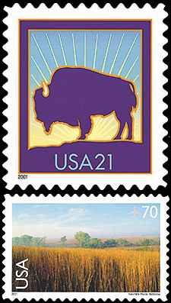
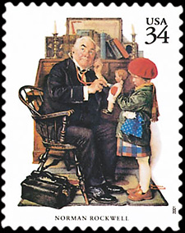

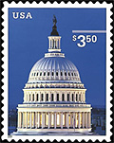
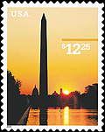
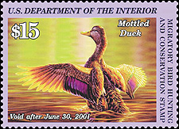
Coin-Changing: Analysis of Greedy Algorithm
Observation. Greedy algorithm is sub-optimal for US postal denominations: 1, 10, 21, 34, 70, 100, 350, 1225, 1500.
Counterexample. 140¢.
Greedy: 100, 34, 1, 1, 1, 1, 1, 1.
Optimal: 70, 70.
Slides by Kevin Wayne. Copyright © 2005 Pearson-Addison Wesley. All rights reserved.
Notes:
note: may not even lead to *feasible* solution if c_1 > 1!
Ex. C = {7, 8, 9}, x = 15

Slide 31
Selecting Breakpoints
Slides by Kevin Wayne. Copyright © 2005 Pearson-Addison Wesley. All rights reserved.

Slide 32
Selecting Breakpoints
Selecting breakpoints.
Road trip from Princeton to Palo Alto along fixed route.
Refueling stations at certain points along the way.
Fuel capacity = C.
Goal: makes as few refueling stops as possible.
Greedy algorithm. Go as far as you can before refueling.
C
C
C
C
Princeton
C
C
C
Palo Alto
1
2
3
4
5
6
7
Slides by Kevin Wayne. Copyright © 2005 Pearson-Addison Wesley. All rights reserved.
Notes:
applications: communication server sending information in chunks of size at most C

Slide 33
Selecting Breakpoints: Greedy Algorithm
Truck driver's algorithm.
Implementation. O(n log n)
Use binary search to select each breakpoint p.
Sort breakpoints so that: 0 = b₀ < b₁ < b₂ < ... < b_{n} = L
S ← {0}
x ← 0
while (x ≠ b_{n})
let p be largest integer such that b_{p} ≤ x + C
if (b_{p} = x)
return "no solution"
x ← b_{p}
S ← S ∪ {p}
return S
breakpoints selected
current location
Slides by Kevin Wayne. Copyright © 2005 Pearson-Addison Wesley. All rights reserved.

Slide 34
Selecting Breakpoints: Correctness
Theorem. Greedy algorithm is optimal.
Pf. (by contradiction)
Assume greedy is not optimal, and let's see what happens.
Let 0 = g₀ < g₁ < . . . < g_{p} = L denote set of breakpoints chosen by greedy.
Let 0 = f₀ < f₁ < . . . < f_{q} = L denote set of breakpoints in an optimal solution with f₀ = g₀, f₁= g₁ , . . . , f_{r} = g_{r} for largest possible value of r.
Note: g_{r+1} > f_{r+1} by greedy choice of algorithm.
g₀
g₁
g₂
g_{r}
g_{r+1}
Greedy:
OPT:
. . .
f₀
f₁
f₂
f_{r}
f_{r+1}
f_{q}
why doesn't optimal solution drive a little further?
Slides by Kevin Wayne. Copyright © 2005 Pearson-Addison Wesley. All rights reserved.

Slide 35
Selecting Breakpoints: Correctness
Theorem. Greedy algorithm is optimal.
Pf. (by contradiction)
Assume greedy is not optimal, and let's see what happens.
Let 0 = g₀ < g₁ < . . . < g_{p} = L denote set of breakpoints chosen by greedy.
Let 0 = f₀ < f₁ < . . . < f_{q} = L denote set of breakpoints in an optimal solution with f₀ = g₀, f₁= g₁ , . . . , f_{r} = g_{r} for largest possible value of r.
Note: g_{r+1} > f_{r+1} by greedy choice of algorithm.
g₀
g₁
g₂
g_{r}
g_{r+1}
Greedy:
OPT:
. . .
f₀
f₁
f₂
f_{r}
f_{q}
another optimal solution has one more breakpoint in common ⇒ contradiction
Slides by Kevin Wayne. Copyright © 2005 Pearson-Addison Wesley. All rights reserved.

Slide 36
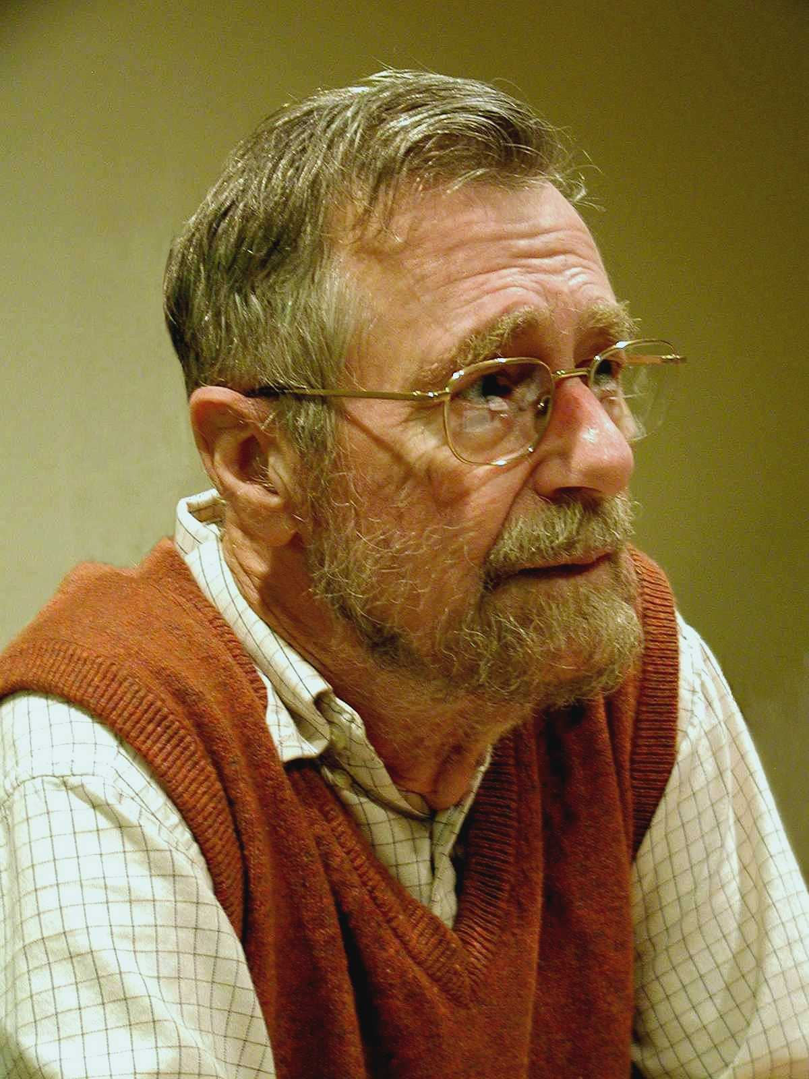
Edsger W. Dijkstra
The question of whether computers can think is like the question of whether submarines can swim.
Do only what only you can do.
In their capacity as a tool, computers will be but a ripple on the surface of our culture. In their capacity as intellectual challenge, they are without precedent in the cultural history of mankind.
The use of COBOL cripples the mind; its teaching should, therefore, be regarded as a criminal offence.
APL is a mistake, carried through to perfection. It is the language of the future for the programming techniques of the past: it creates a new generation of coding bums.
Slides by Kevin Wayne. Copyright © 2005 Pearson-Addison Wesley. All rights reserved.

