Slide 1
Algorithm Design and Analysis (H)
CS216
Prof. Shiqi Yu (于仕琪)
yusq@sustech.edu.cn
http://faculty.sustech.edu.cn/yusq/

Slide 2
Greedy Algorithms
Encoding and Huffman
Slides are supplied by Mathijs de Weerd

Slide 3
Encoding
Why we need encoding?
Difference between human beings and computers
Post code/the address system in China

Slide 4
Encoding
An example
Pay a gold bullion to a worker who will work 7 days for you
You should pay him per day
The gold bullion can only be cut two times

Slide 5
Encoding
64 samples (1 poison)
How many guinea pigs at least to find the poison?
 | 🐁 | 🐁 | 🐁 | 🐁 | 🐁 | 🐁
0 | 0 | 0 | 0 | 0 | 0 | 0
1 | 0 | 0 | 0 | 0 | 0 | 1
2 | 0 | 0 | 0 | 0 | 1 | 0
3 | 0 | 0 | 0 | 0 | 1 | 1
4 | 0 | 0 | 0 | 1 | 0 | 0
…
63 | 1 | 1 | 1 | 1 | 1 | 1

Slide 6
Data Compression
Q. Given a text that uses 32 symbols (26 different letters, space, and some punctuation characters), how can we encode this text in bits?
A. We can encode 2⁵ different symbols using a fixed length of 5 bits per symbol. This is called fixed length encoding.

Slide 7
Data Compression
Q. Some symbols (e, t, a, o, i, n) are used far more often than others. How can we use this to reduce our encoding?
A. Encode these characters with fewer bits, and the others with more bits.

Slide 8
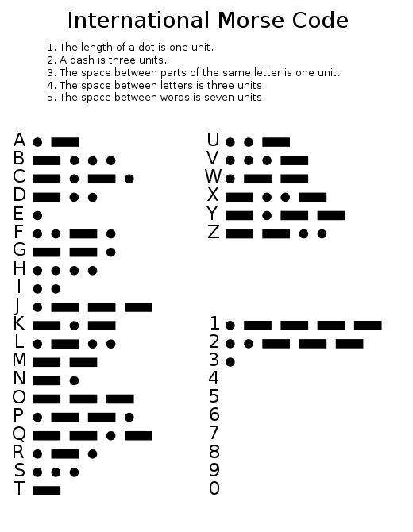
Data Compression
Q. How do we know when the next symbol begins?
A. Use a separation symbol (like the pause in Morse), or make sure that there is no ambiguity by ensuring that no code is a prefix of another one.
Ex. c(a) = 01
c(b) = 010
c(e) = 1
What is 0101?
https://morsecode.world/international/translator.html

Slide 9
Prefix Codes
Definition. A prefix code for a set S is a function c that maps each x∈S to 1s and 0s in such a way that for x,y∈S, x≠y, c(x) is not a prefix of c(y).
Ex. c(a) = 11
c(e) = 01
c(k) = 001
c(l) = 10
c(u) = 000
Q. What is the meaning of 1001000001 ?
A. “leuk”
Suppose frequencies are known in a text of 1G:
f_{a}=0.4, f_{e}=0.2, f_{k}=0.2, f_{l}=0.1, f_{u}=0.1
Q. What is the size of the encoded text?
A. 2*f_{a} + 2*f_{e} + 3*f_{k} + 2*f_{l} + 4*f_{u} = 2.4G

Slide 10
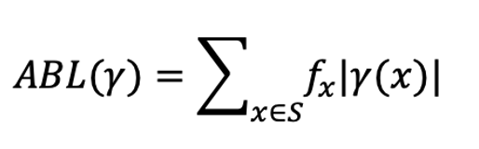
Optimal Prefix Codes
Definition. The average bits per letter of a prefix code c is the sum over all symbols of its frequency times the number of bits of its encoding:
We would like to find a prefix code that is has the lowest possible average bits per letter.
Suppose we model a code in a binary tree…

Slide 11
Representing Prefix Codes using Binary Trees
Ex. c(a) = 11
c(e) = 01
c(k) = 001
c(l) = 10
c(u) = 000
Q. How does the tree of a prefix code look?
0
1
0
1
0
1
e
l
a
0
1
u
k

Slide 12
Representing Prefix Codes using Binary Trees
Ex. c(a) = 11
c(e) = 01
c(k) = 001
c(l) = 10
c(u) = 000
Q. How does the tree of a prefix code look?
A. Only the leaves have a label.
Pf. An encoding of x is a prefix of an encoding of y if and only if the path of x is a prefix of the path of y.
0
1
0
1
0
1
e
l
a
0
1
u
k

Slide 13
Representing Prefix Codes using Binary Trees
Q. What is the meaning of
111010001111101000 ?
0
1
0
1
0
1
e
i
0
1
1
l
m
0
1
s
p

Slide 14
Representing Prefix Codes using Binary Trees
Q. What is the meaning of
111010001111101000 ?
A. “simpel”
Q. How can this prefix code be made more efficient?
0
1
0
1
0
1
e
i
0
1
1
l
m
0
1
s
p

Slide 15
Representing Prefix Codes using Binary Trees
Q. What is the meaning of
111010001111101000 ?
A. “simpel”
Q. How can this prefix code be made more efficient?
A. Change encoding of p and s to a shorter one.
This tree is now full.
0
1
0
1
0
1
e
i
0
1
0
1
l
m
s
0
1
s
p

Slide 16
Representing Prefix Codes using Binary Trees
Definition. A tree is full if every node that is not a leaf has two children.
Claim. The binary tree corresponding to the optimal prefix code is full.
Pf.
w
u
v

Slide 17
Representing Prefix Codes using Binary Trees
Definition. A tree is full if every node that is not a leaf has two children.
Claim. The binary tree corresponding to the optimal prefix code is full.
Pf. (by contradiction)
Suppose T is binary tree of optimal prefix code and is not full.
This means there is a node u with only one child v.
Case 1: u is the root; delete u and use v as the root
Case 2: u is not the root
let w be the parent of u
delete u and make v be a child of w in place of u
w
u
In both cases the number of bits needed to encode any leaf in the subtree of v is decreased. The rest of the tree is not affected.
Clearly this new tree T’ has a smaller ABL than T. Contradiction.
v

Slide 18
Optimal Prefix Codes: False Start
Q. Where in the tree of an optimal prefix code should letters be placed with a high frequency?
A. Near the top.
Greedy template. Create tree top-down, split S into two sets S₁ and S₂ with (almost) equal frequencies. Recursively build tree for S₁ and S₂.
[Shannon-Fano code, 1949] f_{a}=0.32, f_{e}=0.25, f_{k}=0.20, f_{l}=0.18, f_{u}=0.05
e
l
a
k
e
a
0.25
0.18
0.32
0.20
0.25
0.32
u
k
u
l
0.05
0.20
0.05
0.18
Notes:
Q. How to greedily build a tree?

Slide 19
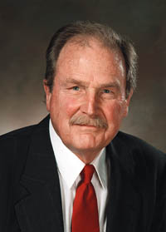
Optimal Prefix Codes: Huffman Encoding
Observation. Lowest frequency items should be at the lowest level in tree of optimal prefix code.
Observation. For n > 1, the lowest level always contains at least two leaves.
Observation. The order in which items appear in a level does not matter.
Claim. There is an optimal prefix code with tree T* where the two lowest-frequency letters are assigned to leaves that are siblings in T*.
Greedy template. [Huffman, 1952] Create tree bottom-up.
Make two leaves for two lowest-frequency letters y and z.
Recursively build tree for the rest using a meta-letter for yz.

Slide 20
Optimal Prefix Codes: Huffman Encoding
Huffman(S) {
if |S|=2 {
return tree with root and 2 leaves
} else {
let y and z be lowest-frequency letters in S
S’ = S
remove y and z from S’
insert new letter ω in S’ with f_{ω}=f_{y}+f_{z}
T’ = Huffman(S’)
T = add two children y and z to leaf ω from T’
return T
}
}
Q. What is the time complexity?
A. T(n) = T(n-1) + O(n)
so O(n²)
Q. How to implement finding lowest-frequency letters efficiently?
A. Use priority queue for S: T(n) = T(n-1) + O(log n) so O(n log n)

Slide 21
Huffman Encoding: Greedy Analysis
Claim. Huffman code for S achieves the minimum ABL of any prefix code.
Pf. by induction, based on optimality of T’ (y and z removed, ω added)
(see next page)
Claim. ABL(T’)=ABL(T)-f_{ω}
Pf.
Notes:
T’ is efficienter omdat yz een level hoger zitten.

Slide 22
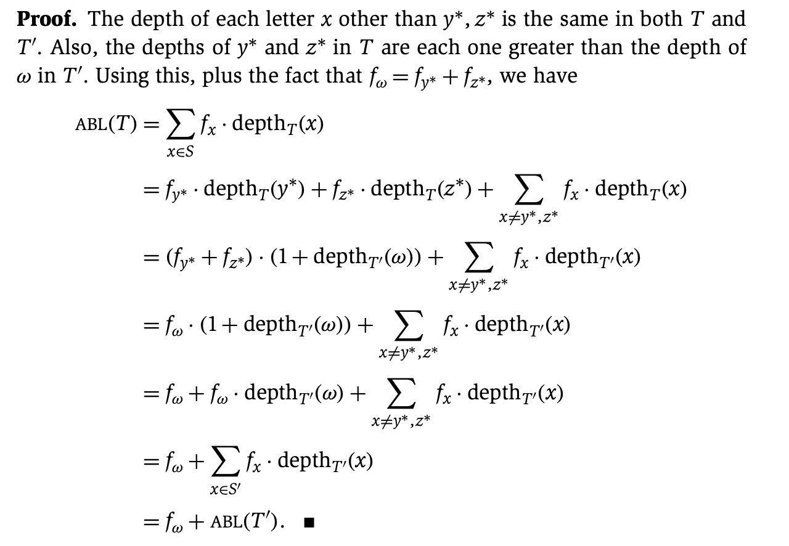
Huffman Encoding: Greedy Analysis
Claim. Huffman code for S achieves the minimum ABL of any prefix code.
Pf. by induction, based on optimality of T’ (y and z removed, ω added)
(see next page)
Claim. ABL(T’)=ABL(T)-f_{ω}
Pf.

Slide 23
Huffman Encoding: Greedy Analysis
Claim. Huffman code for S achieves the minimum ABL of any prefix code.
Pf. (by induction over n=|S|)

Slide 24
Huffman Encoding: Greedy Analysis
Claim. Huffman code for S achieves the minimum ABL of any prefix code.
Pf. (by induction over n=|S|)
Base: For n=2 there is no shorter code than root and two leaves.
Hypothesis: Suppose Huffman tree T’ for S’ of size n-1 with ω instead of y and z is optimal.
Step: (by contradiction)

Slide 25
Huffman Encoding: Greedy Analysis
Claim. Huffman code for S achieves the minimum ABL of any prefix code.
Pf. (by induction)
Base: For n=2 there is no shorter code than root and two leaves.
Hypothesis: Suppose Huffman tree T’ for S’ of size n-1 with ω instead of y and z is optimal. (IH)
Step: (by contradiction)
Idea of proof:
Suppose other tree Z of size n is better.
Delete lowest frequency items y and z from Z creating Z’
Z’ cannot be better than T’ by IH.

Slide 26
Huffman Encoding: Greedy Analysis
Claim. Huffman code for S achieves the minimum ABL of any prefix code.
Pf. (by induction)
Base: For n=2 there is no shorter code than root and two leaves.
Hypothesis: Suppose Huffman tree T’ for S’ with ω instead of y and z is optimal. (IH)
Step: (by contradiction)
Suppose Huffman tree T for S is not optimal.
So there is some tree Z such that ABL(Z) < ABL(T).
Then there is also a tree Z for which leaves y and z exist that are siblings and have the lowest frequency (see observation).
Let Z’ be Z with y and z deleted, and their former parent labeled ω.
Similar T’ is derived from S’ in our algorithm.
We know that ABL(Z’)=ABL(Z)-f_{ω}, as well as ABL(T’)=ABL(T)-f_{ω.}
But also ABL(Z) < ABL(T), so ABL(Z’) < ABL(T’).
Contradiction with IH.

Slide 27
ZIP file format
ZIP: an archive file format that supports lossless data compression.
ZIP File Format Specification
https://pkware.cachefly.net/webdocs/APPNOTE/APPNOTE-6.2.0.txt

