Slide 1
Algorithm Design and Analysis (H)
CS216
Prof. Shiqi Yu (于仕琪)
yusq@sustech.edu.cn
http://faculty.sustech.edu.cn/yusq/

Slide 2

Divide and Conquer
Slides by Kevin Wayne. Copyright © 2005 Pearson-Addison Wesley. All rights reserved.

Slide 3
Divide-and-Conquer
凡治众如治寡 分数是也
孙子兵法
Divide-and-conquer.
Break up problem into several parts.
Solve each part recursively.
Combine solutions to sub-problems into overall solution.
Most common usage.
Break up problem of size n into two equal parts of size ½n.
Solve two parts recursively.
Combine two solutions into overall solution in linear time.
Consequence.
Brute force: n².
Divide-and-conquer: n log n.
Slides by Kevin Wayne. Copyright © 2005 Pearson-Addison Wesley. All rights reserved.

Slide 4
1. Mergesort
Slides by Kevin Wayne. Copyright © 2005 Pearson-Addison Wesley. All rights reserved.
Notes:
"Divide and conquer", Caesar's other famous quote "I came, I saw, I conquered"
Divide-and-conquer idea dates back to Julius Caesar.
Favorite war tactic was to divide an opposing army in two halves, and then assault one half with his entire force.

Slide 5
Sorting
Sorting. Given n elements, rearrange in ascending order.
Applications.
Sort a list of names.
Organize an MP3 library.
Display Google PageRank results.
List RSS news items in reverse chronological order.
Find the median.
Find the closest pair.
Binary search in a database.
Identify statistical outliers.
Find duplicates in a mailing list.
Data compression.
Computer graphics.
Computational biology.
Supply chain management.
Book recommendations on Amazon.
Load balancing on a parallel computer. . . .
non-obvious applications
obvious applications
problems become easy once items are in sorted order
Slides by Kevin Wayne. Copyright © 2005 Pearson-Addison Wesley. All rights reserved.
Notes:
Reminder of why sorting is so important.
Once a set of items is sorted, many other problems become easy.
Data compression = burrows wheeler transform.
supply chain management = schedule jobs of varying length to minimize (weighted) completion time
Computer graphics = convex hull, collinear points
particle simulation usually involves sorting N keys in the range 1 to O(N), but might be done for huge inputs - can be N-body simulation (ala Barnes-Hut variant) or for collision detection
Computational biology = longest common substring

Slide 6
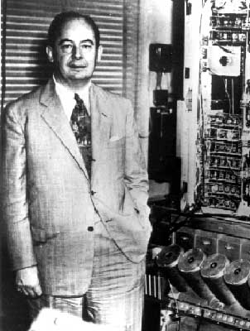
Mergesort
Mergesort.
Divide array into two halves.
Recursively sort each half.
Merge two halves to make sorted whole.
Jon von Neumann (1945)
A
L
G
O
R
I
T
H
M
S
A
L
G
O
R
I
T
H
M
S
divide
O(1)
A
G
L
O
R
H
I
M
S
T
sort
2T(n/2)
A
G
H
I
L
M
O
R
S
T
merge
O(n)
Slides by Kevin Wayne. Copyright © 2005 Pearson-Addison Wesley. All rights reserved.

Slide 7
Merging
Merging. Combine two pre-sorted lists into a sorted whole.
How to merge efficiently?
Linear number of comparisons.
Use temporary array.
Challenge for the bored. In-place merge. [Kronrud, 1969]
A
G
L
O
R
H
I
M
S
T
A
G
H
I
using only a constant amount of extra storage
Slides by Kevin Wayne. Copyright © 2005 Pearson-Addison Wesley. All rights reserved.

Slide 8
Merging
Merge.
Keep track of smallest element in each sorted half.
Insert smallest of two elements into auxiliary array.
Repeat until done.
smallest
smallest
A
G
L
O
R
H
I
M
S
T
A
auxiliary array
Slides by Kevin Wayne. Copyright © 2005 Pearson-Addison Wesley. All rights reserved.

Slide 9
Merging
Merge.
Keep track of smallest element in each sorted half.
Insert smallest of two elements into auxiliary array.
Repeat until done.
smallest
smallest
A
G
L
O
R
H
I
M
S
T
A
G
auxiliary array
Slides by Kevin Wayne. Copyright © 2005 Pearson-Addison Wesley. All rights reserved.

Slide 10
Merging
Merge.
Keep track of smallest element in each sorted half.
Insert smallest of two elements into auxiliary array.
Repeat until done.
smallest
smallest
A
G
L
O
R
H
I
M
S
T
A
G
H
auxiliary array
Slides by Kevin Wayne. Copyright © 2005 Pearson-Addison Wesley. All rights reserved.

Slide 11
Merging
Merge.
Keep track of smallest element in each sorted half.
Insert smallest of two elements into auxiliary array.
Repeat until done.
smallest
smallest
A
G
L
O
R
H
I
M
S
T
A
G
H
I
auxiliary array
Slides by Kevin Wayne. Copyright © 2005 Pearson-Addison Wesley. All rights reserved.

Slide 12
Merging
Merge.
Keep track of smallest element in each sorted half.
Insert smallest of two elements into auxiliary array.
Repeat until done.
smallest
smallest
A
G
L
O
R
H
I
M
S
T
A
G
H
I
L
auxiliary array
Slides by Kevin Wayne. Copyright © 2005 Pearson-Addison Wesley. All rights reserved.

Slide 13
Merging
Merge.
Keep track of smallest element in each sorted half.
Insert smallest of two elements into auxiliary array.
Repeat until done.
smallest
smallest
A
G
L
O
R
H
I
M
S
T
A
G
H
I
L
M
auxiliary array
Slides by Kevin Wayne. Copyright © 2005 Pearson-Addison Wesley. All rights reserved.

Slide 14
Merging
Merge.
Keep track of smallest element in each sorted half.
Insert smallest of two elements into auxiliary array.
Repeat until done.
smallest
smallest
A
G
L
O
R
H
I
M
S
T
A
G
H
I
L
M
O
auxiliary array
Slides by Kevin Wayne. Copyright © 2005 Pearson-Addison Wesley. All rights reserved.

Slide 15
Merging
Merge.
Keep track of smallest element in each sorted half.
Insert smallest of two elements into auxiliary array.
Repeat until done.
smallest
smallest
A
G
L
O
R
H
I
M
S
T
A
G
H
I
L
M
O
R
auxiliary array
Slides by Kevin Wayne. Copyright © 2005 Pearson-Addison Wesley. All rights reserved.

Slide 16
Merging
Merge.
Keep track of smallest element in each sorted half.
Insert smallest of two elements into auxiliary array.
Repeat until done.
first half exhausted
smallest
A
G
L
O
R
H
I
M
S
T
A
G
H
I
L
M
O
R
S
auxiliary array
Slides by Kevin Wayne. Copyright © 2005 Pearson-Addison Wesley. All rights reserved.

Slide 17
Merging
Merge.
Keep track of smallest element in each sorted half.
Insert smallest of two elements into auxiliary array.
Repeat until done.
first half exhausted
smallest
A
G
L
O
R
H
I
M
S
T
A
G
H
I
L
M
O
R
S
T
auxiliary array
Slides by Kevin Wayne. Copyright © 2005 Pearson-Addison Wesley. All rights reserved.

Slide 18
Merging
Merge.
Keep track of smallest element in each sorted half.
Insert smallest of two elements into auxiliary array.
Repeat until done.
first half exhausted
second half exhausted
A
G
L
O
R
H
I
M
S
T
A
G
H
I
L
M
O
R
S
T
auxiliary array
Slides by Kevin Wayne. Copyright © 2005 Pearson-Addison Wesley. All rights reserved.

Slide 19
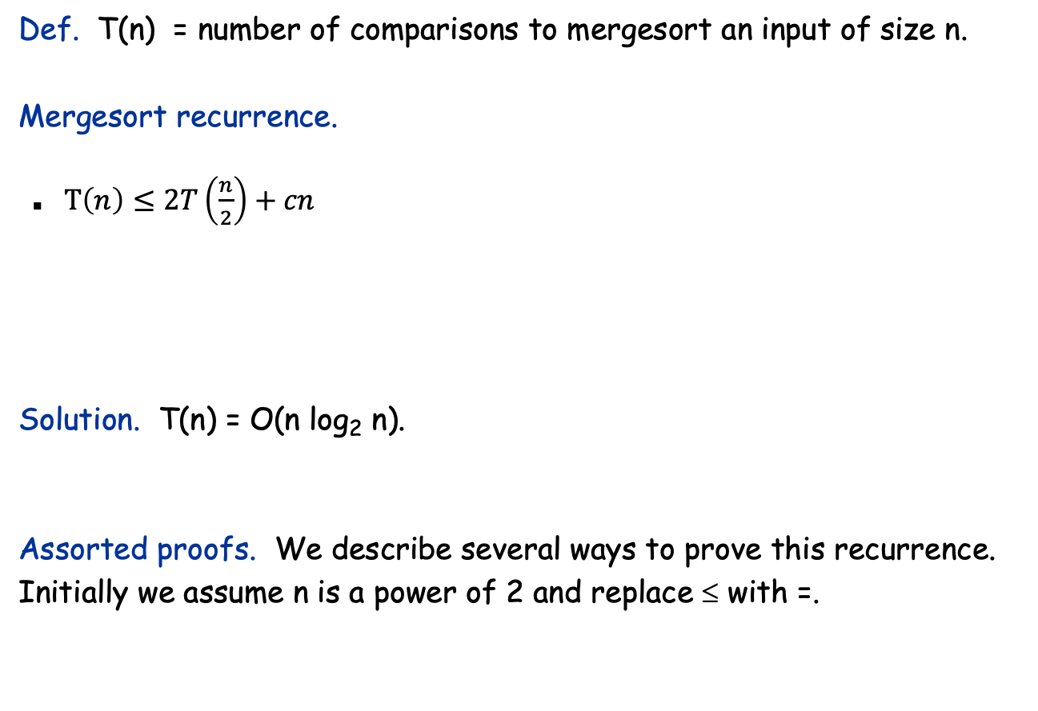
A Useful Recurrence Relation
Slides by Kevin Wayne. Copyright © 2005 Pearson-Addison Wesley. All rights reserved.

Slide 20
Proof by Recursion Tree
T(n)
cn
T(n/2)
T(n/2)
2c(n/2)
T(n/4)
T(n/4)
T(n/4)
T(n/4)
4c(n/4)
log₂n
. . .
T(n / 2^{k})
2^{k} c(n / 2^{k})
. . .
T(2)
T(2)
T(2)
T(2)
T(2)
T(2)
T(2)
T(2)
n/2 *c*2
cn log₂n
Slides by Kevin Wayne. Copyright © 2005 Pearson-Addison Wesley. All rights reserved.

Slide 21
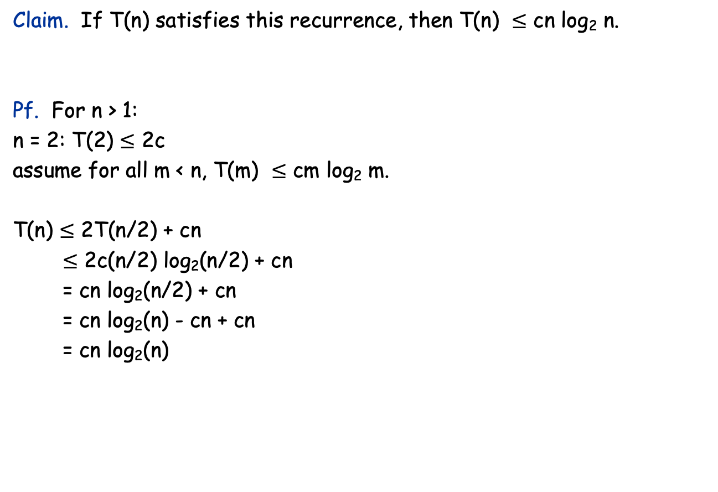
Proof by Telescoping
Slides by Kevin Wayne. Copyright © 2005 Pearson-Addison Wesley. All rights reserved.

Slide 22
2. Counting Inversions
Slides by Kevin Wayne. Copyright © 2005 Pearson-Addison Wesley. All rights reserved.

Slide 23
Counting Inversions
Music site tries to match your song preferences with others.
You rank n songs.
Music site consults database to find people with similar tastes.
Similarity metric: number of inversions between two rankings.
My rank: 1, 2, …, n.
Your rank: a₁, a₂, …, a_{n}.
Songs i and j inverted if i < j, but a_{i} > a_{j}.
Brute force: check all Θ(n²) pairs i and j.
Songs
Inversions
3-2, 4-2
A
B
C
D
E
Me
1
2
3
4
5
You
1
3
4
2
5
Slides by Kevin Wayne. Copyright © 2005 Pearson-Addison Wesley. All rights reserved.
Notes:
amazon.com, launch.com, restaurants, movies, . . .
Note: there can be a quadratic number of inversions.
Asymptotically faster algorithm must compute total number without even looking at each inversion individually.

Slide 24
Counting Inversions: Divide-and-Conquer
Divide-and-conquer.
1
5
4
8
10
2
6
9
12
11
3
7
Slides by Kevin Wayne. Copyright © 2005 Pearson-Addison Wesley. All rights reserved.

Slide 25
Counting Inversions: Divide-and-Conquer
Divide-and-conquer.
Divide: separate list into two pieces.
1
5
4
8
10
2
6
9
12
11
3
7
Divide: O(1).
1
5
4
8
10
2
6
9
12
11
3
7
Slides by Kevin Wayne. Copyright © 2005 Pearson-Addison Wesley. All rights reserved.

Slide 26
Counting Inversions: Divide-and-Conquer
Divide-and-conquer.
Divide: separate list into two pieces.
Conquer: recursively count inversions in each half.
1
5
4
8
10
2
6
9
12
11
3
7
Divide: O(1).
1
5
4
8
10
2
6
9
12
11
3
7
Conquer: 2T(n / 2)
5 blue-blue inversions
8 green-green inversions
5-4, 5-2, 4-2, 8-2, 10-2
6-3, 9-3, 9-7, 12-3, 12-7, 12-11, 11-3, 11-7
Slides by Kevin Wayne. Copyright © 2005 Pearson-Addison Wesley. All rights reserved.

Slide 27
Counting Inversions: Divide-and-Conquer
Divide-and-conquer.
Divide: separate list into two pieces.
Conquer: recursively count inversions in each half.
Combine: count inversions where a_{i} and a_{j} are in different halves, and return sum of three quantities.
1
5
4
8
10
2
6
9
12
11
3
7
Divide: O(1).
1
5
4
8
10
2
6
9
12
11
3
7
Conquer: 2T(n / 2)
5 blue-blue inversions
8 green-green inversions
9 blue-green inversions
5-3, 4-3, 8-6, 8-3, 8-7, 10-6, 10-9, 10-3, 10-7
Combine: ???
Total = 5 + 8 + 9 = 22.
Slides by Kevin Wayne. Copyright © 2005 Pearson-Addison Wesley. All rights reserved.

Slide 28
Counting Inversions: Combine
Combine: count blue-green inversions
Assume each half is sorted.
Count inversions where a_{i} and a_{j} are in different halves.
Merge two sorted halves into sorted whole.
3
7
10
14
18
19
2
11
16
17
23
25
6
3
2
2
0
0
13 blue-green inversions: 6 + 3 + 2 + 2 + 0 + 0
Count: O(n)
2
3
7
10
11
14
16
17
18
19
23
25
Merge: O(n)
Slides by Kevin Wayne. Copyright © 2005 Pearson-Addison Wesley. All rights reserved.

Slide 29
Merge and Count
Merge and count step.
Given two sorted halves, count number of inversions where a_{i} and a_{j} are in different halves.
Combine two sorted halves into sorted whole.
i = 6
3
7
10
14
18
19
2
11
16
17
23
25
two sorted halves
auxiliary array
Total:
Slides by Kevin Wayne. Copyright © 2005 Pearson-Addison Wesley. All rights reserved.

Slide 30
Merge and Count
Merge and count step.
Given two sorted halves, count number of inversions where a_{i} and a_{j} are in different halves.
Combine two sorted halves into sorted whole.
i = 6
3
7
10
14
18
19
2
11
16
17
23
25
two sorted halves
6
2
auxiliary array
Total: 6
Slides by Kevin Wayne. Copyright © 2005 Pearson-Addison Wesley. All rights reserved.

Slide 31
Merge and Count
Merge and count step.
Given two sorted halves, count number of inversions where a_{i} and a_{j} are in different halves.
Combine two sorted halves into sorted whole.
i = 6
3
7
10
14
18
19
2
11
16
17
23
25
two sorted halves
6
2
auxiliary array
Total: 6
Slides by Kevin Wayne. Copyright © 2005 Pearson-Addison Wesley. All rights reserved.

Slide 32
Merge and Count
Merge and count step.
Given two sorted halves, count number of inversions where a_{i} and a_{j} are in different halves.
Combine two sorted halves into sorted whole.
i = 6
3
7
10
14
18
19
2
11
16
17
23
25
two sorted halves
6
2
3
auxiliary array
Total: 6
Slides by Kevin Wayne. Copyright © 2005 Pearson-Addison Wesley. All rights reserved.

Slide 33
Merge and Count
Merge and count step.
Given two sorted halves, count number of inversions where a_{i} and a_{j} are in different halves.
Combine two sorted halves into sorted whole.
i = 5
3
7
10
14
18
19
2
11
16
17
23
25
two sorted halves
6
2
3
auxiliary array
Total: 6
Slides by Kevin Wayne. Copyright © 2005 Pearson-Addison Wesley. All rights reserved.

Slide 34
Merge and Count
Merge and count step.
Given two sorted halves, count number of inversions where a_{i} and a_{j} are in different halves.
Combine two sorted halves into sorted whole.
i = 5
3
7
10
14
18
19
2
11
16
17
23
25
two sorted halves
6
2
3
7
auxiliary array
Total: 6
Slides by Kevin Wayne. Copyright © 2005 Pearson-Addison Wesley. All rights reserved.

Slide 35
Merge and Count
Merge and count step.
Given two sorted halves, count number of inversions where a_{i} and a_{j} are in different halves.
Combine two sorted halves into sorted whole.
i = 4
3
7
10
14
18
19
2
11
16
17
23
25
two sorted halves
6
2
3
7
auxiliary array
Total: 6
Slides by Kevin Wayne. Copyright © 2005 Pearson-Addison Wesley. All rights reserved.

Slide 36
Merge and Count
Merge and count step.
Given two sorted halves, count number of inversions where a_{i} and a_{j} are in different halves.
Combine two sorted halves into sorted whole.
i = 4
3
7
10
14
18
19
2
11
16
17
23
25
two sorted halves
6
2
3
7
10
auxiliary array
Total: 6
Slides by Kevin Wayne. Copyright © 2005 Pearson-Addison Wesley. All rights reserved.

Slide 37
Merge and Count
Merge and count step.
Given two sorted halves, count number of inversions where a_{i} and a_{j} are in different halves.
Combine two sorted halves into sorted whole.
i = 3
3
7
10
14
18
19
2
11
16
17
23
25
two sorted halves
6
2
3
7
10
auxiliary array
Total: 6
Slides by Kevin Wayne. Copyright © 2005 Pearson-Addison Wesley. All rights reserved.

Slide 38
Merge and Count
Merge and count step.
Given two sorted halves, count number of inversions where a_{i} and a_{j} are in different halves.
Combine two sorted halves into sorted whole.
i = 3
3
7
10
14
18
19
2
11
16
17
23
25
two sorted halves
6
3
2
3
7
10
11
auxiliary array
Total: 6 + 3
Slides by Kevin Wayne. Copyright © 2005 Pearson-Addison Wesley. All rights reserved.

Slide 39
Merge and Count
Merge and count step.
Given two sorted halves, count number of inversions where a_{i} and a_{j} are in different halves.
Combine two sorted halves into sorted whole.
i = 3
3
7
10
14
18
19
2
11
16
17
23
25
two sorted halves
6
3
2
3
7
10
11
auxiliary array
Total: 6 + 3
Slides by Kevin Wayne. Copyright © 2005 Pearson-Addison Wesley. All rights reserved.

Slide 40
Merge and Count
Merge and count step.
Given two sorted halves, count number of inversions where a_{i} and a_{j} are in different halves.
Combine two sorted halves into sorted whole.
i = 3
3
7
10
14
18
19
2
11
16
17
23
25
two sorted halves
6
3
2
3
7
10
11
14
auxiliary array
Total: 6 + 3
Slides by Kevin Wayne. Copyright © 2005 Pearson-Addison Wesley. All rights reserved.

Slide 41
Merge and Count
Merge and count step.
Given two sorted halves, count number of inversions where a_{i} and a_{j} are in different halves.
Combine two sorted halves into sorted whole.
i = 2
3
7
10
14
18
19
2
11
16
17
23
25
two sorted halves
6
3
2
3
7
10
11
14
auxiliary array
Total: 6 + 3
Slides by Kevin Wayne. Copyright © 2005 Pearson-Addison Wesley. All rights reserved.

Slide 42
Merge and Count
Merge and count step.
Given two sorted halves, count number of inversions where a_{i} and a_{j} are in different halves.
Combine two sorted halves into sorted whole.
i = 2
3
7
10
14
18
19
2
11
16
17
23
25
two sorted halves
6
3
2
2
3
7
10
11
14
16
auxiliary array
Total: 6 + 3 + 2
Slides by Kevin Wayne. Copyright © 2005 Pearson-Addison Wesley. All rights reserved.

Slide 43
Merge and Count
Merge and count step.
Given two sorted halves, count number of inversions where a_{i} and a_{j} are in different halves.
Combine two sorted halves into sorted whole.
i = 2
3
7
10
14
18
19
2
11
16
17
23
25
two sorted halves
6
3
2
2
3
7
10
11
14
16
auxiliary array
Total: 6 + 3 + 2
Slides by Kevin Wayne. Copyright © 2005 Pearson-Addison Wesley. All rights reserved.

Slide 44
Merge and Count
Merge and count step.
Given two sorted halves, count number of inversions where a_{i} and a_{j} are in different halves.
Combine two sorted halves into sorted whole.
i = 2
3
7
10
14
18
19
2
11
16
17
23
25
two sorted halves
6
3
2
2
2
3
7
10
11
14
16
17
auxiliary array
Total: 6 + 3 + 2 + 2
Slides by Kevin Wayne. Copyright © 2005 Pearson-Addison Wesley. All rights reserved.

Slide 45
Merge and Count
Merge and count step.
Given two sorted halves, count number of inversions where a_{i} and a_{j} are in different halves.
Combine two sorted halves into sorted whole.
i = 2
3
7
10
14
18
19
2
11
16
17
23
25
two sorted halves
6
3
2
2
2
3
7
10
11
14
16
17
auxiliary array
Total: 6 + 3 + 2 + 2
Slides by Kevin Wayne. Copyright © 2005 Pearson-Addison Wesley. All rights reserved.

Slide 46
Merge and Count
Merge and count step.
Given two sorted halves, count number of inversions where a_{i} and a_{j} are in different halves.
Combine two sorted halves into sorted whole.
i = 2
3
7
10
14
18
19
2
11
16
17
23
25
two sorted halves
6
3
2
2
2
3
7
10
11
14
16
17
18
auxiliary array
Total: 6 + 3 + 2 + 2
Slides by Kevin Wayne. Copyright © 2005 Pearson-Addison Wesley. All rights reserved.

Slide 47
Merge and Count
Merge and count step.
Given two sorted halves, count number of inversions where a_{i} and a_{j} are in different halves.
Combine two sorted halves into sorted whole.
i = 1
3
7
10
14
18
19
2
11
16
17
23
25
two sorted halves
6
3
2
2
2
3
7
10
11
14
16
17
18
auxiliary array
Total: 6 + 3 + 2 + 2
Slides by Kevin Wayne. Copyright © 2005 Pearson-Addison Wesley. All rights reserved.

Slide 48
Merge and Count
Merge and count step.
Given two sorted halves, count number of inversions where a_{i} and a_{j} are in different halves.
Combine two sorted halves into sorted whole.
i = 1
3
7
10
14
18
19
2
11
16
17
23
25
two sorted halves
6
3
2
2
2
3
7
10
11
14
16
17
18
19
auxiliary array
Total: 6 + 3 + 2 + 2
Slides by Kevin Wayne. Copyright © 2005 Pearson-Addison Wesley. All rights reserved.

Slide 49
Merge and Count
Merge and count step.
Given two sorted halves, count number of inversions where a_{i} and a_{j} are in different halves.
Combine two sorted halves into sorted whole.
first half exhausted
i = 0
3
7
10
14
18
19
2
11
16
17
23
25
two sorted halves
6
3
2
2
2
3
7
10
11
14
16
17
18
19
auxiliary array
Total: 6 + 3 + 2 + 2
Slides by Kevin Wayne. Copyright © 2005 Pearson-Addison Wesley. All rights reserved.

Slide 50
Merge and Count
Merge and count step.
Given two sorted halves, count number of inversions where a_{i} and a_{j} are in different halves.
Combine two sorted halves into sorted whole.
i = 0
3
7
10
14
18
19
2
11
16
17
23
25
two sorted halves
6
3
2
2
0
2
3
7
10
11
14
16
17
18
19
23
auxiliary array
Total: 6 + 3 + 2 + 2 + 0
Slides by Kevin Wayne. Copyright © 2005 Pearson-Addison Wesley. All rights reserved.

Slide 51
Merge and Count
Merge and count step.
Given two sorted halves, count number of inversions where a_{i} and a_{j} are in different halves.
Combine two sorted halves into sorted whole.
i = 0
3
7
10
14
18
19
2
11
16
17
23
25
two sorted halves
6
3
2
2
0
2
3
7
10
11
14
16
17
18
19
23
auxiliary array
Total: 6 + 3 + 2 + 2 + 0
Slides by Kevin Wayne. Copyright © 2005 Pearson-Addison Wesley. All rights reserved.

Slide 52
Merge and Count
Merge and count step.
Given two sorted halves, count number of inversions where a_{i} and a_{j} are in different halves.
Combine two sorted halves into sorted whole.
i = 0
3
7
10
14
18
19
2
11
16
17
23
25
two sorted halves
6
3
2
2
0
0
2
3
7
10
11
14
16
17
18
19
23
25
auxiliary array
Total: 6 + 3 + 2 + 2 + 0 + 0
Slides by Kevin Wayne. Copyright © 2005 Pearson-Addison Wesley. All rights reserved.

Slide 53
Merge and Count
Merge and count step.
Given two sorted halves, count number of inversions where a_{i} and a_{j} are in different halves.
Combine two sorted halves into sorted whole.
i = 0
3
7
10
14
18
19
2
11
16
17
23
25
two sorted halves
6
3
2
2
0
0
2
3
7
10
11
14
16
17
18
19
23
25
auxiliary array
Total: 6 + 3 + 2 + 2 + 0 + 0 = 13
Slides by Kevin Wayne. Copyright © 2005 Pearson-Addison Wesley. All rights reserved.

Slide 54
Counting Inversions: Implementation
Pre-condition. [Merge-and-Count] A and B are sorted.
Post-condition. [Sort-and-Count] L is sorted.
Sort-and-Count(L) {
if list L has one element
return 0 and the list L
Divide the list into two halves A and B
(r_{A}, A) ← Sort-and-Count(A)
(r_{B}, B) ← Sort-and-Count(B)
(r_{B}, L) ← Merge-and-Count(A, B)
return r = r_{A} + r_{B} + r and the sorted list L
}
Slides by Kevin Wayne. Copyright © 2005 Pearson-Addison Wesley. All rights reserved.

Slide 55
3. Closest Pair of Points
Slides by Kevin Wayne. Copyright © 2005 Pearson-Addison Wesley. All rights reserved.
Notes:
"Divide and conquer", Caesar's other famous quote "I came, I saw, I conquered"
Divide-and-conquer idea dates back to Julius Caesar.
Favorite war tactic was to divide an opposing army in two halves, and then assault one half with his entire force.

Slide 56
Closest Pair of Points
Closest pair. Given n points in the plane, find a pair with smallest Euclidean distance between them.
Fundamental geometric primitive.
Graphics, computer vision, geographic information systems, molecular modeling, air traffic control.
Special case of nearest neighbor, Euclidean MST, Voronoi.
Brute force. Check all pairs of points p and q with Θ(n²) comparisons.
1-D version. O(n log n) easy if points are on a line.
Assumption. No two points have same x coordinate.
fast closest pair inspired fast algorithms for these problems
to make presentation cleaner
Slides by Kevin Wayne. Copyright © 2005 Pearson-Addison Wesley. All rights reserved.
Notes:
Foundation of then-fledgling field of computational geometry.
"Shamos and Hoey (1970's) wanted to work out basic computational primitives in computational geometry. Surprisingly challenging to find an efficient algorithm. Shamos and Hoey asked whether it was possible to do better than quadratic. The algorithm we present is essentially their solution."

Slide 57
Closest Pair of Points: First Attempt
Divide. Sub-divide region into 4 quadrants.
L
Slides by Kevin Wayne. Copyright © 2005 Pearson-Addison Wesley. All rights reserved.

Slide 58
Closest Pair of Points: First Attempt
Divide. Sub-divide region into 4 quadrants.
Obstacle. Impossible to ensure n/4 points in each piece.
L
Slides by Kevin Wayne. Copyright © 2005 Pearson-Addison Wesley. All rights reserved.

Slide 59
Closest Pair of Points
Algorithm.
Divide: draw vertical line L so that roughly ½n points on each side.
L
Slides by Kevin Wayne. Copyright © 2005 Pearson-Addison Wesley. All rights reserved.

Slide 60
Closest Pair of Points
Algorithm.
Divide: draw vertical line L so that roughly ½n points on each side.
Conquer: find closest pair in each side recursively.
L
21
12
Slides by Kevin Wayne. Copyright © 2005 Pearson-Addison Wesley. All rights reserved.

Slide 61
Closest Pair of Points
Algorithm.
Divide: draw vertical line L so that roughly ½n points on each side.
Conquer: find closest pair in each side recursively.
Combine: find closest pair with one point in each side.
Return best of 3 solutions.
seems like Θ(n²)
L
8
21
12
Slides by Kevin Wayne. Copyright © 2005 Pearson-Addison Wesley. All rights reserved.

Slide 62
Closest Pair of Points
Find closest pair with one point in each side, assuming that distance < δ.
L
21
δ = min(12, 21)
12
Slides by Kevin Wayne. Copyright © 2005 Pearson-Addison Wesley. All rights reserved.

Slide 63
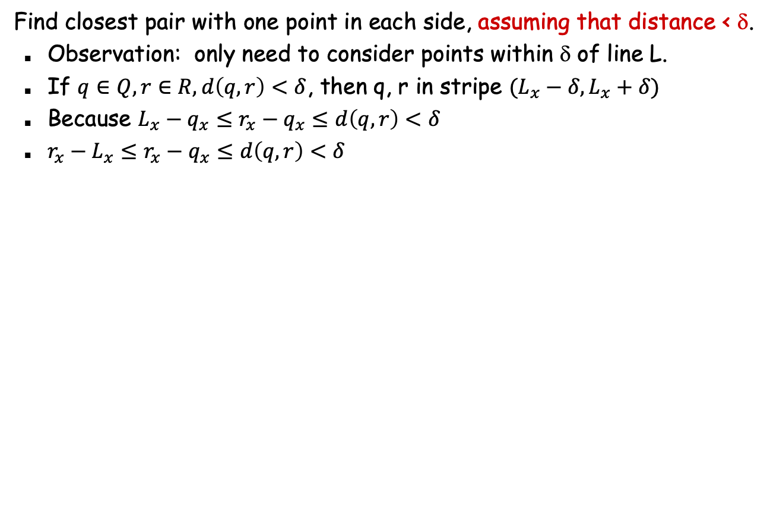
Closest Pair of Points
L
21
δ = min(12, 21)
12
Slides by Kevin Wayne. Copyright © 2005 Pearson-Addison Wesley. All rights reserved.
δ

Slide 64
Closest Pair of Points
Find closest pair with one point in each side, assuming that distance < δ.
Observation: only need to consider points within δ of line L.
Sort points in 2δ-strip by their y coordinate.
L
7
6
5
21
4
δ = min(12, 21)
12
3
2
1
Slides by Kevin Wayne. Copyright © 2005 Pearson-Addison Wesley. All rights reserved.
δ

Slide 65
Closest Pair of Points
Find closest pair with one point in each side, assuming that distance < δ.
Observation: only need to consider points within δ of line L.
Sort points in 2δ-strip by their y coordinate.
Only check distances of those within 11 positions in sorted list!
L
7
6
5
21
4
δ = min(12, 21)
12
3
2
1
Slides by Kevin Wayne. Copyright © 2005 Pearson-Addison Wesley. All rights reserved.
δ

Slide 66
Closest Pair of Points
Def. Let s_{i} be the point in the 2δ-strip, with the i^{th} smallest y-coordinate.
Claim. If |i – j| ≥ 12, then the distance between s_{i} and s_{j} is at least δ.
Pf.
No two points lie in same ½δ-by-½δ box.
Two points at least 2 rows apart have distance ≥ 2(½δ). ▪
Fact. Still true if we replace 12 with 7.
39
j
31
½δ
2 rows
30
½δ
29
i
28
½δ
27
26
25
δ
δ
Slides by Kevin Wayne. Copyright © 2005 Pearson-Addison Wesley. All rights reserved.
Notes:
can reduce neighbors to 6
Note: no points on median line (assumption that no points have same x coordinate ensures that median line can be drawn in this way)

Slide 67
Closest Pair Algorithm
Closest-Pair(p₁, …, p_{n}) {
Compute separation line L such that half the points are on one side and half on the other side.
δ₁ = Closest-Pair(left half)
δ₂ = Closest-Pair(right half)
δ = min(δ₁, δ₂)
Delete all points further than δ from separation line L
Sort remaining points by y-coordinate.
Scan points in y-order and compare distance between each point and next 11 neighbors. If any of these distances is less than δ, update δ.
return δ.
}
O(n log n)
2T(n / 2)
O(n)
O(n log n)
O(n)
Running time O(n log n)
sort by x axis and y axis O(n log n)
Slides by Kevin Wayne. Copyright © 2005 Pearson-Addison Wesley. All rights reserved.
Notes:
separation can be done in O(N) using linear time median algorithm

