Slide 1
Algorithm Design and Analysis (H)
CS216
Prof. Shiqi Yu (于仕琪)
yusq@sustech.edu.cn
http://faculty.sustech.edu.cn/yusq/

Slide 2

Divide and Conquer
Slides by Kevin Wayne. Copyright © 2005 Pearson-Addison Wesley. All rights reserved.

Slide 3
4. Integer Multiplication
Slides by Kevin Wayne. Copyright © 2005 Pearson-Addison Wesley. All rights reserved.

Slide 4
Integer Addition
Addition. Given two n-bit integers a and b, compute a + b.
Grade-school. Θ(n) bit operations.
Remark. Grade-school addition algorithm is optimal.
1
1
1
1
1
1
0
1
1
1
0
1
0
1
0
1
+
0
1
1
1
1
1
0
1
1
0
1
0
1
0
0
1
0
Slides by Kevin Wayne. Copyright © 2005 Pearson-Addison Wesley. All rights reserved.

Slide 5
Integer Multiplication
Addition. Given two n-bit integers a and b, compute a + b.
Grade-school. Θ(n) bit operations.
1
1
0
1
0
1
0
1
×
0
1
1
1
1
1
0
1
1
1
0
1
0
1
0
1
0
0
0
0
0
0
0
0
0
1
1
0
1
0
1
0
1
0
1
1
0
1
0
1
0
1
0
1
1
0
1
0
1
0
1
0
1
1
0
1
0
1
0
1
0
1
1
0
1
0
1
0
1
0
0
0
0
0
0
0
0
0
0
0
1
1
0
1
0
0
0
0
0
0
0
0
0
0
1
Q. Is grade-school multiplication algorithm optimal?
Slides by Kevin Wayne. Copyright © 2005 Pearson-Addison Wesley. All rights reserved.

Slide 6
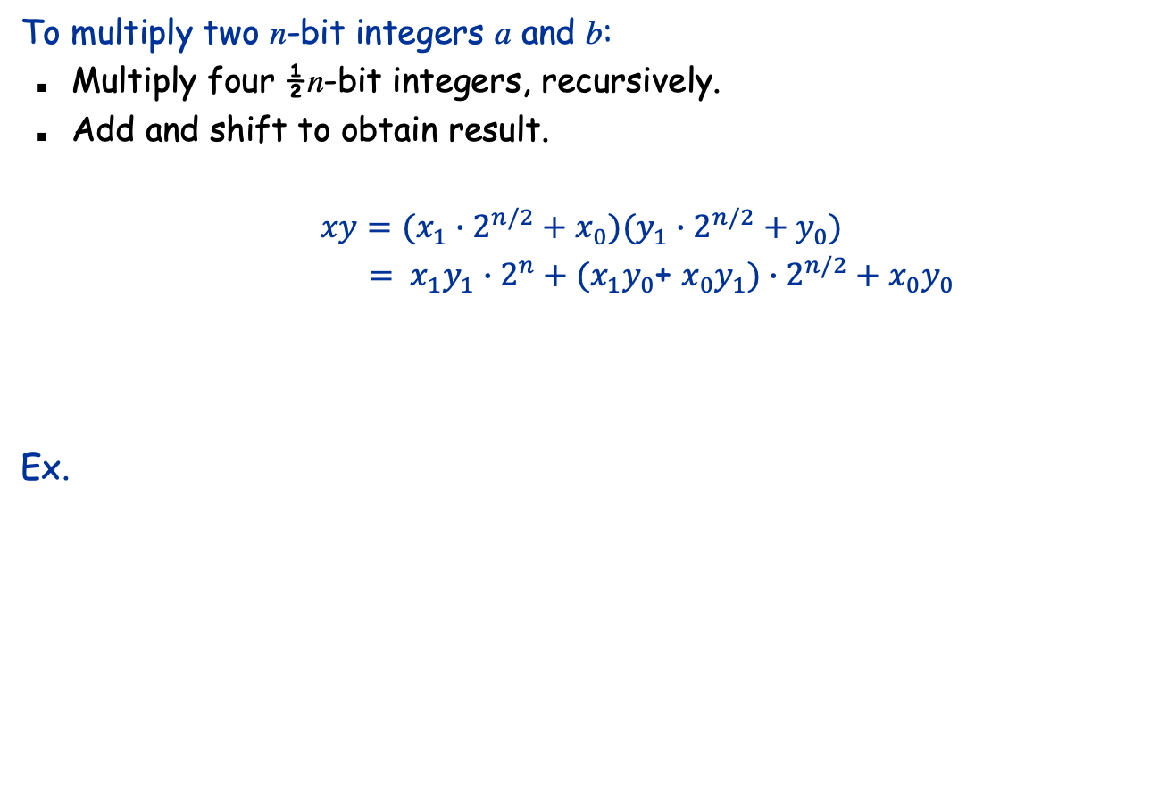
Divide-and-Conquer Multiplication: Warmup
a = 10001101 b = 11100001
a₁
a₀
b₁
b₀
Slides by Kevin Wayne. Copyright © 2005 Pearson-Addison Wesley. All rights reserved.
Notes:
assumes n is a power of 2

Slide 7


Recursion Tree
T(n)
cn
T(n/2)
T(n/2)
T(n/2)
T(n/2)
4c(n/2)
T(n/4)
T(n/4)
T(n/4)
T(n/4)
...
T(n/4)
T(n/4)
T(n/4)
T(n/4)
16c(n/4)
...
...
T(n / 2^{k})
4^{k} c(n / 2^{k})
...
T(2)
T(2)
T(2)
T(2)
...
T(2)
T(2)
T(2)
T(2)
Slides by Kevin Wayne. Copyright © 2005 Pearson-Addison Wesley. All rights reserved.

Slide 8
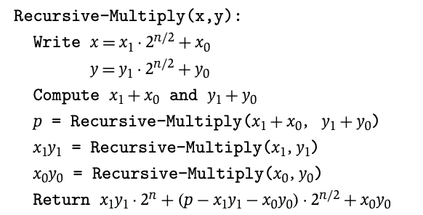
Karatsuba Multiplication
To multiply two n-bit integers a and b:
Add two ½n bit integers.
Multiply three ½n-bit integers, recursively.
Add, subtract, and shift to obtain result.
Theorem. [Karatsuba-Ofman 1962] Can multiply two n-bit integers in O(n^{1.585}) bit operations.
Slides by Kevin Wayne. Copyright © 2005 Pearson-Addison Wesley. All rights reserved.
Notes:
Karatsuba: also works for multiplying two degree N univariate polynomials

Slide 9


Karatsuba: Recursion Tree
T(n)
n
T(n/2)
T(n/2)
T(n/2)
3(n/2)
T(n/4)
T(n/4)
T(n/4)
T(n/4)
T(n/4)
T(n/4)
T(n/4)
T(n/4)
T(n/4)
9(n/4)
...
...
T(n / 2^{k})
3^{k} (n / 2^{k})
...
T(2)
T(2)
T(2)
T(2)
...
T(2)
T(2)
T(2)
T(2)
Slides by Kevin Wayne. Copyright © 2005 Pearson-Addison Wesley. All rights reserved.

Slide 10
5. Convolution and FFT
Slides by Kevin Wayne. Copyright © 2005 Pearson-Addison Wesley. All rights reserved.

Slide 11
Fast Fourier Transform: Applications
Applications.
Optics, acoustics, quantum physics, telecommunications, control systems, signal processing, speech recognition, data compression, image processing.
DVD, JPEG, MP3, MRI, CAT scan.
Numerical solutions to Poisson's equation.
The FFT is one of the truly great computational developments of this [20th] century. It has changed the face of science and engineering so much that it is not an exaggeration to say that life as we know it would be very different without the FFT. -Charles van Loan
Slides by Kevin Wayne. Copyright © 2005 Pearson-Addison Wesley. All rights reserved.
Notes:
Significance. Perhaps single algorithmic discovery that has had the greatest practical impact in history. Progress in these areas limited by lack of fast algorithms.
Variants of FFT used for JPEG, e.g., fast sine/cosine transforms

Slide 12
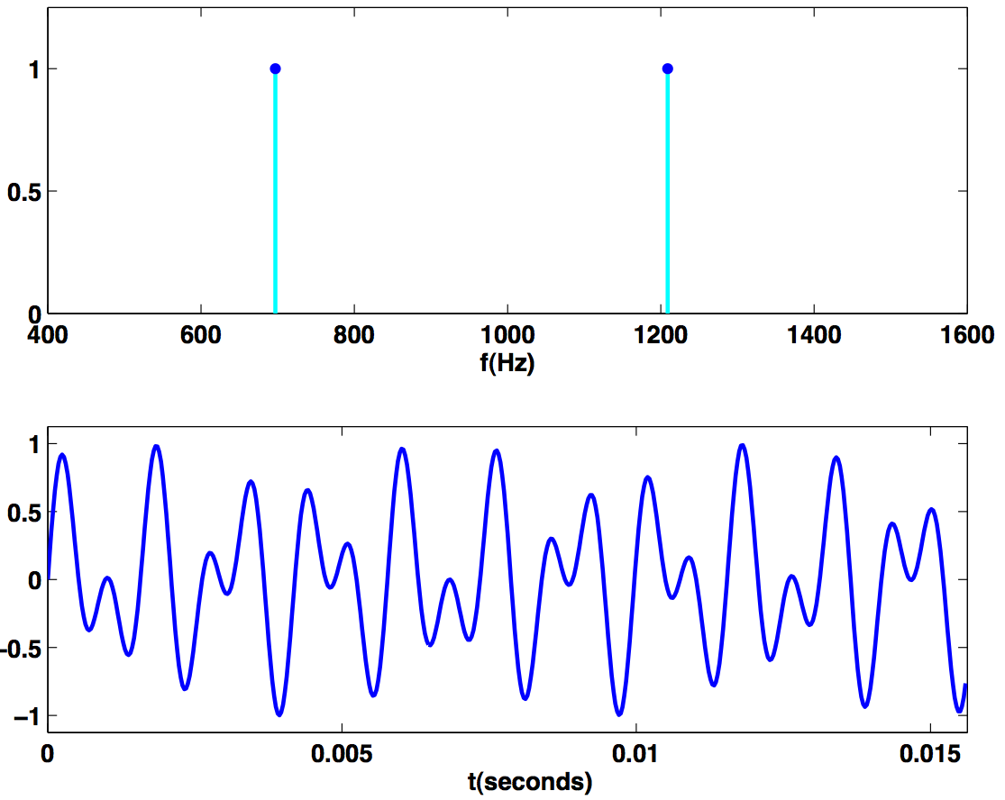
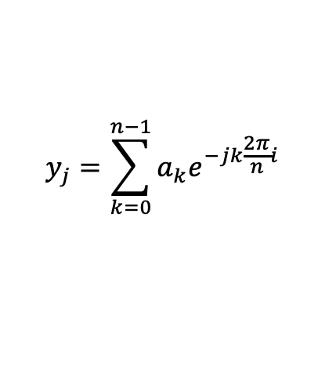
Touch Tone
$$y_{j}=\sum_{k=0}^{n−1}{a_{k}e^{−jk\frac{2π}{n}i}}$$
Button 1 signal.
Magnitude of Fourier transform of button 1 signal.
Reference: Cleve Moler, Numerical Computing with MATLAB
Slides by Kevin Wayne. Copyright © 2005 Pearson-Addison Wesley. All rights reserved.
Notes:
fft is complex number - we plot the magnitude
We assume it's continuous (or many many samples)

Slide 13
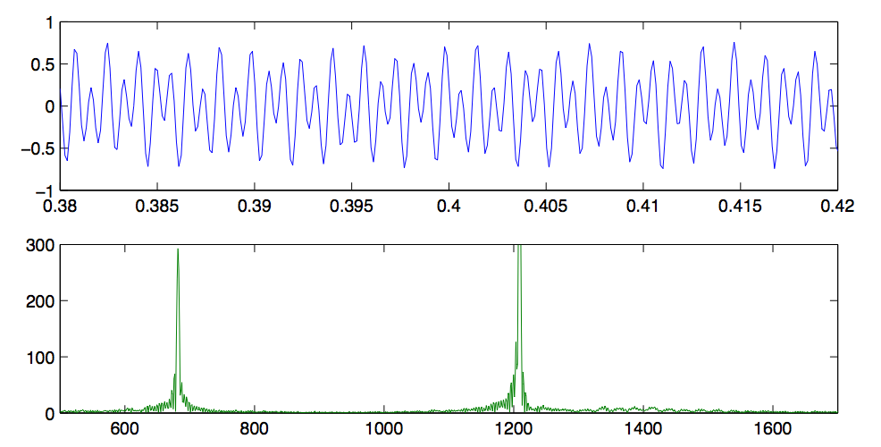
Touch Tone
Button 1 signal. [recorded, 8192 samples per second]
Magnitude of FFT.
Reference: Cleve Moler, Numerical Computing with MATLAB
Slides by Kevin Wayne. Copyright © 2005 Pearson-Addison Wesley. All rights reserved.
Notes:
fft is complex number - we plot the magnitude

Slide 14
Fast Fourier Transform: Brief History
Gauss (1805, 1866). Analyzed periodic motion of asteroid Ceres.
Runge-König (1924). Laid theoretical groundwork.
Danielson-Lanczos (1942). Efficient algorithm.
Cooley-Tukey (1965). Monitoring nuclear tests in Soviet Union and tracking submarines. Rediscovered and popularized FFT.
Importance not fully realized until advent of digital computers.
Slides by Kevin Wayne. Copyright © 2005 Pearson-Addison Wesley. All rights reserved.
Notes:
Gauss' algorithm published posthumously in 1866

Slide 15
Convolution
(a₀,a₁,a₂,…,a_{n-1})
What’s convolution?
O(n²)?
(b₀,b₁,b₂,…,b_{n-1})
Slides by Kevin Wayne. Copyright © 2005 Pearson-Addison Wesley. All rights reserved.

Slide 16
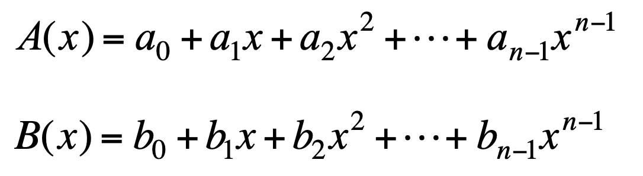
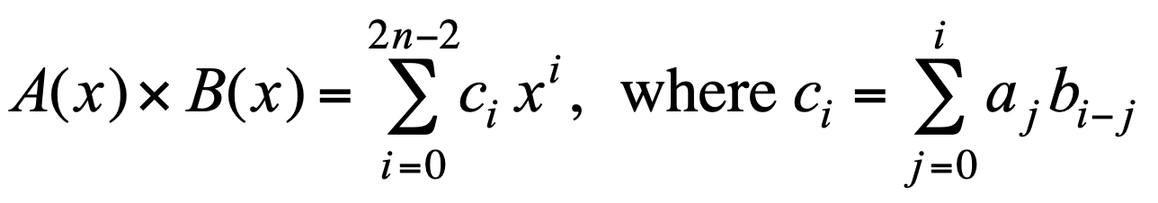
Polynomials: Coefficient Representation
Polynomial. [coefficient representation]
Add: O(n) arithmetic operations.
Evaluate: O(n) using Horner's method.
Multiply (convolve): O(n²) using brute force.
Slides by Kevin Wayne. Copyright © 2005 Pearson-Addison Wesley. All rights reserved.
Notes:
can also multiply in O(n^1.585) using Karatsuba polynomial multiplication

Slide 17
Polynomials: Point-Value Representation
Fundamental theorem of algebra. [Gauss, PhD thesis] A degree n polynomial with complex coefficients has n complex roots.
Corollary. A degree n-1 polynomial A(x) is uniquely specified by its evaluation at n distinct values of x.
y
y_{j} = A(x_{j})
x_{j}
x
Slides by Kevin Wayne. Copyright © 2005 Pearson-Addison Wesley. All rights reserved.
Notes:
deep theorem - proof requires analysis
conjectures in 17th century, but not rigorously proved until Gauss' phd thesis
established imaginary numbers as fundamental mathematical objects

Slide 18
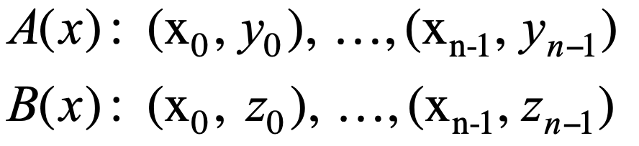
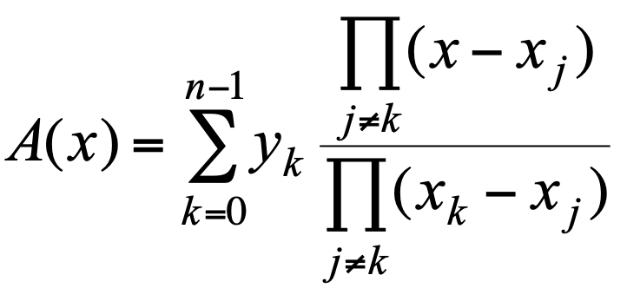
Polynomials: Point-Value Representation
Polynomial. [point-value representation]
Add: O(n) arithmetic operations.
Multiply: O(n), but need 2n-1 points.
Evaluate: O(n²) using Lagrange's formula.
Slides by Kevin Wayne. Copyright © 2005 Pearson-Addison Wesley. All rights reserved.
Notes:
Lagrange's formula is numerically unstable

Slide 19
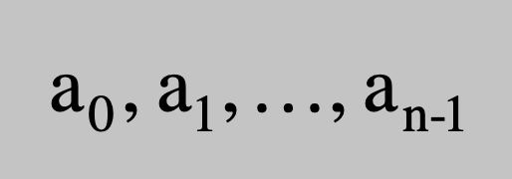
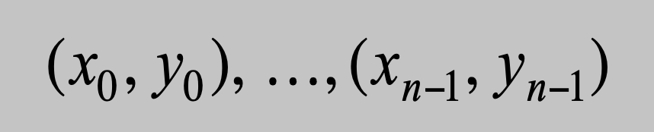
Converting Between Two Polynomial Representations
Tradeoff. Fast evaluation or fast multiplication. We want both!
Goal. Make all ops fast by efficiently converting between two representations.
Representation
Multiply
Evaluate
Coefficient
O(n²)
O(n)
Point-value
O(n)
O(n²)
coefficient representation
point-value representation
Slides by Kevin Wayne. Copyright © 2005 Pearson-Addison Wesley. All rights reserved.

Slide 20
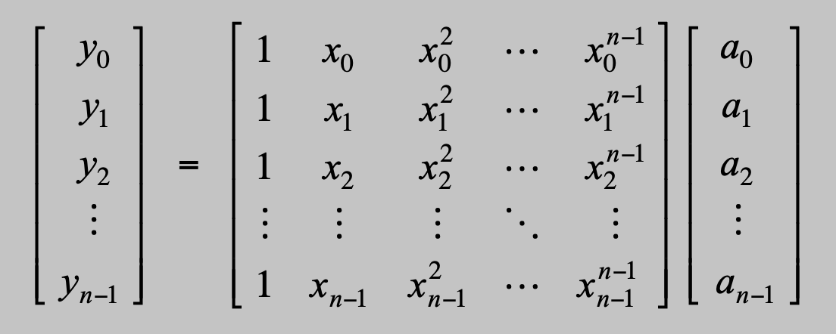
Converting Between Two Polynomial Representations: Brute Force
Coefficient to point-value. Given a polynomial a₀ + a₁ x + ... + a_{n-1} x^{n-1}, evaluate it at n distinct points x₀, ... , x_{n-1}.
O(n²) for matrix-vector multiply
O(n³) for Gaussian elimination
Vandermonde matrix is invertible iff x_{i} distinct
Point-value to coefficient. Given n distinct points x₀, ..., x_{n-1} and values y₀, ..., y_{n-1}, find unique polynomial a₀ + a₁ x + ... + a_{n-1} x^{n-1} that has given values at given points.
Slides by Kevin Wayne. Copyright © 2005 Pearson-Addison Wesley. All rights reserved.

Slide 21
Coefficient to Point-Value Representation: Intuition
Coefficient to point-value. Given a polynomial a₀ + a₁ x + ... + a_{n-1} x^{n-1}, evaluate it at n distinct points x₀, ... , x_{n-1}.
Divide. Break polynomial up into even and odd powers.
A(x) = a₀ + a₁x + a₂x² + a₃x³ + a₄x⁴ + a₅x⁵ + a₆x⁶ + a₇x⁷.
A_{even}(x) = a₀ + a₂x + a₄x² + a₆x³.
A_{odd} (x) = a₁ + a₃x + a₅x² + a₇x³.
A(-x) = A_{even}(x²) + x A_{odd}(x²).
A(-x) = A_{even}(x²) - x A_{odd}(x²).
Intuition. Choose two points to be ±1.
A(-1) = A_{even}(1) + 1 A_{odd}(1).
A(-1) = A_{even}(1) - 1 A_{odd}(1).
Can evaluate polynomial of degree ≤ n at 2 points by evaluating two polynomials of degree ≤ ½n at 1 point.
Slides by Kevin Wayne. Copyright © 2005 Pearson-Addison Wesley. All rights reserved.

Slide 22
Coefficient to Point-Value Representation: Intuition
Coefficient to point-value. Given a polynomial a₀ + a₁ x + ... + a_{n-1} x^{n-1}, evaluate it at n distinct points x₀, ... , x_{n-1}.
Divide. Break polynomial up into even and odd powers.
A(x) = a₀ + a₁x + a₂x² + a₃x³ + a₄x⁴ + a₅x⁵ + a₆x⁶ + a₇x⁷.
A_{even}(x) = a₀ + a₂x + a₄x² + a₆x³.
A_{odd} (x) = a₁ + a₃x + a₅x² + a₇x³.
A(-x) = A_{even}(x²) + x A_{odd}(x²).
A(-x) = A_{even}(x²) - x A_{odd}(x²).
Intuition. Choose four points to be ±1, ±i.
A(-1) = A_{even}(-1) + 1 A_{odd}( 1).
A(-1) = A_{even}(-1) - 1 A_{odd}(-1).
A(-i) = A_{even}(-1) + i A_{odd}(-1).
A(-i) = A_{even}(-1) - i A_{odd}(-1).
Can evaluate polynomial of degree ≤ n at 2 points by evaluating two polynomials of degree ≤ ½n at 1 point.
Slides by Kevin Wayne. Copyright © 2005 Pearson-Addison Wesley. All rights reserved.

Slide 23
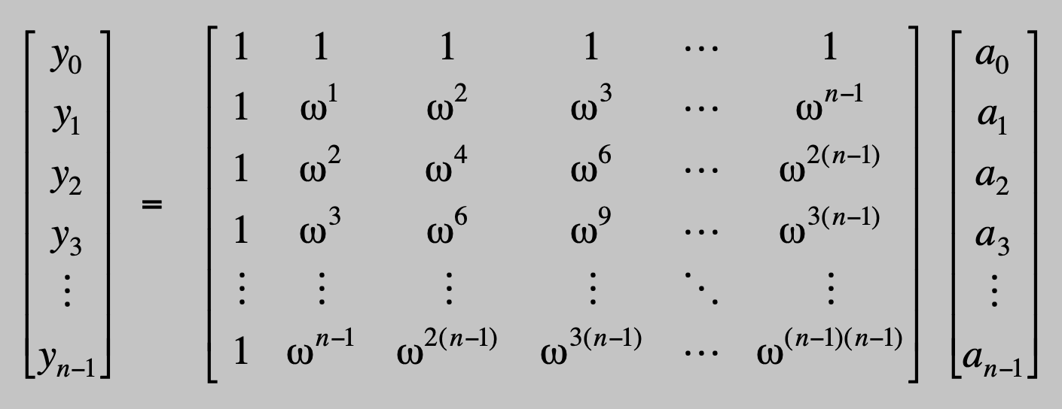
Discrete Fourier Transform
Coefficient to point-value. Given a polynomial a₀ + a₁ x + ... + a_{n-1} x^{n-1}, evaluate it at n distinct points x₀, ... , x_{n-1}.
Key idea: choose x_{k} = ω^{k} where ω is principal n^{th} root of unity.
Discrete Fourier transform
Fourier matrix F_{n}
Slides by Kevin Wayne. Copyright © 2005 Pearson-Addison Wesley. All rights reserved.

Slide 24
Roots of Unity
Def. An n^{th} root of unity is a complex number x such that x^{n} = 1.
Fact. The n^{th} roots of unity are: ω⁰, ω¹, …, ω^{n-1} where ω = e ^{2π i / n}.
Pf. (ω^{k})^{n} = (e ^{2π i k / n}) ^{n} = (e ^{π i} ) ^{2k} = (-1) ^{2k} = 1.
Fact. The ½n^{th} roots of unity are: ν⁰, ν¹, …, ν^{n/2-1} where ν = e ^{4π i / n}.
Fact. ω² = ν and (ω²)^{k} = ν^{k}.
ω² = ν¹ = i
ω³
ω¹
ω⁴ = ν² = -1
n = 8
ω⁰ = ν⁰ = 1
ω⁵
ω⁷
Slides by Kevin Wayne. Copyright © 2005 Pearson-Addison Wesley. All rights reserved.
ω⁶ = ν³ = -i
Notes:
forms a group under multiplication (similar to additive group Z_n modulo n)

Slide 25
Fast Fourier Transform
Goal. Evaluate a degree n-1 polynomial A(x) = a₀ + ... + a_{n-1} x^{n-1} at its n^{th} roots of unity: ω⁰, ω¹, …, ω^{n-1}.
Divide. Break polynomial up into even and odd powers.
A_{even}(x) = a₀ + a₂x + a₄x² + … + a_{n/2-2} x^{(n-1)/2}.
A_{odd} (x) = a₁ + a₃x + a₅x² + … + a_{n/2-1} x^{(n-1)/2}.
A(x) = A_{even}(x²) + x A_{odd}(x²).
Conquer. Evaluate degree A_{even}(x) and A_{odd}(x) at the ½n^{th} roots of unity: ν⁰, ν¹, …, ν^{n/2-1}.
Combine.
A(ω^{k+n}) = A_{even}(ν^{k}) + ω^{k} A_{odd}(ν^{k}), 0 ≤ k < n/2
A(ω^{k+n/2}) = A_{even}(ν^{k}) - ω^{k} A_{odd}(ν^{k}), 0 ≤ k < n/2
ν^{k} = (ω^{k})² = (ω^{k+ ½n})²
ω^{k+½n} = -ω^{k}
Slides by Kevin Wayne. Copyright © 2005 Pearson-Addison Wesley. All rights reserved.

Slide 26
FFT Algorithm
fft(n, a₀,a₁,…,a_{n-1}) {
if (n == 1) return a₀
(e₀,e₁,…,e_{n/2-1}) ← FFT(n/2, a₀,a₂,a₄,…,a_{n-2})
(d₀,d₁,…,d_{n/2-1}) ← FFT(n/2, a₁,a₃,a₅,…,a_{n-1})
for k = 0 to n/2 - 1 {
ω^{k} ← e^{2πik/n}
y_{k} ← e_{k} + ω^{k} d_{k}
y_{k+n/2} ← e_{k} - ω^{k} d_{k}
}
return (y₀,y₁,…,y_{n-1})
}
Slides by Kevin Wayne. Copyright © 2005 Pearson-Addison Wesley. All rights reserved.

Slide 27
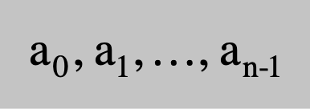
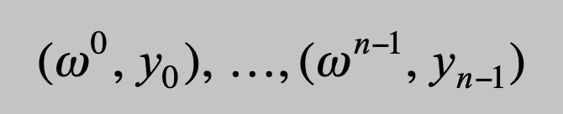
FFT Summary
Theorem. FFT algorithm evaluates a degree n-1 polynomial at each of the n^{th} roots of unity in O(n log n) steps.
Running time. T(2n) = 2T(n) + O(n) ⇒ T(n) = O(n log n).
assumes n is a power of 2
O(n log n)
coefficient representation
point-value representation
Slides by Kevin Wayne. Copyright © 2005 Pearson-Addison Wesley. All rights reserved.

Slide 28
Recursion Tree
a₀, a₁, a₂, a₃, a₄, a₅, a₆, a₇
perfect shuffle
a₀, a₂, a₄, a₆
a₁, a₃, a₅, a₇
a₀, a₄
a₂, a₆
a₁, a₅
a₃, a₇
a₀
a₄
a₂
a₆
a₁
a₅
a₃
a₇
000
100
010
110
001
101
011
111
"bit-reversed" order
Slides by Kevin Wayne. Copyright © 2005 Pearson-Addison Wesley. All rights reserved.
Notes:
each recursive call performs a "perfect shuffle"
leaves of tree are in "bit-reversed" order - if you read the bits backwards, it counts from 000 to 111 in binary

Slide 29
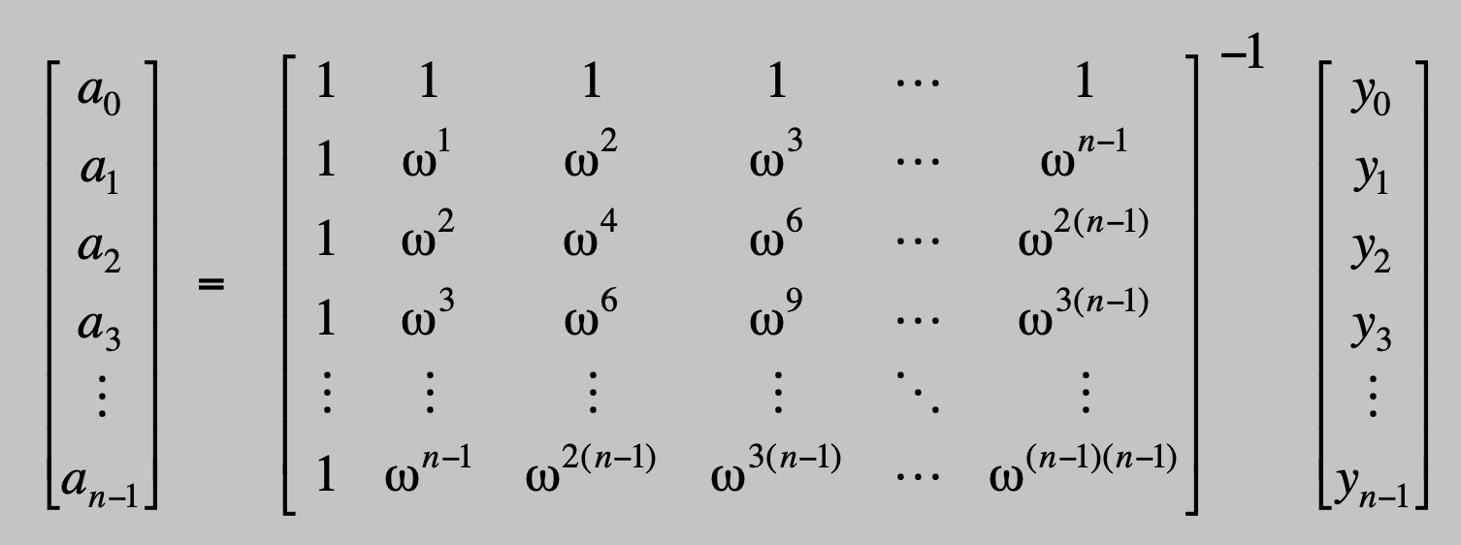
Point-Value to Coefficient Representation: Inverse DFT
Goal. Given the values y₀, ... , y_{n-1} of a degree n-1 polynomial at the n points ω⁰, ω¹, …, ω^{n-1}, find unique polynomial a₀ + a₁ x + ... + a_{n-1} x^{n-1} that has given values at given points.
Inverse DFT
Fourier matrix inverse (F_{n})⁻¹
Slides by Kevin Wayne. Copyright © 2005 Pearson-Addison Wesley. All rights reserved.

Slide 30
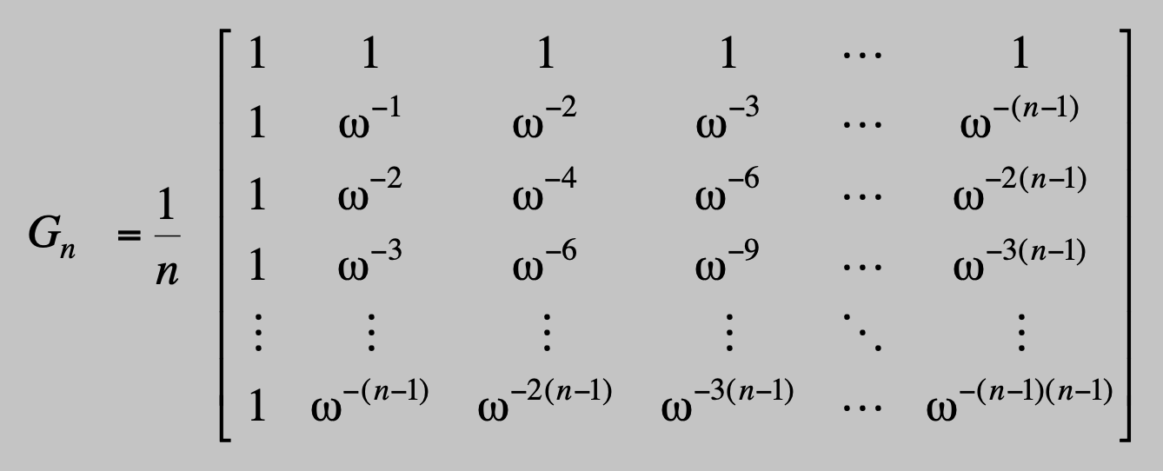
Inverse FFT
Claim. Inverse of Fourier matrix is given by following formula.
Consequence. To compute inverse FFT, apply same algorithm but use ω⁻¹ = e ^{-2π i / n} as principal n^{th} root of unity (and divide by n).
Slides by Kevin Wayne. Copyright © 2005 Pearson-Addison Wesley. All rights reserved.

Slide 31
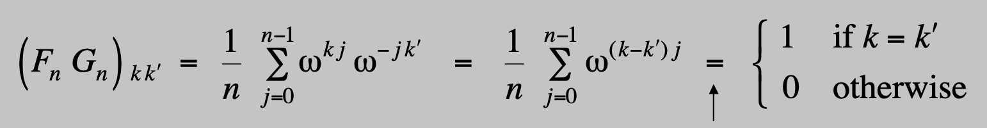
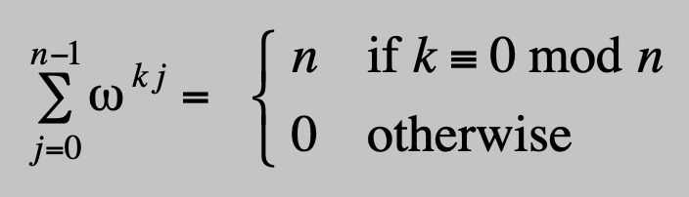
Inverse FFT: Proof of Correctness
Claim. F_{n} and G_{n} are inverses.
Pf.
Summation lemma. Let ω be a principal n^{th} root of unity. Then
Pf.
If k is a multiple of n then ω^{k} = 1 ⇒ sums to n.
Each n^{th} root of unity ω^{k} is a root of x^{n} - 1 = (x - 1) (1 + x + x² + ... + x^{n-1}).
if ω^{k} ≠ 1 we have: 1 + ω^{k} + ω^{k(2)} + . . . + ω^{k(n-1)} = 0 ⇒ sums to 0. ▪
summation lemma
Slides by Kevin Wayne. Copyright © 2005 Pearson-Addison Wesley. All rights reserved.

Slide 32
Inverse FFT: Algorithm
ifft(n, a₀,a₁,…,a_{n-1}) {
if (n == 1) return a₀
(e₀,e₁,…,e_{n/2-1}) ← FFT(n/2, a₀,a₂,a₄,…,a_{n-2})
(d₀,d₁,…,d_{n/2-1}) ← FFT(n/2, a₁,a₃,a₅,…,a_{n-1})
for k = 0 to n/2 - 1 {
ω^{k} ← e^{-2πik/n}
y_{k} ← (e_{k} + ω^{k} d_{k}) / n
y_{k+n/2} ← (e_{k} - ω^{k} d_{k}) / n
}
return (y₀,y₁,…,y_{n-1})
}
Slides by Kevin Wayne. Copyright © 2005 Pearson-Addison Wesley. All rights reserved.

Slide 33
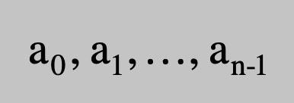

Inverse FFT Summary
Theorem. Inverse FFT algorithm interpolates a degree n-1 polynomial given values at each of the n^{th} roots of unity in O(n log n) steps.
assumes n is a power of 2
O(n log n)
O(n log n)
coefficient representation
point-value representation
Slides by Kevin Wayne. Copyright © 2005 Pearson-Addison Wesley. All rights reserved.

Slide 34
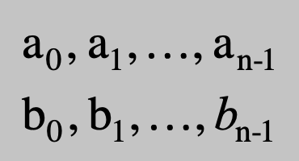
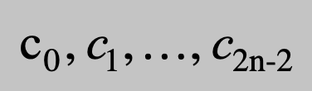
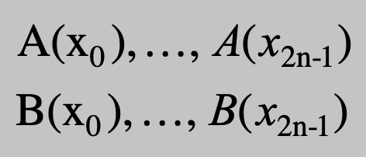
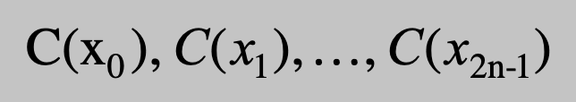
Polynomial Multiplication
Theorem. Can multiply two degree n-1 polynomials in O(n log n) steps.
coefficient representation
coefficient representation
FFT
O(n log n)
inverse FFT
O(n log n)
point-value multiplication
O(n)
Slides by Kevin Wayne. Copyright © 2005 Pearson-Addison Wesley. All rights reserved.

Slide 35
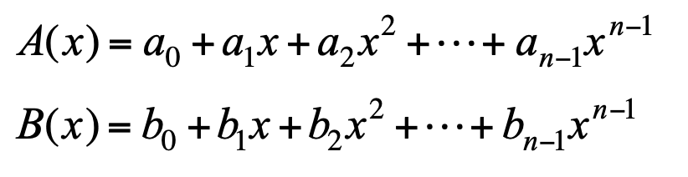
Integer Multiplication
Integer multiplication. Given two n bit integers a = a_{n-1} … a₁a₀ and b = b_{n-1} … b₁b₀, compute their product c = a × b.
Convolution algorithm.
Form two polynomials.
Note: a = A(2), b = B(2).
Compute C(x) = A(x) × B(x).
Evaluate C(2) = a × b.
Running time: O(n log n) complex arithmetic operations.
Theory. [Schönhage-Strassen 1971] O(n log n log log n) bit operations.
Theory. [Fürer 2007] O(n log n 2^{O(log *n)}) bit operations.
Practice. [GNU Multiple Precision Arithmetic Library] GMP proclaims to be "the fastest bignum library on the planet." It uses brute force, Karatsuba, and FFT, depending on the size of n.
Slides by Kevin Wayne. Copyright © 2005 Pearson-Addison Wesley. All rights reserved.

Slide 36
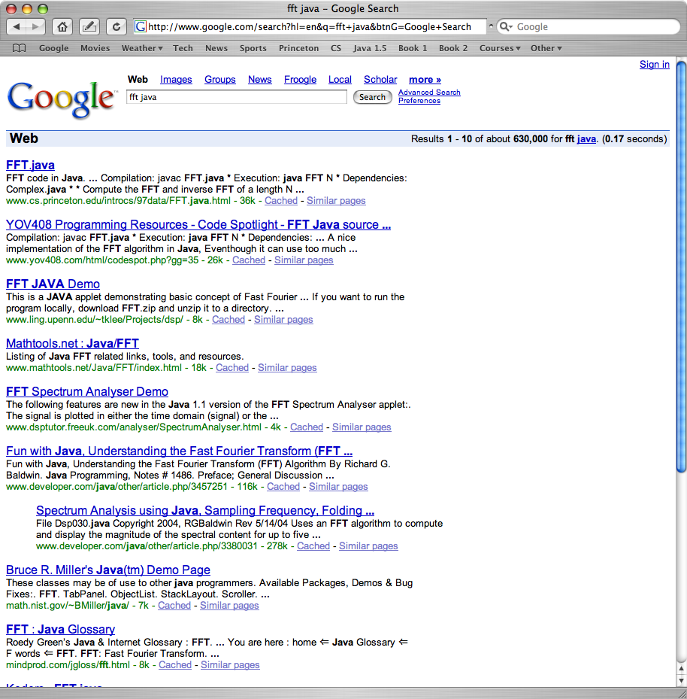
FFT in Practice ?
Slides by Kevin Wayne. Copyright © 2005 Pearson-Addison Wesley. All rights reserved.

Slide 37
FFT in Practice
Fastest Fourier transform in the West. [Frigo and Johnson]
Optimized C library.
Features: DFT, DCT, real, complex, any size, any dimension.
Won 1999 Wilkinson Prize for Numerical Software.
Portable, competitive with vendor-tuned code.
Implementation details.
Instead of executing predetermined algorithm, it evaluates your hardware and uses a special-purpose compiler to generate an optimized algorithm catered to "shape" of the problem.
Core algorithm is nonrecursive version of Cooley-Tukey radix 2 FFT.
O(n log n), even for prime sizes.
Reference: http://www.fftw.org
Slides by Kevin Wayne. Copyright © 2005 Pearson-Addison Wesley. All rights reserved.

