Slide 1
Algorithm Design and Analysis (H)
CS216
Prof. Shiqi Yu (于仕琪)
yusq@sustech.edu.cn
http://faculty.sustech.edu.cn/yusq/

Slide 2
Assignment 1
A better assignment/project

Slide 3
The power of O(K^{n})
Understand the resource demanded in fight against COVID-19.

Slide 4

Dynamic Programming
Slides by Kevin Wayne. Copyright © 2005 Pearson-Addison Wesley. All rights reserved.

Slide 5
Algorithmic Paradigms
Greedy. Build up a solution incrementally, myopically optimizing some local criterion.
Divide-and-conquer. Break up a problem into sub-problems, solve each sub-problem independently, and combine solution to sub-problems to form solution to original problem.
Dynamic programming. Break up a problem into a series of overlapping sub-problems, and build up solutions to larger and larger sub-problems.
Slides by Kevin Wayne. Copyright © 2005 Pearson-Addison Wesley. All rights reserved.
Notes:
overlapping sub-problem = sub-problem whose results can be reused several times

Slide 6
Dynamic Programming History
Bellman. [1950s] Pioneered the systematic study of dynamic programming.
Etymology.
Dynamic programming = planning over time.
Secretary of Defense was hostile to mathematical research.
Bellman sought an impressive name to avoid confrontation.
"it's impossible to use dynamic in a pejorative sense"
"something not even a Congressman could object to"
Reference: Bellman, R. E. Eye of the Hurricane, An Autobiography.
Slides by Kevin Wayne. Copyright © 2005 Pearson-Addison Wesley. All rights reserved.

Slide 7
Dynamic Programming Applications
Areas.
Bioinformatics.
Control theory.
Information theory.
Operations research.
Computer science: theory, graphics, AI, compilers, systems, ….
Some famous dynamic programming algorithms.
Unix diff for comparing two files.
Viterbi for hidden Markov models.
Smith-Waterman for genetic sequence alignment.
Bellman-Ford for shortest path routing in networks.
Cocke-Kasami-Younger for parsing context free grammars.
Slides by Kevin Wayne. Copyright © 2005 Pearson-Addison Wesley. All rights reserved.

Slide 8
1. Weighted Interval Scheduling
Slides by Kevin Wayne. Copyright © 2005 Pearson-Addison Wesley. All rights reserved.
Notes:
1-24,26-37

Slide 9
Weighted Interval Scheduling
Weighted interval scheduling problem.
Job j starts at s_{j}, finishes at f_{j}, and has weight or value v_{j} .
Two jobs compatible if they don't overlap.
Goal: find maximum weight subset of mutually compatible jobs.
a
b
c
d
e
f
g
h
Time
0
1
2
3
4
5
6
7
8
9
10
Slides by Kevin Wayne. Copyright © 2005 Pearson-Addison Wesley. All rights reserved.

Slide 10
Unweighted Interval Scheduling Review
Recall. Greedy algorithm works if all weights are 1.
Consider jobs in ascending order of finish time.
Add job to subset if it is compatible with previously chosen jobs.
Observation. Greedy algorithm can fail spectacularly if arbitrary weights are allowed.
weight = 999
b
weight = 1
a
Time
0
1
2
3
4
5
6
7
8
9
10
11
Slides by Kevin Wayne. Copyright © 2005 Pearson-Addison Wesley. All rights reserved.

Slide 11
Weighted Interval Scheduling
Notation. Label jobs by finishing time: f₁ ≤ f₂ ≤ . . . ≤ f_{n} .
Def. p(j) = largest index i < j such that job i is compatible with j.
Ex: p(8) = 5, p(7) = 3, p(2) = 0.
1
2
3
4
5
6
7
8
Time
0
1
2
3
4
5
6
7
8
9
10
11
Slides by Kevin Wayne. Copyright © 2005 Pearson-Addison Wesley. All rights reserved.

Slide 12
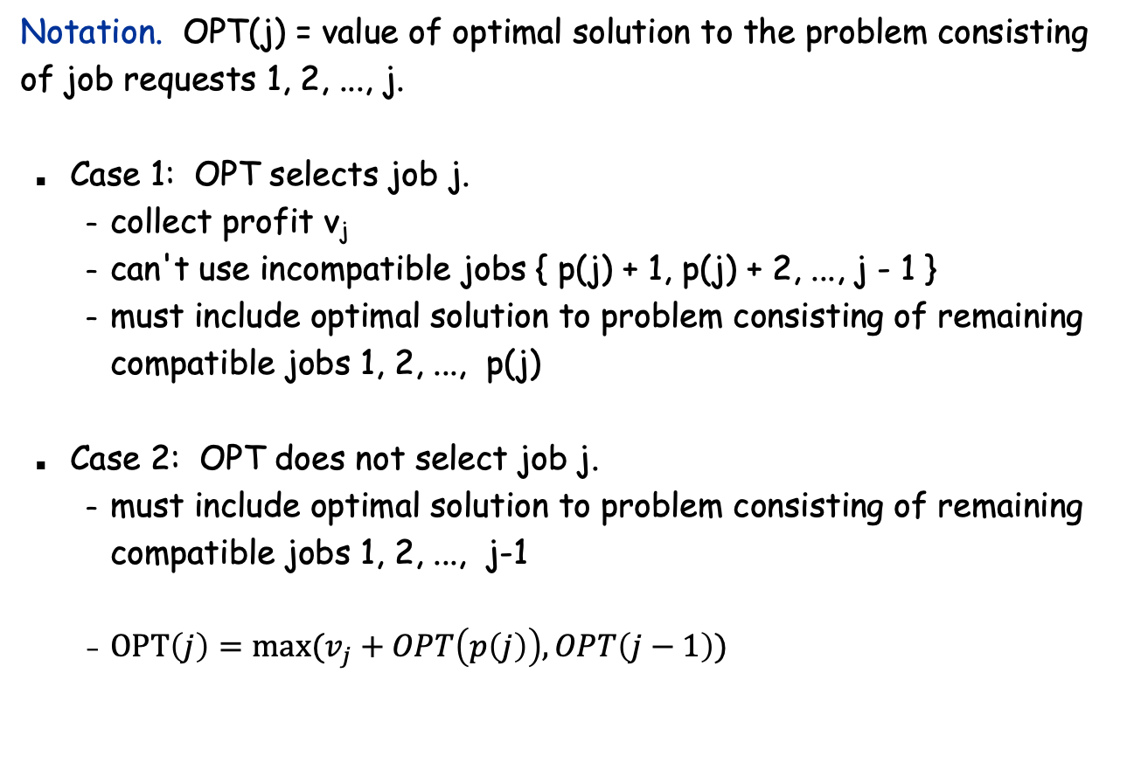
Dynamic Programming: Binary Choice
optimal substructure
Slides by Kevin Wayne. Copyright © 2005 Pearson-Addison Wesley. All rights reserved.

Slide 13
Weighted Interval Scheduling: Brute Force
Brute force algorithm.
Input: n, s₁,…,s_{n ,} f₁,…,f_{n ,} v₁,…,v_{n}
Sort jobs by finish times so that f₁ ≤ f₂ ≤ ... ≤ f_{n}.
Compute p(1), p(2), …, p(n)
Compute-Opt(j) {
if (j = 0)
return 0
else
return max(v_{j} + Compute-Opt(p(j)), Compute-Opt(j-1))
}
Slides by Kevin Wayne. Copyright © 2005 Pearson-Addison Wesley. All rights reserved.

Slide 14
Weighted Interval Scheduling: Brute Force
Observation. Recursive algorithm fails spectacularly because of redundant sub-problems ⇒ exponential algorithms.
Ex. Number of recursive calls for family of "layered" instances grows like Fibonacci sequence.
5
1
4
3
2
3
3
2
2
1
4
2
1
1
0
1
0
5
p(1) = 0, p(j) = j-2
1
0
Slides by Kevin Wayne. Copyright © 2005 Pearson-Addison Wesley. All rights reserved.

Slide 15
Weighted Interval Scheduling: Memoization
Memoization. Store results of each sub-problem in a cache; lookup as needed.
Input: n, s₁,…,s_{n ,} f₁,…,f_{n ,} v₁,…,v_{n}
Sort jobs by finish times so that f₁ ≤ f₂ ≤ ... ≤ f_{n}.
Compute p(1), p(2), …, p(n)
for j = 1 to n
M[j] = empty
M[0] = 0
M-Compute-Opt(j) {
if (M[j] is empty)
M[j] = max(v_{j} + M-Compute-Opt(p(j)), M-Compute-Opt(j-1))
return M[j]
}
global array
Slides by Kevin Wayne. Copyright © 2005 Pearson-Addison Wesley. All rights reserved.

Slide 16
Weighted Interval Scheduling: Running Time
Claim. Memorized version of algorithm takes O(n log n) time.
Sort by finish time: O(n log n).
Computing p(⋅) : O(n log n) via sorting by start time.
M-Compute-Opt(j): each invocation takes O(1) time and either
(i) returns an existing value M[j]
(ii) fills in one new entry M[j] and makes two recursive calls
Progress measure Φ = # nonempty entries of M[].
initially Φ = 0, throughout Φ ≤ n.
(ii) increases Φ by 1 ⇒ at most 2n recursive calls.
Overall running time of M-Compute-Opt(n) is O(n). ▪
Remark. O(n) if jobs are pre-sorted by start and finish times.
Slides by Kevin Wayne. Copyright © 2005 Pearson-Addison Wesley. All rights reserved.

Slide 17
Weighted Interval Scheduling: Finding a Solution
Q. Dynamic programming algorithms computes optimal value. What if we want the solution itself?
A. Do some post-processing.
# of recursive calls ≤ n ⇒ O(n).
Run M-Compute-Opt(n)
Run Find-Solution(n)
Find-Solution(j) {
if (j = 0)
output nothing
else if (v_{j} + M[p(j)] > M[j-1])
print j
Find-Solution(p(j))
else
Find-Solution(j-1)
}
Slides by Kevin Wayne. Copyright © 2005 Pearson-Addison Wesley. All rights reserved.

Slide 18
Weighted Interval Scheduling: Bottom-Up
Bottom-up dynamic programming. Unwind recursion.
Input: n, s₁,…,s_{n ,} f₁,…,f_{n ,} v₁,…,v_{n}
Sort jobs by finish times so that f₁ ≤ f₂ ≤ ... ≤ f_{n}.
Compute p(1), p(2), …, p(n)
Iterative-Compute-Opt {
M[0] = 0
for j = 1 to n
M[j] = max(v_{j} + M[p(j)], M[j-1])
}
Slides by Kevin Wayne. Copyright © 2005 Pearson-Addison Wesley. All rights reserved.

Slide 19
2. Segmented Least Squares
Slides by Kevin Wayne. Copyright © 2005 Pearson-Addison Wesley. All rights reserved.
Notes:
1-24,26-37

Slide 20
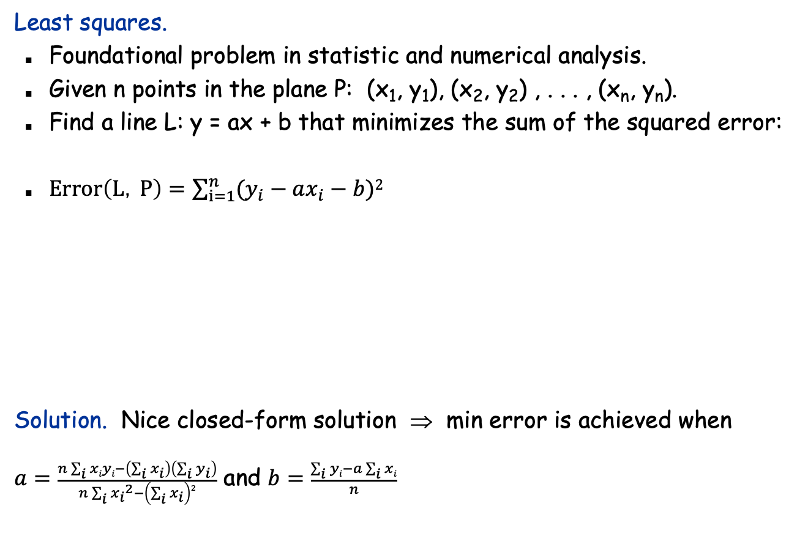
Segmented Least Squares
y
x
Slides by Kevin Wayne. Copyright © 2005 Pearson-Addison Wesley. All rights reserved.
Notes:
the term "regression" stems from the work of Sir Francis Galton (1822-1911), a famous geneticist, who studied the heights of fathers and their sons. He found that offspring of a parent of larger than average height tended to be smaller than their parents, and offspring of parents of smaller than average size tended to be larger than their parents. "regression toward mediocrity".
Gauss (1809-1811) used Gaussian elimination to solve multiple linear regression
Gauss-Markov theorem (least squares estimates are uniformly minimum variance estimates (UMVUE) among all linear unbiased estimates)

Slide 21
Segmented Least Squares
Segmented least squares.
Points lie roughly on a sequence of several line segments.
Given n points in the plane (x₁, y₁), (x₂, y₂) , . . . , (x_{n}, y_{n}) with
x₁ < x₂ < ... < x_{n}, find a sequence of lines that minimizes f(x).
Q. What's a reasonable choice for f(x) to balance accuracy and parsimony?
goodness of fit
number of lines
y
Slides by Kevin Wayne. Copyright © 2005 Pearson-Addison Wesley. All rights reserved.
x

Slide 22
Segmented Least Squares
Segmented least squares.
Points lie roughly on a sequence of several line segments.
Given n points in the plane (x₁, y₁), (x₂, y₂) , . . . , (x_{n}, y_{n}) with
x₁ < x₂ < ... < x_{n}, find a sequence of lines that minimizes:
the sum of the sums of the squared errors E in each segment
the number of lines L
Tradeoff function: E + c L, for some constant c > 0.
y
Slides by Kevin Wayne. Copyright © 2005 Pearson-Addison Wesley. All rights reserved.
x

Slide 23
Dynamic Programming: Multiway Choice
Notation.
OPT(j) = minimum cost for points p₁, p_{i+1} , . . . , p_{j}.
e(i, j) = minimum sum of squares for points p_{i}, p_{i+1} , . . . , p_{j}.
To compute OPT(j):
Last segment uses points p_{i}, p_{i+1} , . . . , p_{j} for some i.
Cost = e(i, j) + c + OPT(i-1).
Slides by Kevin Wayne. Copyright © 2005 Pearson-Addison Wesley. All rights reserved.

Slide 24
Segmented Least Squares: Algorithm
INPUT: n, p₁,…,p_{N ,} c
Segmented-Least-Squares() {
M[0] = 0
for j = 1 to n
for i = 1 to j
compute the least square error e_{ij} for the segment p_{i},…, p_{j}
for j = 1 to n
M[j] = min _{1 ≤ i ≤ j} (e_{ij} + c + M[i-1])
return M[n]
}
Running time. O(n³).
Bottleneck = computing e(i, j) for O(n²) pairs, O(n) per pair using previous formula.
can be improved to O(n²) by pre-computing various statistics
Slides by Kevin Wayne. Copyright © 2005 Pearson-Addison Wesley. All rights reserved.

