Slide 1
Algorithm Design and Analysis (H)
CS216
Prof. Shiqi Yu (于仕琪)
yusq@sustech.edu.cn
http://faculty.sustech.edu.cn/yusq/

Slide 2
The power of O(K^{n})
Rice on a chessboard

Slide 3

Dynamic Programming
Slides by Kevin Wayne. Copyright © 2005 Pearson-Addison Wesley. All rights reserved.

Slide 4
3. Knapsack Problem
Notes:
1-24,26-37

Slide 5
Knapsack Problem
Knapsack problem.
Given n objects and a "knapsack."
Item i weighs w_{i} > 0 kilograms and has value v_{i} > 0.
Knapsack has capacity of W kilograms.
Goal: fill knapsack so as to maximize total value.
Ex: { 3, 4 } has value 40.
Greedy: repeatedly add item with maximum ratio v_{i} / w_{i}.
Ex: { 5, 2, 1 } achieves only value = 35 ⇒ greedy not optimal.
#
value
weight
W = 11
1
1
1
2
6
2
3
18
5
4
22
6
5
28
7

Slide 6
Dynamic Programming: False Start
Def. OPT(i) = max profit subset of items 1, …, i.
Case 1: OPT does not select item i.
OPT selects best of { 1, 2, …, i-1 }
Case 2: OPT selects item i.
accepting item i does not immediately imply that we will have to reject other items
without knowing what other items were selected before i, we don't even know if we have enough room for i
Conclusion. Need more sub-problems!

Slide 7
Dynamic Programming: Adding a New Variable
Def. OPT(i, w) = max profit subset of items 1, …, i with weight limit w.
Case 1: OPT does not select item i.
OPT selects best of { 1, 2, …, i-1 } using weight limit w
Case 2: OPT selects item i.
new weight limit = w – w_{i}
OPT selects best of { 1, 2, …, i–1 } using this new weight limit
$$OPT\left(i,w\right)=\max_{}{(OPT\left(i−1,w\right), v_{i}+OPT\left(i−1,w−w_{i}\right))}$$

Slide 8
Knapsack Problem: Bottom-Up
Knapsack. Fill up an n-by-W array.
Input: n, W, w₁,…,w_{N,} v₁,…,v_{N}
for w = 0 to W
M[0, w] = 0
for i = 1 to n
for w = 1 to W
if (w_{i} > w)
M[i, w] = M[i-1, w]
else
M[i, w] = max {M[i-1, w], v_{i} + M[i-1, w-w_{i} ]}
return M[n, W]
$$OPT\left(i,w\right)=\max_{}{(OPT\left(i−1,w\right), v_{i}+OPT\left(i−1,w−w_{i}\right))}$$

Slide 9
Knapsack Algorithm
W + 1
0
1
2
3
4
5
6
7
8
9
10
11
φ
0
0
0
0
0
0
0
0
0
0
0
0
{ 1 }
0
1_{{1}}
1_{{1}}
1_{{1}}
1_{{1}}
1_{{1}}
1_{{1}}
1_{{1}}
1_{{1}}
1_{{1}}
1_{{1}}
1_{{1}}
n + 1
{ 1, 2 }
0
1_{{1}}
6_{{2}}
7_{{1,2}}
7_{{1,2}}
7_{{1,2}}
7_{{1,2}}
7_{{1,2}}
7_{{1,2}}
7_{{1,2}}
7_{{1,2}}
7_{{1,2}}
{ 1, 2, 3 }
0
1_{{1}}
6_{{2}}
7_{{1,2}}
7_{{1,2}}
18_{{3}}
19_{{1,3}}
24_{{2,3}}
25_{{1,2,3}}
25_{{1,2,3}}
25_{{1,2,3}}
25_{{1,2,3}}
{ 1, 2, 3, 4 }
0
1_{{1}}
6_{{2}}
7_{{1,2}}
7_{{1,2}}
18_{{3}}
22_{{4}}
24_{{2,3}}
28_{{2,4}}
29_{{1,2,4}}
29_{{1,2,4}}
40_{{3,4}}
{ 1, 2, 3, 4, 5 }
0
1_{{1}}
6_{{2}}
7_{{1,2}}
7_{{1,2}}
18_{{3}}
22_{{4}}
28_{{5}}
29_{{1,5}}
34_{{2,5}}
34_{{2,5}}
40_{{3,4}}
Item
Value
Weight
W = 11
1
1
1
OPT: { 3, 4 }
value = 18 + 22 = 40
2
6
2
3
18
5
$$OPT\left(i,w\right)=\max_{}{(OPT\left(i−1,w\right), v_{i}+OPT\left(i−1,w−w_{i}\right))}$$
4
22
6
5
28
7

Slide 10
Knapsack Problem: Running Time
Running time. Θ(n W).
Not polynomial in input size!
"Pseudo-polynomial."
Decision version of Knapsack is NP-complete. [Chapter 8]
Can a value of at least V be achieved under a restriction of a certain capacity W?
Knapsack approximation algorithm. There exists a poly-time algorithm that produces a feasible solution that has value within 0.01% of optimum. [Section 11.8]

Slide 11
4 RNA Secondary Structure
Notes:
1-24,26-37

Slide 12
RNA Secondary Structure
RNA. String B = b₁b₂…b_{n} over alphabet { A, C, G, U }.
Secondary structure. RNA is single-stranded so it tends to loop back and form base pairs with itself. This structure is essential for understanding behavior of molecule.
Ex: GUCGAUUGAGCGAAUGUAACAACGUGGCUACGGCGAGA
C
A
A
A
A
U
G
C
C
G
U
A
A
G
U
G
A
U
U
A
A
C
G
C
U
G
G
C
G
C
G
A
G
C
G
A
U
complementary base pairs: A-U, C-G
G

Slide 13
RNA Secondary Structure
Secondary structure. A set of pairs S = { (b_{i}, b_{j}) } that satisfy:
[Watson-Crick.] S is a matching and each pair in S is a Watson-Crick complement: A-U, U-A, C-G, or G-C.
[No sharp turns.] The ends of each pair are separated by at least 4 intervening bases. If (b_{i}, b_{j}) ∈ S, then i < j - 4.
[Non-crossing.] If (b_{i}, b_{j}) and (b_{k}, b_{l}) are two pairs in S, then we cannot have i < k < j < l.
Free energy. Usual hypothesis is that an RNA molecule will form the secondary structure with the optimum total free energy.
Goal. Given an RNA molecule B = b₁b₂…b_{n}, find a secondary structure S that maximizes the number of base pairs.
approximate by number of base pairs

Slide 14
RNA Secondary Structure: Examples
Examples.
G
G
G
G
G
C
U
G
G
C
U
C
G
C
G
C
U
A
U
A
U
A
G
U
A
U
A
U
A
base pair
A
U
G
U
G
G
C
C
A
U
A
U
G
G
G
G
C
A
U
A
G
U
U
G
G
C
C
A
U
≤4
ok
sharp turn
crossing

Slide 15
RNA Secondary Structure: Subproblems
First attempt. OPT(j) = maximum number of base pairs in a secondary structure of the substring b₁b₂…b_{j}.
Difficulty. Results in two sub-problems.
Finding secondary structure in: b₁b₂…b_{t-1}.
Finding secondary structure in: b_{t+1}b_{t+2}…b_{n-1}.
match b_{t} and b_{n}
1
t
n
OPT(t-1)
need more sub-problems

Slide 16
Dynamic Programming Over Intervals
Notation. OPT(i, j) = maximum number of base pairs in a secondary structure of the substring b_{i}b_{i+1}…b_{j}.
Case 1. If i ≥ j - 4.
OPT(i, j) = 0 by no-sharp turns condition.
Case 2. Base b_{j} is not involved in a pair.
OPT(i, j) = OPT(i, j-1)
Case 3. Base b_{j} pairs with b_{t} for some i ≤ t < j - 4.
non-crossing constraint decouples resulting sub-problems
OPT(i, j) = 1 + max_{t} { OPT(i, t-1) + OPT(t+1, j-1) }
Remark. Same core idea in CKY algorithm to parse context-free grammars.
take max over t such that i ≤ t < j-4 and b_{t} and b_{j} are Watson-Crick complements

Slide 17
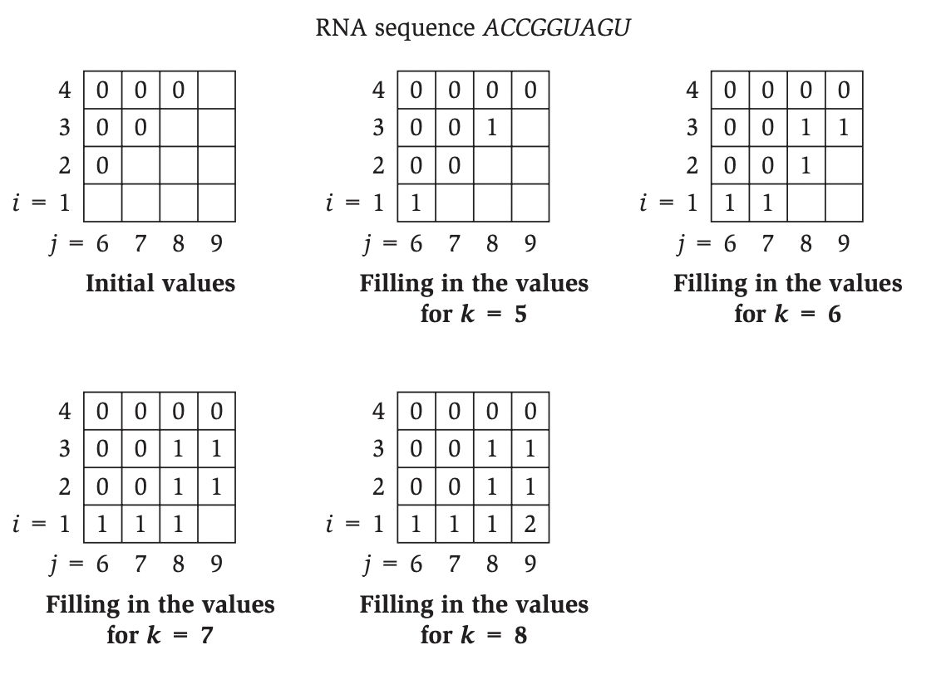
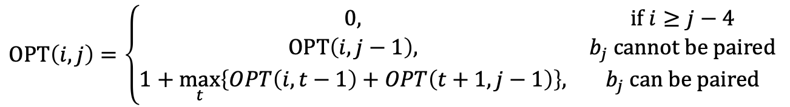
Example
$$OPT\left(i,j\right)=\left\{\begin{matrix}0, & \text{if} i≥j−4 \\ OPT\left(i,j−1\right), & b_{j} cannot be paired \\ 1+\max_{t}\left\{OPT\left(i,t−1\right)+OPT\left(t+1,j−1\right)\right\}, & b_{j} \text{can} \text{be} \text{paired}\end{matrix}\right.$$

Slide 18
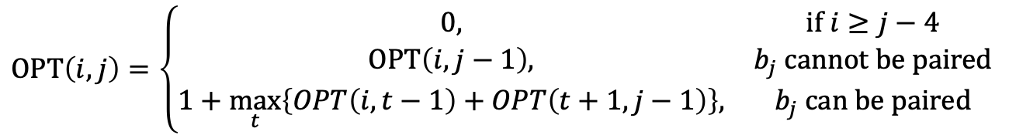
Bottom Up Dynamic Programming Over Intervals
Q. What order to solve the sub-problems?
A. Do shortest intervals first.
Running time. O(n³).
RNA(b₁,…,b_{n}) {
for k = 5, 6, …, n-1
for i = 1, 2, …, n-k
j = i + k
Compute M[i, j]
return M[1, n]
}
4
0
0
0
3
0
0
i
2
0
1
6
7
8
9
using recurrence
j
$$OPT\left(i,j\right)=\left\{\begin{matrix}0, & \text{if} i≥j−4 \\ OPT\left(i,j−1\right), & b_{j} cannot be paired \\ 1+\max_{t}\left\{OPT\left(i,t−1\right)+OPT\left(t+1,j−1\right)\right\}, & b_{j} \text{can} \text{be} \text{paired}\end{matrix}\right.$$

Slide 19
Dynamic Programming Summary
Recipe.
Characterize structure of problem.
Recursively define value of optimal solution.
Compute value of optimal solution.
Construct optimal solution from computed information.
Dynamic programming techniques.
Binary choice: weighted interval scheduling.
Multi-way choice: segmented least squares.
Adding a new variable: knapsack.
Dynamic programming over intervals: RNA secondary structure.
Top-down vs. bottom-up: different people have different intuitions.
Viterbi algorithm for HMM also uses DP to optimize a maximum likelihood tradeoff between parsimony and accuracy
CKY parsing algorithm for context-free grammar has similar structure

