Slide 1
Strategy/Policy Pattern
Notes:
1

Slide 2
Authors and Presenters
2
David Jalisevs
Donal Howe
Aeden Moylan
Notes:
2

Slide 3
Brief Description
3
The strategy pattern is a behavioral design pattern that lets you define a family of algorithms, put each of them into a separate class, and make their objects interchangeable
Notes:
3

Slide 4
Purpose
4
It is one of the behavioural design patterns
The strategy pattern works using inheritance and polymorphism examples will be shown soon in our code.
We design multiple algorithms and allow the client decide which one to implement and it is passed as a parameter
when we have multiple algorithm for a specific task and client decides the actual implementation to be used at runtime
Notes:
4

Slide 5
Pros
5
Easily readable code design
Lets you isolate the code which makes it safer and easier to debug
Smaller function sizes, prevents the need for large switch statements and a lot of conditional statements
Notes:
5

Slide 6
Cons
6
Issues associated with Pattern
The application must be aware of the strategies to select the right one.
Need good understanding of inheritance and polymorphism
Limits the desire to find better solutions
If used for multiple things hard to change due to tight coupling
Notes:
6

Slide 7
Example Usage
7
Link to github: https://github.com/AedenMoylan/Strategy_Example
We will talk about the usage during the demonstration and examples of good code.
we will demonstrate the problems and benefits with the pattern also.
Notes:
7

Slide 8
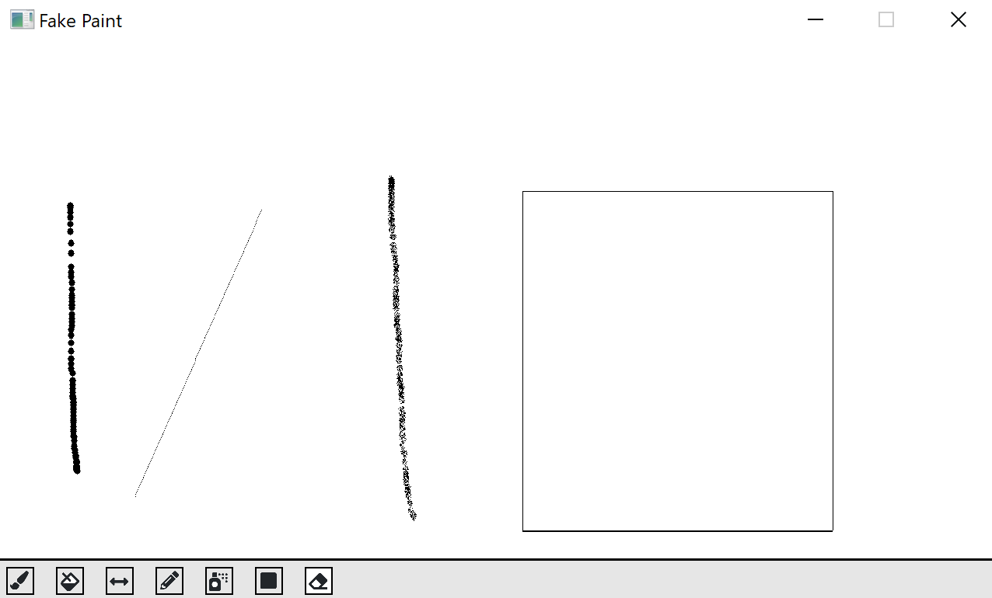
Program Example
8
Notes:
8

Slide 9
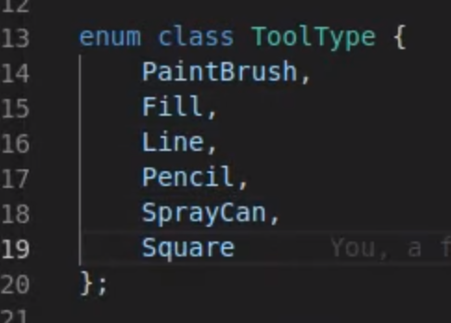
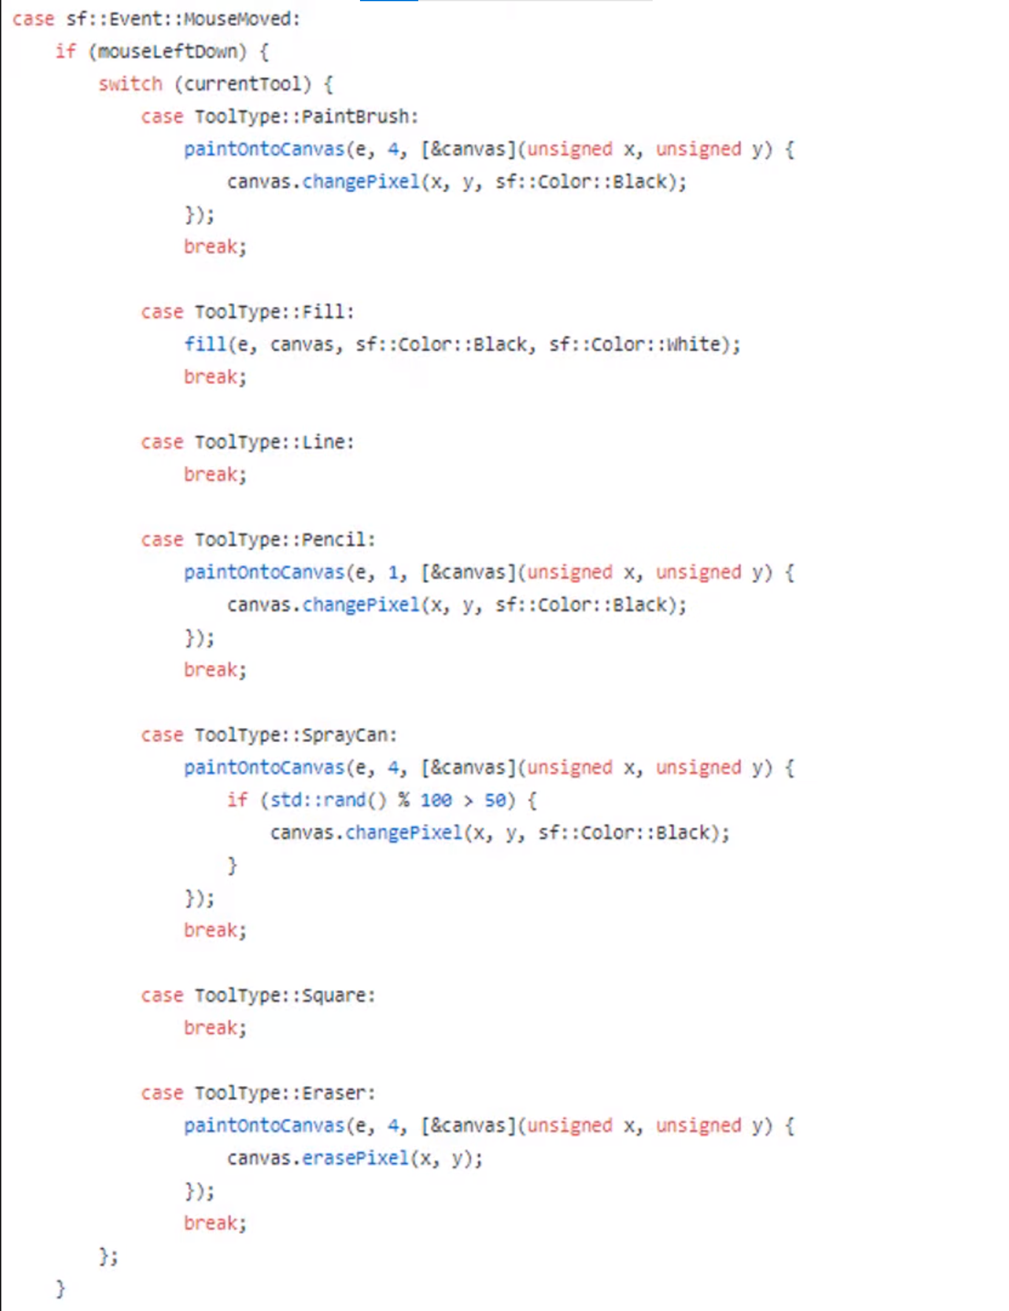
Sample Bad Code
9
Notes:
9

