Slide 1

Football Analytics API
XJCO3011 Web Services and Web Data Coursework 1
Leo Chen
April 2026

Slide 2

Project Overview & Objectives
CORE MISSION
▶
Develop a robust, data-driven RESTful web service for Premier League football statistics.
20
▶
Bridge the gap between raw sports data and programmable, analytical access.
API ENDPOINTS
▶
Demonstrate advanced API design principles, relational data modeling, and secure authentication.
3
KEY CAPABILITIES
CORE DATA MODELS
▶
Full CRUD management for Teams, Players, and Matches.
45
▶
Complex data aggregation for dynamic league tables and rankings.
AUTOMATED TESTS

Slide 3




System Architecture & Technology Stack
Python 3.11
FastAPI
SQLAlchemy
SQLite
CORE LOGIC
PRESENTATION
DATA ACCESS
STORAGE
Chosen for its unparalleled ecosystem in data processing and readability. Native async support enables non-blocking I/O.
Delivers high performance (Starlette) and strict type safety (Pydantic). Auto-generates interactive Swagger UI docs.
Abstracts complex SQL into Pythonic objects. Enforces relational integrity and mitigates SQL injection vulnerabilities.
Provides zero-configuration portability. Fully supports standard SQL operations required for demonstrating relational modeling.

Slide 4



Relational Database Schema Design
Team
Player
Match
The central entity storing club information including name, city, stadium, manager, and budget.
Stores individual statistics such as goals, assists, appearances, and disciplinary cards.
Captures the outcome and detailed statistics of a game, including possession and shots.
1-to-Many relationship with Players
1-to-Many relationship with Matches (Home)
Linked to exactly one Team
Contains two Foreign Keys
Uses team_id as Foreign Key
home_team_id points to Team
1-to-Many relationship with Matches (Away)
Establishes a clear hierarchy
away_team_id points to Team

Slide 5



Core API Functionality: CRUD Operations
RESOURCE
READ (PUBLIC)
WRITE (SECURED)
QUERY CAPABILITIES
Teams
GET /teams/
POST, PUT, DELETE
Filter by
city
GET /teams/{id}
Search by
name
Players
GET /players/
POST, PUT, DELETE
Filter by
team, position, nationality
GET /players/{id}
Sort by
goals, assists, cards
Matches
GET /matches/
POST, PUT, DELETE
Filter by
season, team
GET /matches/{id}
Filter by
date range
Universal Pagination
Strict Validation
Standardized Responses
page & page_size parameters on all lists
Pydantic schemas enforce data integrity
Consistent JSON structures & HTTP codes

Slide 6




Advanced Analytics Endpoints
League Table
Team Performance
Player Rankings
GET /analytics/league-table
GET /analytics/team-performance/{id}
GET /analytics/player-rankings
Calculates standings from match results (points, GD, W/D/L).
Top players sorted by goals, assists, or other stats.
Team metrics including home/away form and scoring averages.
Head-to-Head
Season Summary
GET /analytics/head-to-head
GET /analytics/season-summary
Historical comparisons and match outcomes between two teams.
Overview of the season: total and average goals per match.
These endpoints show complex data aggregation, transforming raw data into high-level football intelligence.

Slide 7






Security: JWT Authentication
STATELESS MECHANISM
ROUTE PROTECTION STRATEGY
JSON Web Tokens (JWT)
Public Endpoints
Implemented using python-jose. Provides a highly scalable, stateless authentication mechanism. The server does not need to maintain session state in memory or a database, reducing overhead.
All GET requests (retrieving teams, players, matches, and analytics) are freely accessible without authentication, allowing public data consumption.
Protected Endpoints
Secure Password Hashing
All write operations (POST, PUT, DELETE) require a valid JWT token passed in the Authorization header.
Passwords are never stored in plaintext. They are securely hashed using bcrypt before being persisted to the database, ensuring protection against data breaches.
Client Request
Includes Bearer Token
FastAPI Middleware
Validates Signature & Expiry
Route Handler
Executes DB Operation

Slide 8
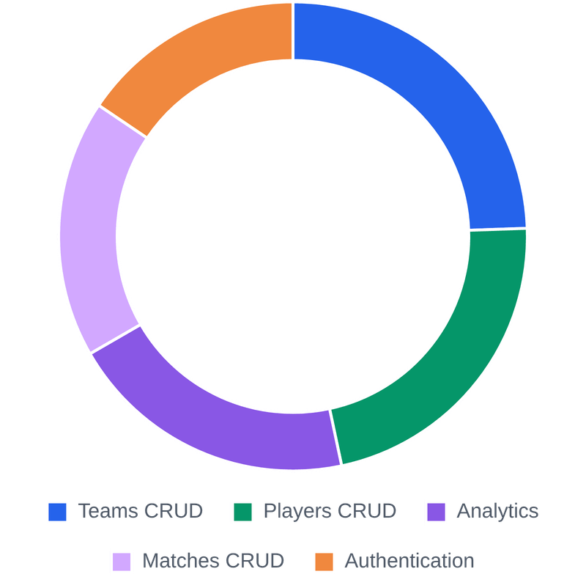
Testing Methodology & Coverage
RIGOROUS VALIDATION STRATEGY
■
Complete Test Isolation
45-TEST SUITE BREAKDOWN
Utilizes a dedicated in-memory SQLite database (sqlite:///:memory:). Tables are freshly created and dropped for every single test to guarantee deterministic results.
■
Pytest Fixture Injection
Heavy reliance on fixtures to streamline setup. Fixtures automatically inject database sessions, TestClients, seed data, and valid JWT headers.
45
TOTAL TESTS
■
Explicit Edge Case Coverage
Tests explicitly validate HTTP status codes (200, 201, 400, 401, 403, 404, 422) and handle edge cases like invalid foreign keys and duplicate registrations.

Slide 9




Challenges & Future Improvements
DEVELOPMENT CHALLENGES
ARCHITECTURAL ROADMAP
ORM Ambiguity Resolution
PostgreSQL Migration
The Match model required two foreign keys pointing to the Team model (home and away). This caused an AmbiguousForeignKeysError in SQLAlchemy, resolved by explicitly defining the foreign_keys argument in the relationship definitions.
Replacing SQLite with PostgreSQL to resolve concurrent write limitations and unlock advanced analytical SQL functions (e.g., Window Functions) for a production-ready environment.
Redis Caching Layer
Dependency Conflicts
Implementing in-memory caching for computationally heavy analytics endpoints (like the League Table) to drastically reduce database load and improve response times to sub-millisecond levels.
Encountered a ValueError during testing related to password length limits in newer versions of the bcrypt library. Diagnosed and resolved by pinning the dependency to a stable, compatible version (4.0.1).
Automated Data Ingestion
Integrating a background task scheduler (e.g., Celery) to periodically fetch and ingest live data from authoritative third-party APIs, ensuring data freshness without manual intervention.

