Slide 1

Football Analytics API
XJCO3011 Web Services and Web Data Coursework 1
Chen Haotian
April 2026

Slide 2

Project Overview & Objectives
CORE MISSION
▶
Develop a robust, data-driven RESTful web service for Premier League football statistics.
20
▶
Bridge the gap between raw sports data and programmable, analytical access.
API ENDPOINTS
▶
Demonstrate advanced API design principles, relational data modeling, and secure authentication.
3
KEY CAPABILITIES
CORE DATA MODELS
▶
Full CRUD management for Teams, Players, and Matches.
45
▶
Complex data aggregation for dynamic league tables and rankings.
AUTOMATED TESTS

Slide 3




System Architecture & Technology Stack
Python 3.11
FastAPI
SQLAlchemy
SQLite
CORE LOGIC
PRESENTATION
DATA ACCESS
STORAGE
Chosen for its unparalleled ecosystem in data processing and readability. Native async support enables non-blocking I/O.
Delivers high performance (Starlette) and strict type safety (Pydantic). Auto-generates interactive Swagger UI docs.
Abstracts complex SQL into Pythonic objects. Enforces relational integrity and mitigates SQL injection vulnerabilities.
Provides zero-configuration portability. Fully supports standard SQL operations required for demonstrating relational modeling.

Slide 4



Relational Database Schema Design
Team
Player
Match
The central entity storing club information including name, city, stadium, manager, and budget.
Stores individual statistics such as goals, assists, appearances, and disciplinary cards.
Captures the outcome and detailed statistics of a game, including possession and shots.
1-to-Many relationship with Players
1-to-Many relationship with Matches (Home)
Linked to exactly one Team
Contains two Foreign Keys
Uses team_id as Foreign Key
home_team_id points to Team
1-to-Many relationship with Matches (Away)
Establishes a clear hierarchy
away_team_id points to Team

Slide 5



Core API Functionality: CRUD Operations
RESOURCE
READ (PUBLIC)
WRITE (SECURED)
QUERY CAPABILITIES
Teams
GET /teams/
POST, PUT, DELETE
Filter by
city
GET /teams/{id}
Search by
name
Players
GET /players/
POST, PUT, DELETE
Filter by
team, position, nationality
GET /players/{id}
Sort by
goals, assists, cards
Matches
GET /matches/
POST, PUT, DELETE
Filter by
season, team
GET /matches/{id}
Filter by
date range
Universal Pagination
Strict Validation
Standardized Responses
page & page_size parameters on all lists
Pydantic schemas enforce data integrity
Consistent JSON structures & HTTP codes

Slide 6




Advanced Analytics Endpoints
League Table
Team Performance
Player Rankings
GET /analytics/league-table
GET /analytics/team-performance/{id}
GET /analytics/player-rankings
Calculates standings from match results (points, GD, W/D/L).
Top players sorted by goals, assists, or other stats.
Team metrics including home/away form and scoring averages.
Head-to-Head
Season Summary
GET /analytics/head-to-head
GET /analytics/season-summary
Historical comparisons and match outcomes between two teams.
Overview of the season: total and average goals per match.
These endpoints show complex data aggregation, transforming raw data into high-level football intelligence.

Slide 7






Security: JWT Authentication
STATELESS MECHANISM
ROUTE PROTECTION STRATEGY
JSON Web Tokens (JWT)
Public Endpoints
Implemented using python-jose. Provides a highly scalable, stateless authentication mechanism. The server does not need to maintain session state in memory or a database, reducing overhead.
All GET requests (retrieving teams, players, matches, and analytics) are freely accessible without authentication, allowing public data consumption.
Protected Endpoints
Secure Password Hashing
All write operations (POST, PUT, DELETE) require a valid JWT token passed in the Authorization header.
Passwords are never stored in plaintext. They are securely hashed using bcrypt before being persisted to the database, ensuring protection against data breaches.
Client Request
Includes Bearer Token
FastAPI Middleware
Validates Signature & Expiry
Route Handler
Executes DB Operation

Slide 8
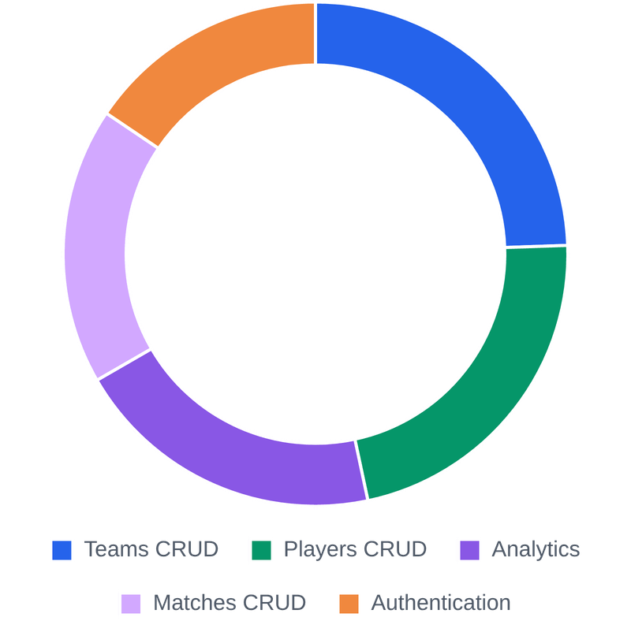
Testing Methodology & Coverage
RIGOROUS VALIDATION STRATEGY
■
Complete Test Isolation
45-TEST SUITE BREAKDOWN
Utilizes a dedicated in-memory SQLite database (sqlite:///:memory:). Tables are freshly created and dropped for every single test to guarantee deterministic results.
■
Pytest Fixture Injection
Heavy reliance on fixtures to streamline setup. Fixtures automatically inject database sessions, TestClients, seed data, and valid JWT headers.
45
TOTAL TESTS
■
Explicit Edge Case Coverage
Tests explicitly validate HTTP status codes (200, 201, 400, 401, 403, 404, 422) and handle edge cases like invalid foreign keys and duplicate registrations.

Slide 9

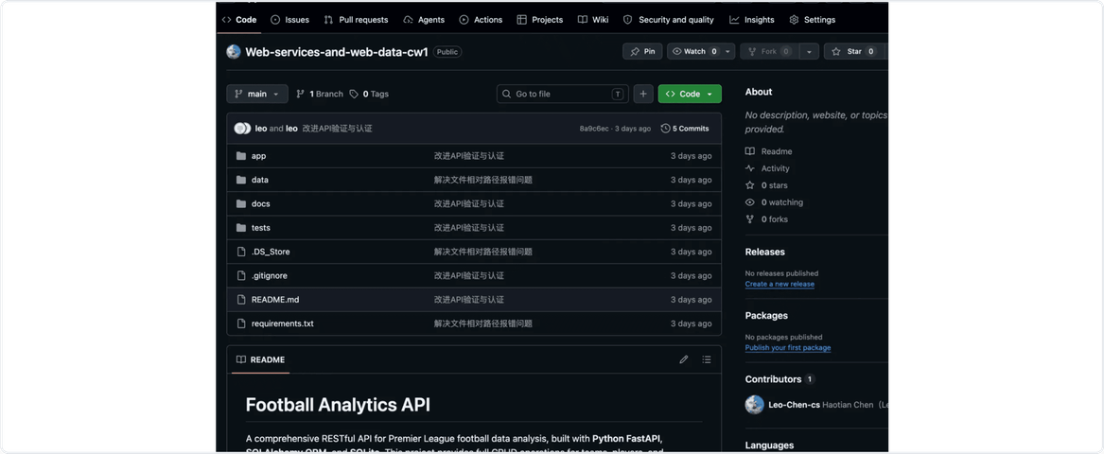

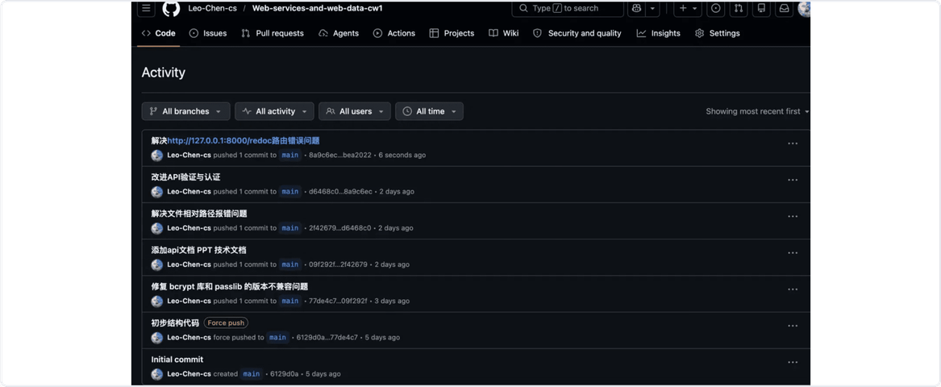

Version Control Practices & Commit History
Atomic & Frequent Commits
Code changes are committed in small, logical units (e.g., "改进API验证与认证", "解决文件相对路径报错问题"). This ensures easier tracking, debugging, and reverting if necessary.
Descriptive Commit Messages
Every commit message clearly explains what was changed and why, providing a transparent history of the development process for all collaborators.
Fig 1: Repository Structure & Recent Commits
Structured Repository
The GitHub repository maintains a clean structure
app
tests
docs
data
, alongside essential files like
,
,
, and
and
requirements.txt
.gitignore
with separated directories for
.
Fig 2: Detailed Commit Activity Log

Slide 10



API Documentation Overview
The API Documentation is meticulously authored using LaTeX and delivered as a professional PDF document. It serves as the definitive contract for consumers integrating with the Football Analytics API.
Comprehensive Coverage
Developer Ready
Academic Formatting
Details all 20 RESTful endpoints across Teams, Players, Matches, Analytics, and Auth.
Provides exact example requests for immediate testing.
Typeset in Times New Roman to meet strict coursework guidelines.
Illustrates expected JSON responses for both success and failure scenarios.
Structured with clear hierarchical headings and monospaced code blocks.
Clearly defines required and optional query parameters and path variables.
Documents standard HTTP error codes (400, 401, 404, 500).
Maintained directly alongside the codebase in the /docs directory.
Explains the JWT Authentication flow and header requirements.

Slide 11
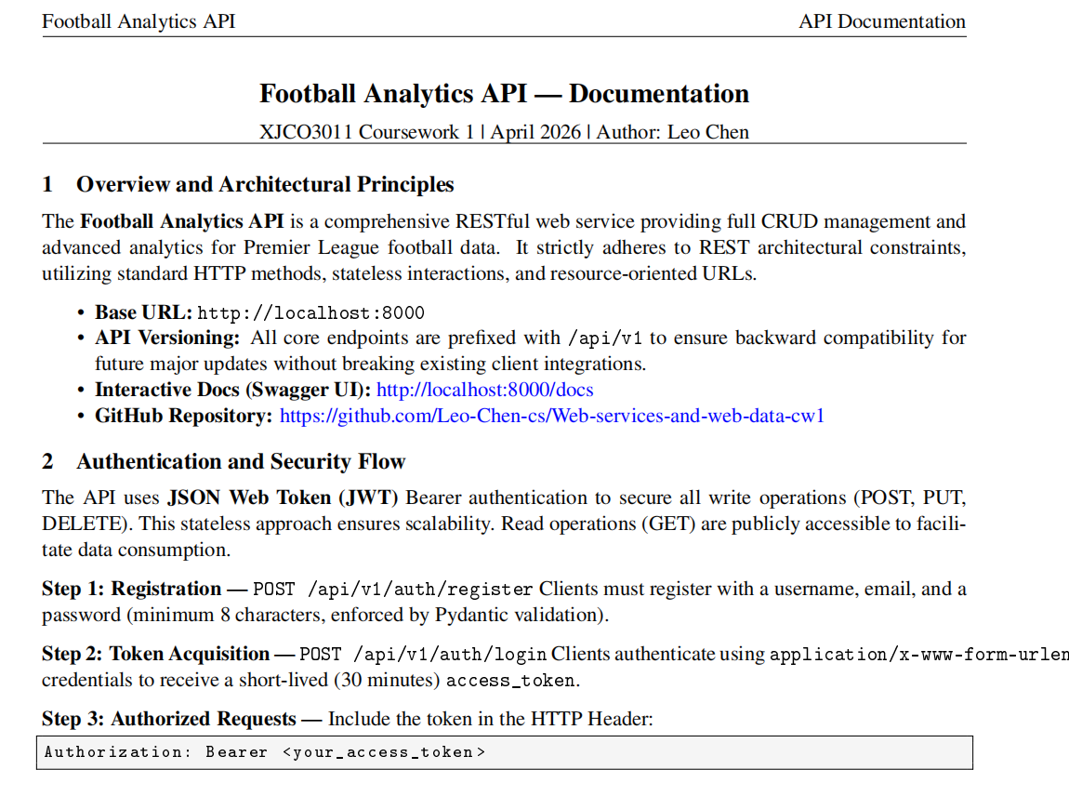
API Documentation Overview（screenshot）

Slide 12



Technical Report Highlights
Architecture & Design
Testing Methodology
Detailed justification for selecting FastAPI (asynchronous performance, automatic Swagger UI) and SQLite (zero-configuration portability).
Comprehensive overview of the Pytest suite covering 45 independent test cases.
Explanation of testing strategies: happy paths, edge cases, authentication failures, and data validation.
Explanation of the layered architecture separating routing, business logic, and data access.
Analysis of the relational database schema, including the handling of dual foreign keys for matches.
Challenges & Learnings
Reflection on resolving SQLAlchemy AmbiguousForeignKeysError during model relationships setup.
GenAI Declaration
Documentation of debugging the bcrypt version compatibility issue that caused initial test failures.
Transparent disclosure of AI assistance in code scaffolding and documentation formatting.
Includes complete Conversation Logs as an appendix, adhering strictly to the 5-page limit for the main content.

Slide 13






All Deliverables Summary
Code Repository
Complete FastAPI source code, SQLAlchemy models, SQLite database, and Pytest suite. Maintained on GitHub with a structured commit history demonstrating iterative development.
READY
API Documentation
A comprehensive, LaTeX-typeset PDF documenting all 20 endpoints. Includes detailed request/response formats, authentication flows, and HTTP status codes.
READY
Technical Report
A 5-page academic report (Times New Roman) justifying architectural choices, detailing testing methodologies, and including a complete GenAI usage declaration log.
READY

