Slide 1
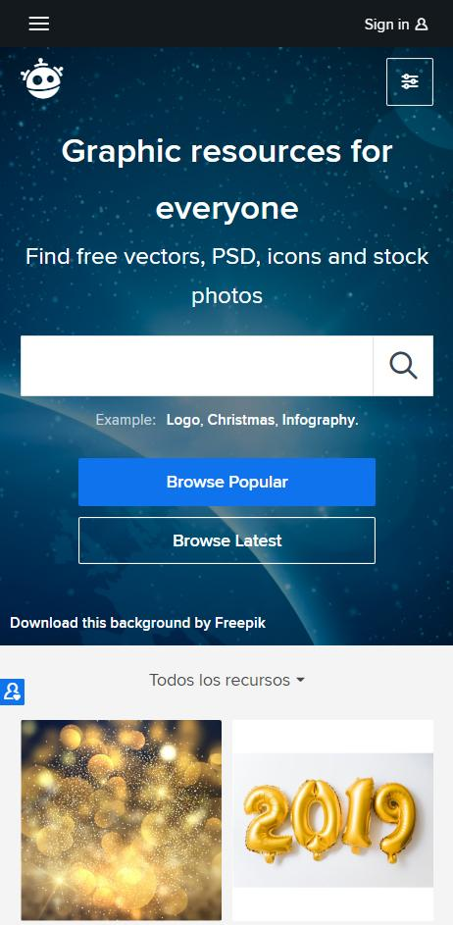
INNOVATIVE APP PITCH DECK
Here is where your presentation begins!
NEPTUNE
Neptune is the eighth planet.

Slide 2
TABLE OF CONTENTS
01
02
03
04
1. POINT
You can describe the topic of the section here
2. POINT
You can describe the topic of the section here
3. POINT
You can describe the topic of the section here
4. POINT
You can describe the topic of the section here

Slide 3
INTRODUCTION
This is the Introduction.

Slide 4
ONE PROBLEM
THIS IS THE PROBLEM

Slide 5
OUR TEAM
NAME
NAME
NAME
You can describe the topic of the section here
You can describe the topic of the section here
You can describe the topic of the section here

Slide 6
01
NAME OF THE SECTION
You can enter a subtitle here if you need it

Slide 7
COMPETITIVE ADVANTAGE
THEM
US
Mercury is the closest planet to the Sun and the smallest one in the Solar System
Neptune is the fourth-largest planet in the Solar System and the farthest one from the Sun

Slide 8
PROBLEM
THIS IS THE PROBLEM

Slide 9
SOLUTION
THIS IS THE SOLUTION

Slide 10
SWOT ANALYSIS
WORDS
WORDS
S
W
WORDS
0
T
WORDS

Slide 11
PRODUCT OVERVIEW
TITLE
TITLE
TITLE
WORDS
WORDS
WORDS

Slide 12
—SOMEONE FAMOUS
“This is a quote. Words full of wisdom that someone important said and can make the reader get inspired.”

Slide 13
02
NAME OF THE SECTION
You can enter a subtitle here if you need it

Slide 14
OUR PLANS
BASIC
PRO
PREMIUM
List your features
List your features
List your features
List your features
List your features
List your features
List your features
List your features
List your features
$30
$50
$70

Slide 15
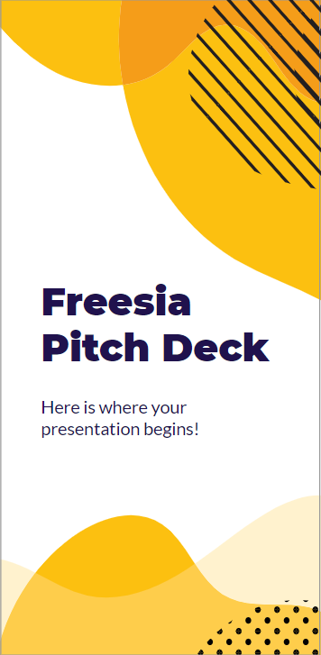
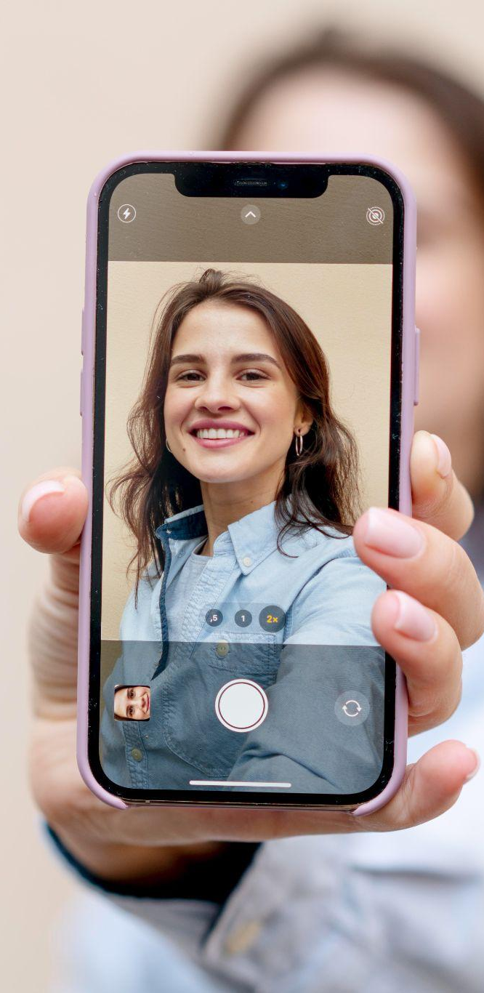
PRODUCT DEMO
INTERFACE
You can replace the images on these screens with your own work. Just delete these ones, add yours and center it properly

Slide 16
CLOSE VIEW
UI/UX VIEW
You can replace the images on these screens with your own work. Just delete these ones, add yours, and center it properly so it looks cool
NEPTUNE
Neptune is the eighth planet.

Slide 17
03
NAME OF THE SECTION
You can enter a subtitle here if you need it

Slide 18
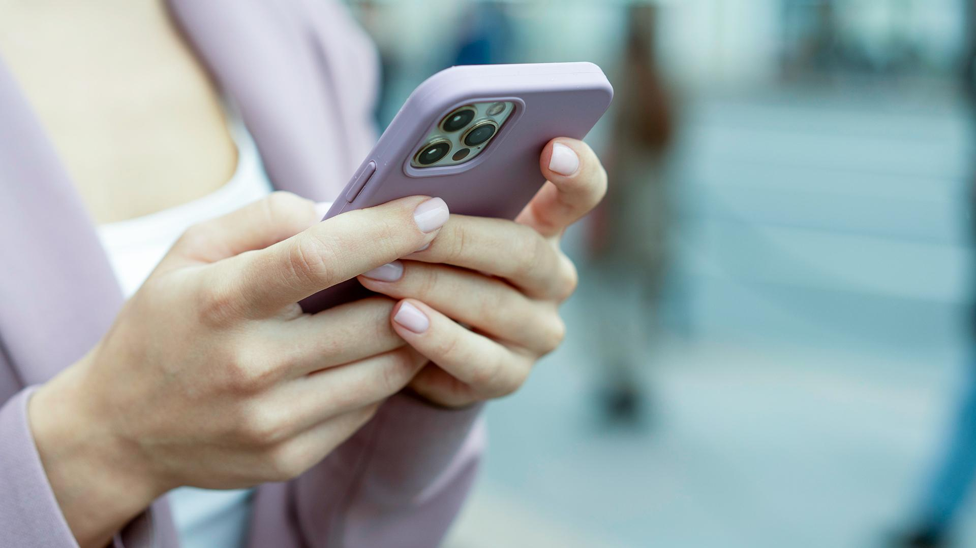
A PICTURE IS WORTH A THOUSAND WORDS

Slide 19
SIGNIFICANT PEOPLE
WORDS
—PERSON
WORDS
—PERSON

Slide 20
321,000,000
Big numbers catch your audience’s attention

Slide 21
IMPORTANT LISTS
You can list your reference websites or publications here
You can list your reference websites or publications here
You can list your reference websites or publications here
You can list your reference websites or publications here

Slide 22
MARKET SIZE
50%
50%
VENUS
MERCURY
Venus is the second planet from the Sun
Mercury is the closest planet to the Sun

Slide 23
04
NAME OF THE SECTION
You can enter a subtitle here if you need it

Slide 24
TITLE
VENUS
SATURN
MERCURY
Venus has a beautiful name and is the second planet from the Sun. It’s terribly hot
Saturn is the only planet with rings. It is a gas giant made of hydrogen
Mercury is the closest planet to the Sun and the smallest in the Solar System
NEPTUNE
JUPITER
MARS
Neptune is the fourth-largest planet in the Solar System
Jupiter is a gas giant and also the biggest planet in the Solar System
Despite being red, Mars is actually a cold place full of iron oxide dust

Slide 25
OUR TIMING
Neptune is the farthest planet from the Sun
Jupiter is the biggest planet in the Solar System
Saturn is composed of hydrogen
and helium
1
3
5
2
4
Venus has a beautiful name, but it’s terribly hot
Despite being red, Mars is actually a cold place

