Slide 1
Operational Efficiency
Analysis Report
Manufacturing Production Line
Prepared: April 24, 2026

Slide 2
Executive Summary
Key findings at a glance
Overall System Efficiency Score: 56.9/100 (NEEDS IMPROVEMENT)
Total Records Analyzed: 16,000
Critical Bottlenecks Identified: 2
Current Avg Processing Time: 55.9 min/step
Projected Improved Time: 55.6 min/step
Expected Improvement: 0.6%
ML Model Accuracy (R2): 0.784

Slide 3
Efficiency Scores by Process Step
Scored on cycle time, wait time, errors, and rework
Material Receiving: 82/100 [EXCELLENT]
Material Inspection: 63/100 [OK]
Pre-Processing: 55/100 [OK]
Assembly: 12/100 [CRITICAL]
Quality Control: 34/100 [CRITICAL]
Finishing & Packaging: 66/100 [GOOD]
Final Inspection: 63/100 [OK]
Warehouse Storage: 80/100 [EXCELLENT]
System Average: 56.9/100

Slide 4
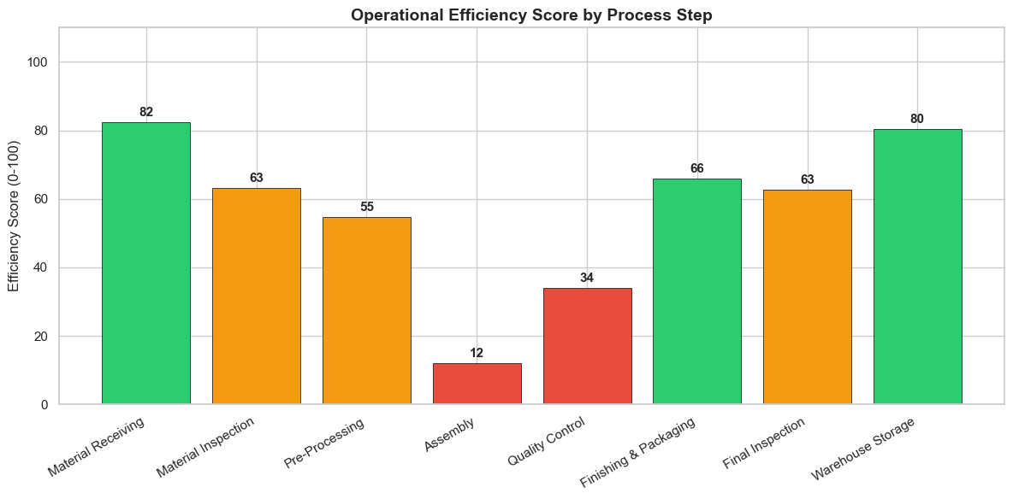
Efficiency Scores Overview

Slide 5
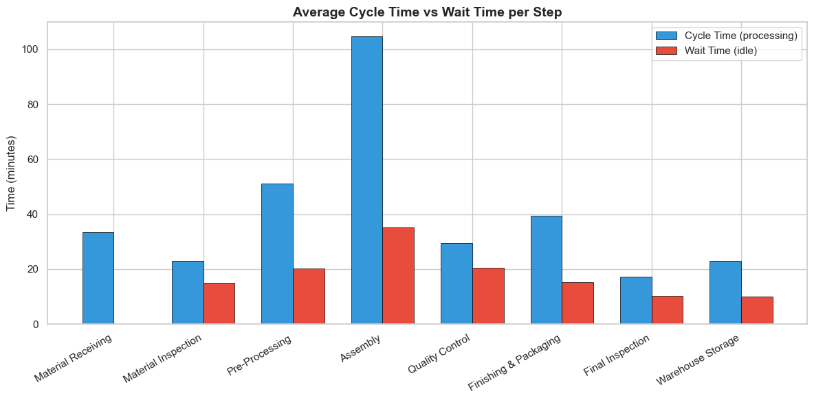
Cycle Time vs Wait Time Analysis

Slide 6
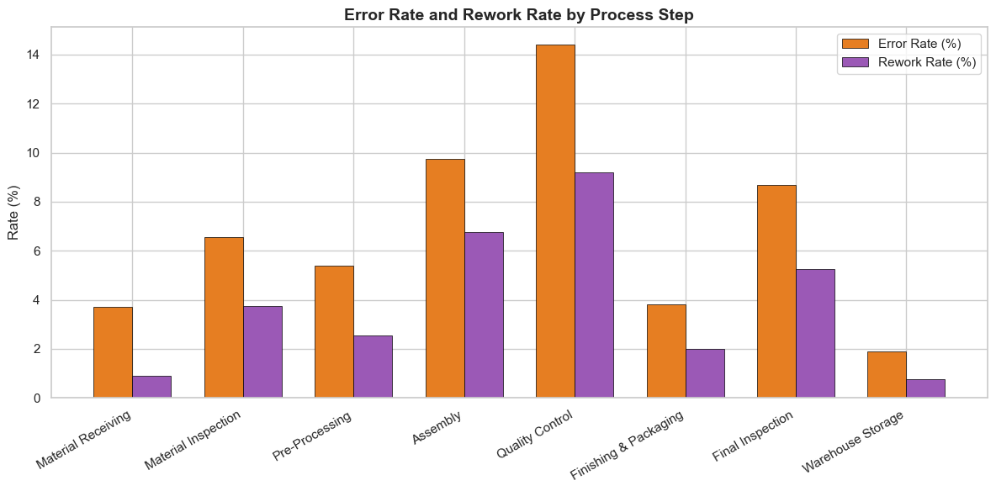
Error and Rework Rates

Slide 7
Bottleneck Analysis
2 critical bottleneck(s) identified
BOTTLENECK #1: Assembly (Production)
Score: 12.1 | Grade: F - Critical
- HIGH WAIT TIME - avg 35 min
- SLOW PROCESSING - avg 105 min
- HIGH ERROR RATE - 9.8% of orders
- HIGH REWORK RATE - 6.8% of orders
BOTTLENECK #2: Quality Control (Quality)
Score: 34.1 | Grade: F - Critical
- HIGH ERROR RATE - 14.4% of orders
- HIGH REWORK RATE - 9.2% of orders

Slide 8
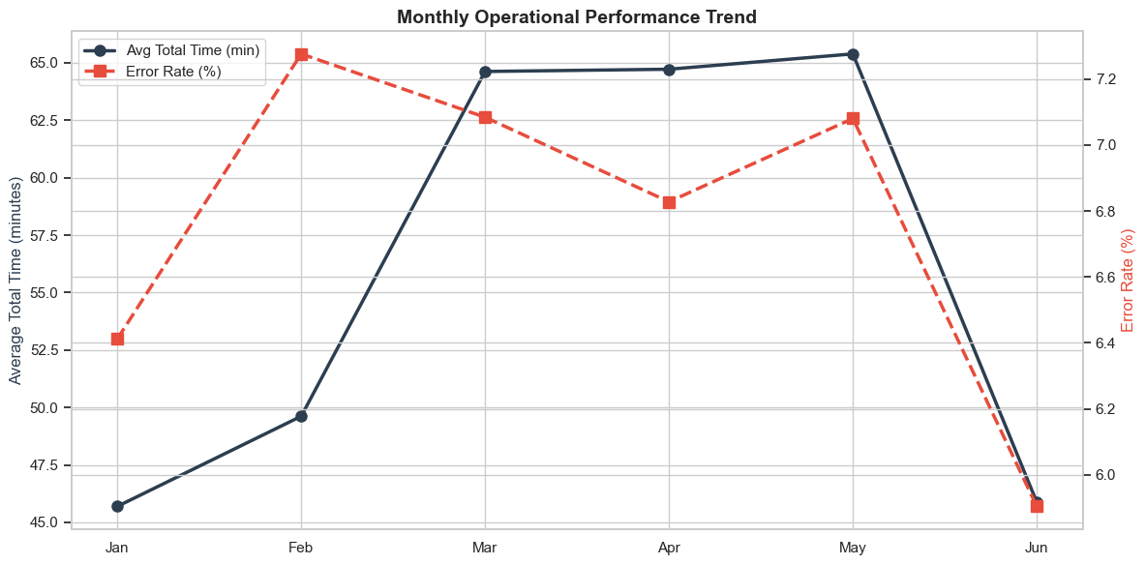
Monthly Performance Trend

Slide 9
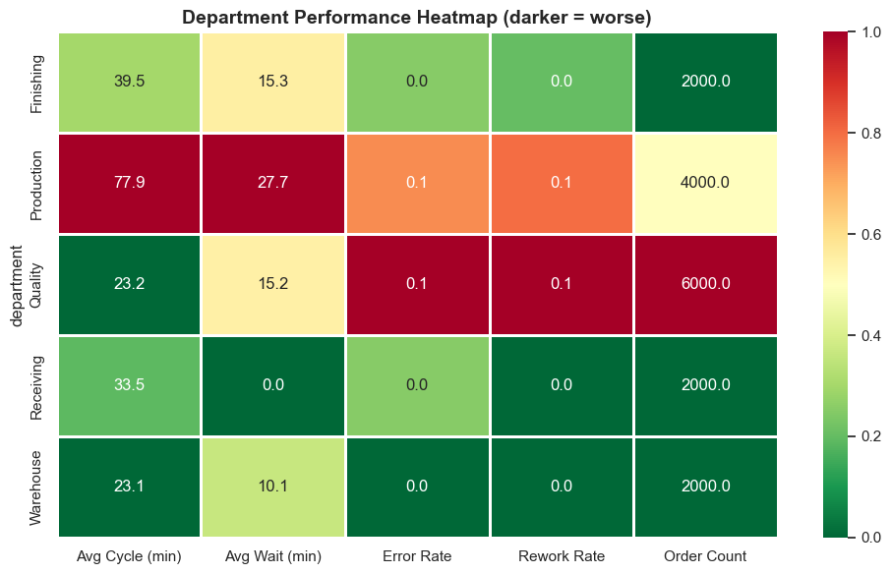
Department Performance Heatmap

Slide 10
Recommendations
Proposed improvements to address bottlenecks
--- Assembly (Production) ---
Current Score: 12.1 (F - Critical)
WAIT TIME Issue:
- Add more staff during peak hours to reduce queue times
- Implement a priority queue system for Express/Rush orders
- Consider parallel processing where possible
SLOW PROCESSING Issue:
- Standardize the process with clear SOPs (Standard Operating Procedures)
- Invest in automation tools (barcode scanners, conveyor systems)
- Provide additional training to staff
HIGH ERROR RATE Issue:
- Implement checklist-based verification at each step

Slide 11
Performance Predictions
ML-powered forecasting
Prediction Model: Random Forest (100 trees)
Model Accuracy: R2 = 0.784, MAE = 12.8 min
CURRENT SYSTEM:
Average processing time: 55.9 min/step
IMPROVED SYSTEM (after fixing bottlenecks):
Projected processing time: 55.6 min/step
EXPECTED IMPROVEMENT: 0.6%

Slide 12
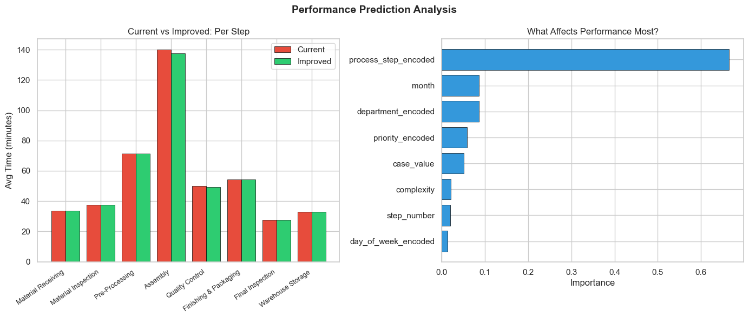
Current vs Improved Performance

Slide 13
Next Steps
Recommended action plan
1. Address critical bottlenecks immediately (F-grade steps)
2. Implement quick wins: checklists, priority queues, SOPs
3. Invest in automation for high-error steps
4. Re-run analysis monthly to track improvement
5. Set target: raise system score from 57 to 75+ within 6 months
Contact: Generated by Operational Efficiency Scoring System

