Slide 1
Data 200 graduate project option 2
Image Classification

Slide 2
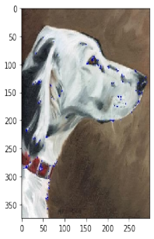
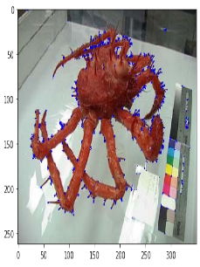
Feature: Corner
Using HarrisCorner method to find corners in the image
Corner_rate as scaler feature for whole image and 4*4 matrix feature for each

Slide 3
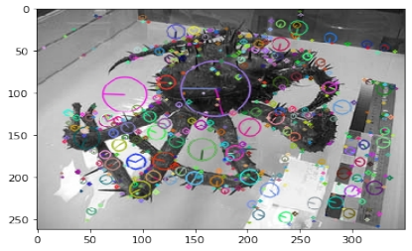
Feature: Sift
Using sift to find image’s keypoints and the descriptor for each keypoint.
Since there are too many keypoint information, use bag of words to cluster them to certain centers.

Slide 4
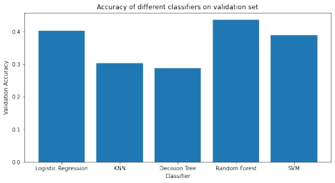
Performance of non-NN models
Random Forest performs best.
Up to 43% acc on validation data

Slide 5
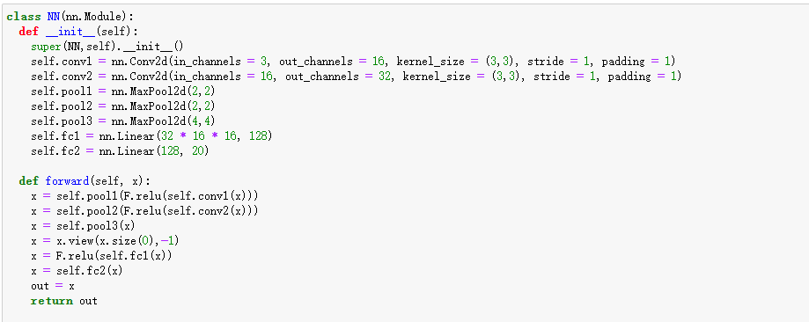
CNN model
Run on colab
Up to 48% acc on validation data

