Slide 1
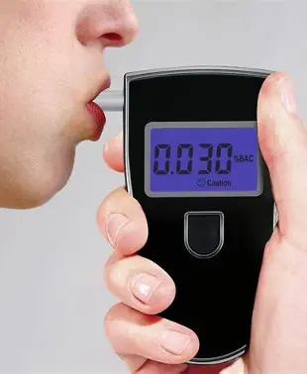
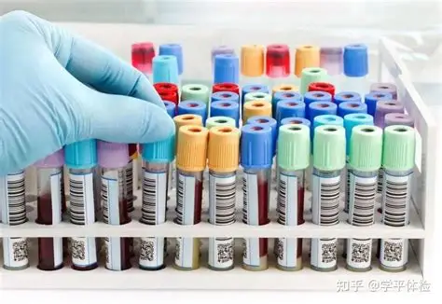

Background: standardized alcohol test
Alcohol impairment is a safety risk far beyond driving
Pre-duty and random alcohol screening is mandated across aviation, rail, trucking, maritime, heavy industry, and healthcare — not only roadside DUI enforcement (e.g., U.S. DOT 49 CFR Part 40).
Established, validated screening modalities
Evidential breath and blood tests quantify breath/blood alcohol concentration (BrAC/BAC) and are the legal standard of proof for impairment.
Standardized Field Sobriety Test (SFST) battery — including Horizontal Gaze Nystagmus — validated by NHTSA as a reliable indicator of BAC ≥ 0.08% (Stuster & Burns, 1998).
Limitation: Shared operating assumption
All of these assume the operator is physically present, a trained administrator is on site, and dedicated hardware is at hand.
Always administrator + site bound

Slide 2
The shift: safety-critical work is moving to remote control
Large under Population & Scaling fast
Nearly 8 million people hold safety-sensitive transportation jobs — pilots, truck drivers, subway operators, ship captains, pipeline controllers, locomotive engineers — all covered by DOT drug-and-alcohol regulations (U.S. DOT).
Remote operation is the fastest-growing edge: 400,000+ FAA-certified remote pilots and ~390,000 registered commercial drones (Aug 2024); the market is forecast to roughly triple to ~$35B by 2028 (FAA UAS data, 2024).
Teleoperated control already runs mining haulage, trucking, and last-mile delivery; “remote driving” is formalized in SAE J3016 and permitted in Germany and several U.S. states (SAE J3016, 2021).
Fitness-for-duty is a hard, safety-sensitive requirement
Aviation treats remote pilots as safety-sensitive — no operation within 8 h of alcohol or at BAC ≥ 0.04% (FAA §107.27 / §91.17); remote-driving guidance likewise mandates licensed operators (e.g., German BASt).
… but current enforcement does not fit the console
Oversight rests on self-certification plus post-incident testing — no operator-side, pre-shift check.
Need = a self-administered, few-second, hardware-free readiness check, enforceable pre-shift and periodically.

Slide 3
Why current smartphone methods fall short as a pass/fail gate
Current approaches rely on voluntary behavior / performance signals
Gait and body sway from phone accelerometers (Suffoletto et al., 2020; Kao et al., 2012), plus typing, reaction-time, attention tasks, and — more recently — voice features.
Why this is insufficient as a “want-to-pass” gate
Gameable — effort and practice can mask impairment when passing unlocks the shift.
Context-bound — they need a task window or a walking scenario, impractical at a seated console.
Wrong target — they measure performance (confounded by skill, fatigue, and practice), not a physiological signature of impairment.

Slide 4
Related work: ocular biomarkers of alcohol impairment
Gaze nystagmus (HGN / VGN) — involuntary, BAC-linked
Alcohol induces involuntary horizontal — and, at higher doses, vertical — gaze nystagmus that the subject can neither suppress nor perceive (Wilkinson et al., 1974).
HGN is the most accurate single component of the NHTSA SFST battery for detecting BAC ≥ 0.08% (Stuster & Burns, 1998).
Pupillary light reflex (PLR) — autonomic, objective
Quantitative pupillometry detects subtle neurological / autonomic impairment in subjects who appear clinically normal (Capó-Aponte et al., 2013); pupillary dynamics shift with alcohol (Jochum et al., 2016).
Most related work:
Using nystagmus + PLR to check drug use using smartphone device link

Slide 5
Our approach: an active, self-administered ocular readiness check
A few-second, self-administered eye test. The operator cooperates, but because pass/fail gates the shift, the test must withstand a motivated “want-to-pass” user.
Involuntary ocular biomarkers (PLR + horizontal / vertical nystagmus)
You can fake alertness on a reaction game, but you cannot suppress nystagmus or balance pupil dynamics — these are under autonomic, not voluntary, control.
Validation
Eric protocol: Multi-stage controlled-dosing ground truth: BrAC, SFST, and the Biphasic Alcohol Effects Scale (B-BAES; Martin et al., 1993).

Slide 6
References
FAA. 14 CFR §107.27 & §91.17 — Operation of a small UAS under the influence of alcohol or drugs. U.S. Federal Aviation Administration.
FAA. UAS by the Numbers — remote pilot certification and drone registration data (2024).
SAE International. (2021). J3016: Taxonomy and Definitions for Terms Related to Driving Automation Systems (incl. remote driving).
U.S. DOT. 49 CFR Part 40 — Procedures for Transportation Workplace Drug and Alcohol Testing Programs.
Stuster, J., & Burns, M. (1998). Validation of the Standardized Field Sobriety Test Battery at BACs Below 0.10 Percent. NHTSA, DOT HS 808 839.
Wilkinson, I. M. S., Kime, R., & Purnell, M. (1974). Alcohol and human eye movement. Brain, 97(4), 785–792.
Suffoletto, B., et al. (2020). Using smartphone accelerometers to sense gait impairments due to alcohol intoxication. Journal of Studies on Alcohol and Drugs, 81(4), 505–510.
Kao, H.-L., Ho, B.-J., Lin, A. C., & Chu, H.-H. (2012). Phone-based gait analysis to detect alcohol usage. UbiComp ’12, 661–662.
Capó-Aponte, J. E., et al. (2013). Pupillary light reflex as an objective biomarker for early identification of blast-induced mTBI.
Jochum, T., et al. (2016). Diverse autonomic regulation of pupillary function during alcohol withdrawal. Drug and Alcohol Dependence, 159, 142–151.
Czajka, A., & Bowyer, K. W. (2018). Presentation attack detection for iris recognition: an assessment of the state of the art. ACM Computing Surveys, 51(4).
Rigas, I., & Komogortsev, O. V. (2015). Eye movement-driven defense against iris print-attacks. Pattern Recognition Letters, 68, 202–208.
Martin, C. S., et al. (1993). Development and validation of the Biphasic Alcohol Effects Scale. Alcohol: Clinical and Experimental Research, 17(1), 140–146.

