Slide 1
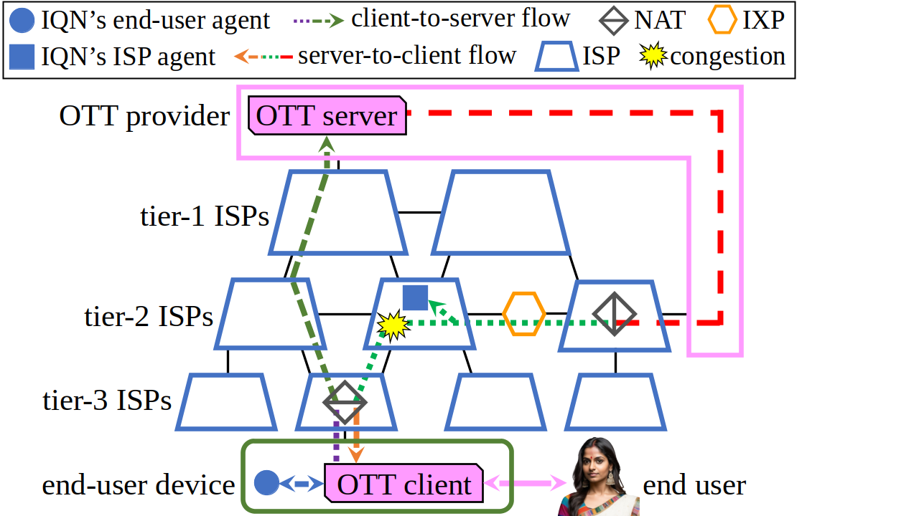

Slide 2
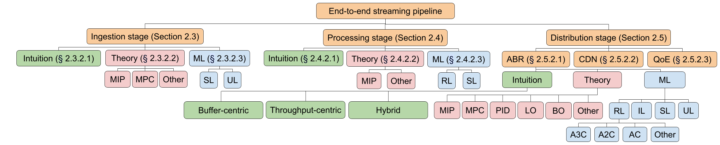

Slide 3
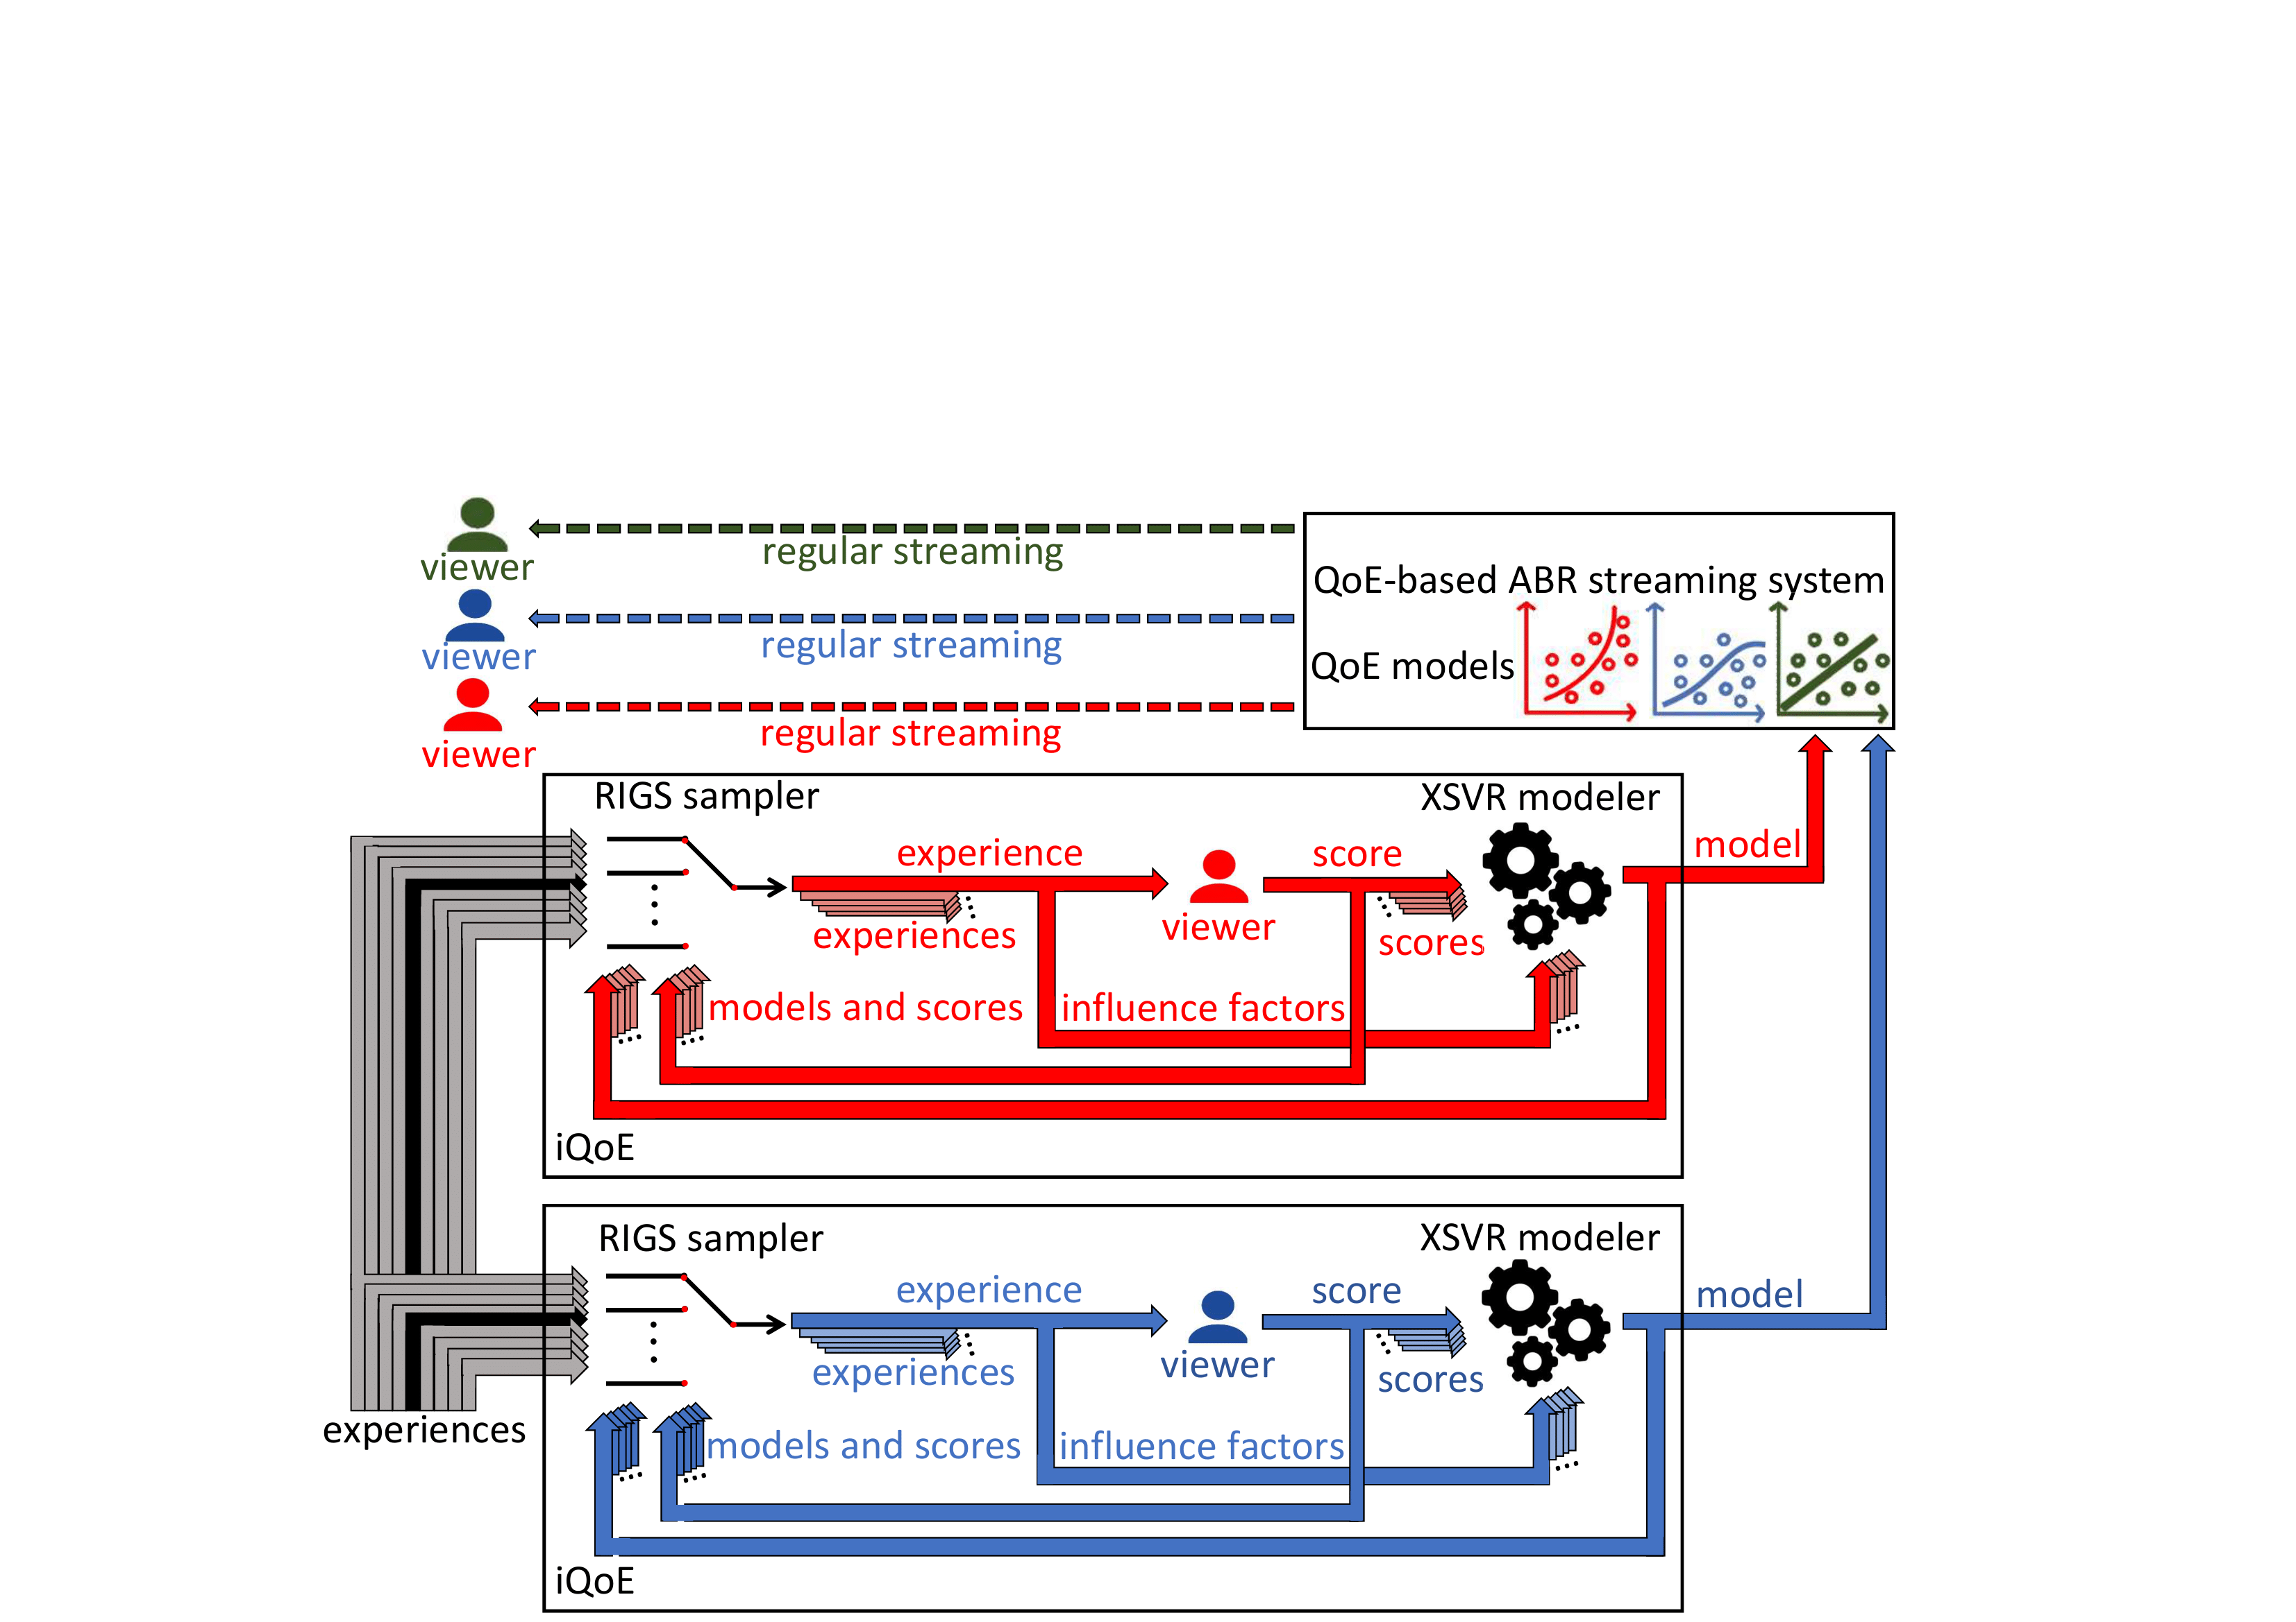

Slide 5
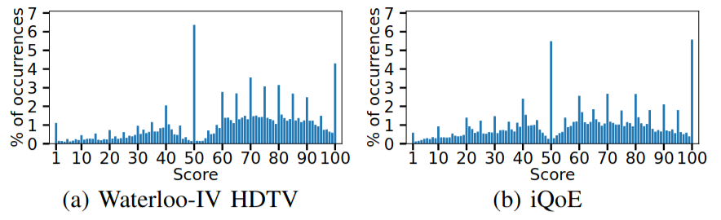

Slide 6
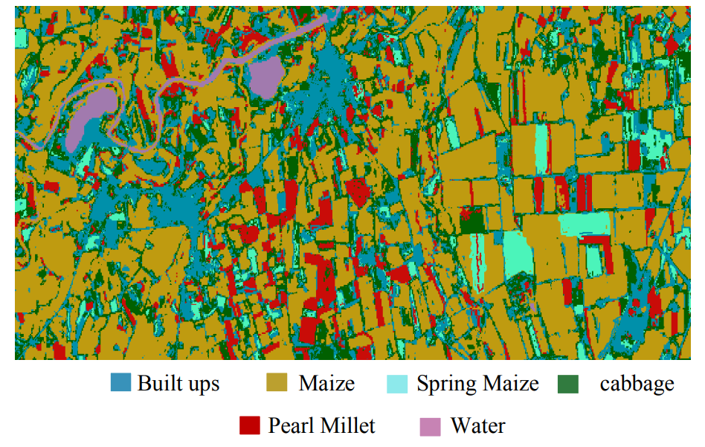

Slide 7


Packet pattern

Slide 8

QoE

Slide 9



Slide 10




Slide 11


Personalized
QoE model

