Slide 1
C/S & P2P

Slide 2
Contents
What does protocol mean?
C/S
P2P

Slide 3
What does protocol mean?

Slide 4
What does protocol mean?
Code Control
Process Control
Three questions
What is the protocol designed to do?
What do the messages mean?
What are the characteristics of the protocol?

Slide 5
C/S & P2P

Slide 6
Client - Server

Slide 7
Overview
Services
Raw data transfer
Encrypted data transfer
Request the catalogue of the server
Features
Multiple services
Process bar that functions successfully while multiple files are transferred.
Multiple threads

Slide 8
Peer to Peer

Slide 9
Overview
Protocol: based on BitTorrent
Programming Framework: Twisted
Features:
Peers may join and leave the torrent at any time
Resume from breakpoint
Rarest first selection
Tracker with low load and high efficiency

Slide 10
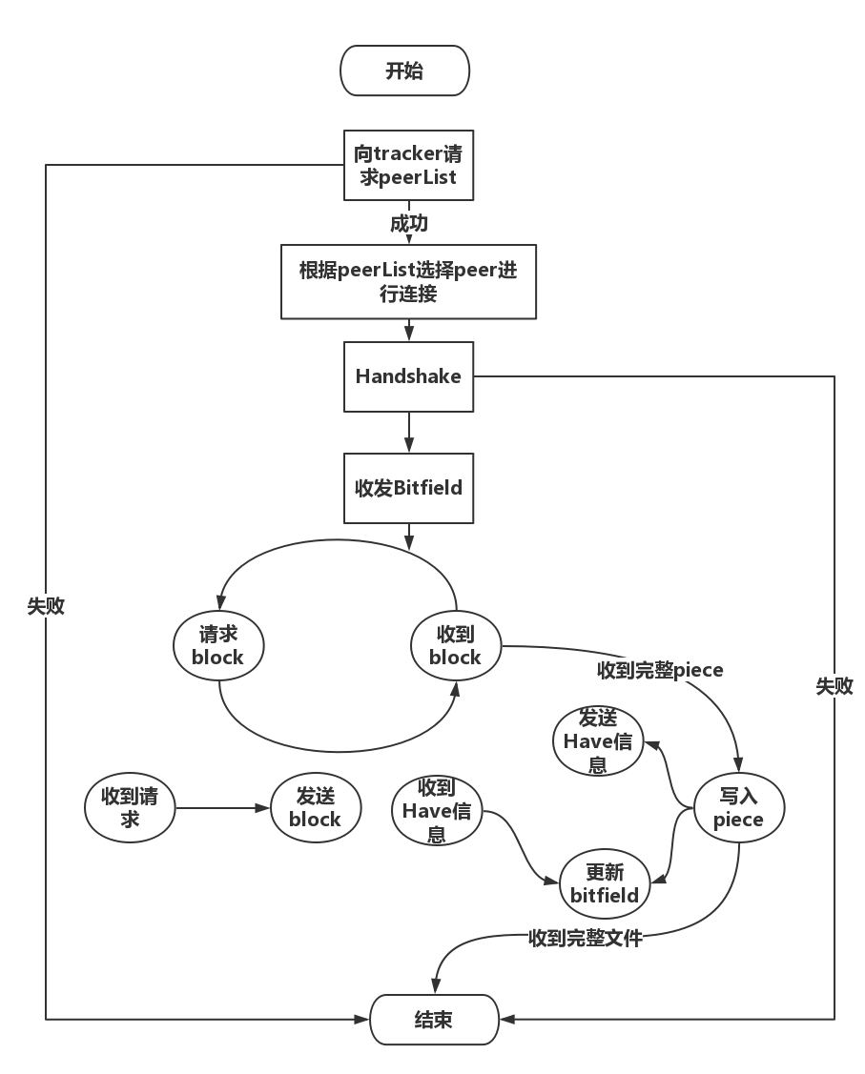

Slide 11
Protocol
Tracker – Client
Tracker with low load
Tracker with high efficiency
UDP instead of HTTP
Compact form of peer list

Slide 12
Protocol
Peer – Peer
Flexibility
Resume from breakpoint
Rarest first selection

Slide 13
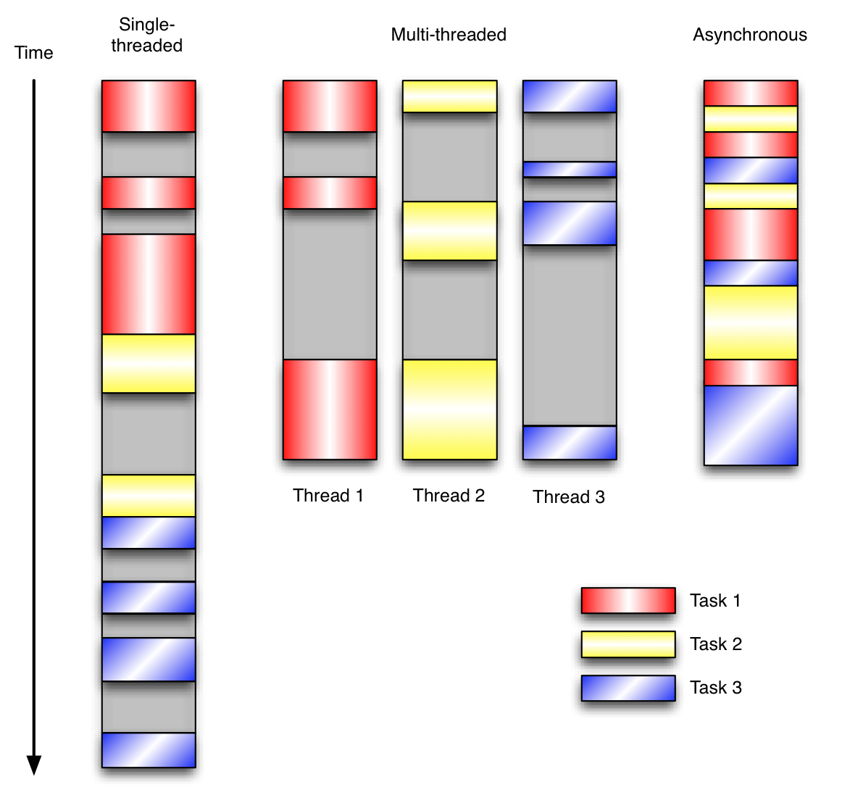
Twisted
Event-driven Programming
Asynchronous

Slide 14
Implementation
Event-driven design
Timer events
Eg. Send keep-alive messages at intervals
Data receiving events
Eg. Receive a “have” msg. -> update the peer’s bitfield
Eg. Receive a “request” msg. -> send a “piece” msg.
Other events
Eg. Finish downloading a piece -> validate & file update

Slide 15
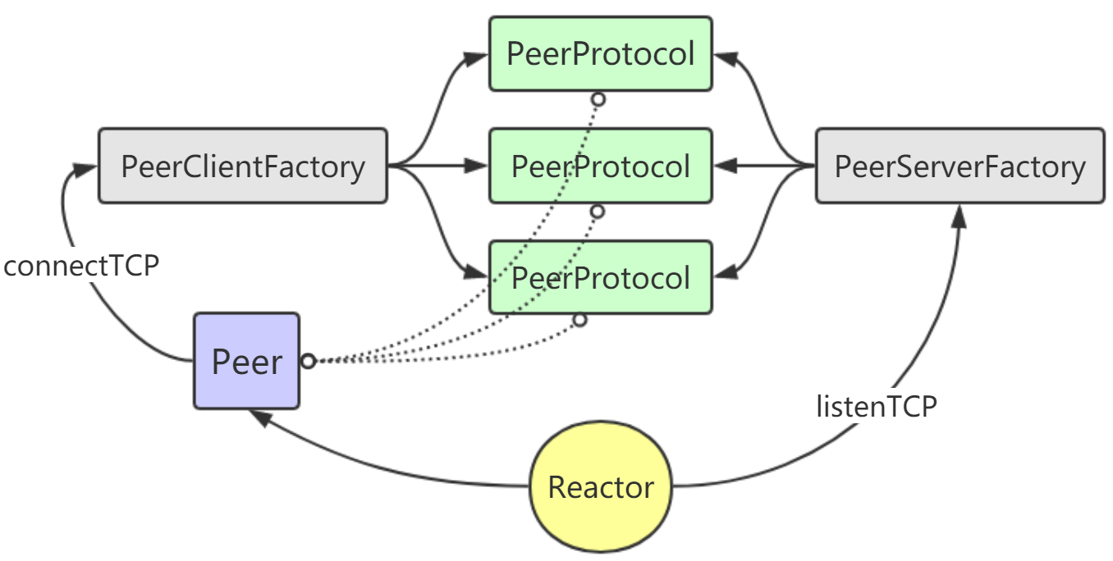
Implementation
Twisted-based framework

