Slide 1
Lab 6
2019/04/29

Slide 2
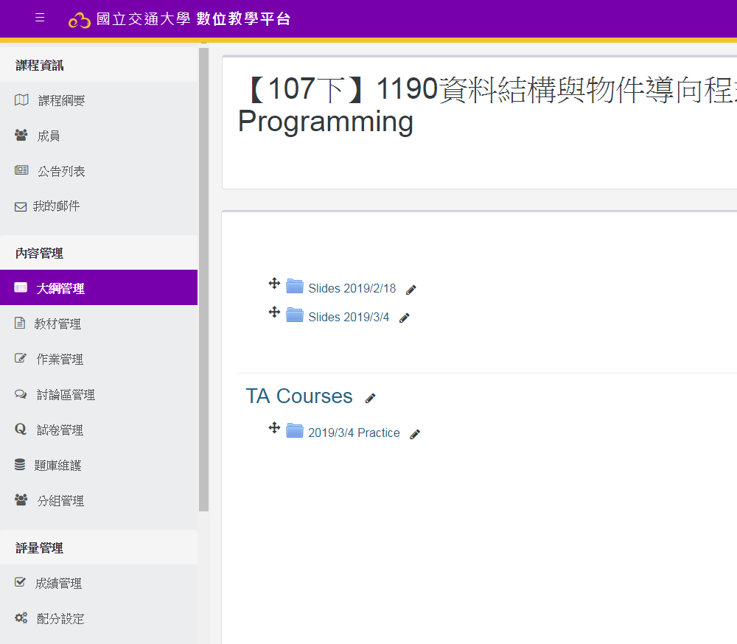
上機 (1)
New E3 課程網頁內
考試時間到才會開啟，
10分鐘內下載完畢
遲到超過10分鐘，該次以0分計

Slide 3
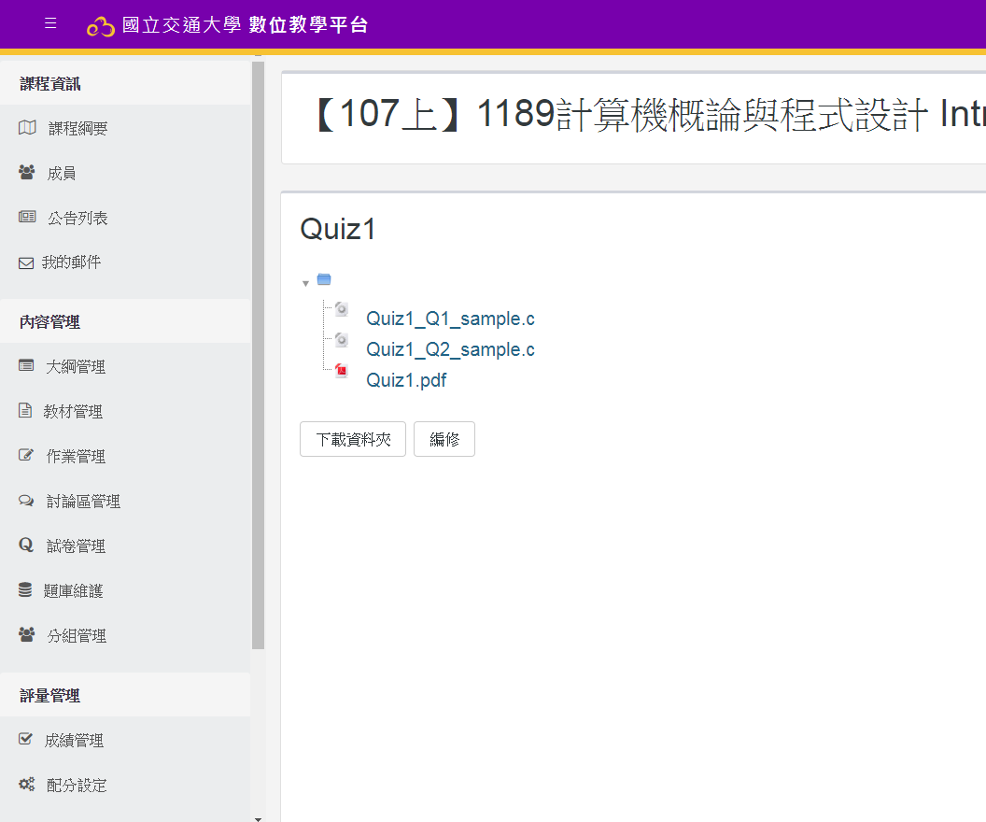
上機 (1)
下載完記得先解壓縮，再開始編寫程式
點擊下載

Slide 4
考試規則
可以翻閱你覺得有幫助的書、講義 (教室會斷網!!)
不得作弊，違者依校規論處
若有格式錯誤的情形，會將該題分數 ×0.8 計算
本次練習都只需繳交 Header file 不得更該 main_Q1.c 中任何內容 繳交時請自行將 Header file 檔名改為 學號 – 題號 如：0756704-1.h 註：不需變更 ifndef, define, include 的檔名
總共只有一次繳交機會，請務必確認格式正確後，再舉手找助教繳交。
行動電子產品 (手機、平板電腦等等)請收在包包內，不要放在桌面上或使用它。

Slide 5
Header file
Header file contains function declarations and macro definitions to be shared between several source files.
For example
In Header file (*.h) , you can add any function or declaration except main function

Slide 6
Q1 – Array
Description
Create a simple class template name Array which contains functions below:
Constructor: set the initial array value and length
Destructor
find_max: return the biggest value in the array.
find_min: return the smallest value in the array.
seek_index: seek and return the index of the input parameter, if the parameter isn’t exist return -1.
calculate: calculate and return a special value by summing up the value in odd and even position (not index!!!!) separately, and subtracts the sum of even position from the sum of odd position.
display: print all the value in the array with following format:
Add “_” (an underline) between each output value
Need line feed in the end(需要換行).

Slide 7
Q1 – Array
Description of input value
Your program is supposed to be able to handle “ int ” and “ double ” format
First value represents the datatype of test data :
if it’s 1, the input will be integer; otherwise, double
Second value represents the length of the array
Then the following values are the values of array
Last two values are the values which are going to be sought

Slide 8
Example
Sample Input1
Sample Input2
Sample Output1
Sample Output2
1
6
7 235 128 497 32 331
497 7
7_235_128_497_32_331
-896
3_0
7_497
2
4
0.5 9.5 4.77 -2.55
12.7 0.5
0.5_9.5_4.77_-2.55
-1.68
-1_0
-2.55_9.5

Slide 9
Q2 – FindSum
Description
Given an array of numbers and a specific sum, print out the pairs whose value add
up to the sum. Your program is supposed to be able to handle “int” and “double” format.
[Caution] In the following example, only consider the first pair that adds up to the sum. From the Sample Input 1,we know that 3 comes before 7. Thus, only consider the (3,7) pair and (7,3) will not be considered. Also, only allow the pair appears once.

Slide 10
Q2 – FindSum
Description of input value
The input will ask user to type 1 or 0, which stands for finding sum for int array and double array respectively. Also, it will ask user to enter the sum.
The range for element in int array is (-500~500)
The range for element in double array is (-500.0~500.0)
Description of output value
The output should show all the possible pairs with the following requirement.
Add “_” (an underline) between the elements in each pair
Need line feed in the end(需要換行)
Show total amount of pairs

Slide 11
Example
Sample Input1
0
4 6 3 7 1 5 8 2 9 20 4 3 7 3 6
10
Sample Output1
4_6
3_7
1_9
8_2
4
Sample Input2
1
2.5 8.5 6.5 15.5 26.0 31.5 4.5 6.5 17.0 23.5 15.5 30.0 2.5 17.0 1.0
32.5
Sample Output2
2.5_30
6.5_26
15.5_17
31.5_1
4

Slide 12
Q&A

