Slide 1
Homework 1
Computer Vision 2023 Spring

Slide 2
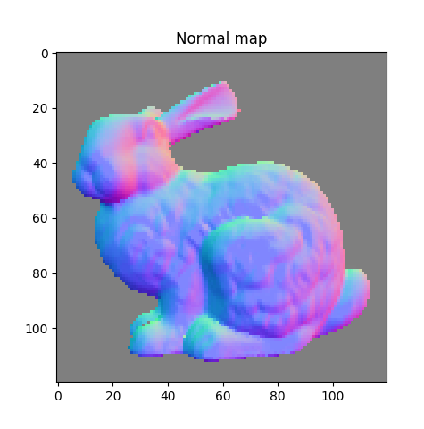
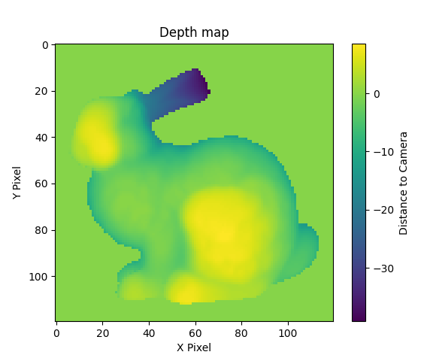
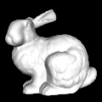

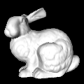
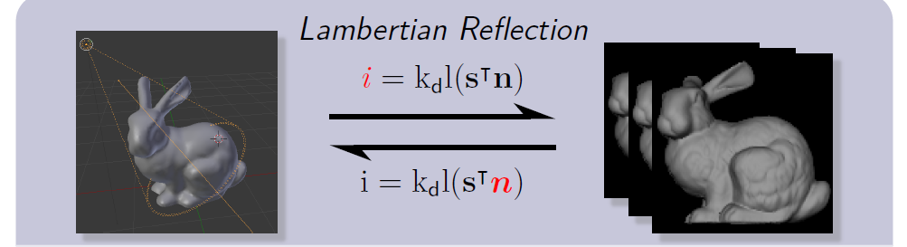
Photometric Stereo
Notes:
HW1 is Photometric Stereo, you need to use grayscale image lighting from different direction to compute the normal vector and use normal vector to reconstruct the 3D surface of model.
In this HW you may get 6 grayscale image and a text file storing the information of direction of light and we assume that the surface of model is Lambertian surface.

Slide 3
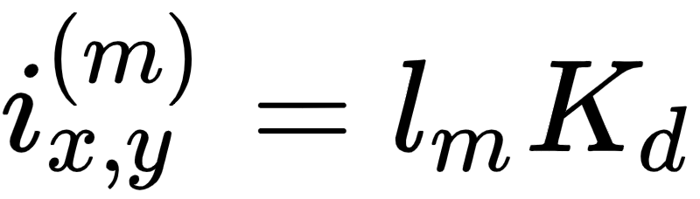

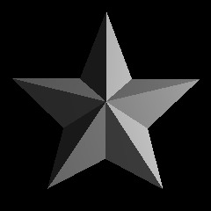


Normal Estimation
According to the reflection model, we suppose that the unknown normal vector n and the intensity i in the mth image at pixel (x,y) will satisfy the equation. Kd is the coefficient of material , l is the “unit vector” of light vector
Notes:
According to the reflection model, for every pixel the unknow normal vector will satisfy the equation below. In this equation i is the intensity or color of pixel and l is the unit voctor of light , Kd is a constant coefficient represent the material of surface and n is the normal vector.

Slide 4
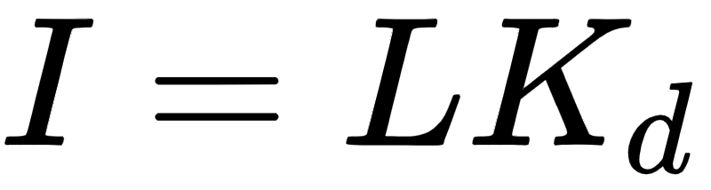



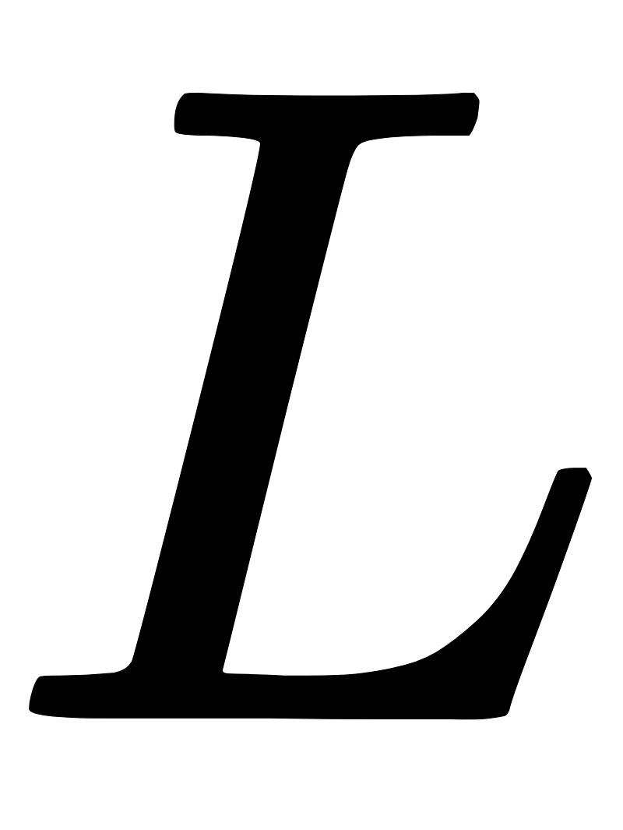

Normal Estimation
Assume we have m images and image width is w and height is h
We can construct an over-determined linear system and solve it to get the normal vector of every pixel
3
m
m
w * h
w * h
3
Notes:
Assume we have m images . we can expand the equation to a over-determinded linear system like below.
Every row of matrix I represent one image and every row of L represents the light direction of image we can construct I and L from provided data.
And because Kd is a constant also unknow here , we combine it with N to single matrix and try to find out this unknow matrix.

Slide 5
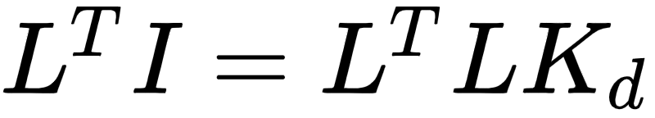
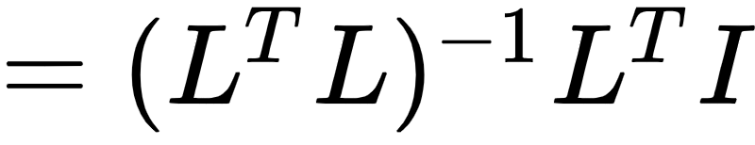
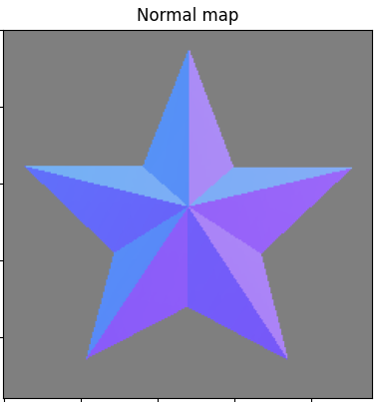
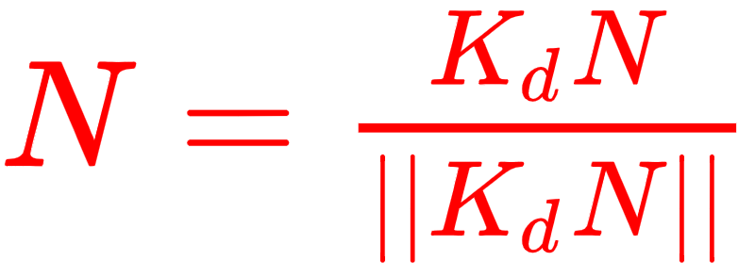
Normal Estimation
Solving this equation through pseudo-inverse (or QR , SVD decomposition)
The result is KdN but we need “unit normal vector”.
Fortunately for n(x,y) , Kd(x,y) is a constant so we can directly apply vector normalization on KdN(x,y)
Notes:
We can solve this equation through pseudo-inverse (or QR , SVD decomposition) to get KdN , Kd is unknow but it’s a constant. So we can apply vector normalization on every normal of N to get unit normal vector.

Slide 6
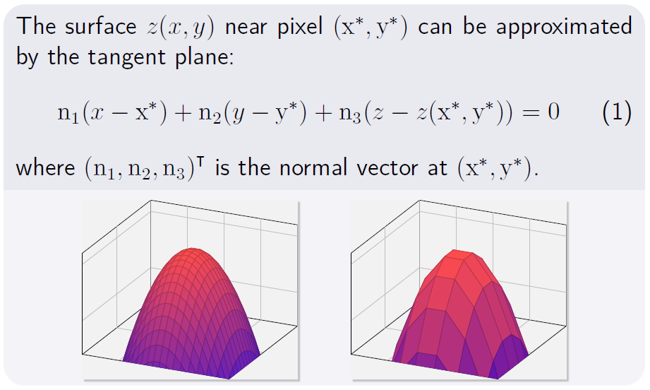
Surface Reconstruction 1.
Notes:
After we get unit normal vector , we can use it to calculate the Z value and reconstruct the surface. Here we give you two idea to calculate the Z value.
First idea is that a normal vector can be represent to a tangent plane

Slide 7
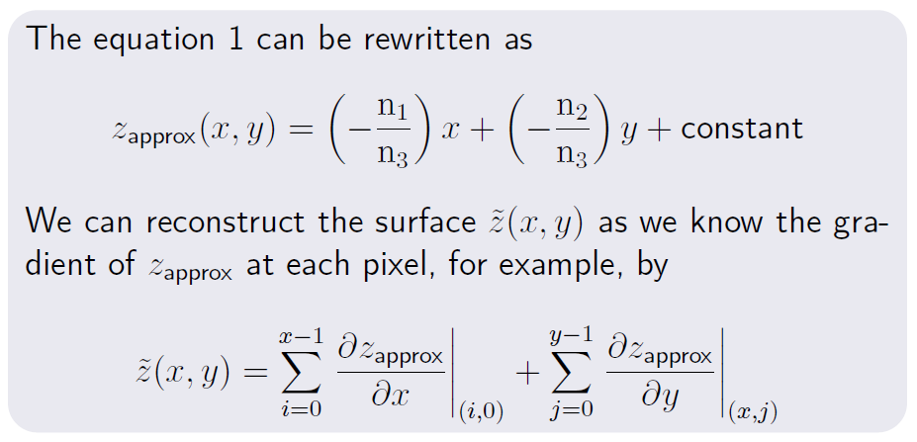
Surface Reconstruction 1.
Notes:
Simplifying it we can get this equation. This equation is simply to calculate its gradient. You can only use normal vector to get it. Because gradient means the change of z value at pixel x,y , we can accumate the gradient from initial point to pixel (x,y) to approximate the Z value of this pixel.

Slide 8

Surface Reconstruction 1.
Other Tips
You may need to use some method such like integral from different direction or begining at different initial point and average those result to let surface more smooth
Sanity Check
Notes:
Although this way is easy but there is a problem. If the point is far away from initial point it may exist huge error. So you may need to think out other method to reduce this error.
Maybe you can do the integral from different direction or beginiing at different initial point. the initial point can be any place such like on the left right corner or center depending on programmer. or do the sanity check, check its second partial derivative

Slide 9

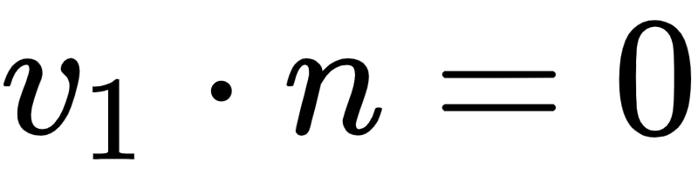
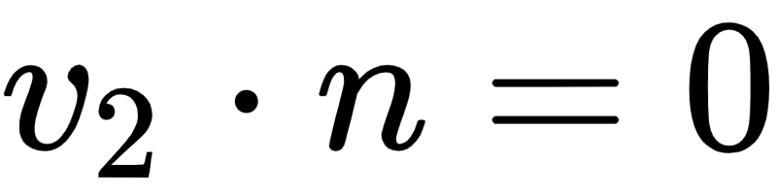
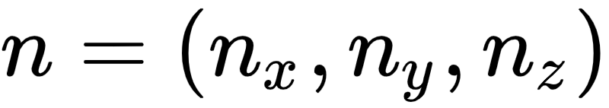
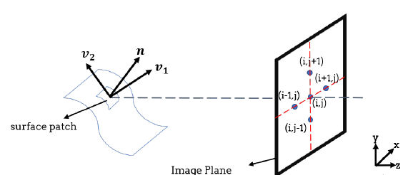


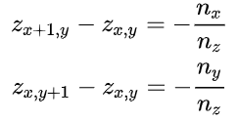
Surface Reconstruction 2.
The Normal n must be orthogonal to the vector v1 & v2
Reference : https://pages.cs.wisc.edu/~csverma/CS766_09/Stereo/stereo.html
Notes:
The second idea is that the any two vector on surface must be orthogonal to the normal vector. So we can use two vector v1 and v2. These two vector are parallel to surface. So the dot product of these two vector and normal vector must equal to 0. And for every pixel we can get these two equations.

Slide 10

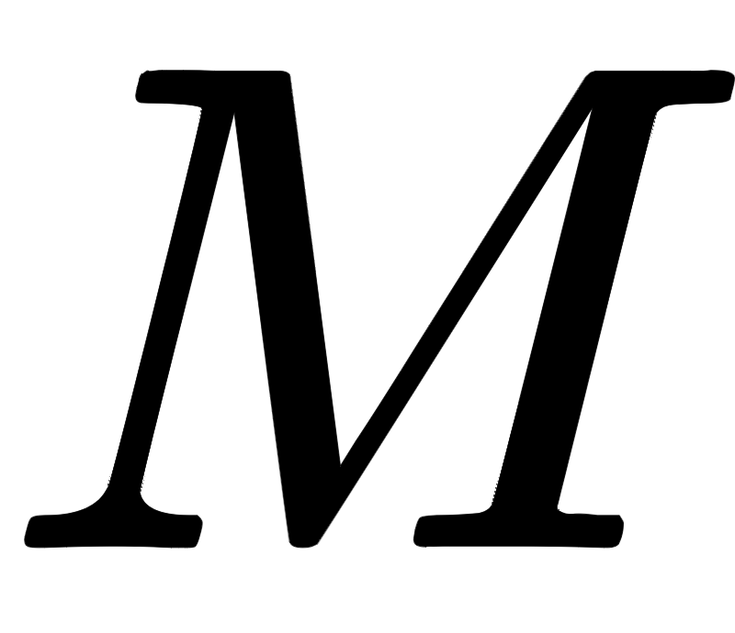
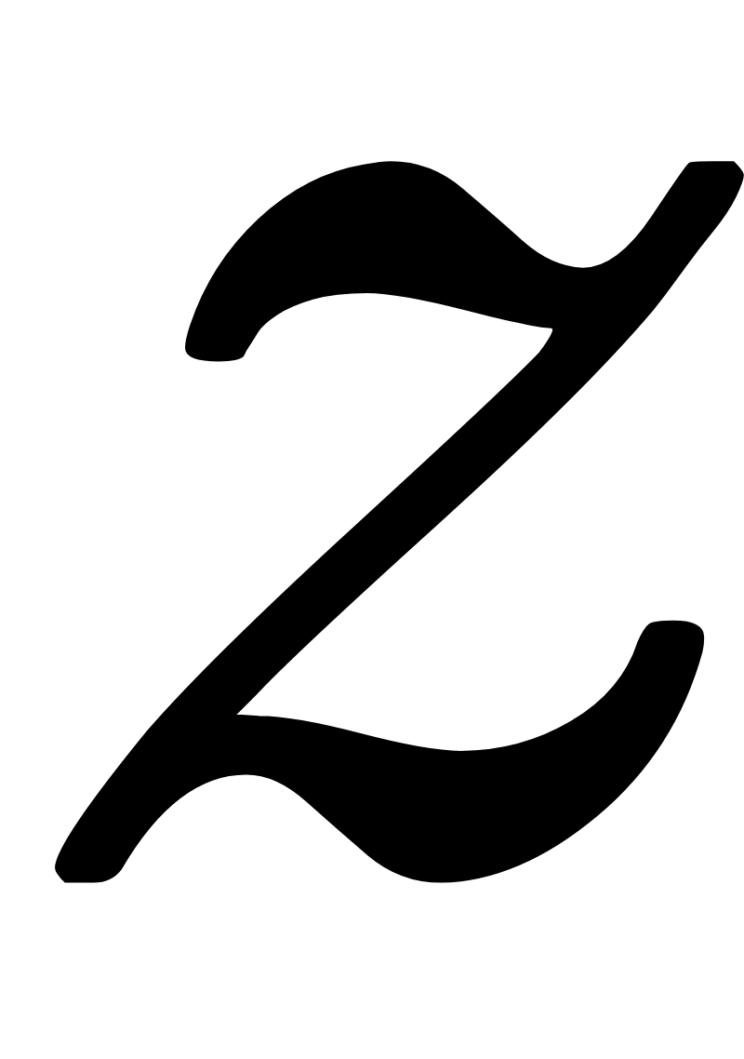
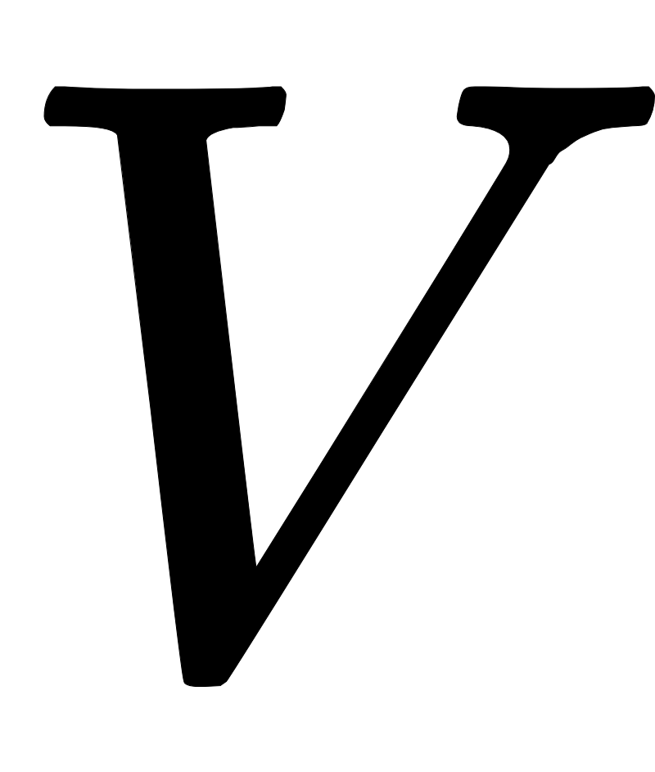
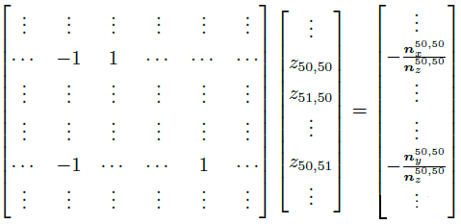
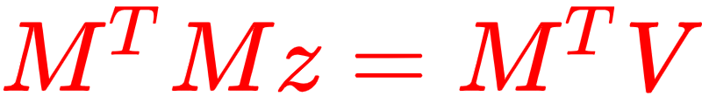
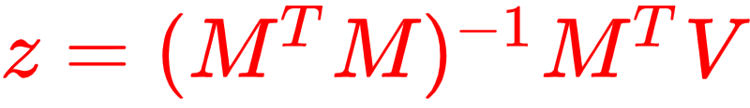
Surface Reconstruction 2.
We can use this two equations of every pixels to construct a linear system M may be a big sparse matrix (Let image size S = image width * image height)
We can use pseudo inverse again to solve it
2S x S
S x 1
2S x 1
Notes:
Again we can expand these two equation to construct another linear system and use pseudo inverse to get z value.
Here need to becareful that the matrix M is a big sparse matirx , every row only contains two element, you may need some data structure to save the memory.

Slide 11

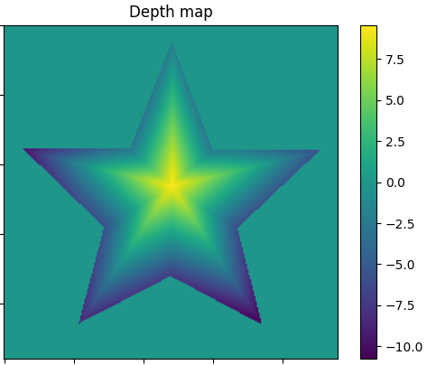
Surface Reconstruction 2.
Other Tips
You may need to eliminate some pixel already known its depth value is 0 to reduce the size & complexity of
You can create a “mask” to focus on those unknow depth
Notes:
You may need to eliminate some pixel already known its depth value. As you see , after you get normal vector of every pixel we can confirm some z value must be zero. And you don’t need to calculate those value again , so you can use a mask to reduce the size and complexity of linear system and let it focus on thoes unknow pixel.

Slide 12

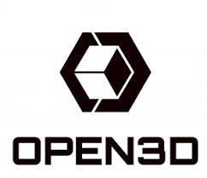

Install
Python 3.6
OpenCV : http://opencv.org
pip install opencv-python
open3D: http://www.open3d.org/
pip install open3d
matplotlib: https://matplotlib.org/
pip install matplotlib
You can install other library which you are family with for solving linear equation ( But don’t use the library directly complete the photometric stereo or you may not get score)
Notes:
This homework we use python and provide some function for visualization and saving the result to Polygon File Format(ply file)
So you need to install below three library and you are allow to use the library you are family with to solve the linear equation. But don’t use the library directly complete the photometric stereo or you may not get score.

Slide 13
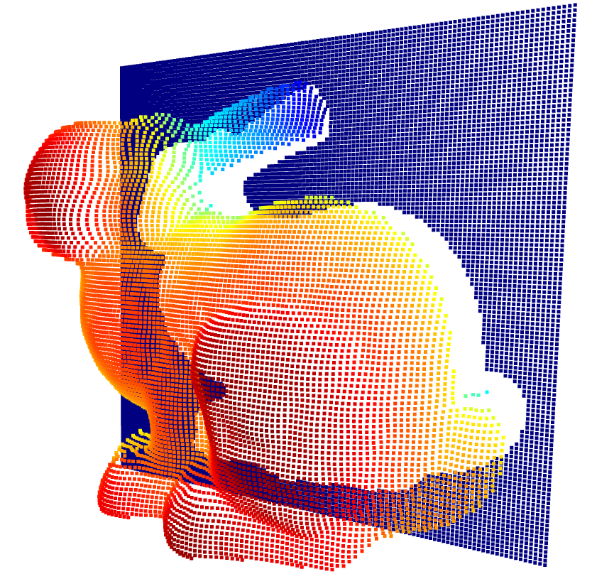
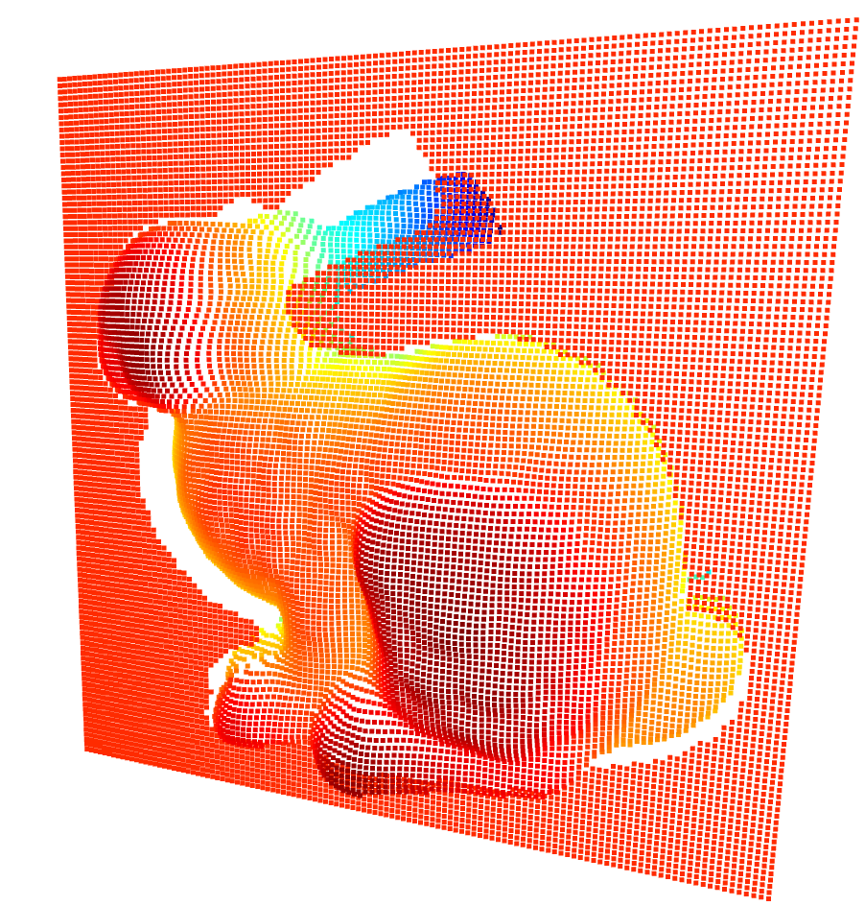
Input & Output
Input:
3 case (bunny , star , venus)
6 .bmp image
LightSource.txt
Output:
.ply file(Polygon File Format)
(named as bunny.ply , star.ply , venus.ply respectively)
using the open3D to output ply file
You can use the function "save_ply()" we provide (this function may set 0 depth vaule to minimum depth value let whole model float on a plane)
If you don’t like the way to display whole model floating on a base plane, you can change the way to save ply file. The only limitation is that the ply file need to be able to open and show the result by “show_ply()” function.
Notes:
This homework there are three case you need to reconstrut the surface of these three model and for every case you need to read 6 bit map images and a lightsource text file containing the information of light vector.
and you need to output Polygon file format (which filename extension is .ply). For output you can use the function we provided, save_ply to output the result or if you don’t like the present of this function. you can write it by yourself. The only limitation is that the ply file must be able to be opened by the function show_ply().

Slide 14
Grading
60% Reconstruct surfaces of “bunny” & “star” data (30% / per data) (let surface smooth as possible as you can. The score you get will depend on the quality of your reconstructed surface)
20% show the normal map and depth map of “bunny” & “star” in report. (5% each)
10% Simply explain your implementation and what kind of “method” you use to enhance the result and compare the result (in report)
(Don’t just paste the code with comment)
10% reconstruct surfaces of “venus” (This case you may need to find some ways to deal with some extrem normal result, or you wont’s get full score.) and explain in report. (we may treat “venus” more strictly than “bunny” & “star”)

Slide 15
Deadline
Deadline : 2023/03/23 (四) 11:59 pm
Please zip the all files and name it as {studentID}_HW1.zip : ex. 311553000_HW1.zip (wrong file format may get -10% panelty)
Zip file format:
1. {studentID}_report.pdf
2. bunny.ply, star.ply, venus.ply
3. your code
Penalty of 3% of the value of the assignment per late day
late one day : your_score * 0.97
late two days : your_score * 0.94 …
If late, you need to notify all TAs through e-mail or you won’t get scored.
Feel free to ask questions on E3 forum, or send e-mails through E3 platform to all TAs for personal questions.

