Slide 1
Quantum computing for image recognition via convolutional neural networks
Leopoldo Morante Castillo

Slide 2
Outline
Classical CNNs
Quantum Convolutional Neural Networks
Quantum-enhanced CNNs: Quanvolutional Neural Networks
Residual Quanvolutional Neural Networks

Slide 3
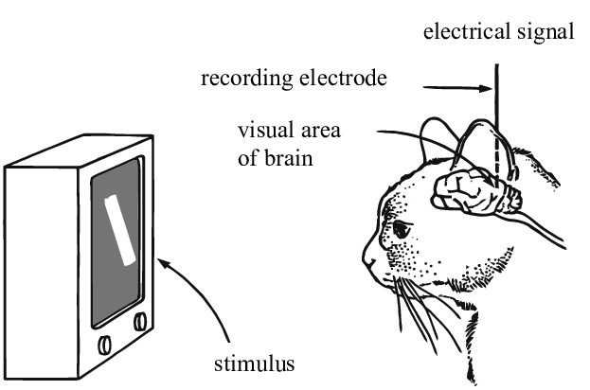
CNNs are neural networks designed to work with images.
The CNN architecture is inspired by biology
Hubel and Wiesel
Nobel prize winners for discoveries in how the visual system processes information.
Kunihiko Fukushima
Neocognitron was one of the first neural network architectures to introduce these ideas to solve pattern recognition tasks.
Yan LeCun
CNN architecture and training process as we know it today.

Slide 4
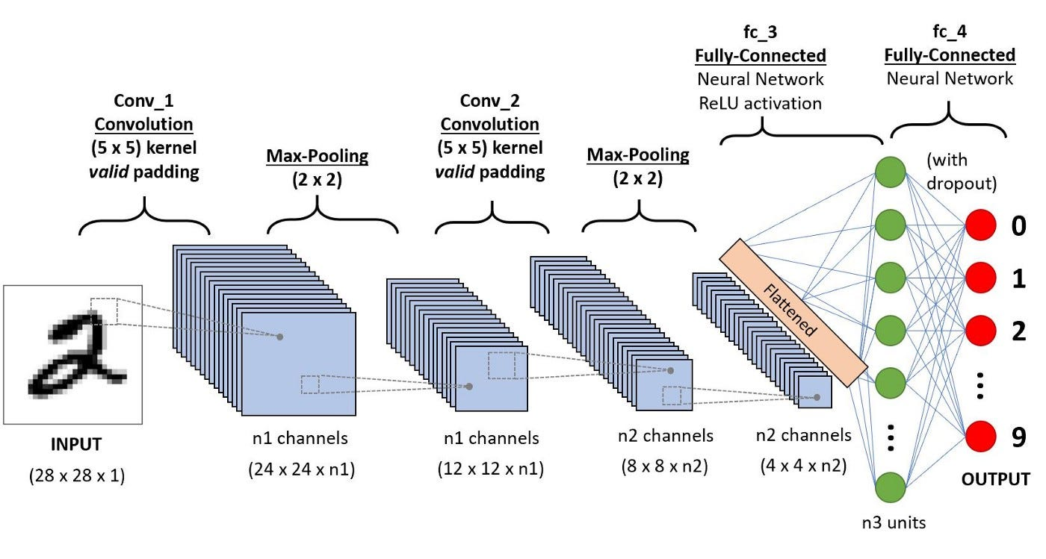
The CNN architecture
Feature extraction stage
The image goes through convolution layers and pooling layers.
Its purpose is to extract important features from the input image, so the classification stage can use it.
Classification stage
Flattens the features found into a vector and then uses a fully connected layer to do the classification.

Slide 5
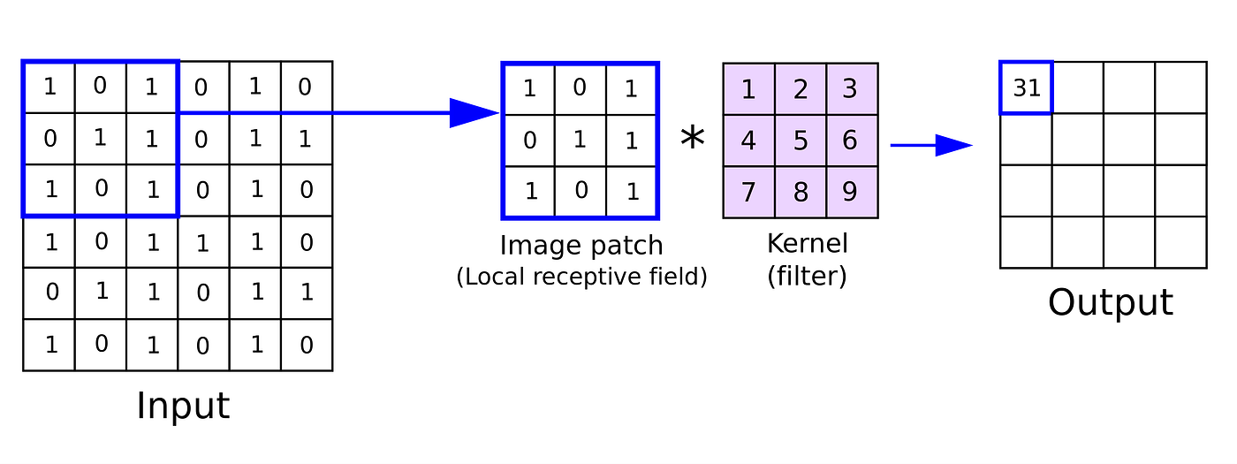
The convolutional layer
Its role is to extract spatial patterns / features.
It’s composed of several filters which are learnable matrices.
They are used to compute the convolution: an element-wise product between the elements of the filter and a block of data which is then summed up.
The output of a convolutional layer is called a feature map. It reflects how well and where within the image the filter detected some pattern.
It’s usually followed by an activation function like ReLU.

Slide 6
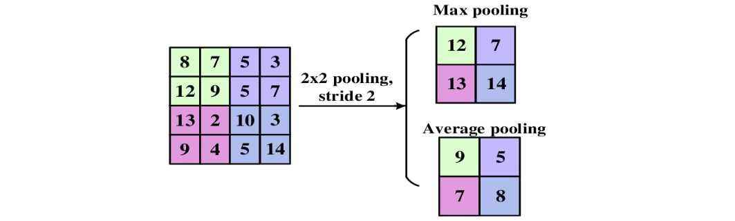
The pooling layer
Its role is to reduce the number of features
Helps to reduce computational cost, memory cost and to avoid overfitting.
There are different types, but the most common ones are max pooling and average pooling.

Slide 7
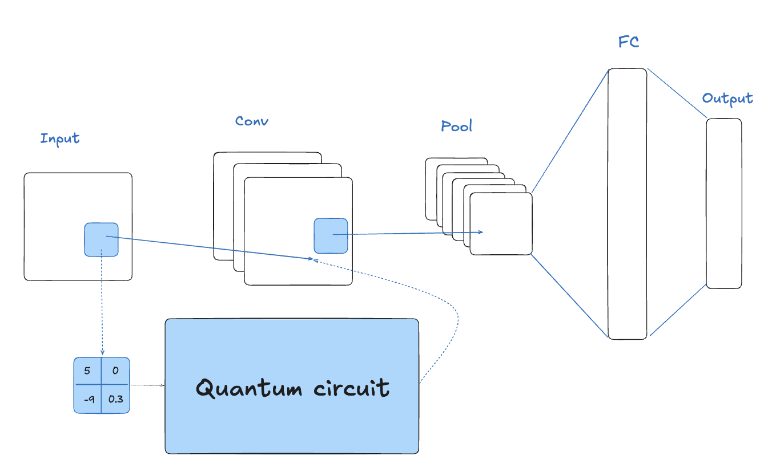
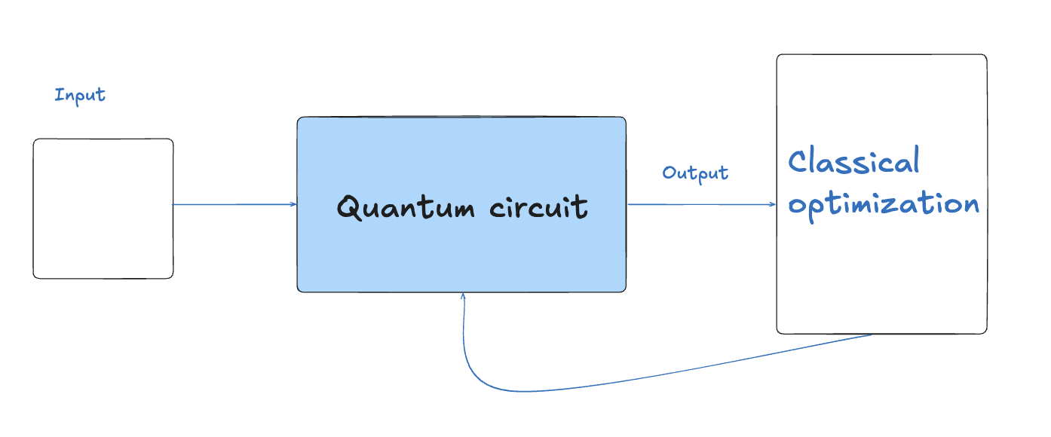
Two paradigms to mix quantum computation and image classification
Quanvolutional Neural Networks
Quantum Convolutional Neural Networks

Slide 8
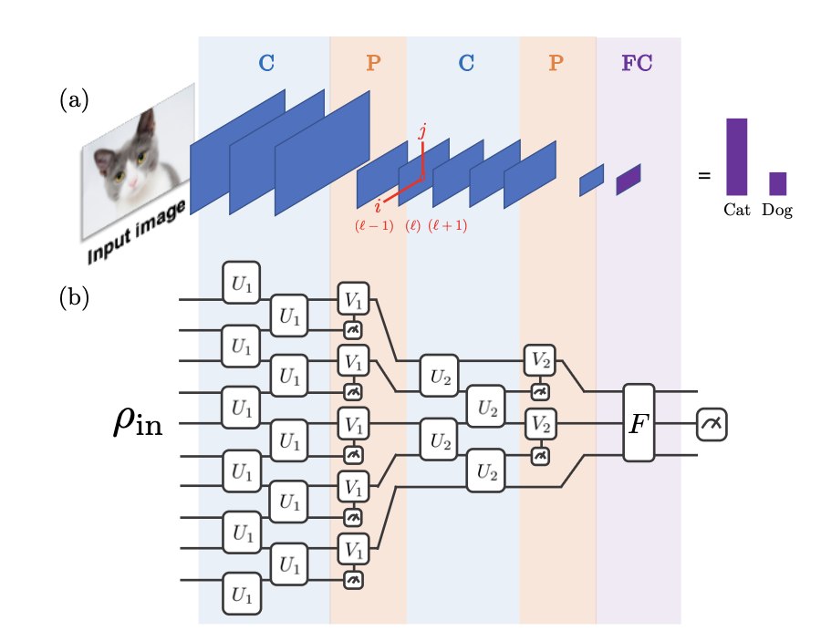
The first Quantum convolutional neural network model
Proposed by Cong et al. in 2019.
Is a Variational Quantum Circuit
Motivated by the classical CNN architecture.
Convolutional layers = Applying unitary gates in a translational invariant manner. Gates are applied to pairs of adjacent qubits.
Pooling layers = Measuring a fraction of qubits and applying unitary rotations depending on output.
Fully Connected layer = Applying a unitary F on the remaining qubits.
Output is obtained from measuring some fixed number of qubits.
Used in the paper for physics tasks
Quantum phase recognition

Slide 9
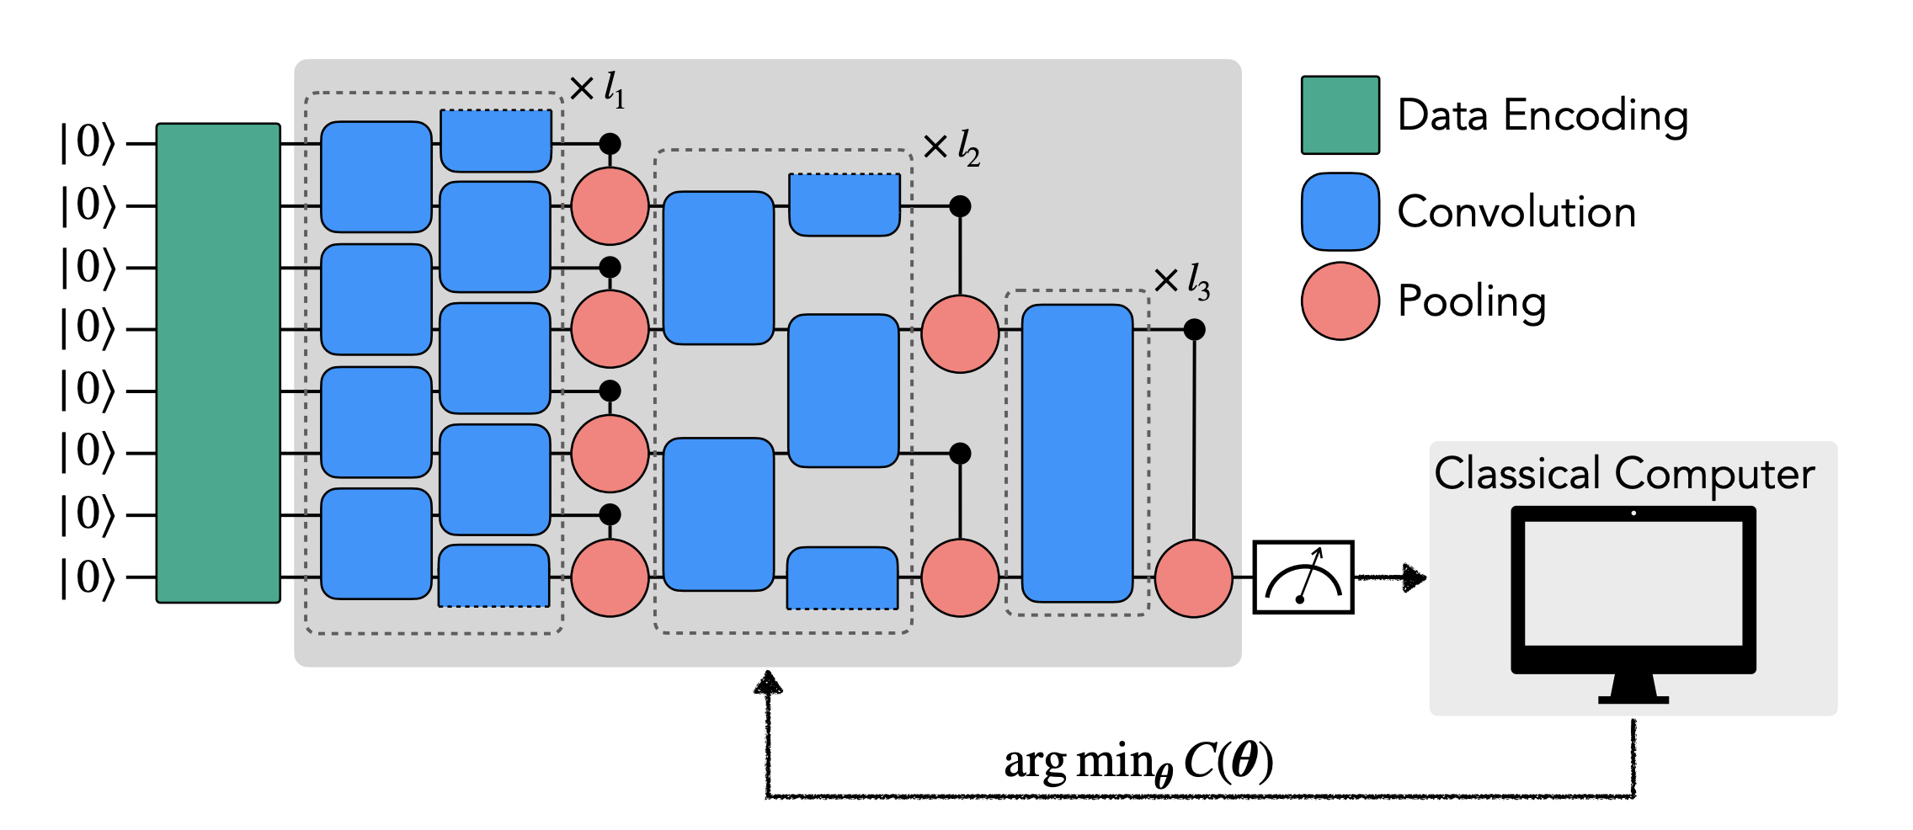
Quantum convolutional neural network for image classification
Different implementations, but all try to maintain the main ideas of convolution and pooling.
We will work with the one proposed by Tak Hur for MNIST classification.

Slide 10
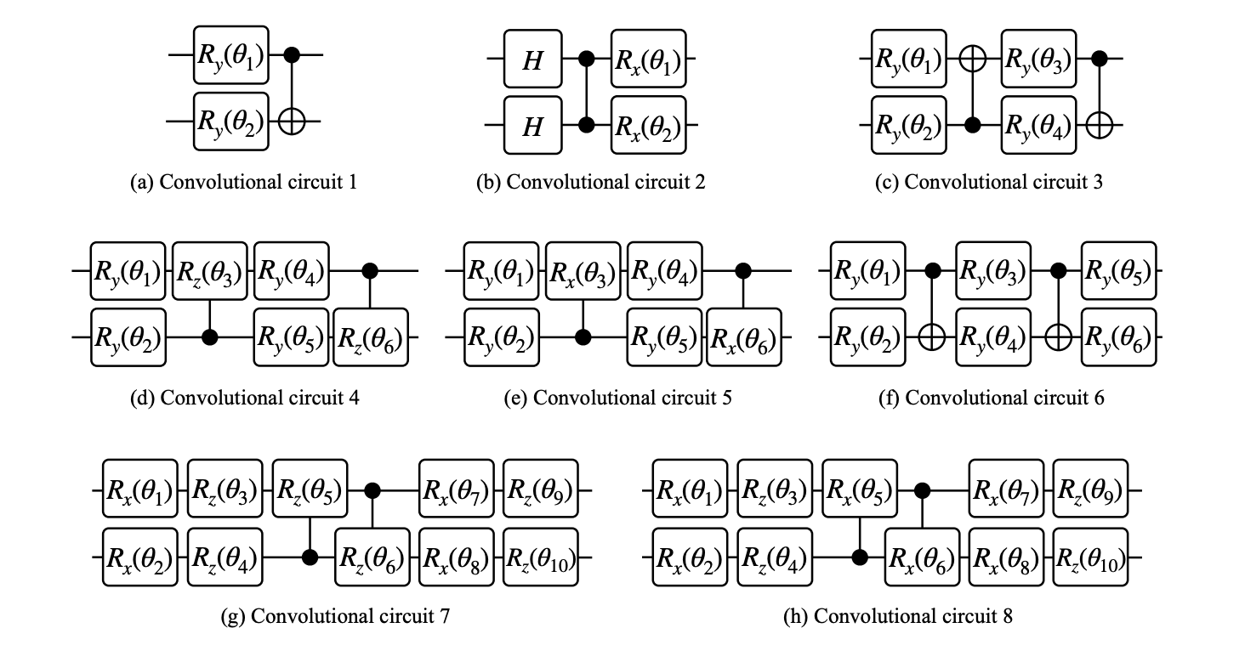
Several convolutional layers to try out!

Slide 11
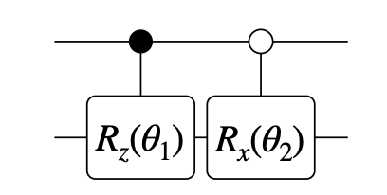
Pooling layer’s circuit
Two controlled rotations are applied. The first is applied when the control qubit is 1 (black circle) and the second when the control qubit is 0 (white circle).
The control qubit is ”traced out” after the gate operations in order to reduce the dimension.

Slide 12
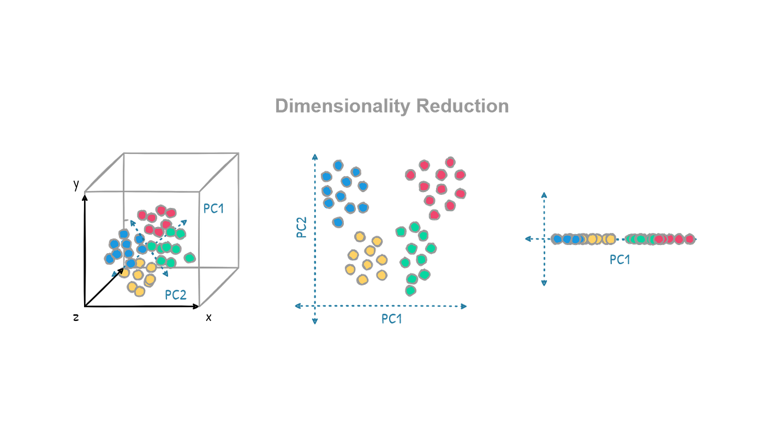
How to handle image data?
Image data can be seen as a matrix with pixels. Each pixel is considered a feature.
Current quantum computers can’t handle training high resolution images (a lot of pixels).
The data has to be reduced in some intelligent way so that QCNN can handle it, but we do not lose a lot of information.
Dimensionality reduction techniques are applied as a preprocessing stage.
PCA, autoencoding, interpolation.

Slide 13
CODE!
Let’s see the Quantum convolutional neural network in action on the QCNN.ipynb file

Slide 14
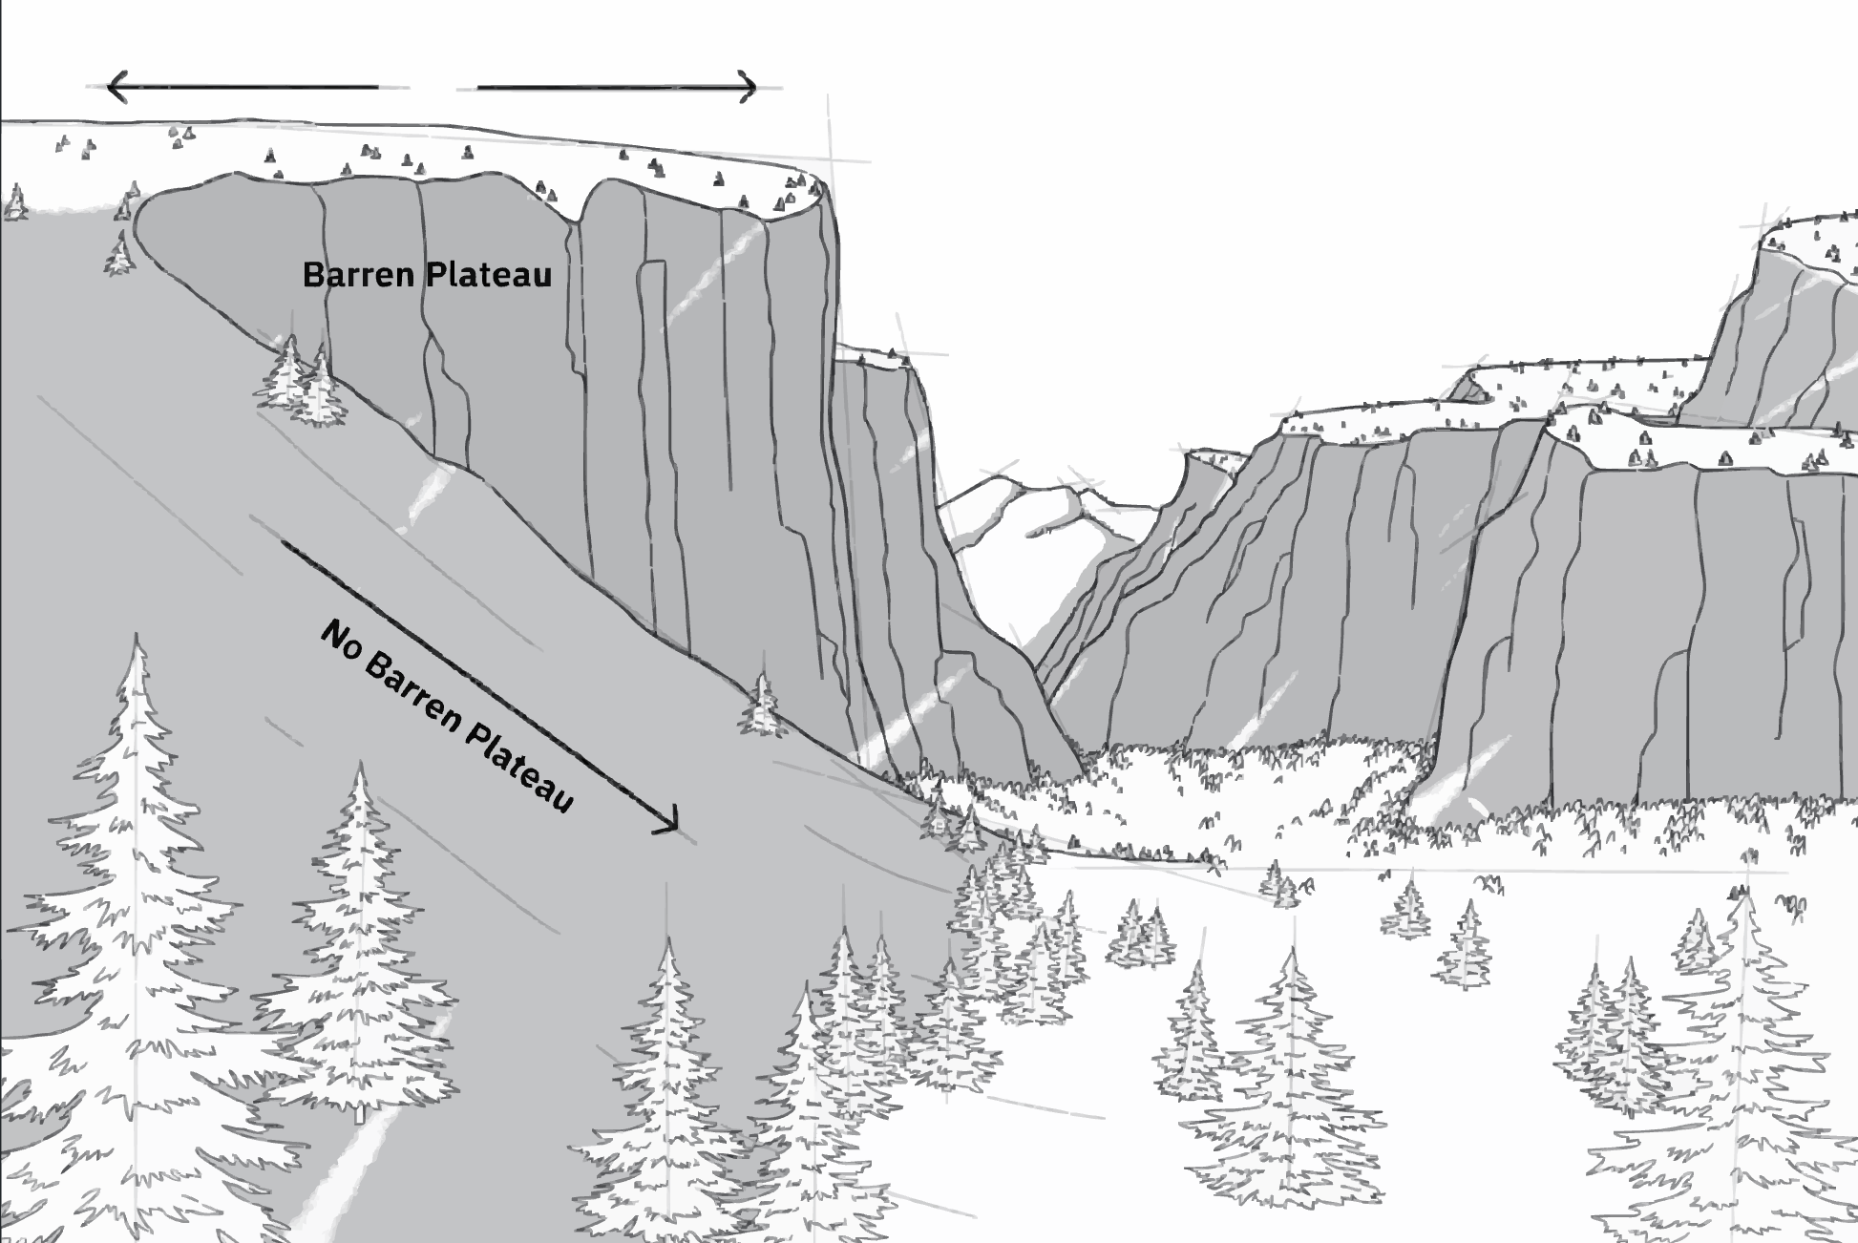
Limitations of Quantum convolutional neural networks
In order to process image data with current hardware, we need to reduce the dimensionality of it. Even if we use good dimensionality reduction techniques, we lose some information in the process.
Barren plateaus: Training deep QCNNs can lead to the vanishing gradient problem. Our model “stops learning”.

Slide 15
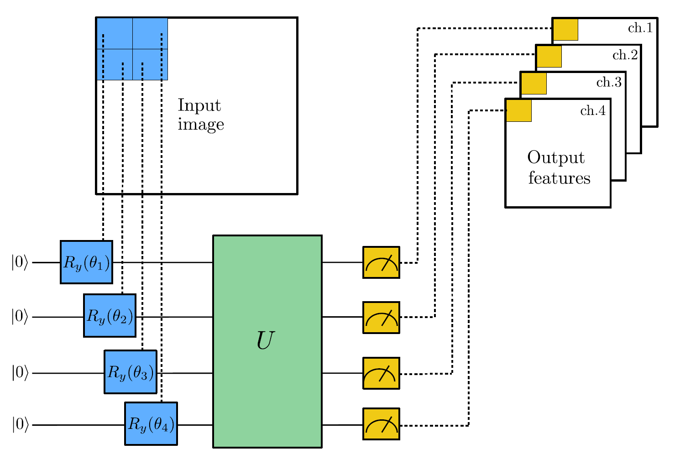
Quanvolutional neural networks
We will work with the one proposed by Henderson for MNIST classification.
The quantum circuit is used as a preprocessing step.
There is no parameter optimization. The circuit is fixed and used before the training of the actual network.
The layers in U are chosen at random.
The image is divided into squares of 2x2.
The output of the circuit is the expectation value of each of those 4 pixels after the circuit.

Slide 16
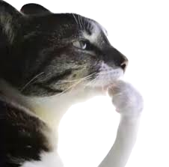
Why using Quanvolutional neural networks might help us?
Although random, quantum circuits can introduce some interesting non-linear transformations between input pixels. This could help improve the model’s results.
These transformations can only be achieved through quantum computation since they involve quantum phenomena like entanglement.
It does not use as many qubits as other approaches and does not require a training process.
It can integrate easily into ML pipelines as a preprocessing stage.

Slide 17
CODE!
Let’s see the Quanvolutional Neural Network in action on the QuanNN.ipynb file

Slide 18
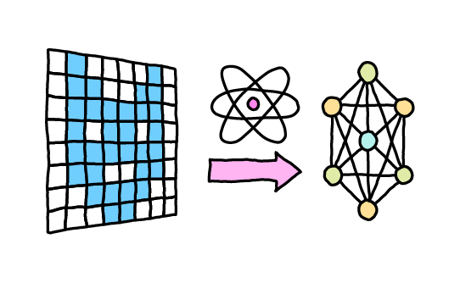
Limitations of Quanvolutional neural networks
Quanvolutional layers are static. Good performance depends on the random circuit we are using.
Some work has been done in order to make the quanvolutional layers trainable. However, one big problem is that the computation of the gradient is only available for the last quanvolutional layer.

Slide 19
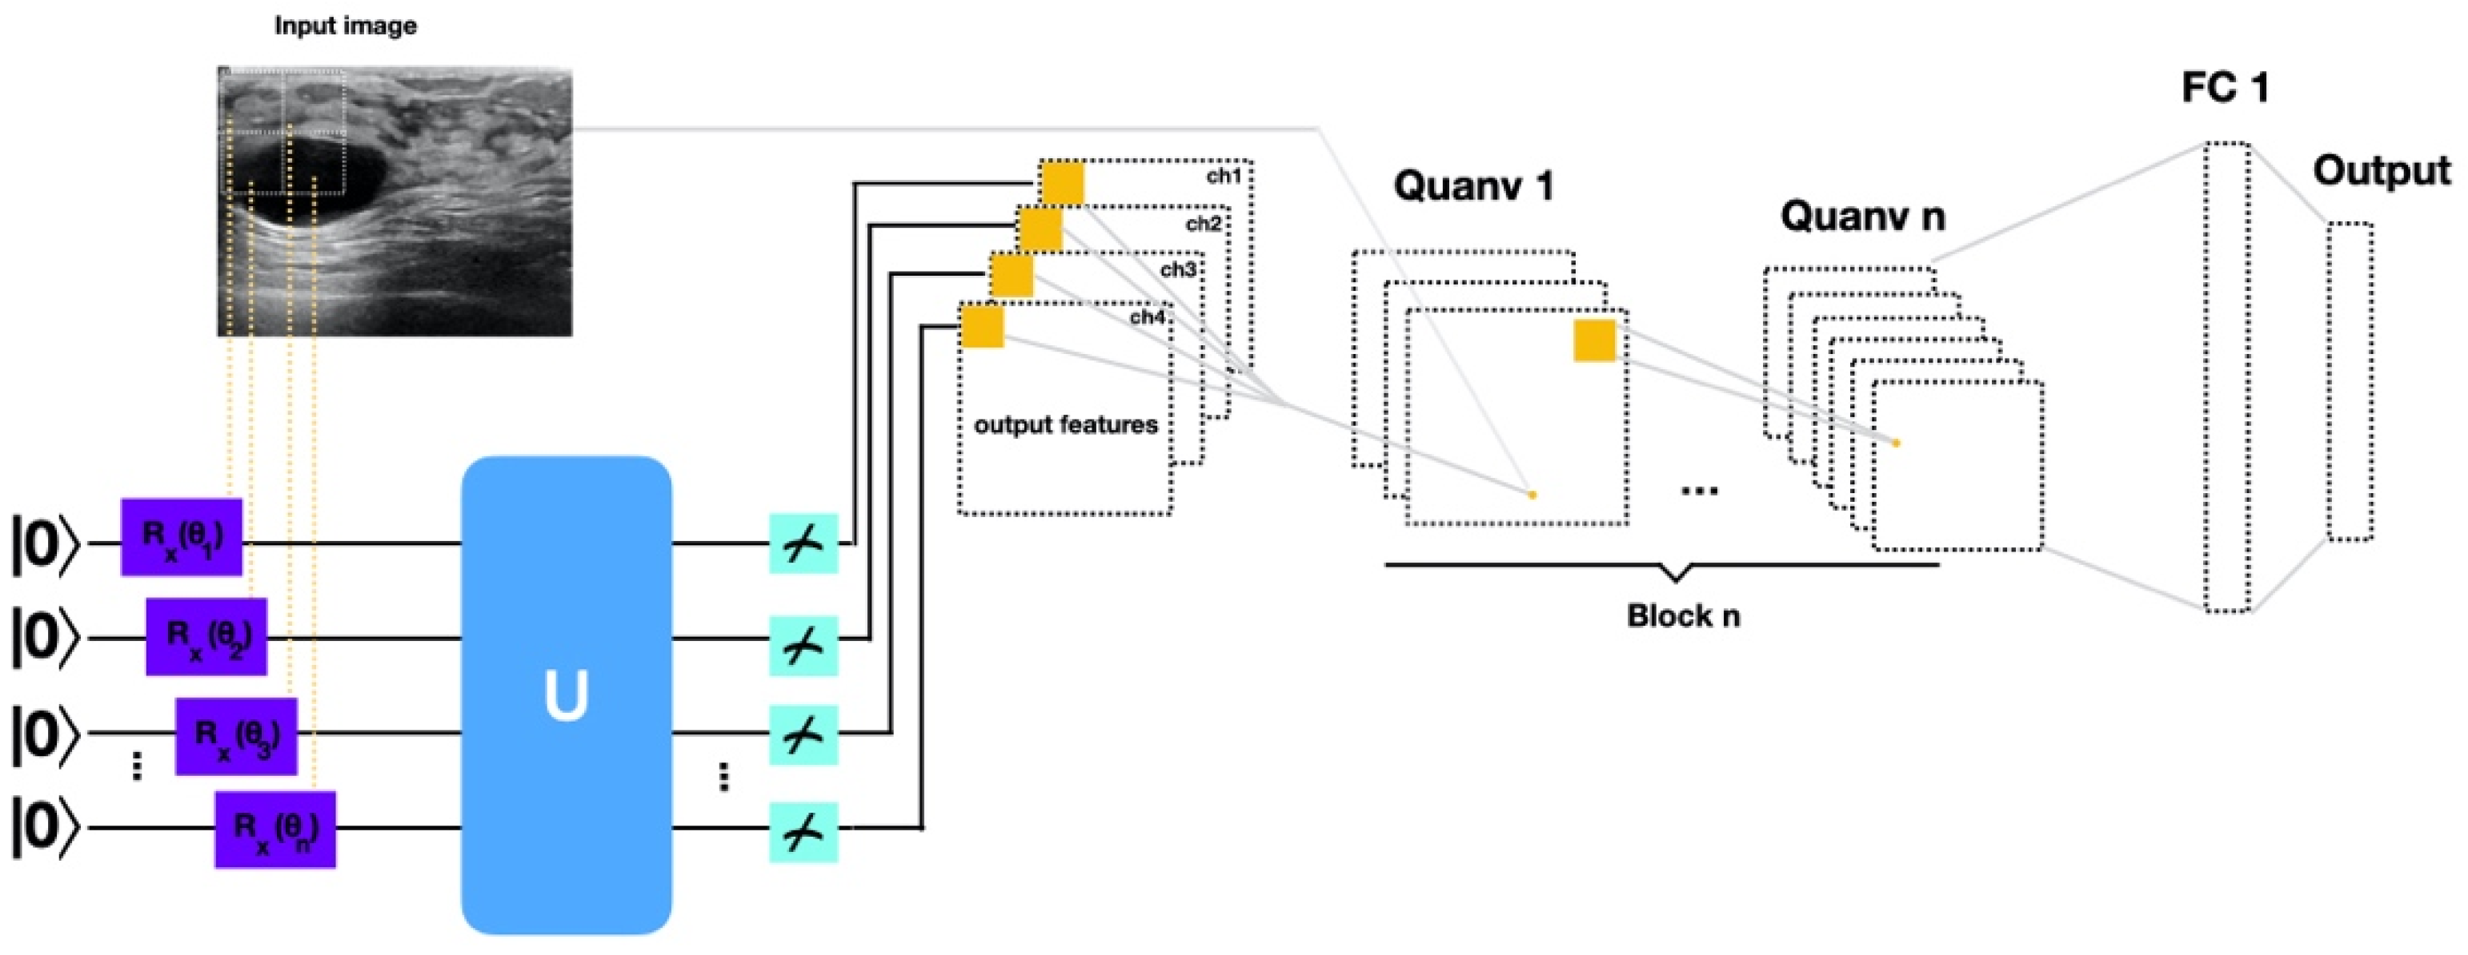
Residual Quanvolutional Neural Networks
In order to train a model with several trainable quanvolutional layers, we need to address the problem with the gradients we mentioned.
Muhammad Kashif and Muhammad Shafique proposed the Residual Quanvolutional Neural Network in 2025.
The main idea of a Residual Network (quantum or classical) is to add connections between layers, so that relevant information is not lost through the layers when calculating gradients.

Slide 20
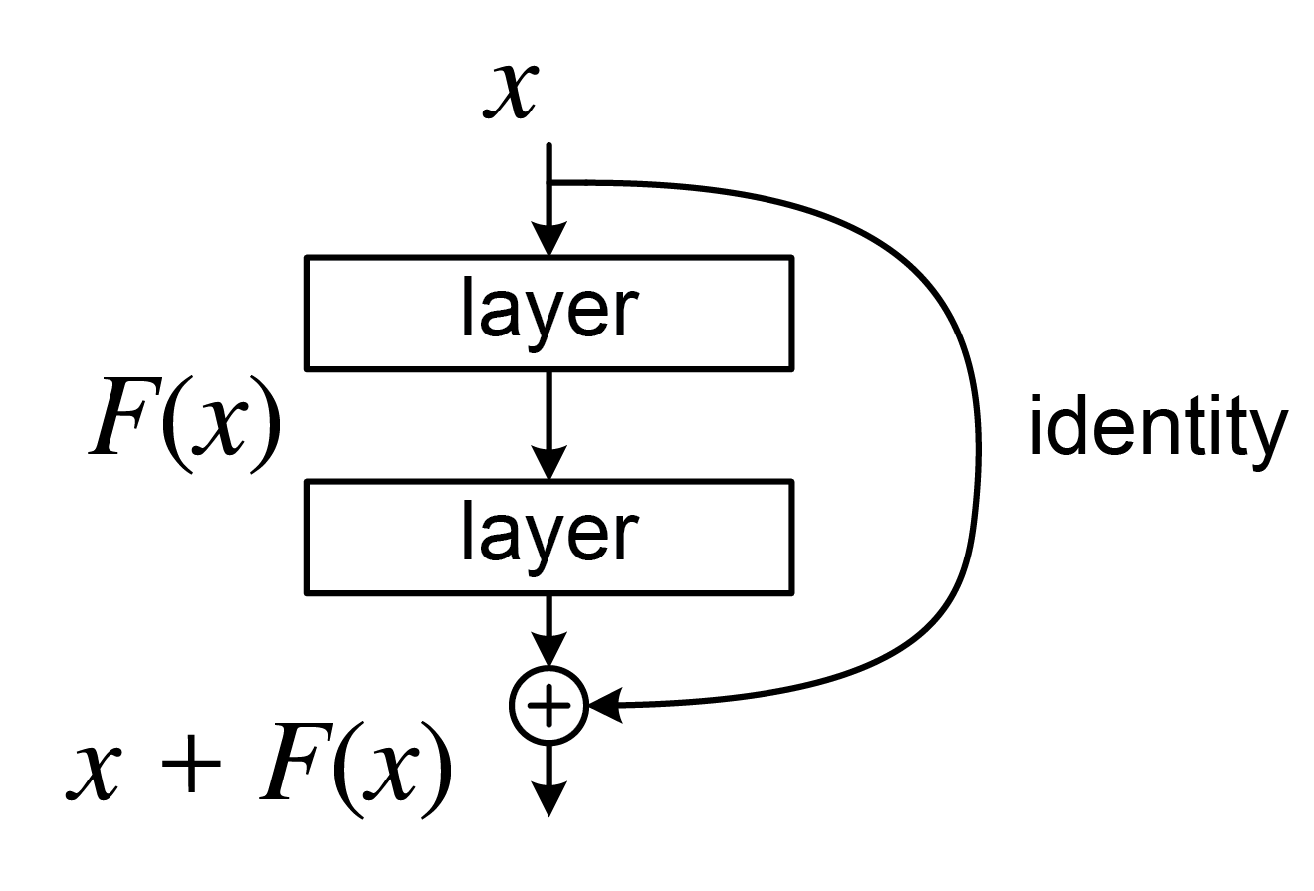
Residual block’s role
ResQuNNs incorporate residual blocks between quanvolutional layers. The residual blocks combine the output of existing quanvolutional layers with their own or the previous layer’s input before forwarding it to the subsequent quanvolutional layer.
The integration of residual blocks ensures that gradients flow efficiently across the network, thereby overcoming the challenges associated with training multiple quanvolutional layers.
Not every random residual configuration results in comprehensive gradient flow throughout the network, and the residual blocks need to be strategically placed between quanvolutional layers.

Slide 21
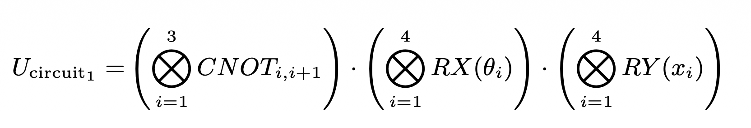
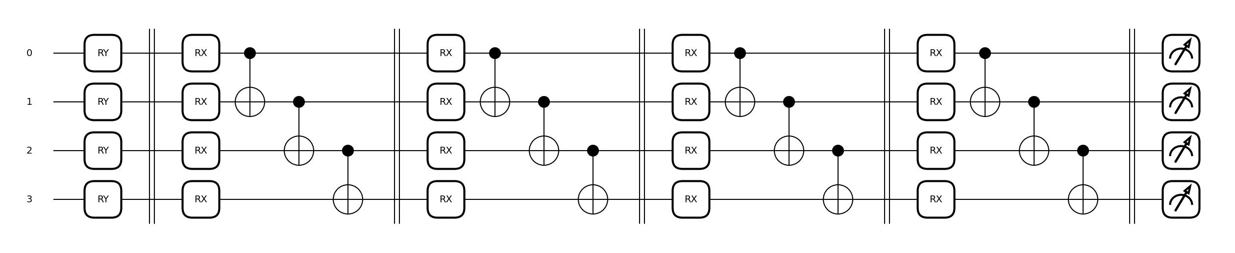
Quanvolutional layer’s circuit

Slide 22
CODE!
Let’s see the Residual Quanvolutional Neural Network in action on the ResQuanCNN.ipynb file

Slide 23
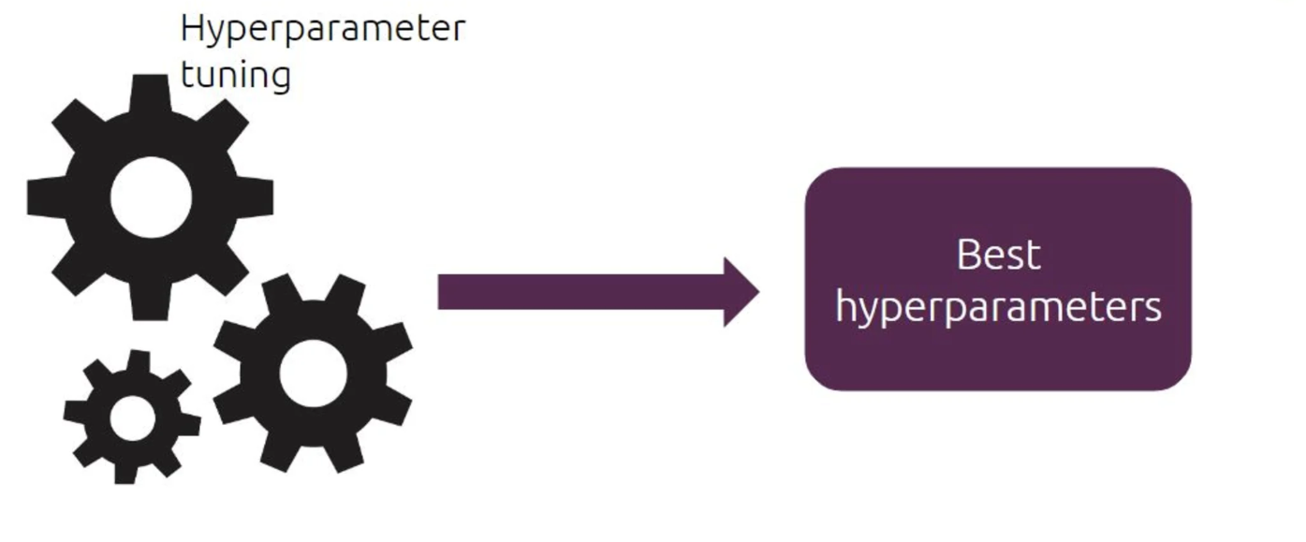
Limitations of Residual Quanvolutional neural networks
It takes significantly more time to train than other approaches in which the quantum circuits parameters are not optimized.
Choosing where and how to include residual connections is very important to get good results.

Slide 24
References
[1] I. Cong, S. Choi and M. D. Lukin, “Quantum Convolutional Neural Networks,” arXiv preprint arXiv:1810.03787, 2019. [Online]. Available: https://arxiv.org/pdf/1810.03787
[2] Northeast Quantum Forum. (2025, October 27). Soonwon Choi - Quantum Convolutional Neural Networks [Video]. YouTube. URL: https://youtu.be/e2XrbWuaQNQ?si=iFyo2n-wnX5egwwB
[2] Northeast Quantum Forum. (2020, February 6). Q2B 2019 | Quantum Convolutional Neural Networks | Iris Cong | Harvard [Video]. YouTube. URL: https://youtu.be/C7kK5m7d10Q?si=92FTDbdhswd75-2z
[3] T. Hur, L. Kim and D. K. Park,” Quantum convolutional neural network for classical data classification”, arXiv preprint arXiv:2108.00661, 2022. [Online]. Available: https://arxiv.org/pdf/2108.00661
[4] M. Henderson, S. Shakya, S. Pradhan and T. Cook, “Quanvolutional Neural Networks: Powering Image Recognition with Quantum Circuits”, arXiv preprint arXiv:1904.04767, 2019. [Online]. Available: https://arxiv.org/pdf/1904.04767
[5] Kashif, M., Shafique, M. Deep quanvolutional neural networks with enhanced trainability and gradient propagation. Sci Re|p 15, 21764 (2025). https://doi.org/10.1038/s41598-025-06035-4

Slide 25
Github repository
https://github.com/Leo11wasd/quantum_computing/tree/main/QCNN_presentacion

