Slide 1


An Analysis of PCA and Autoencoder Generated Factors in Predicting S&P Returns
Santa Clara University
December 6th, 2019
Leo Barbosa

Slide 2






Agenda
Add image / keep blank
01
02
03
04
05
06
Objectives
PostgreSQL Database
Data Pipeline
Forecast Factors/Returns
Results
Conclusion
Notes:
Add images: the black and white background can be substituted with an image, totally or partially
Change Icons: to modify icons, delete current icon and paste a new icon in the same place. Resize, recolor (Format > Color)
Change Shape: Shapes can be modified by selecting the shape > Format > Edit Shape > Change Shape

Slide 3




Objectives
01
PostgreSQL Database
To set up PostgreSQL Database at SCU with Dow30 and S&P500 historical components and associated data
02
Develop Data Pipeline
To develop data pipeline for generating daily, weekly, monthly returns for a given period for either Dow30 or S&P500 indices
03
Predict S&P 500 returns
To predict, using PCA and Autoencoder factors, if the S&P500 will go up or down
04
Learn
To learn as much as you can… it is not about the grade, or the paper… it is about what sticks after graduation

Slide 4
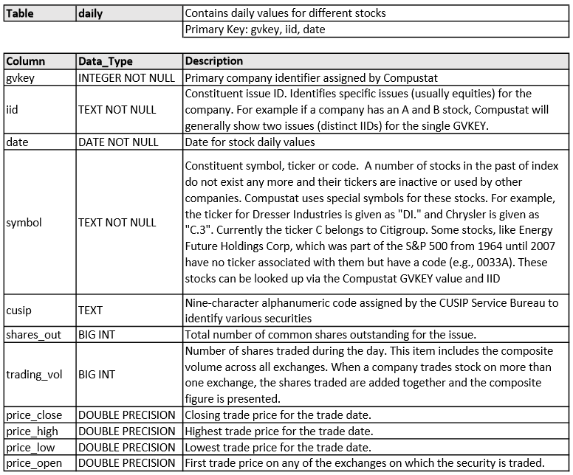
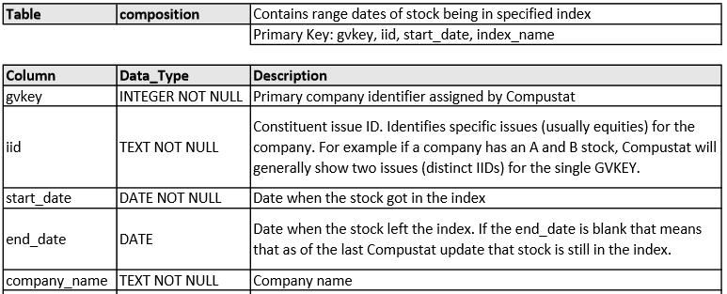



PostgreSQL Database
Datasource:
Compustat - Capital IQ. (n.d.). North America Daily / Index Constituents. Retrieved from Wharton Research Data Services: "WRDS" wrds.wharton.upenn.edu
Compustat - Capital IQ. (n.d.). North America Daily / Security Daily. Retrieved from Wharton Research Data Services: "WRDS" wrds.wharton.upenn.edu
Reliable data available from 1984
Notes:
Add images: the white background can be substituted with an image, covering the background totally or partially. Pictures with white areas work better to contrast text. Alternatively, the big icon in the hexagon can be substituted by and image

Slide 5
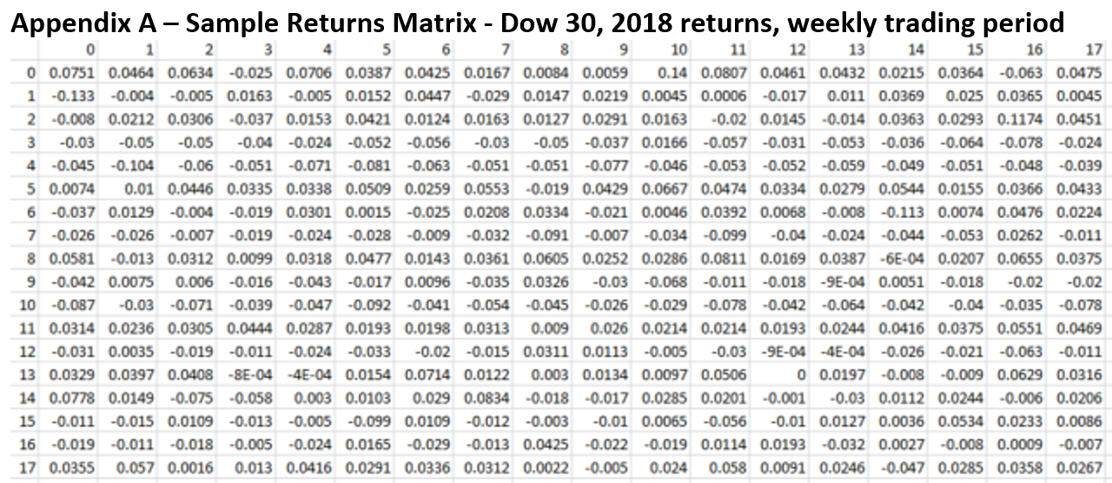
Data Pipeline

Slide 6
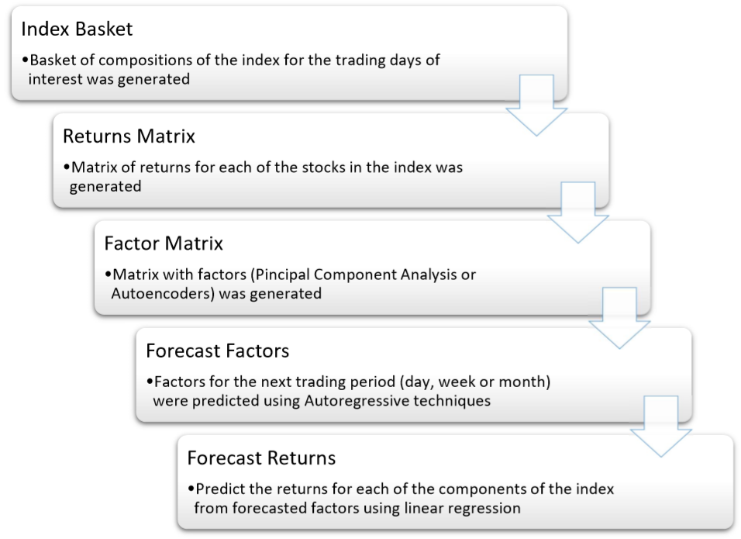
Predict S&P Returns
Can we predict if S&P 500 is going up or down?

Slide 7
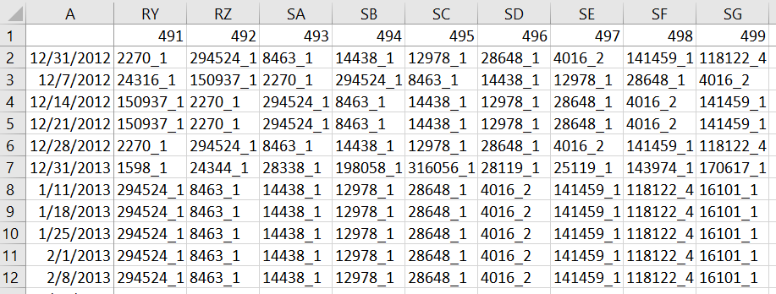
Index Basket example (weekly returns)

Slide 8
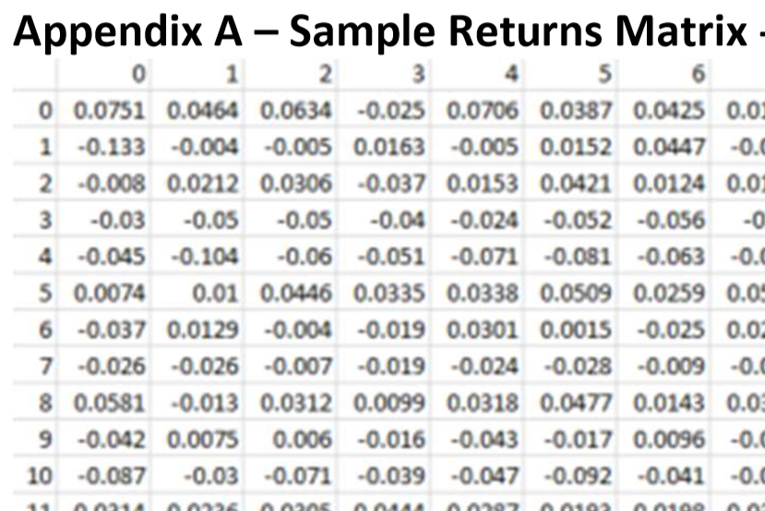
Returns Matrix
Returns calculated based with respect to previous trading period close:
Daily: With respect to previous trading day
Weekly: With respect to last trading
Monthly: With respect to last trading day of month
Matrix with size: (lookback: 252, # constituents of index: 500)
Lookback: # of trading periods to include for factor generation

Slide 9
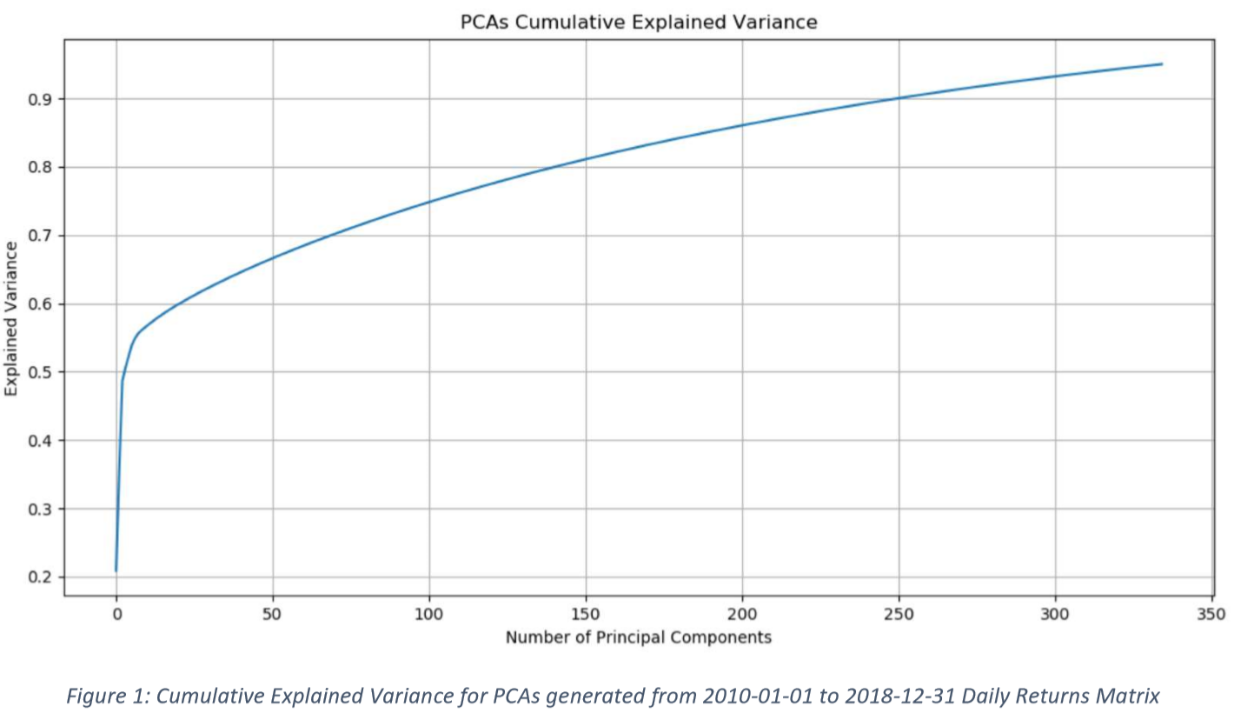
Factors Matrix
Factors generated using two techniques:
Principal Component Analysis (PCA)
Autoencoders
Matrix with size: (lookback: 252, # of factors: 100)

Slide 10
Forecasts
Factors:
Autoregressive Model – AR: using Akaike Information Criterion (AIC) for selecting the optimal lag length.
Autoregressive Model with Moving Average – ARMA: pmdarima.arima.auto_arima was used. The auto_arima function was fit using AIC.
Returns:
Linear Regression using the forecasted factors: Predict 500 returns

Slide 11
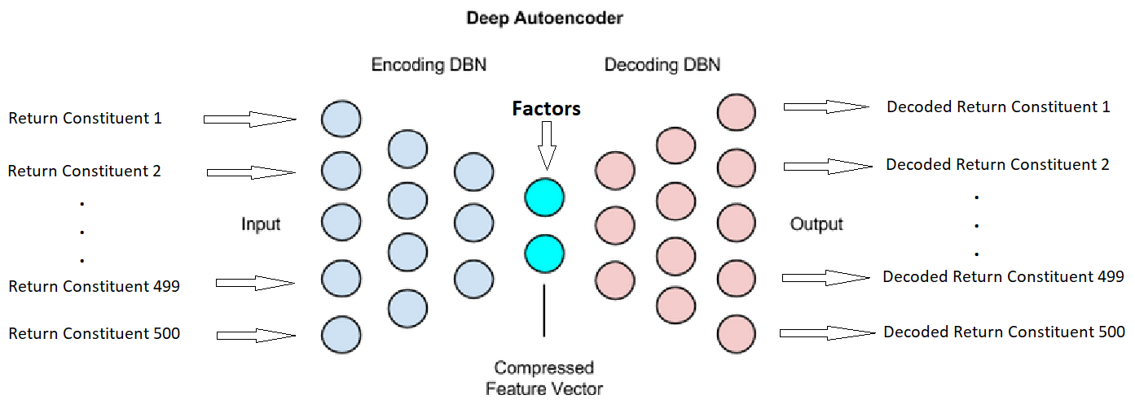
Autoencoder
Input layer: 500 nodes
Encoder hidden layer 1: Dense(360, activation='tanh')
Encoder hidden layer 2: Dense(220, activation='tanh')
Encoder hidden layer 3: Dense(100, activation='tanh') [middle layer]
Decoder hidden layer 4: Dense(220, activation='tanh')
Decoder hidden layer 5: Dense(360, activation='tanh')
Output layer: Dense(500, activation='linear')

Slide 12
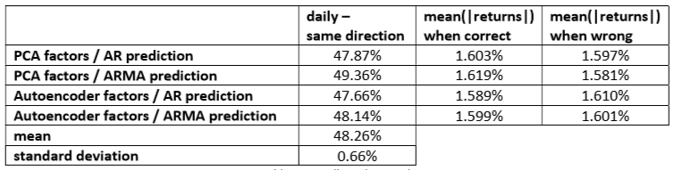

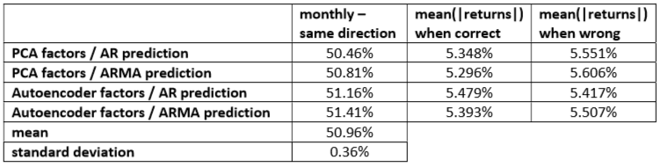
Results
The results show that none of the techniques used significantly outperforms a simple guess (50% split) on which stocks will go up or down in the next trading cycle, with overall results (daily, weekly and monthly) having a mean of 49.95% and a standard deviation of 1.36%.
Notes:
Daily 62
Weekly 65
Monthly 61

Slide 13
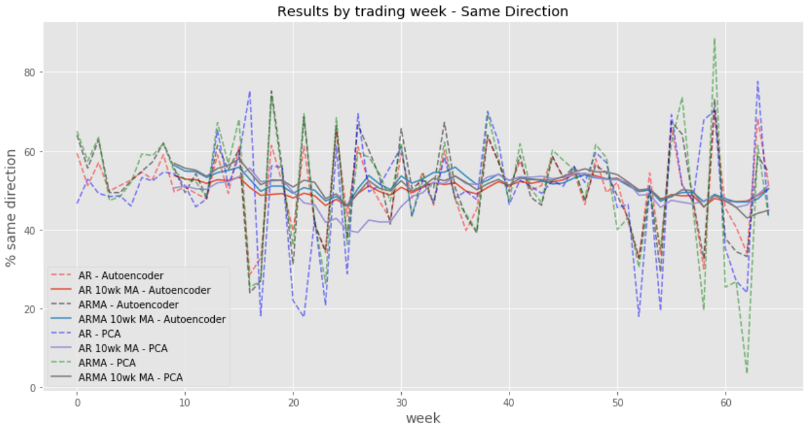
Results – Weekly – Same Direction

Slide 14
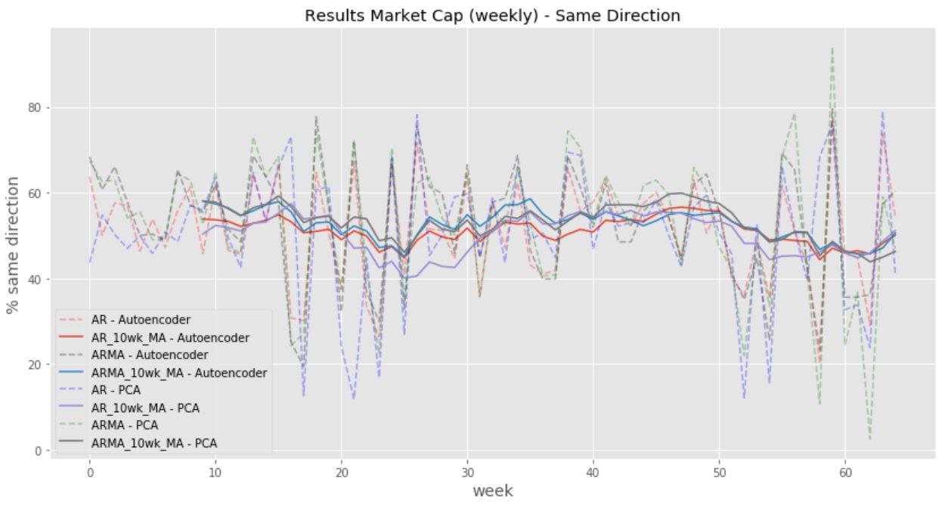
Results – Weekly – Market Cap

Slide 15



Conclusion
Next Steps
To forecast returns using the Autoencoder decoder. We believe this would yield better results.
Explore other techniques for factor and returns prediction
Project Conclusions
Project Team
Results for individual trading periods, some do show significant outperformance, however this happens inconsistently in an unpredictable manner.
The market weighted results, while interesting for weekly and monthly trading periods, are inconsistent and unreliable for trading.
Leo Barbosa – MSBA Candidate. Graduating June 2020
https://www.linkedin.com/in/leobarbosa8216/
Dan Trepanier – MSBA Program Director
THANK YOU!!!
Notes:
Swap 2 & 3.

Slide 16

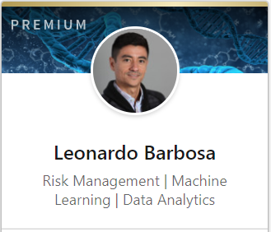
SCU MSBA Candidate. Graduating June 2020
https://www.linkedin.com/in/leobarbosa8216/

Slide 17
Appendix

Slide 18
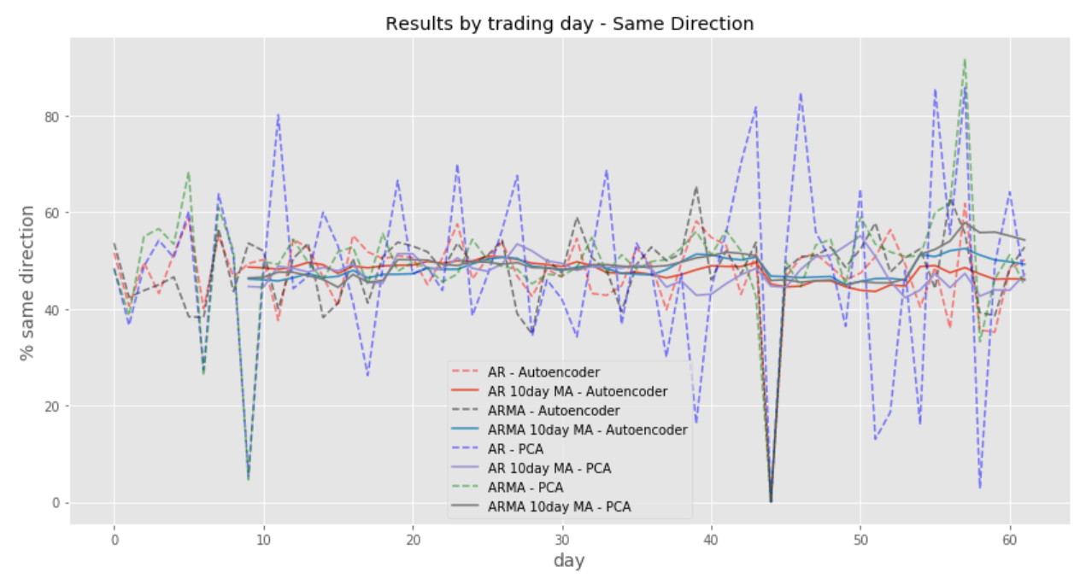

Slide 19
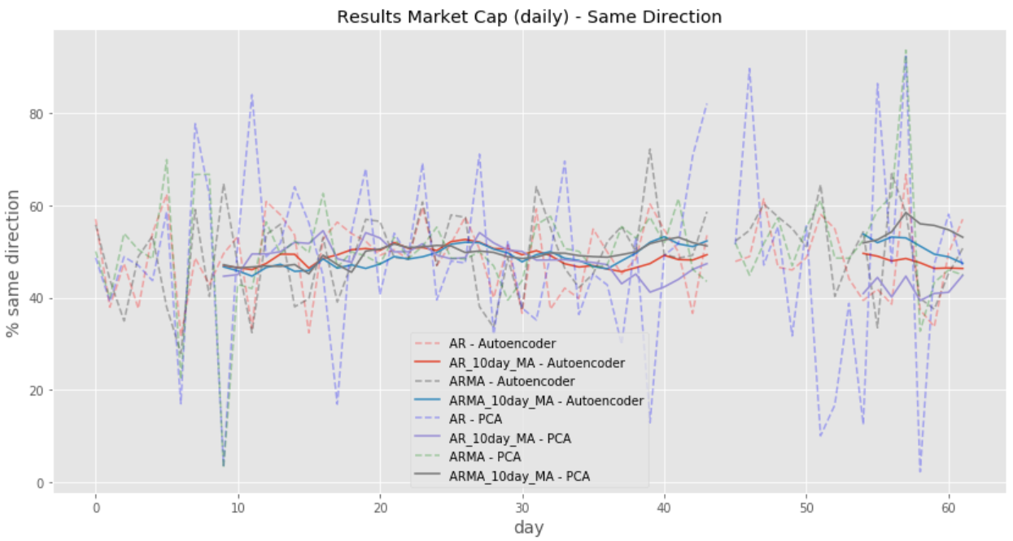

Slide 20
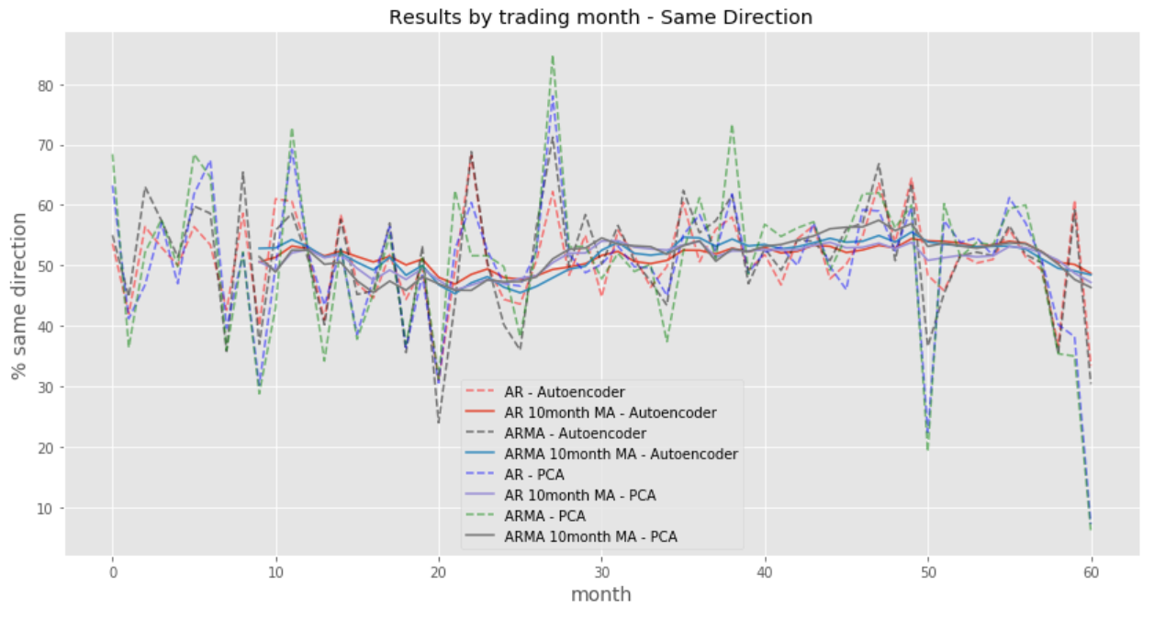

Slide 21
