Slide 1
Denver Bike Map & Text Analysis
Project for Regis University MSDS 696 - Meng Luo

Slide 2
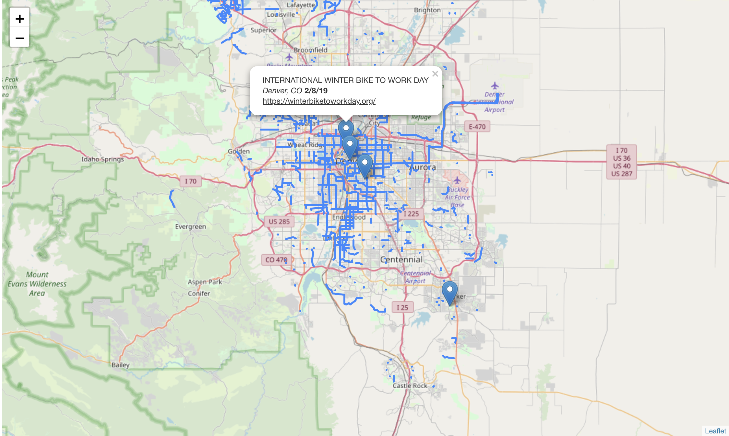
Result - Active Maps
https://milite.github.io/MSDS/

Slide 3
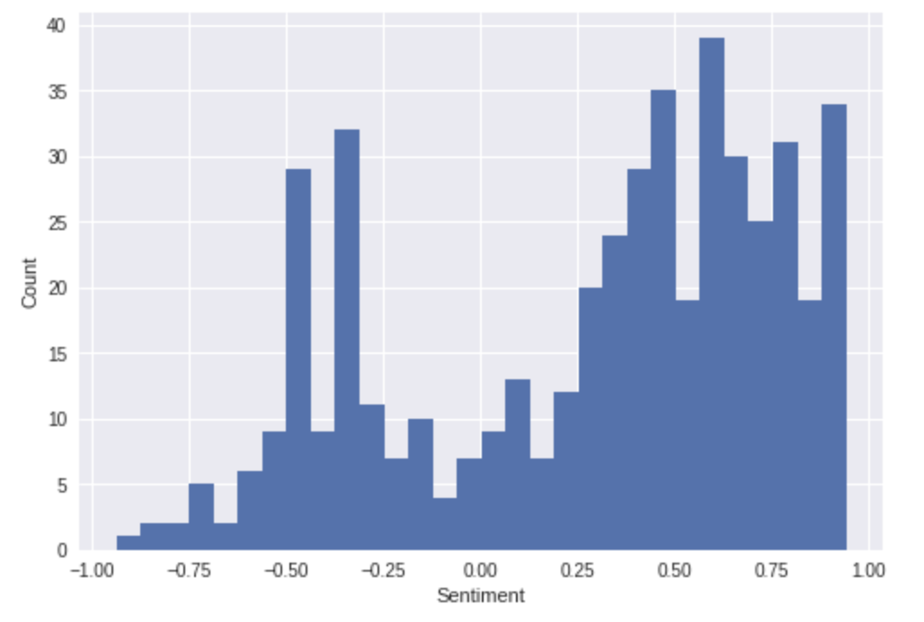
Result – Text: Sentiment Intensity Analysis
Example tweets
Non-neutural polarity counts
tweet | compound | neg | neu | pos
sometimes goals need benefit time happen come ... | 0.4588 | 0.0 | 0.769 | 0.231
friends great friendships priceless thank mona... | 0.9584 | 0.0 | 0.136 | 0.864
framed marquette alloy mountain sram suntour r... | 0.0000 | 0.0 | 1.000 | 0.000
fuji nevada er mountain onsale fujibike er | 0.0000 | 0.0 | 1.000 | 0.000
rock climbing amp riding sunday appreciate gol... | 0.4019 | 0.0 | 0.722 | 0.278

Slide 4
Process – Map
Obtain data sets from DRCOG, Bike Denver and Bicycle CO
Clean and transfer data
Apply GeoJSON data to folium as maps and layers.
Test the best parameters (zoom, data size, etc.)
* Could not gain access to data from Strava, CDOT, Reddit and The Know
*Had to limit data size to better present online.

Slide 5
Process – Text Analytics
Apply and connect to twitter
Collect tweets with key words
Remove links, user handles, weird characters, etc.
Get lower case lemmas
*Twitter developers have limited access: tweepy.API(auth,wait_on_rate_limit=True)
Notes:
Pron, digits and punctations; Check points

Slide 6
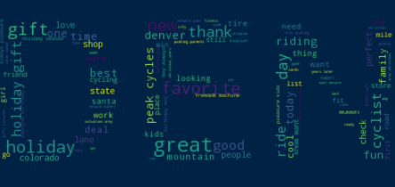
Process – Text Analytics
Create wordclouds
Sentiment Intensity Analysis
Filter, count and plot
Tokenize
* I should have monitored how the general mood showing in tweets have changed.
Notes:
Holiday ; icy

Slide 7
Process – Data comparison
Convert all main steps to functions
Comparing data collected from other bike-friendly cities: Wausau (WI), Santa Monica (CA) and Washington(D.C.)
* Failed to submit although the code is completed:
Twitter developer accounts locked out;
No backup data and text

Slide 8
Conclusions
Interactive Maps using GeoJSON and folium
Text Analytics on keywords-based tweets: wordcloud, SIA
*Failed on time management about data cleaning/preparation
*Failed on keeping data backups

Slide 9
References
Bicycle Colorado Event Calendar.(2018, Decemeber).Bicycle Colorado.Retrieved from https://www.bicyclecolorado.org/events/
Bicycle Facility Inventory Dataet.(2018).Denver Regional Council of Governments.Retrieved from https://data.drcog.org/dataset/bicycle-facility-inventory Bike
Denver Events page.(2018, December).Bike Denver.Retrieved from https://bikedenver.org/events/
Course materials from MSDS680,682,and 696.(2018).Regis University

