Slide 1



Slide 2

Introduction
What is cloud storage?
How does cloud storage work?
Cloud Storage - Business Benefits
What does it cost to users?
Advantages of Cloud Storage
Disadvantages of Cloud Storage
Conclusion

Slide 3

Cloud storage is a model of data storage in which the digital data is stored in logical pools, the physical storage spans multiple servers (and often locations), and the physical environment is typically owned and managed by a hosting company.

Slide 4


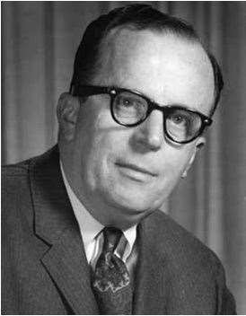


History
  J.C.R. Licklider – One of the fathers of the cloud based computing idea.
  Global network that allows access from anywhere at anytime.
  Technological limits of the 60’s.
Concept
  Cloud storage is a service model in which data is maintained, managed and backed up remotely and made available to users over a network (typically the Internet).

Slide 5
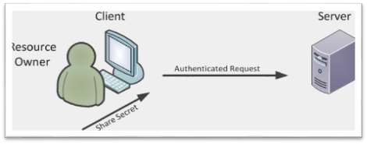

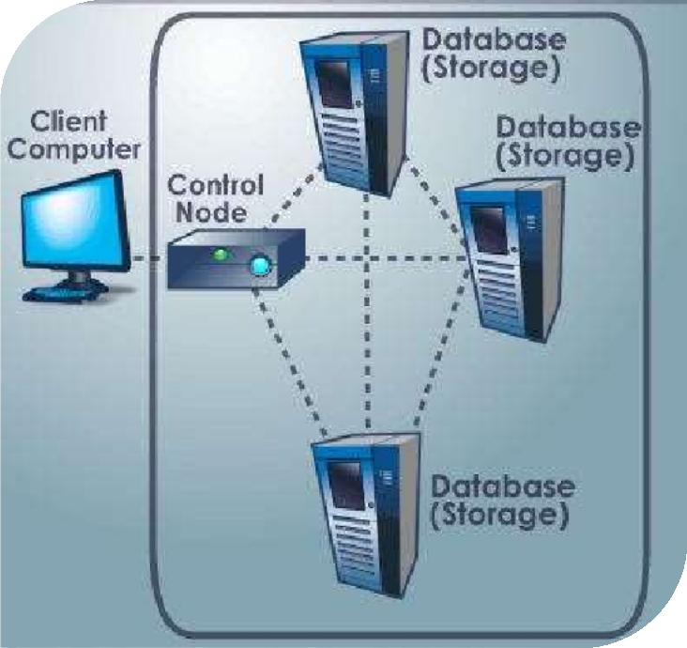
Redundancy
  Core of cloud computing
Equipment
  Data servers
  Power supplies
Data files
  Replication

Slide 6
iCloud
iCloud is a service provided by Apple
5GB storage space is free of
cost
Once the iCloud is used you can share your stored data on any of your different Apple devices
Aceess to all files, music, calendar, email

Slide 7

With cloud storage, there's no need for CDs, external hard drives, or localized servers.
Data is quickly and automatically updated in the cloud and available for your retrieval whenever you need it.
Should your office become the victim of a burglary, fire, or
natural disaster, your data is safe and secure in the cloud, even if
your physical assets are destroyed.
One of the greatest benefits of cloud storage is its ability to grow with its users.
With no need for physical, on-site storage space, you can have a smaller workspace, less equipment to buy, and fewer IT employees to maintain your equipment and manage your data.

Slide 8
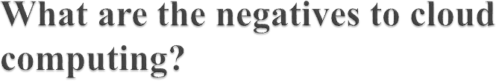

Security: Many companies may not want to hand over their data to an external organization to store, fearing that they may not have the right security
software to protect the company’s data.
🞄 Performance: There were several incidents that some cloud-service providers temporarily went down or lost customer’s data.

Slide 9
Usability
Bandwidth
Accessibility
Disaster Recovery
Cost Savings

Slide 10
Usability
Bandwidth
Accessibility
Data Security
Software

Slide 11

Grid Computing was the last research-led centralised approach.
However there are concerns that the mainstream adoption of cloud computing could cause many problems for users.
Many new open source systems appearing that you
can install and run on your local cluster.

Slide 12


