Slide 1

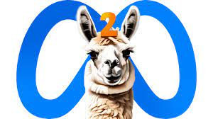





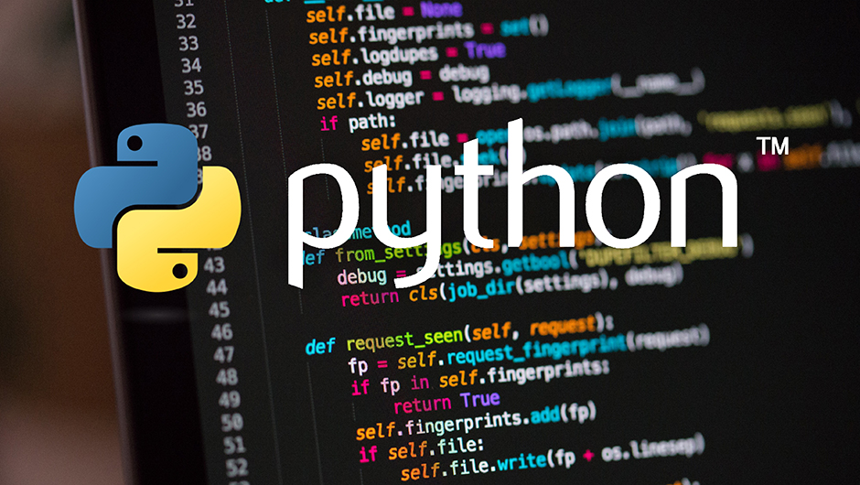
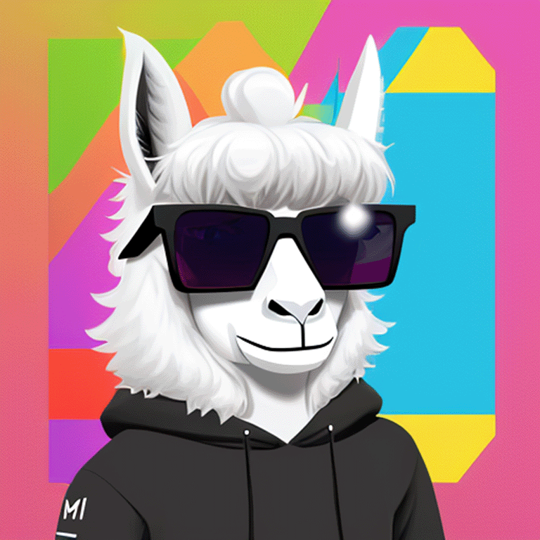

software & tools
* LLaMa-2 models
* Docker
* Python
* PostgreSQL
* Psycopg2
* llama-cpp-python
* llama.cpp project
* Loguru
* Ubuntu

Slide 2


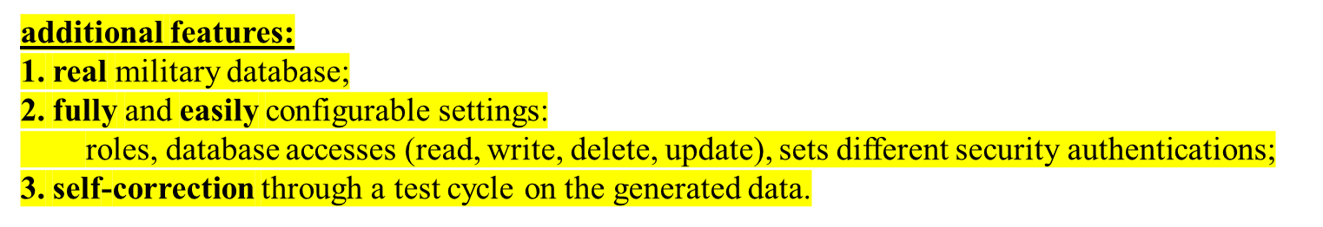


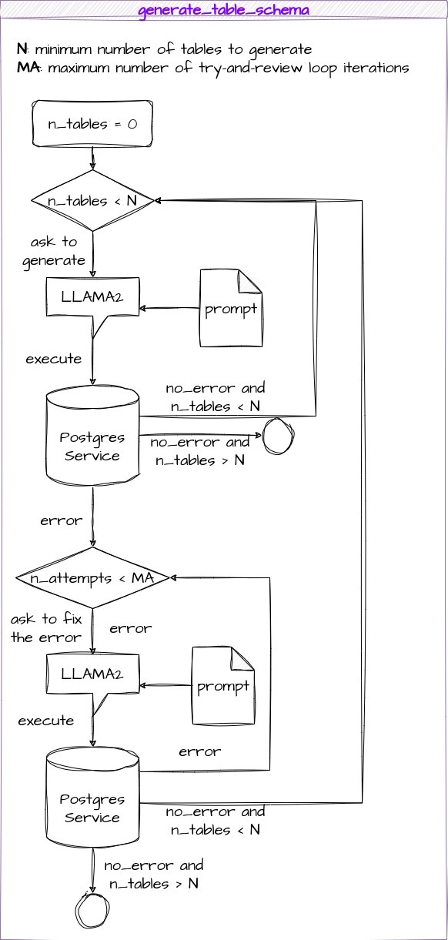
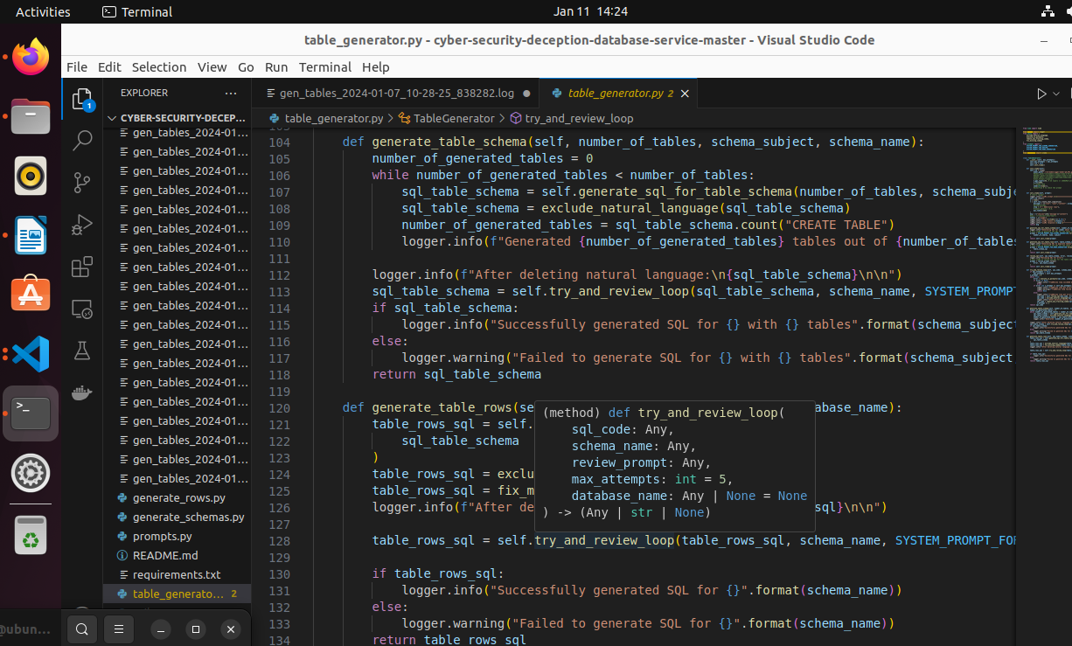
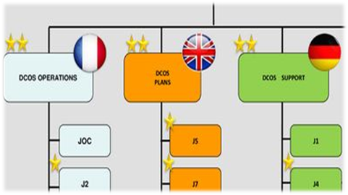
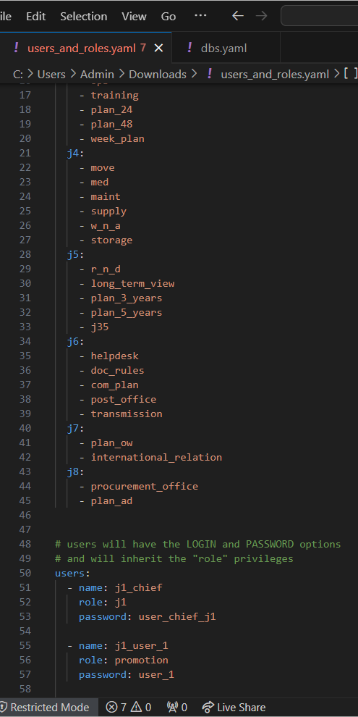
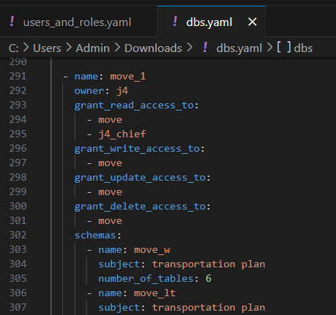

project requirements + additional features
requirements:
* image OCI compliant ready to be instantiated;
* configurable settings for client connections at image build-time: authentication, credentials, and ports;
* auto-generate complex schema and data from scratch;
* import an existing schema and generate data to populate it.
1
2
3

Slide 3

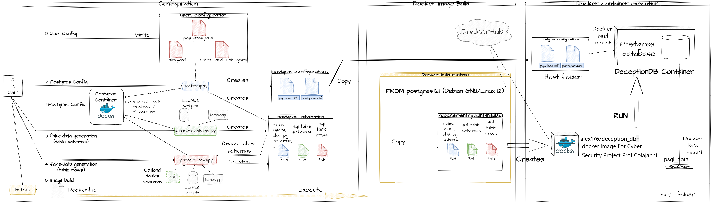
project architecture

Slide 4
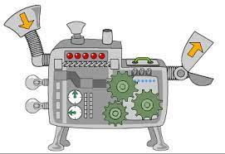
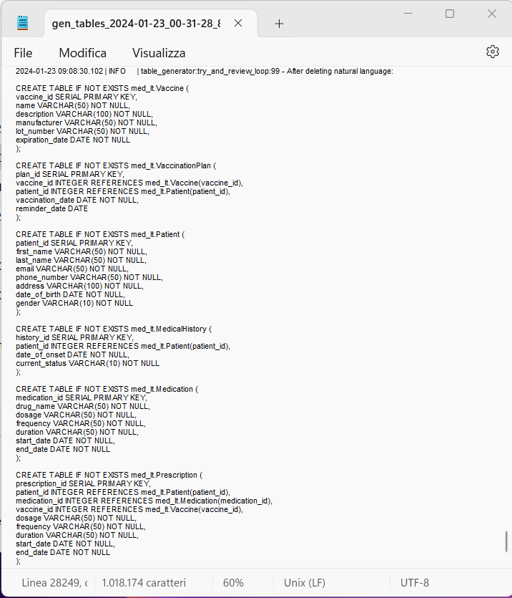
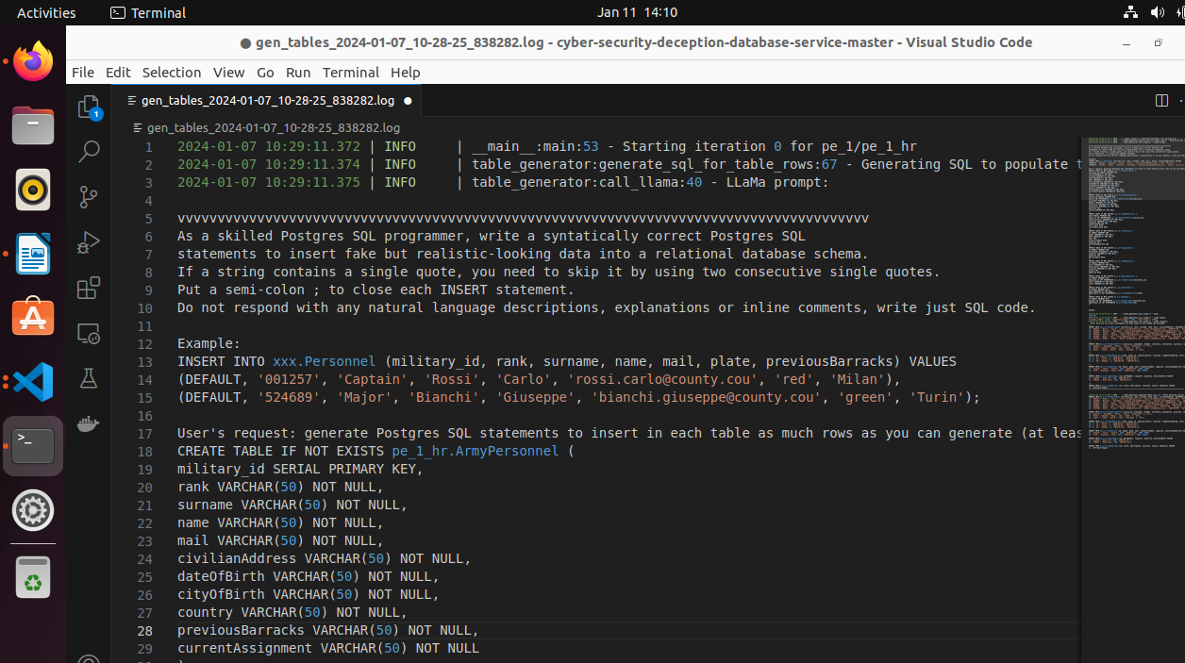
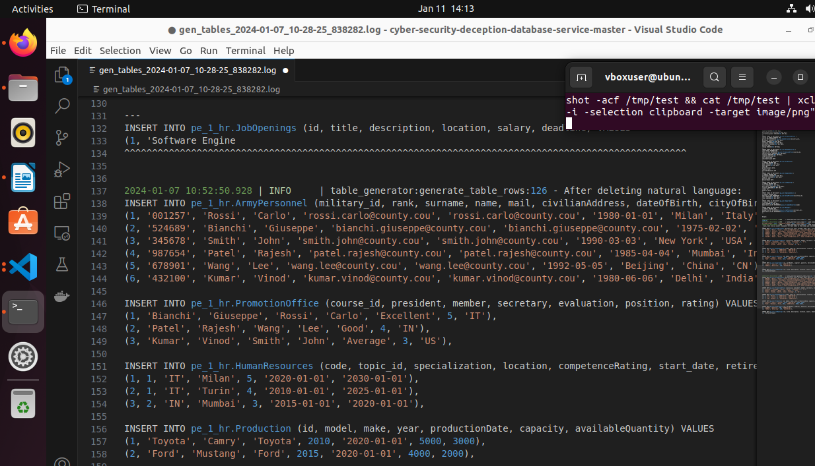
outputs

Slide 5
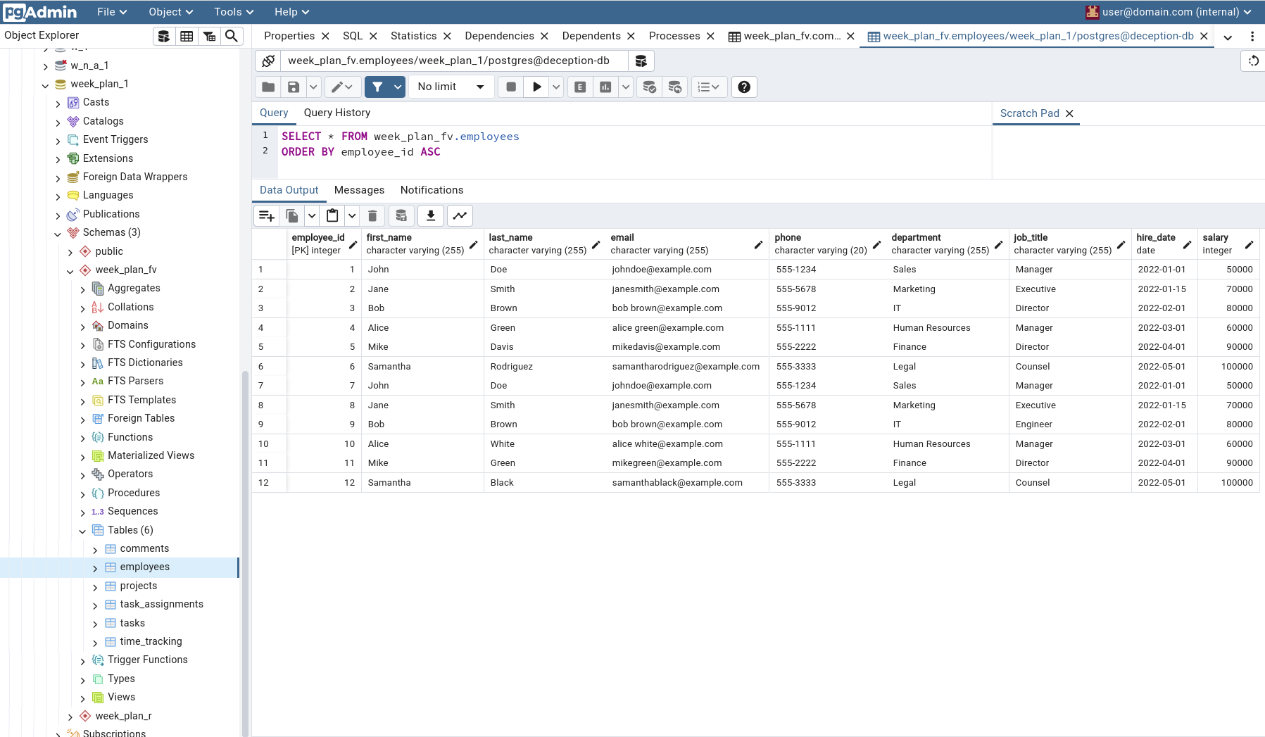
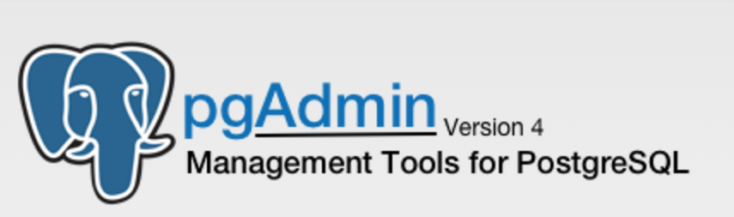
outputs

Slide 6
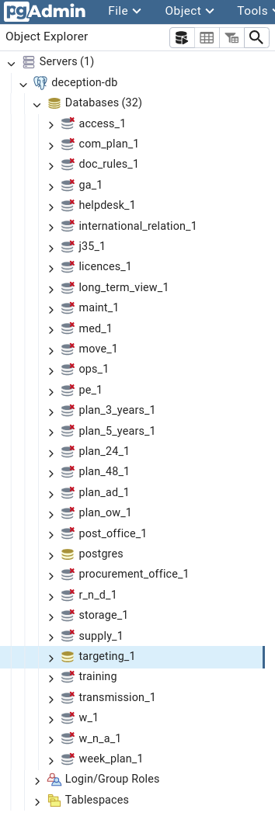
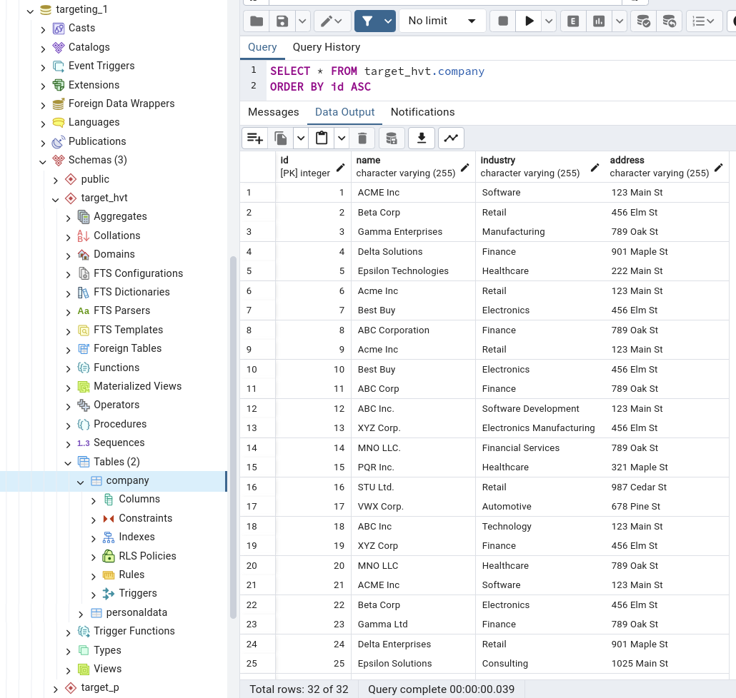

outputs
final remarks
* self-correction test of the generated data is highly recommended;
* feasible upgrade is the self-generation of the configuration.

