Slide 1
z_{eq}
North
H’
H
ε
Nadir
π-α
y_{eq}
West
A
East
x_{eq}
South
Zenith

Slide 2
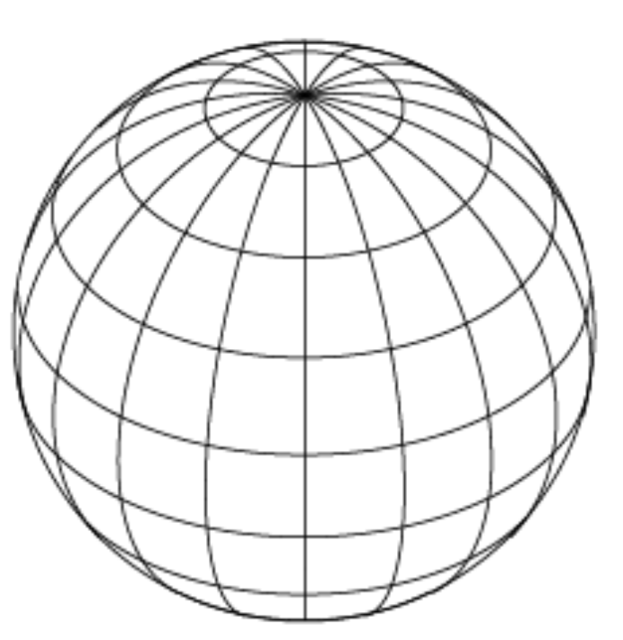
North
ε
East
H
α
A

