Slide 1
Annual vs Casual Member Ridership Differences
Presented by: Leonardo Capocci
Last updated: 05/30/2023
Rough guide of speaker notes included

Slide 2
Table of Contents
Objective
Data Analyses
Key Insights
Convesion Strategy

Slide 3
Objective
Identify if there are differences in ride duration and ride frequency between annual member and casual member’s ridership through the week.
Notes:
The objective of this case study is to understand how annual members and casual riders use Cyclistic bikes differently. By analyzing the ridership patterns and behaviors of these two groups, the goal is to gain insights that will inform the design of a new marketing strategy to convert casual riders into annual members.

Slide 4
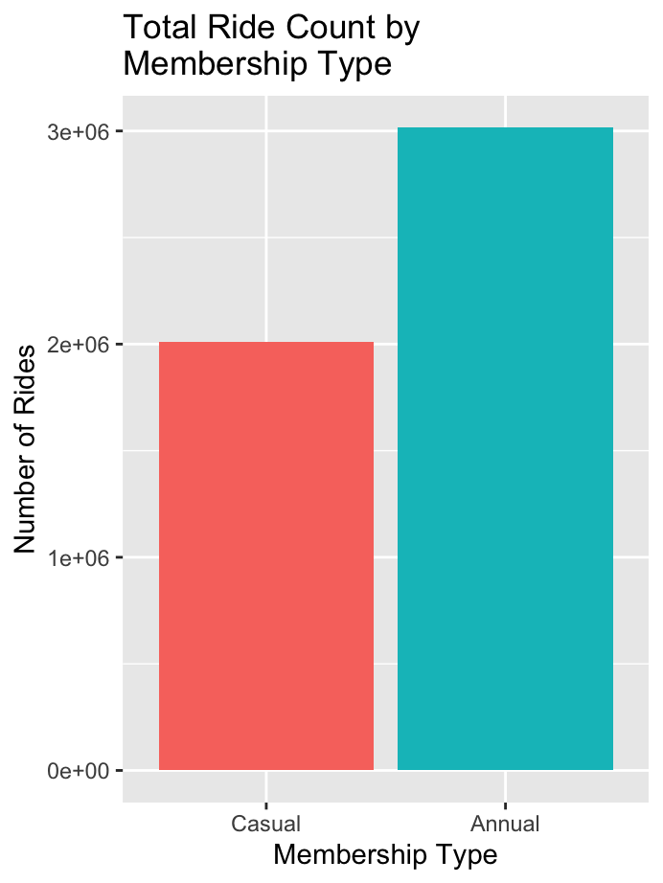
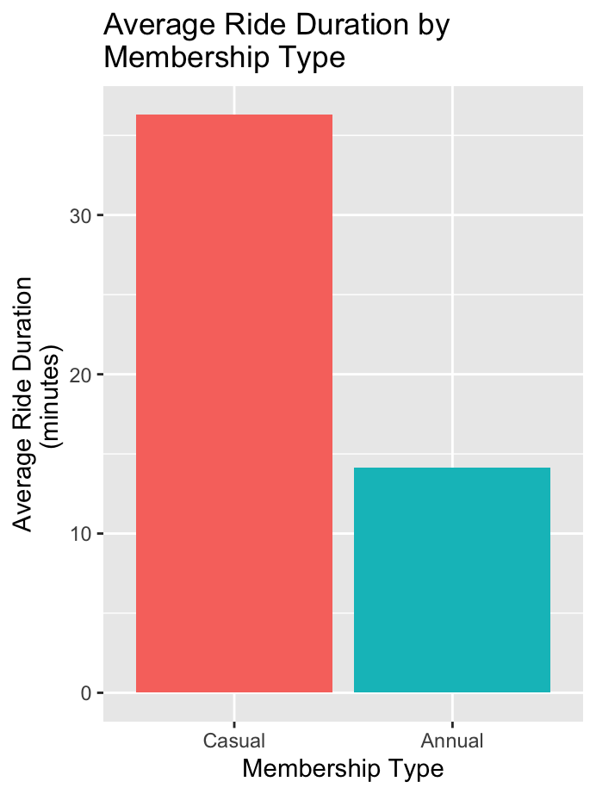
Overall Member Analysis
Notes:
This graph shows the difference between casual members and annual members as it pertains to their overall ride count. The blue bar represents our annual members and the red our casual members.
We can see that annual members have a total ride count of 3 million, whereas the casual members sit at a total of 2 million.
Now this second graph shows the comparison between member types regarding their ride duration, where we can see that casual members have an average ride duration of 36 minutes and annual members have an average ride duration of 14 minutes.

Slide 5
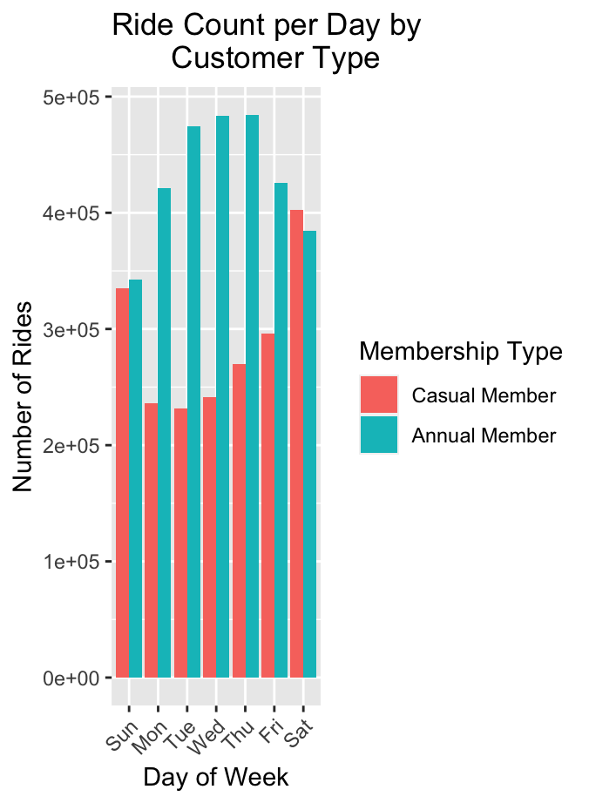
Ride Count Through the Week
Notes:
Delving further into the details of the ride count by looking at it through the week we get this graph with days of the week on the x axis and number of rides on the y axis and the color of members types are the same as previous (point to legend)
This graph allows us to see than the ride count of annual members is elevated during weekdays and the the ride count of casual members is elevated on the weekends. This highly suggests that annual members are often using our bikes to commute to their jobs whereas casual members are more often using them for leisurely rides.

Slide 6
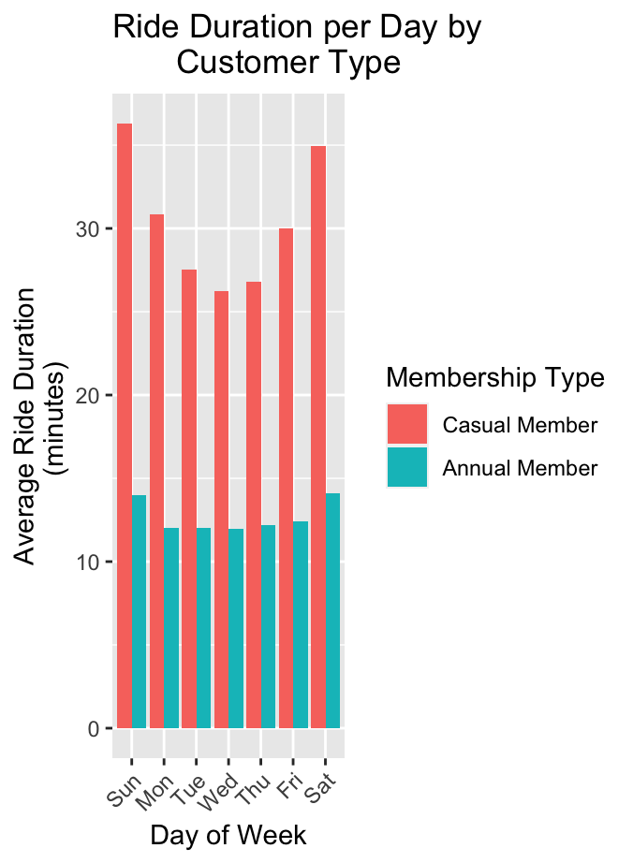
Ride Duration Through the Week
Notes:
Now looking at a similar graph but for ride duration through the week with days of the week on the x axis and the ride duration on the y axis, we can see that annual members average ride durations are very constant through the week with very little change. Casual members’ average ride durations peak on the weekend on reach their lowest time on Wednesday.

Slide 7
Key Insights
Annual members use Cyclistic more often and more frequently than casual members
Casual members’ ride count and ride duration peak on the weekends
Casual members use Cyclistic for leisure more often than commuting
Notes:
Annual members use Cyclistic more often and more frequently than casual members, however casual members are a significant portion of the overall ride count and have a higher average ride duration than the annual members consistently
Casual members’ ride count and ride duration peak on the weekends.
The data implies that casual members use Cyclistic more for leisure than for commuting so we should tailor targeted promotions to leisurely riders.

Slide 8
Conversion Strategy
Target the casual riders with promotions
Give a generous trial period for casual riders to test it out
Create plans more tailored to leisurely riders
Social media outreach
Notes:
We should target riders who are riding less consistently through the week and more often on weekends with promotions tailored for leisurely riders showing the benefits of an annual plan.
A generous time for a trial period will be beneficial as it convinces casual members to give the premium membership a taste where they will then be signing up for a year.
Plans that are more tailored towards leisurely riders could help attract more—for example, an annual plan that is cheaper than the normal annual plan but has perhaps a fixed number of rides per week/month that you can’t go over.
Social media outreach is a very effective method of brand awareness and can go a long way in convincing people that were on the edge of getting a membership or not.

Slide 9
Further Analysis
Seasonal patterns of ridership data
Feedback forms when signing up for annual membership
Surveys for both casual and annual members on pricing and plan flexibility
Notes:
This slide contains some ideas for further analysis
It could be valuable to analyze the seasonal patterns of ridership data as we could optimize bike availability and alter marketing campaigns accordingly.
Additionally, implementing feedback forms in the upgrade to annual membership process could help us get rid of any friction zones in the process that may be losing us some potential members.
Surveys on both casual and annual members regarding pricing and plan flexibility could be beneficial as it could help us form an ideal pricing plan for the leisurely plan package that I proposed earlier, or help us adjust the standard annual plan that we currently have.

