Slide 1
Paul A. Tipler • Gene Mosca
Physics for Scientists and Engineers
Fifth Edition
Chapter 1:
Systems of Measurement
Copyright © 2003 by W. H. Freeman & Company

Slide 2


Slide 3
1-1
Units

Slide 4
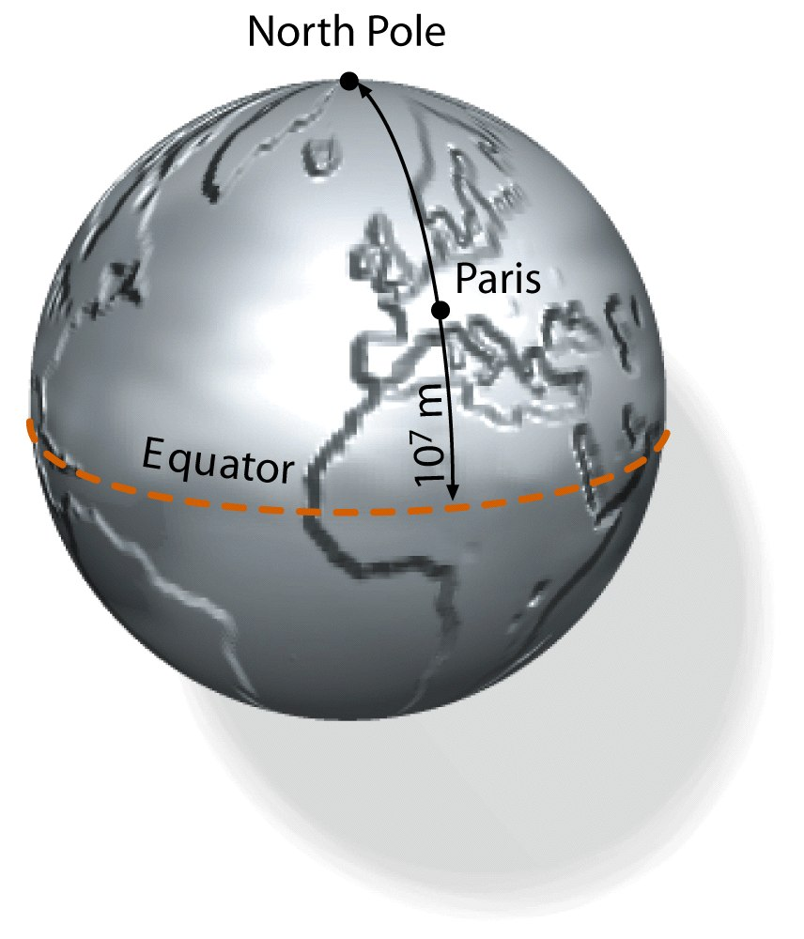

Slide 5
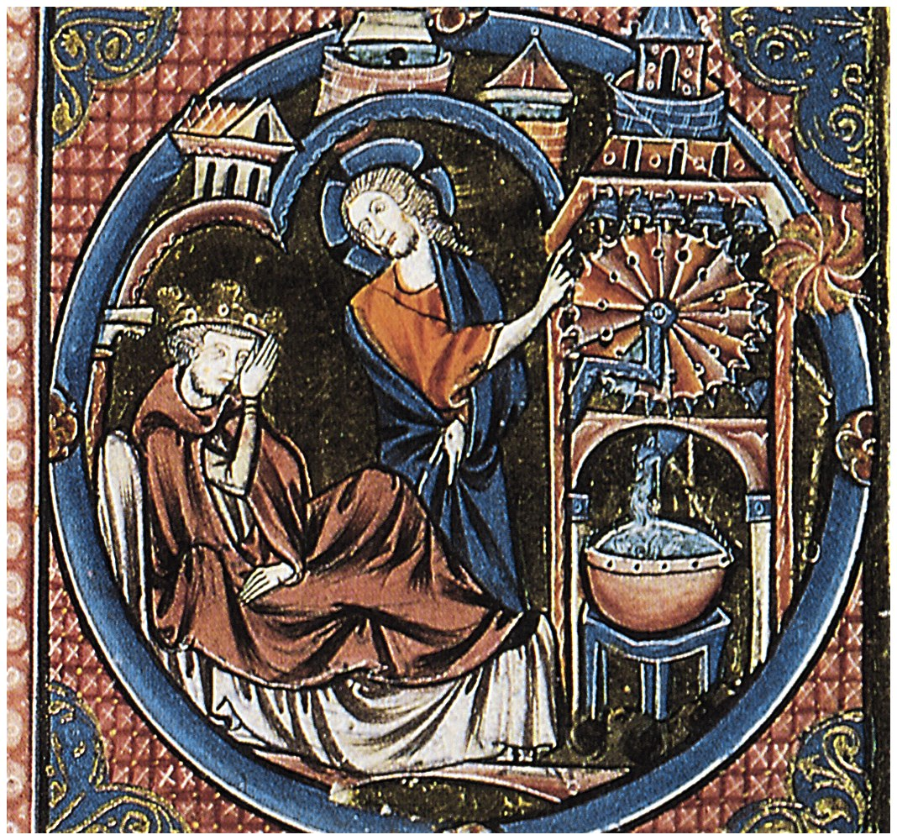

Slide 6
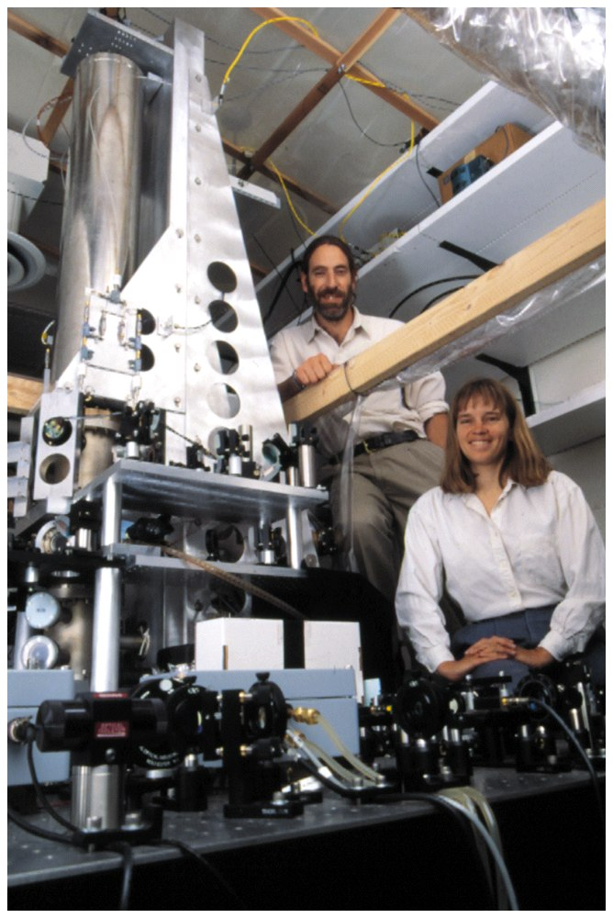

Slide 7
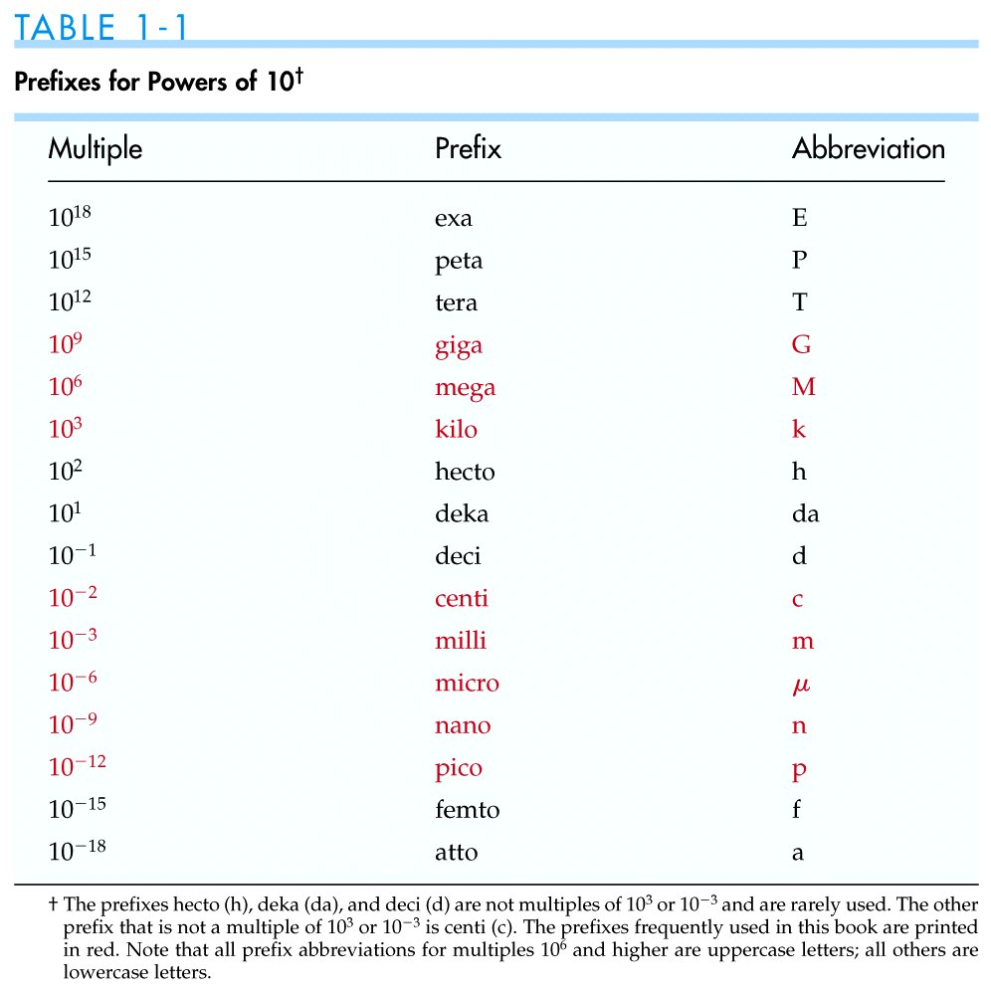

Slide 8
1-2
Conversion of Units

Slide 9


Slide 10
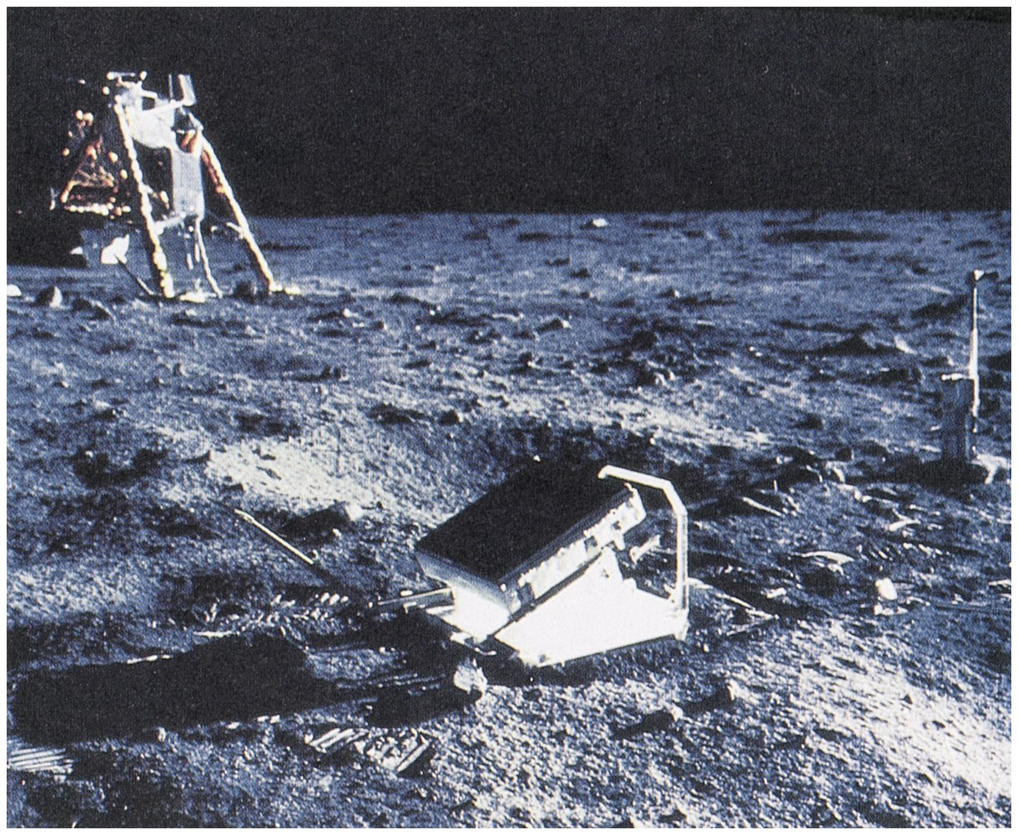

Slide 11


Slide 12
1-3
Dimensions of Physical Quantities

Slide 13
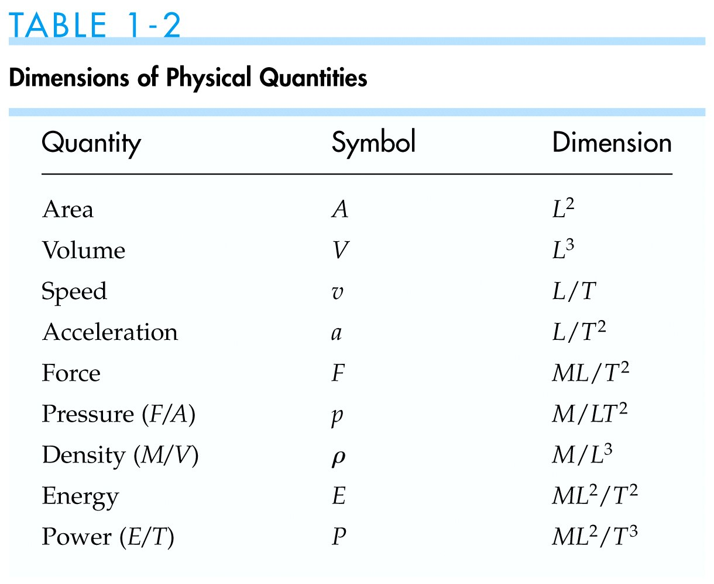

Slide 14
1-4
Scientific Notation

Slide 15
1-5
Significant Figures and Order of Magnitude

Slide 16
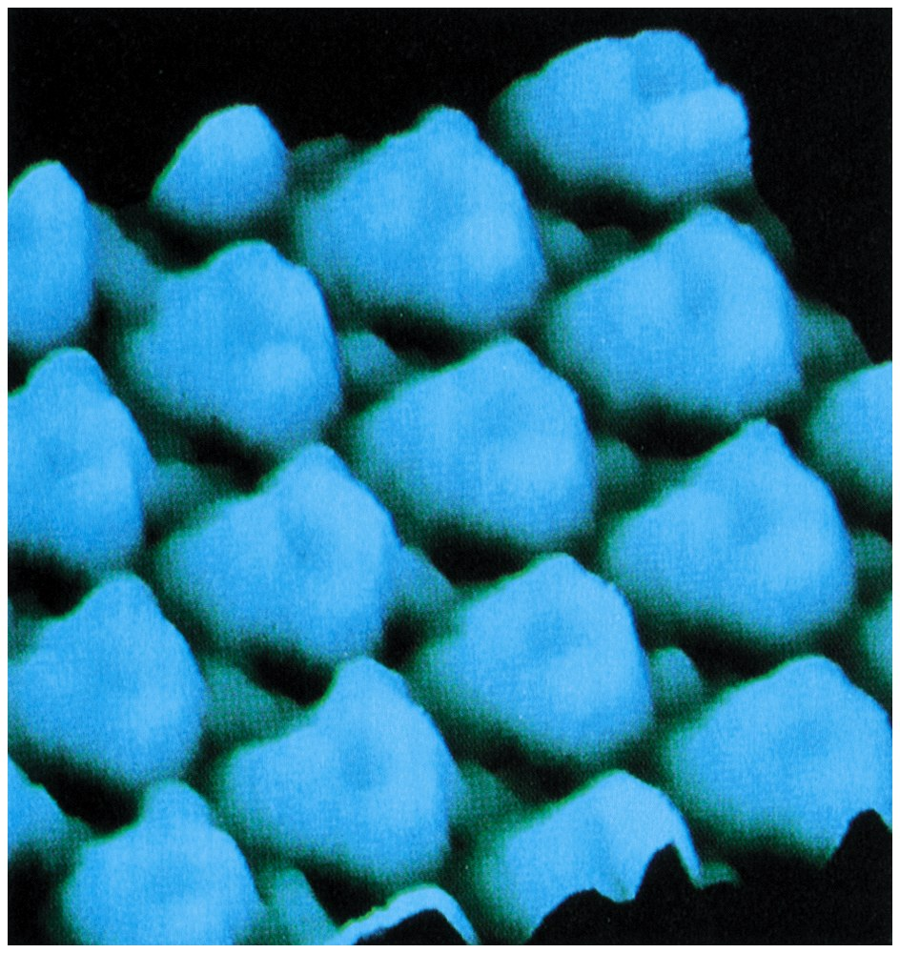

Slide 17
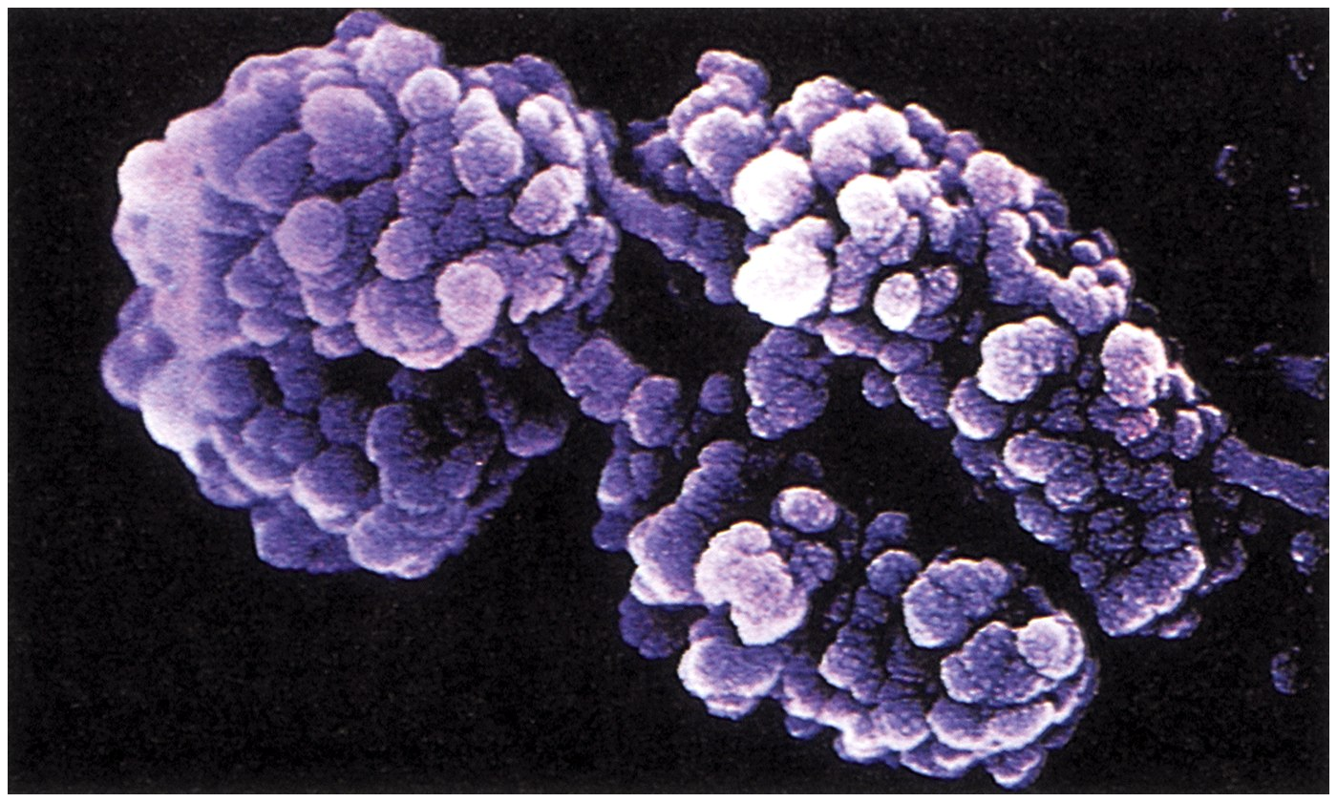

Slide 18


Slide 19


Slide 20
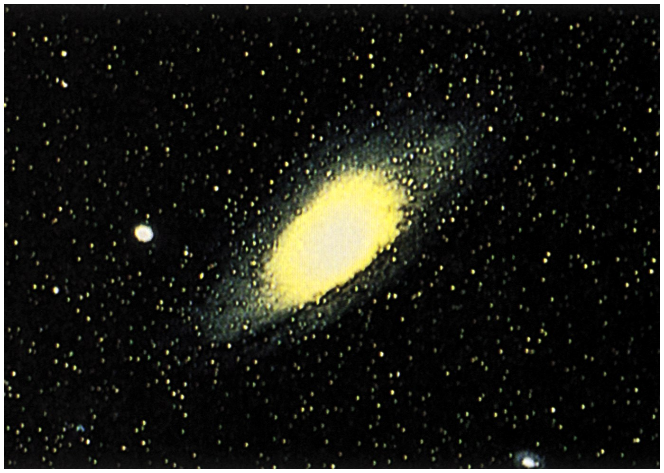

Slide 21
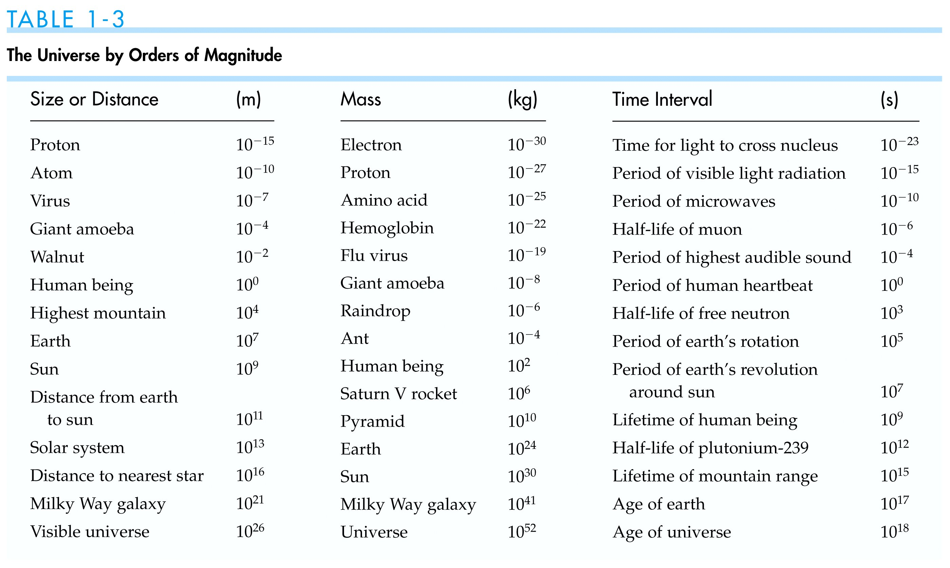

Slide 22
Problems

Slide 23
