Slide 1
Paul A. Tipler • Gene Mosca
Physics for Scientists
and Engineers
Fifth Edition
Chapter 17:
Temperature and the
Kinetic Theory of Gases
Copyright © 2003 by W. H. Freeman & Company

Slide 2


Slide 3
17-1
Thermal Equilibrium and
Temperature

Slide 4
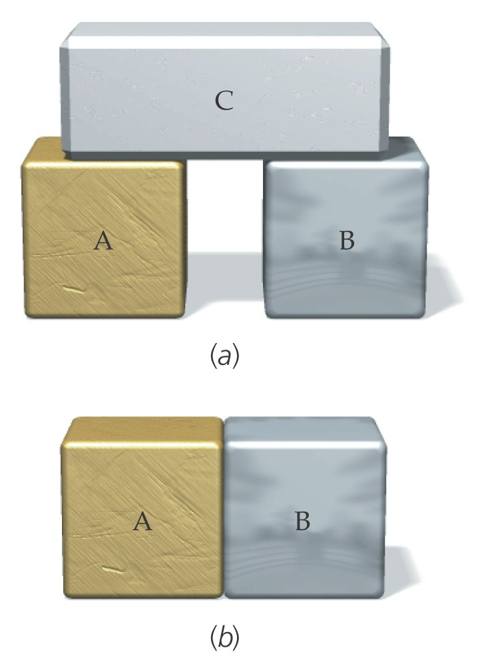

Slide 5
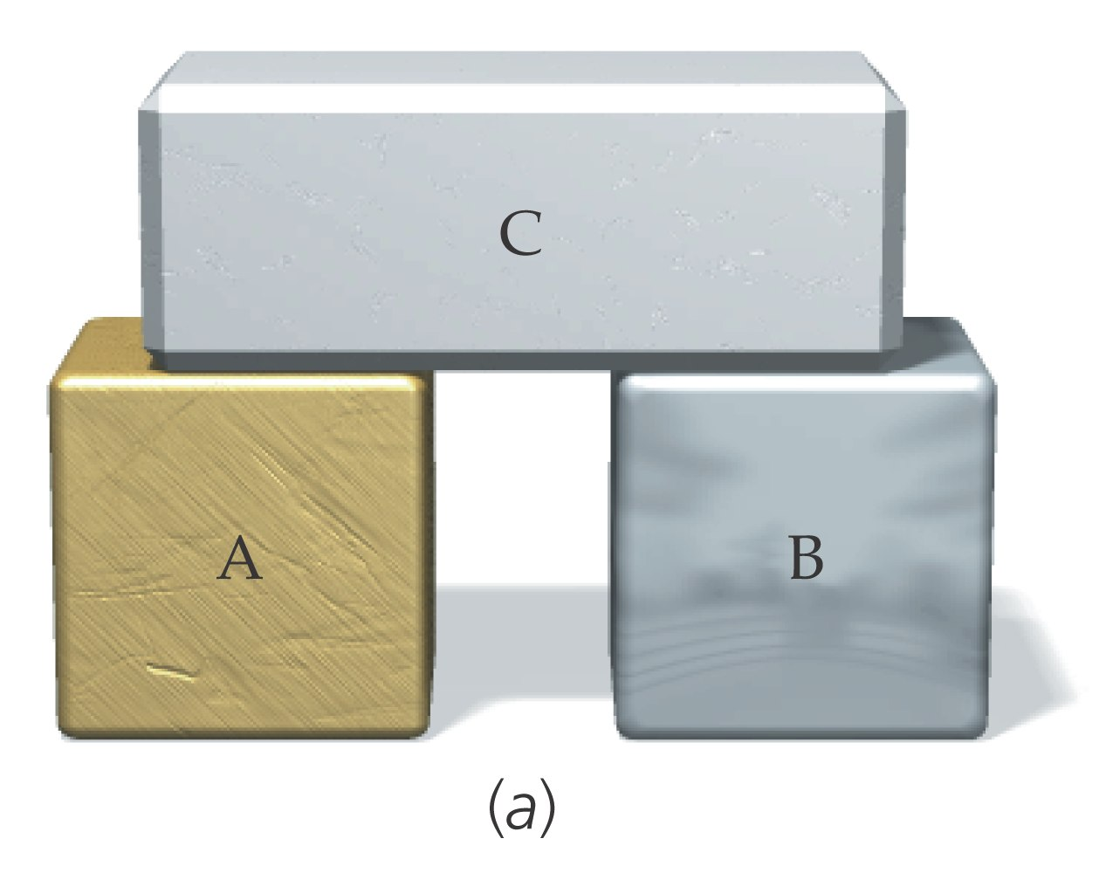

Slide 6
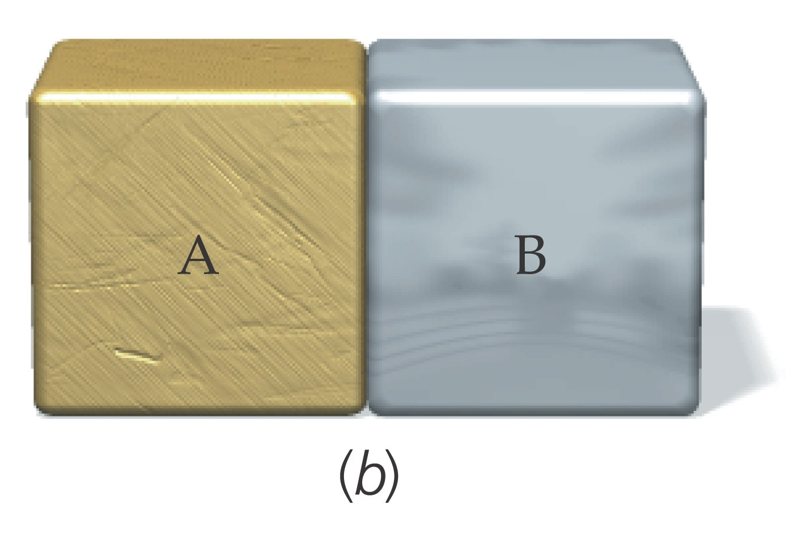

Slide 7


Slide 8
17-2
The Celsius and Fahrenheit
Temperature Scales

Slide 9


Slide 10
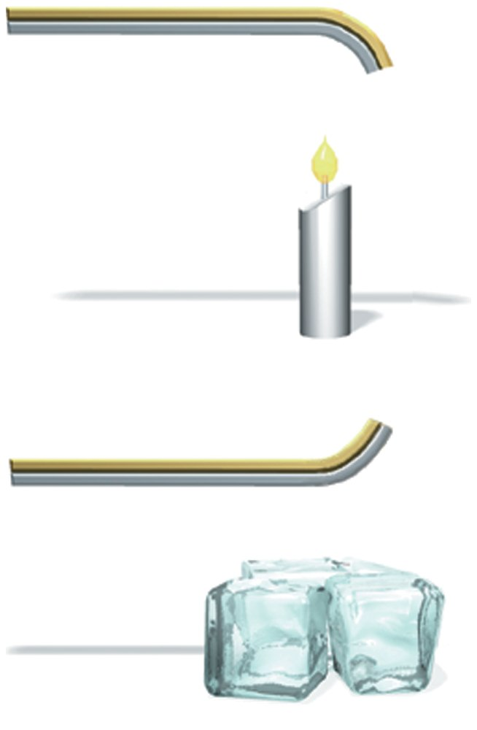

Slide 11
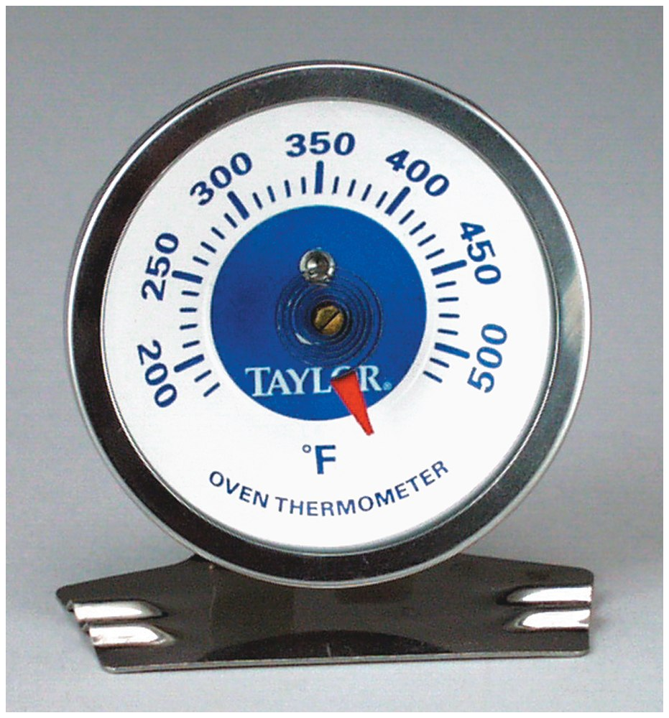

Slide 12
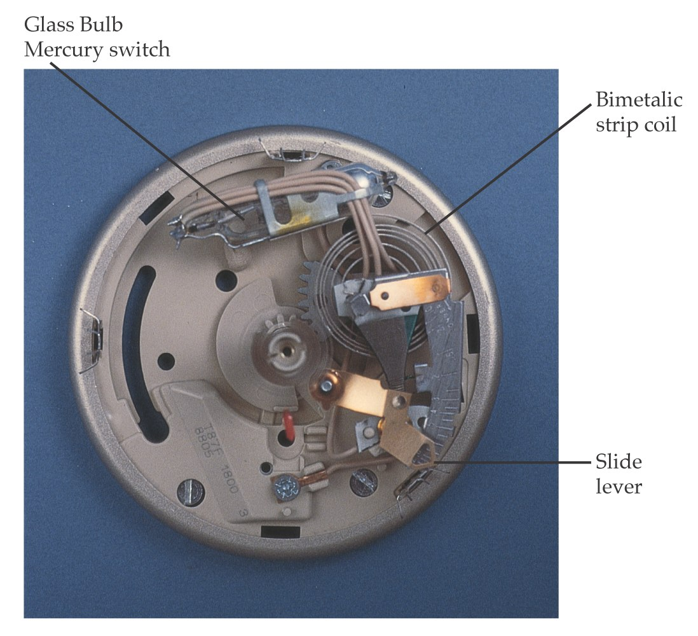

Slide 13
17-3
Gas Thermometers and the
Absolute Temperature Scale

Slide 14
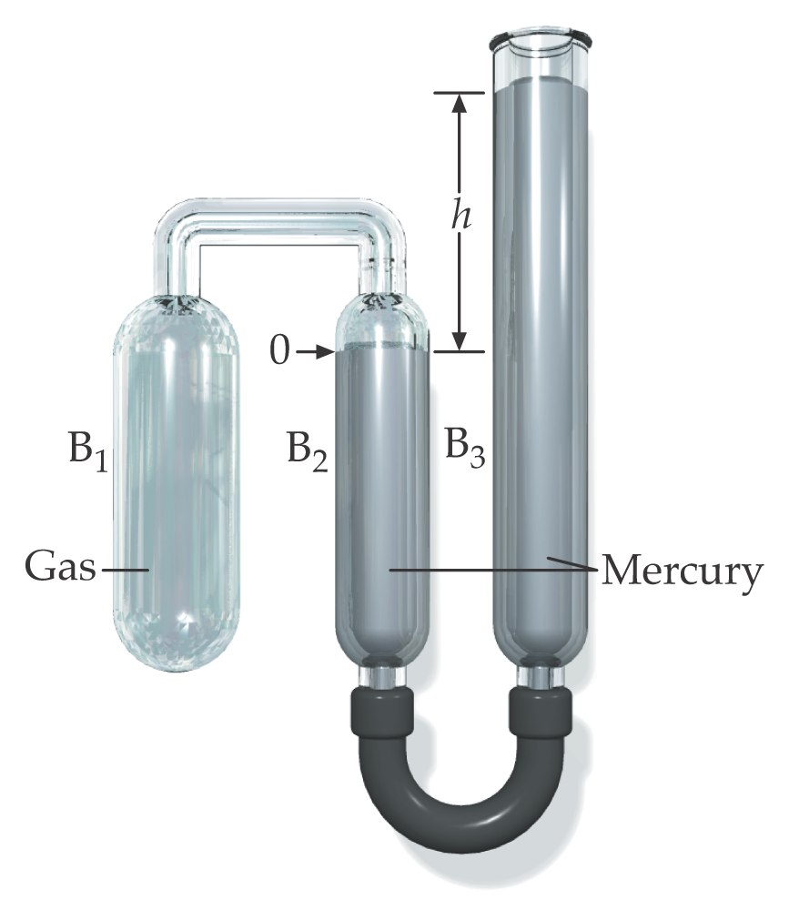

Slide 15
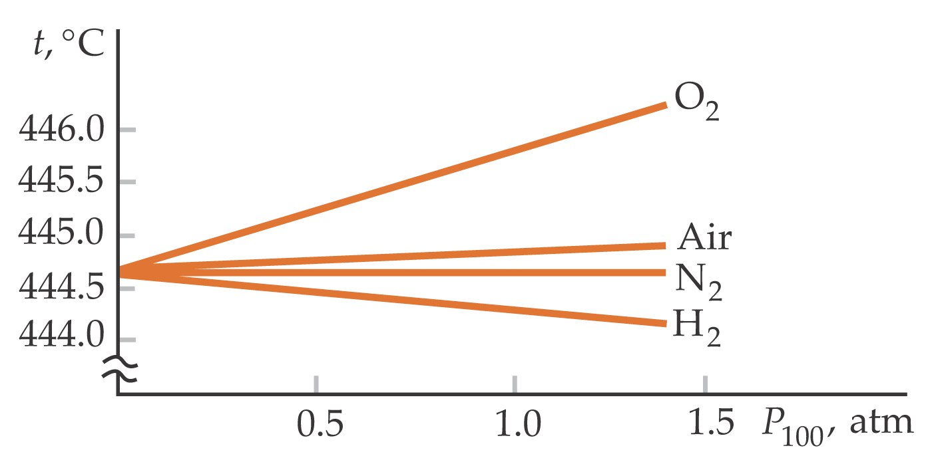

Slide 16
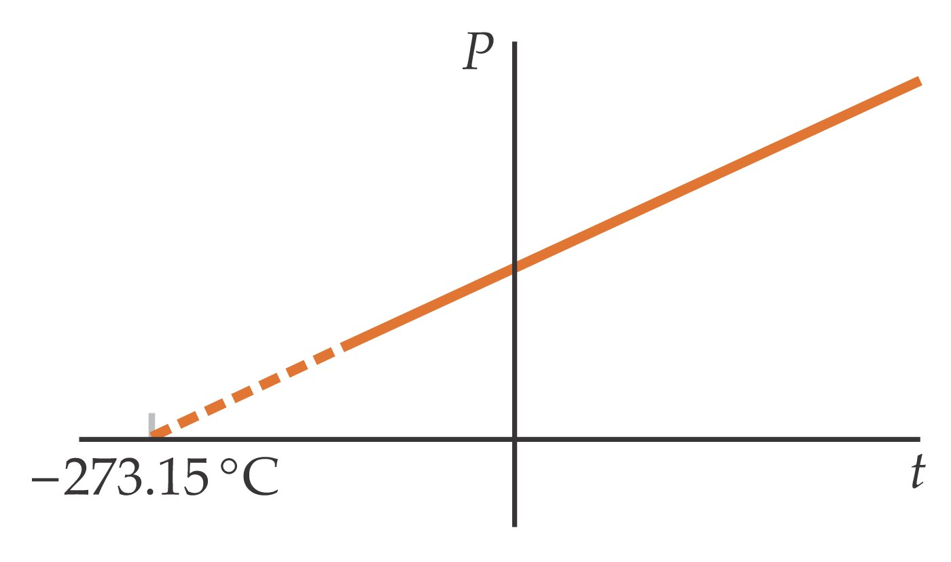

Slide 17
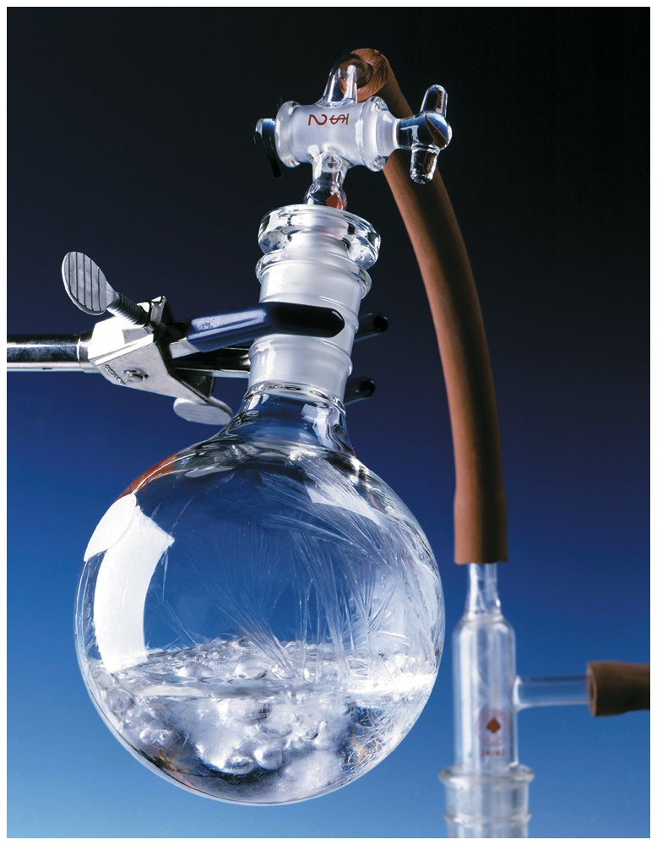

Slide 18
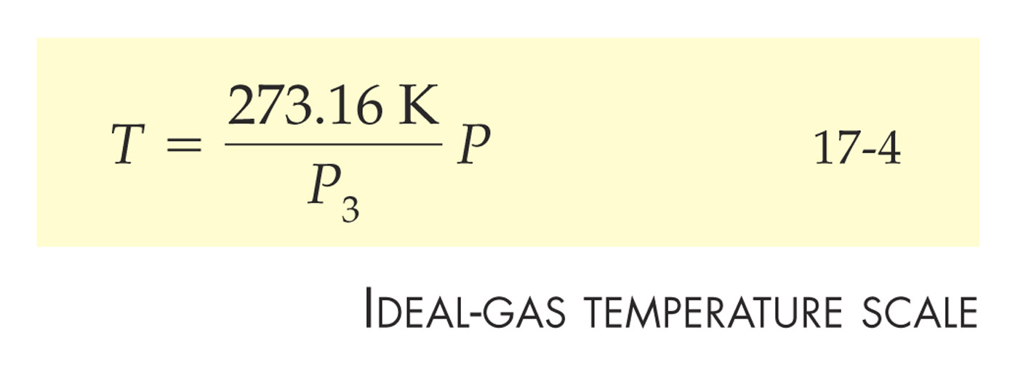

Slide 19
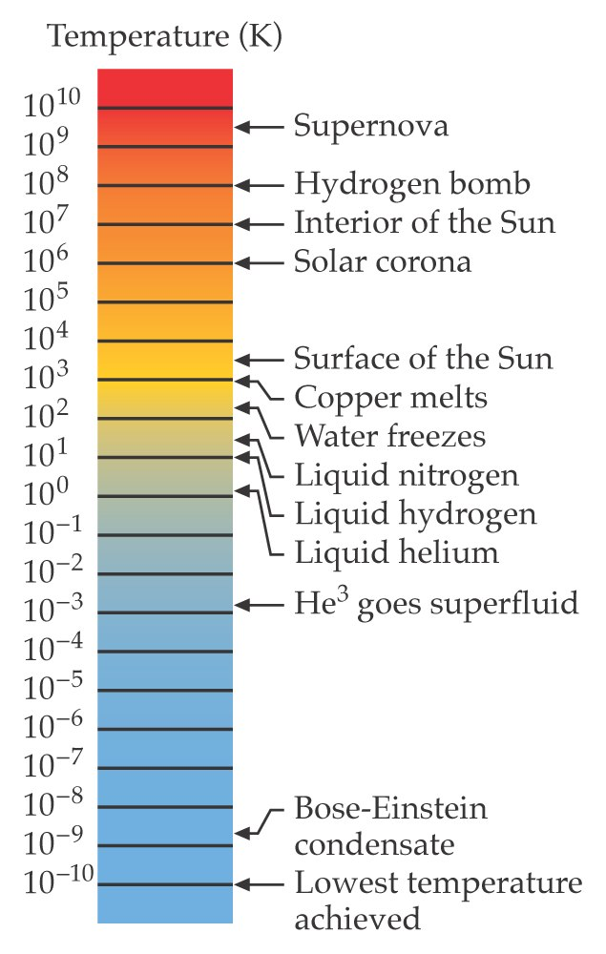

Slide 20


Slide 21
17-4
The Ideal-Gas Law

Slide 22
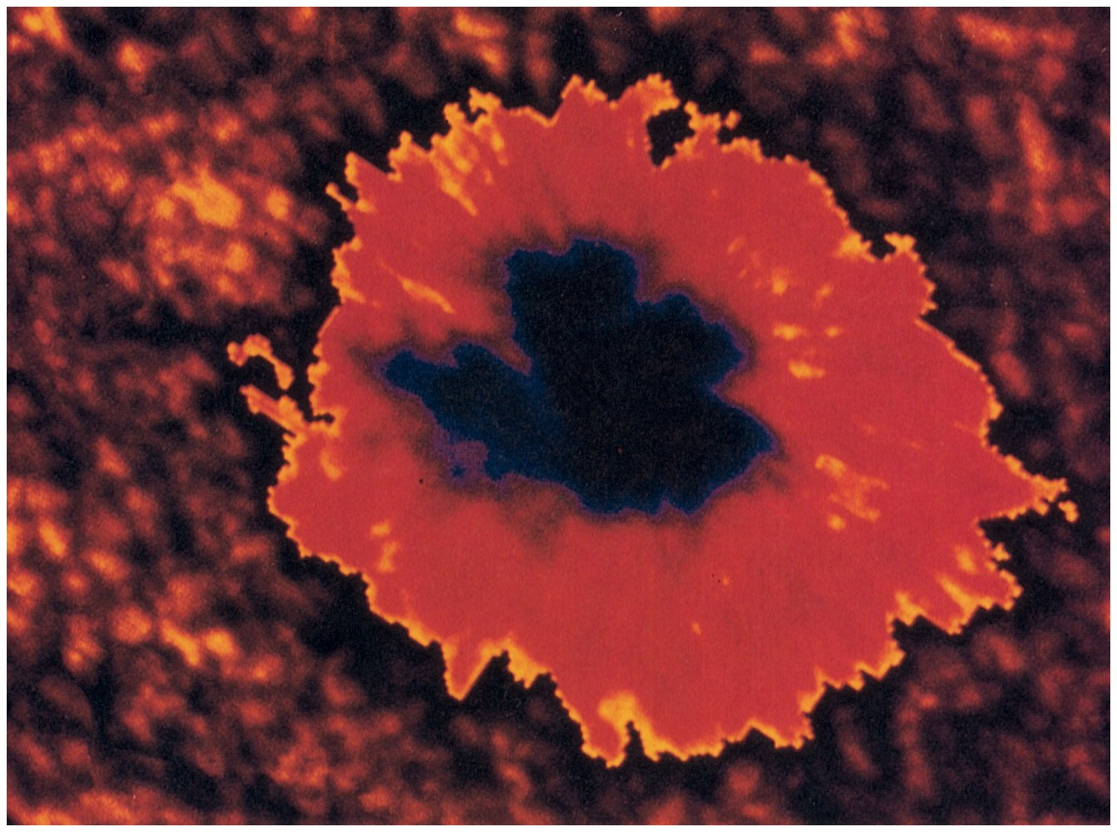

Slide 23


Slide 24
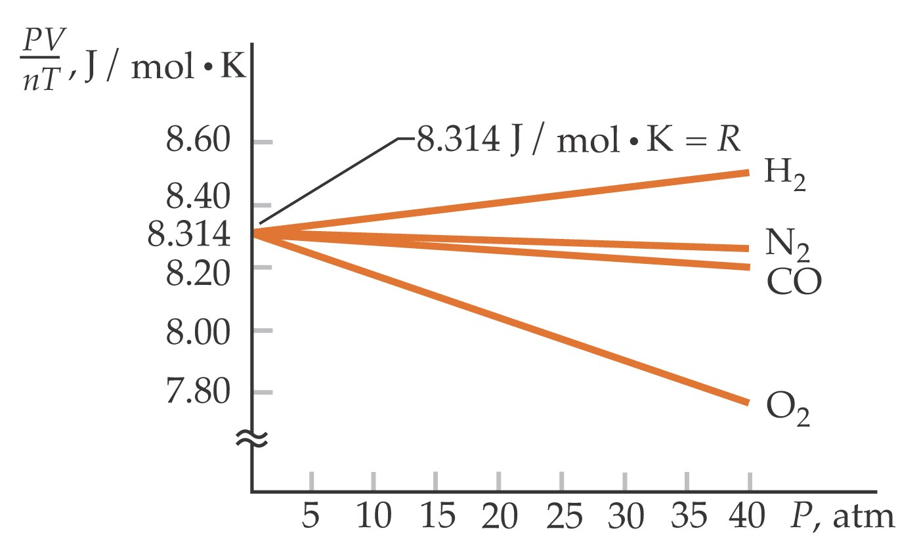

Slide 25


Slide 26
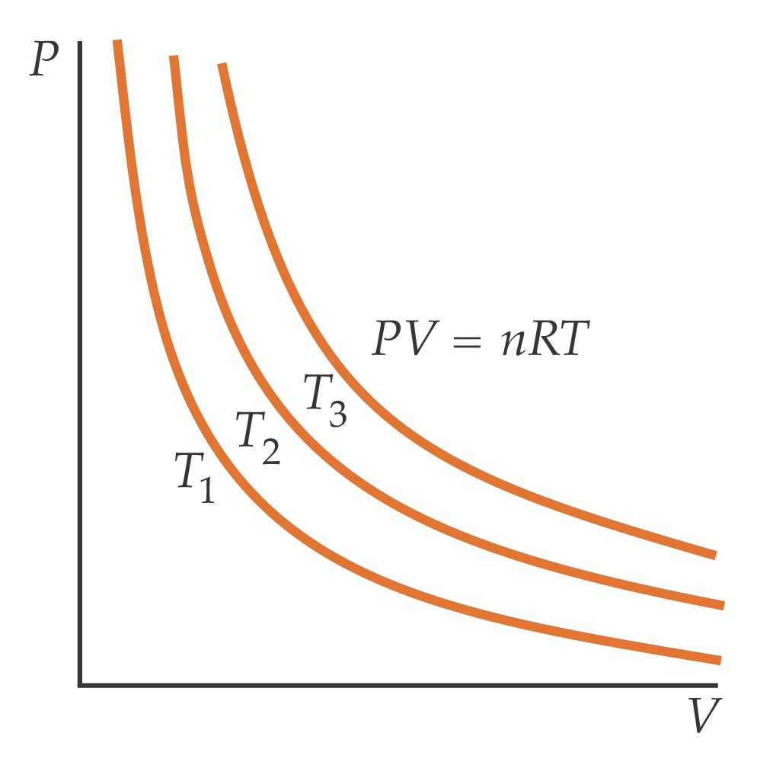

Slide 27
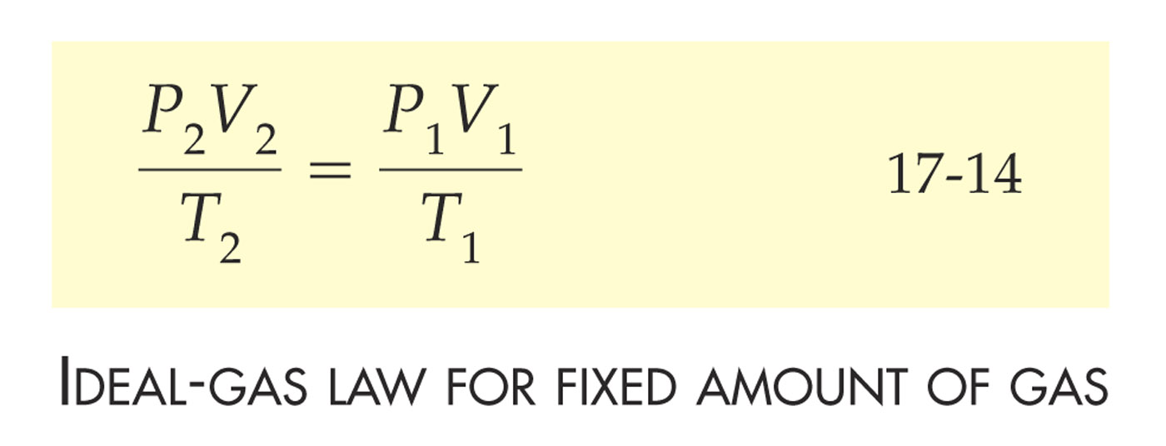

Slide 28
17-5
The Kinetic Theory of Gases

Slide 29
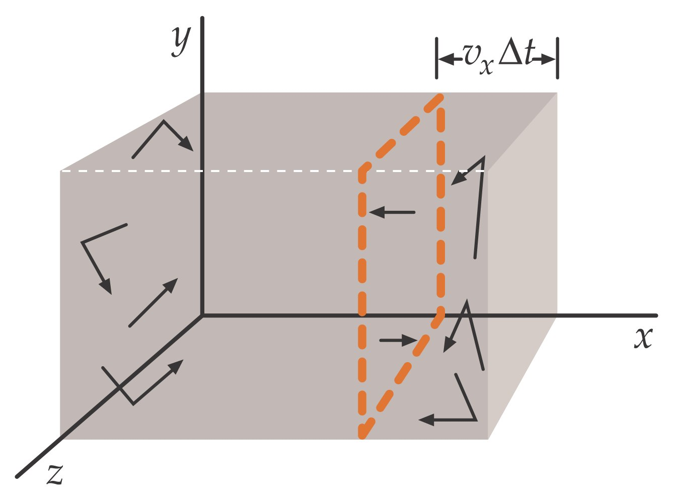

Slide 30


Slide 31


Slide 32


Slide 33


Slide 34
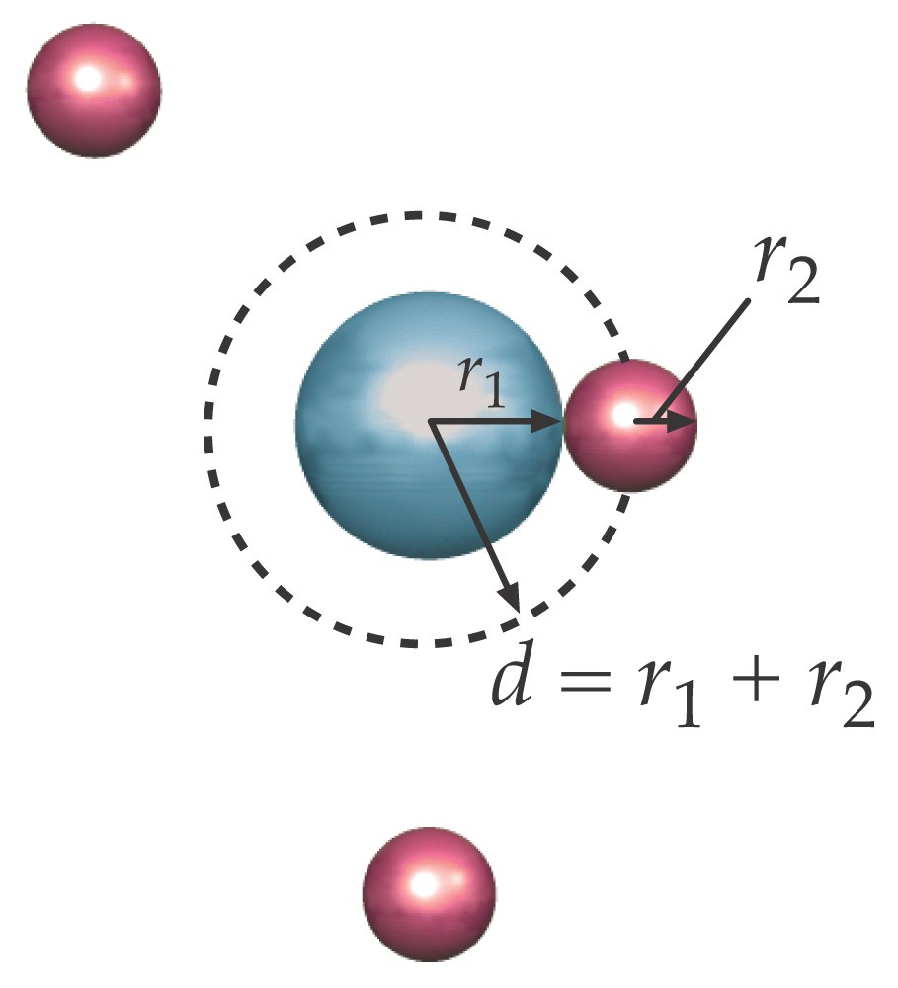

Slide 35
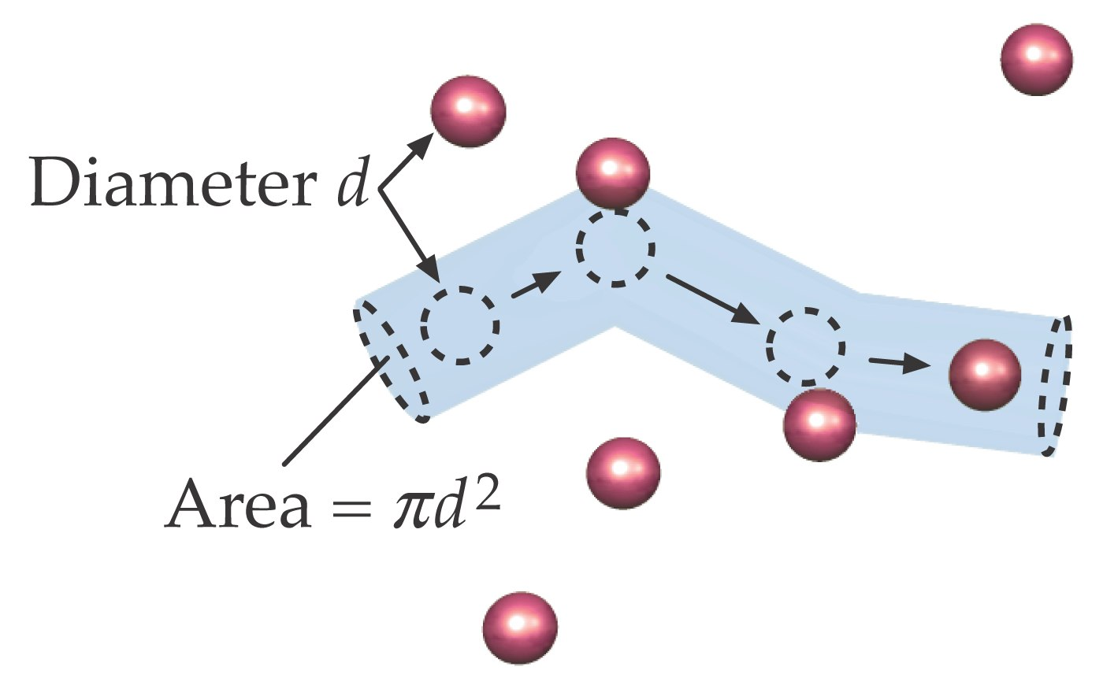

Slide 36
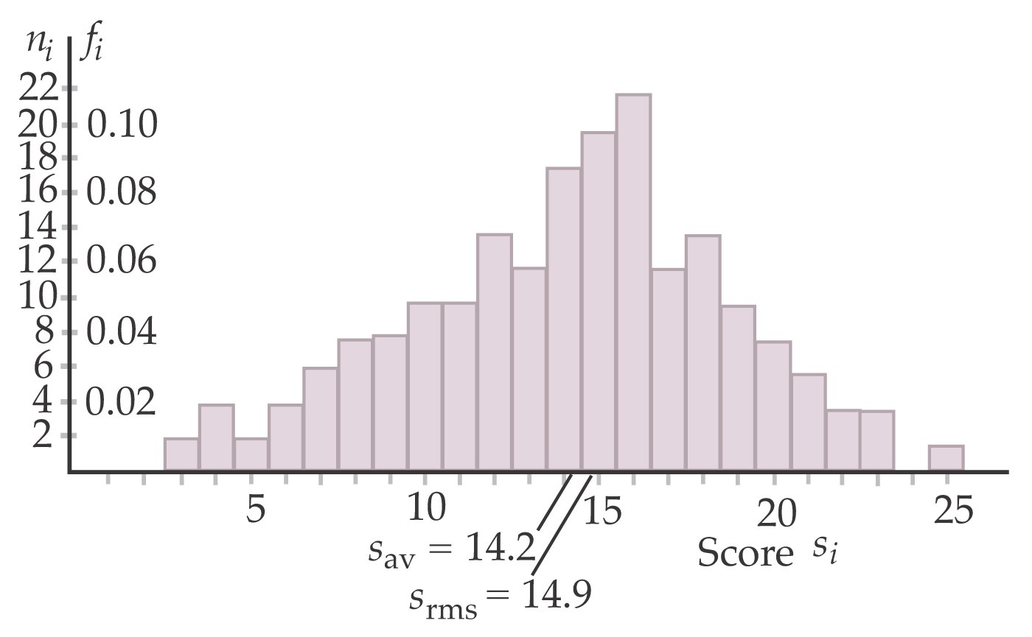

Slide 37
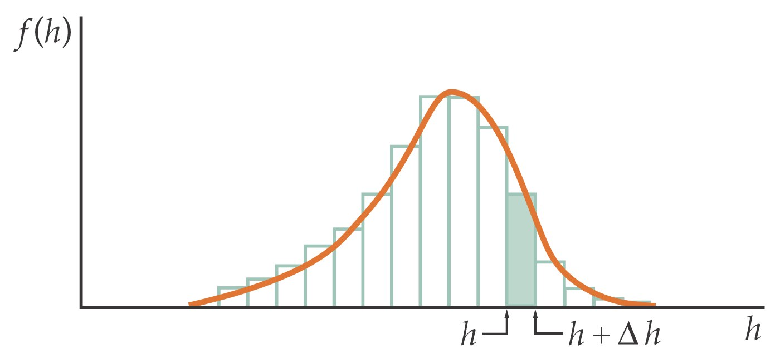

Slide 38
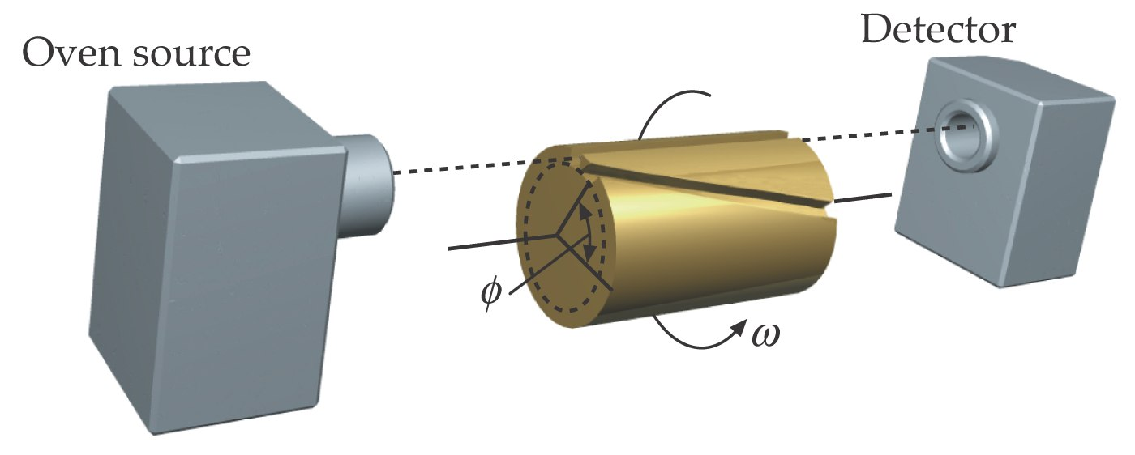

Slide 39
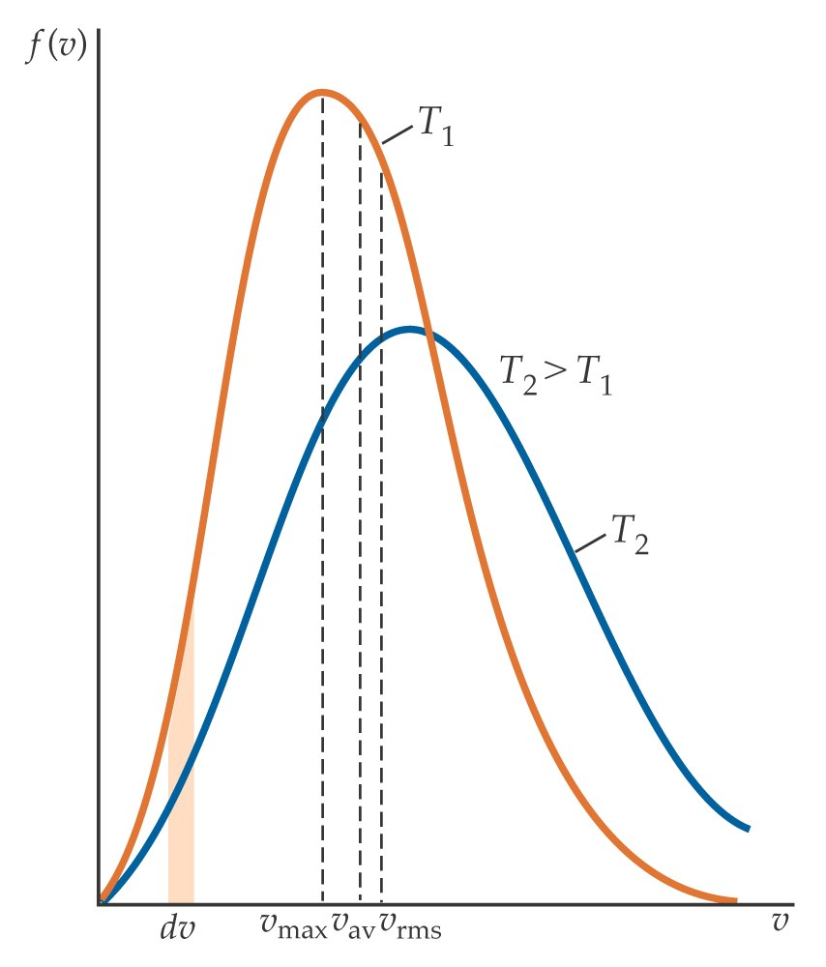

Slide 40


Slide 41


Slide 42
Problems

Slide 43
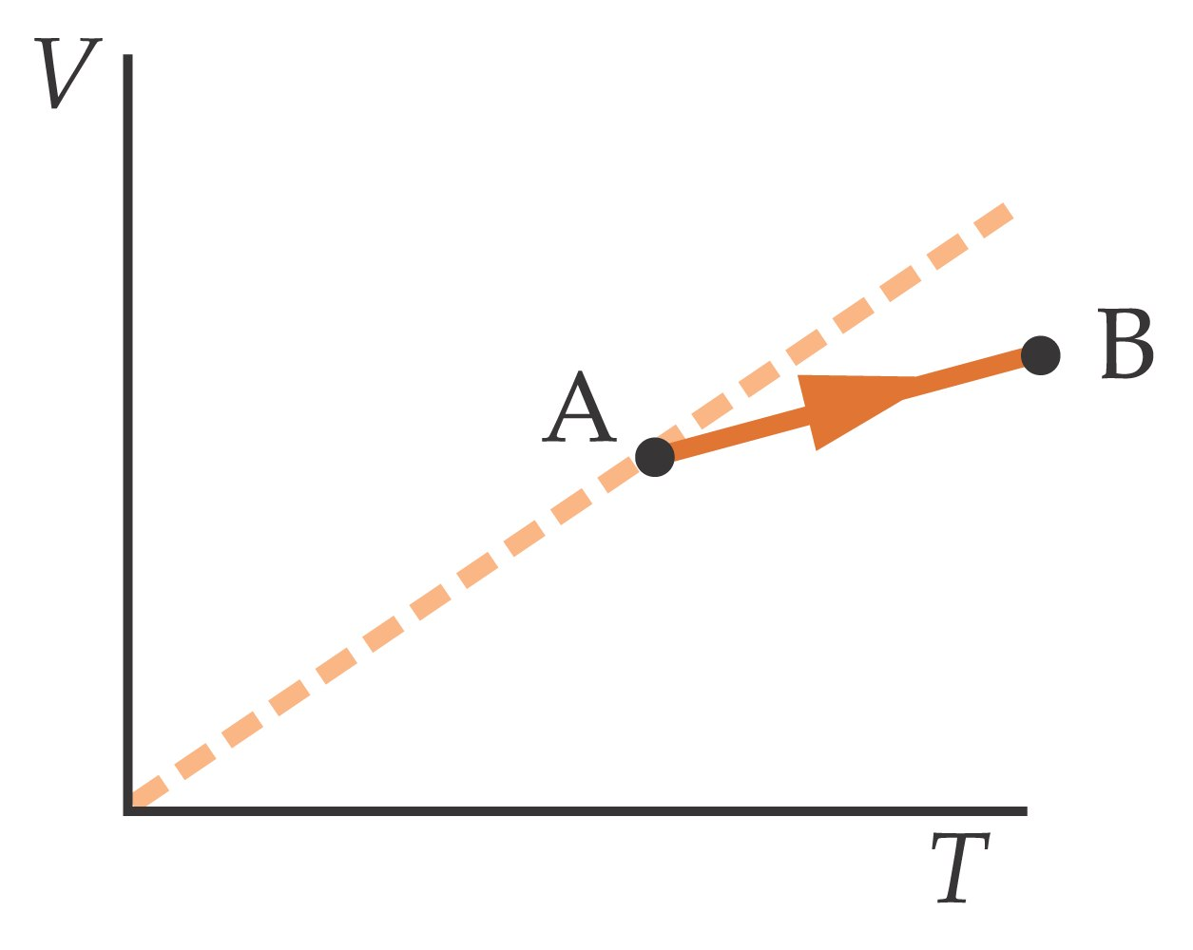

Slide 44
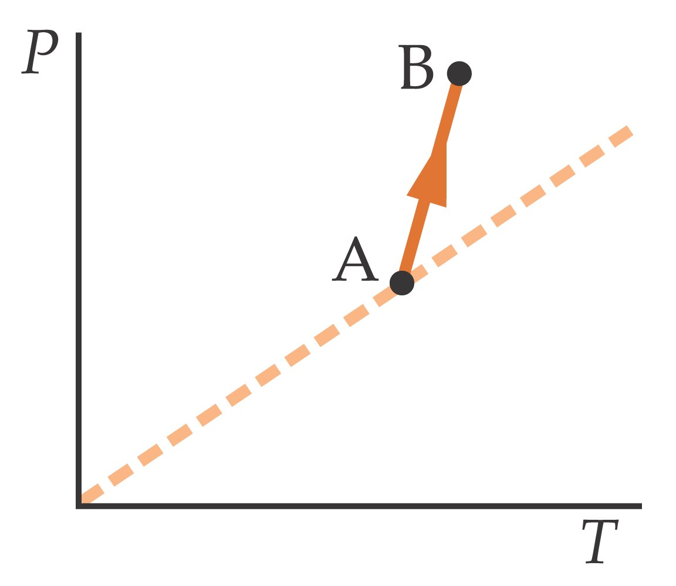

Slide 45
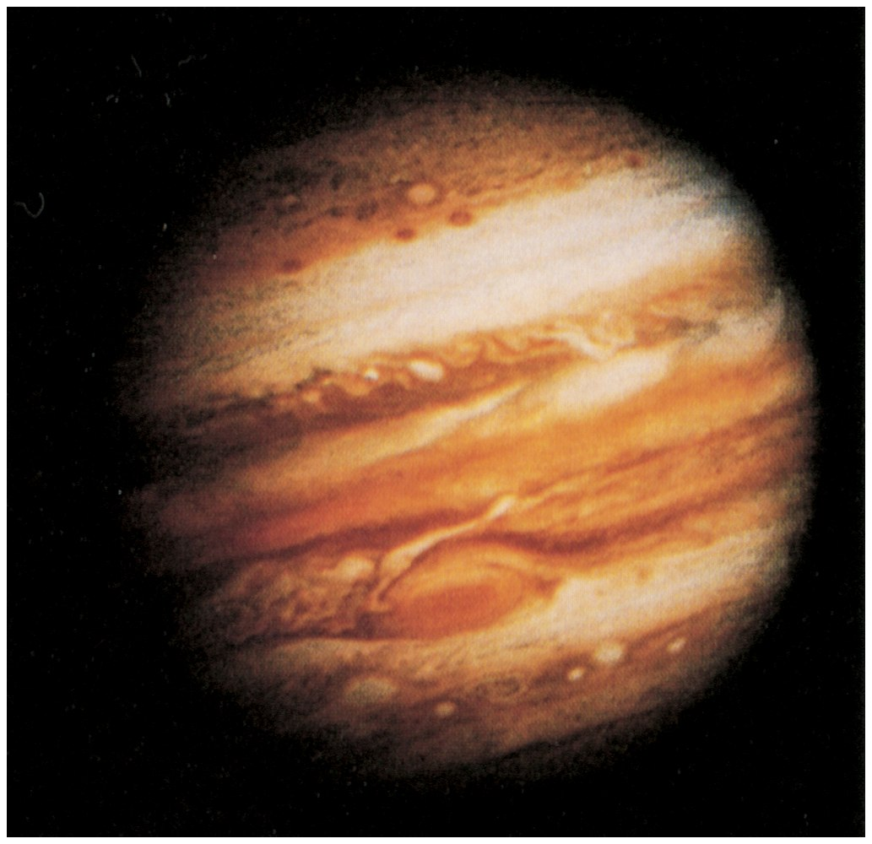

Slide 46
