Slide 1
Physics for Scientists and Engineers
Paul A. Tipler • Gene Mosca
Fifth Edition
Chapter 34:
Wave–Particle Duality
and Quantum Physics
Copyright © 2004 by W. H. Freeman & Company

Slide 2
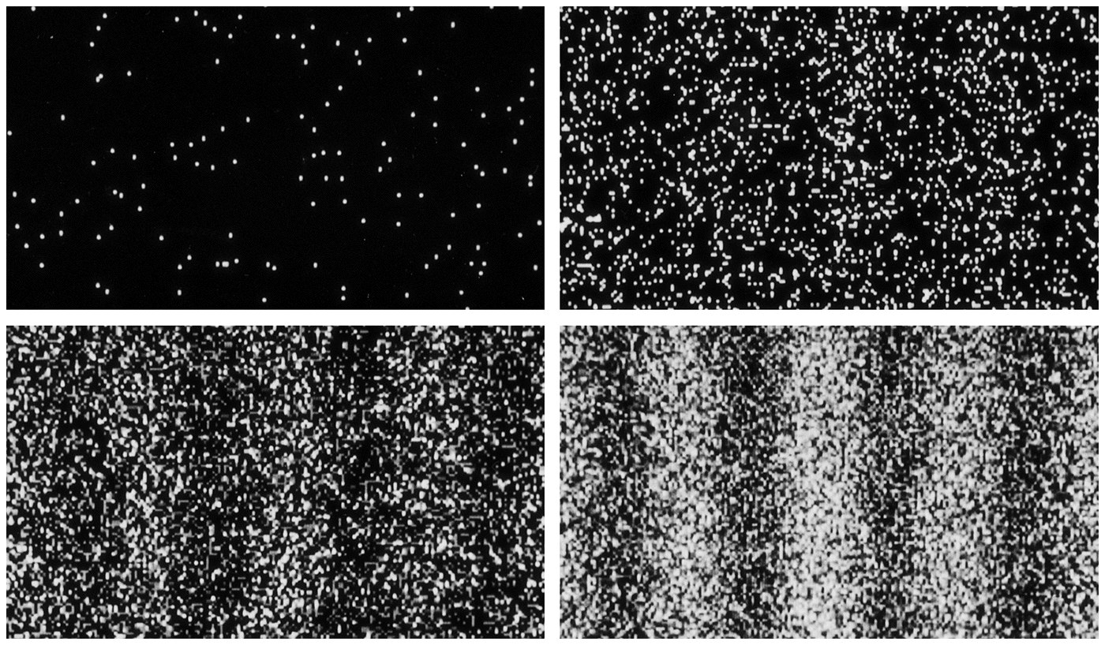

Slide 3
34-1
Light

Slide 4
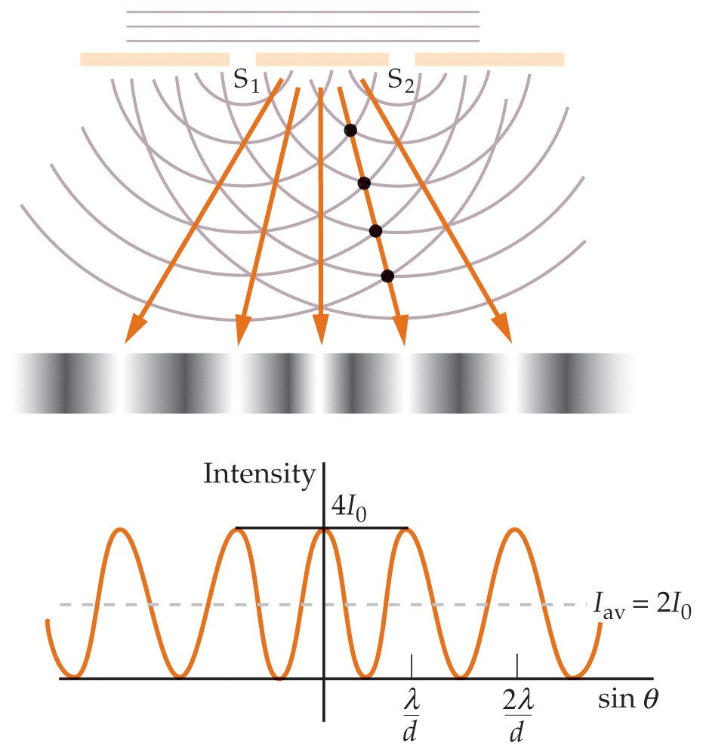

Slide 5
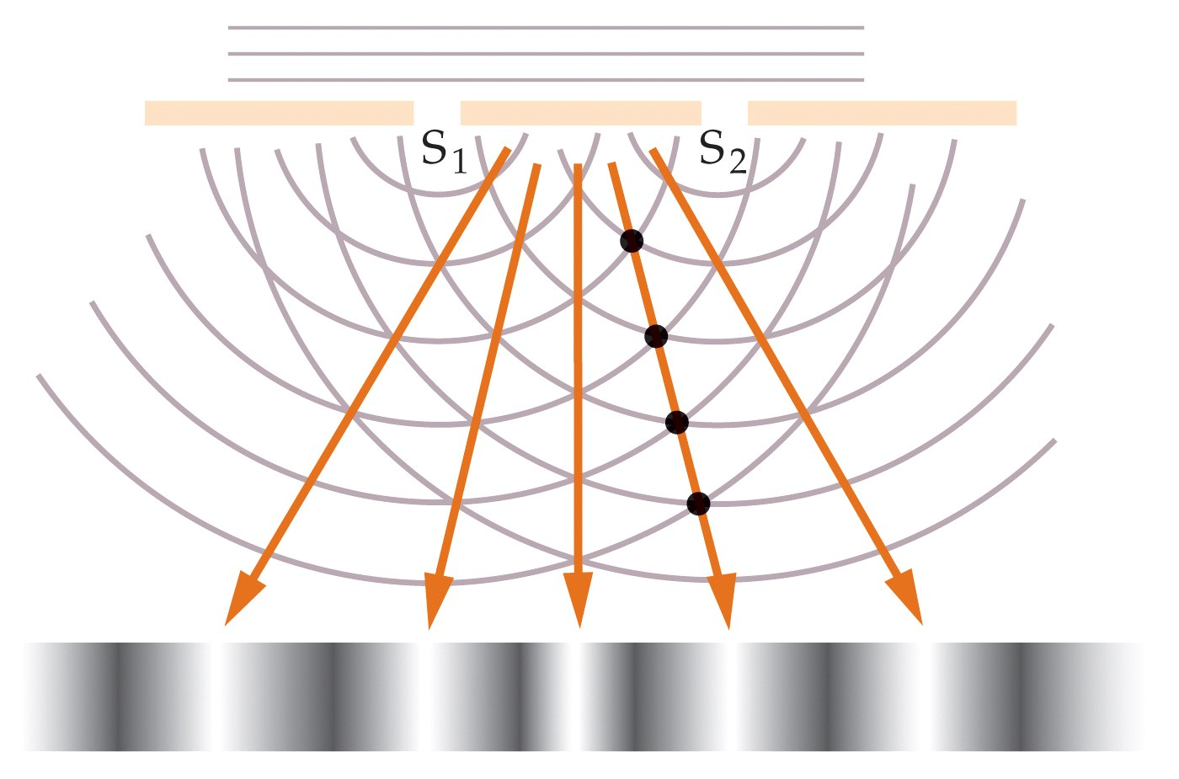

Slide 6
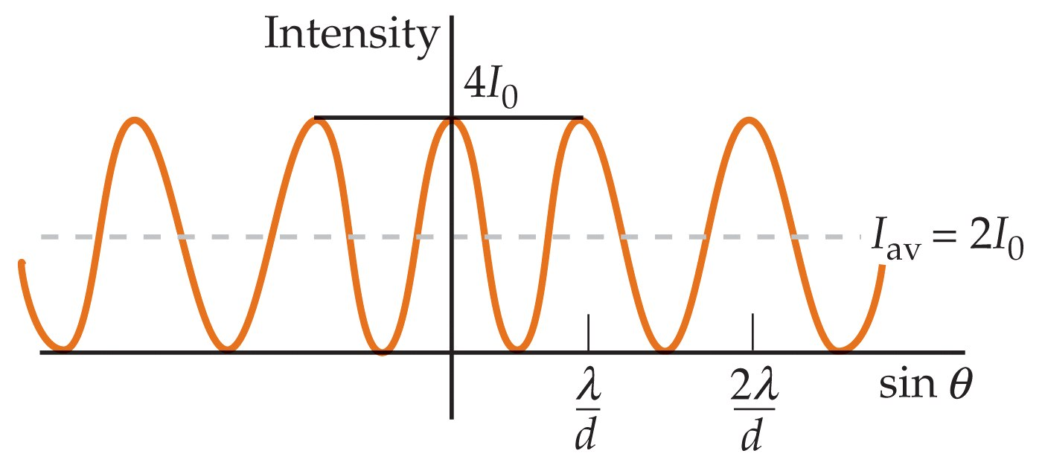

Slide 7
34-2
The Particle Nature of Light: Photons

Slide 8
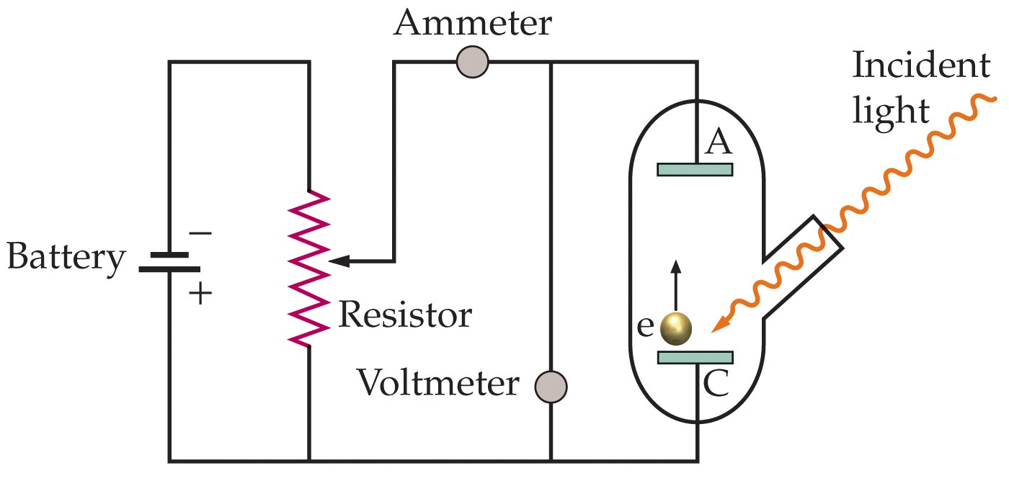

Slide 9
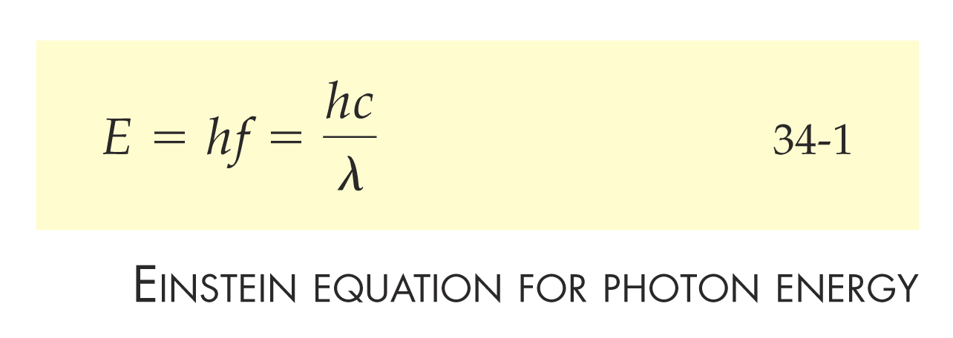

Slide 10


Slide 11


Slide 12
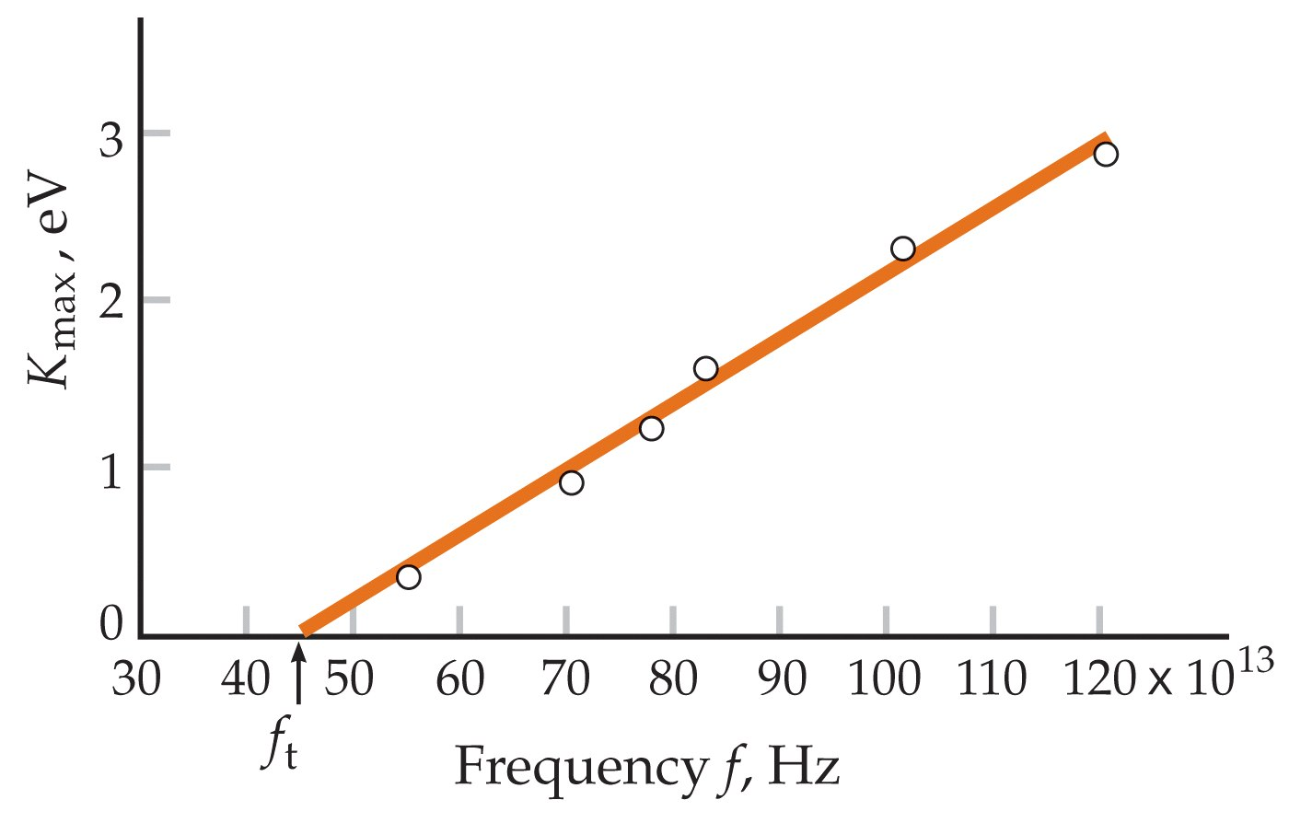

Slide 13
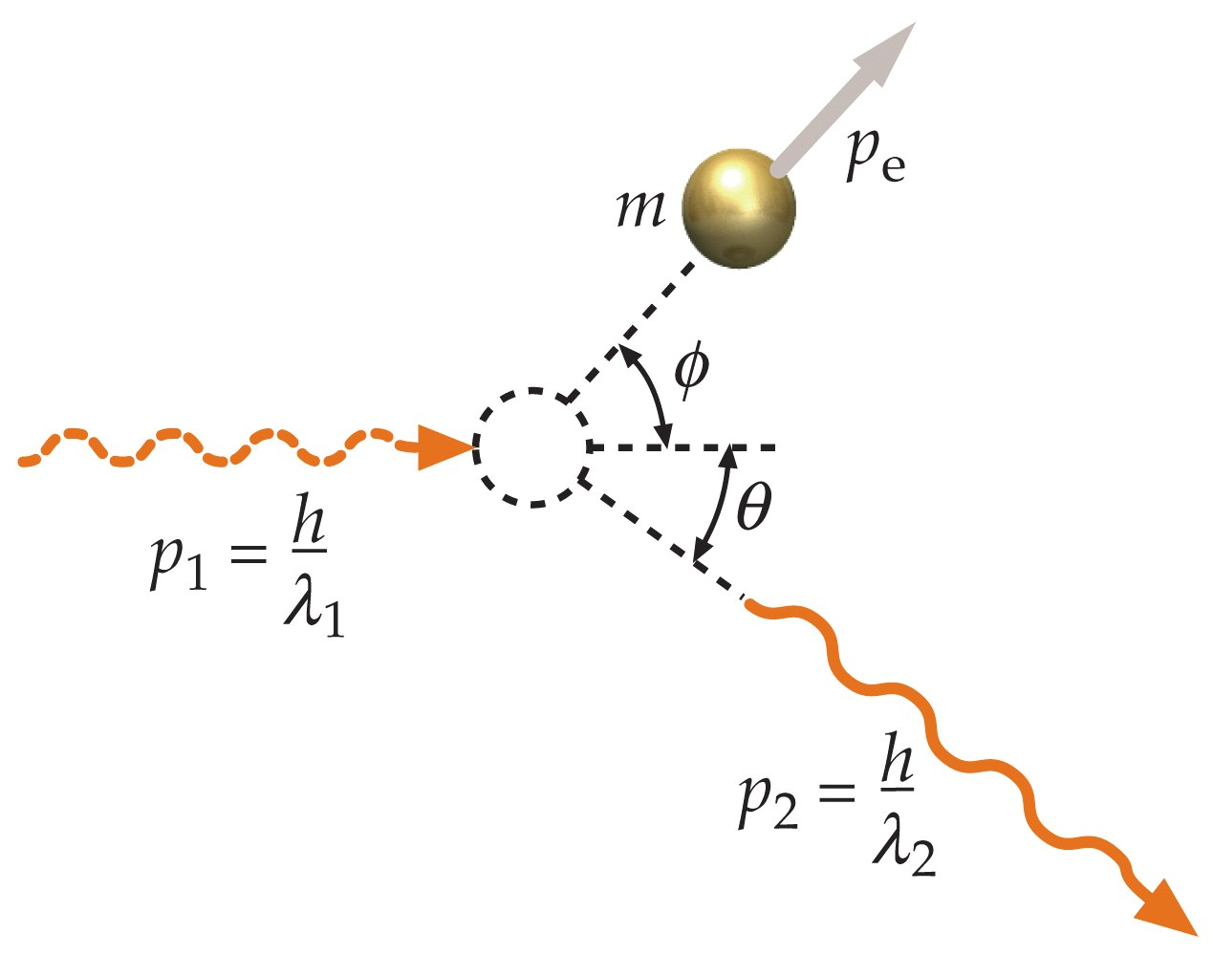

Slide 14
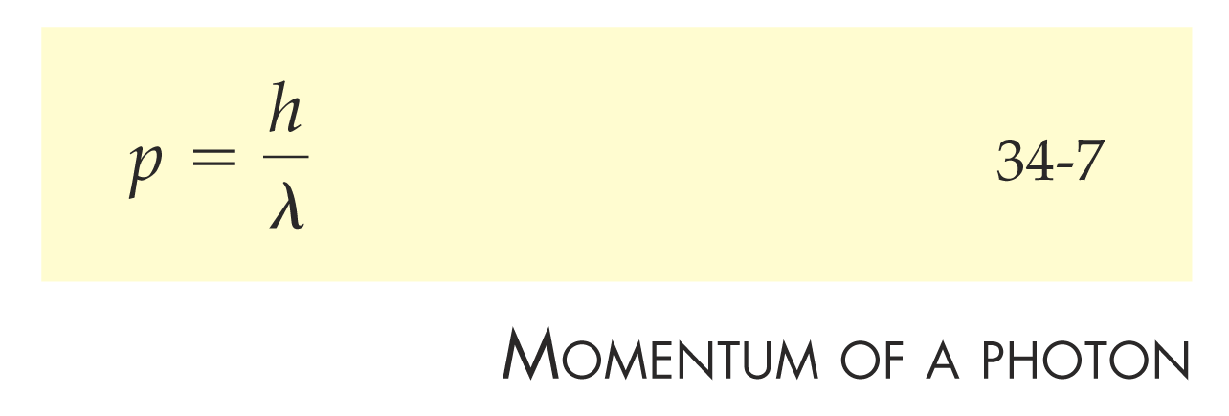

Slide 15
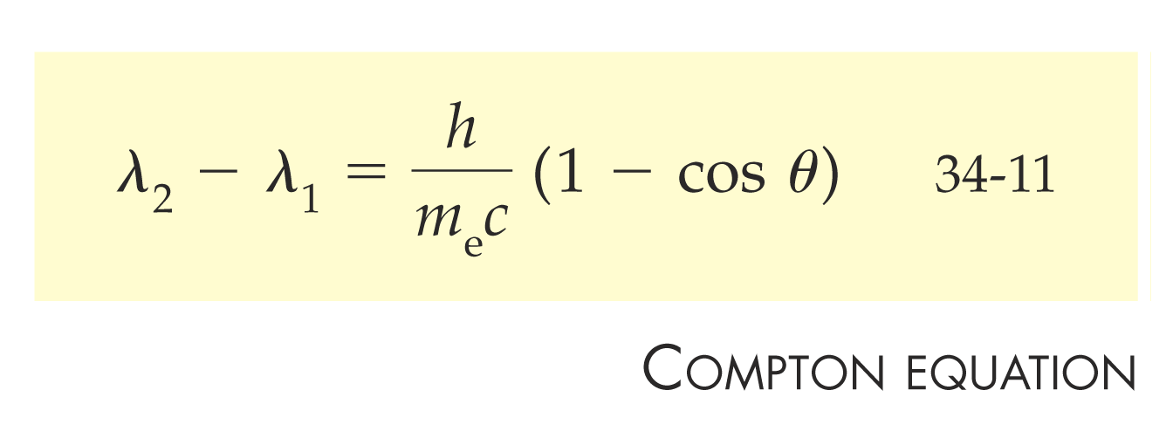

Slide 16
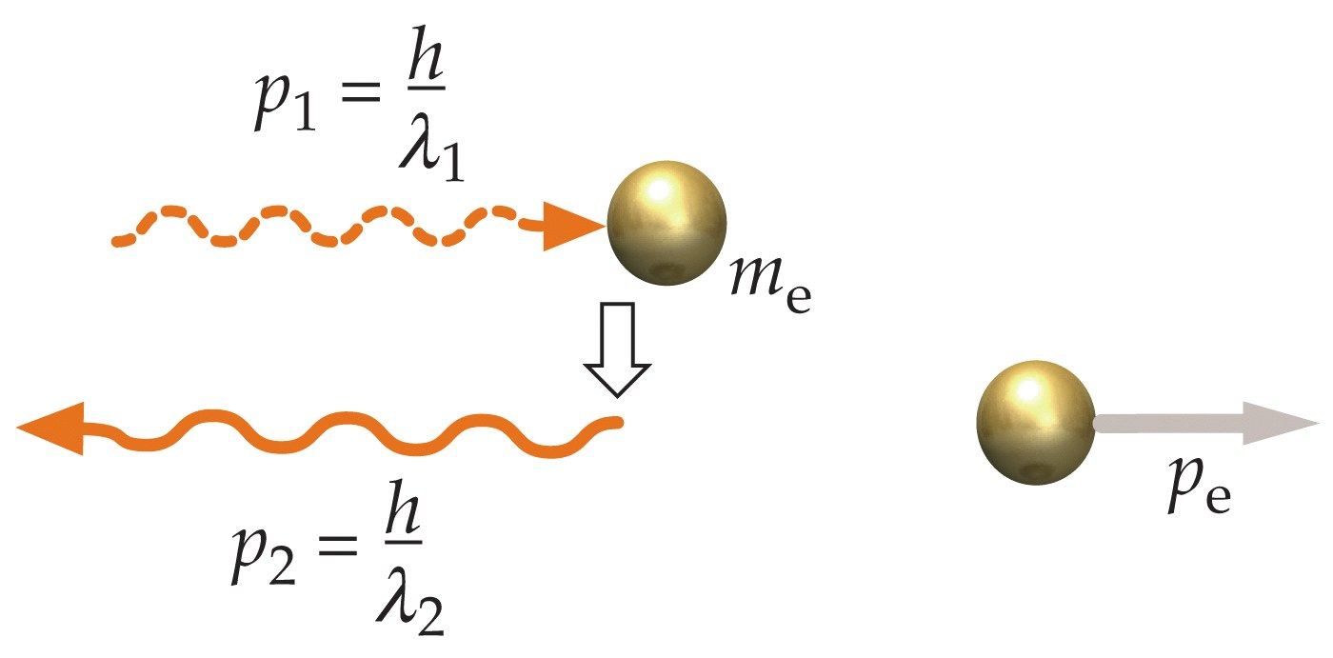

Slide 17
34-3
Energy Quantization in Atoms

Slide 18
34-4
Electrons and Matter Waves

Slide 19
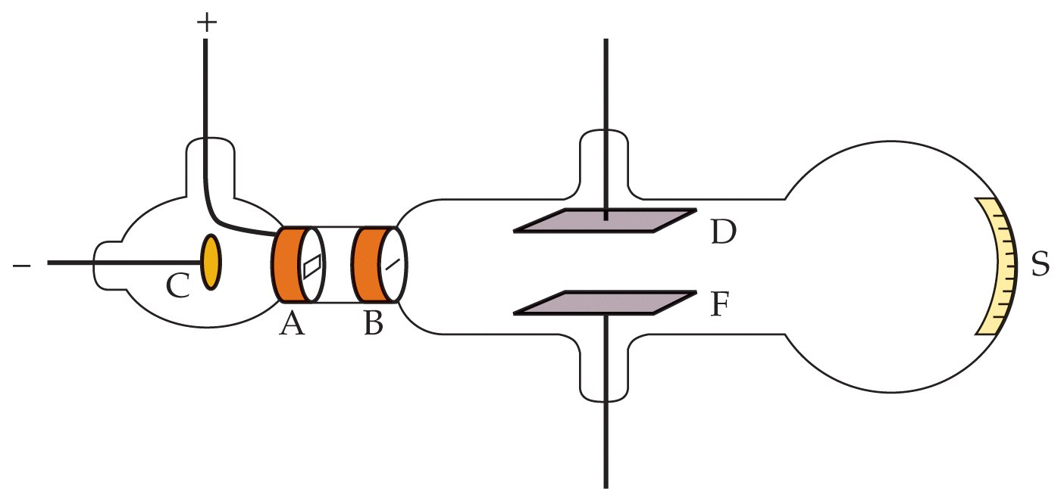

Slide 20


Slide 21


Slide 22


Slide 23


Slide 24
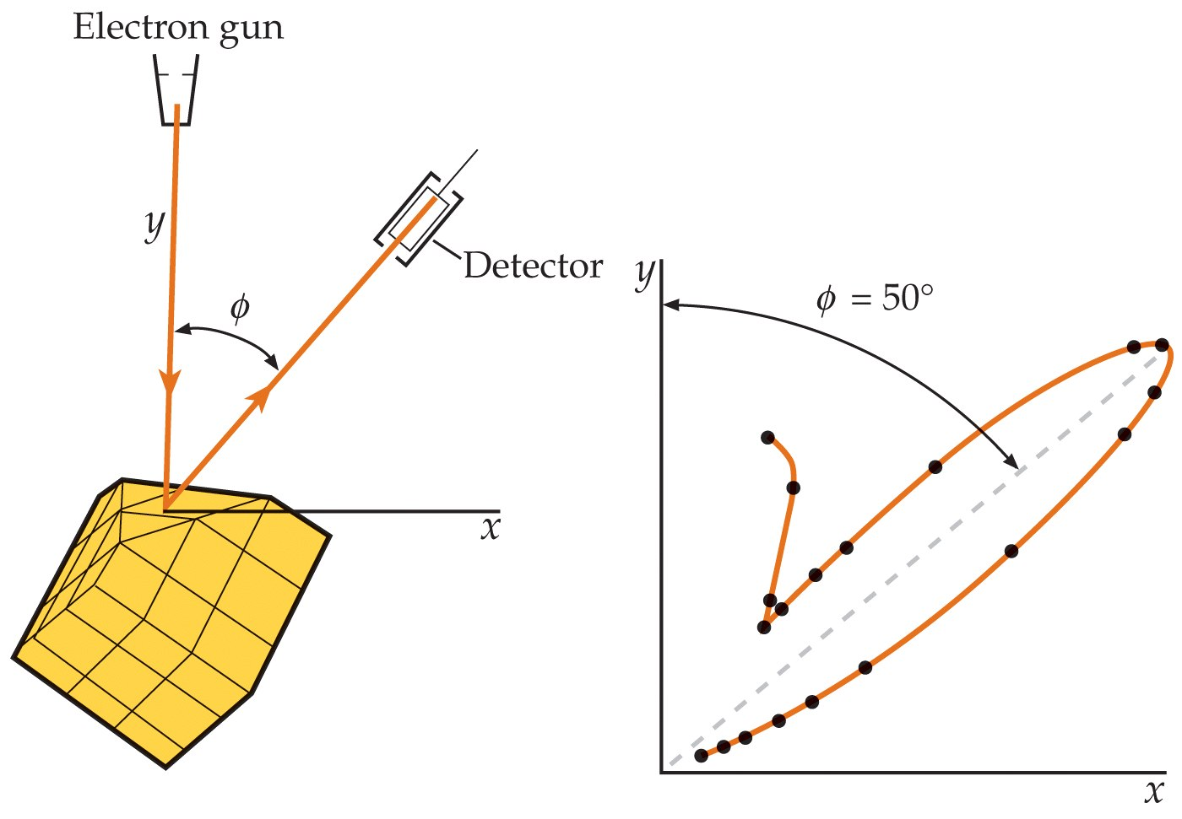

Slide 25


Slide 26
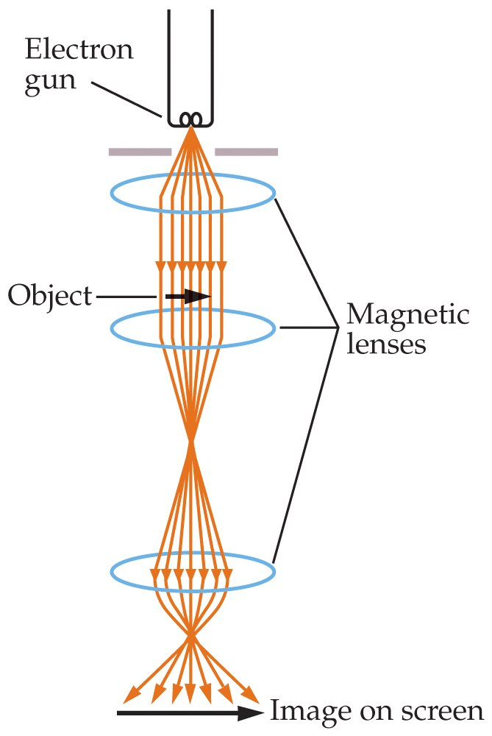

Slide 27
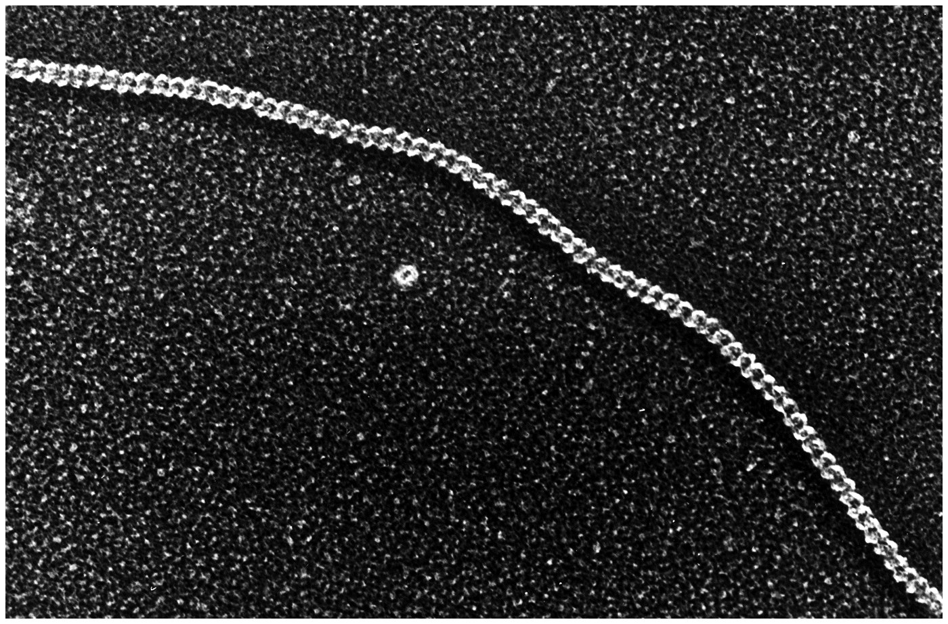

Slide 28
34-5
The Interpretation of the Wave Function

Slide 29


Slide 30
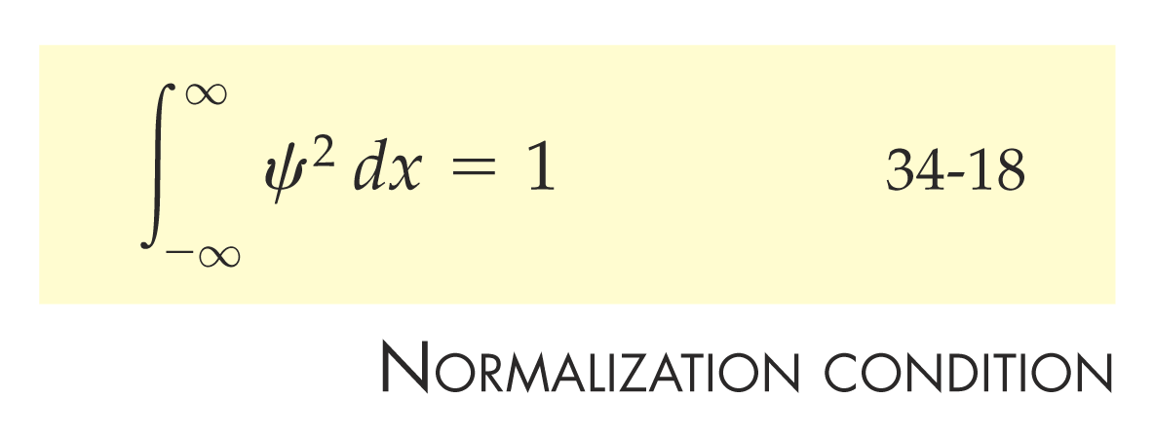

Slide 31
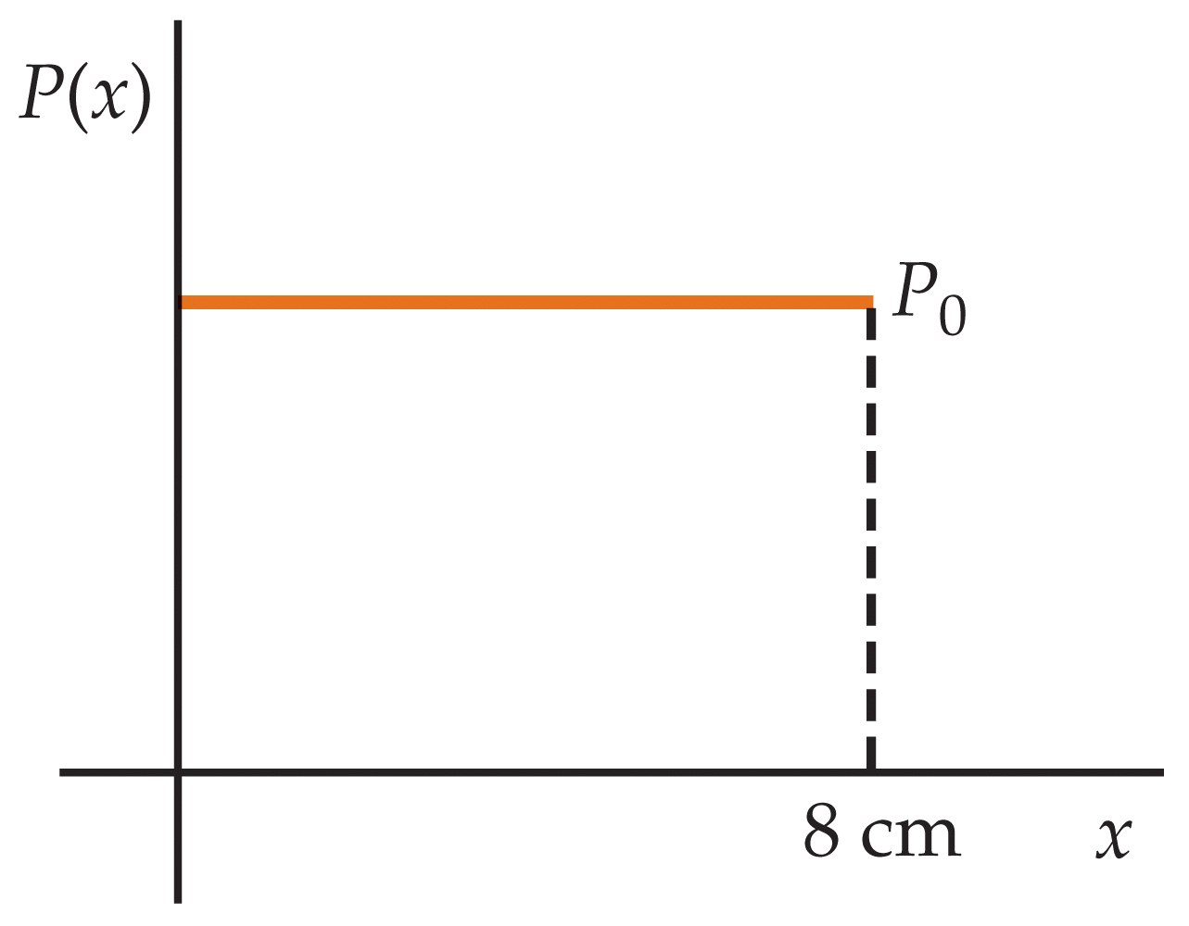

Slide 32
34-6
Wave–Particle Duality

Slide 34
34-7
A Particle in a Box

Slide 35
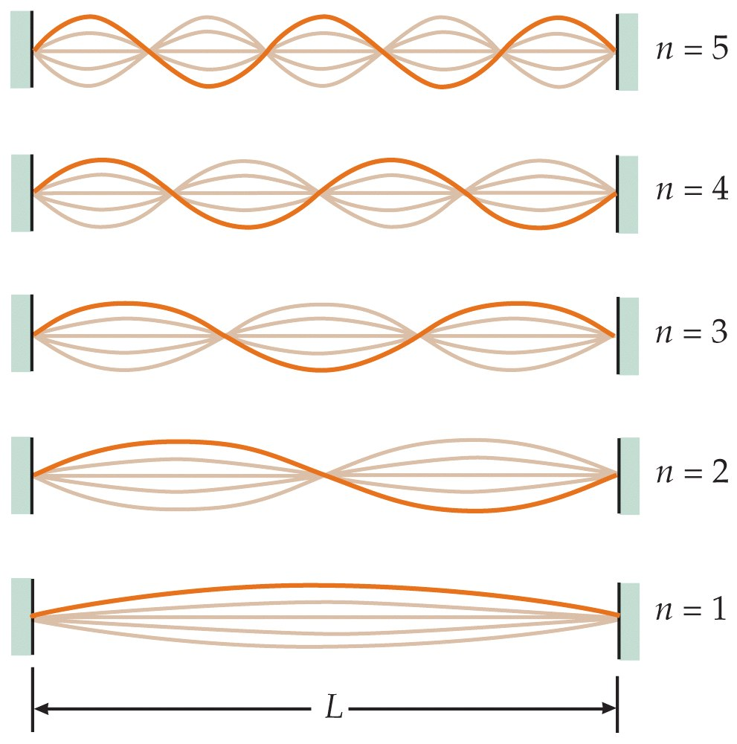

Slide 36


Slide 37
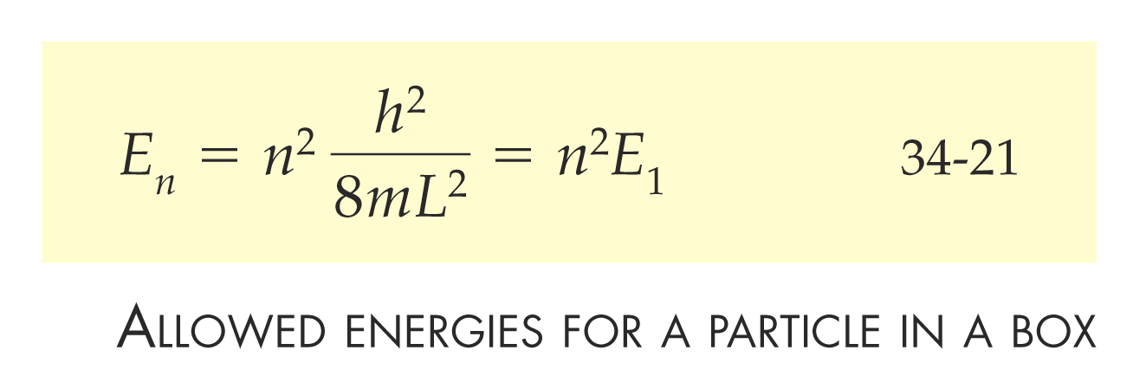

Slide 38
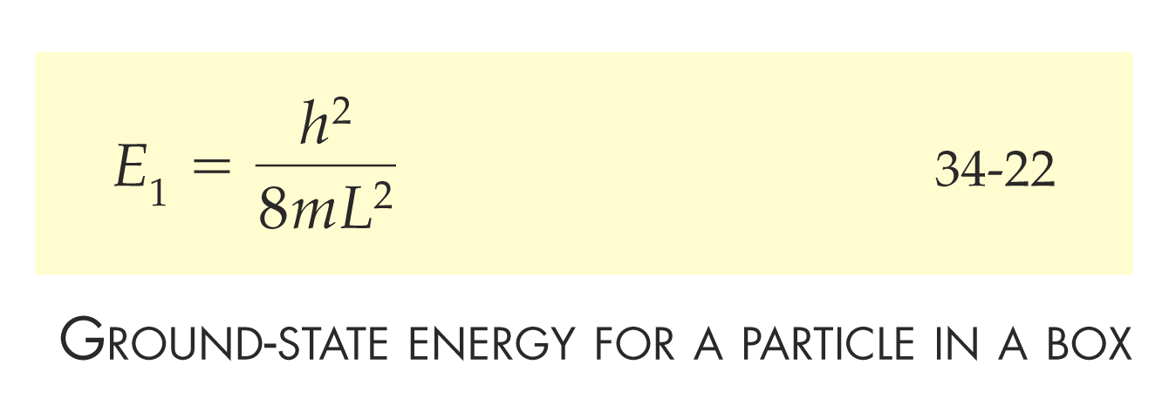

Slide 39
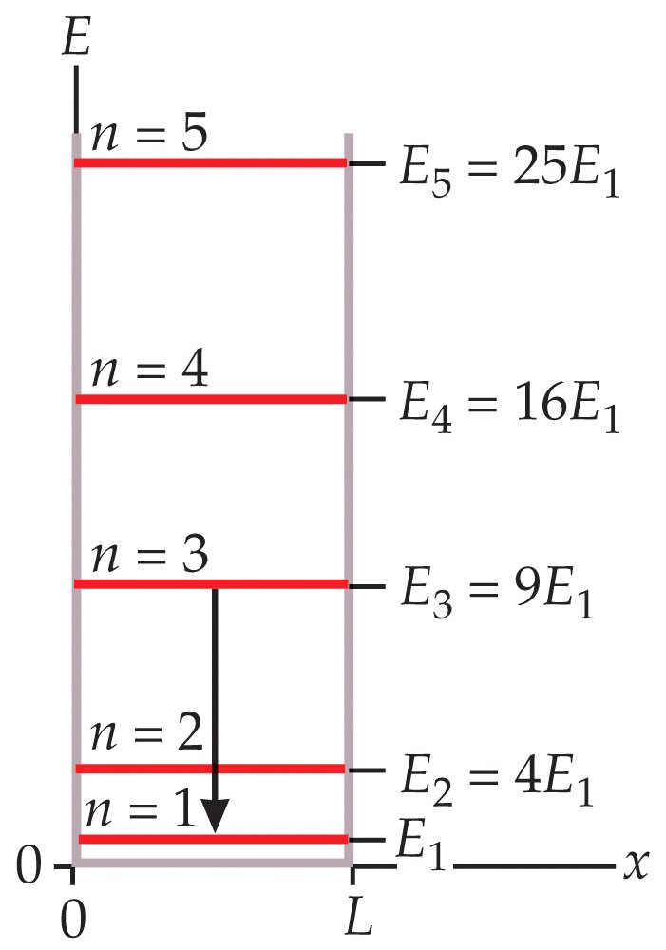

Slide 40
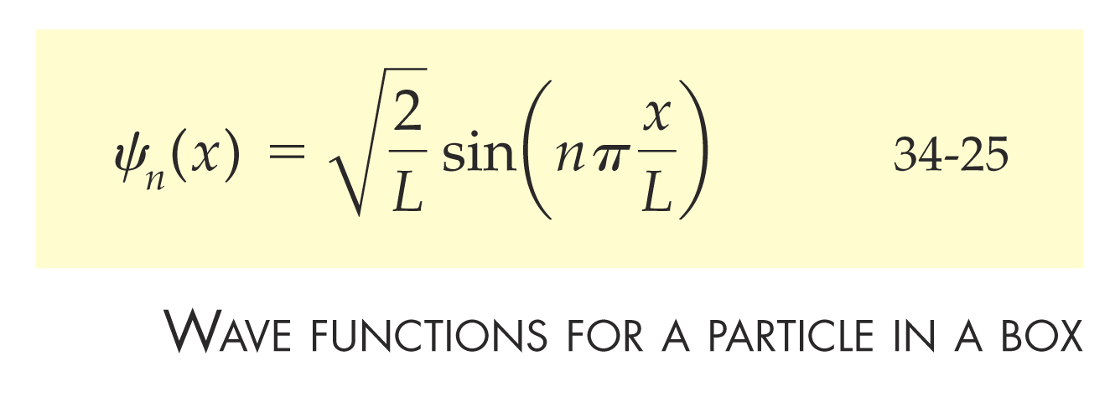

Slide 41
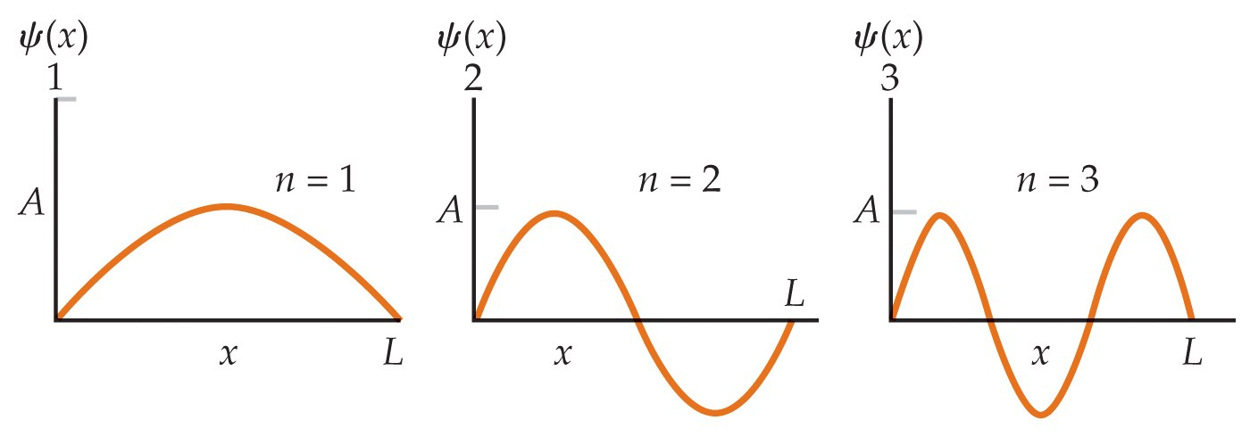

Slide 42


Slide 43
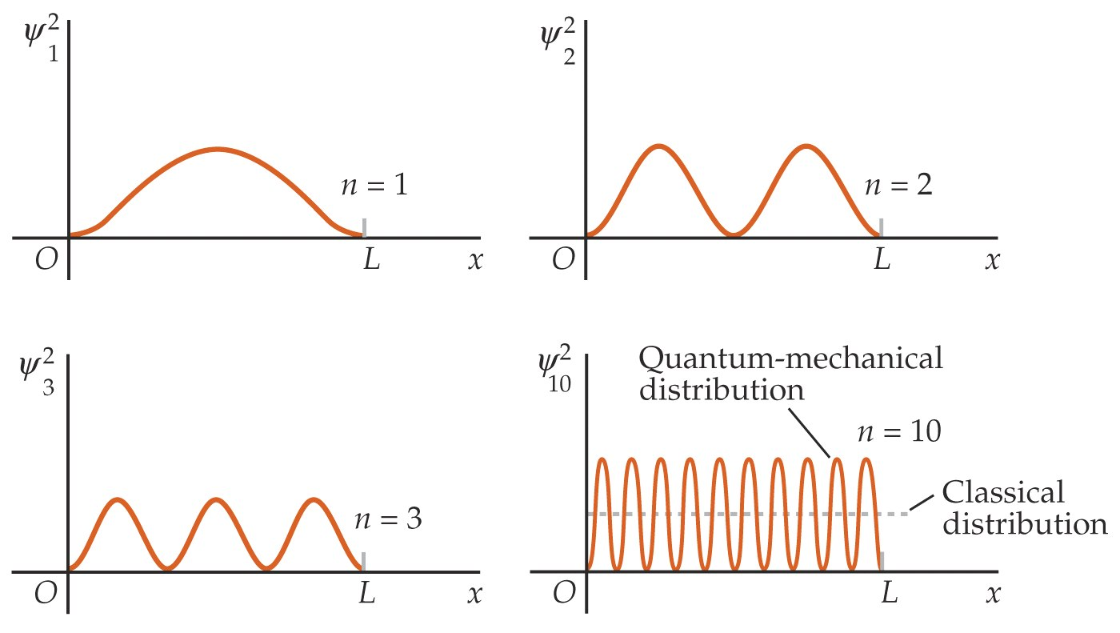

Slide 44
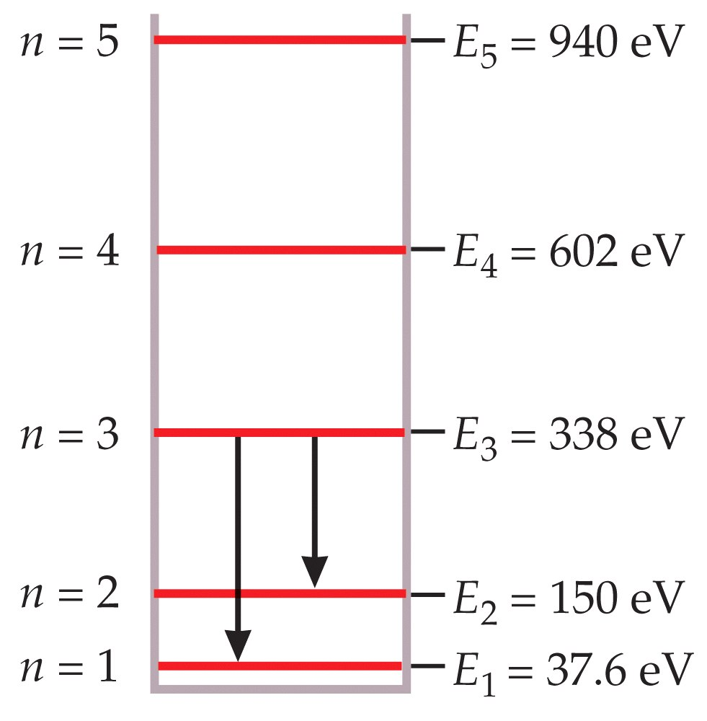

Slide 45
34-8
Expectation Values

Slide 46
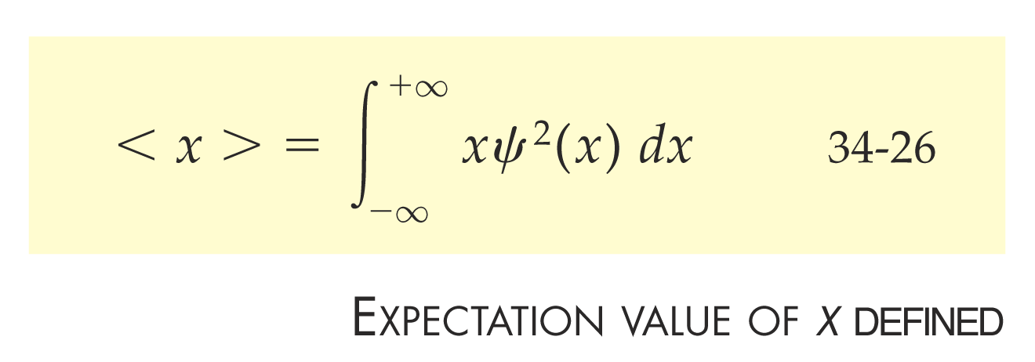

Slide 47


Slide 48


Slide 49
34-9
Energy Quantization in
Other Systems

Slide 50
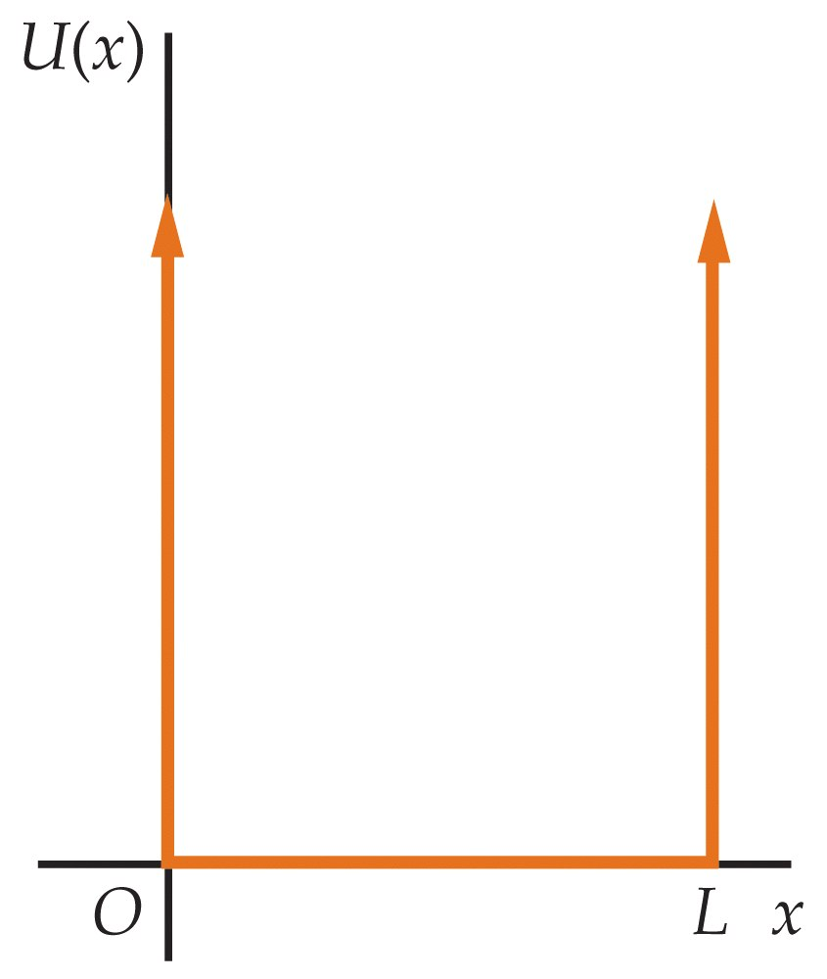

Slide 51
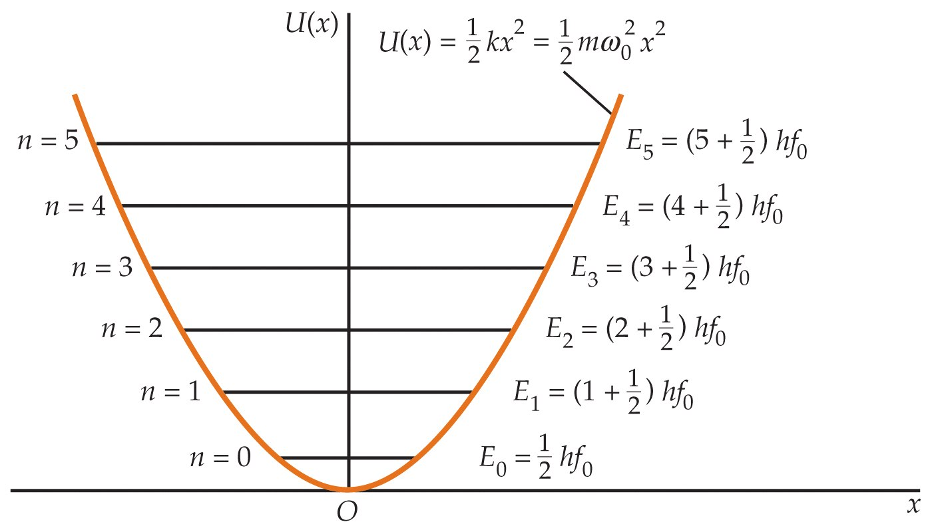

Slide 52
