Slide 1
Paul A. Tipler • Gene Mosca
Physics for Scientists
and Engineers
Fifth Edition
Chapter R:
Special Relativity
Copyright © 2003 by W. H. Freeman & Company

Slide 2
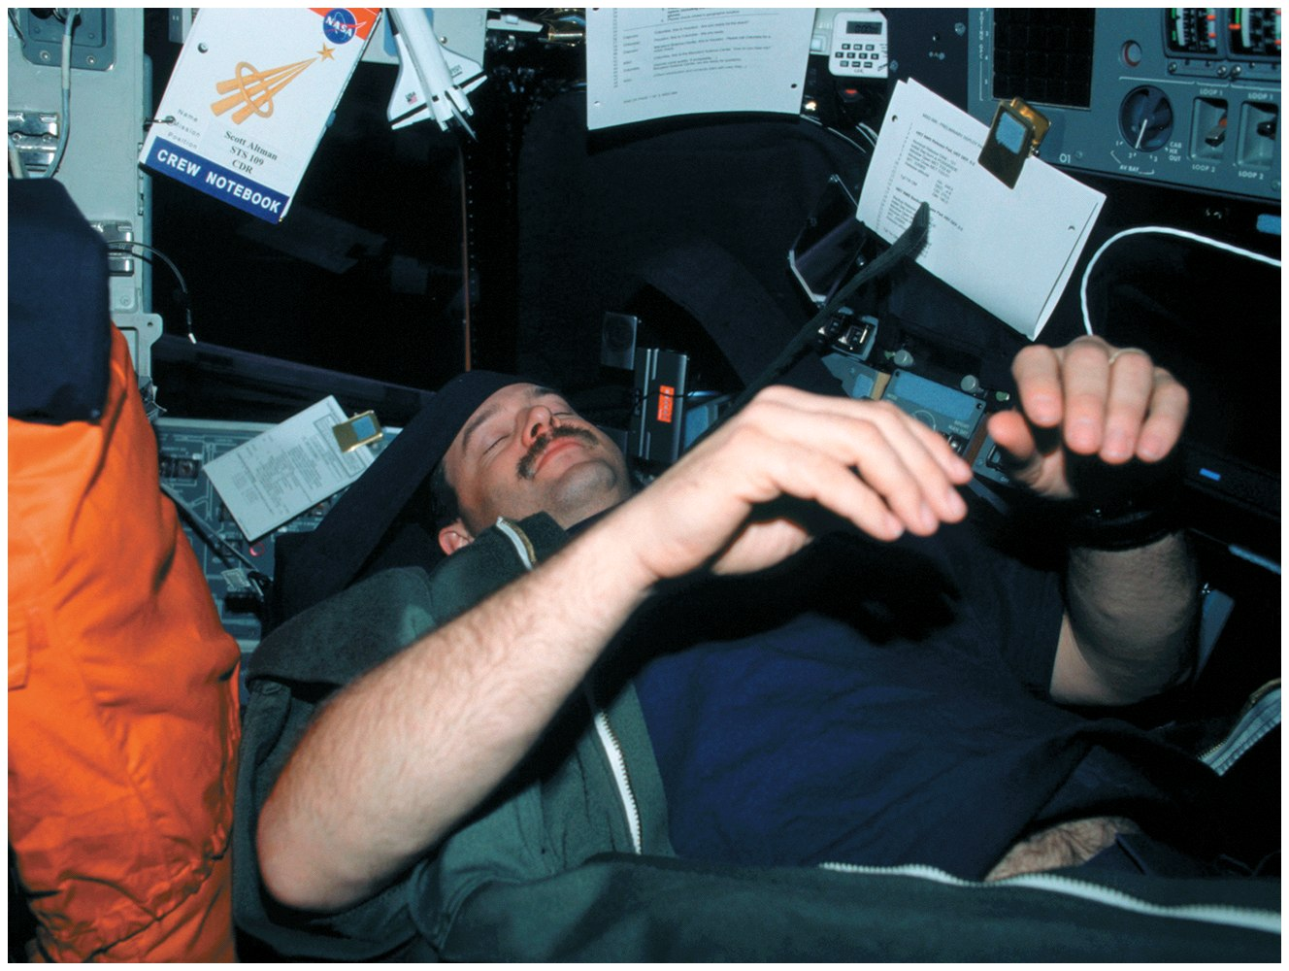

Slide 3
R-1
The Principle of Relativity and the Constancy of the Speed of Light

Slide 4
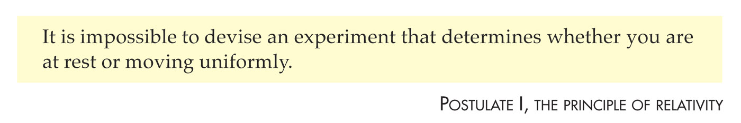

Slide 5
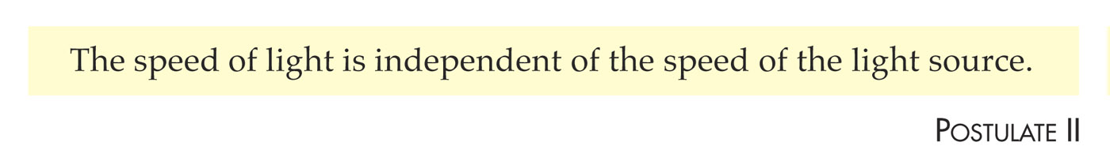

Slide 6
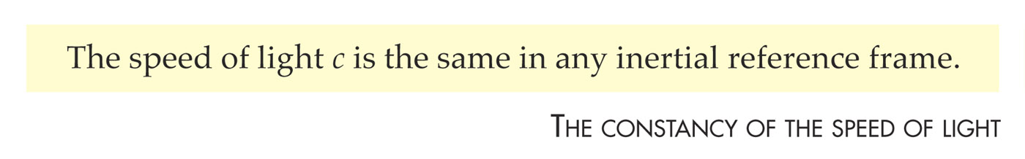

Slide 7
R-2
Moving Sticks

Slide 8
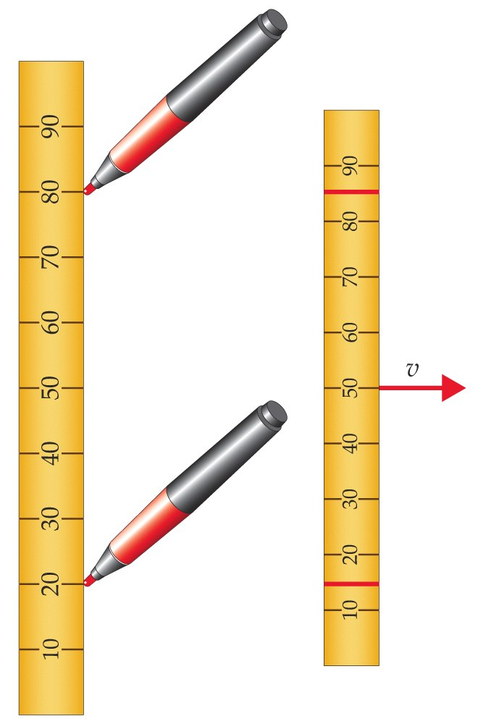

Slide 9
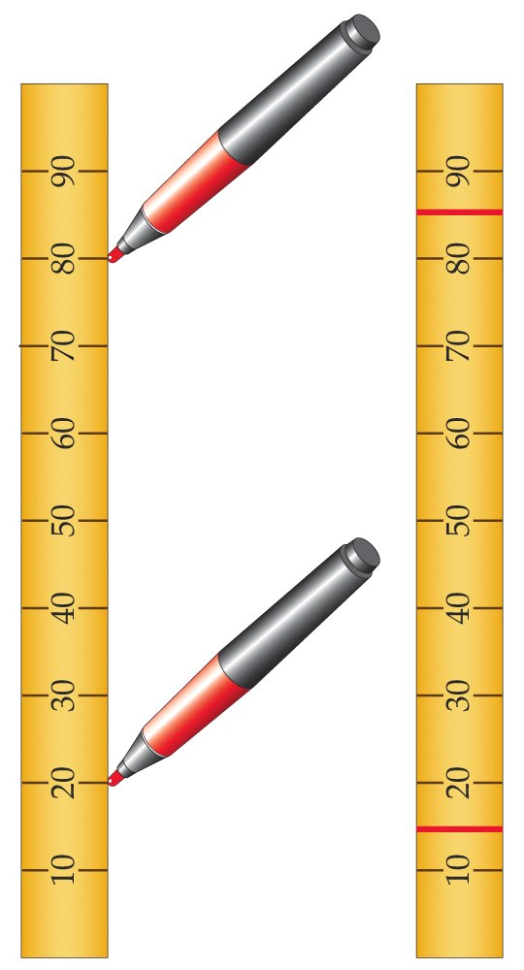

Slide 10
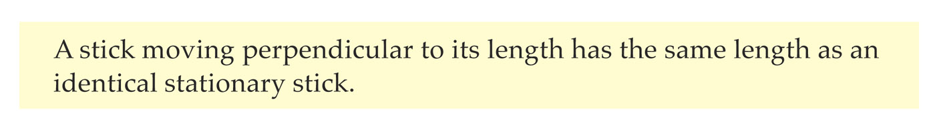

Slide 11
R-3
Moving Clocks

Slide 12
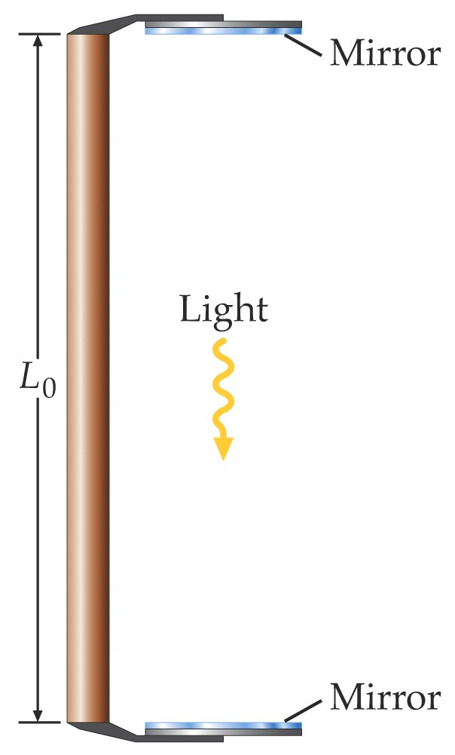

Slide 13
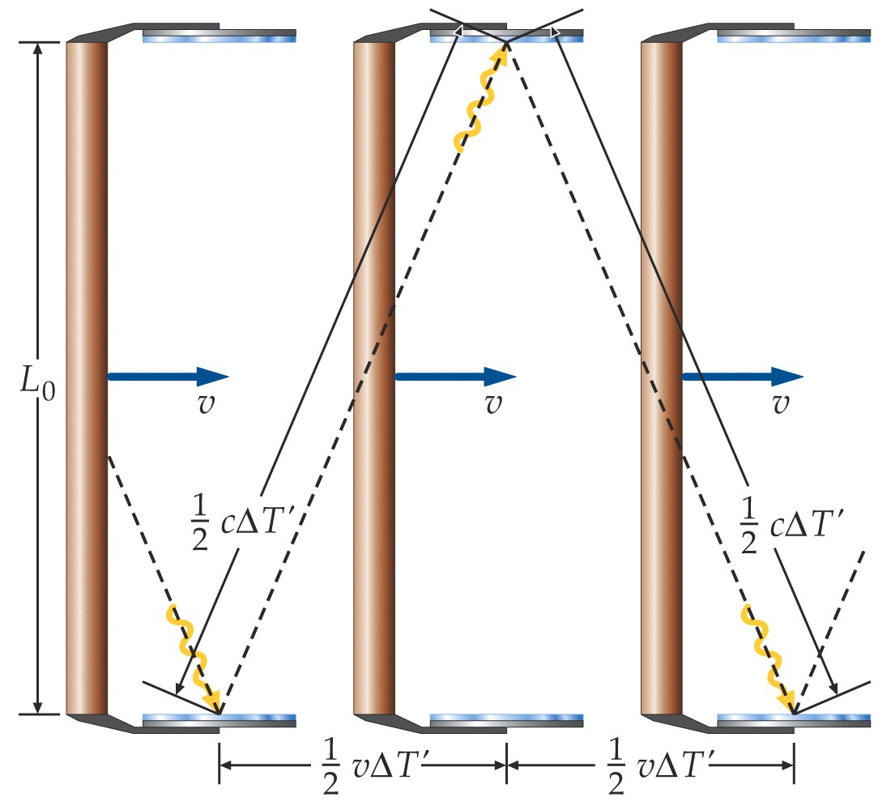

Slide 14
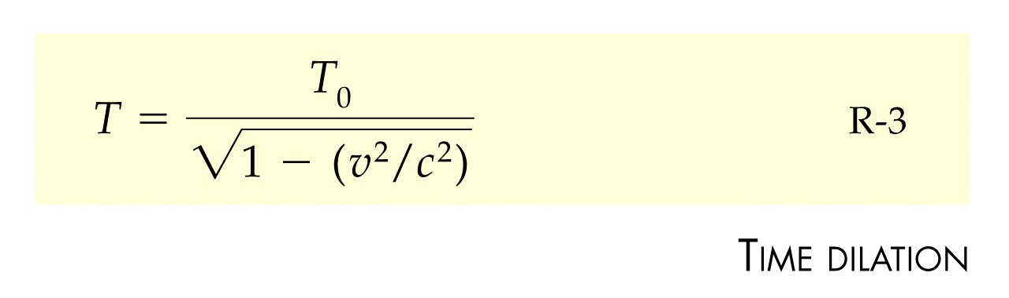

Slide 15
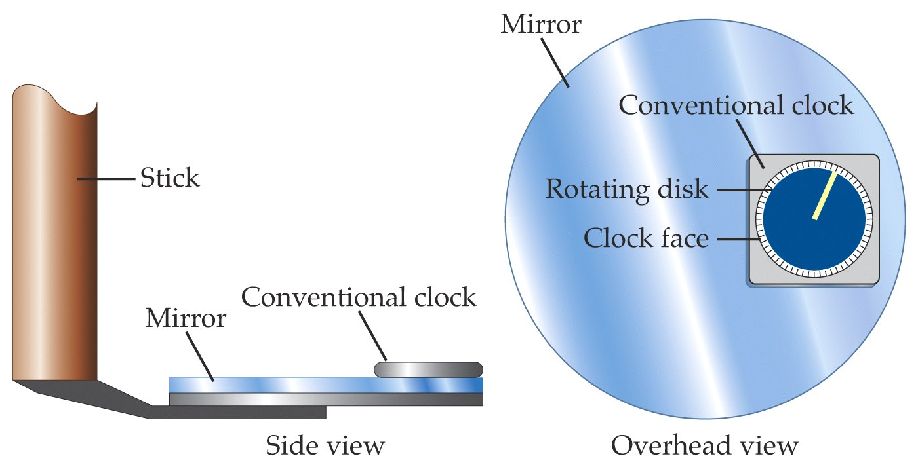

Slide 16
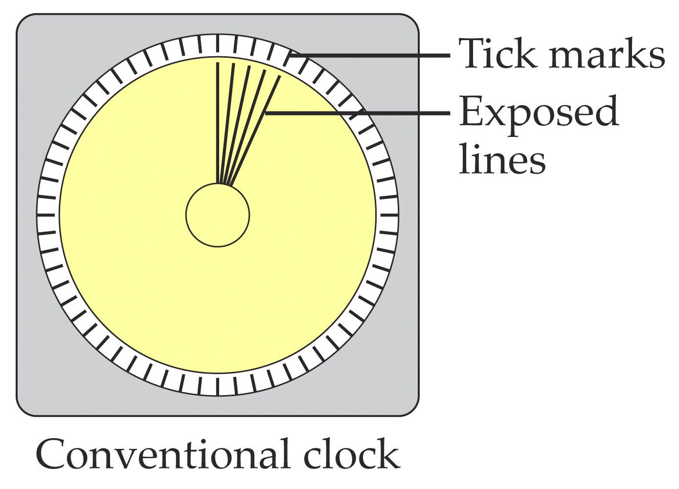

Slide 17
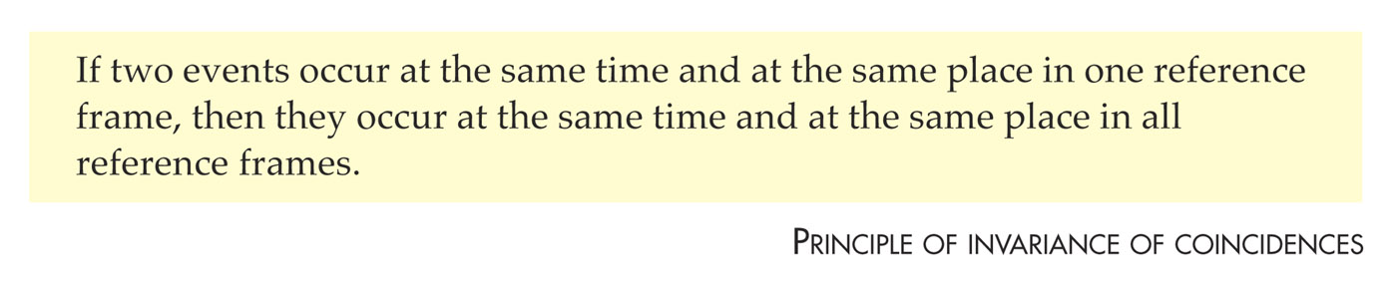

Slide 18
R-4
Moving Sticks Again

Slide 19
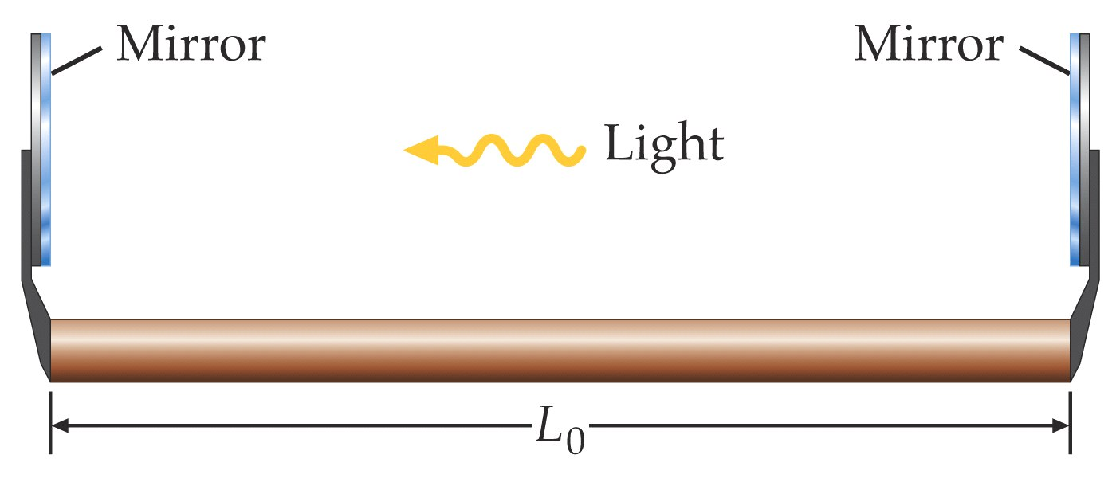

Slide 20
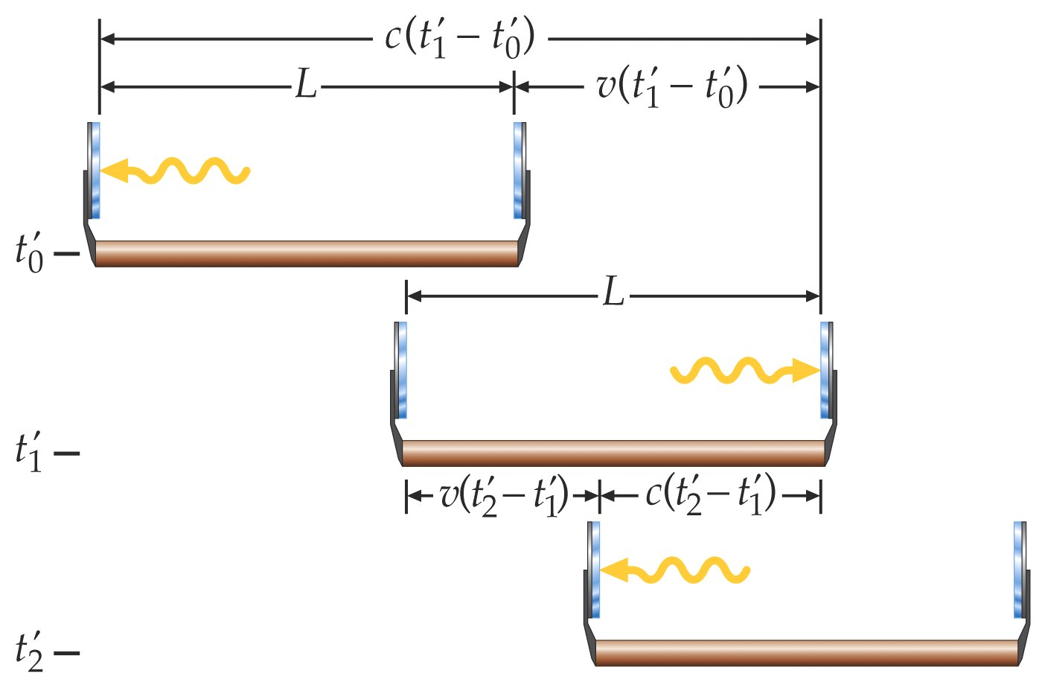

Slide 21
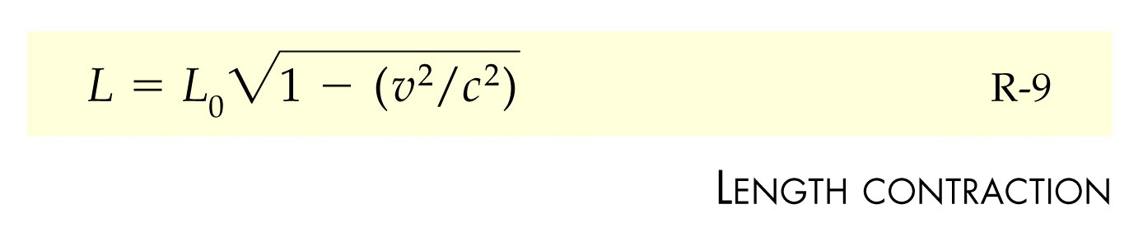

Slide 22
R-5
Distant Clocks and Simultaneity

Slide 23
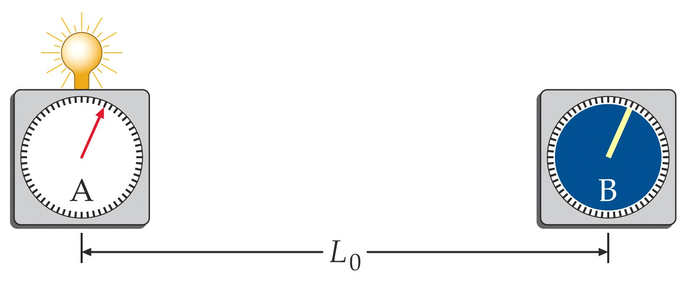

Slide 24
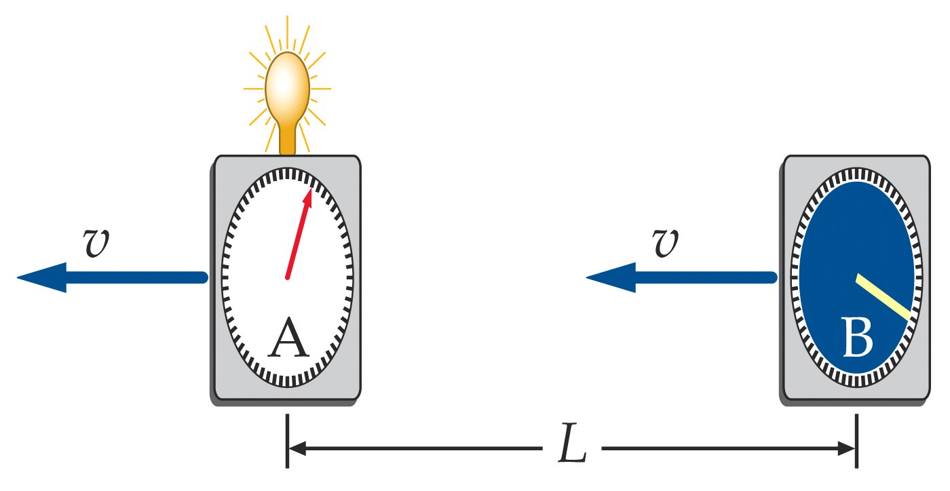

Slide 25
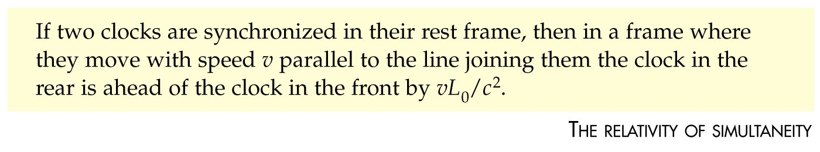

Slide 26
R-6
Applying the Rules

Slide 27
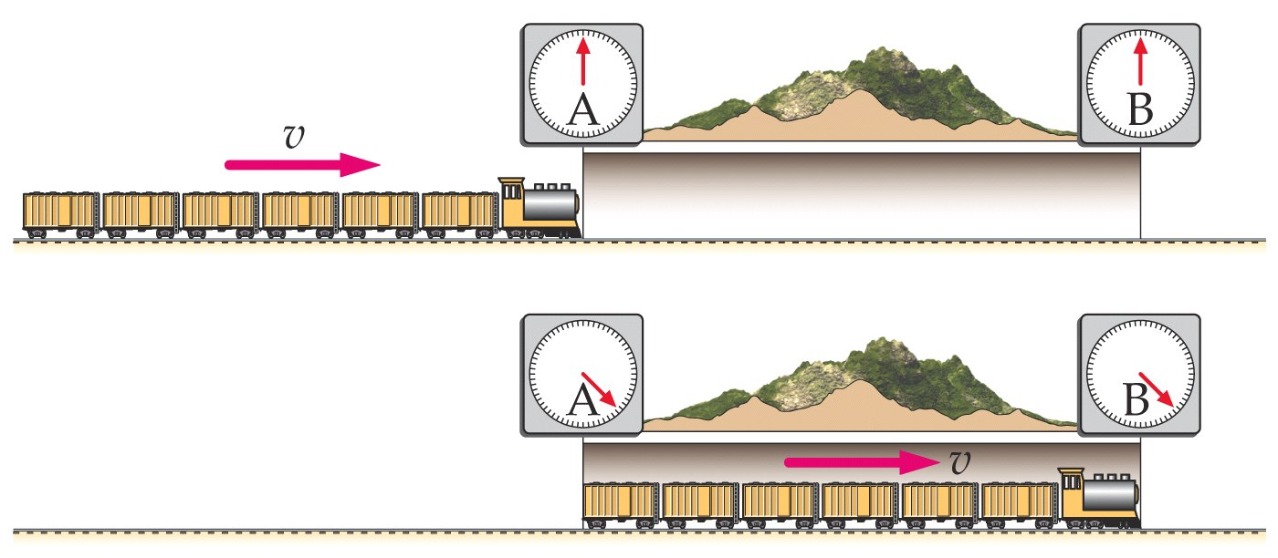

Slide 28
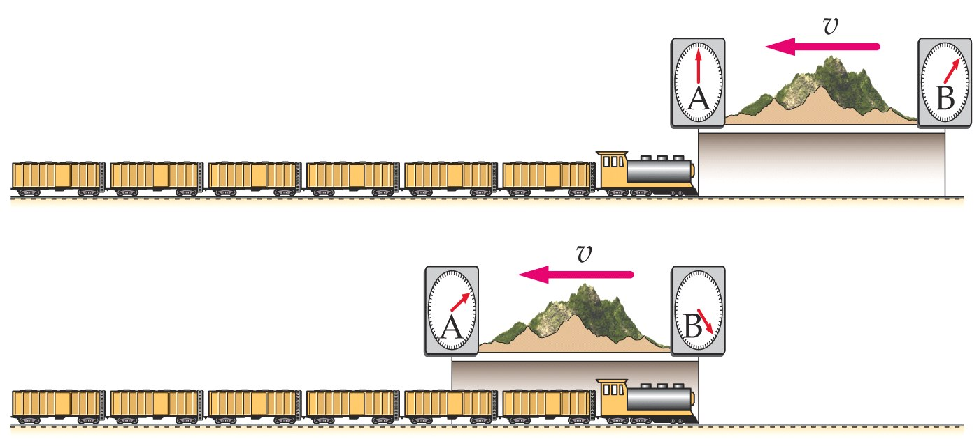

Slide 29
R-7
Relativistic Momentum, Mass, and Energy

Slide 30
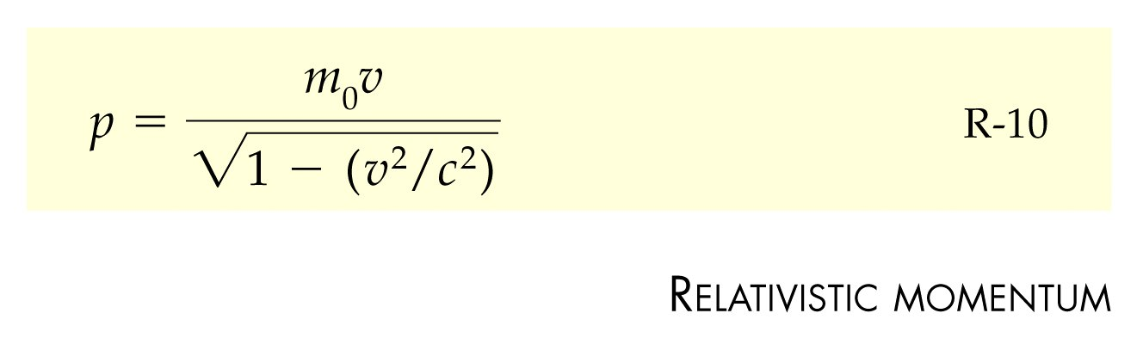

Slide 31
Problems

Slide 32
