Slide 1
Physics for Scientists and Engineers
Paul A. Tipler • Gene Mosca
Fifth Edition
Chapter 23:
Electric Potential
Copyright © 2004 by W. H. Freeman & Company

Slide 2


Slide 3
23-1
Potential Difference

Slide 4


Slide 5


Slide 6


Slide 7


Slide 8
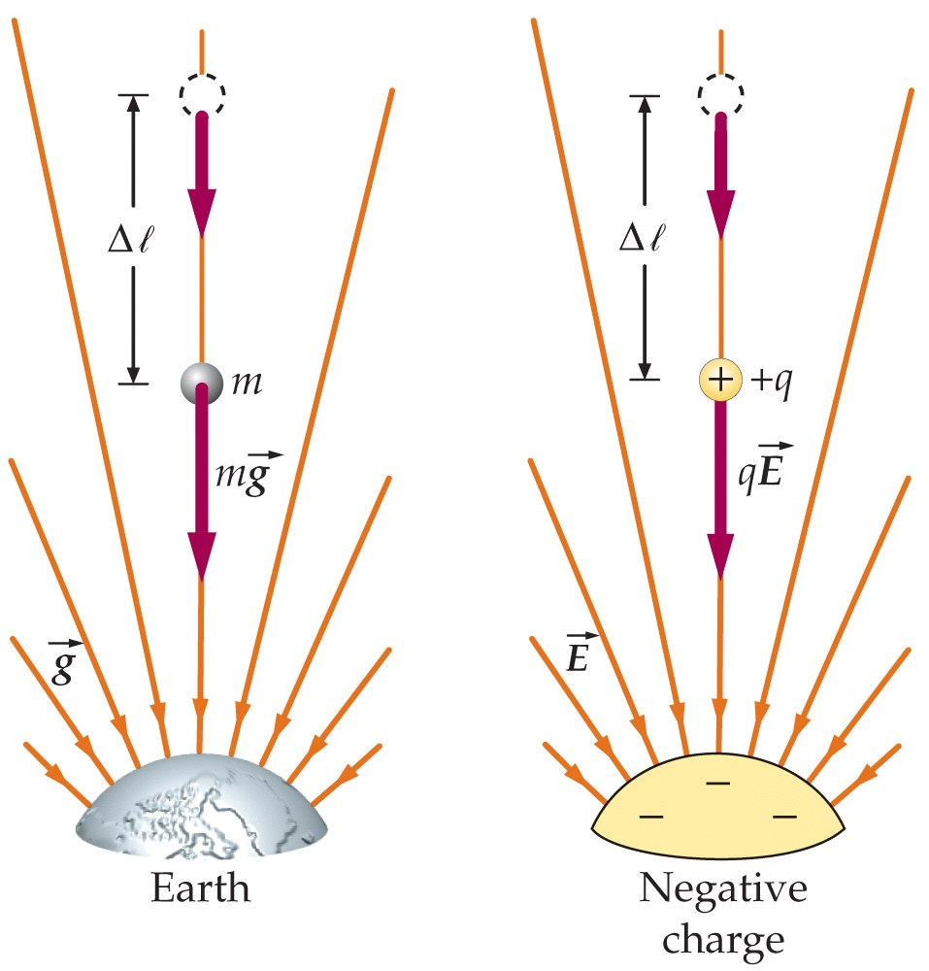

Slide 9
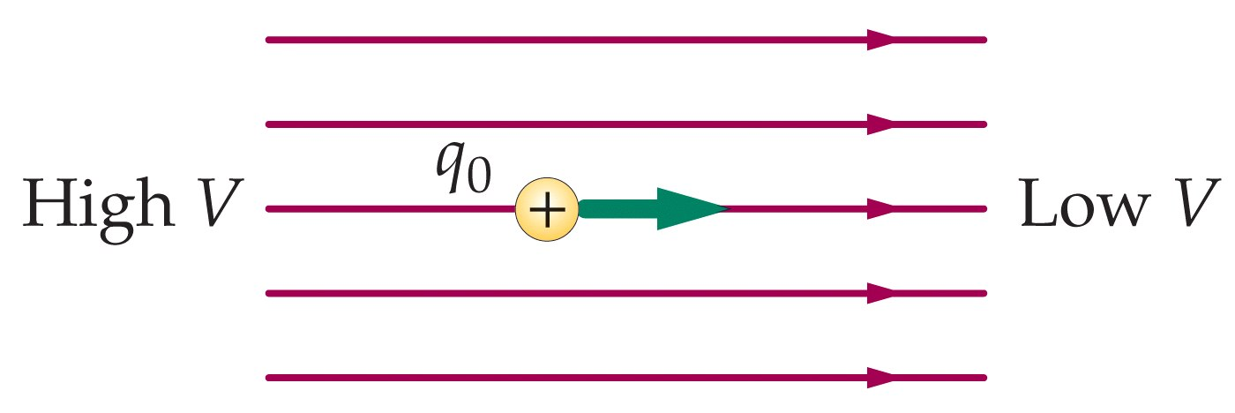

Slide 10
23-2
Potential Due to a System of Point Charges

Slide 11
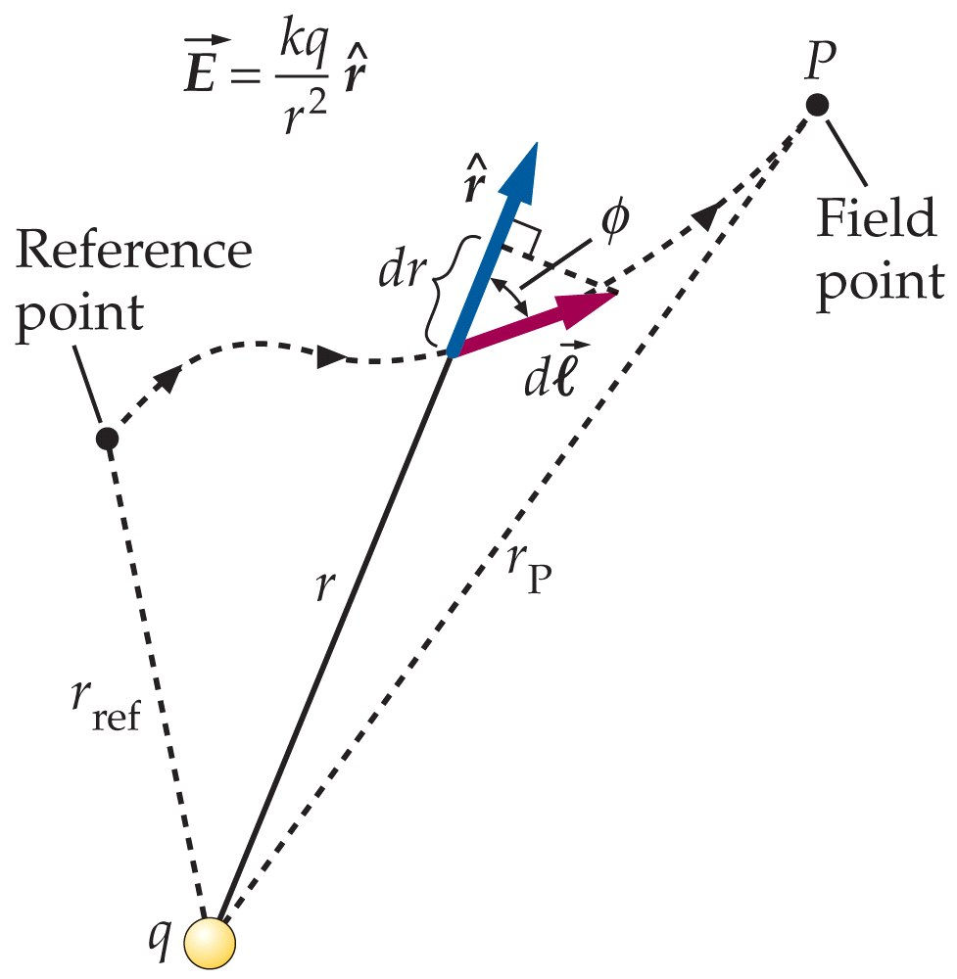

Slide 12


Slide 13


Slide 14


Slide 15
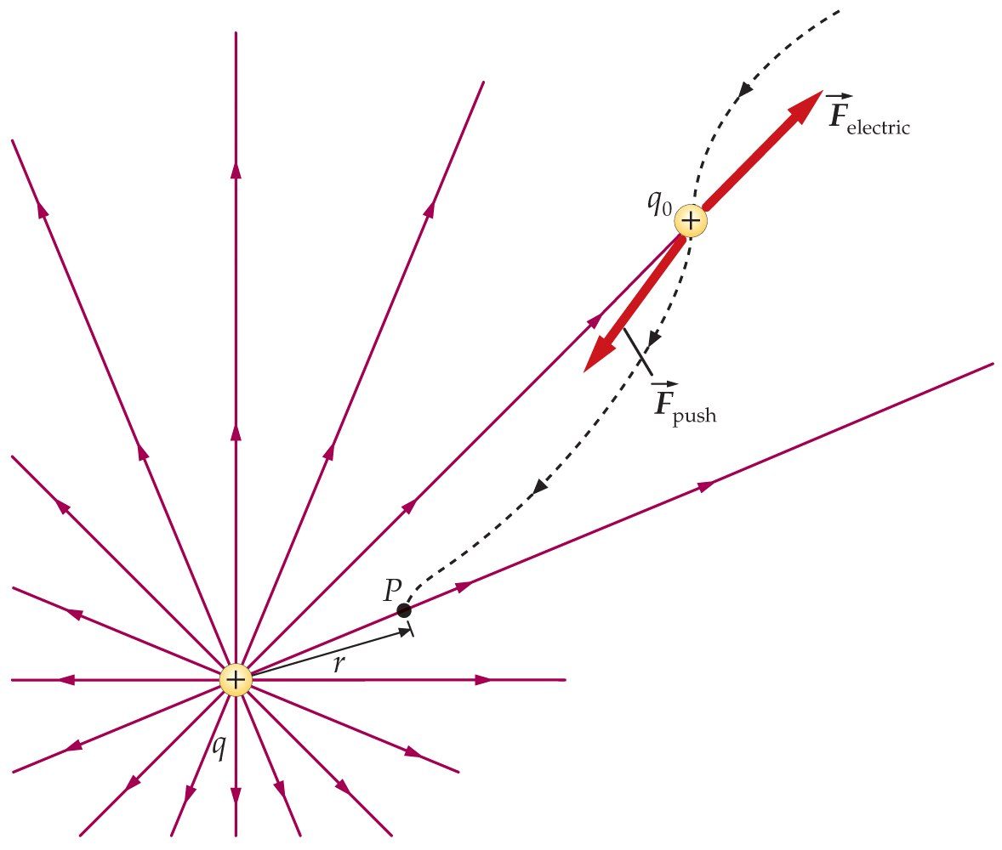

Slide 16


Slide 17
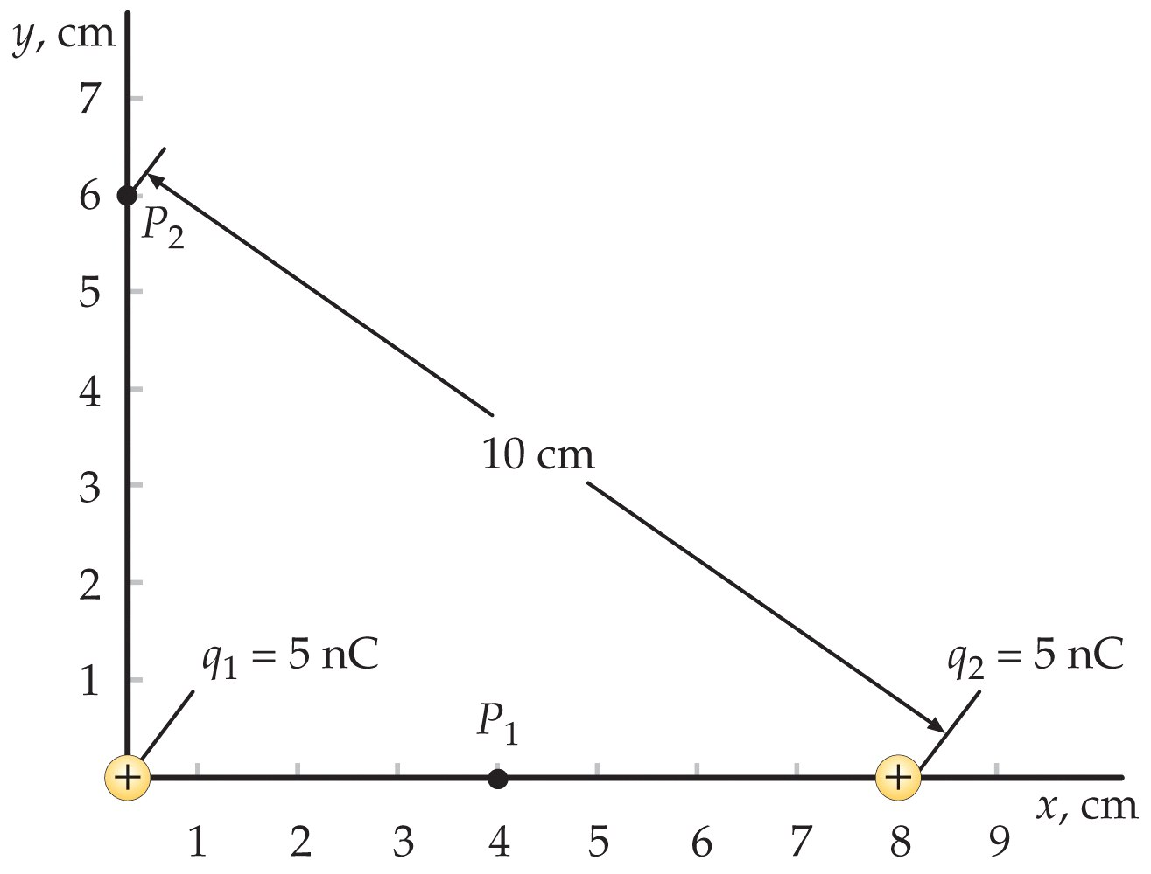

Slide 18
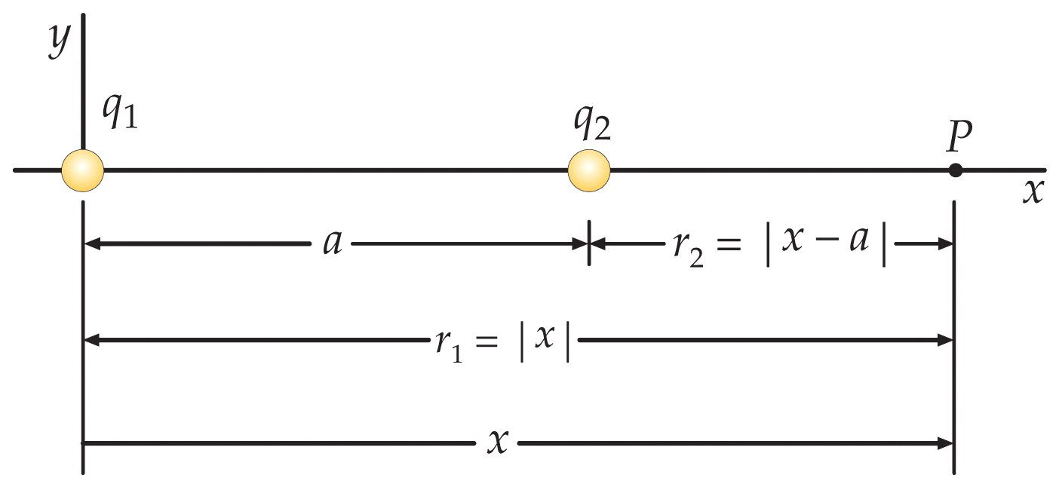

Slide 19
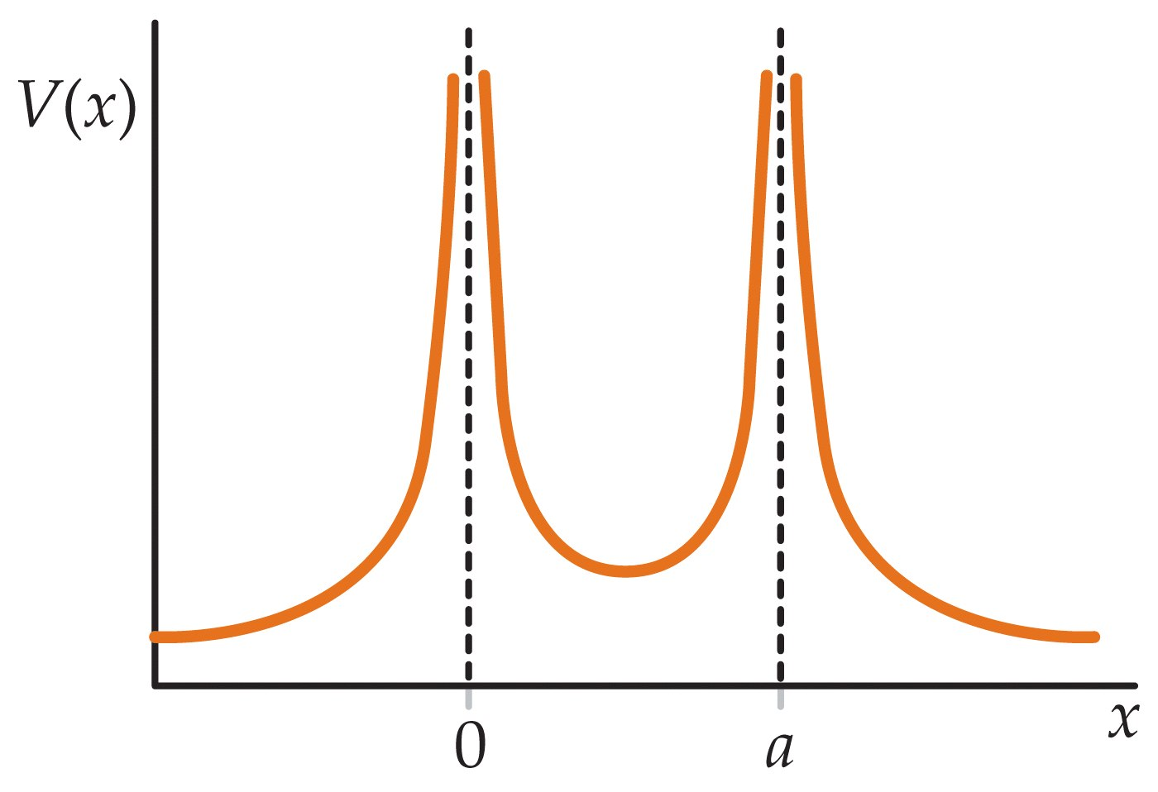

Slide 20
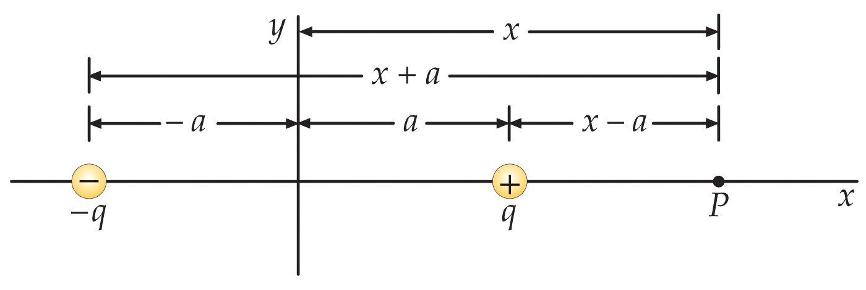

Slide 21
23-3
Computing the Electric Field From the Potential

Slide 22
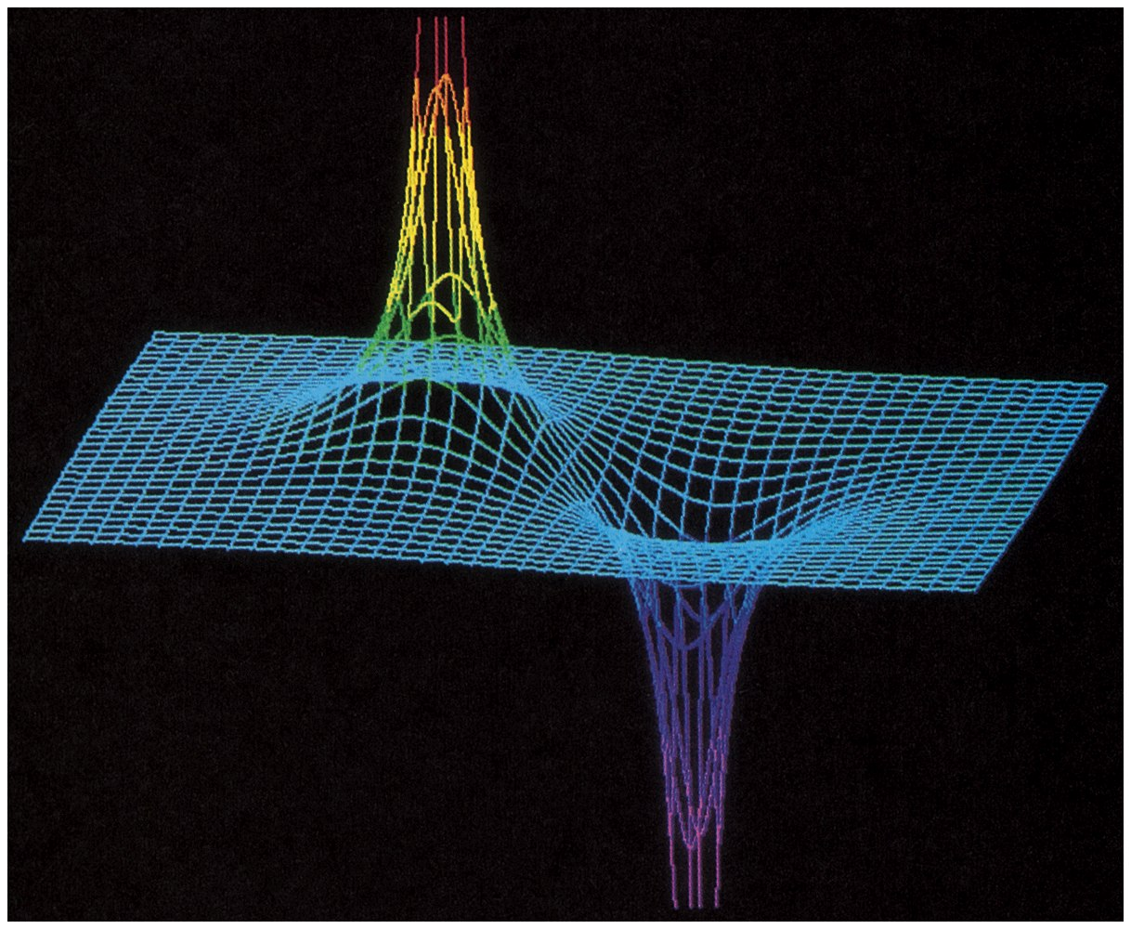

Slide 23
23-4
Calculations of V for Continuous Charge Distributions

Slide 24


Slide 25
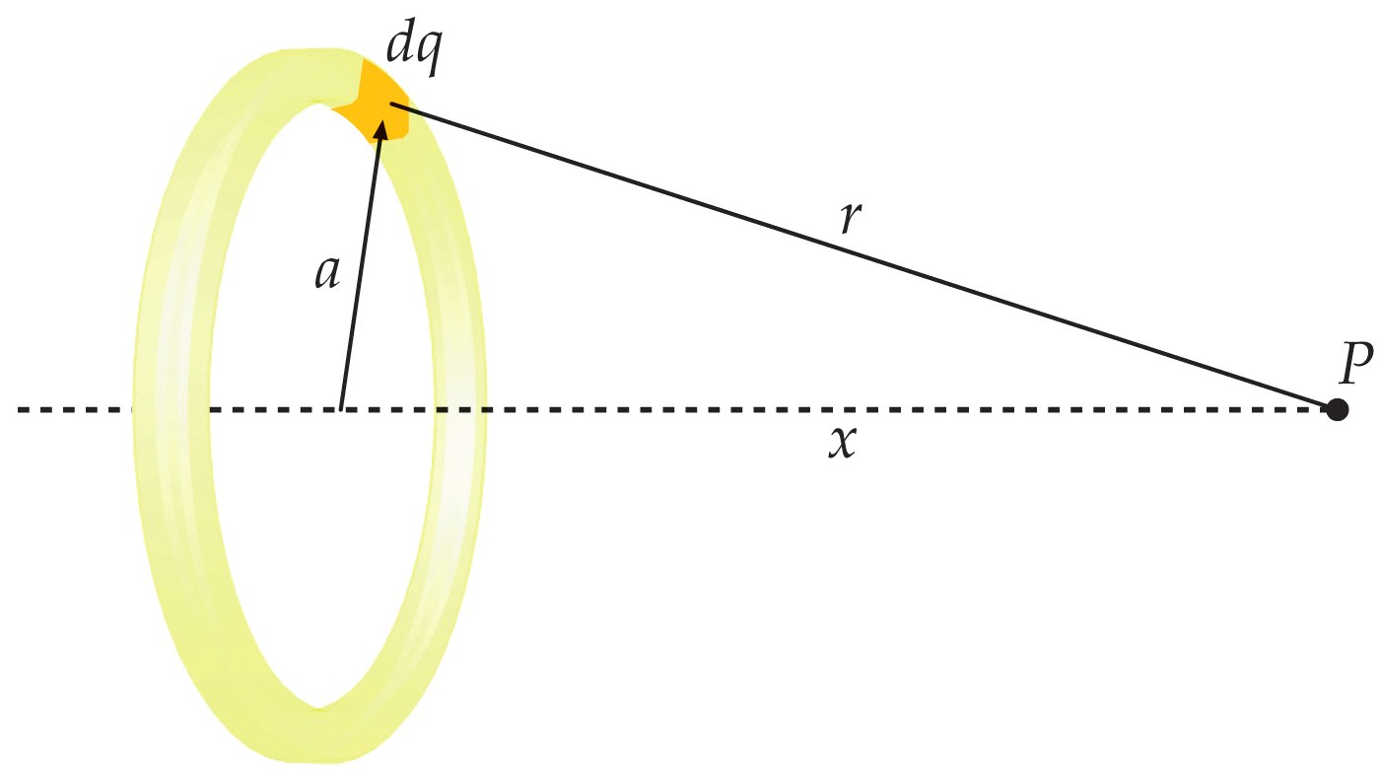

Slide 26


Slide 27
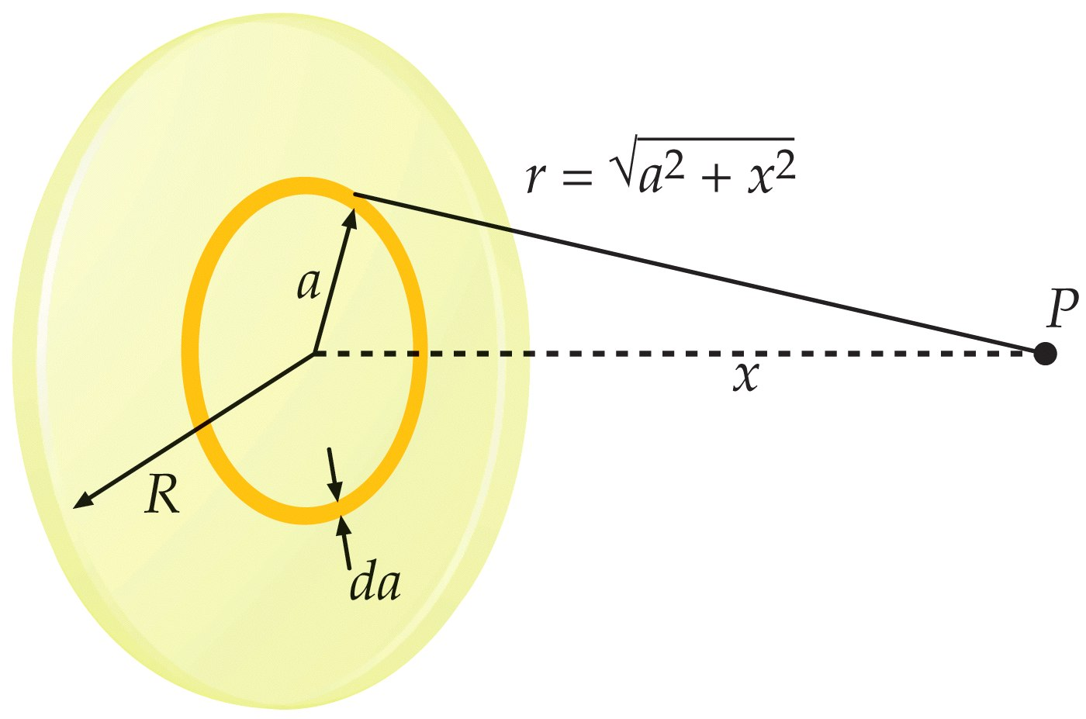

Slide 28


Slide 29
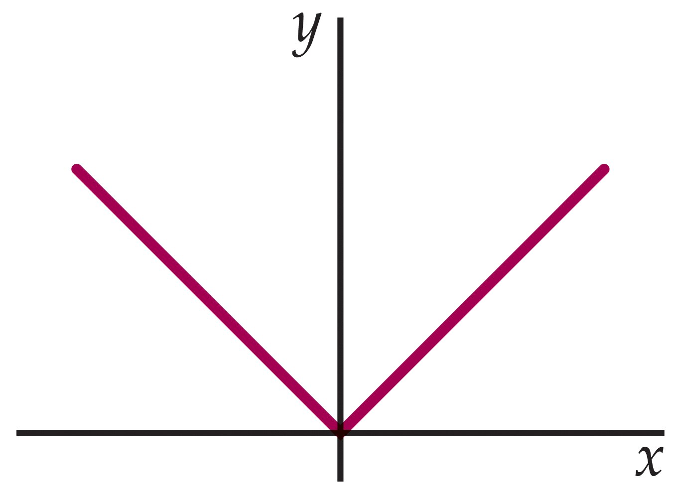

Slide 30
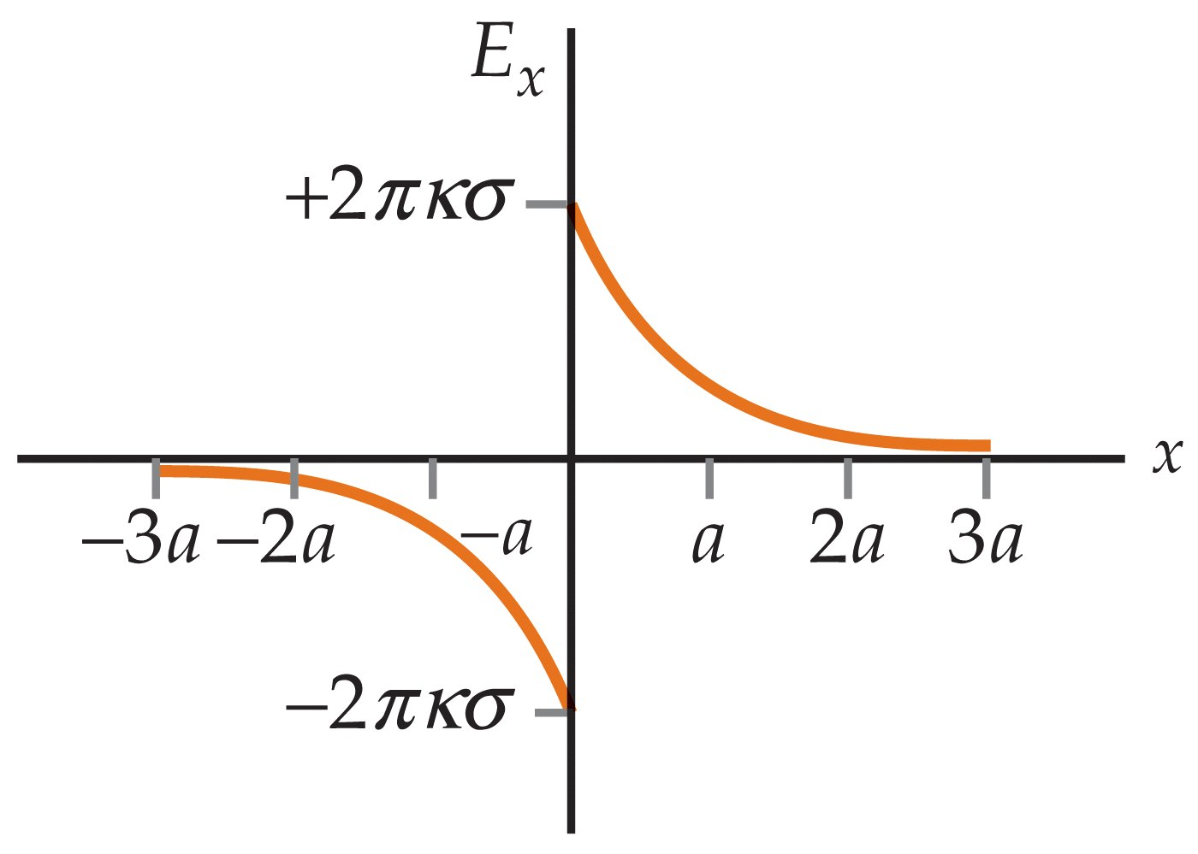

Slide 31
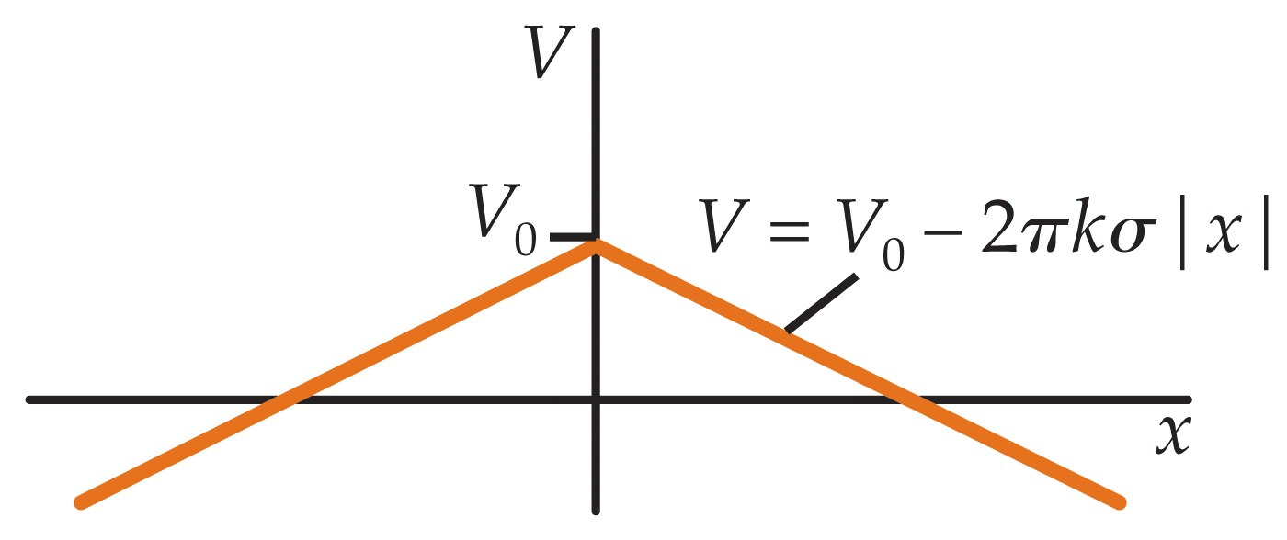

Slide 32


Slide 33
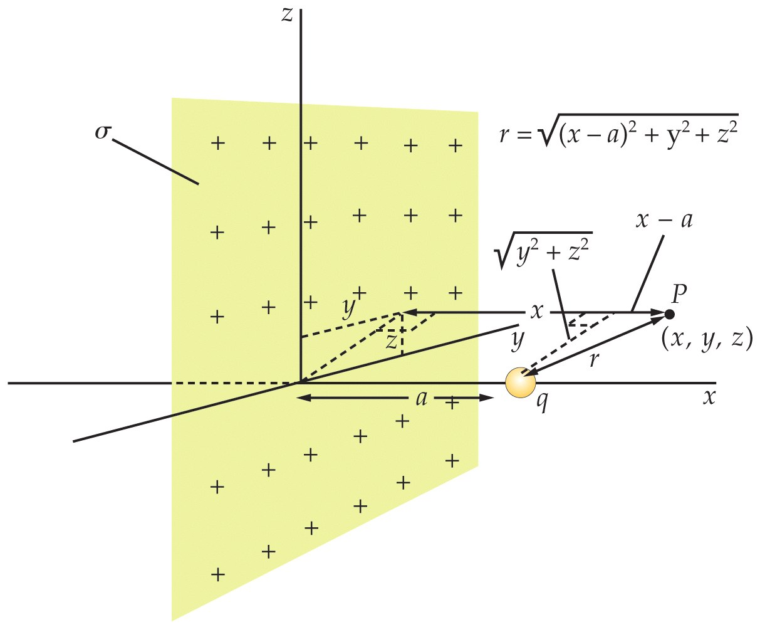

Slide 34
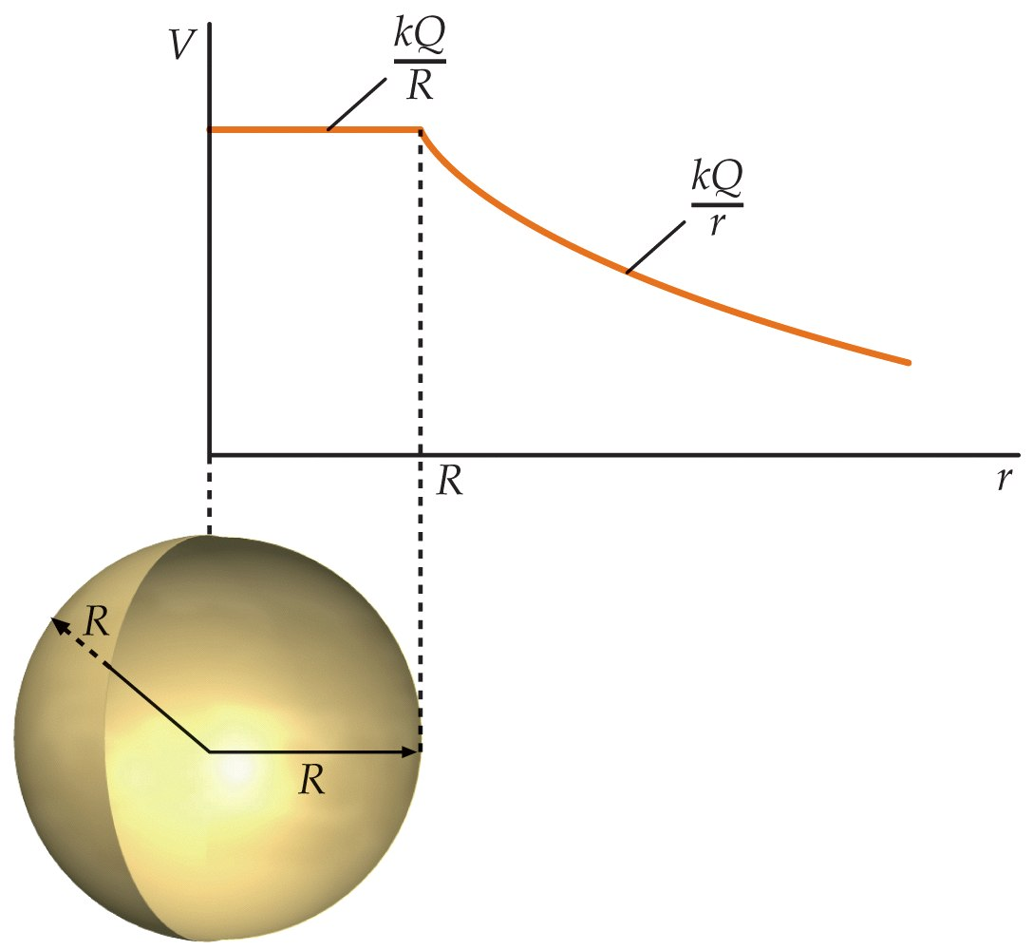

Slide 35


Slide 36
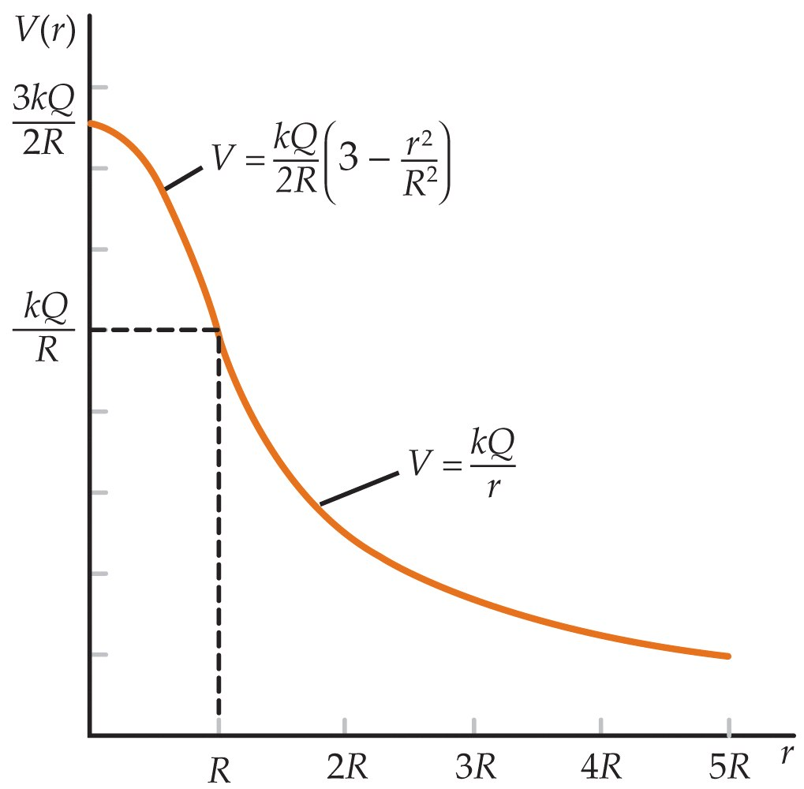

Slide 37
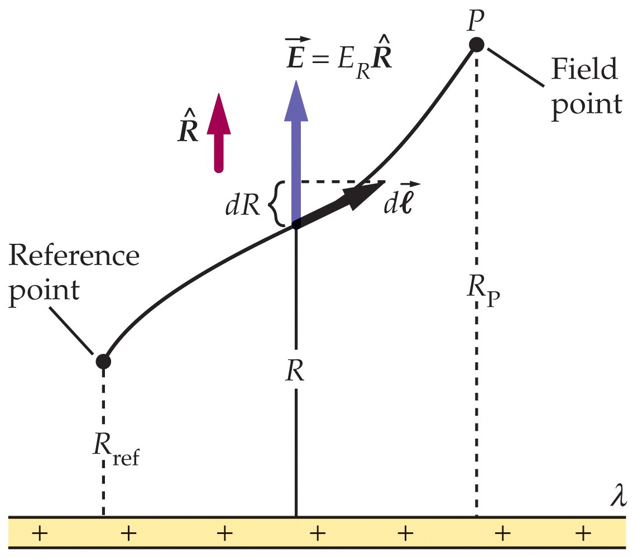

Slide 38


Slide 39
23-5
Equipotential Surfaces

Slide 40
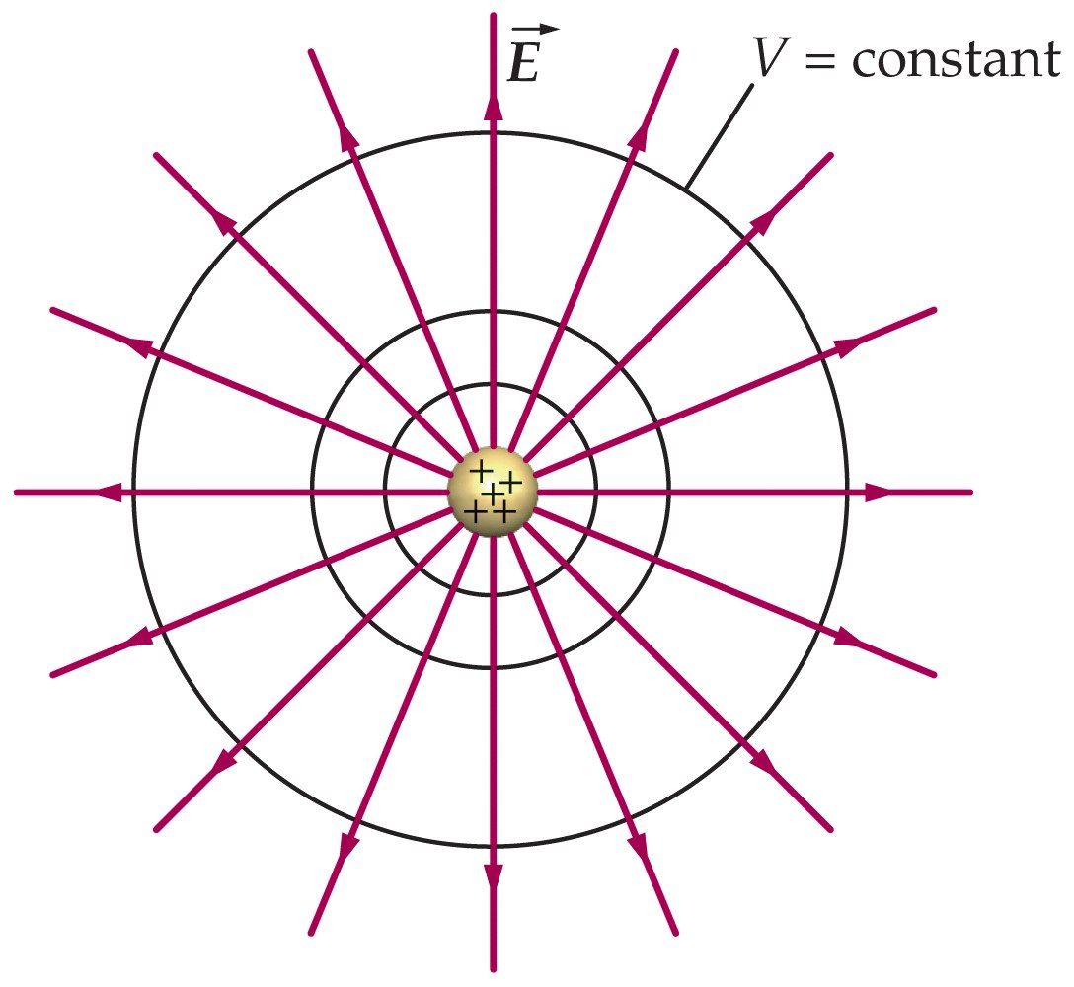

Slide 41
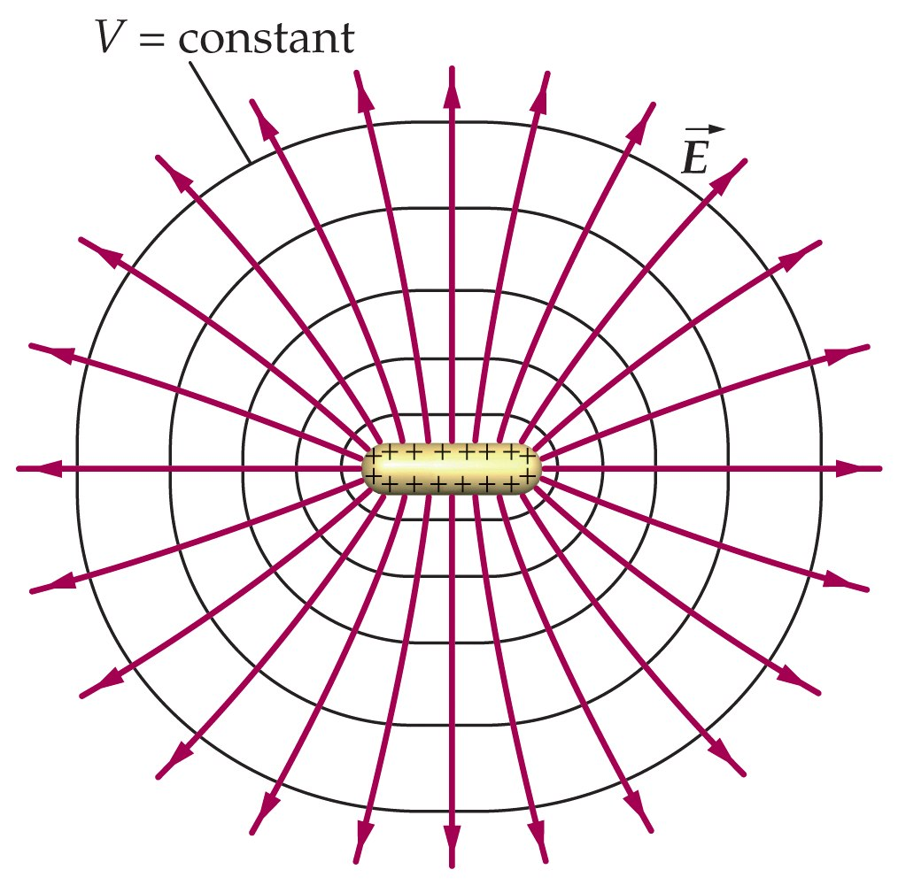

Slide 42
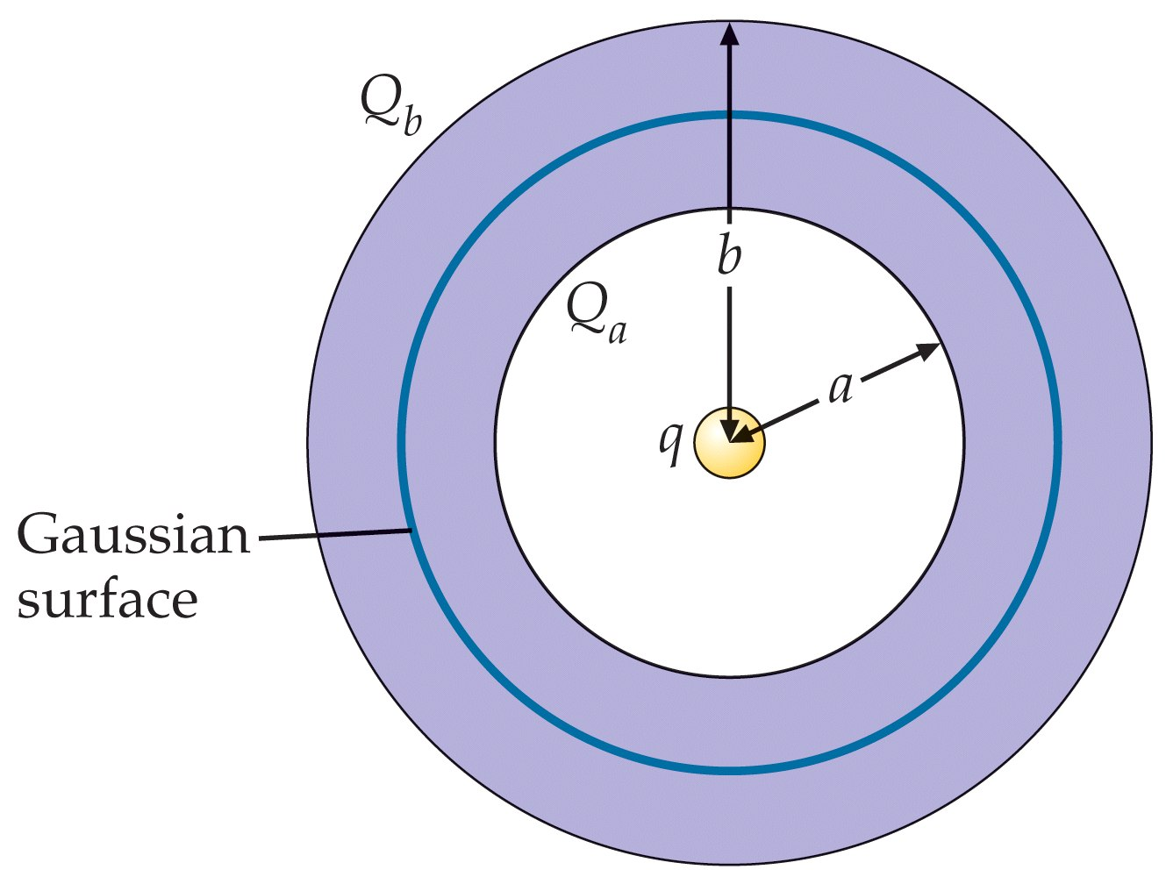

Slide 43
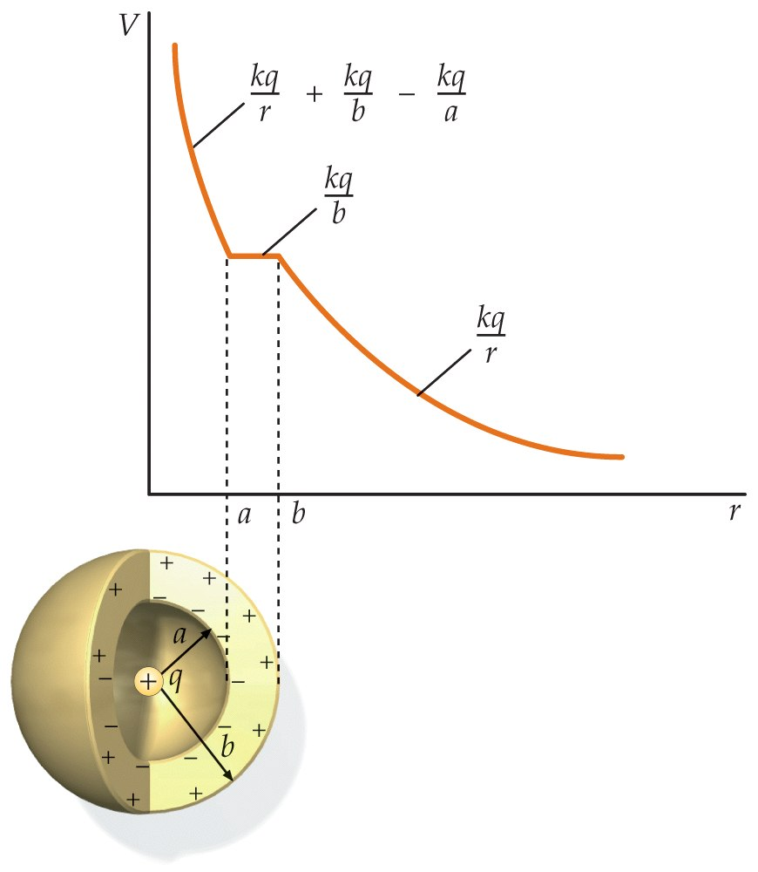

Slide 44
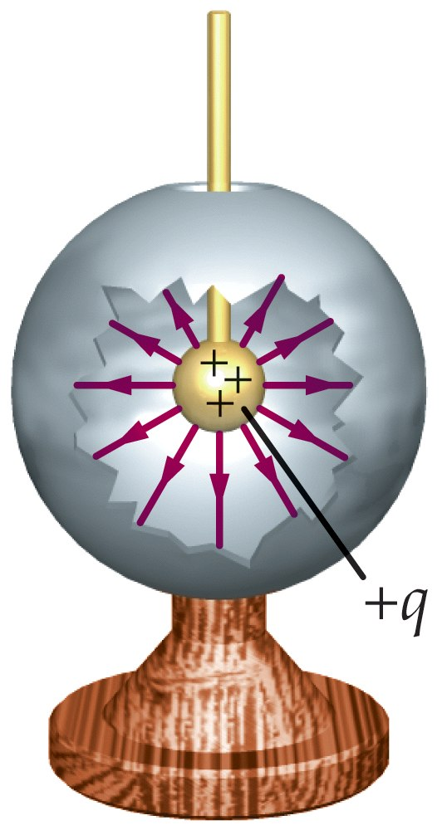

Slide 45
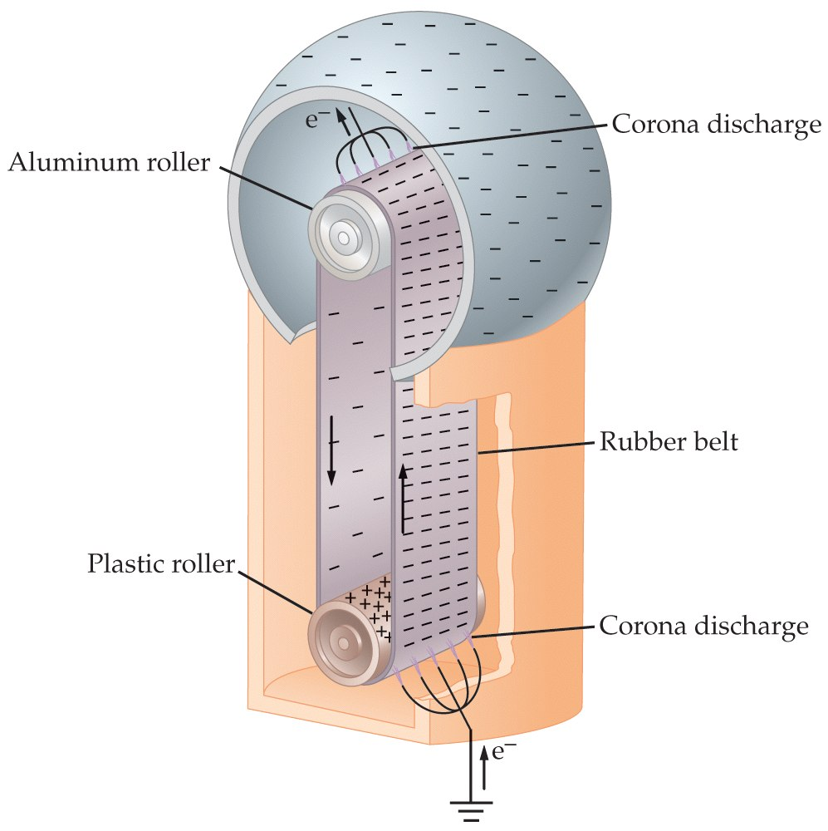

Slide 46
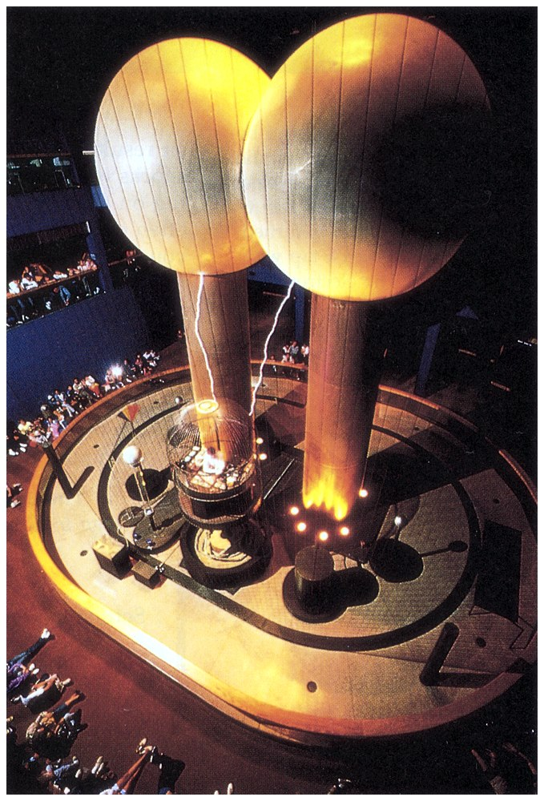

Slide 47


Slide 48
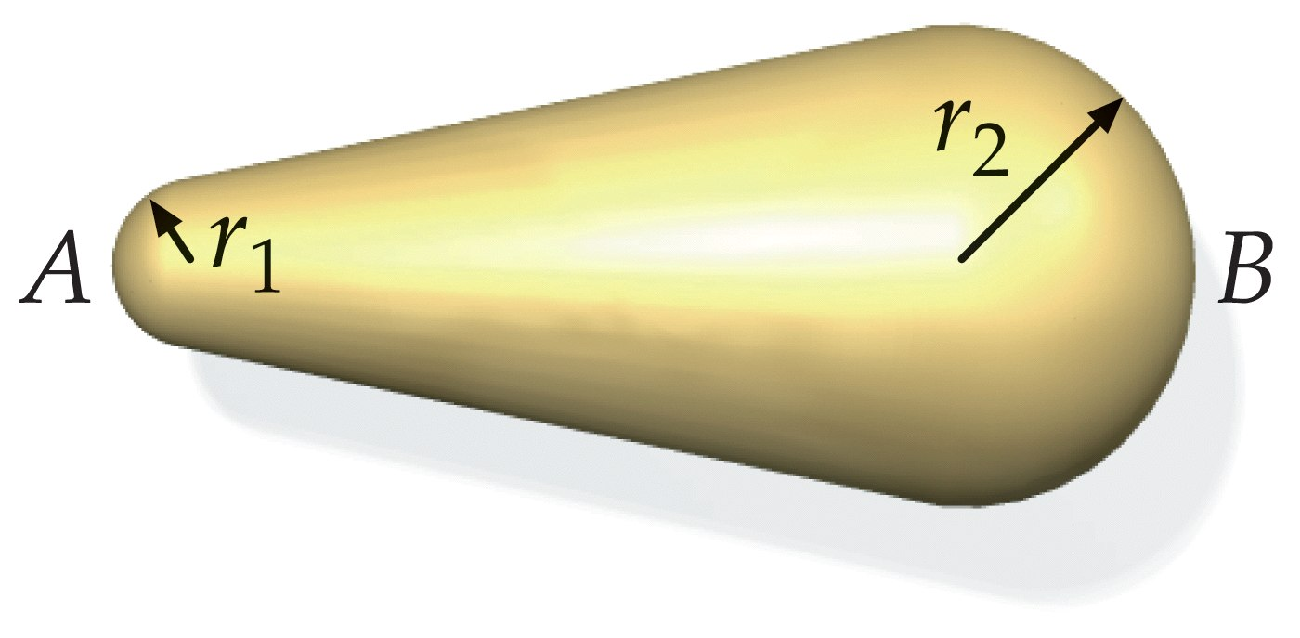

Slide 49
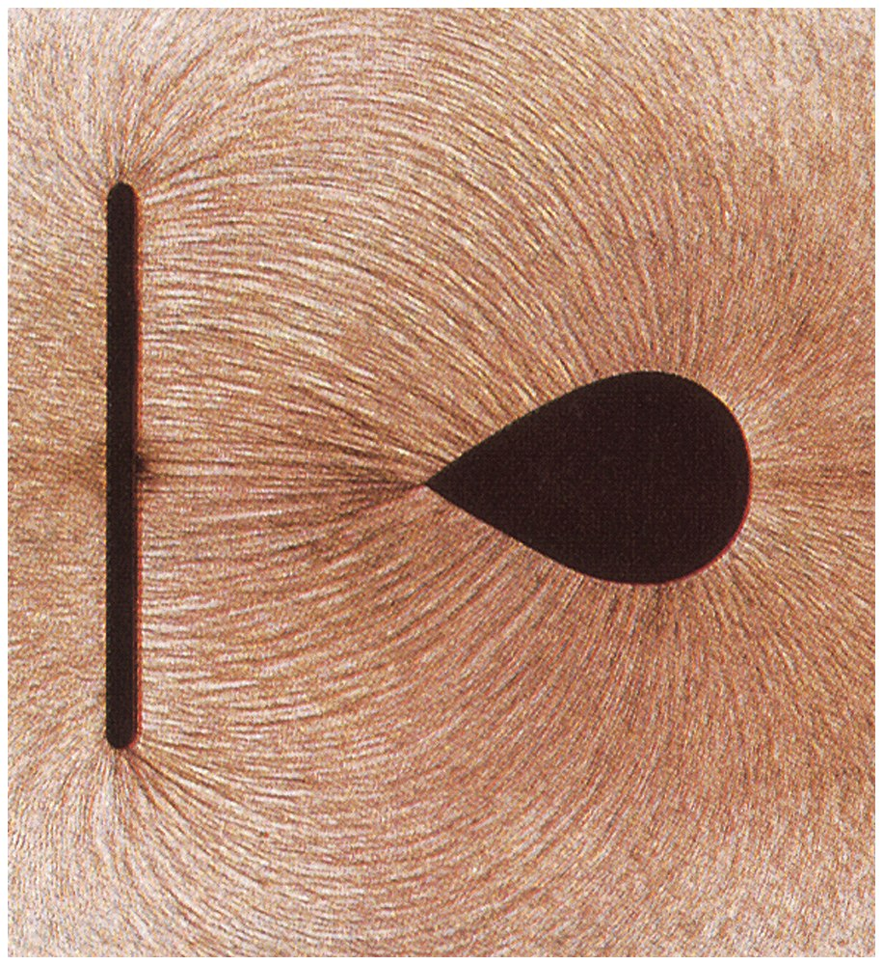

Slide 50
Problems

Slide 51
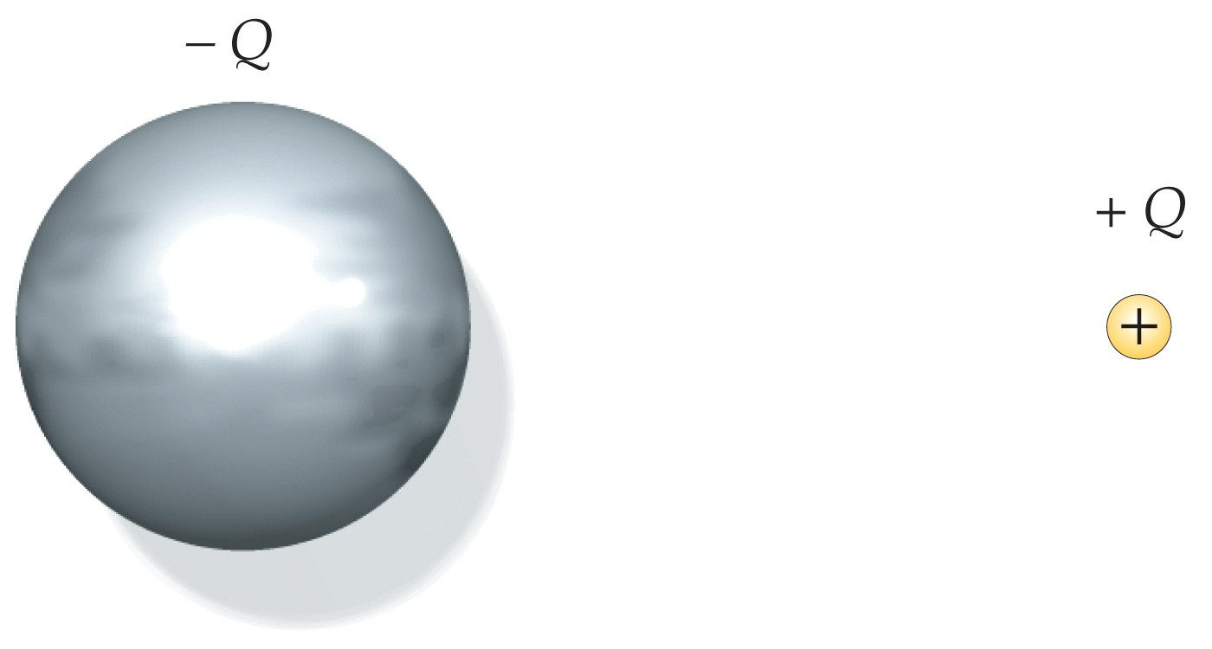

Slide 52
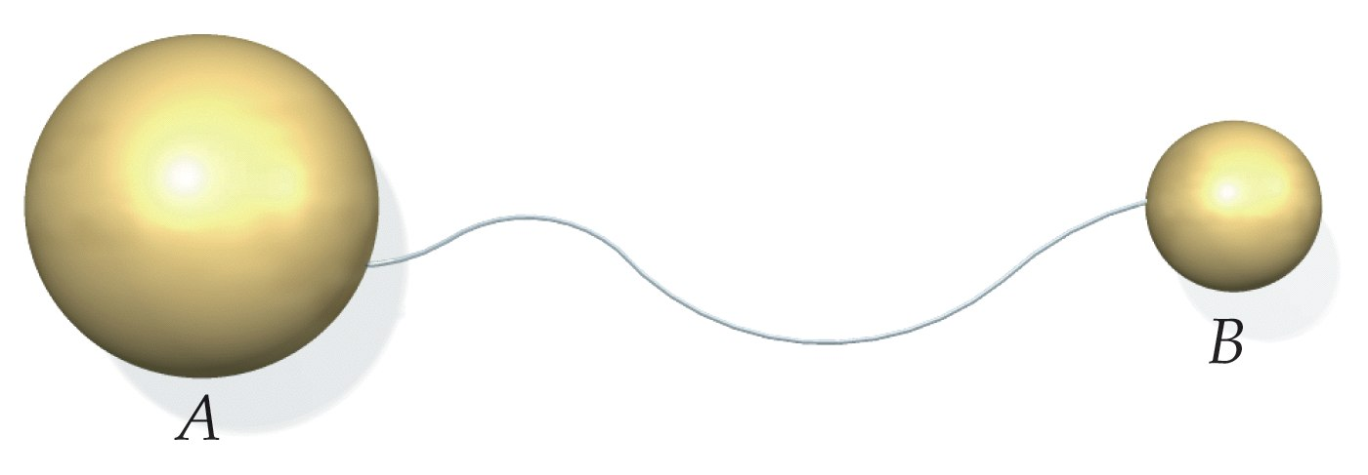

Slide 53
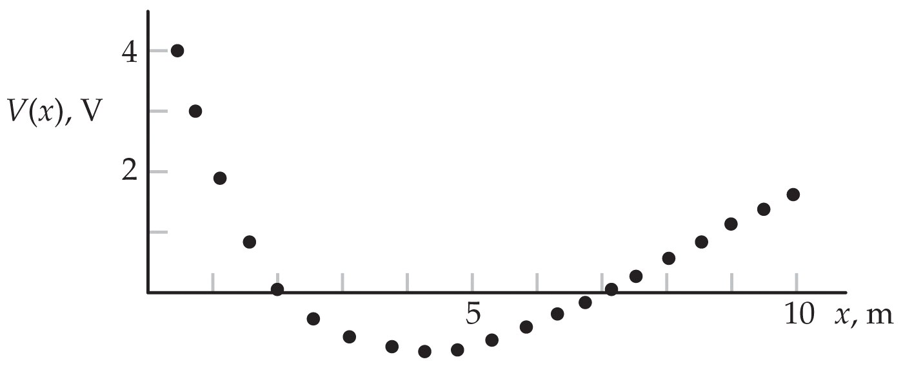

Slide 54
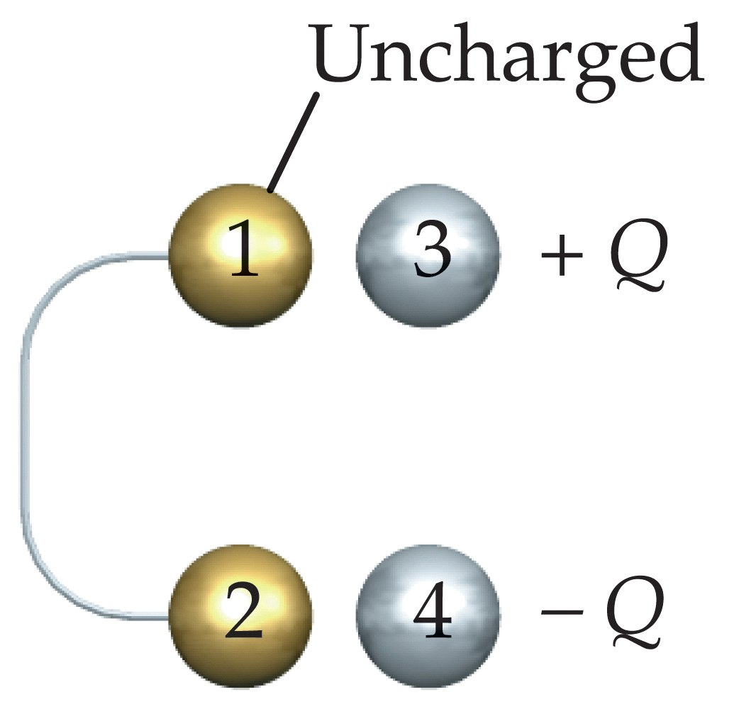

Slide 55
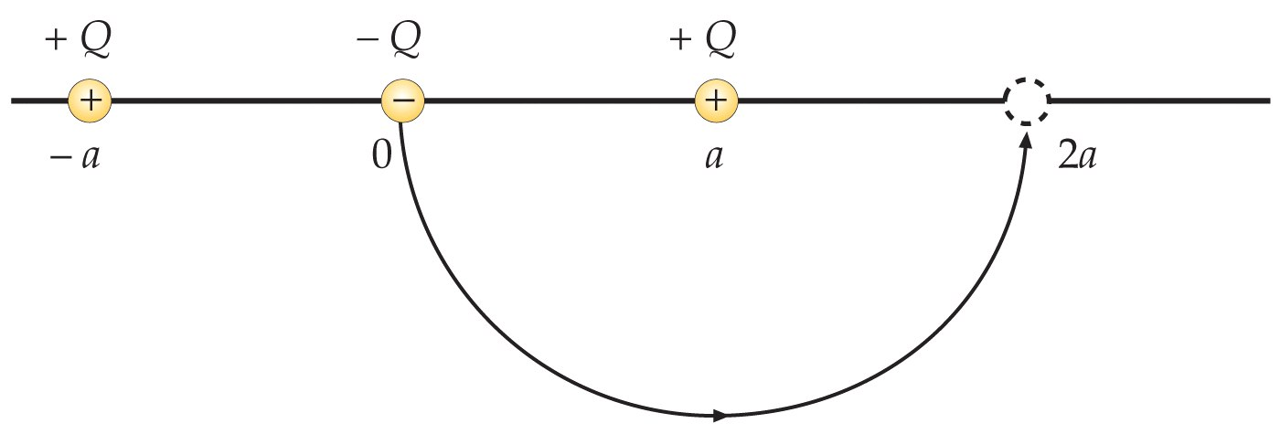

Slide 56
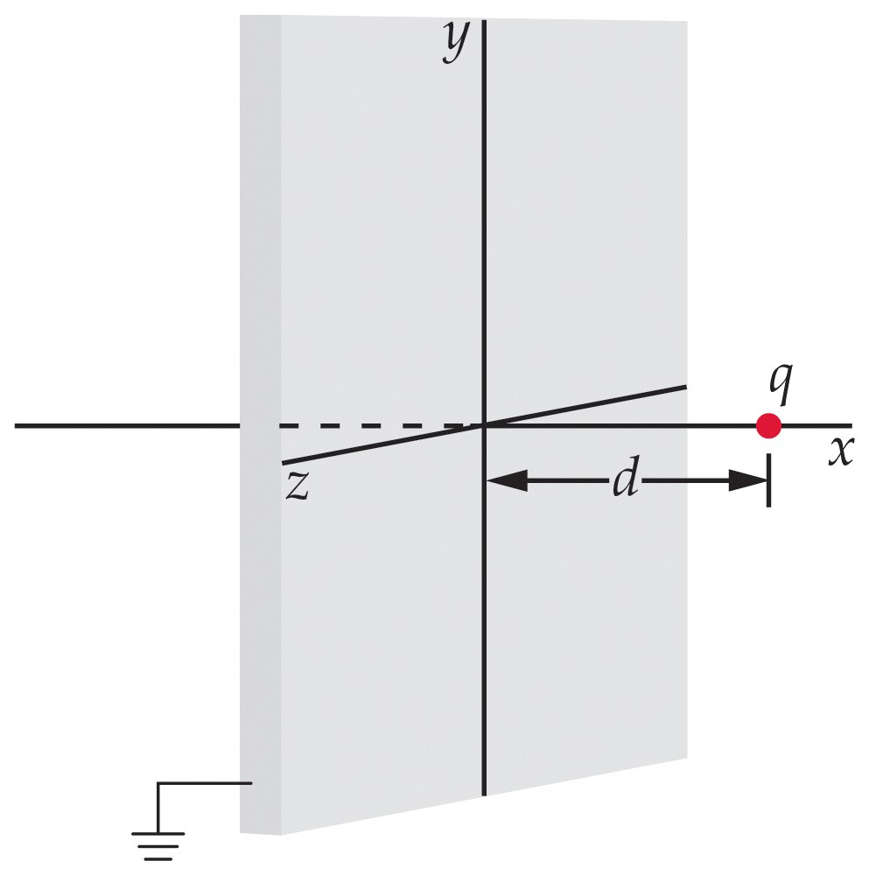

Slide 57
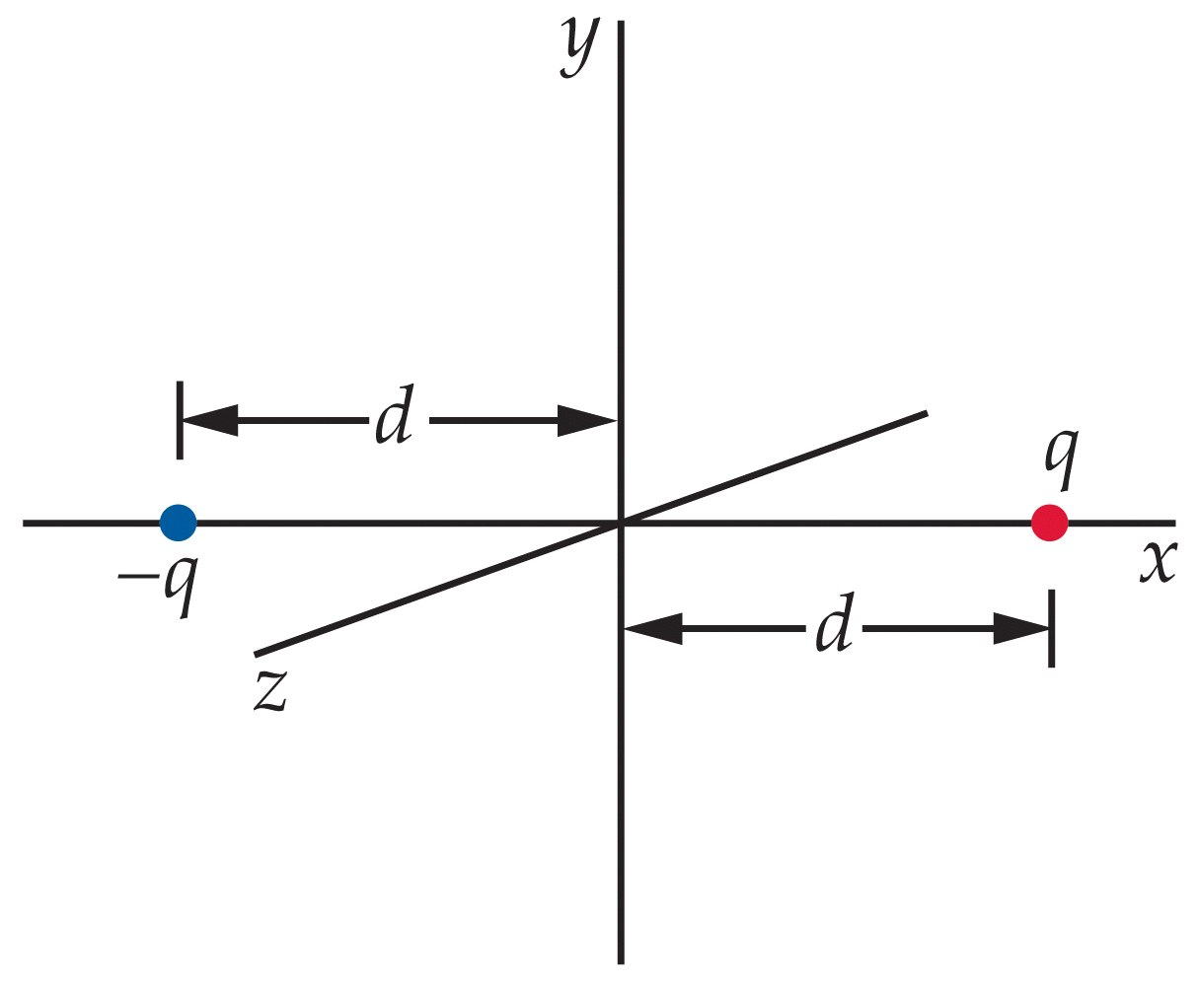

Slide 58
