Slide 1
Physics for Scientists and Engineers
Paul A. Tipler • Gene Mosca
Fifth Edition
Chapter 30:
Maxwell’s Equations and Electromagnetic Waves
Copyright © 2004 by W. H. Freeman & Company

Slide 2
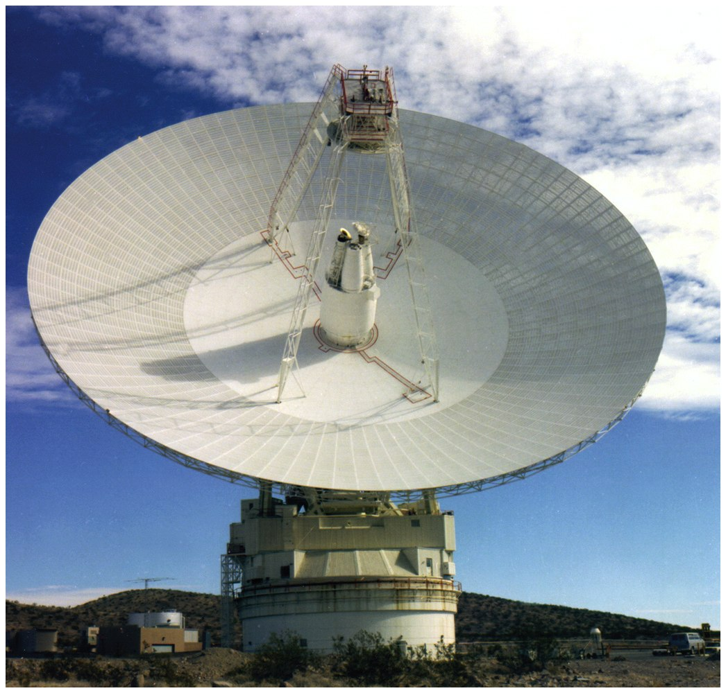

Slide 3
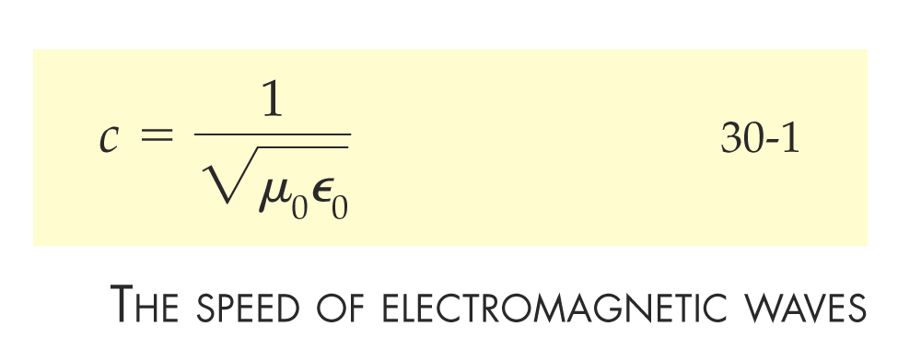

Slide 4
30-1
Maxwell’s Displacement Current

Slide 5
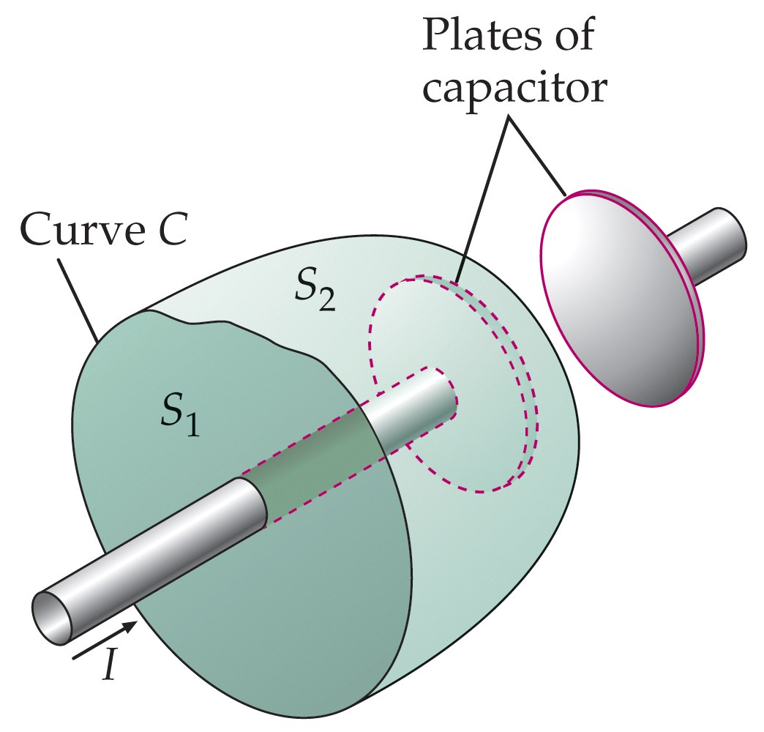

Slide 6


Slide 7


Slide 8
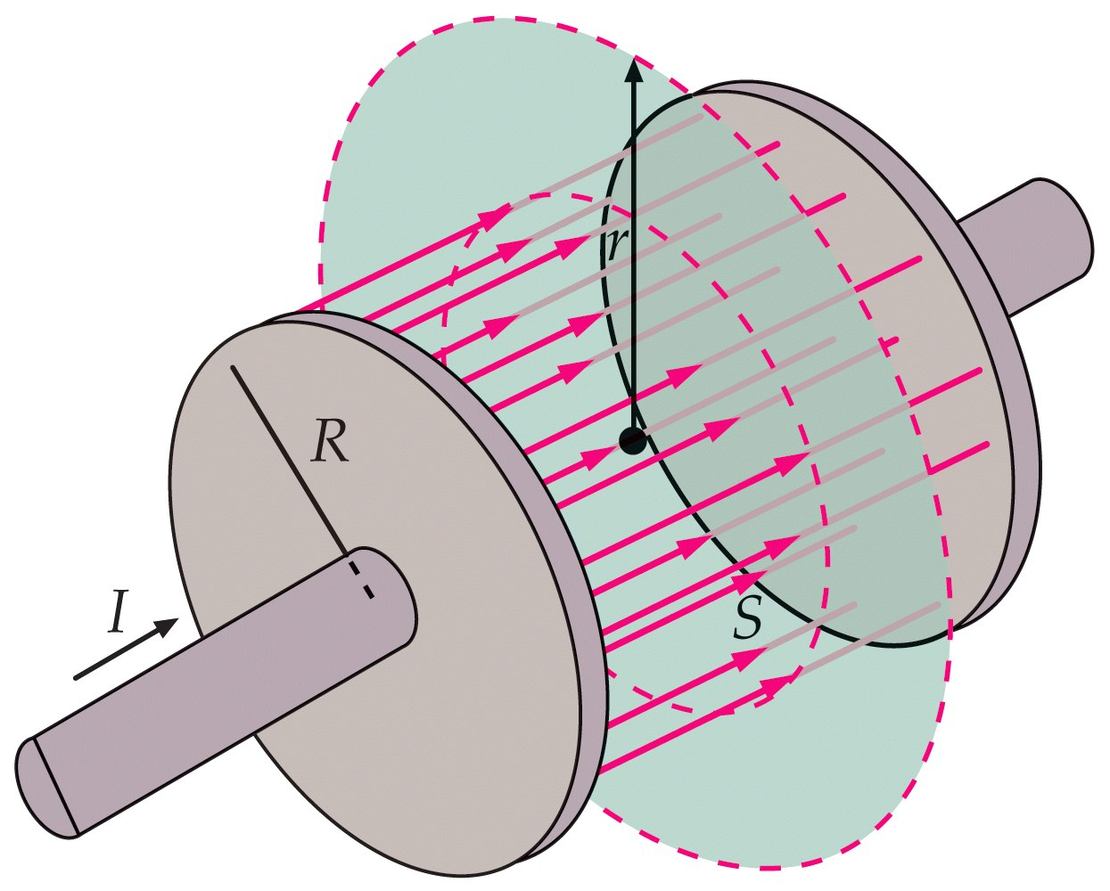

Slide 9
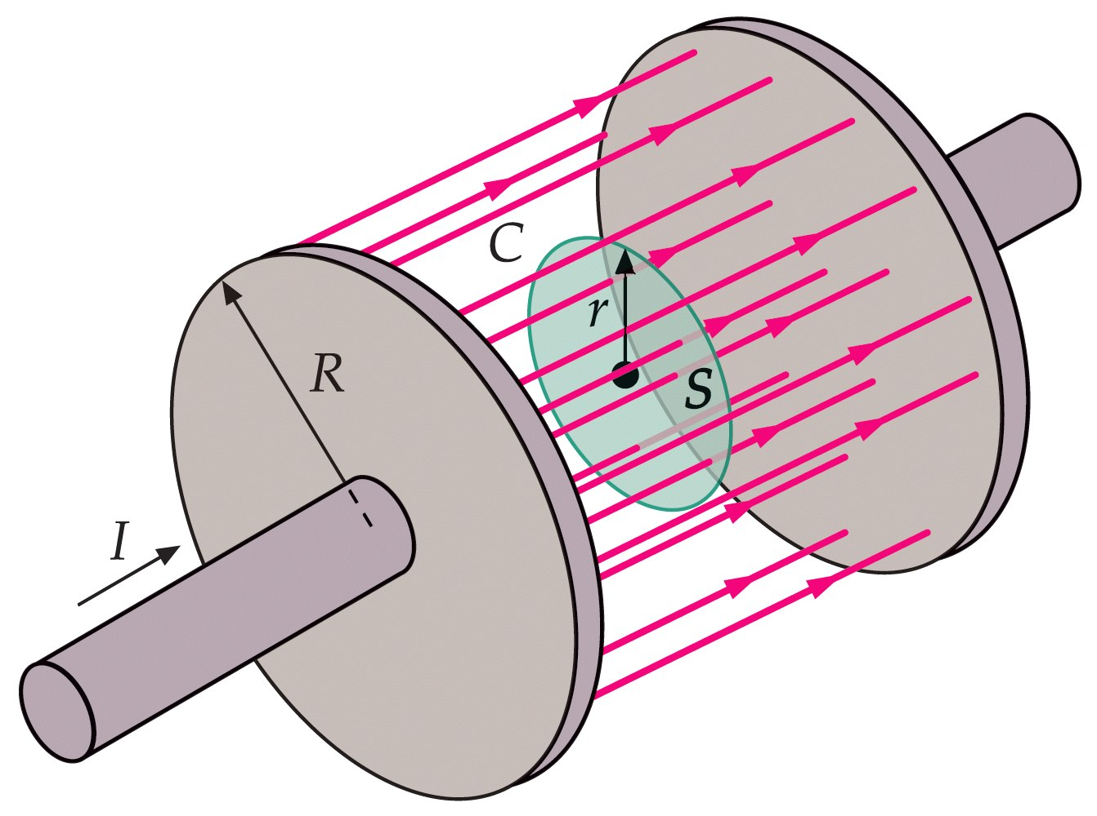

Slide 10
30-2
Maxwell’s Equations

Slide 11


Slide 12


Slide 13


Slide 14


Slide 15
30-3
Electromagnetic Waves

Slide 16


Slide 17
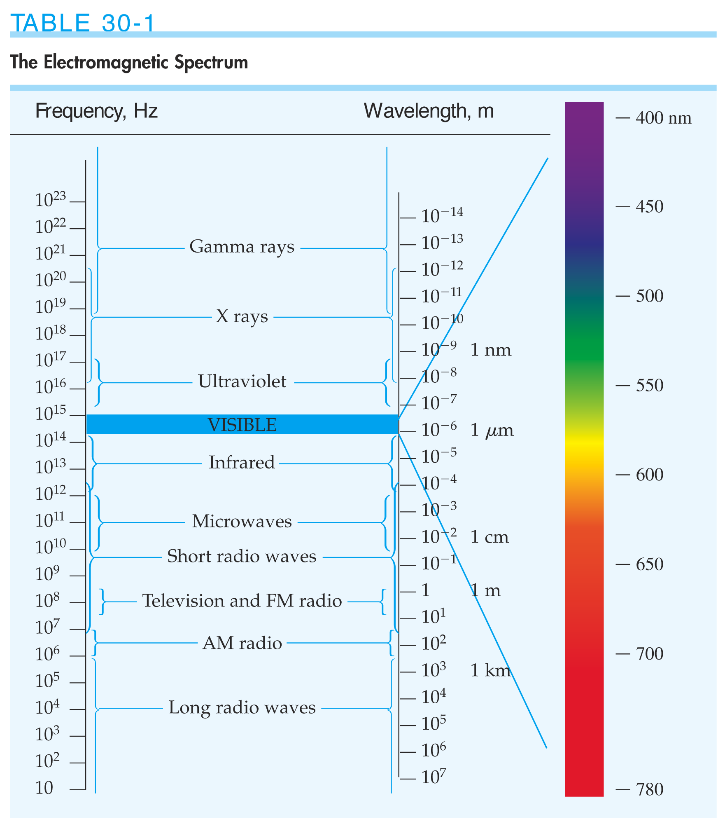

Slide 18
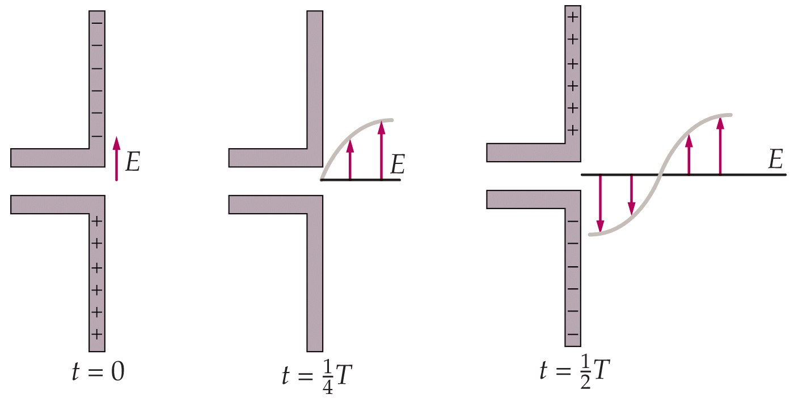

Slide 19
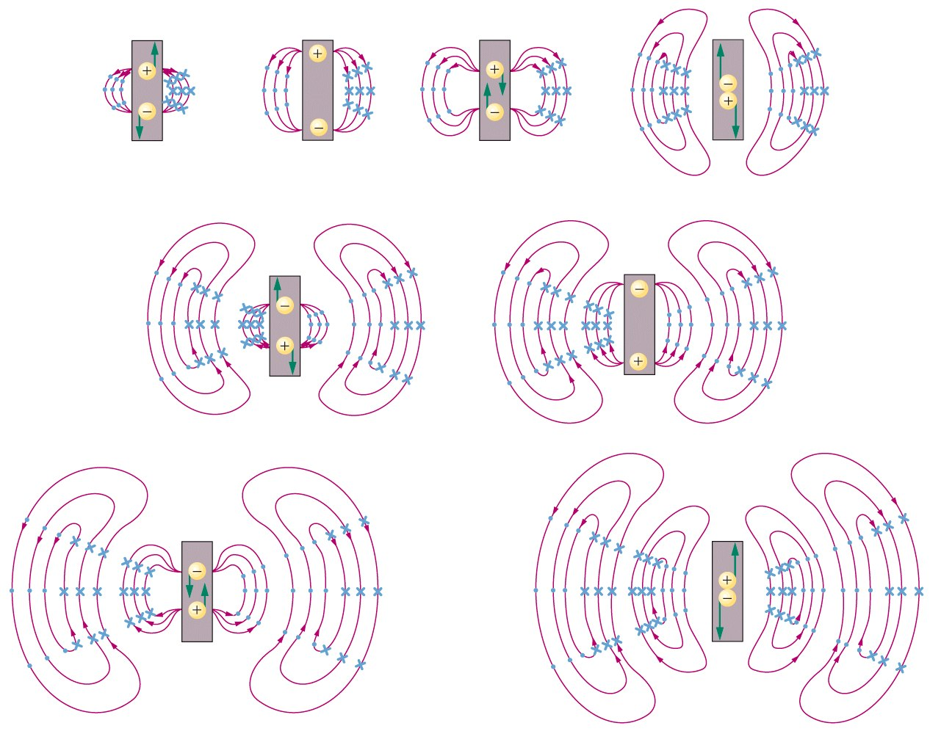

Slide 20
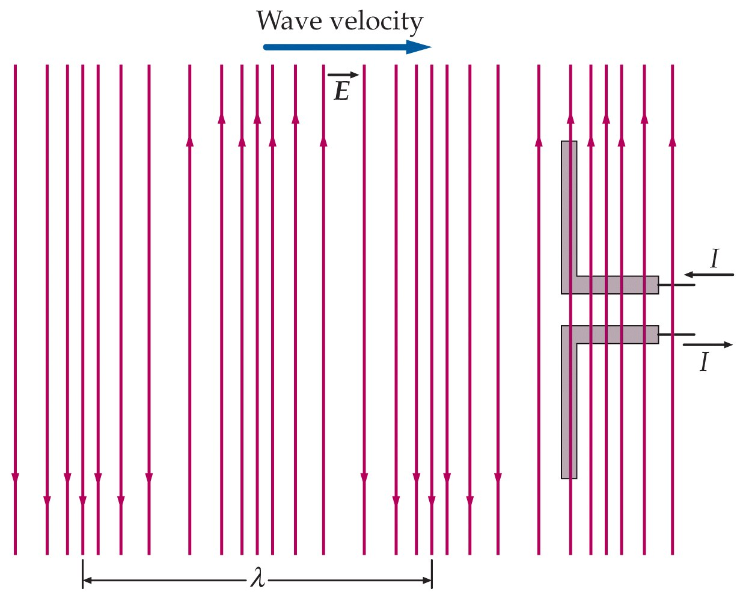

Slide 21
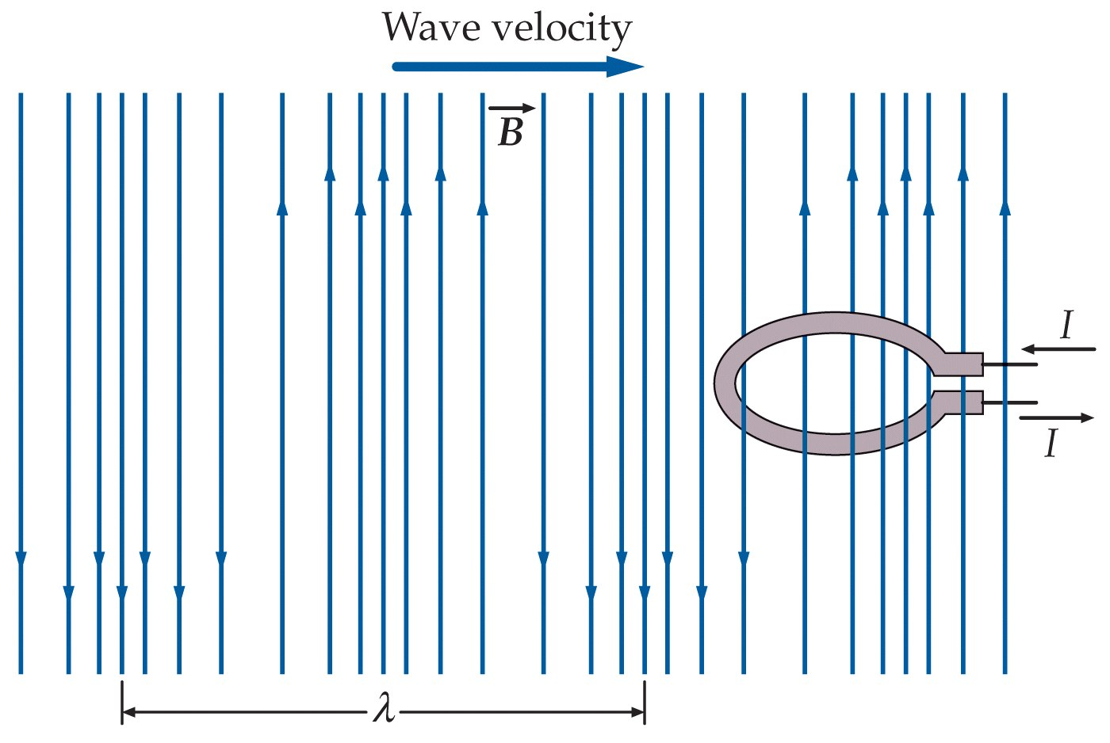

Slide 22
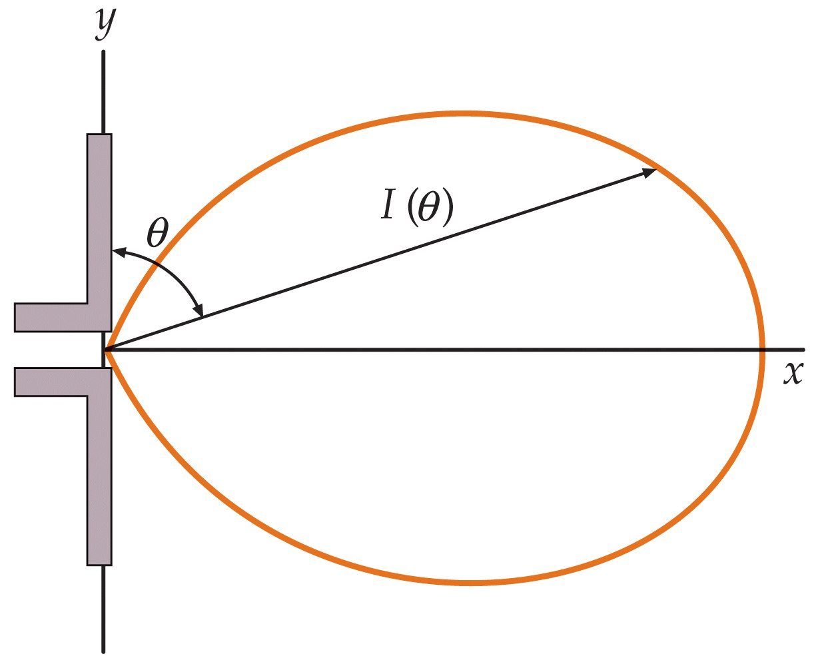

Slide 23


Slide 24


Slide 25
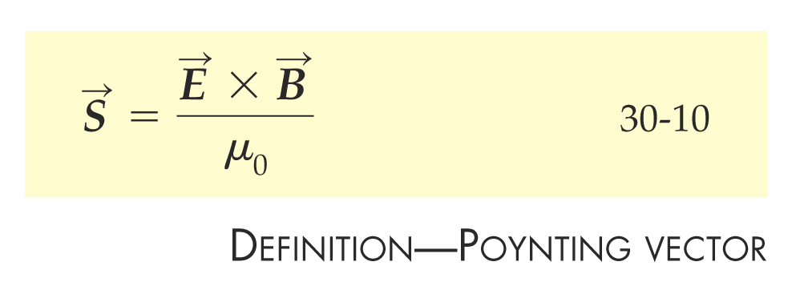

Slide 26


Slide 27
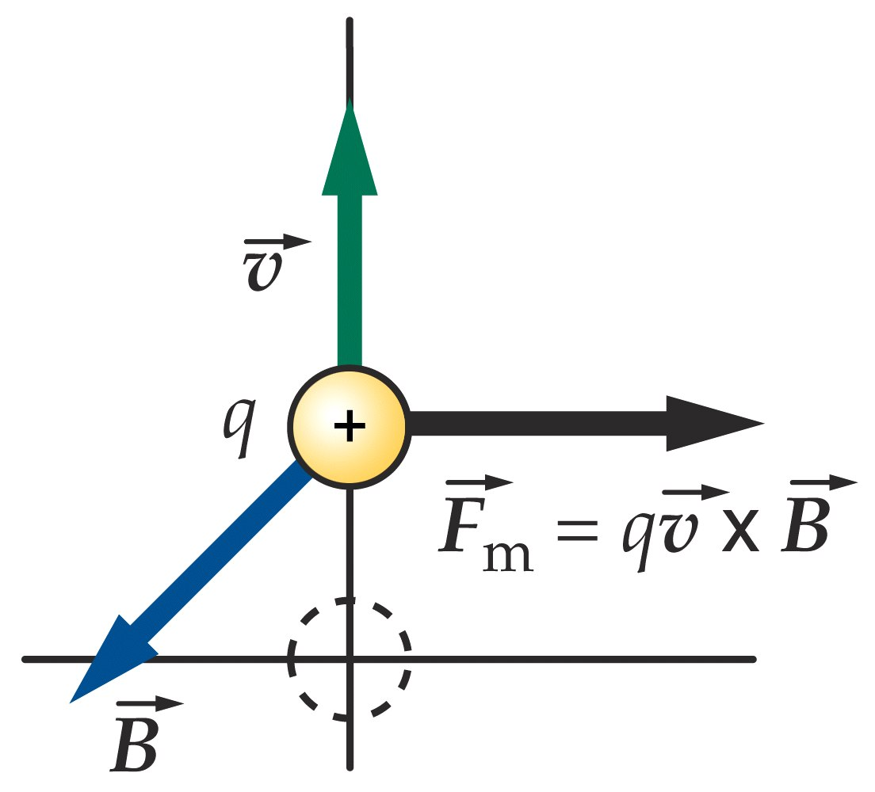

Slide 28


Slide 29
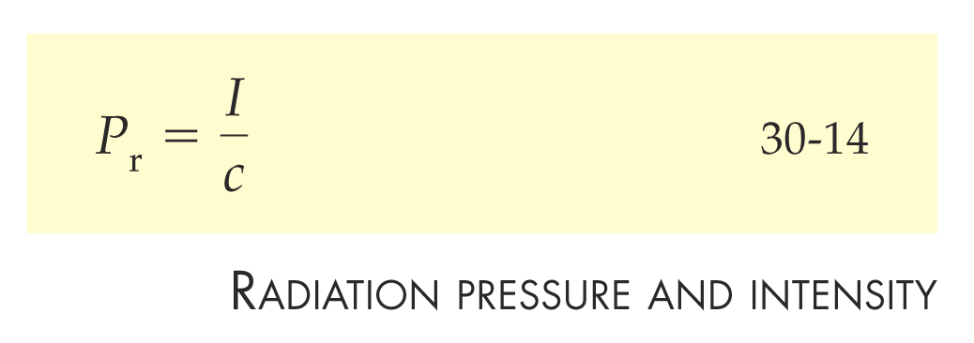

Slide 30


Slide 31
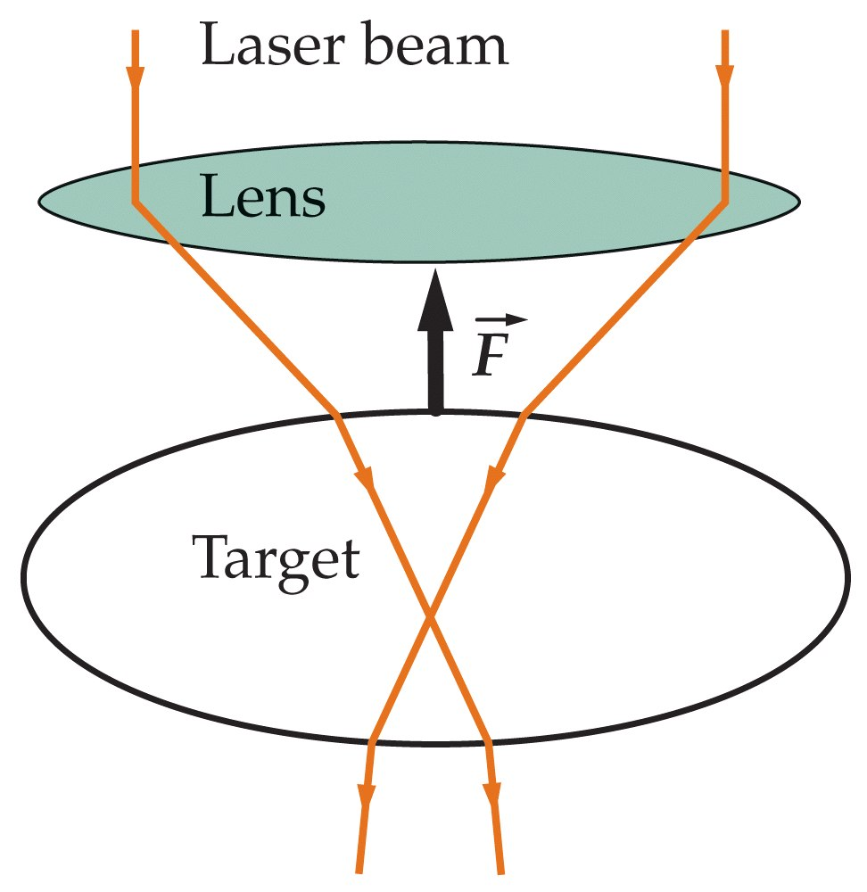

Slide 32
30-4
The Wave Equation for Electromagnetic Waves

Slide 33


Slide 34


Slide 35
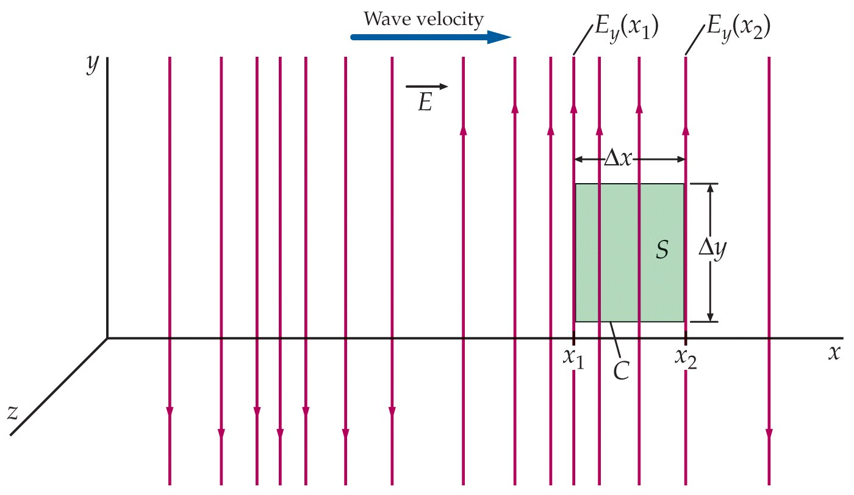

Slide 36
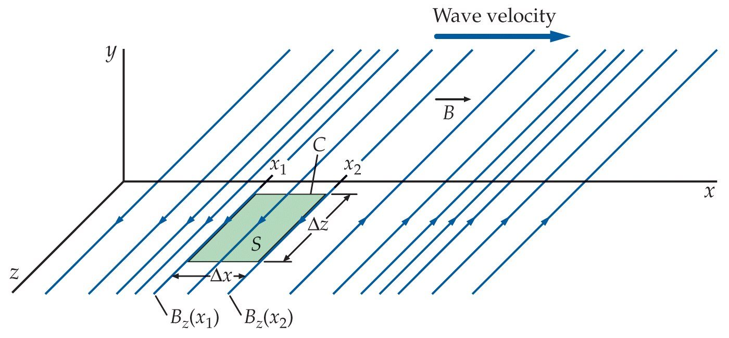

Slide 37
Problems

Slide 38
