Slide 1
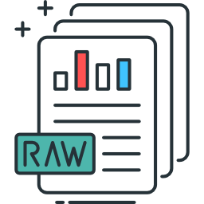
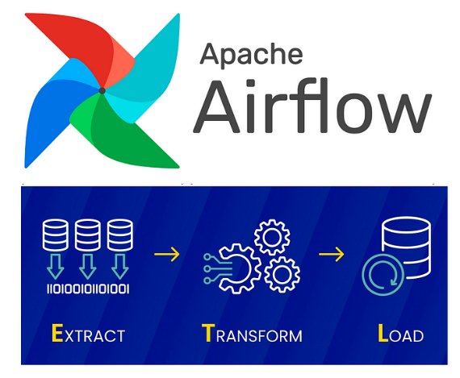






Save & Load rawdata
Download rawdata
Split, Transform & Save data
Save models & experiments
Production model
Request
Load models
ETL process
Model experimentation process
Production process

