Slide 1
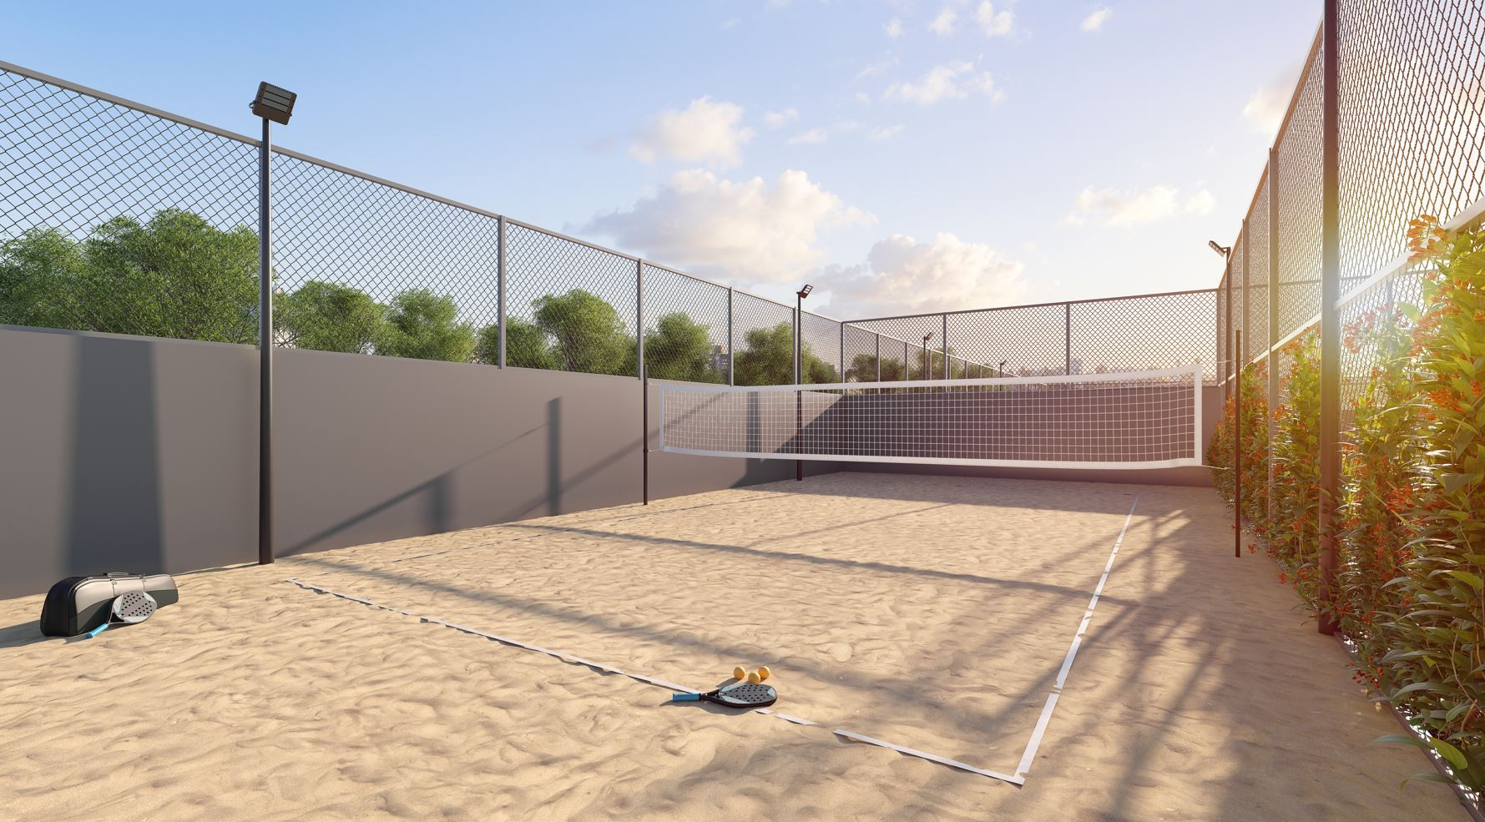


QUADRA DE BEACH TENNIS

