Slide 2





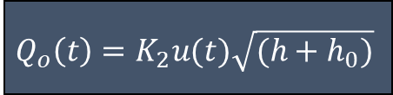
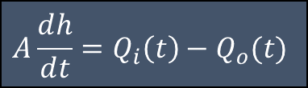





$$Q_{i}(t)$$
$$y_{sp}$$
+
-
$$e(t)$$
$${LC}_{42}$$
$$u(t)$$
$$Q_{o}\left(t\right)=K_{2}u(t)\sqrt{(h+h_{0})}$$
$$Q_{o}(t)$$
$$A\frac{ⅆh}{ⅆt}=Q_{i}\left(t\right)−Q_{o}(t)$$
$$h$$
$${LT}_{42}$$
$$y_{m}$$
$$h$$

Slide 3

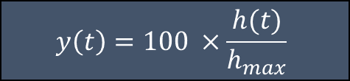
$$y_{sp}=100×\frac{h_{sp}}{h_{max}}$$
$$y\left(t\right)=100 ×\frac{h(t)}{h_{max}}$$

Slide 4


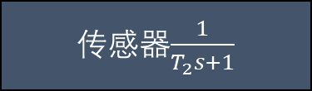



















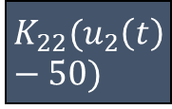



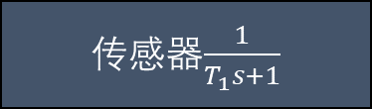


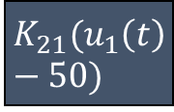






$$e_{{\dot{θ}}_{1}}$$
$$θ_{sp1}$$
+
-
$$e_{θ_{1}}$$
$控制器$1
+
-
$$控制器$$
$$2$$
$$u_{1}$$
$$K_{21}(u_{1}\left(t\right)−50)$$
$$τ_{1}(t)$$
$公式$2-1
$${\ddot{θ}}_{1}$$
$$\frac{1}{s}$$
$${\dot{θ}}_{1}$$
$$\frac{1}{s}$$
$$θ_{1}$$
$$θ_{m1}$$
$${\dot{θ}}_{1m}$$
传感器$\frac{1}{T_{2}s+1}$
传感器$\frac{1}{T_{1}s+1}$
$$e_{θ_{2}}$$
$$e_{{\dot{θ}}_{2}}$$
$$τ_{2}(t)$$
$${\ddot{θ}}_{2}$$
$${\dot{θ}}_{2}$$
$$θ_{2}$$
$$θ_{sp2}$$
+
-
$控制器$1
+
-
$$控制器$$
$$2$$
$$u_{2}$$
$$K_{22}(u_{2}\left(t\right)−50)$$
$公式$2-1
$$\frac{1}{s}$$
$$\frac{1}{s}$$
$$θ_{m2}$$
$${\dot{θ}}_{2m}$$
传感器$\frac{1}{T_{2}s+1}$
传感器$\frac{1}{T_{1}s+1}$

