Slide 1

混杂场景下物体分割与位姿估计
指导老师：王越
参与成员：xuhao38, Chenrui Han, LeoDuhz

Slide 2
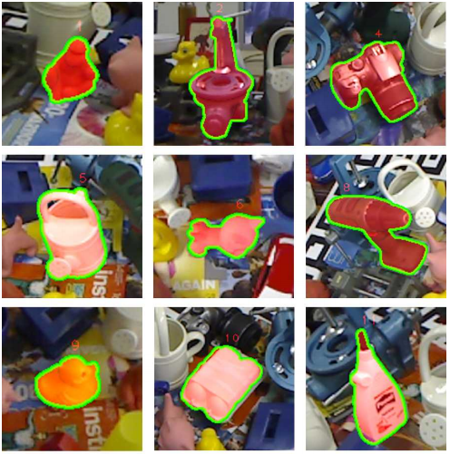
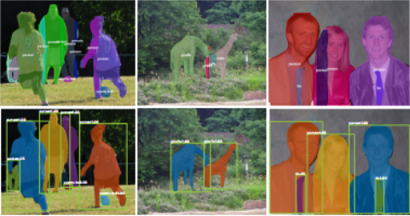
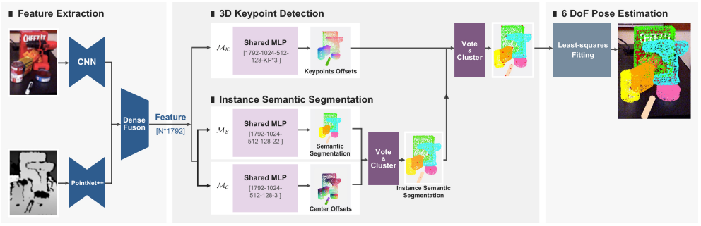
我们要做什么？
+
=
物体分割网络
位姿估计网络
物体同时分割与位姿估计联合优化网络

Slide 3
项目的优势与意义
基础任务
物体分割网络
+
位姿估计网络
进阶任务
物体分割与
位姿估计
联合优化网络
形成RGBD图像-物体位姿
完整的闭式流程
更精确的物体分割改善位姿估计表现
位姿估计包含的尺寸信息帮助物体
分割区分形状相似大小不同的物体

Slide 4
技术路线
1
2
3
4
5
参考Mask R-CNN等设计物体分割网络
物体分割网络与位姿解码器网络结合
在公开数据集LineMOD等上进行测试
参考之前网络设计经验，设计并训练同时分割与位姿估计网络，多任务学习进行联合优化
进一步测试分割与位姿估计精度改变效果，评估联合网络效果

Slide 5
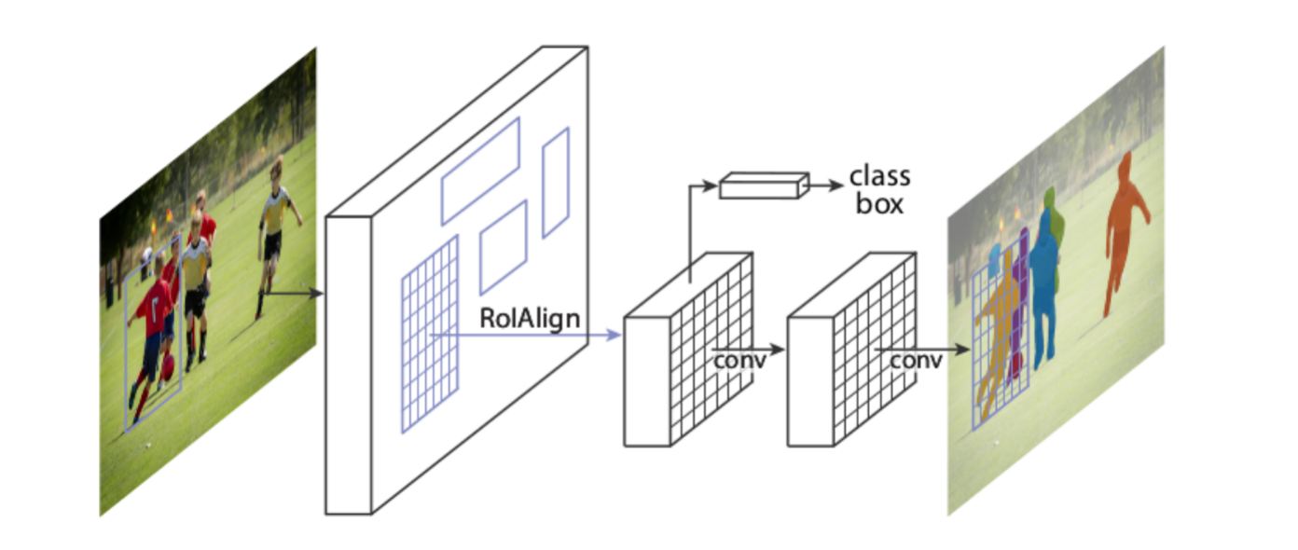
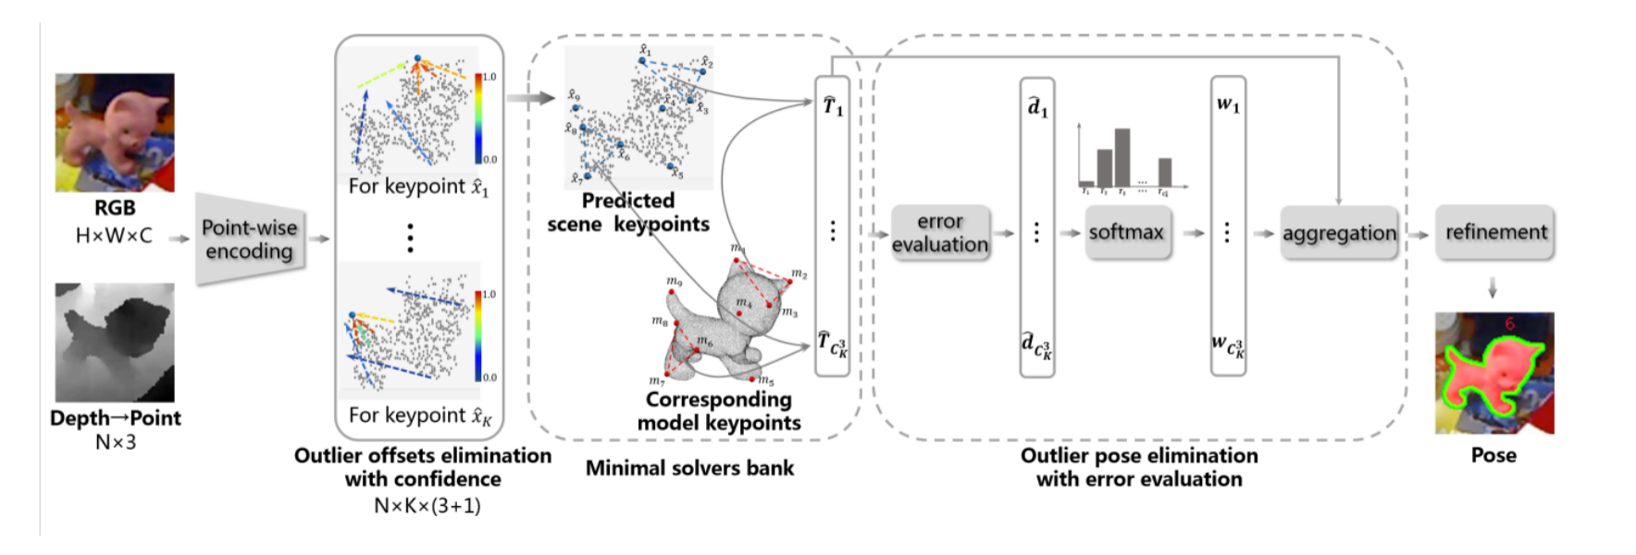
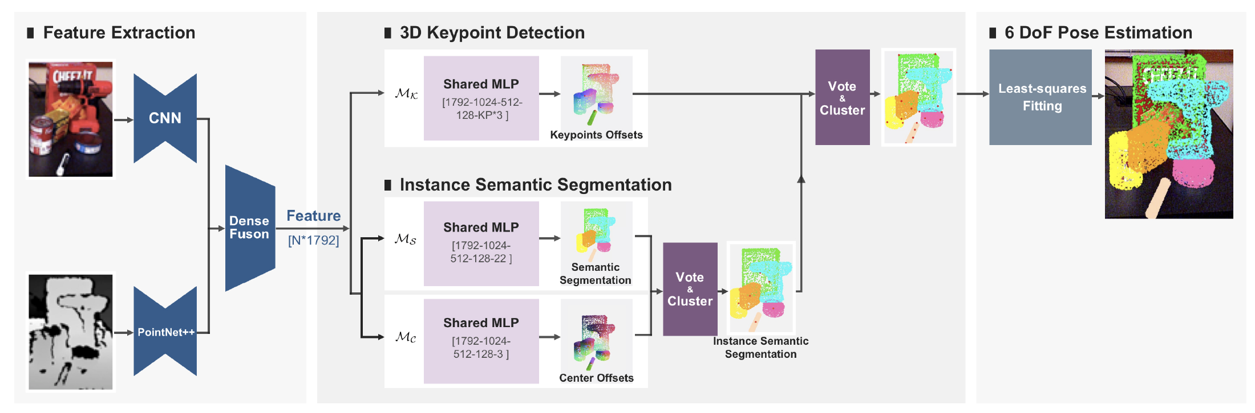
计划目标
实现物体语义分割网络
在现有位姿估计网络的基础上将分割网络集成
构建物体同时分割与位姿估计联合优化网络，提高分割和位姿估计精度

Slide 6
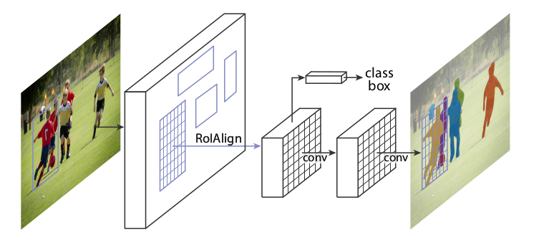
分割解码器网络
operation on RoI(region of interest)
idea from the R-CNN paper
input image -> extract region proposals ->
compute CNN features -> classify
three branches
one for class
one for box
one for mask
MULTI-TASK!

Slide 7
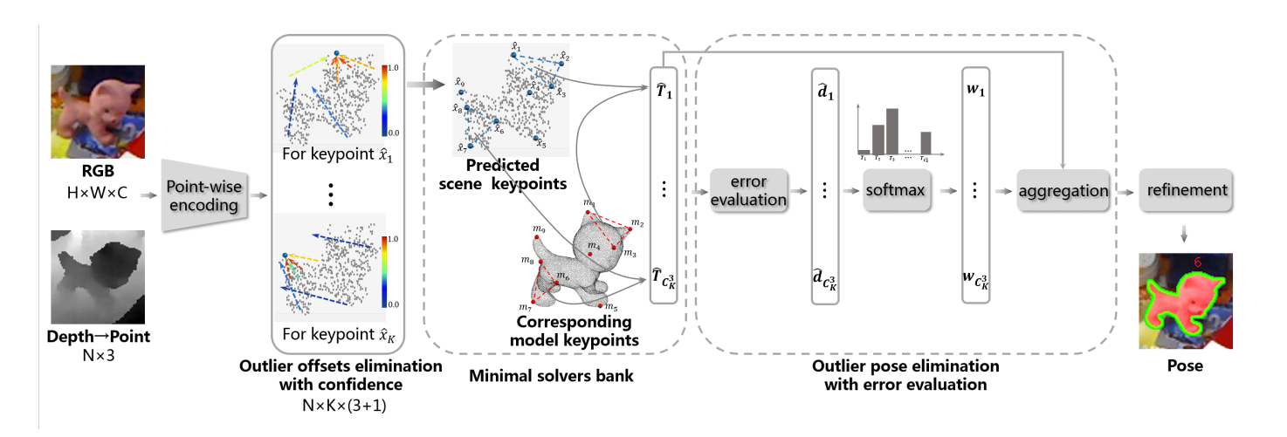
位姿估计解码器网络
Predict the point-wise point-to-keypoint offsets from the segmented RGB-D frame.
Predict the corresponding confidences meanwhile for the aggregation of 3D keypoints.
Enumerate every 3 keypoints among all keypoints to estimate multiple poses and build solvers bank.
Estimate the pose by weighted aggregation with differentiable outliers elimination and final refinement.
Notes:
The point-wise point-to-keypoint offsets are predicted from the segmented RGB-D frame. We predict the corresponding
confidences meanwhile for the robust aggregation of 3D keypoints. Then multiple poses are estimated by exhaustively enumerating every 3 keypoints
among all candidate keypoints to build minimal solvers bank. Next, the pose is estimated robustly by weighted aggregation with differentiable outliers
elimination and final refinement.

Slide 8
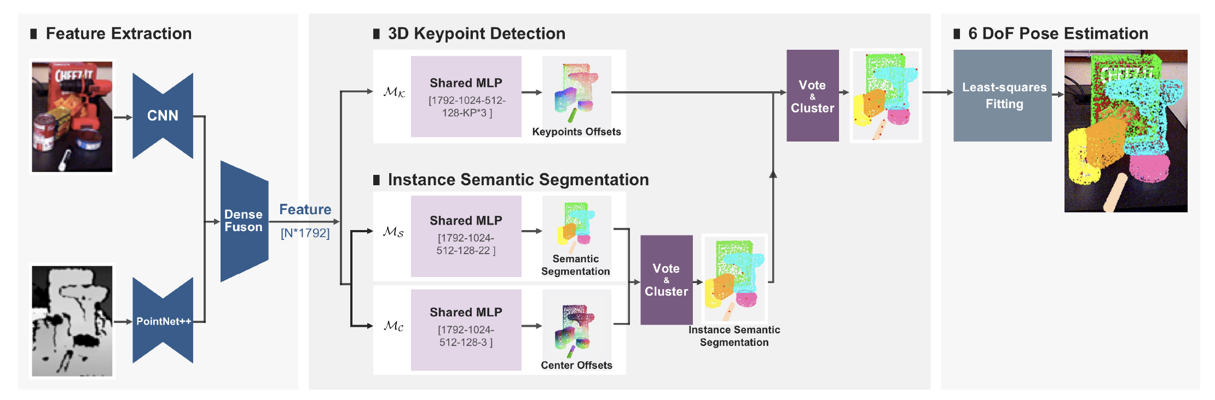
同时物体分割与位姿估计网络
Take the feature information of the color and depth information separately and then fuse them
Predict the key points defined in advance, the classification label of each point, and the center point offset
Use mean shift clustering to solve the division of different instances
Use Least squares to fit the transformation of the world coordinate system and the camera coordinate system
MK,MC andMS to predict the translation offsets to keypoints, center point and semantic labels of each point respectively
Notes:
我们计划对彩色和深度信息分别取特征信息然后融合，对提前定义好的关键点、每个点的分类label、中心点偏移进行预测，使用mean shift聚类来解决不同实例的划分，最后用最小二乘来拟合世界坐标系和摄像机坐标系的变换
我们计划训练一个类似图上所示的3D 关键点检测模块 M_k，用于预测逐点到 3D 关键点的偏移；以及一个语义分割模块 M_s 和中心点投票模块 M_c，用于实例语义分割。这样网络训练自然形成一个多任务学习任务。

Slide 9
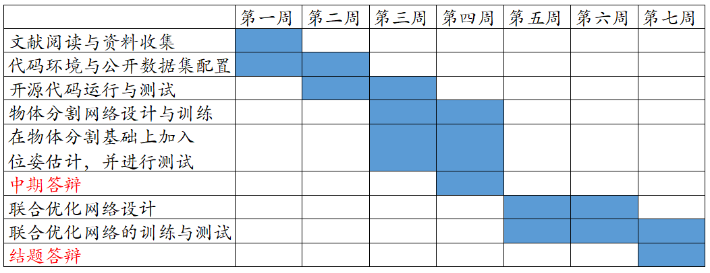
项目实施方案

Slide 10
参考文献
[1]Hua, Weitong, et al. "Rede: End-to-end object 6d pose robust estimation using differentiable outliers elimination." IEEE Robotics and Automation Letters 6.2 (2021): 2886-2893.
[2]He, Yisheng, et al. "Pvn3d: A deep point-wise 3d keypoints voting network for 6dof pose estimation." Proceedings of the IEEE/CVF conference on computer vision and pattern recognition. 2020.
[3]He, Kaiming, et al. "Mask r-cnn." Proceedings of the IEEE international conference on computer vision. 2017.
[4]R. Girshick. Fast R-CNN. In ICCV, 2015.
[5]E. Brachmann, A. Krull, F. Michel, S. Gumhold, J. Shotton, and C. Rother. Learning 6d object pose estimation using 3d object coordinates. In European conference on computer vision, pages 536–551. Springer, 2014.
[6]M. Sundermeyer, Z.-C. Marton, M. Durner, M. Brucker, and R. Triebel, “Implicit 3d orientation learning for 6d object detection from rgb images,” in Proceedings of the European Conference on Computer Vision (ECCV), 2018, pp. 699–715.

Slide 11
THANK YOU
欢迎各位老师指导

