Slide 1

Simulation-Based Analysis of Blockchain Architectures: Double-Spend Attacks
Technische Universität München
Bachelor‘s Thesis
Leo Eichhorn
Garching, 17 July 2018

Slide 2
Motivation
TODO
Leo Eichhorn | Bachelor‘s Thesis | Simulation-Based Analysis of Blockchain Architectures
2

Slide 3
Outline
Context
Blockchain
Double-Spend Attacks
Problem Statement
Approach
Blockchain Simulation
Analysis
Empirical Model
Conclusion
Leo Eichhorn | Bachelor‘s Thesis | Simulation-Based Analysis of Blockchain Architectures
3

Slide 4
Blockchain
Distributed database
Entries (blocks) are linked by their hashes
Peer-to-peer network of nodes maintaining local copies of the blockchain
Next block is chosen by first node solving cryptographic puzzle (proof of work) and broadcasted to all peers
No intermediate, trusted authority
Unterscheidung Bitcoin \ Blockchain, Proof of work <-
Leo Eichhorn | Bachelor‘s Thesis | Simulation-Based Analysis of Blockchain Architectures
4

Slide 5
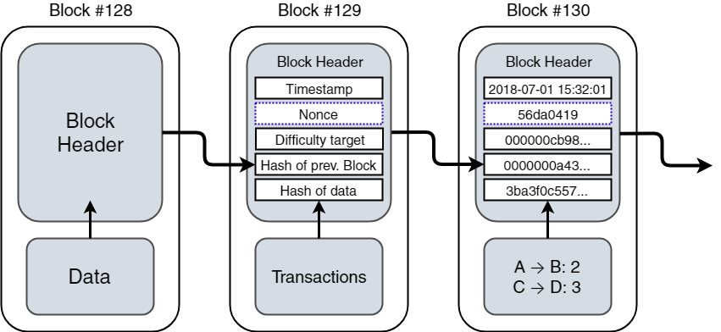
Blockchain Structure (Bitcoin)
Leo Eichhorn | Bachelor‘s Thesis | Simulation-Based Analysis of Blockchain Architectures
5

Slide 6
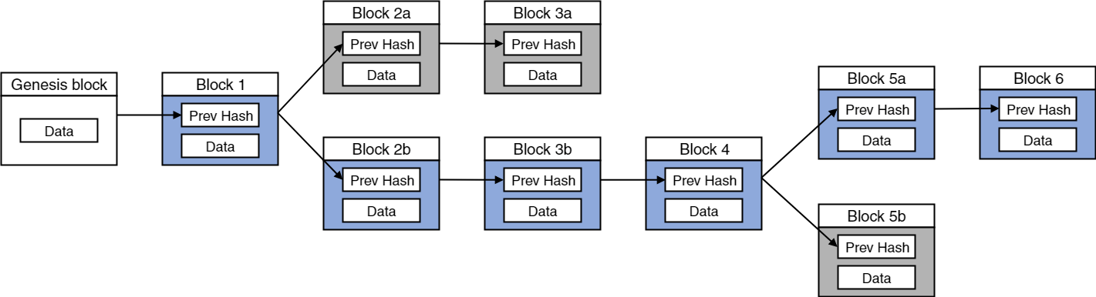
Block Propagation / Stale Blocks
Peer-to-peer networks are influenced by latency times
Two blocks mined at roughly the same time: branch in blockchain
Consensus is eventually retained due to longest chain rule
Blocks of shorter branch turn stale
Stale blocks indicate a waste of computational power
Leo Eichhorn | Bachelor‘s Thesis | Simulation-Based Analysis of Blockchain Architectures
6

Slide 7
Double-Spend Attacks
Name related to Bitcoin:
Group of dishonest nodes revert transaction to a merchant after receiving the purchased product
Attacker needs to mine new blocks faster than the remaining network
TODO: Visual example of double-spend attack
Leo Eichhorn | Bachelor‘s Thesis | Simulation-Based Analysis of Blockchain Architectures
7

Slide 8
Problem Statement
A blockchain architecture‘s resistance against double-spend attacks (RADS) may depend on many factors
Existing models of RADS primarily consider distribution of hashing power between attacking and honest party
Missing realistic parameters and empirical evidence
Graphische Funktion 8 Ins 2 outs
Knowing more about factors affecting RADS would allow architect to improve predictions
Leo Eichhorn | Bachelor‘s Thesis | Simulation-Based Analysis of Blockchain Architectures
8

Slide 9
Approach
Identify parameters affecting RADS (literature)
Implement simulator for blockchain architectures
Modelling the identified parameters
Analyse parameters‘ effects on RADS using experimentation
Measure percentage of successful double-spend attacks on simulated architecture under different configurations
Formulate empirical model of RADS based on results
Graphisch
Leo Eichhorn | Bachelor‘s Thesis | Simulation-Based Analysis of Blockchain Architectures
9

Slide 10
Outline
Context
Blockchain Simulation
Simulation Parameters
Simulation Model
Analysis
Empirical Model
Conclusion
Leo Eichhorn | Bachelor‘s Thesis | Simulation-Based Analysis of Blockchain Architectures
10

Slide 11
Simulation Parameters
Number of attacking and trusted nodes
Number of Confirmations the targeted entity is relying on
Difficulty of mining a new block (proof of work)
Network topology and latency
Leo Eichhorn | Bachelor‘s Thesis | Simulation-Based Analysis of Blockchain Architectures
11

Slide 12
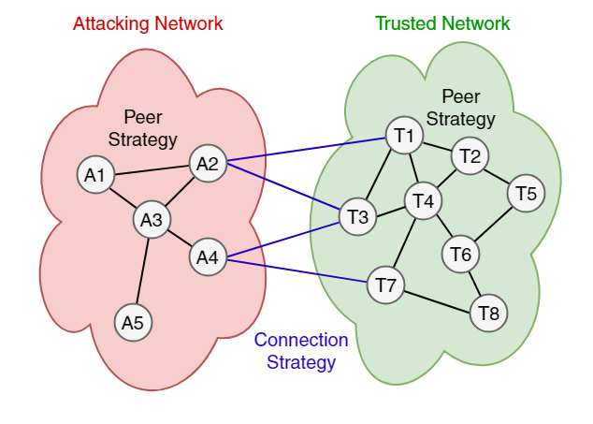
Simulation Model
Leo Eichhorn | Bachelor‘s Thesis | Simulation-Based Analysis of Blockchain Architectures
12

Slide 13
Outline
Context
Blockchain Simulation
Analysis
Experiment Design
Results
Empirical Model
Conclusion
Leo Eichhorn | Bachelor‘s Thesis | Simulation-Based Analysis of Blockchain Architectures
13

Slide 14
Experiment Design
Eight independent variables of interval scales
Factorial design out of reach
Multiple experiments testing each individual parameter
Not currently tested variables are fixed to default values
Dependent variables:
Percentage of successful double-spends (PDS)
Percentage of stale blocks (PSB)
Leo Eichhorn | Bachelor‘s Thesis | Simulation-Based Analysis of Blockchain Architectures
14

Slide 15
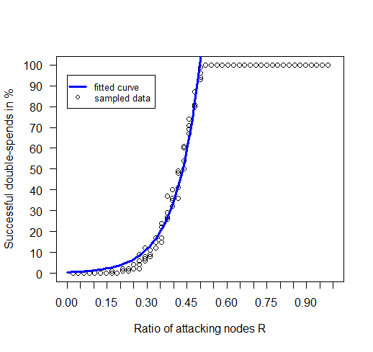
Ratio of attacking nodes R
Double-spends for R > 0.5 always succeed
But: DSA at R = 0.5 not guranteed
Simulator end condition?
Influence of other Parameters?
Leo Eichhorn | Bachelor‘s Thesis | Simulation-Based Analysis of Blockchain Architectures
15

Slide 16
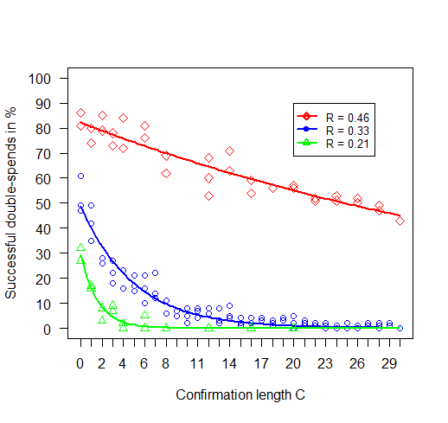
Confirmations C
PDS decreases exponentially
Leo Eichhorn | Bachelor‘s Thesis | Simulation-Based Analysis of Blockchain Architectures
16

Slide 17
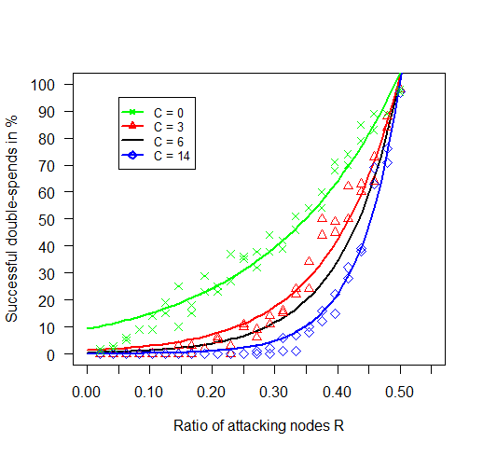
Confirmations C
PDS decreases exponentially
No effect once majority of computing power under attackers‘ control
Leo Eichhorn | Bachelor‘s Thesis | Simulation-Based Analysis of Blockchain Architectures
17

Slide 18
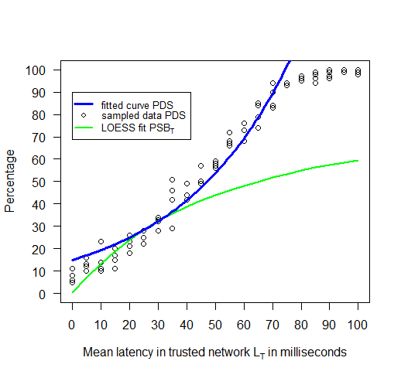
Trusted Latency L_{T}
Percentage of stale blocks increases with rising latency
More computing power is wasted on generation of stale blocks
Lower resistance against double-spend attacks
Leo Eichhorn | Bachelor‘s Thesis | Simulation-Based Analysis of Blockchain Architectures
18

Slide 19
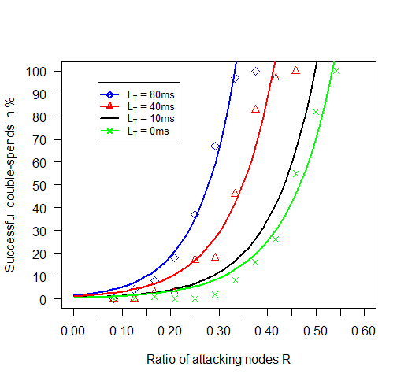
Trusted Latency L_{T}
Direct effect on value of R
Effect of L_{A} analogous (opposite direction)
Network densities D_{T}, D_{A} produce similar effects
Leo Eichhorn | Bachelor‘s Thesis | Simulation-Based Analysis of Blockchain Architectures
19

Slide 20
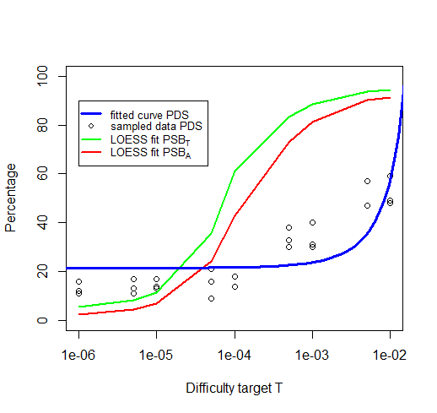
Difficulty target T
High T increases the rate of new blocks
Amplifies effect of network topology resulting in more stale blocks
Leo Eichhorn | Bachelor‘s Thesis | Simulation-Based Analysis of Blockchain Architectures
20

Slide 21
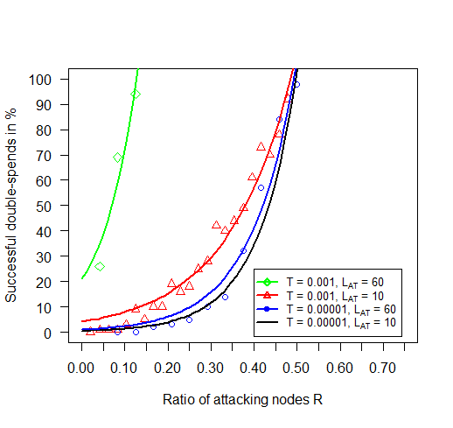
Difficulty target T
T can be used to reduce effect of topology
Low difficutly target creates more time between block creations
Less stale blocks even at higher latencies
Leo Eichhorn | Bachelor‘s Thesis | Simulation-Based Analysis of Blockchain Architectures
21

Slide 22
Outline
Context
Blockchain Simulation
Analysis
Empirical Model
Building the Model
Model
Conclusion
Leo Eichhorn | Bachelor‘s Thesis | Simulation-Based Analysis of Blockchain Architectures
22

Slide 23
Building the Model
All individual curves were sufficiently described by simple exponential models
Begin with exponential model of single parameter R
Iteratively include remaining parameters
Fit resulting model to experimental data after each iteration step
Graphisch
Leo Eichhorn | Bachelor‘s Thesis | Simulation-Based Analysis of Blockchain Architectures
23

Slide 24

Model
Empirical constants omitted
Multiplied by 100 to receive percentage
exp(x) corresponds to e^{x}
Leo Eichhorn | Bachelor‘s Thesis | Simulation-Based Analysis of Blockchain Architectures
24

Slide 25

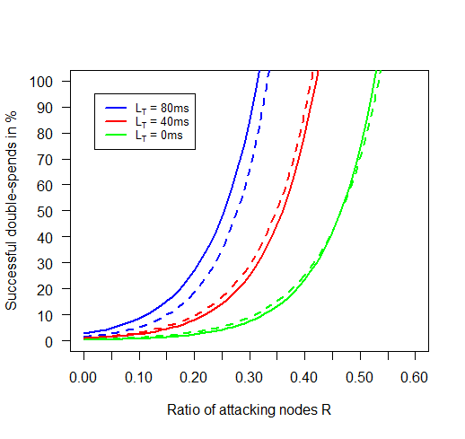
Model
Effects of latency are amplified by density and mining difficulty
Computation of more stale blocks influences effective value of Nodes
Leo Eichhorn | Bachelor‘s Thesis | Simulation-Based Analysis of Blockchain Architectures
25

Slide 26

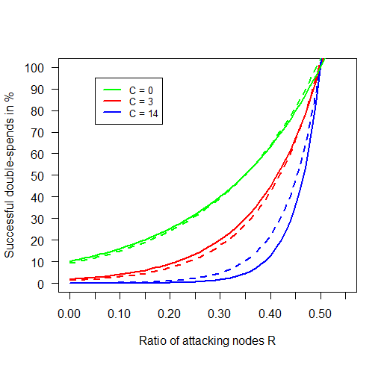
Model
C and LC produce dampening effect
No effect if majority of effective mining power controlled by attacker
Leo Eichhorn | Bachelor‘s Thesis | Simulation-Based Analysis of Blockchain Architectures
26

Slide 27
Conclusion
Simulator -> model -> Additional findings:
Definition of double-spend attack as 51% or majority attack is misleading
Capability of conducting double-spend attacks depends on distribution of effective mining power
Architectures with higher stale block rates are more vulnerable
Implication:
Simulator and model can be used to predict a blockchain architecture‘s resistance against double-spend attacks
Leo Eichhorn | Bachelor‘s Thesis | Simulation-Based Analysis of Blockchain Architectures
27

Slide 28
References
Leo Eichhorn | Bachelor‘s Thesis | Simulation-Based Analysis of Blockchain Architectures
28

