Slide 1

Simulation-Based Analysis of Blockchain Architectures: Double-Spend Attacks
Technische Universität München
Bachelor‘s Thesis
Leo Eichhorn
Garching, 17 July 2018

Slide 2
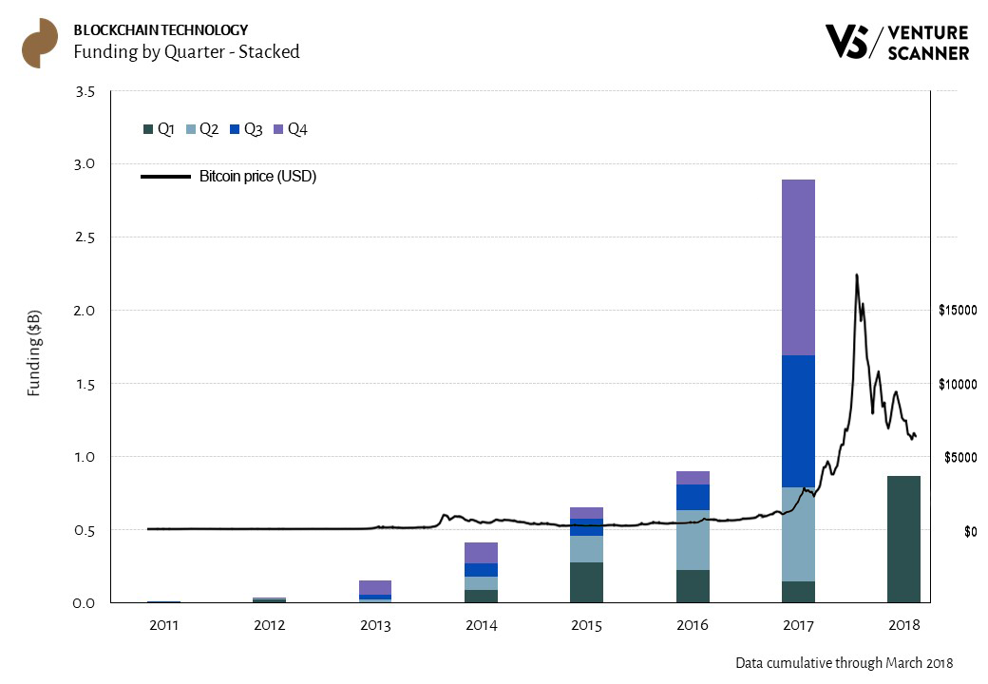
Motivation
Leo Eichhorn | Bachelor‘s Thesis | Simulation-Based Analysis of Blockchain Architectures
2

Slide 3
Outline
Context
Blockchain
Double-Spend Attacks
Problem Statement
Approach
Blockchain Simulation
Analysis
Empirical Model
Conclusion
Leo Eichhorn | Bachelor‘s Thesis | Simulation-Based Analysis of Blockchain Architectures
3

Slide 4
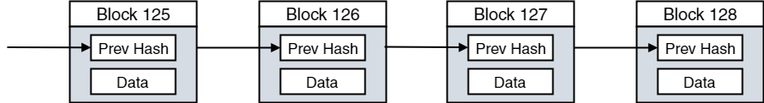
Blockchain
Distributed database
Entries (blocks) are linked by their hashes
Peer-to-peer network of nodes maintaining local copies of the blockchain
Next block is chosen by “random” node and broadcasted to all peers
No intermediate, trusted authority
Leo Eichhorn | Bachelor‘s Thesis | Simulation-Based Analysis of Blockchain Architectures
4

Slide 5

Bitcoin
“Random” node is represented by first node solving cryptographic puzzle (proof of work)
Changing nonce values in block until hash smaller than a target mining difficulty
Requires high amount of computational power
Node is compensated with block reward and transaction fees
Leo Eichhorn | Bachelor‘s Thesis | Simulation-Based Analysis of Blockchain Architectures
5

Slide 6
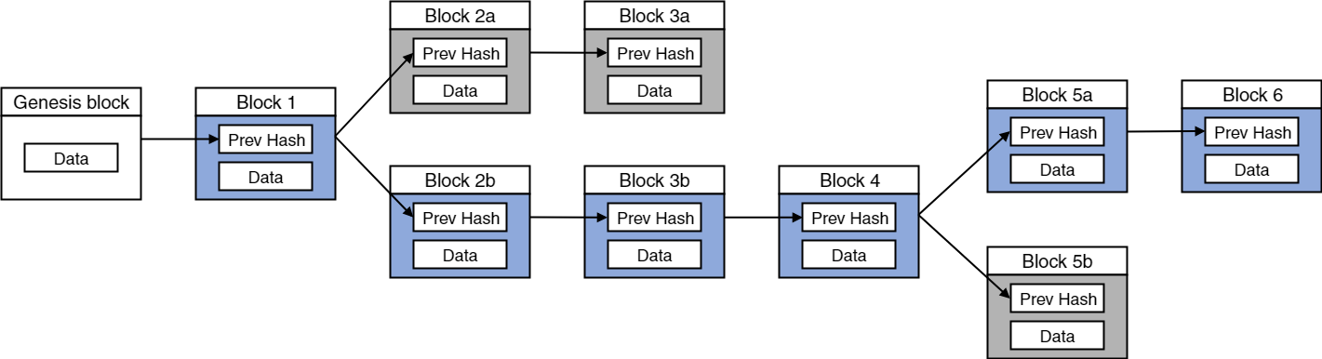
Block Propagation / Stale Blocks
Peer-to-peer networks are influenced by latency times
Two blocks mined at roughly the same time: branch in blockchain
Consensus is eventually retained due to longest chain rule
Blocks of shorter branch turn stale
Stale blocks indicate a waste of computational power
Leo Eichhorn | Bachelor‘s Thesis | Simulation-Based Analysis of Blockchain Architectures
6

Slide 7
Double-Spend Attacks
Name related to Bitcoin:
Group of dishonest nodes reverts transaction to a merchant after receiving the purchased product
Attacker needs to mine new blocks faster than the remaining network
Leo Eichhorn | Bachelor‘s Thesis | Simulation-Based Analysis of Blockchain Architectures
7

Slide 8
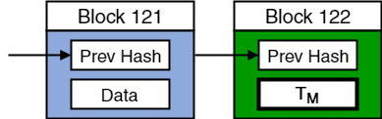
Example DSA with 3 Confirmations
Attacker A generates two transactions:
T_{M} , to pay the merchant ( A → M: 500 )
T_{A} , to revert the payment ( A → A: 500 )
T_{M} is published an mined into the next block
Leo Eichhorn | Bachelor‘s Thesis | Simulation-Based Analysis of Blockchain Architectures
8

Slide 9
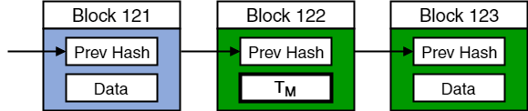
Example DSA with 3 Confirmations
Honest network keeps mining on the longest chain
Merchant M waits until payment T_{M} is confirmed
Leo Eichhorn | Bachelor‘s Thesis | Simulation-Based Analysis of Blockchain Architectures
9

Slide 10
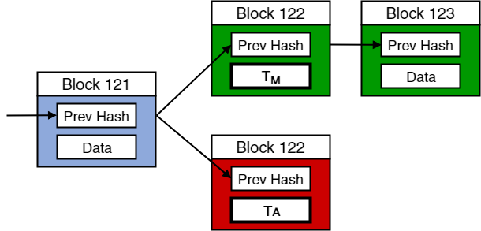
Example DSA with 3 Confirmations
Attacking party secretly starts mining a branch containing T_{A}
On top of latest block before T_{M} is mined into the blockchain
Leo Eichhorn | Bachelor‘s Thesis | Simulation-Based Analysis of Blockchain Architectures
10

Slide 11
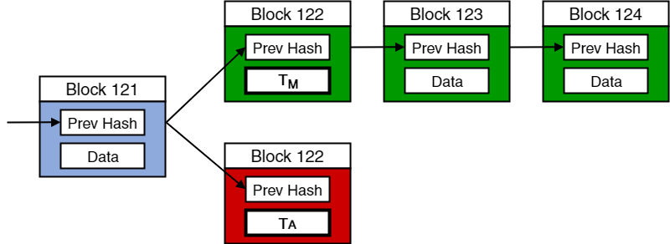
Example DSA with 3 Confirmations
Merchant‘s payment T_{M} is confirmed
M delivers the purchased product (irreversible)
T_{M} confirmed
Leo Eichhorn | Bachelor‘s Thesis | Simulation-Based Analysis of Blockchain Architectures
11

Slide 12
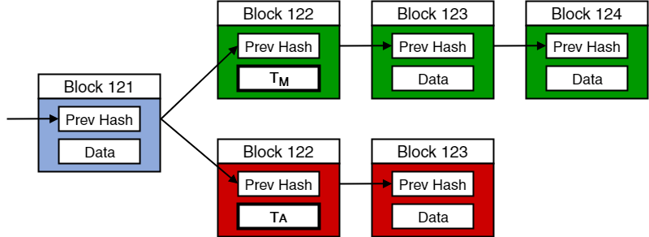
Example DSA with 3 Confirmations
A tries to mine more blocks than the remaining network in order to replace T_{M} with T_{A}
Leo Eichhorn | Bachelor‘s Thesis | Simulation-Based Analysis of Blockchain Architectures
12

Slide 13
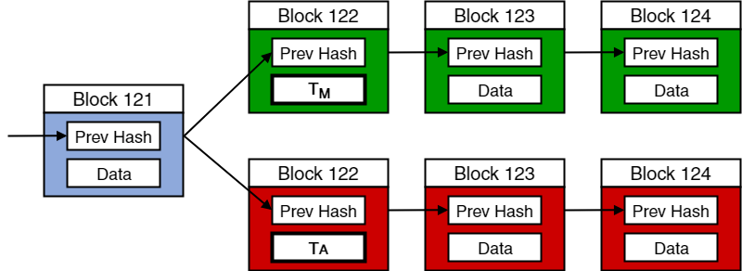
Example DSA with 3 Confirmations
A tries to mine more blocks than the remaining network in order to replace T_{M} with T_{A}
Leo Eichhorn | Bachelor‘s Thesis | Simulation-Based Analysis of Blockchain Architectures
13

Slide 14
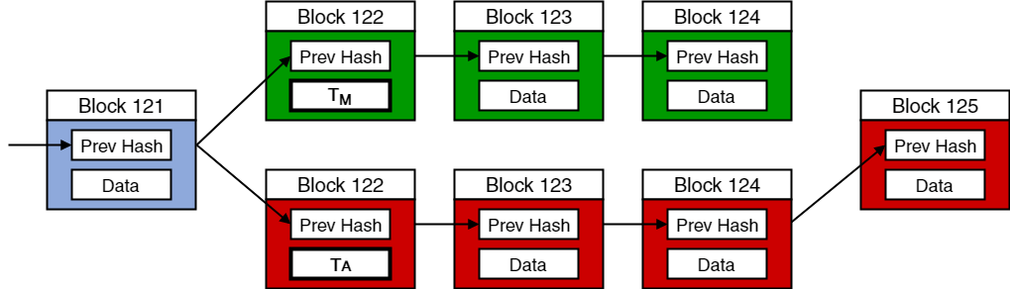
Example DSA with 3 Confirmations
A tries to mine more blocks than the remaining network in order to replace T_{M} with T_{A}
Leo Eichhorn | Bachelor‘s Thesis | Simulation-Based Analysis of Blockchain Architectures
14

Slide 15
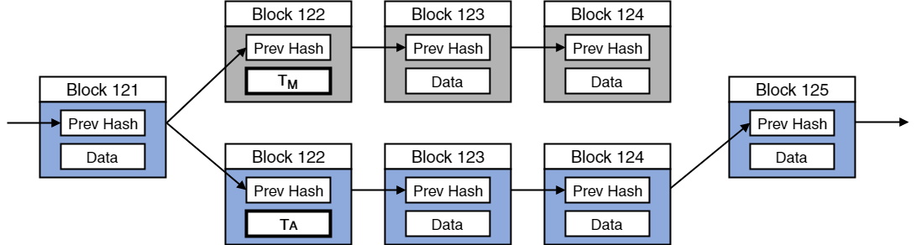
Example DSA with 3 Confirmations
A publishes the longer chain
Blockchain containing more proof of work is new valid chain
Branch containing T_{M} turns stale
A keeps the delivered product and the payment
Leo Eichhorn | Bachelor‘s Thesis | Simulation-Based Analysis of Blockchain Architectures
15

Slide 16
Problem Statement
A blockchain architecture‘s resistance against double-spend attacks (RADS) may depend on many factors
Knowing more about factors affecting RADS and function f would allow architect to improve predictions
A
f
B
RADS
Z
Leo Eichhorn | Bachelor‘s Thesis | Simulation-Based Analysis of Blockchain Architectures
16

Slide 17
Approach
Identify parameters affecting RADS
Literature
Model & simulate parameters
Java blockchain simulator
Analyse parameters‘ effects on RADS (experimentation)
RADS for different configurations
Formulate empirical model
Results & Insights
Leo Eichhorn | Bachelor‘s Thesis | Simulation-Based Analysis of Blockchain Architectures
17

Slide 18
Outline
Identify parameters affecting RADS
Literature
Context
Blockchain Simulation
Simulation Parameters
Simulation Model
Analysis
Empirical Model
Conclusion
Model & simulate parameters
Java blockchain simulator
Analyse parameters‘ effects on RADS (experimentation)
PDS / PSB for different configurations
Formulate empirical model
Results & Insights
Leo Eichhorn | Bachelor‘s Thesis | Simulation-Based Analysis of Blockchain Architectures
18

Slide 19
Simulation Parameters
PDS: Percentage of successful double-spend attacks
PSB: Percentage of stale blocks
Ratio of attacking / trusted nodes -
R
f
Number of confirmations -
C
Mining difficulty target -
T
PDS
L_{T}
Latency in network
L_{A}
L_{C}
PSB
D_{T}
Topology (density) of network
D_{A}
Leo Eichhorn | Bachelor‘s Thesis | Simulation-Based Analysis of Blockchain Architectures
19

Slide 20
Outline
Identify parameters affecting RADS
Literature
Context
Blockchain Simulation
Simulation Parameters
Simulation Model
Analysis
Empirical Model
Conclusion
Model & simulate parameters
Java blockchain simulator
Analyse parameters‘ effects on RADS (experimentation)
PDS / PSB for different configurations
Formulate empirical model
Results & Insights
Leo Eichhorn | Bachelor‘s Thesis | Simulation-Based Analysis of Blockchain Architectures
20

Slide 21
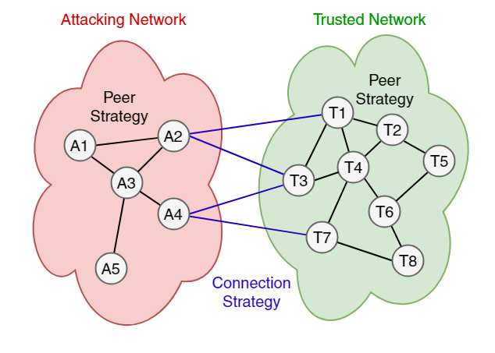
Simulation Model
D_{A}
D_{T}
L_{T}
L_{A}
L_{C}
Leo Eichhorn | Bachelor‘s Thesis | Simulation-Based Analysis of Blockchain Architectures
21

Slide 22
Outline
Identify parameters affecting RADS
Literature
Context
Blockchain Simulation
Analysis
Experiments
Summary
Empirical Model
Conclusion
Model & simulate parameters
Java blockchain simulator
Analyse parameters‘ effects on RADS (experimentation)
PDS / PSB for different configurations
Formulate empirical model
Results & Insights
Leo Eichhorn | Bachelor‘s Thesis | Simulation-Based Analysis of Blockchain Architectures
22

Slide 23
Experiment Design
Eight independent variables of interval scales
Factorial design out of reach
Multiple experiments testing each individual parameter
Not currently tested variables are fixed to default values
Dependent variables:
Percentage of successful double-spends (PDS)
Percentage of stale blocks (PSB)
Leo Eichhorn | Bachelor‘s Thesis | Simulation-Based Analysis of Blockchain Architectures
23

Slide 24
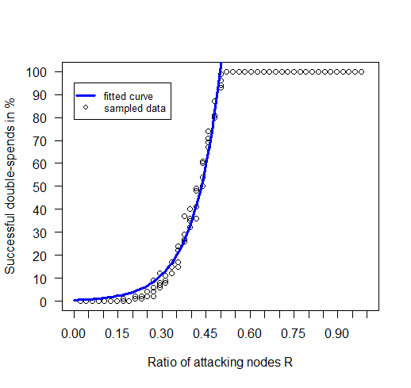
Ratio of attacking nodes R
Double-spends for R > 0.5 always succeed
But: DSA at R = 0.5 not guranteed
Simulator end condition?
Influence of other Parameters?
Leo Eichhorn | Bachelor‘s Thesis | Simulation-Based Analysis of Blockchain Architectures
24

Slide 25
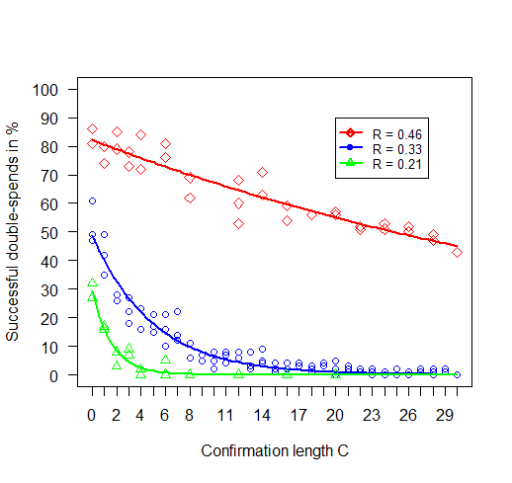
Confirmations C
PDS decreases exponentially
Leo Eichhorn | Bachelor‘s Thesis | Simulation-Based Analysis of Blockchain Architectures
25

Slide 26
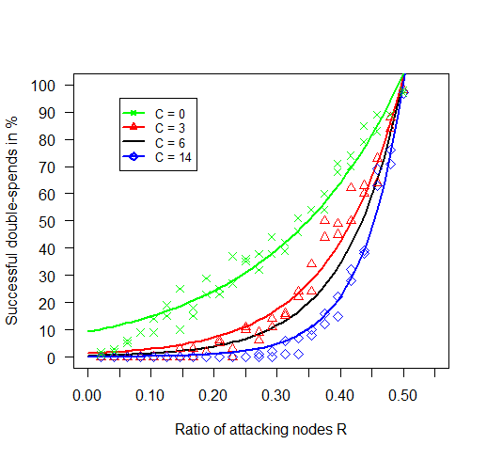
Confirmations C
PDS decreases exponentially
No effect once majority of computing power under attackers‘ control
Leo Eichhorn | Bachelor‘s Thesis | Simulation-Based Analysis of Blockchain Architectures
26

Slide 27
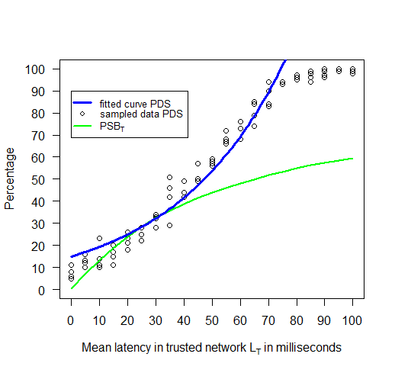
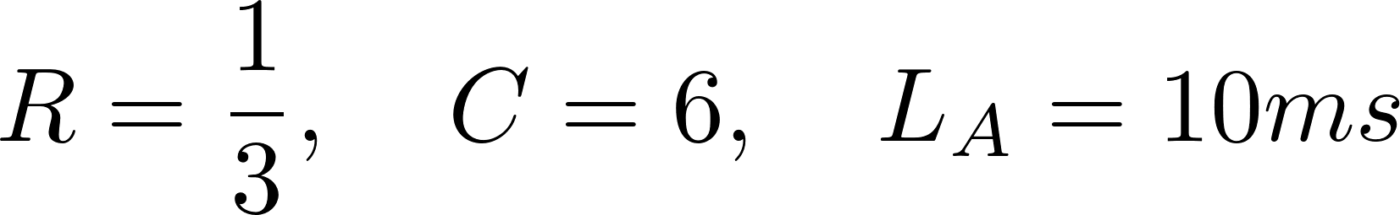
Trusted Latency L_{T}
Percentage of stale blocks increases with rising latency
More computing power is wasted on generation of stale blocks
Lower resistance against double-spend attacks
Leo Eichhorn | Bachelor‘s Thesis | Simulation-Based Analysis of Blockchain Architectures
27

Slide 28
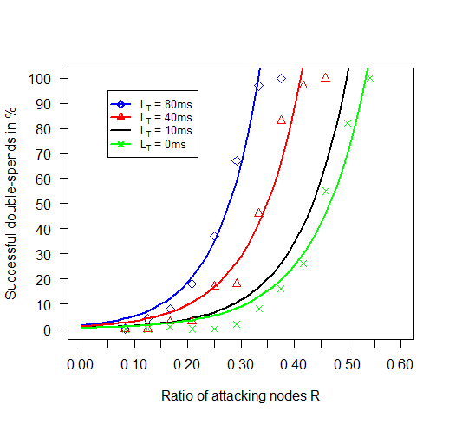
Trusted Latency L_{T}
Direct effect on value of R
Network density D_{T} produces similar effects
Effect can be reduced by higher mining difficulty
Leo Eichhorn | Bachelor‘s Thesis | Simulation-Based Analysis of Blockchain Architectures
28

Slide 29
Summary
PDS increases exponentially with increasing R
Effective value of R is influenced by PSB of both networks
PSB depends on latency, density and mining difficulty parameters
Confirmations C successfully reduce PDS exponentially, as long as effective value of R less than 50%
Leo Eichhorn | Bachelor‘s Thesis | Simulation-Based Analysis of Blockchain Architectures
29

Slide 30
Outline
Identify parameters affecting RADS
Literature
Context
Blockchain Simulation
Analysis
Empirical Model
Building the Model
Model formula
Conclusion
Model & simulate parameters
Java blockchain simulator
Analyse parameters‘ effects on RADS (experimentation)
PDS / PSB for different configurations
Formulate empirical model
Results & Insights
Leo Eichhorn | Bachelor‘s Thesis | Simulation-Based Analysis of Blockchain Architectures
30

Slide 31
Building the Model
All experiments sufficiently fitted to exponential models
Simple exponential model of parameter R
Final model
Fit empirical constants to data
[all parameters included]
Include next parameter (analytically / trial and error)
Leo Eichhorn | Bachelor‘s Thesis | Simulation-Based Analysis of Blockchain Architectures
31

Slide 32
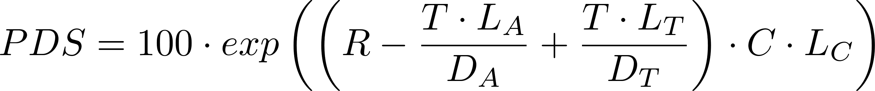
Model
PDS indicative of RADS
Empirical constants omitted
Multiplied by 100 to receive percentage
exp(x) corresponds to e^{x}
Leo Eichhorn | Bachelor‘s Thesis | Simulation-Based Analysis of Blockchain Architectures
32

Slide 33
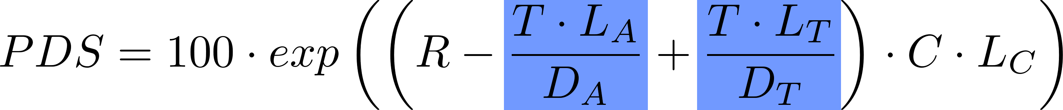
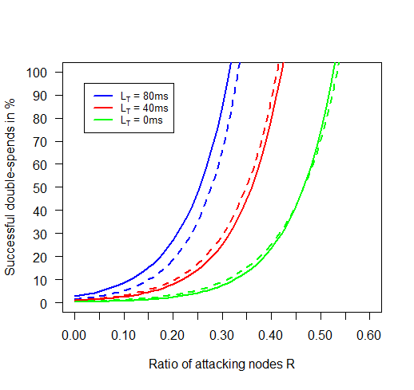
Model
Effects of latency are amplified by density and mining difficulty
Computation of more stale blocks influences effective value of Nodes
Leo Eichhorn | Bachelor‘s Thesis | Simulation-Based Analysis of Blockchain Architectures
33

Slide 34
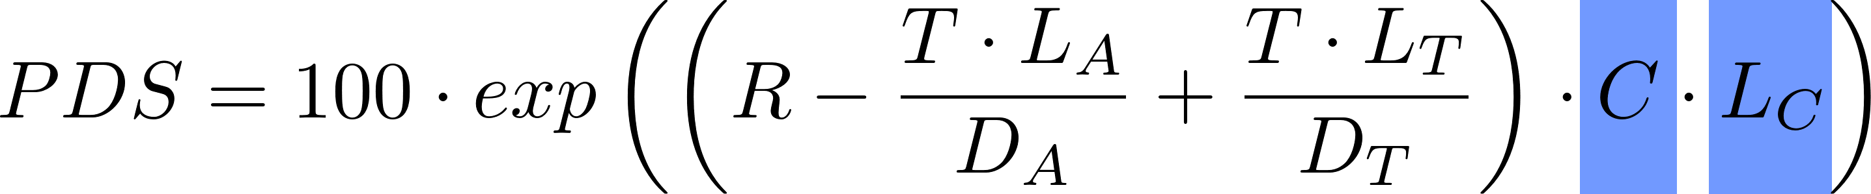
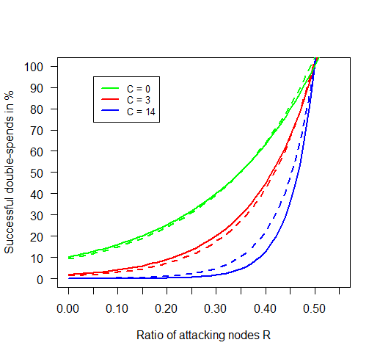
Model
C and L_{C} produce dampening effect
No effect once majority of effective mining power controlled by attacker
Leo Eichhorn | Bachelor‘s Thesis | Simulation-Based Analysis of Blockchain Architectures
34

Slide 35
Conclusion
Identify parameters affecting RADS
Literature
Model & simulate parameters
Java blockchain simulator
Analyse parameters‘ effects on RADS (experimentation)
PDS / PSB for different configurations
Formulate empirical model
Results & Insights
Leo Eichhorn | Bachelor‘s Thesis | Simulation-Based Analysis of Blockchain Architectures
35

Slide 36
Conclusion
Additional findings:
Definition of double-spend attack as 51% or majority attack is misleading
Capability of conducting double-spend attacks depends on distribution of effective mining power
Architectures with higher stale block rates are more vulnerable
Implication:
Simulator and model can be used to predict a blockchain architecture‘s resistance against double-spend attacks
Leo Eichhorn | Bachelor‘s Thesis | Simulation-Based Analysis of Blockchain Architectures
36

Slide 37
References
Andreas M. Antonopoulos. Mastering Bitcoin: Programming the Open Blockchain. "O'Reilly Media, Inc.", 2017.
C. Decker and R. Wattenhofer. Information propagation in the Bitcoin network. In IEEE P2P 2013 Proceedings, pages 1-10, 2013.
Satoshi Nakamoto. Bitcoin: A peer-to-peer electronic cash system. 2008.
Carlos Pinzon and Camilo Rocha. Double-spend attack models with time advantage for bitcoin. Electronic Notes in Theoretical Computer Science, 329:79-103, 2016. CLEI 2016 - The Latin American Computing Conference.
Meni Rosenfeld. Analysis of hashrate-based double spending. CoRR, abs/1402.2009, 2014.
Leo Eichhorn | Bachelor‘s Thesis | Simulation-Based Analysis of Blockchain Architectures
37

Slide 38
Thank you!
Leo Eichhorn | Bachelor‘s Thesis | Simulation-Based Analysis of Blockchain Architectures
38

Slide 39
Backup
Leo Eichhorn | Bachelor‘s Thesis | Simulation-Based Analysis of Blockchain Architectures
39

Slide 40
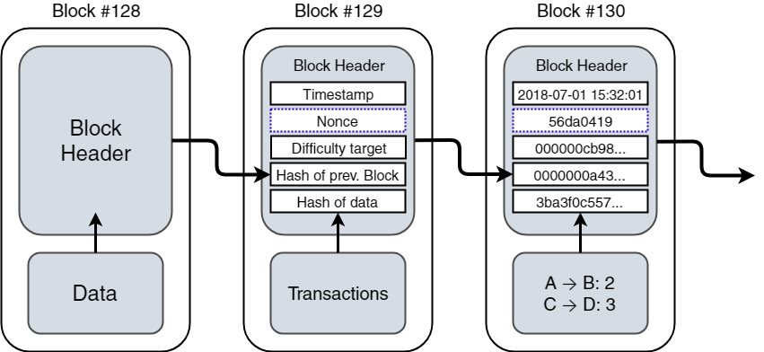
Blockchain Structure (Bitcoin)
Leo Eichhorn | Bachelor‘s Thesis | Simulation-Based Analysis of Blockchain Architectures
40

Slide 41
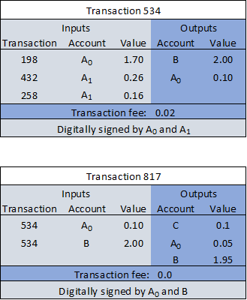
Transaction Structure (Bitcoin)
Leo Eichhorn | Bachelor‘s Thesis | Simulation-Based Analysis of Blockchain Architectures
41

Slide 42
Experiments
Leo Eichhorn | Bachelor‘s Thesis | Simulation-Based Analysis of Blockchain Architectures
42

Slide 43
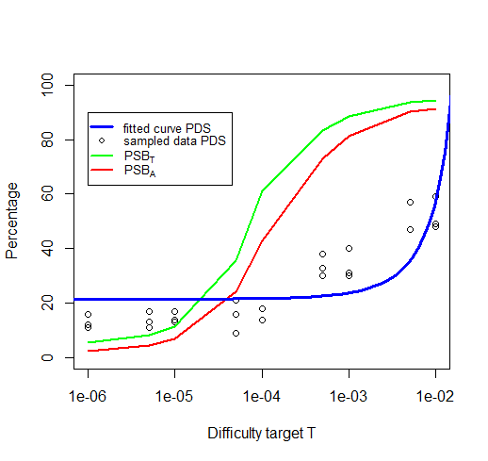
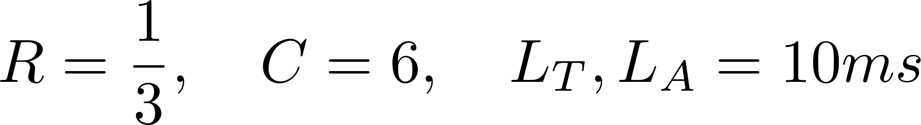
Difficulty target T
High T increases the rate of new blocks
Amplifies effect of network topology resulting in more stale blocks
Leo Eichhorn | Bachelor‘s Thesis | Simulation-Based Analysis of Blockchain Architectures
43

Slide 44
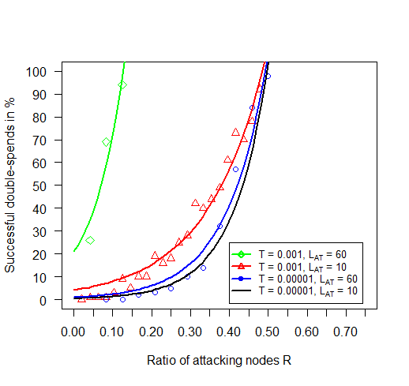
Difficulty target T
T can be used to reduce effect of topology
Low difficutly target creates more time between block creations
Less stale blocks even at higher latencies
Leo Eichhorn | Bachelor‘s Thesis | Simulation-Based Analysis of Blockchain Architectures
44

Slide 45
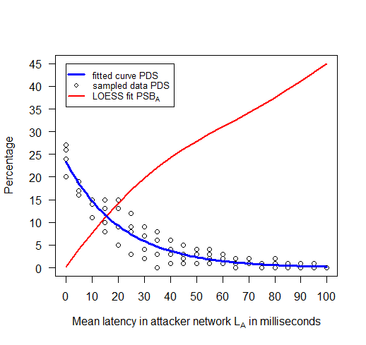
Attacker Latency L_{A}
Leo Eichhorn | Bachelor‘s Thesis | Simulation-Based Analysis of Blockchain Architectures
45

Slide 46
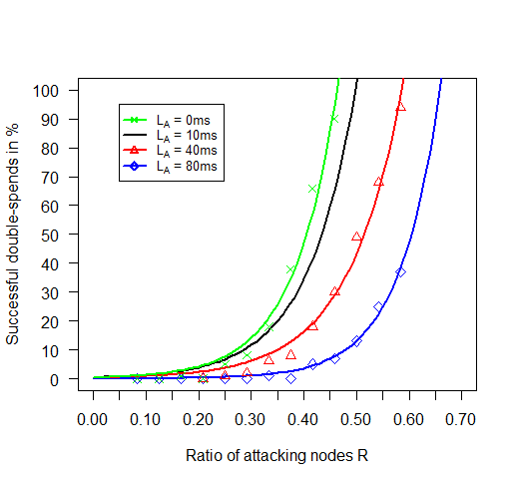
Attacker Latency L_{A}
Leo Eichhorn | Bachelor‘s Thesis | Simulation-Based Analysis of Blockchain Architectures
46

Slide 47
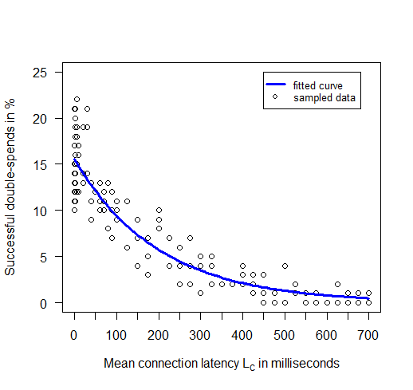
Connection Latency L_{C}
Leo Eichhorn | Bachelor‘s Thesis | Simulation-Based Analysis of Blockchain Architectures
47

Slide 48
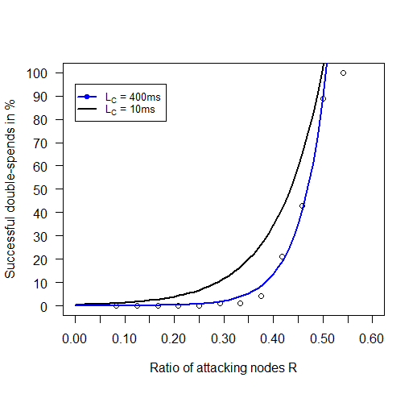
Connection Latency L_{C}
Leo Eichhorn | Bachelor‘s Thesis | Simulation-Based Analysis of Blockchain Architectures
48

Slide 49
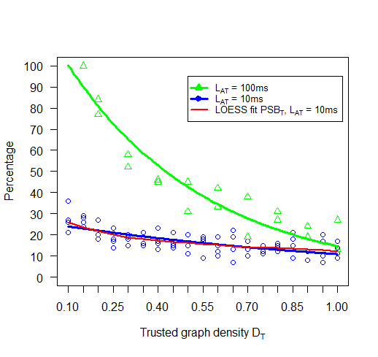
Trusted Density D_{T}
Leo Eichhorn | Bachelor‘s Thesis | Simulation-Based Analysis of Blockchain Architectures
49

Slide 50
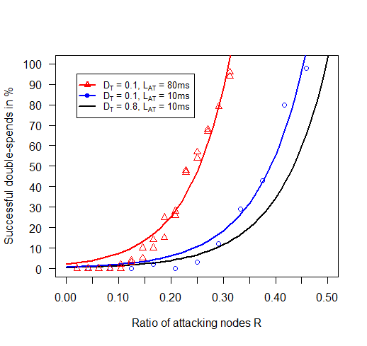
Trusted Density D_{T}
Leo Eichhorn | Bachelor‘s Thesis | Simulation-Based Analysis of Blockchain Architectures
50

Slide 51
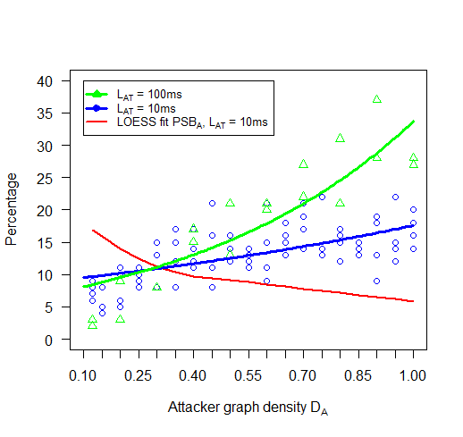
Attacker Density D_{A}
Leo Eichhorn | Bachelor‘s Thesis | Simulation-Based Analysis of Blockchain Architectures
51

Slide 52
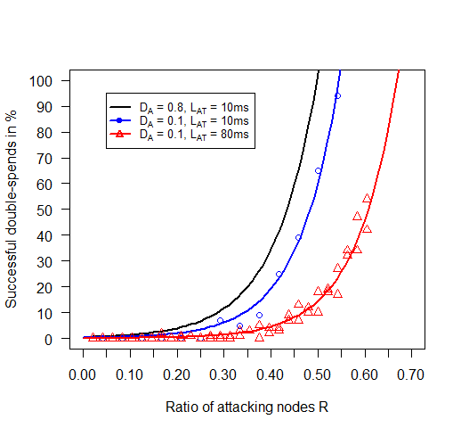
Attacker Density D_{A}
Leo Eichhorn | Bachelor‘s Thesis | Simulation-Based Analysis of Blockchain Architectures
52

Slide 53
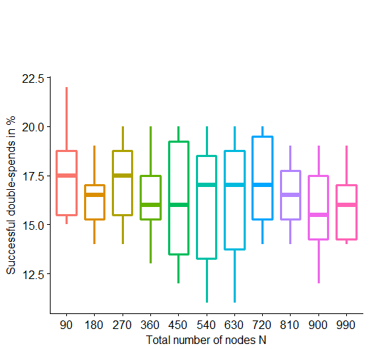
Number of Nodes N
Leo Eichhorn | Bachelor‘s Thesis | Simulation-Based Analysis of Blockchain Architectures
53

Slide 54
Comparison
Leo Eichhorn | Bachelor‘s Thesis | Simulation-Based Analysis of Blockchain Architectures
54

Slide 55
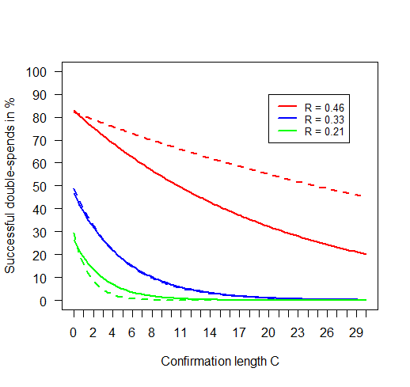
Confirmation length C
Leo Eichhorn | Bachelor‘s Thesis | Simulation-Based Analysis of Blockchain Architectures
55

Slide 56
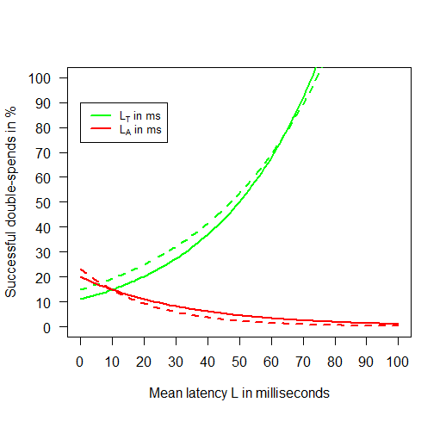
Latency L_{T} , L_{A}
Leo Eichhorn | Bachelor‘s Thesis | Simulation-Based Analysis of Blockchain Architectures
56

Slide 57
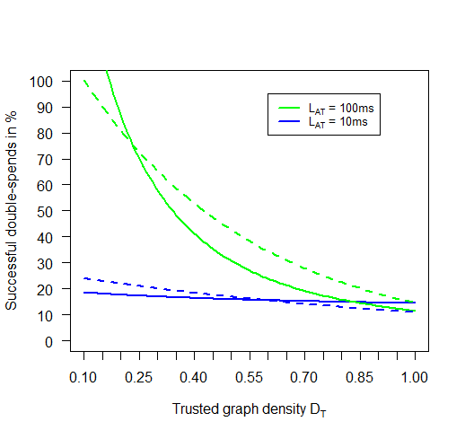
Trusted Density D_{T}
Leo Eichhorn | Bachelor‘s Thesis | Simulation-Based Analysis of Blockchain Architectures
57

Slide 58
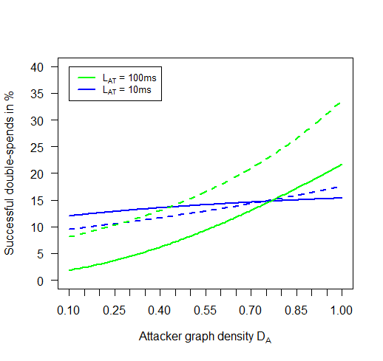
Attacker Density D_{A}
Leo Eichhorn | Bachelor‘s Thesis | Simulation-Based Analysis of Blockchain Architectures
58

Slide 59
Simulator
Leo Eichhorn | Bachelor‘s Thesis | Simulation-Based Analysis of Blockchain Architectures
59

Slide 60
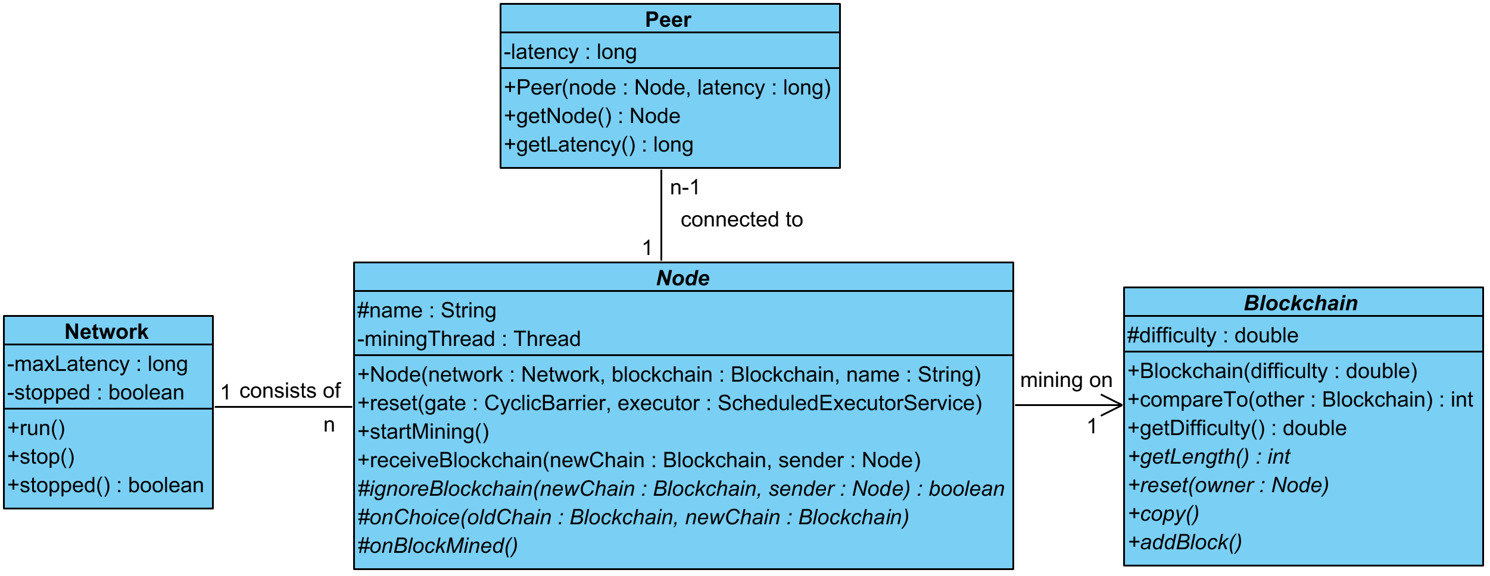
Simulator Framework
Leo Eichhorn | Bachelor‘s Thesis | Simulation-Based Analysis of Blockchain Architectures
60

Slide 61
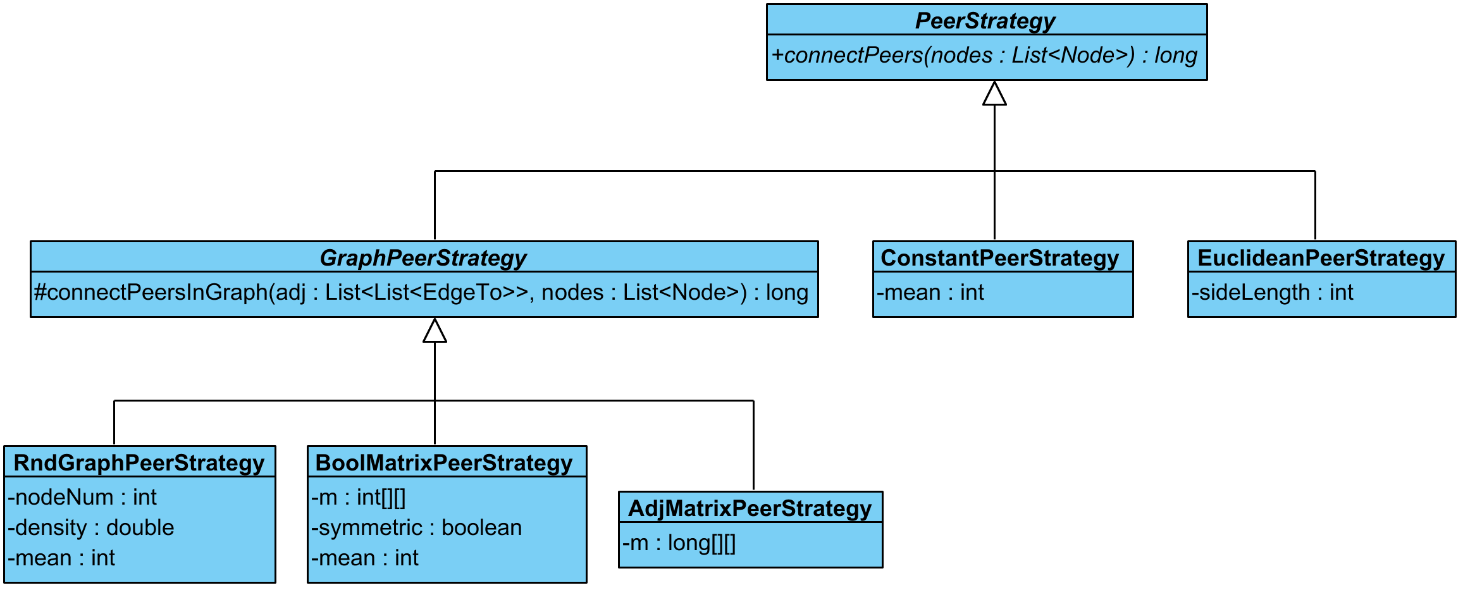
PeerStrategy
Leo Eichhorn | Bachelor‘s Thesis | Simulation-Based Analysis of Blockchain Architectures
61

Slide 62
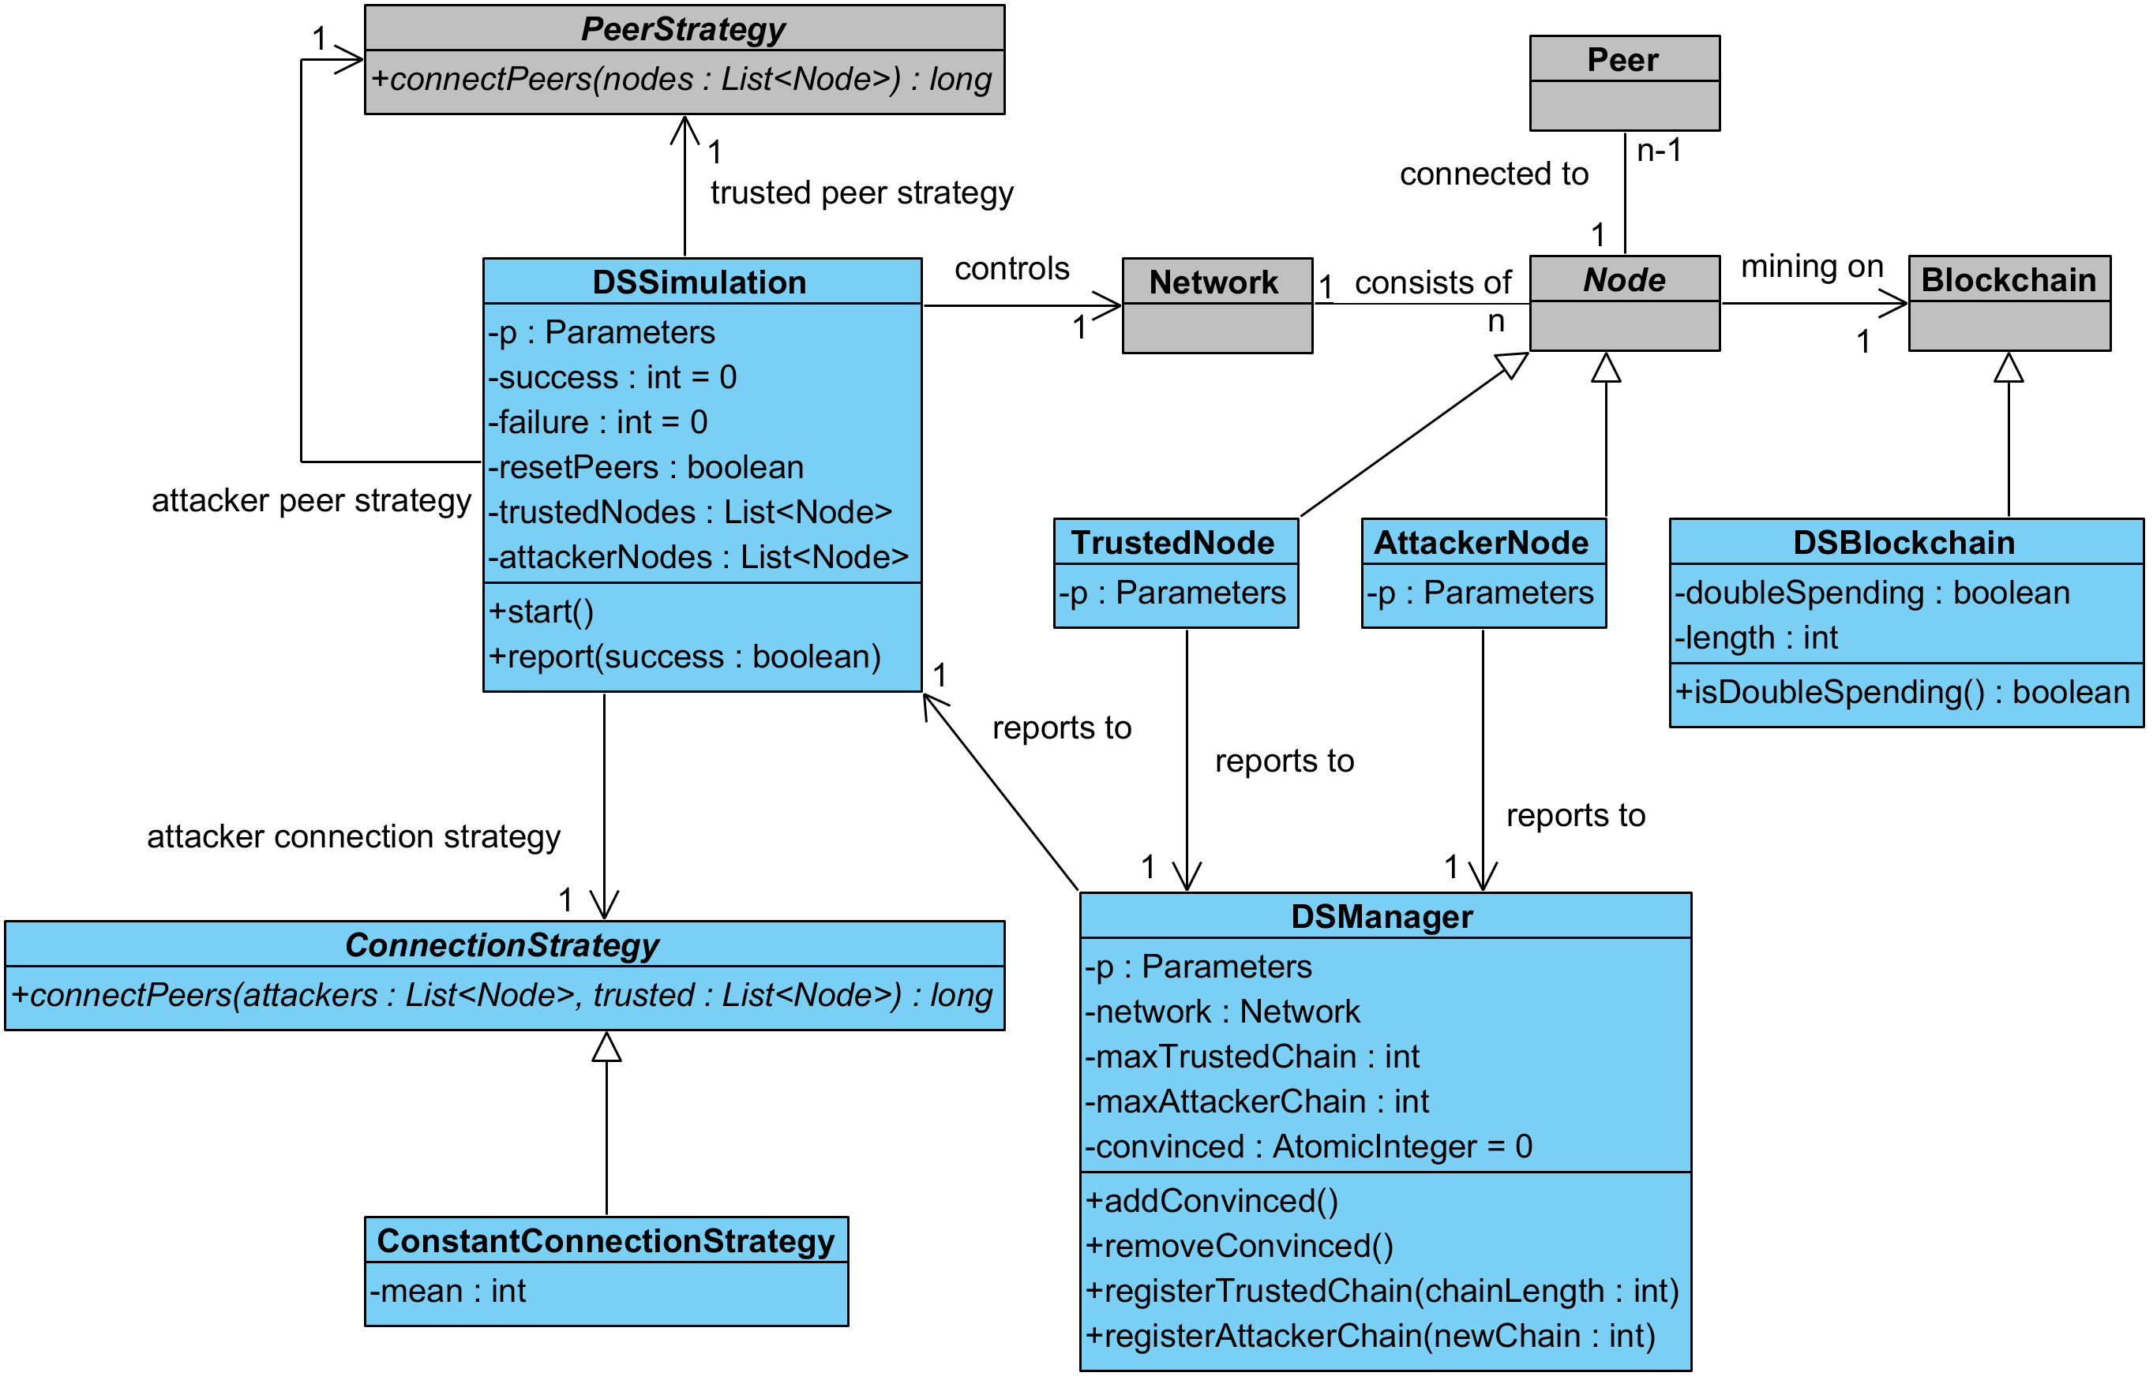
Double-Spend Simulator
Leo Eichhorn | Bachelor‘s Thesis | Simulation-Based Analysis of Blockchain Architectures
62

Slide 63
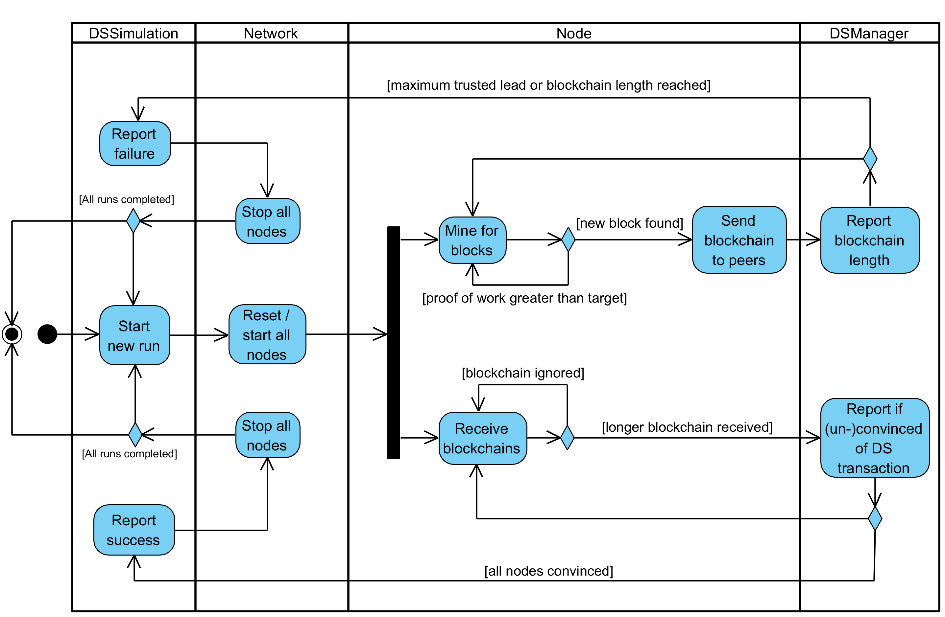
Activity Diagram
Leo Eichhorn | Bachelor‘s Thesis | Simulation-Based Analysis of Blockchain Architectures
63

