Slide 1
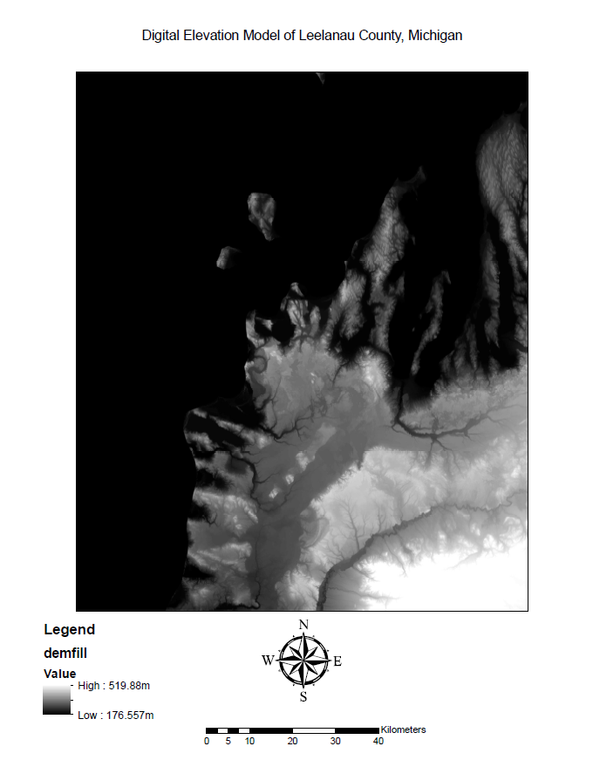
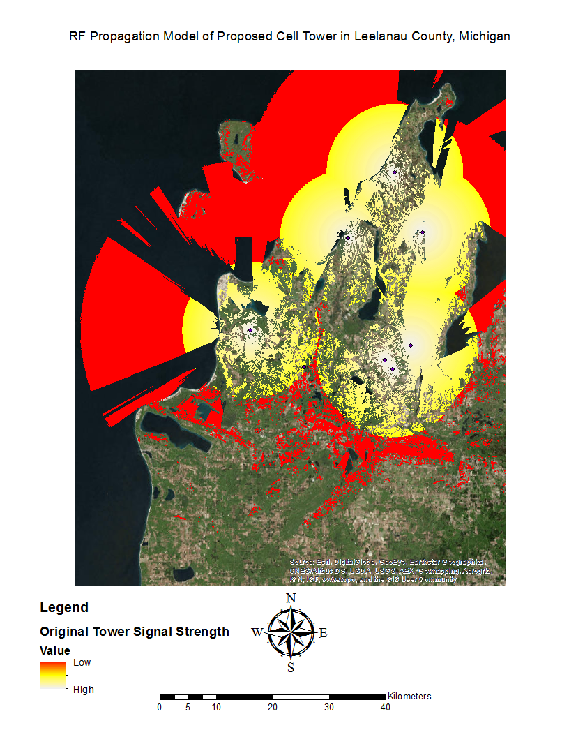
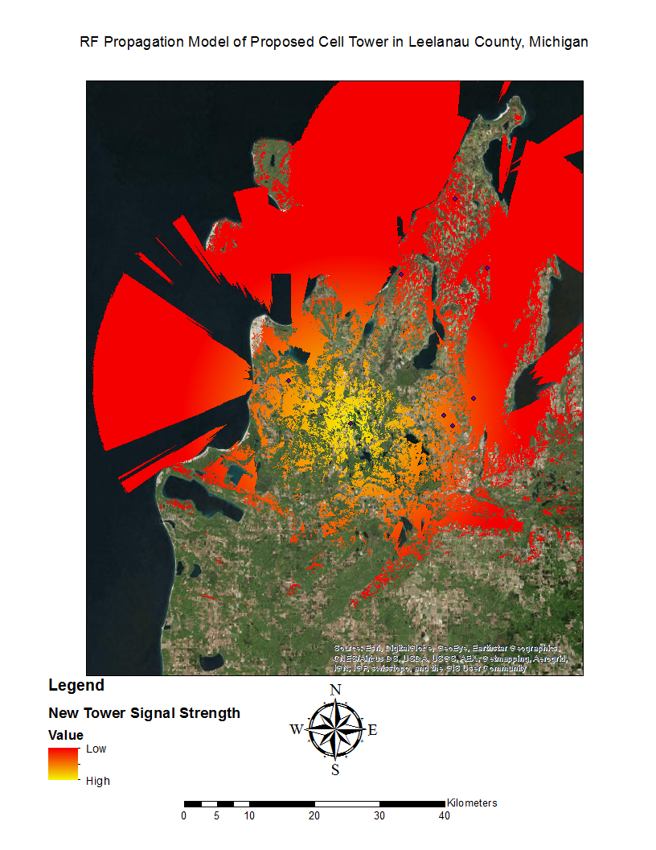
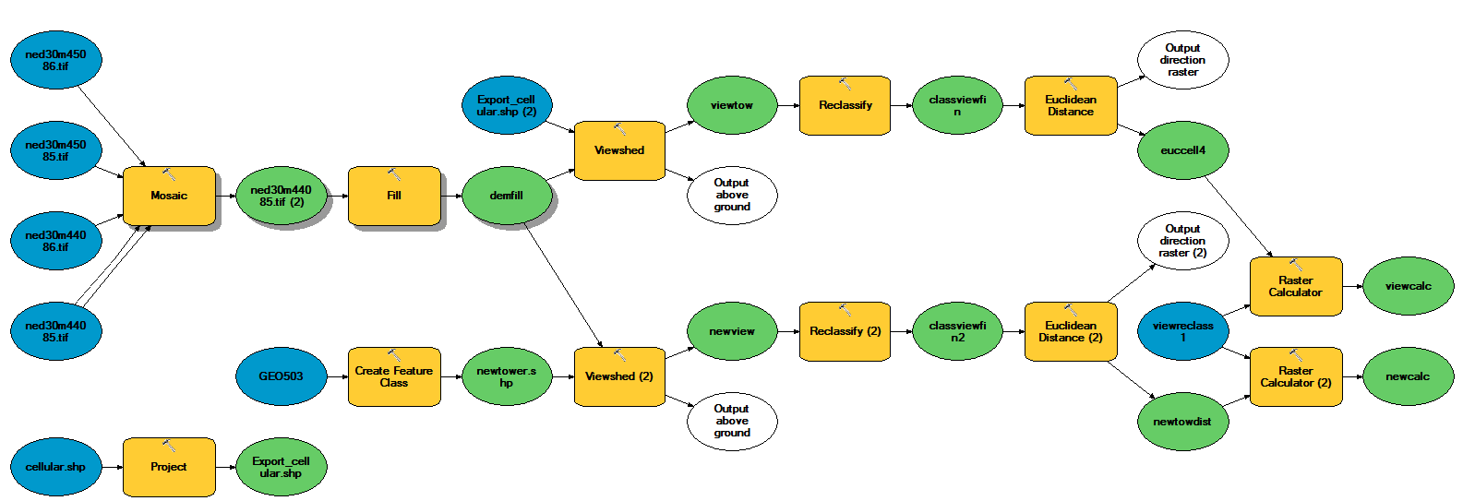
Cell Tower Coverage Model in Leelanau, Michigan Leo Furnari
Dept. of Geography
GEO 503 Final Project
Spring 2016
Introduction
The area of Leelanau county was observed for cellular coverage analysis. An area of south Leelanau, consisting of a largely farmlands, was found to have a dead spot. This study proposes that a cellular tower be built to increase the overall coverage and present a budget for its initial cost and management.
Data and methods
The data used in this study was gathered through the USDA Geospatial Data Gateway¹ and the FCC² . Included in the USDA data was elevation data (DEMs) with filenames such as “ned30m45086.tif”. Each of the 30m DEMs were mosaicked into one file with the ArcGIS Mosaic tool. A Fill function was run on the resulting DEM to ensure that there were no inconsistencies in the data, “demfill”. This file was essential to each of the viewshed functions. The FCC data included a file “cellular.shp” which contained all of the cellular towers in the US. This shapefile was projected to the same coordinate system, “Export_cellular.shp”.
A viewshed function was run on demfill with Export_cellular.shp as the input point. This was considered the original tower layout, “viewtow”. The data in this shapefile was reclassified to ensure that all non-visible areas were eliminated from the raster, “classviewfin”. The raster data now represented fully visible data, a Euclidean Distance function was run on classviewfin which created “euccell4”. A binary reclassification layer “viewreclass1” was used in a Raster Calculation along with euccell4 to remove excessive layers and create “viewcalc”, an moderately accurate representation of the signal strength of each tower given the DEM.
Methods, cont.
The proposed tower was found to have a good, high-elevation area that does not intrude on urban development. The Create Feature Class tool in ArcGIS was used to create the vector point layer in this spot, “newtower.shp”.
Discussion
Further research into RF communications for monitoring of various data can be accomplished with similar data.
Conclusion
Results
Figure 1 is the ArcGIS ModelBuilder model for the project. Figure 2 is the DEM of Leelanau County. Figure 3 is the propagation model of the original towers. Figure 4 is the propagation model of the proposed tower.
Figure 2.
Figure 3.
Figure 4.
Figure 1.
References
1. National Elevation Dataset 30 Meter 1-degree Tiles. (n.d.). Retrieved March 25, 2016, from http://datagateway.nrcs.usda.gov/ Publication Place: Fort Worth, TX. Publisher: National Cartography & Geospatial Center
2. Federal Communications Commission (FCC) Geospatial Data, United States - Minnesota Geospatial Commons. (n.d.). Retrieved March 30, 2016, from https://gisdata.mn.gov/dataset/util-fcc

