Slide 1
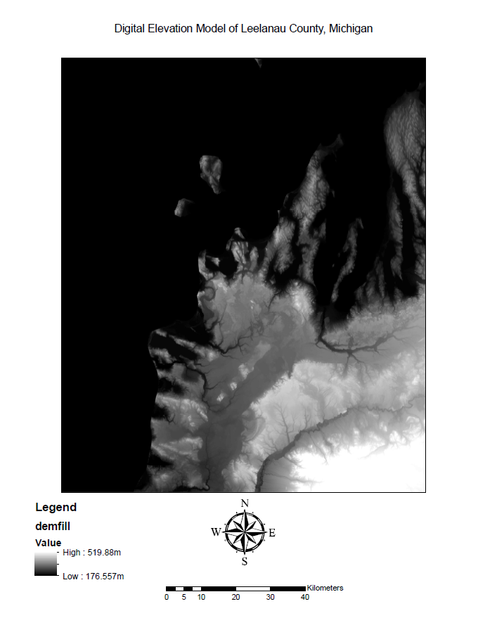
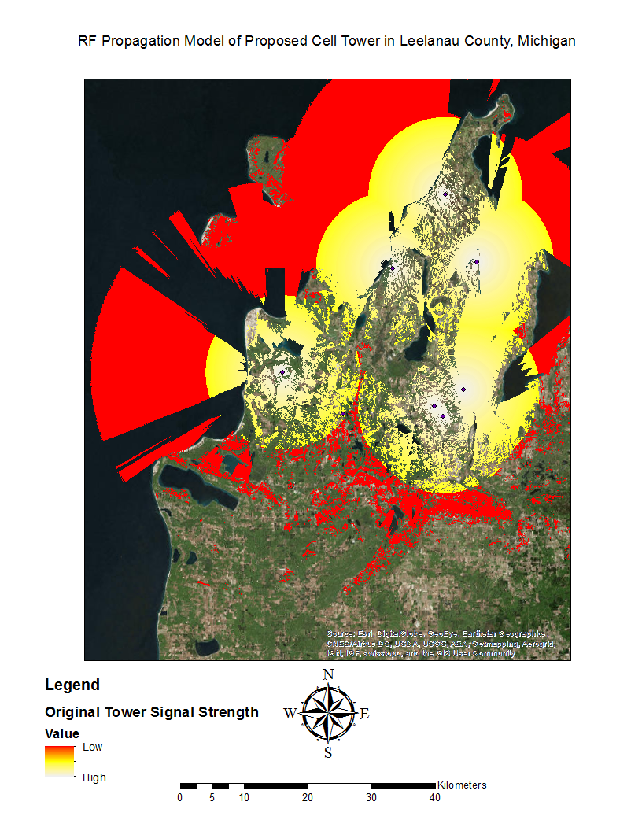
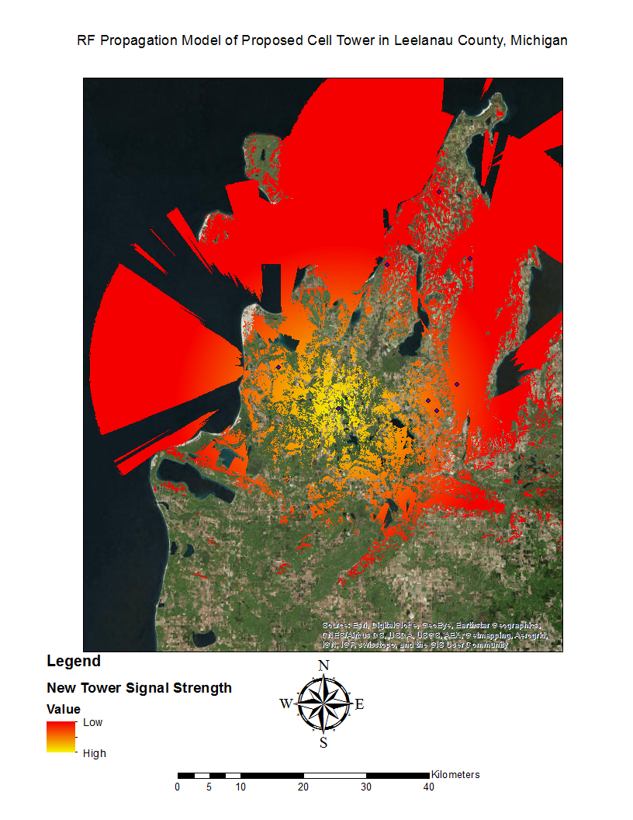
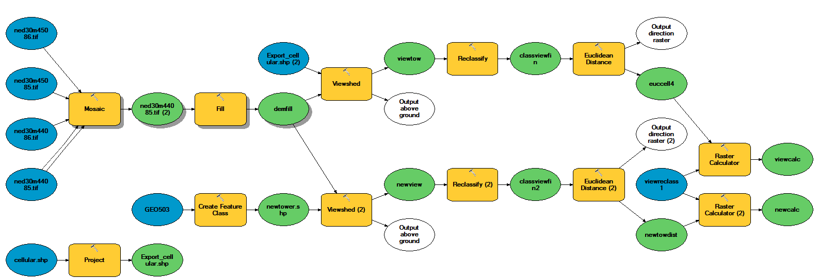
Cell Tower Coverage Model in Leelanau, Michigan Created by: Leo Furnari
Dept. of Geography
GEO 503 Final Project
Spring 2016
Introduction
The area of Leelanau county, Michigan was observed for cellular coverage analysis. An area of south Leelanau, consisting of a largely farmlands, was found to have a dead spot. This study proposes that a cellular tower be built to increase the overall coverage in the county.
Data and methods
The data used in this study was gathered through the USDA Geospatial Data Gateway¹ and the FCC² . ArcGIS was used to process all of the data for this study. Included in the USDA data was elevation data (DEMs) with filenames such as “ned30m45086.tif”. Each of the 30m DEMs were mosaicked into one file with the ArcGIS Mosaic tool. A Fill function was run on the resulting DEM to ensure that there were no inconsistencies in the data, “demfill”. This file was essential to each of the viewshed functions. The FCC data included a file “cellular.shp” which contained all of the cellular towers in the US. This shapefile was projected to the same coordinate system, “Export_cellular.shp”.
A viewshed function was run on demfill with Export_cellular.shp as the input point. This was considered the original tower layout, “viewtow”. The data in this shapefile was reclassified to ensure that all non-visible areas were eliminated from the raster, “classviewfin”. The raster data now represented fully visible data, a Euclidean Distance function was run on classviewfin which created “euccell4”. A binary reclassification layer “viewreclass1” was used in a Raster Calculation along with euccell4 to remove excessive layers and create “viewcalc”, an moderately accurate representation of the signal strength of each tower given the DEM.
Methods, cont.
The proposed tower was found to have a good, high-elevation area that does not intrude on urban development. The Create Feature Class tool in ArcGIS was used to create the vector point layer in this spot, “newtower.shp”. The attribute table of the new tower was altered to add a field named “OFFSETA”, which was given a value of 50 to measure its height in meters. Similar operations to that of Export_cellular.shp were done on this file to make another propagation model to fill in the gaps of the previous one:
(recall parameters necessary for the tools from previous sections)
Viewshed: “newview”.
Reclassify: “classviewfin2”.
Euclidean Distance: “newtowdist”.
Raster Calculator: “newcalc”.
Discussion
Similar studies can be done using a more realistic model involving atmospheric variables and the actual physics of signal propagation, rather than viewshed analysis. Further research into RF communications can be accomplished with similar data. Various communication commissions hold federal data which represents wireless network towers. Coverage optimization is becoming increasingly important in an age of connected monitoring devices. Data veracity depends on reliable connections from sensors to gateways. Reduction of expenses can be achieved with optimization packages for ArcGIS.
Conclusion
It was found that a single tower could satisfy full coverage in the county. The initial setup of cell towers in the county was satisfactory with little room for improvement. Given the expenses of the project, it would depend on the funding available for maintenance to be considered viable.
Results
Based on modern pricing conventions for cell towers, a single tower built in this area would cost around $200,000³.
Figure 1 is the ArcGIS ModelBuilder for the project.
Figure 2 is the DEM of Leelanau County, ned30m45086.tif.
Figure 3 is the propagation model of the original towers, viewcalc.
Figure 4 is the propagation model of the proposed tower, newcalc.
Figure 1.
Figure 2.
Figure 3.
Figure 4.
References
1. National Elevation Dataset 30 Meter 1-degree Tiles. (n.d.). Retrieved March 25, 2016, from http://datagateway.nrcs.usda.gov/ Publication Place: Fort Worth, TX. Publisher: National Cartography & Geospatial Center
2. Federal Communications Commission (FCC) Geospatial Data, United States - Minnesota Geospatial Commons. (n.d.). Retrieved March 30, 2016, from https://gisdata.mn.gov/dataset/util-fcc
3. Foster, N. (2015, June 09). How Much Does A Cell Tower Cost? | Airwave Advisors. Retrieved April 27, 2016, from http://www.airwaveadvisors.com/how-much-does-a-cell-tower-cost/

