Slide 1

Shared Mental Models in Generative AI-Based Multi-Agent Systems: A Simulation Study Grounded in Human Team Cognition Theory
Leonard Hegemann
Betreuende: Carolin Jung, Dominik Fetzer

Slide 2
Motivation & Research Question
1

Slide 3
Motivation of multi-agent systems
Find me the next unicorn!
Track technological shifts, regulation, consumer behaviour, and emerging markets.
Look for painful, frequent, expensive problems faced by specific customer groups.
Assess market size, willingness to pay, scalability, timing, and plausibility
Map existing companies, substitutes, failed attempts, and barriers to entry

Slide 4
Motivation of multi-agent systems
Find me the next unicorn!
Results are good, but can I make them better?
Instead of using a single agent, you can use a team of agents because they allow complex problem solving through collective intelligence.

Slide 5
Motivation of multi-agent systems
Find me the next unicorn!
Trend Scout
Problem Hunter
Competitor Analyst
Venture Strategist
Track technological shifts, regulation, consumer behaviour, and emerging markets.
Look for painful, frequent, expensive problems faced by specific customer groups.
Map existing companies, substitutes, failed attempts, and barriers to entry
Assess market size, willingness to pay, scalability, timing, and plausibility

Slide 6
Problem with multi-agent systems
Find me the next unicorn!
Results are worse (Smit et al., 2024)?!
Mere presence of multiple agents does not guarantee effective and efficient collaboration (Tambe, 1997; Knop et al., 2026). This is consistent with research on human teams. Collective performance depends not only on individual member resources, but also on team processes through which members coordinate their actions and combine their resources (Kozlowski & Ilgen, 2006; Marks et al., 2001). As LLM-based agents produce human-like communicative behaviour, one might use human team cognition theory as a lense on how to reach the potential of collective performance in MAS.

Slide 7
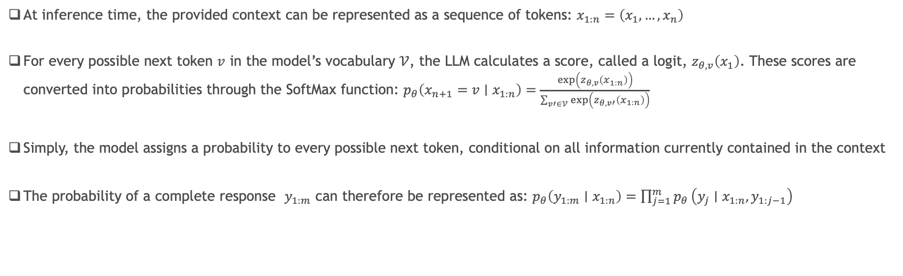
Change behaviour without changing the models parameters?
At inference time, the provided context can be represented as a sequence of tokens: $x_{1:n}=\left(x_{1},…,x_{n}\right)$
For every possible next token $v$ in the model’s vocabulary $𝒱$, the LLM calculates a score, called a logit, $z_{θ,v}\left(x_{1}\right)$. These scores are converted into probabilities through the SoftMax function: $p_{θ}\left(x_{n+1}=v∣x_{1:n}\right)=\frac{\exp\left(z_{θ,v}\left(x_{1:n}\right)\right)}{\sum_{v′∈𝒱}{\exp\left(z_{θ,v′}\left(x_{1:n}\right)\right)}}$
Simply, the model assigns a probability to every possible next token, conditional on all information currently contained in the context
The probability of a complete response $y_{1:m}$ can therefore be represented as: $p_{θ}\left(y_{1:m}∣x_{1:n}\right)=\prod_{j=1}^{m}{p_{θ}}\left(y_{j}∣x_{1:n},y_{1:j−1}\right)$
The only way to change a model's response without changing the parameters is changing the context, so that important elements of the interaction and discussion stay relevant in the process of generating the next token

Slide 8
Research Question I: Behavioural Approach
Human team cognition theory
Multi-agent systems
How does a shared-mental-model-inspired structured memory mechanism affect the efficiency and effectiveness of LLM-based multi-agent systems across different levels of accessible discussion context?

Slide 9
Research Question II: Mathematical approach
Human team cognition theory
Multi-agent systems
NOT DONE IN SCOPE OF THESIS
How does the added memory context change the model’s internal next-token distribution?

Slide 10
Theoretical Background: I-P-O & SMM
2

Slide 11
Input-Process-Output Framework (I-P-O)
Human team cognition perspective
Shared mental model
Communication
Cooperation
Team performance
Input
Process
Outcome
SMM-inspired structured memory mechanism
Agent communication
Agent cooperation
MAS effectiveness
MAS efficiency
Multi-agent system perspective
Mathieu et al., 2000

Slide 12
Shared mental models
Shared mental models
A team’s shared understanding of the task, team roles, and interaction processes, enabling effective coordination and higher team performance.
Task mental model
Team mental model
“Shared understanding of the task”
Task procedures
Strategies
Equipment and resoures
Environmental constraints
“Shared understanding of collaboration”
Roles and responsibilities
Information flow
Knowledge of team members
Interaction patterns
Cannon-Bowers et al., 1993

Slide 13
Theoretical Background: MAS
3

Slide 14
From LLM to MAS
Single Agent
Multi-agent system
Context and memory
One autonomous LLM-based agent
Role, goal, and tools
Solves a task from its own information state
Multiple specialised agents
Different roles, tools, and perspectives
Interact to solve a joint task
Context: information available at inference time, bounded by context window
Memory: information retained across model calls
Retrieved memory informs later decisions

Slide 15




Current state of the Art of MAS Frameworks
How do current AI Frameworks design context and memory?
A common default in contemporary agent frameworks is to maintain prior messages, agent responses, and tool interactions as an accumulating short-term context that is reintroduced into subsequent model calls.
What is not yet the default is a structured and adaptive representation of evolving team knowledge: a team mental model.

Slide 16
Architecture
4

Slide 17
Architecture
Framework: Google ADK (sufficient flexibility and complexity)
Number of agents: 3
Model: Open weight GPT OSS 120B (self-hosted at the University of Hohenheim)
Communication topology: Decentralised, with a randomised speaking order
Shared Mental Model: Structured Markdown-based memory including the current knowledge state, updated after each discussion contribution and inserted into the agents’ input context
Consensus: A simulation run ends when either
all agents agree on one candidate, or
a majority selects one candidate after five rounds

Slide 18
Architecture
Agent layer
Autonomous discussion agents that can call each other as tools.
Communication layer
Shared public discussion channel for all agents.
Memory layer
Maintains and updates SMM-inspired structured memories.
Consensus layer
Checks whether agents have reached agreement.
Anna Keller
Discussion agent
Public messages
Anna Keller
Structured memory
Peer tool calls
Updates structured memory
After each public message
If consensus achieved
Markus Weber
Discussion agent
Public messages
Markus Weber
Structured memory
Public discussion channel
Consensus
Checker
Final decision
Peer tool calls
Updates structured memory
Sofia Brandt
Discussion agent
Public messages
Sofia Brandt
Structured memory
If consensus not achieved

Slide 19
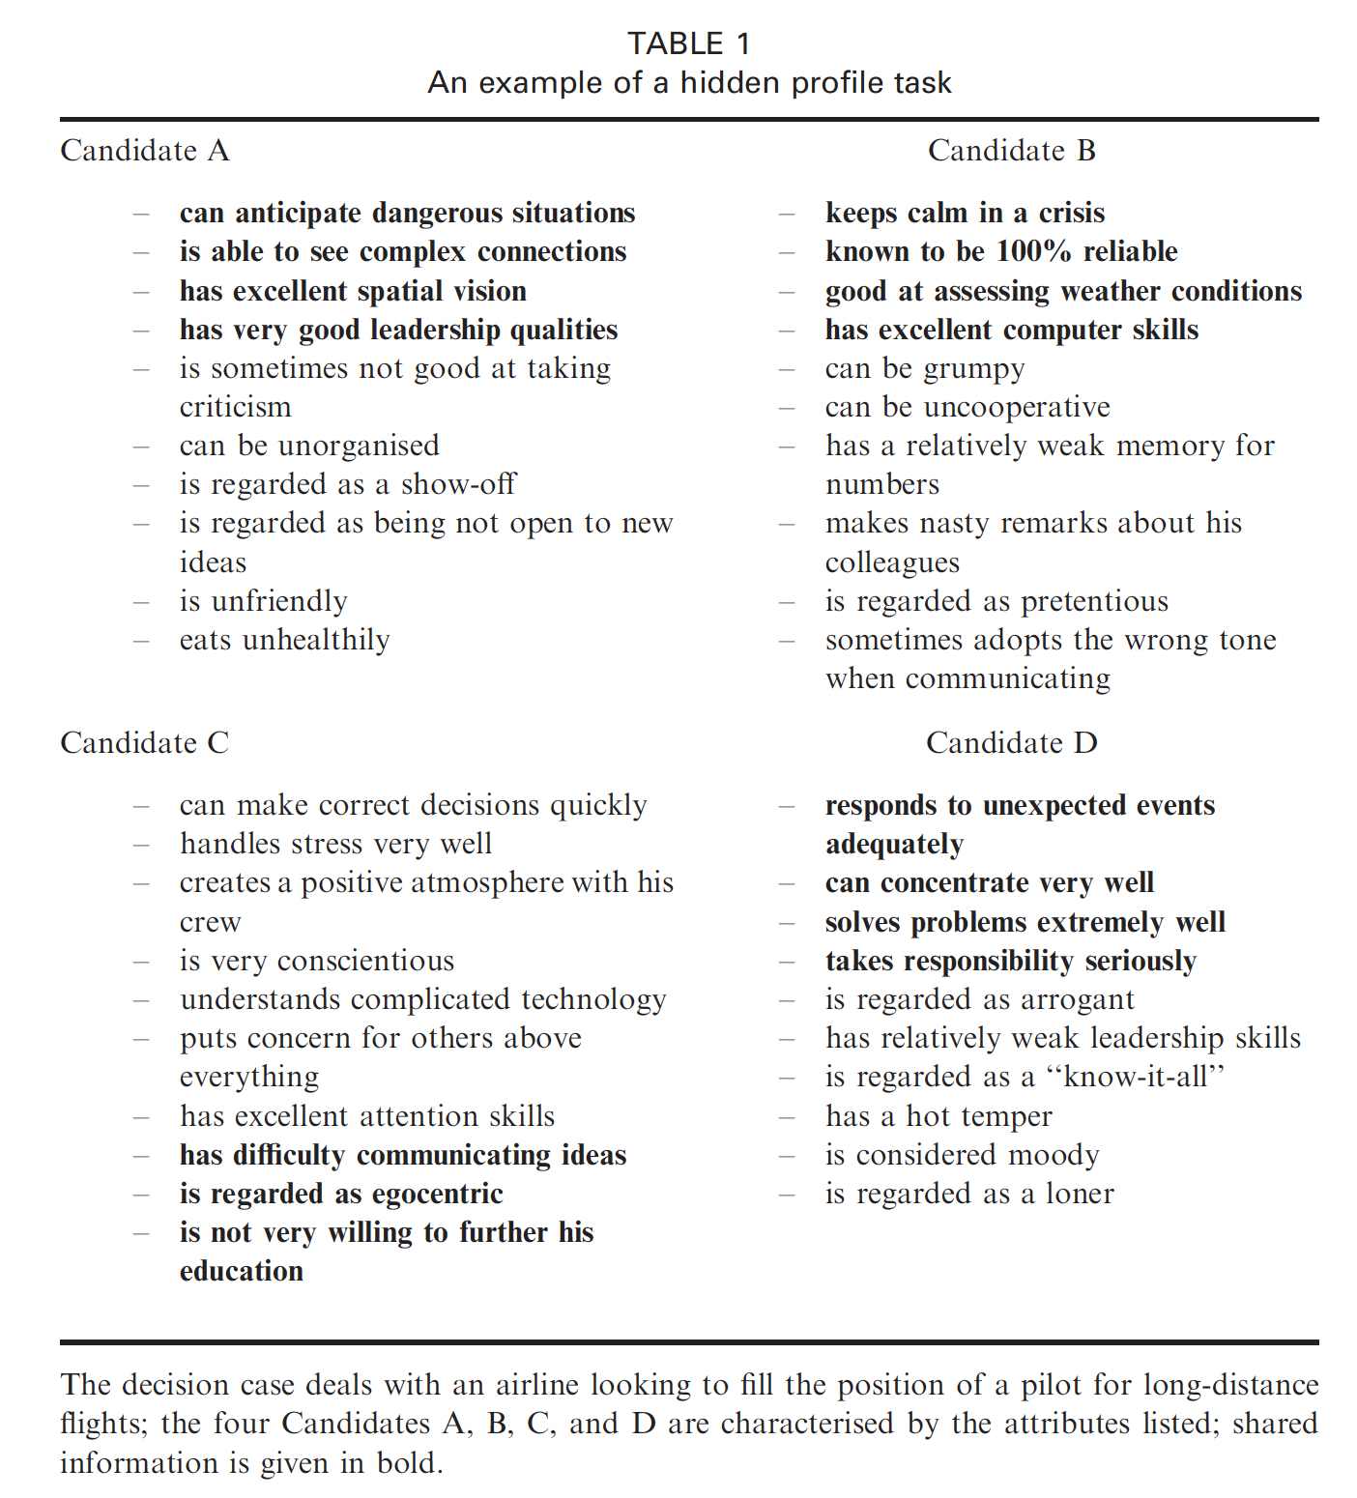
Hidden profile paradigm as generalization of MAS
Decision-relevant information is distributed across multiple group members
A group can identify the best option only if members share, discuss, and jointly integrate their private information
This is precisely where multi-agent systems become relevant: specialised agents must exchange information and coordinate in order to reach a collective decision
The task is therefore representative of distributed-information decision making in multi-agent systems
Schulz-Hardt et al. (2006)
The specific personnel-selection task used in this study was adapted from Schulz-Hardt et al. (2006).

Slide 20
Hypotheses
5

Slide 21
Simulation: Independent Variables
Konstrukte | Definition | Manipulation
Shared-mental-model-inspired structured memory mechanism | The presence of an explicit and dynamically updated team mental model. | Absent: Baseline – Agents have no explicit shared mental model and rely exclusively on the discussion history, similar to current frameworks like Google ADK or LangChain Present: SMM configurations - Agents receive an explicit shared mental model that is updated throughout the discussion
Degree of interaction context transparency | The degree to which previous interaction context is visible to an agent as input, enabling it to align its response with the team’s prior discussion, shared evidence, and current decision state. | Low: Agents can only read their current shared mental model plus the raw public discussion output and any targeted question-and-answer exchanges involving the immediately preceding agent Moderate: Agents can read their shared mental model plus the full public discussion history and targeted question-and-answer exchanges of all preceding agents High: Agents can read their shared mental model, the full public discussion history, targeted question-and-answer exchanges plus all agent-generated reasoning traces from previous discussion turns

Slide 22
Forschungsmodell
Shared Context Management
Team process
Performance Decomposition
Communication quality
H4a
Coordination efficiency
H1a, H2a, H3a
Context configuration
H4b
Cooperation
quality
H5a
Coordination effectiveness
H1b, H2b, H3b
H5b
H# | Hypotheses
1a | LLM-based multi-agent systems employing a shared-mental-model-inspired structured memory mechanism exhibit higher communication quality than systems without such a mechanism.
1b | LLM-based multi-agent systems employing a shared-mental-model-inspired structured memory mechanism exhibit higher cooperation quality than systems without such a mechanism.
2a | Within shared-mental-model-based configurations, moderate discussion context transparency results in higher communication quality than low discussion context transparency.
2b | Within shared-mental-model-based configurations, moderate discussion context transparency results in higher cooperation quality than low discussion context transparency.
3a | Within shared-mental-model-based configurations, moderate discussion context transparency results in higher communication quality than high discussion context transparency.
3b | Within shared-mental-model-based configurations, moderate discussion context transparency results in higher cooperation quality than high discussion context transparency.
4a | Communication quality has a positive influence on efficiency.
4b | Communication quality has a positive influence on effectiveness.
5a | Cooperation quality has a positive influence on efficiency.
5b | Cooperation quality has a positive influence on effectiveness.

Slide 23
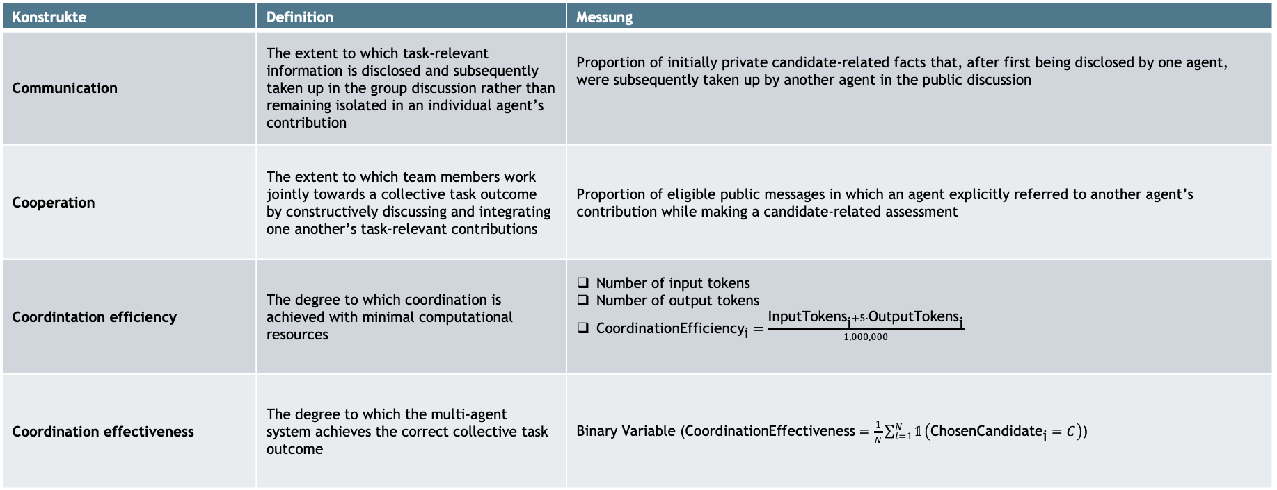
Simulation: Dependent Variables
Konstrukte | Definition | Messung
Communication | The extent to which task-relevant information is disclosed and subsequently taken up in the group discussion rather than remaining isolated in an individual agent’s contribution | Proportion of initially private candidate-related facts that, after first being disclosed by one agent, were subsequently taken up by another agent in the public discussion
Cooperation | The extent to which team members work jointly towards a collective task outcome by constructively discussing and integrating one another’s task-relevant contributions | Proportion of eligible public messages in which an agent explicitly referred to another agent’s contribution while making a candidate-related assessment
Coordintation efficiency | The degree to which coordination is achieved with minimal computational resources | Number of input tokens Number of output tokens $\text{CoordinationEfficienc}{\text{y}}_{\text{i}}=\frac{\text{InputToken}{\text{s}}_{\text{i}}+5⋅\text{OutputToken}{\text{s}}_{\text{i}}}{1,000,000}$
Coordination effectiveness | The degree to which the multi-agent system achieves the correct collective task outcome | Binary Variable ($\text{CoordinationEffectiveness}=\frac{1}{N}\sum_{i=1}^{N}{𝟙}\left(\text{ChosenCandidat}{\text{e}}_{\text{i}}=C\right)$)

Slide 24
Results
6

Slide 25
Descriptive statistics
Bedingungen
Baseline
Kein SMM + Vollständige Diskussionshistorie
Low
SMM + Output des letzten Agenten
Moderate
SMM + vollständige Diskussionshistorie
High
SMM + vollständige Diskussionshistorie + Reasoning Traces

Slide 26
Hypotheses testing

Slide 27
Top takeaways
Structured memory improves communication and cooperation - but not uniformly
Communication improved across all structured-memory conditions, cooperation improved only under low transparency.
More context is not better
Limited raw discussion context produced the strongest communication, cooperation and the highest decision accuracy.
Communication and cooperation play different roles
Communication increased decision quality but required more tokens, cooperation reduced token usage and showed marginal effectiveness gains.

Slide 28
Thank you!
Leonard Hegemann
Betreuende: Carolin Jung, Dominik Fetzer

