Slide 1
How to host an LLM for sensitive data
22.04.2026 – Leonard Hegemann (B.Sc. Digital Business Management)

Slide 2
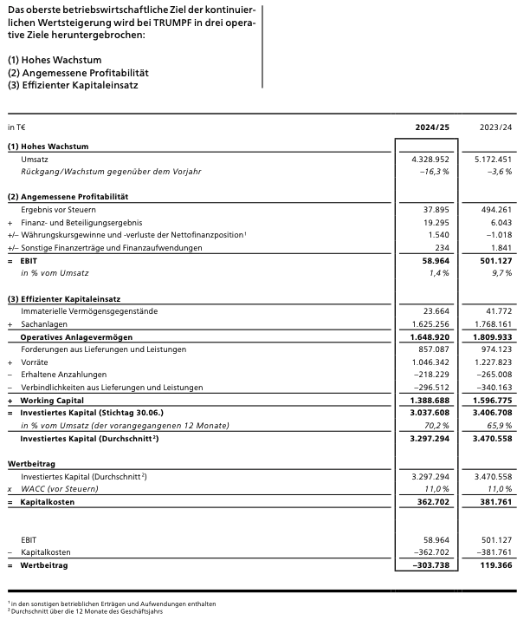
Problem with Sensitive data

Slide 3

Potential Solution: Startups like NENNA AI

Slide 4
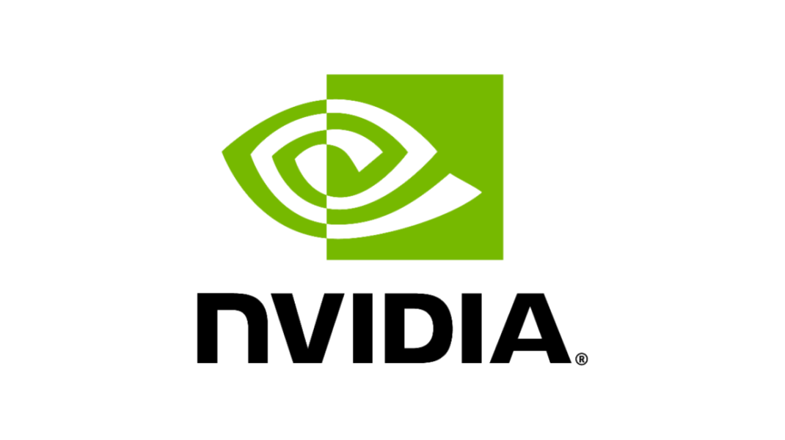
Potential Solution: NIVIDIA

Slide 5
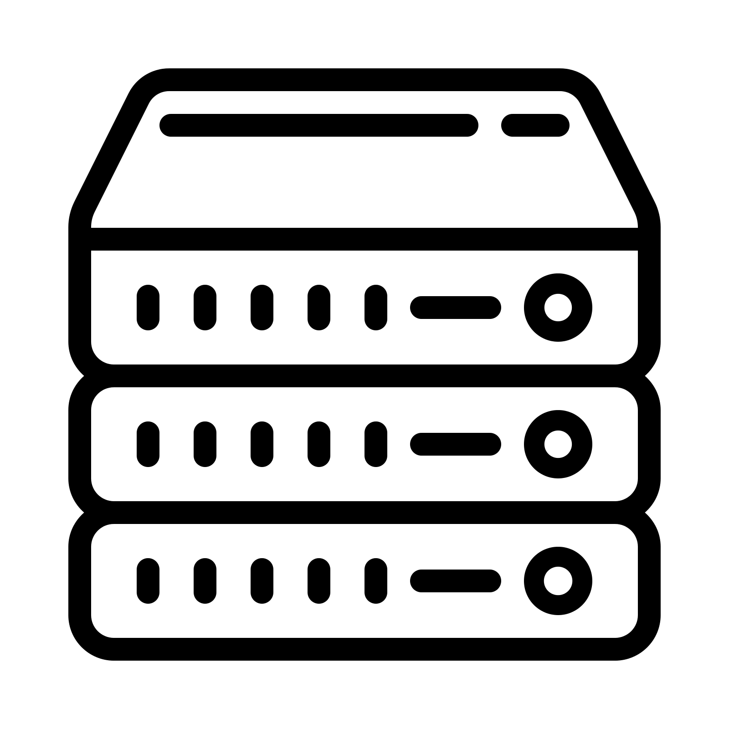
SAFE Solution: Self Hosting

Slide 6
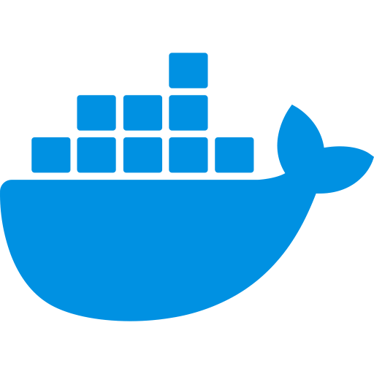
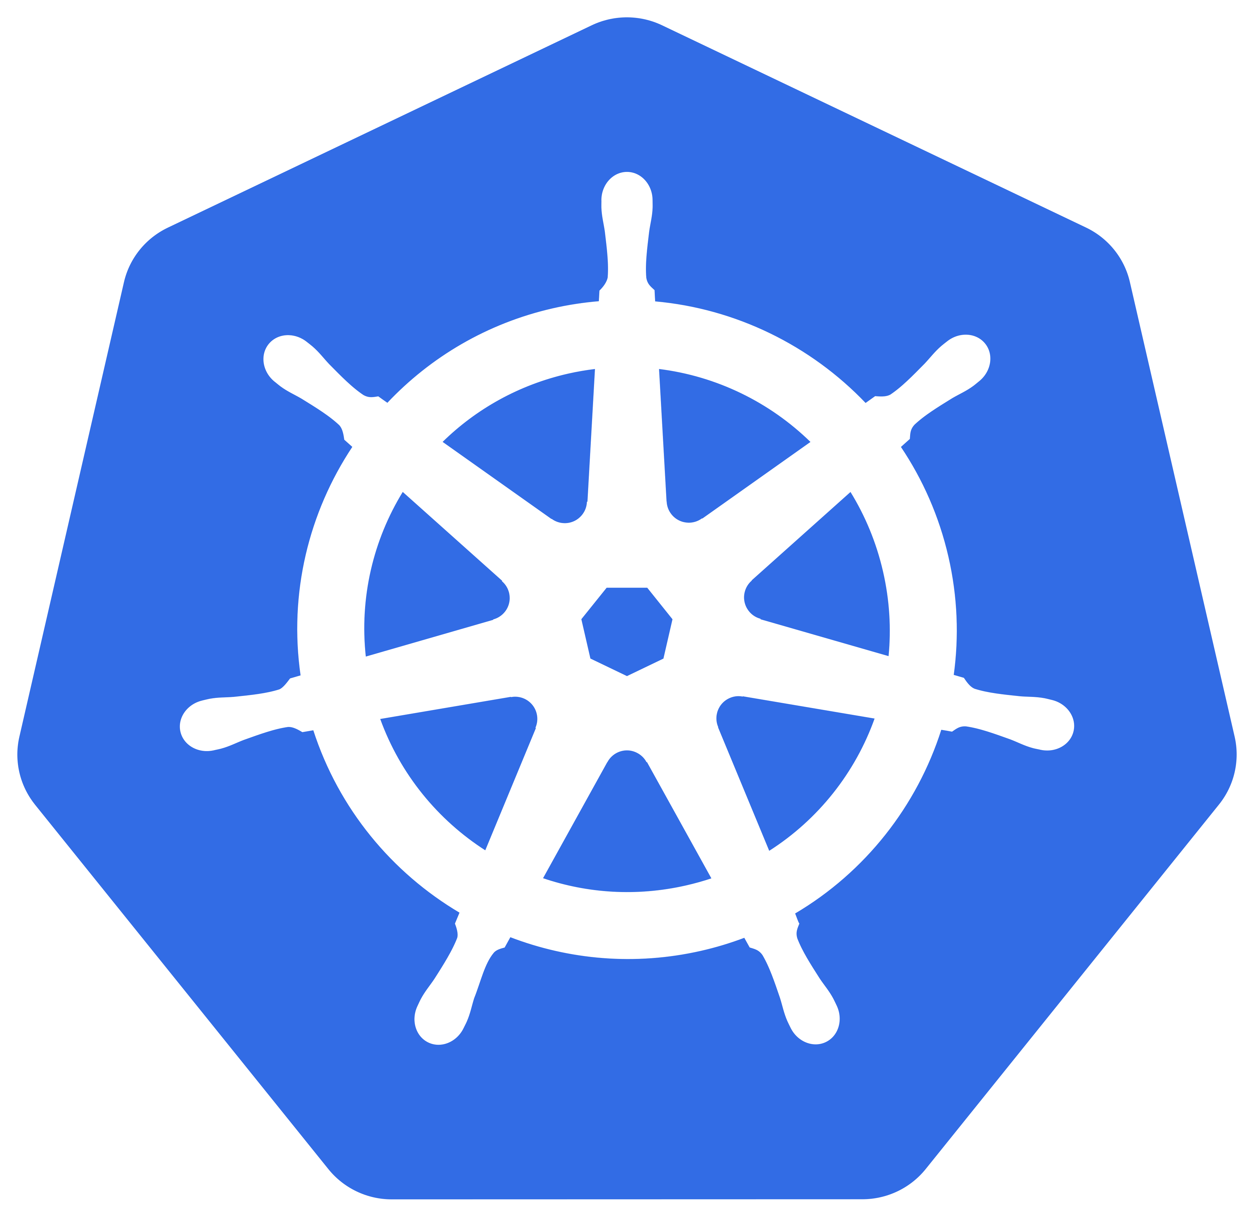

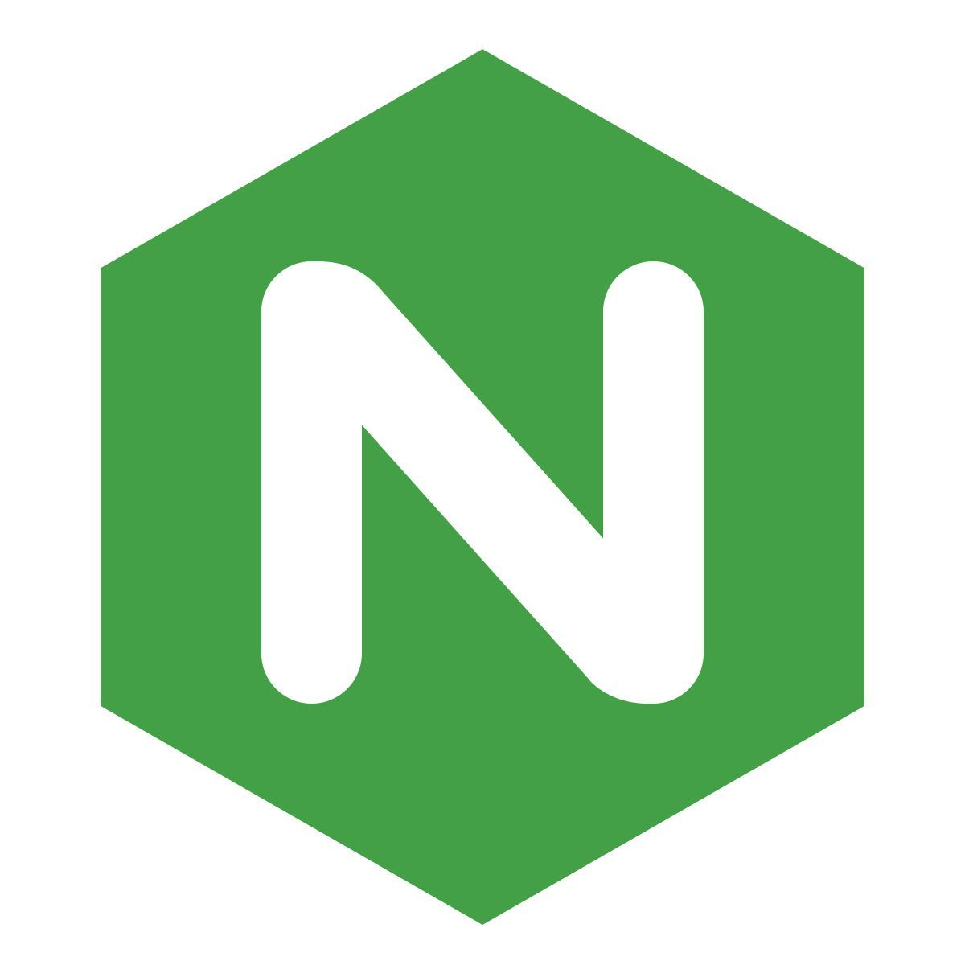




Self Hosting: Behind the scenes

Slide 7
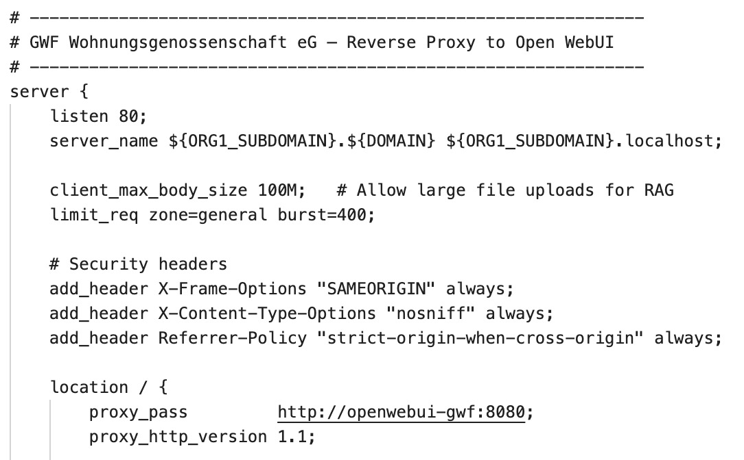
SELF HOSTING: NGINX
Serves static landing page
Acts as reverse proxy to route traffic away from the landing page
Maps subdomains to organization-specific services

Slide 8
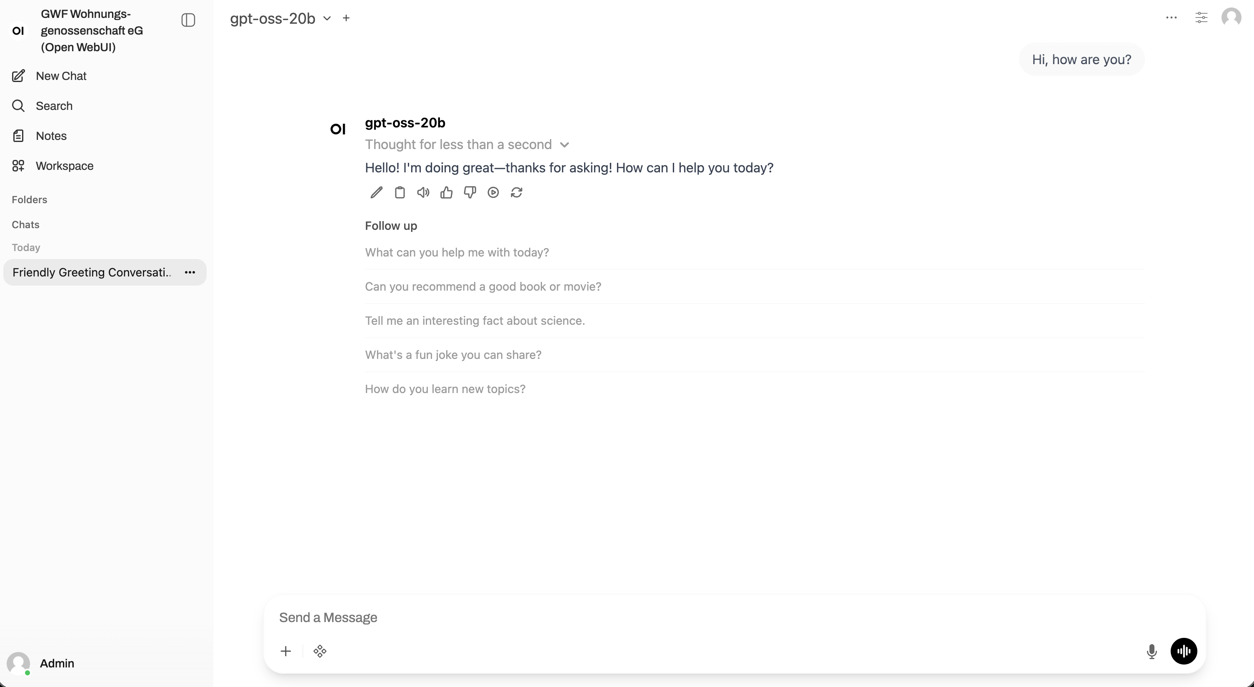
SELF HOSTING: OPEN web ui
Acts as frontend
Users can chat with their data (RAG)
Users can natively trigger N8N workflows through tools

Slide 9
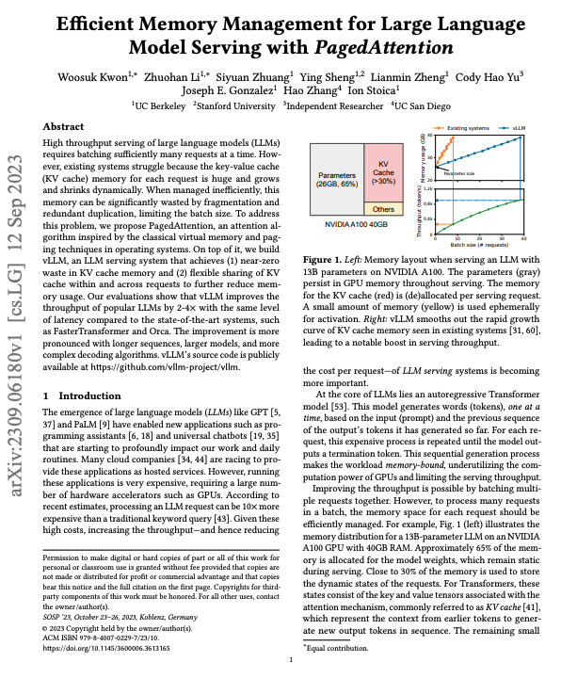
SELF HOSTING: VLLM
Runs chat model (gpt-oss 20b) and reranker
Exposes them through OpenAI compatible API
High-Perfomance focus (PagedAttention, Continious Batching, Quantization)
Enables you to host many models that are available on HuggingFace
Notes:
In the decoding process, all the input tokens to the LLM produce their attention key and value matrices, and these matrices are kept in GPU memory to generate next tokens. These cached key and value tensors are often referred to as KV cache.
Before, each incoming request got a big fixed chunk of GPU memory, where most of the memory was waster (“just in case”). vLLM splits the memory into small reusable blocks. Consequently, you only allocate the memory that you actually need, and identical requests can share the same blocks.
This idea is inspired by how operating systems manage memory. This block style memory enables continuous batching, where new requests are added finished ones are removed on the fly. The GPU is basically always working and never waiting. In the end, you can serve way more requests at the same time on the same GPU
In a RAG system, your documents are first split into small chunks. When you ask a question, the system uses embeddings to quickly find the most relevant chunks, then a reranker scores the query + chunk and reorders them to pick the best few.
These top chunks are passed to the LLM, which chooses the information that is being passed in the final output.

Slide 10
SELF HOSTING: Postgres INSTEAD of SQLITE
Persistent storage for multi-user app data
User data (email, password)
Chat history
API Keys
…
Storage of Embeddings for RAG

Slide 11
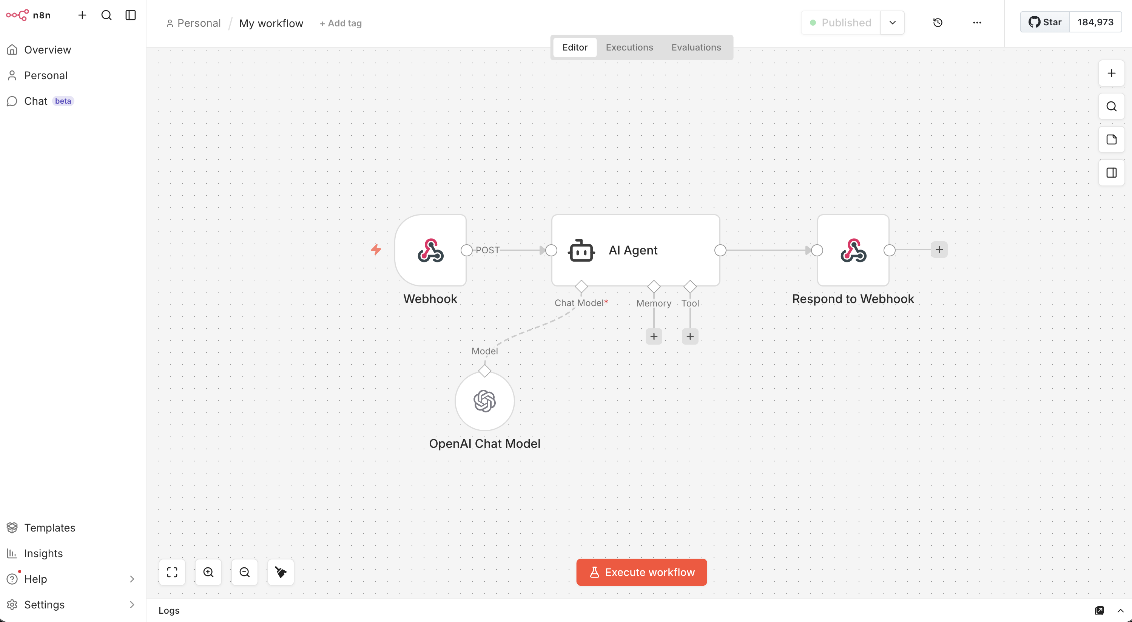
SELF HOSTING: N8N
No-code to low-code workflow automations
Can be triggered through Open WebUI Webhook
Easy connection to countless third party tools (WhatsApp, Telegram, Teams, Outlook, …)

Slide 12
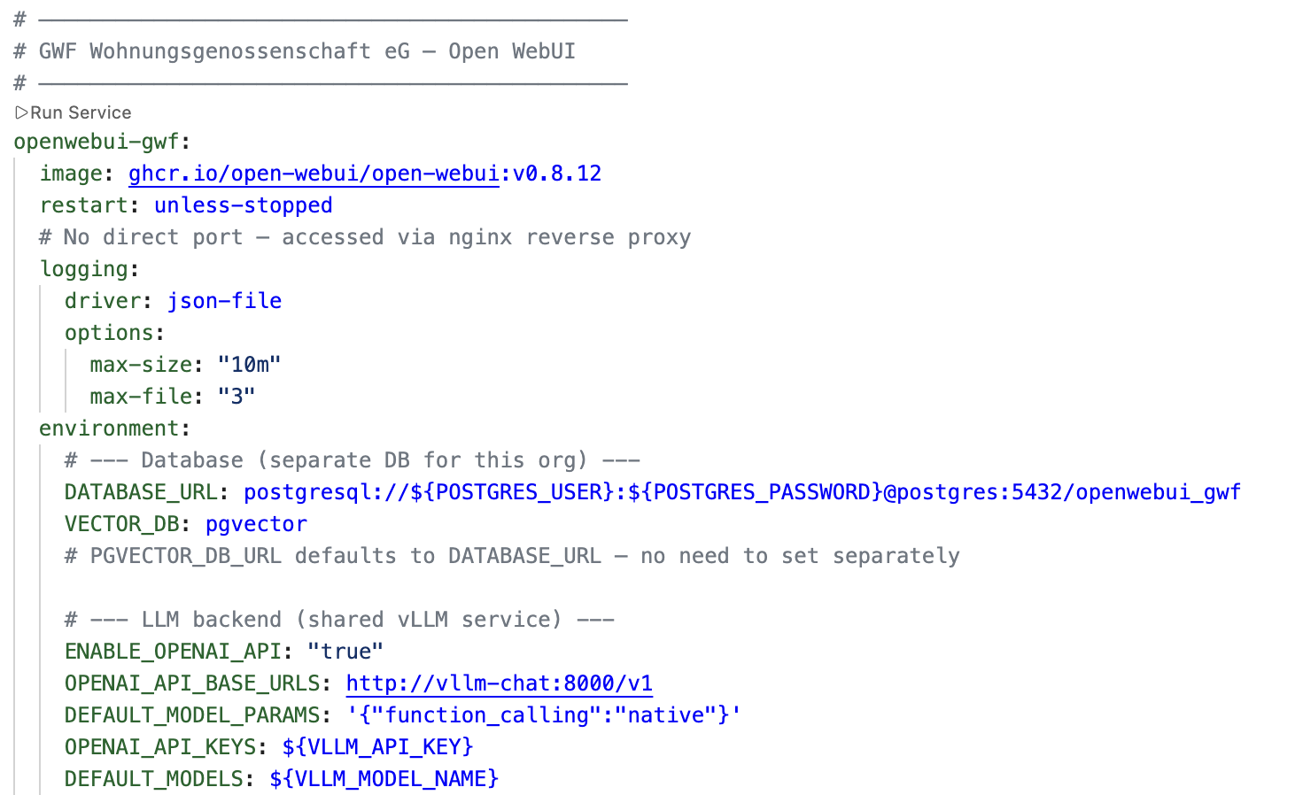
SELF HOSTING: Docker
Packages each service and its dependencies in a container
Enables portability
Easy deployment
Runs all services via one docker-compose.yaml

Slide 13
SELF HOSTING: Kubernetes
Runs and orchestrates pods (basically containers) on nodes (VM/physical server)
Keeps the desired number of instances running (self-healing)
Scales up/down based on demand
Updates applications without downtime (rolling updates)
Notes:
Kubernetes is a platform for running and managing containerized applications across multiple machines. A Kubernetes cluster consists of several nodes, which are individual machines (virtual or physical) that provide resources like CPU, memory, and sometimes GPUs. On these nodes, Kubernetes runs Pods, which are the smallest units of execution and usually contain a single container.
You first create a cluster by adding nodes, and each node automatically reports its available resources to Kubernetes. Instead of manually starting containers, you define your application in terms of a desired state—for example, which container image to run, how many instances (Pods) should exist, and what resources they require.
Kubernetes then takes over the operational work. It schedules Pods onto suitable nodes based on available resources, runs the containers inside them, and continuously ensures that the desired number of Pods is maintained by recreating any that fail. It can also scale the number of Pods up or down depending on load, distribute incoming traffic across them, and roll out updates without downtime. In essence, you describe what your application should look like, and Kubernetes automatically handles how to keep it running reliably on the available machines.

Slide 14

Future plans & thoughts
Deploy as subdomain on https://subdomain.aidaho.uni-hohenheim.de
Let people test it
Prepare Data Backups
How many users can the system handle with 40gb of vRAM?
Host outside of Hohenheim (Hetzner)

Slide 15
Self Hosting: Requirements
DEMO

Slide 16
Thank you for your attention!
22.04.2026 – Leonard Hegemann (B.Sc. Digital Business Management)

