Slide 1

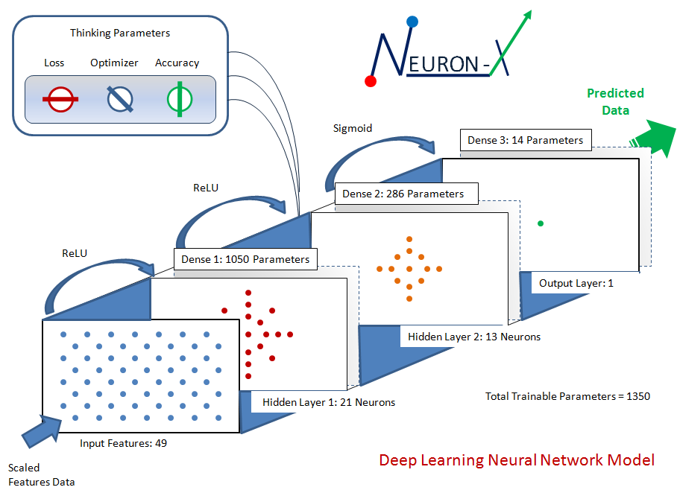
DATA SERVICES
FOUNDERS: PRATEEK SHARMA | LEO HARADA | WILLIAM OLESINSKI

Slide 2

WHO WE ARE?
First B2B Service Based Platform focused on providing optimized industry specific solutions for mid-to-small size businesses.
Area we focus on specializing:
| CONSUMER BEHAVIOR | TREND ANALYSIS
| FINANCIAL PERFORMANCE | OPERATIONAL ANALYTICS
| COMPETITIVE ANALYSIS | PREDICTIVE ANALYTICS

Slide 3



MEET THE TEAM
PRATEEK SHARMA
LEAD DATA SCIENTIST
MBA – Finance Management Services
LEO HARADA
DATA SCIENTIST
UC Irvine, B.S. - Business Economics & Management
WILLIAM OLESINSKI
DATA GURU
UC Santa Cruz, B.A., Financial Advisor

Slide 4

OUR MOTIVATION
The lack of knowledge and research by mid to small size businesses and the failure to perform as well as large corporations during the pandemic showcased how important it is to have an accurate predictive modelling strategy.
Industry specific Machine Learning Models will allow smaller organizations to compete with larger organizations.

Slide 5
WHAT WE DO?
CREATE: ARTIFICIAL NEURAL NETWORK (ANN)
Parameters
Sigmoid
Loss
Optimizer
Accuracy
Dense 3: 14 Parameters
PREDICTED
DATA
ReLU
Dense 2: 286 Parameters
ReLU
Dense 1: 1050 Parameters
Output Layer: 1
Hidden Layer 2: 13 Neurons
Total Trainable
Parameters = 1350
Hidden Layer 1: 21 Neurons
SCALED FEATURES IN
Input Features: 49
CUSTOMIZED
BUILD

Slide 6








HOW DO
WE BUILD OUR
CUSTOMIZED MODELS?
Scikit-learn
1
2
3
4
5
6
Pre-process
Data
Build Model Architecture
Run Training & Evaluation
Make Predictions!
Monitor & Upgrades
Deploy

Slide 7


WE OFFER: INDUSTRY SPECIFIC SOLUTIONS
FINTECH INDUSTRY
GROWTH RATE (2018 - 2022)
CAGR 24.8%
3X
“Technology could replace approximately 30% of banking jobs by as early as 2023. A huge portion of this staggering change can be attributed to the widespread use of big data, particularly in the growing field of predictive analytics.”
- VIKRAM PANDIT | FORMER CITIGROUP CEO
$127.66 B
$309.98 B
GLOBAL MARKET SIZE (2018)
MARKET SIZE FORECAST (2022)
Source: https://www.thebusinessresearchcompany.com/press-coverage/global-fintech-market-size

Slide 8

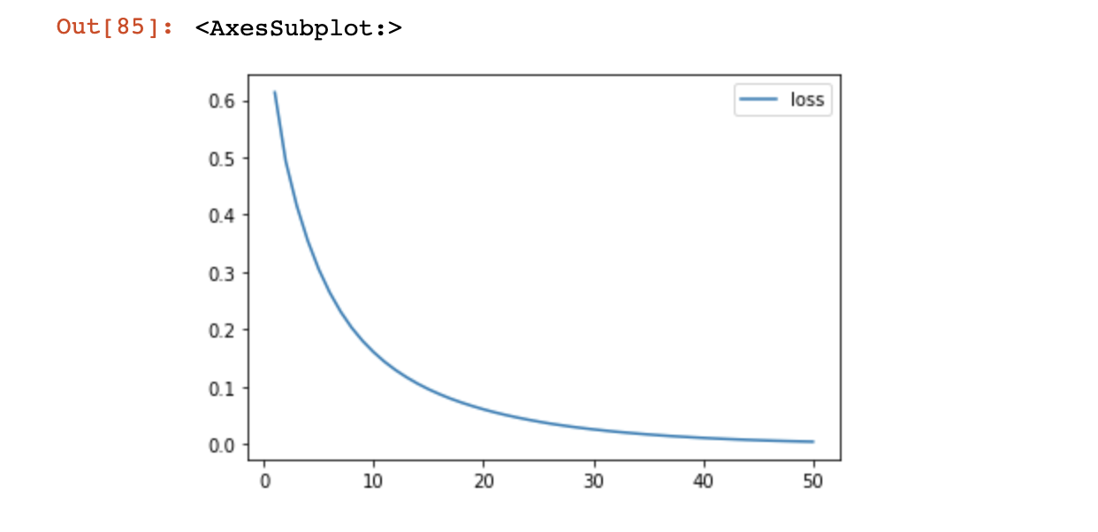
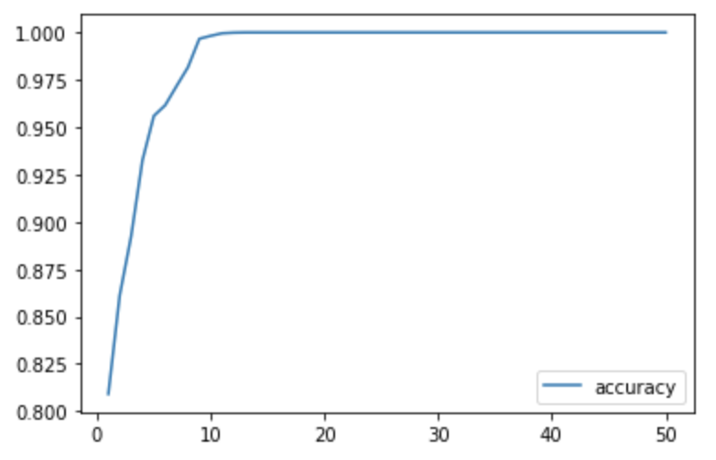

TECHNICAL SPECIFICATIONS
MODEL: Binary Classification
LAYERS: 2 Hidden Layers (3 Denses)
ARCHITECTURE: Keras/Tensorflow
ACTIVATIONS: ReLU & SIGMOID
INPUT/OUTPUT
SLOTS: 45 Features & 1 Output
LOSS: Binary Crossentropy
OPTIMIZER: Adam
ACCURACY: Accuracy
Training Cycles: 50 Epochs
PREDICTS
MARKET INDICATORS
(BUY - SELL)
Loss: 01%
Accuracy: 100%
INPUT FEATURES
Simple Moving Averages
Volume
Closing Price
Actual Returns
OPERATIONAL EFFICIENCY STRATEGIC DECISION MAKING ANALYTICS
Eliminates Biased Emotions
Increased Returns
100% ACCURACY
FINTECH NEURON

Slide 9

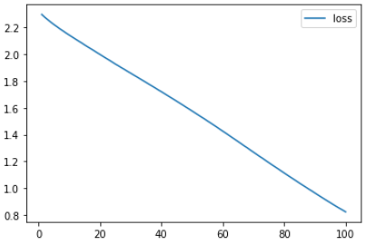
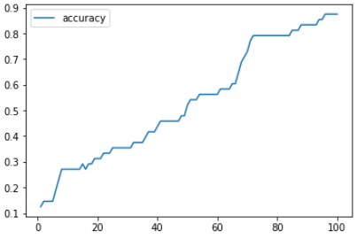
TECHNICAL SPECIFICATIONS
MODEL: Multi-Class Classification
LAYERS: 2 Hidden Layers (3 Denses)
ARCHITECTURE: Keras/Tensorflow
ACTIVATIONS: ReLU & SOFTMAX
INPUT/OUTPUT
SLOTS: 31 Features & 10 Outputs
LOSS: Categorical Crossentropy
OPTIMIZER: Adam
ACCURACY: Accuracy
Training Cycles: 100 Epochs
PREDICTS
CRYPTO CHOICE
(Coins, Digital Assets)
Loss: 82%
Accuracy: 87.50%
INPUT FEATURES
Demographics (Age, Gender, Income etc.)
Investment Amount
Job Industry
Holding Period
MANAGING PRODUCTS COST SAVINGS ANALYTICS
Profits on
Trades
Operational Expenses
88% ACCURACY
FINTECH NEURON

Slide 10

WE OFFER: INDUSTRY SPECIFIC SOLUTIONS
STREAMING APP INDUSTRY
GROWTH RATE (2021-2028)
CAGR 21%
4X
“It’s about getting that title to the right person, .. we are able to unlock audiences for titles that you wouldn’t expect.”
- TODD YELLIN | NETFLIX VP OF PRODUCT
$59.14 B
$223.98 B
MARKET SIZE (2021)
REVENUE FORECAST (2028)
Source: groundviewresearch.com

Slide 11

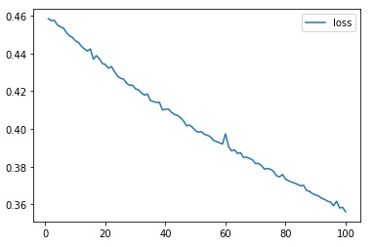
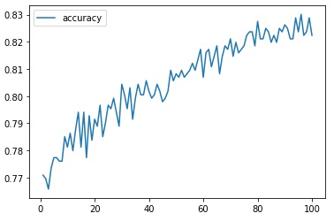

TECHNICAL SPECIFICATIONS
MODEL: Binary Classification
LAYERS: 2 Hidden Layers (3 Denses)
ARCHITECTURE: Keras/Tensorflow
ACTIVATIONS: ReLU & SIGMOID
INPUT/OUTPUT
SLOTS: 32 Features & 1 Output
LOSS: Binary Crossentropy
OPTIMIZER: Adam
ACCURACY: Accuracy
Training Cycles: 100 Epochs
PREDICTS
CONTENT TYPE
(MOVIES VS WEB SERIES)
Loss: 30%
Accuracy: 83%
INPUT FEATURES
Demographics (Age, Gender, Income etc.)
Content Preferences
Subscription Renewals
Time Spent on App
CONSUMER BASE COST SAVINGS ANALYTICS
CUSTOMER
RETENTION RATE
5 MINUTES
PER VIEW
83% ACCURACY
STREAMING APP NEURON

Slide 12

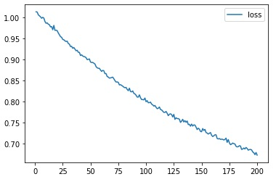
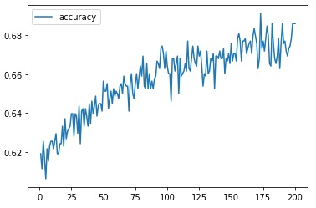
TECHNICAL SPECIFICATIONS
MODEL: Multi-Class Classification
LAYERS: 2 Hidden Layers (3 Denses)
ARCHITECTURE: Keras/Tensorflow
ACTIVATIONS: ReLU & SOFTMAX
INPUT/OUTPUT
SLOTS: 45 Features & 10 Outputs
LOSS: Categorical Crossentropy
OPTIMIZER: Adam
ACCURACY: Accuracy
Training Cycles: 200 Epochs
PREDICTS
CATEGORY TYPE
(Categories: Action, SciFi, Comedy etc.)
Loss: 67%
Accuracy: 70%
INPUT FEATURES
Demographics (Age, Gender, Income etc.)
Content Preferences
Subscription Renewals
Time Spent on App
CONSUMER BASE COST SAVINGS ANALYTICS
CUSTOMER
RETENTION RATE
5 MINUTES
PER VIEW
70% ACCURACY
STREAMING APP NEURON

Slide 13




MONETIZATION STRATEGY
SUBSCRIPTION BASED PLATFORM
DATA SERVICES

Slide 14

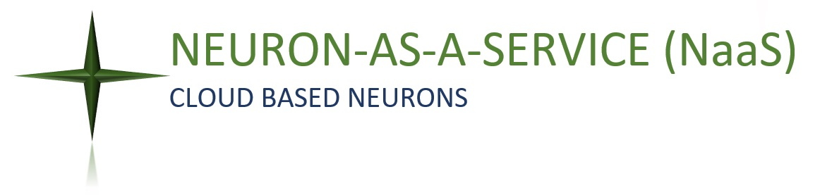

NEXT STEPS – TO THE MOON
2022
2025
2035

Slide 15

THANKS FOR BEING WITH US!!
- FINTECH PROJECT -

