Slide 1
Threat Modeling
A technique for building secure systems

Slide 2
Secure Systems - Options
Just build it
Build the system first, then "paste on" security
Build the system first then pitch it over the wall to the security folks
Make it so secure that no one can use it
Recognize that there's a tradeoff
Keep security in mind from the start
Work with security folks from the start
Involve everyone
Recommend and present options, risks, costs to management
Industry best practices
Notes:
Ask listeners/viewers to decide which are the good versus bad options
The only way to make it completely secure is to make it completely inaccessible
There is always going to be some risk (same as above)
There will always be some attack method you didn't think of
What's the goal?

Slide 3
Threat Modeling - What do we do, and how?
We try to figure out:
What can go wrong
Who would want to do wrong
What would they want to do
How we can prevent that
We:
Use industry standard terms and techniques
Involve people with various skill sets
Iterate
Notes:
Q: Why use industry standard terms and techniques? A: Because:
There is a limited, well-defined set of categories things that can go wrong
There is a better chance that by following the cookbook you'll discover things, than that you'll overlook something
It gets you into a mindset, so if there is something not covered in the cookbook you're more likely to think of it
It's really valuable for later conversations with security folks
It's really valuable for life

Slide 4
Threat Modeling - Steps
We:
1. Define key scenarios
2. Model the application using Data Flow Diagrams (DFDs)
3. Determine threat types for each DFD element
4. Calculate risk
5. Plan mitigations

Slide 5
Threat Modeling - what, how, when
We try to find "anti-scenarios" or "bad use cases"
We think like security folks, black hat, white hat
We analyze the System Under Design
We do it as part of the design process
  Reduces cost by cutting down redesign, rework

Slide 6
Threat Modeling Terms
Adversary
  It's helpful to imagine, characterize them
Asset
Attack
  Adversary tries to take advantage of a vulnerability
  Degree of success ≠ degree of damage
Mitigations
  Ways to eliminate or reduce vulnerabilities
Threat Tree
  Graphical representation of assets, threats, mitigations
Vulnerability
  A flaw or weakness an adversary could exploit

Slide 7
Threat Modeling helps security, plus…
What are we really doing?
  Methodically focusing on vulnerabilities and mitigations
  Helps us build a more secure system
  Sometimes a mitigation is "leave it out"
  Q: How important/necessary is this piece, really?
This process delivers side benefits
  Often we find we can drop a piece; makes for better design
  Savings of effort, time, cost, regardless of security aspect
  "The cost of fixing defects after deployment is almost 15x greater than detecting and eliminating them during development." - IDC, IBM Systems Sciences Institute
  Cost of vulnerability in live product - potentially enormous

Slide 8
The Security Lifecycle
Security kickoff, register project
Security training
Security design/architecture, best practices review
Review attack terminology, thinking
Threat modeling
Use the best design and development practices
Use security tools
Test, design review (pen test), final security review
Write documents including Response Plan
Provide security tools for the product or service
Post-deployment security response
Notes:
It can get fancy and formal, but it doesn't have to.
How this ties in to other deliverables, checkpoints, signoffs, releases, is up to management.

Slide 9
Threat Modeling - Goals
Identify the application's vulnerabilities
  And estimate and rank them
Determine which threats require mitigation
Mitigate: reduce risk to an acceptable level

Slide 10
Threat Modeling - Steps
Requires thought, care, research, involvement:
  Define scenarios (use cases and anti-use cases)
    (above and below steps can be parallelized/simultaneous)
  Create Data Flow Diagram
Formulaic:
  List threat types
  Build threat trees, and/or outlines (optional)
  Determine the risk
Requires thought, care, research, involvement:
  Choose and plan mitigations
Notes:
Refer to the actual DFD.
Point out that the Context Diagram is quite "unsatisfying" - it doesn't at all feel like you're seeing enough detail.
The Level 0 DFD does better; you start to get a picture of who's interacting with whom, passing what information.
But, it still leaves questions.
Each question gets answered by further decomposition.
Boundaries don't have to be just between machines. Can be between processes, threads, JVMs, et cetera.

Slide 11
Threat Modeling - Pictures
External Interactor: people, news feeds, data feeds, streams, events, notifications
Data Process: service, web service, assembly, executable (.exe), library (.dll), JAR, daemon
Data Flow: SQL query/result set, function call, network traffic, shared memory, message
Data Store: file, database, registry, shared memory, XML doc, disk, structure, JSON

Slide 12
Be Careful To Include All The Pieces (1/3)
Not This
But This
Data
Entry
Tool
Data Entry
Operator
Data Files
Data Files
Service
Service

Slide 13
Be Careful To Include All The Pieces (2/3)
Not This
But This
Data Files
Data Files
Replication
Engine
Data Files
Data Files

Slide 14
Be Careful To Include All The Pieces (3/3)
Not This
But This
User
User
Data Entry
Tool
Data Files
Data Files

Slide 15
Vocabulary List 1 of 3: CIA
C - Confidentiality
I - Integrity
A - Availability
Confidentiality: Nobody can read it that shouldn't
Integrity: Nobody can write to it that shouldn't, or foul up a write; data remain correct
Availability: System is up; data and functionality are available to the right people at acceptable level of service (response time & rate)
Notes:
Talk here

Slide 16
Vocabulary List 2 of 3: STRIDE
S T R I D E
S - Spoofing: I pretend to be you
T - Tampering: I change data, or a system
component (code, a configuration)
R - Repudiation: I claim I didn't actually do a thing, a
transaction (like make a purchase)
I - Information Disclosure: I get information I
shouldn't have access to
D - Denial of Service: I make the system unavailable
E - Elevation of Privilege: I get privileges I shouldn't
have
Notes:
Talk here

Slide 17
Vocabulary List 3 of 3: DREAD
D R E A D
D - Damage: how bad would an attack be?
R - Reproducibility: how easy it is to reproduce the
attack?
E - Exploitability: how much work is it to launch the
attack?
A - Affected users: how many people will be
impacted?
D - Discoverability: how easy it is to discover the
threat?
Notes:
Talk here

Slide 18
Threats by asset
S T R I D E
External Interactor
Process
Data Store
Data Flow
Notes:
This is what makes it formulaic. This chart is fixed, it never changes, it's the same from project to project and company to company.
It basically defines steps in a fixed algorithm, that we will then follow.

Slide 19
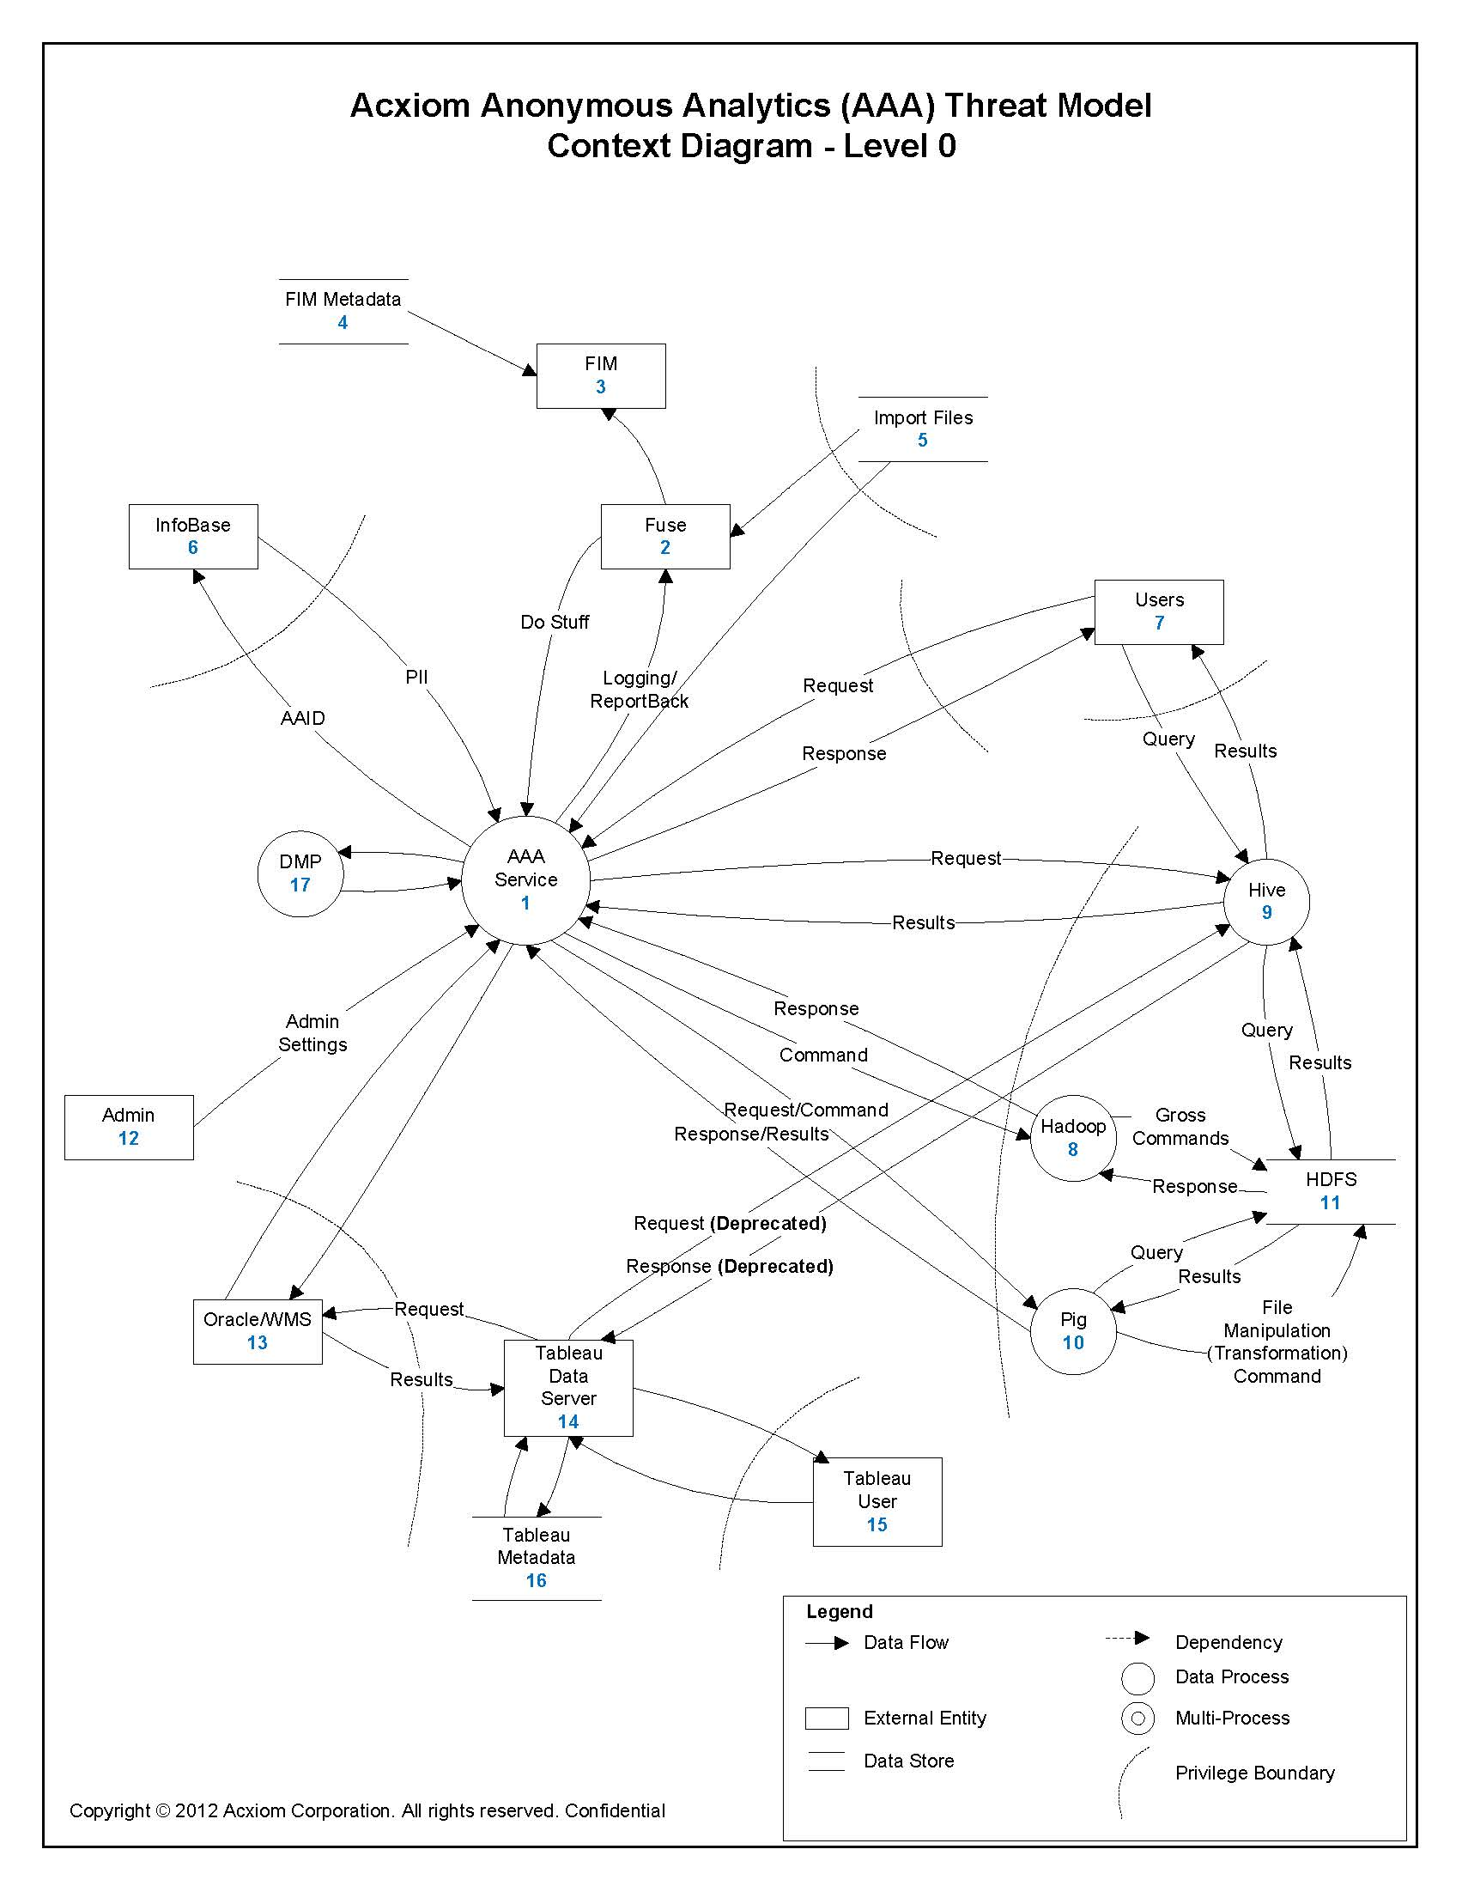
Notes:
Say: "This is a Data Flow Diagram (DFD)."
Briefly explain.
Much nicer to bring up the real drawing to show 'em.

Slide 20
Now list all assets from the DFD
By type by number
External Interactors: 2, 3, 6, 7, 12, 13, 14, 15
Processes: 1, 8, 9, 10, 17
Data Stores: 4, 5, 11, 16
Data Flows: 1-2, 1-6, 1-7, 1-8, 1-9, 1-10, 1-13, 2-1,
2-3, 4-3, 5-1, 5-2, 6-1, 7-1, 7-9, 8-1, 8-11, 9-1, 9-7, 9-11, 9-14, 10-1, 10-11 (twice), 11-8, 11-9, 11-10, 12-1, 13-1, 13-14, 14-9, 14-13, 14-15, 14-16, 15-14, 16-14
Notes:
Talk here

Slide 21
Now list threats from previous step
Spoofing:
  E: 2, 3, 6, 7, 12, 13, 14, 15
  P: 1, 8, 9, 10, 17
Tampering:
  P: 1, 8, 9, 10, 17
  DS: 4, 5, 11, 16
  DF: {long list}
Repudiation:
  E: 2, 3, 6, 7, 12, 13, 14, 15
  P: 1, 8, 9, 10, 17
Information Disclosure:
  P: 1, 8, 9, 10, 17
  DS: 4, 5, 11, 16
  DF: {long list}
Denial of Service:
  P: 1, 8, 9, 10, 17
  DS: 4, 5, 11, 16
  DF: {long list}
Elevation of Privilege:
  P: 1, 8, 9, 10, 17
Notes:
Talk here

Slide 22
Threat Reduction
You can save time by grouping assets
  Treating them as one
  If (and only if):
    They're within the same trust boundary
    Use the same technology
  This saves lots of time
  Especially for data flows!
  Note that this can guide our non-security architecture
Notes:
Talk here

Slide 23
Threat Evaluation, Quantification
There is really a lot of judgment here.
  What is the ease of guessing a password?
Get experts to help you if you/they can.
Recall DREAD:
  Damage - how bad would an attack be?
  Reproducibility - how easy it is to reproduce the attack?
  Exploitability - how much work is it to launch the attack?
  Affected users - how many people will be impacted?
  Discoverability - how easy it is to discover the threat?
You can assign numbers, and calculate
  But then what?
    Pick a cutoff? Where?
    Send a spreadsheet up to management?
  Remember: the numbers are your servant, not your master.
Notes:
Talk here

Slide 24
Threat Ranking
Critical
Elevation of privilege
Running malicious code
High
Denial of service against a server
Medium
Denial of service against a server that stops when attack does
Low
Denial of service against a client
(This list is just one sample guideline)
Notes:
Talk here

Slide 25
Threat Mitigation
High risk - eliminate it
Best: remove from product
OK: remedy with countermeasure
  Technological
  Behavioral/procedural (only boss knows PW)
  This may amount to making it medium or low risk
Medium risk - mitigate it
Layers of access
Countermeasures as above
Low risk - monitor it (but how?)
Sending reports to somebody, they get ignored.
Warn, counsel, train
Policies, procedures, NDAs, employment contracts
Notes:
Note that every countermeasure creates another risk.
Q: What if the boss isn't around when the PW is needed?
A: Keep the password in the sealed file folder in the bin on the wall
Risk: Somebody will get to it, it'll get lost, it'll go obsolete…

Slide 26
Mitigation Techniques
Threat | How to mitigate
Spoofing | Authentication
Tampering | Integrity
Repudiation | Nonrepudiation
Information Disclosure | Confidentiality
Denial of Service | Availability
Elevation of Privilege | Authorization
This is general
Some of the "how"s are really 30,000 foot goals
"Nonrepudiation" is really just a mirror of the problem…
Security experts and folks (e. g. developers) who've done this kind of work can really help here.
Notes:
See how nicely STRIDE and CIA go together
But some of these are only generalities; buzzwords even

Slide 27
Final Notes
Thanks to Dan Sellers of Microsoft Canada for original packaging of these concepts and permission/disclaimer of "ownership."
Thank you audience!

