Slide 1
Project Template
Team:
Staff: Carlo Antenucci, Leonardo Iannacone, Alessandro Fedi
Project name:
“Rock, Paper, Scissors, Lizard, Spock”

Slide 2


Scenario
(A1)
PLAYER 1
PLAYER 2
PC
+
JVM
PC
+
JVM
SIB
SIB
SIB
Smart-M3

Slide 3

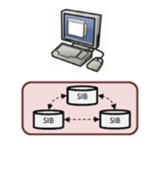
HW Architecture
Player
TCP/IP
GAME UI
JVM
SMART-M3

Slide 4
SW Architecture
Player
S4_End game
KP
Leave game
KP
Hit
SIB
SMART M3
S3_Hit
KP
Waiting games
S2_Waiting games
SIB
SIB
KP
Incoming player
S1_Waiting opponent
Producer
KP
Create new game
Send hit
Join game
Leave game
GUI
Consumer
Update
Producer
Subscribe
Aggregator
Query

Slide 5
HW/SW Infrastructure
Smart-M3
Player
SIB
S4_End game
KP
SIB
SIB
S3_Hit
KP
S2_Waiting games
KP
S1_Waiting opponent
KP
Producer
KP

Slide 6
Data flow
Player 2
KP
S1_Waiting opponent
Join game
Player 1
KP
S2_Waiting games
Create new game
KP
Send hit
Producer
KP
S3_Hit
Leave game
KP
S4_End game

Slide 7
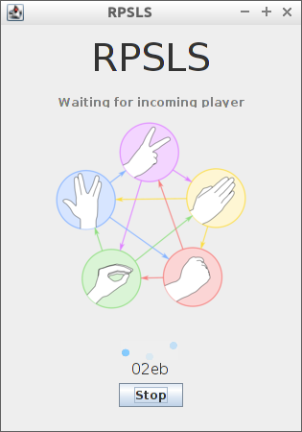
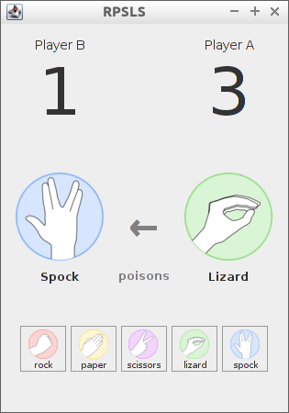
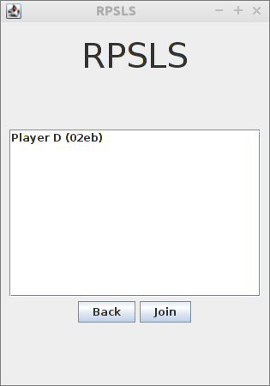
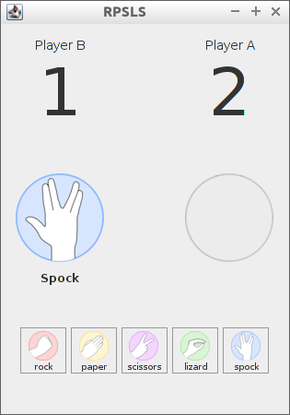
Client Interactions
KP
Start game
KP
Waiting opponent
Send hit
KP
Player D
Player A
Smart-M3
SIB
SIB
SIB
Player C
Player B
KP
Join game
Waiting hit
KP
KP
Waiting games

Slide 8
Reference ontology class tree
InteractiveGame
GameDescription
CommandType
ControlSet
owl:Thing
Command
CommandInterface
GameStatus
Person

Slide 9
Datatype Properties
Property name | Domain
hasName | Person
hasScore | GameSession
hasTime | Command

Slide 10
Object Properties
Property name | Domain | Range
HasCommand | CommandInterface | Command
HasCommandInterface | GameSession | CommandInterface
HasCommandType | Commmand | CommandType
HasControlSet | InteractiveGame | ControlSet
HasGameDescription | GameSession | GameDescription
HasGameSession | InteractiveGame | GameSession
HasGuest | GameSession | Person
HasHome | GameSession | Person
HasIssuer | Command | Person
HasObserver | GameSession | Person
HasPlayer | GameSession | Person
HasStatus | GameSession | GameStatus
HasSupportedCommand | ControlSet | CommandType

Slide 11
Individuals
Individuals | Types
RPSLS | IntereractiveGame
RPSLS-ControlSet | ControlSet
Active | Gamestatus
Ended | Gamestatus
Paused | Gamestatus
Waiting | Gamestatus
Lizard | CommandType
Paper | CommandType
Rock | CommandType
Scissors | CommandType
Spock | CommandType

Slide 12
Instances
InteractiveGame
“Score”
GameSession
HasScore
HasGameSession
InteractiveGame_URI
GameSession_URI
HasControlSet
HasGameDescription
GameDescription_URI
HasGuest
ControlSet
HasStatus
HasHome
GameDescription
GameStatus_URI
HasObserver
HasSupportedCommand
GameStatus
ControlSet_URI
HasPlayer
HasCommandInterface
CommandInterface
Person_URI
Person
rdf:type
CommandType_URI
CommandInterface_URI
HasName
CLASS
CommandType
HasCommand
“Name”
Property
HasIssuer
“Time”
Class Instance
Command_URI
HasTime
Literal
HasCommandType
Command

Slide 13
General
Ontology acknowledgment
InteractiveGame
“Score”
GameSession
HasScore
HasGameSession
InteractiveGame_URI
GameSession_URI
HasControlSet
HasGameDescription
GameDescription_URI
HasGuest
ControlSet
HasStatus
HasHome
GameDescription
GameStatus_URI
HasObserver
HasSupportedCommand
GameStatus
ControlSet_URI
HasPlayer
HasCommandInterface
CommandInterface
Person_URI
Person
rdf:type
CommandType_URI
CommandInterface_URI
HasName
CLASS
CommandType
HasCommand
“Name”
Property
HasIssuer
“Time”
Class Instance
Command_URI
HasTime
Literal
HasCommandType
Command

Slide 14
Producer
General ontology awareness
InteractiveGame
“Score”
GameSession
HasScore
HasGameSession
InteractiveGame_URI
GameSession_URI
HasControlSet
HasGameDescription
GameDescription_URI
HasGuest
ControlSet
HasStatus
HasHome
GameDescription
GameStatus_URI
HasObserver
HasSupportedCommand
GameStatus
ControlSet_URI
HasPlayer
HasCommandInterface
CommandInterface
Person_URI
Person
rdf:type
CommandType_URI
CommandInterface_URI
HasName
CLASS
CommandType
HasCommand
“Name”
Property
HasIssuer
“Time”
Class Instance
Command_URI
HasTime
Literal
HasCommandType
Command

Slide 15
Producer
Create new player ontology awareness
InteractiveGame
“Score”
GameSession
HasScore
HasGameSession
InteractiveGame_URI
GameSession_URI
HasControlSet
HasGameDescription
GameDescription_URI
HasGuest
ControlSet
HasStatus
HasHome
GameDescription
GameStatus_URI
HasObserver
HasSupportedCommand
GameStatus
ControlSet_URI
HasPlayer
HasCommandInterface
CommandInterface
Person_URI
Person
rdf:type
CommandType_URI
CommandInterface_URI
HasName
CLASS
CommandType
HasCommand
“Name”
Property
HasIssuer
“Time”
Class Instance
Command_URI
HasTime
Literal
HasCommandType
Command

Slide 16
Producer
Create new game ontology awareness
InteractiveGame
“Score”
GameSession
HasScore
HasGameSession
InteractiveGame_URI
GameSession_URI
HasControlSet
HasGameDescription
GameDescription_URI
HasGuest
ControlSet
HasStatus
HasHome
GameDescription
GameStatus_URI
HasObserver
HasSupportedCommand
GameStatus
ControlSet_URI
HasPlayer
HasCommandInterface
CommandInterface
Person_URI
Person
rdf:type
CommandType_URI
CommandInterface_URI
HasName
CLASS
CommandType
HasCommand
“Name”
Property
HasIssuer
“Time”
Class Instance
Command_URI
HasTime
Literal
HasCommandType
Command

Slide 17
S2_Waiting games
Ontology awareness
InteractiveGame
“Score”
GameSession
HasScore
HasGameSession
InteractiveGame_URI
GameSession_URI
When producer inserts new game, subscription sends notify with new data.
If waiting game changes status in activate or ended send notify obsolete
HasControlSet
HasGameDescription
GameDescription_URI
HasGuest
ControlSet
HasStatus
HasHome
GameDescription
GameStatus_URI
HasObserver
HasSupportedCommand
GameStatus
ControlSet_URI
HasPlayer
HasCommandInterface
CommandInterface
Person_URI
Person
rdf:type
CommandType_URI
CommandInterface_URI
HasName
CLASS
CommandType
HasCommand
“Name”
Property
HasIssuer
“Time”
Class Instance
Command_URI
HasTime
Literal
HasCommandType
Command

Slide 18
Producer
Join game ontology awareness
InteractiveGame
“Score”
GameSession
HasScore
HasGameSession
InteractiveGame_URI
GameSession_URI
HasControlSet
HasGameDescription
GameDescription_URI
HasGuest
ControlSet
HasStatus
HasHome
GameDescription
GameStatus_URI
HasObserver
HasSupportedCommand
GameStatus
ControlSet_URI
HasPlayer
HasCommandInterface
CommandInterface
Person_URI
Person
rdf:type
CommandType_URI
CommandInterface_URI
HasName
CLASS
CommandType
HasCommand
“Name”
Property
HasIssuer
“Time”
Class Instance
Command_URI
HasTime
Literal
HasCommandType
Command

Slide 19
S1_Waiting opponent
Ontology awareness
InteractiveGame
“Score”
GameSession
HasScore
HasGameSession
InteractiveGame_URI
GameSession_URI
When player joins a waiting game subscription sends a notification to the home player
HasControlSet
HasGameDescription
GameDescription_URI
HasGuest
ControlSet
HasStatus
HasHome
GameDescription
GameStatus_URI
HasObserver
HasSupportedCommand
GameStatus
ControlSet_URI
HasPlayer
HasCommandInterface
CommandInterface
Person_URI
Person
rdf:type
CommandType_URI
CommandInterface_URI
HasName
CLASS
CommandType
HasCommand
“Name”
Property
HasIssuer
“Time”
Class Instance
Command_URI
HasTime
Literal
HasCommandType
Command

Slide 20
Producer
Send hit ontology awareness
InteractiveGame
“Score”
GameSession
HasScore
HasGameSession
InteractiveGame_URI
GameSession_URI
HasControlSet
HasGameDescription
GameDescription_URI
HasGuest
ControlSet
HasStatus
HasHome
GameDescription
GameStatus_URI
HasObserver
HasSupportedCommand
GameStatus
ControlSet_URI
HasPlayer
HasCommandInterface
CommandInterface
Person_URI
Person
rdf:type
CommandType_URI
CommandInterface_URI
HasName
CLASS
CommandType
HasCommand
“Name”
Property
HasIssuer
“Time”
Class Instance
Command_URI
HasTime
Literal
HasCommandType
Command

Slide 21
S3_Hit
Ontology awareness
InteractiveGame
“Score”
GameSession
HasScore
HasGameSession
InteractiveGame_URI
GameSession_URI
When player sends hit subscription notify to his opponent that there is a new command into command interface
HasControlSet
HasGameDescription
GameDescription_URI
HasGuest
ControlSet
HasStatus
HasHome
GameDescription
GameStatus_URI
HasObserver
HasSupportedCommand
GameStatus
ControlSet_URI
HasPlayer
HasCommandInterface
CommandInterface
Person_URI
Person
rdf:type
CommandType_URI
CommandInterface_URI
HasName
CLASS
CommandType
HasCommand
“Name”
Property
HasIssuer
“Time”
Class Instance
Command_URI
HasTime
Literal
HasCommandType
Command

Slide 22
Producer
Leave game ontology awareness
InteractiveGame
“Score”
GameSession
HasScore
HasGameSession
InteractiveGame_URI
GameSession_URI
HasControlSet
HasGameDescription
GameDescription_URI
HasGuest
ControlSet
HasStatus
HasHome
GameDescription
GameStatus_URI
HasObserver
HasSupportedCommand
GameStatus
ControlSet_URI
HasPlayer
HasCommandInterface
CommandInterface
Person_URI
Person
rdf:type
CommandType_URI
CommandInterface_URI
HasName
CLASS
CommandType
HasCommand
“Name”
Property
HasIssuer
“Time”
Class Instance
Command_URI
HasTime
Literal
HasCommandType
Command

Slide 23
S4_Leave game
Ontology awareness
InteractiveGame
“Score”
GameSession
HasScore
HasGameSession
InteractiveGame_URI
GameSession_URI
When game status changes subscription notify to home and guest that the game is ended and players evaluate who win and loose or if opponent leaves.
HasControlSet
HasGameDescription
GameDescription_URI
HasGuest
ControlSet
HasStatus
HasHome
GameDescription
GameStatus_URI
HasObserver
HasSupportedCommand
GameStatus
ControlSet_URI
HasPlayer
HasCommandInterface
CommandInterface
Person_URI
Person
rdf:type
CommandType_URI
CommandInterface_URI
HasName
CLASS
CommandType
HasCommand
“Name”
Property
HasIssuer
“Time”
Class Instance
Command_URI
HasTime
Literal
HasCommandType
Command

