Slide 1
Project Template
Team:
Staff: Carlo Antenucci, Leonardo Iannacone, Alessandro Fedi
Project name:
“Rock, Paper, Scissors, Lizard, Spock”

Slide 2


Scenario
PLAYER 1
PLAYER 2
PC
+
JVM
PC
+
JVM
Smart-M3
SIB
SIB
SIB
ADMIN
PC
+
JVM

Slide 3

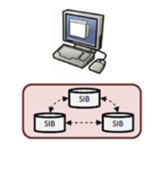
HW Architecture
Player
TCP/IP
GAME UI
JVM
SMART-M3
TCP/IP
Admin
ADMIN UI
JVM

Slide 4
SW Architecture
Player
S4_End game
KP
Leave game
KP
Hit
SIB
SMART M3
S3_Hit
KP
Waiting games
S2_Waiting games
SIB
SIB
KP
Incoming player
S1_Waiting opponent
Player producer
KP
Create new game
Send hit
Join game
Leave game
GUI
Init SIB
Clean SIB
Reset SIB
Delete games
Ending games
Consumer
Update
S5_Ending games
KP
Producer
Subscribe
Admin
Aggregator
Query
KP
Admin producer
GUI

Slide 5
HW/SW Infrastructure
Smart-M3
Player
SIB
S4_End game
KP
SIB
SIB
S3_Hit
KP
S2_Waiting games
KP
Admin
S1_Waiting opponent
KP
S5_Ending games
KP
Player producer
KP
Admin producer
KP

Slide 6
Data flow
Player 2
KP
S1_Waiting opponent
Join game
Player 1
KP
S2_Waiting games
Create new game
KP
Send hit
Player producer
KP
S3_Hit
Leave game
KP
S4_End game

Slide 7

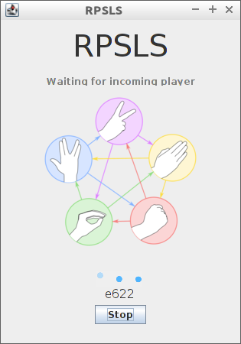
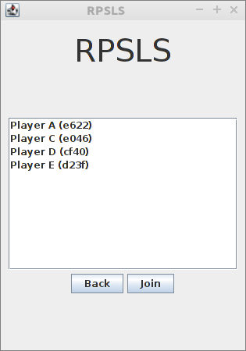
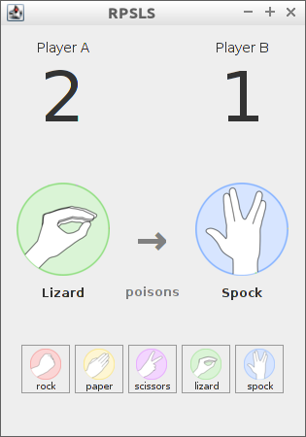
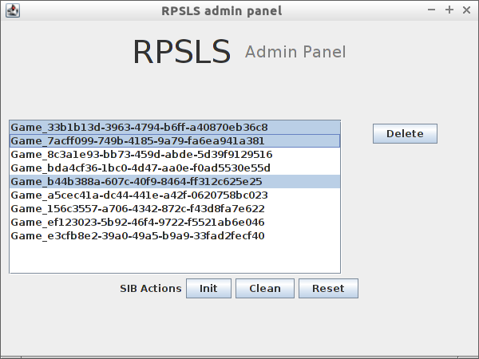
Client Interactions
Game 2
Player 3
Player 4
Waiting opponent…
Smart-M3
KP
Start game
KP
Join game
KP
Send hit
KP
Waiting opponent
KP
Waiting games
KP
Waiting hit
SIB
Player n
SIB
SIB
KP
Delete game
Game 1
KP
Ending games
Player 2
Player 1

Slide 8
Reference ontology class tree
InteractiveGame
GameDescription
CommandType
ControlSet
owl:Thing
Command
CommandInterface
GameStatus
Person

Slide 9
Datatype Properties
Property name | Domain
hasName | Person
hasScore | GameSession
hasTime | Command

Slide 10
Object Properties
Property name | Domain | Range
HasCommand | CommandInterface | Command
HasCommandInterface | GameSession | CommandInterface
HasCommandType | Commmand | CommandType
HasControlSet | InteractiveGame | ControlSet
HasGameDescription | GameSession | GameDescription
HasGameSession | InteractiveGame | GameSession
HasGuest | GameSession | Person
HasHome | GameSession | Person
HasIssuer | Command | Person
HasObserver | GameSession | Person
HasPlayer | GameSession | Person
HasStatus | GameSession | GameStatus
HasSupportedCommand | ControlSet | CommandType

Slide 11
Individuals
Individuals | Types
RPSLS | IntereractiveGame
RPSLS-ControlSet | ControlSet
Active | Gamestatus
Ended | Gamestatus
Paused | Gamestatus
Waiting | Gamestatus
Lizard | CommandType
Paper | CommandType
Rock | CommandType
Scissors | CommandType
Spock | CommandType

Slide 12
Instances
InteractiveGame
“Score”
GameSession
HasScore
HasGameSession
InteractiveGame_URI
GameSession_URI
HasControlSet
HasGameDescription
GameDescription_URI
HasGuest
ControlSet
HasStatus
HasHome
GameDescription
GameStatus_URI
HasObserver
HasSupportedCommand
GameStatus
ControlSet_URI
HasPlayer
HasCommandInterface
CommandInterface
Person_URI
Person
rdf:type
CommandType_URI
CommandInterface_URI
HasName
CLASS
CommandType
HasCommand
“Name”
Property
HasIssuer
“Time”
Class Instance
Command_URI
HasTime
Literal
HasCommandType
Command

Slide 13
General
Ontology acknowledgment
InteractiveGame
“Score”
GameSession
HasScore
HasGameSession
InteractiveGame_URI
GameSession_URI
HasControlSet
HasGameDescription
GameDescription_URI
HasGuest
ControlSet
HasStatus
HasHome
GameDescription
GameStatus_URI
HasObserver
HasSupportedCommand
GameStatus
ControlSet_URI
HasPlayer
HasCommandInterface
CommandInterface
Person_URI
Person
rdf:type
CommandType_URI
CommandInterface_URI
HasName
CLASS
CommandType
HasCommand
“Name”
Property
HasIssuer
“Time”
Class Instance
Command_URI
HasTime
Literal
HasCommandType
Command

Slide 14
Admin producer
Init, clean and reset ontology awareness
InteractiveGame
“Score”
GameSession
HasScore
HasGameSession
InteractiveGame_URI
GameSession_URI
HasControlSet
HasGameDescription
GameDescription_URI
HasGuest
ControlSet
HasStatus
HasHome
GameDescription
GameStatus_URI
HasObserver
HasSupportedCommand
GameStatus
Admin, using init function,
inject into SIB ontology’s static part,
using clean function remove
all game’s entries from SIB,
and using reset removes all
entries from SIB
ControlSet_URI
HasPlayer
HasCommandInterface
CommandInterface
Person_URI
Person
rdf:type
CommandType_URI
CommandInterface_URI
HasName
CLASS
CommandType
HasCommand
“Name”
Property
HasIssuer
“Time”
Class Instance
Command_URI
HasTime
Literal
HasCommandType
Command

Slide 15
Client producer
General ontology awareness
InteractiveGame
“Score”
GameSession
HasScore
HasGameSession
InteractiveGame_URI
GameSession_URI
HasControlSet
HasGameDescription
GameDescription_URI
HasGuest
ControlSet
HasStatus
HasHome
GameDescription
GameStatus_URI
HasObserver
HasSupportedCommand
GameStatus
ControlSet_URI
HasPlayer
HasCommandInterface
CommandInterface
Person_URI
Person
rdf:type
CommandType_URI
CommandInterface_URI
HasName
CLASS
CommandType
HasCommand
“Name”
Property
HasIssuer
“Time”
Class Instance
Command_URI
HasTime
Literal
HasCommandType
Command

Slide 16
Client producer
Create new player ontology awareness
InteractiveGame
“Score”
GameSession
HasScore
HasGameSession
InteractiveGame_URI
GameSession_URI
HasControlSet
HasGameDescription
GameDescription_URI
HasGuest
ControlSet
HasStatus
HasHome
GameDescription
GameStatus_URI
HasObserver
HasSupportedCommand
GameStatus
ControlSet_URI
HasPlayer
HasCommandInterface
CommandInterface
Person_URI
Person
rdf:type
CommandType_URI
CommandInterface_URI
HasName
CLASS
CommandType
HasCommand
“Name”
Property
HasIssuer
“Time”
Class Instance
Command_URI
HasTime
Literal
HasCommandType
Command

Slide 17
Client producer
Create new game ontology awareness
InteractiveGame
“Score”
GameSession
HasScore
HasGameSession
InteractiveGame_URI
GameSession_URI
HasControlSet
HasGameDescription
GameDescription_URI
HasGuest
ControlSet
HasStatus
HasHome
GameDescription
GameStatus_URI
HasObserver
HasSupportedCommand
GameStatus
ControlSet_URI
HasPlayer
HasCommandInterface
CommandInterface
Person_URI
Person
rdf:type
CommandType_URI
CommandInterface_URI
HasName
CLASS
CommandType
HasCommand
“Name”
Property
HasIssuer
“Time”
Class Instance
Command_URI
HasTime
Literal
HasCommandType
Command

Slide 18
S2_Waiting games
Ontology awareness
InteractiveGame
“Score”
GameSession
HasScore
HasGameSession
InteractiveGame_URI
GameSession_URI
When producer inserts new game, subscription sends notify with new data.
If waiting game changes status in activate or ended send notify obsolete
HasControlSet
HasGameDescription
GameDescription_URI
HasGuest
ControlSet
HasStatus
HasHome
GameDescription
GameStatus_URI
HasObserver
HasSupportedCommand
GameStatus
ControlSet_URI
HasPlayer
HasCommandInterface
CommandInterface
Person_URI
Person
rdf:type
CommandType_URI
CommandInterface_URI
HasName
CLASS
CommandType
HasCommand
“Name”
Property
HasIssuer
“Time”
Class Instance
Command_URI
HasTime
Literal
HasCommandType
Command

Slide 19
Client producer
Join game ontology awareness
InteractiveGame
“Score”
GameSession
HasScore
HasGameSession
InteractiveGame_URI
GameSession_URI
HasControlSet
HasGameDescription
GameDescription_URI
HasGuest
ControlSet
HasStatus
HasHome
GameDescription
GameStatus_URI
HasObserver
HasSupportedCommand
GameStatus
ControlSet_URI
HasPlayer
HasCommandInterface
CommandInterface
Person_URI
Person
rdf:type
CommandType_URI
CommandInterface_URI
HasName
CLASS
CommandType
HasCommand
“Name”
Property
HasIssuer
“Time”
Class Instance
Command_URI
HasTime
Literal
HasCommandType
Command

Slide 20
S1_Waiting opponent
Ontology awareness
InteractiveGame
“Score”
GameSession
HasScore
HasGameSession
InteractiveGame_URI
GameSession_URI
When player joins a waiting game subscription sends a notification to the home player
HasControlSet
HasGameDescription
GameDescription_URI
HasGuest
ControlSet
HasStatus
HasHome
GameDescription
GameStatus_URI
HasObserver
HasSupportedCommand
GameStatus
ControlSet_URI
HasPlayer
HasCommandInterface
CommandInterface
Person_URI
Person
rdf:type
CommandType_URI
CommandInterface_URI
HasName
CLASS
CommandType
HasCommand
“Name”
Property
HasIssuer
“Time”
Class Instance
Command_URI
HasTime
Literal
HasCommandType
Command

Slide 21
Client producer
Send hit ontology awareness
InteractiveGame
“Score”
GameSession
HasScore
HasGameSession
InteractiveGame_URI
GameSession_URI
HasControlSet
HasGameDescription
GameDescription_URI
HasGuest
ControlSet
HasStatus
HasHome
GameDescription
GameStatus_URI
HasObserver
HasSupportedCommand
GameStatus
ControlSet_URI
HasPlayer
HasCommandInterface
CommandInterface
Person_URI
Person
rdf:type
CommandType_URI
CommandInterface_URI
HasName
CLASS
CommandType
HasCommand
“Name”
Property
HasIssuer
“Time”
Class Instance
Command_URI
HasTime
Literal
HasCommandType
Command

Slide 22
S3_Hit
Ontology awareness
InteractiveGame
“Score”
GameSession
HasScore
HasGameSession
InteractiveGame_URI
GameSession_URI
When player sends hit subscription notify to his opponent that there is a new command into command interface
HasControlSet
HasGameDescription
GameDescription_URI
HasGuest
ControlSet
HasStatus
HasHome
GameDescription
GameStatus_URI
HasObserver
HasSupportedCommand
GameStatus
ControlSet_URI
HasPlayer
HasCommandInterface
CommandInterface
Person_URI
Person
rdf:type
CommandType_URI
CommandInterface_URI
HasName
CLASS
CommandType
HasCommand
“Name”
Property
HasIssuer
“Time”
Class Instance
Command_URI
HasTime
Literal
HasCommandType
Command

Slide 23
Client producer
Leave game ontology awareness
InteractiveGame
“Score”
GameSession
HasScore
HasGameSession
InteractiveGame_URI
GameSession_URI
HasControlSet
HasGameDescription
GameDescription_URI
HasGuest
ControlSet
HasStatus
HasHome
GameDescription
GameStatus_URI
HasObserver
HasSupportedCommand
GameStatus
ControlSet_URI
HasPlayer
HasCommandInterface
CommandInterface
Person_URI
Person
rdf:type
CommandType_URI
CommandInterface_URI
HasName
CLASS
CommandType
HasCommand
“Name”
Property
HasIssuer
“Time”
Class Instance
Command_URI
HasTime
Literal
HasCommandType
Command

Slide 24
S4_Leave game
Ontology awareness
InteractiveGame
“Score”
GameSession
HasScore
HasGameSession
InteractiveGame_URI
GameSession_URI
When game status changes
subscription notify to home and guest that the game is ended and players
evaluate who win and loose or
if opponent leaves.
HasControlSet
HasGameDescription
GameDescription_URI
HasGuest
ControlSet
HasStatus
HasHome
GameDescription
GameStatus_URI
HasObserver
HasSupportedCommand
GameStatus
ControlSet_URI
HasPlayer
HasCommandInterface
CommandInterface
Person_URI
Person
rdf:type
CommandType_URI
CommandInterface_URI
HasName
CLASS
CommandType
HasCommand
“Name”
Property
HasIssuer
“Time”
Class Instance
Command_URI
HasTime
Literal
HasCommandType
Command

Slide 25
S5_Ending games
Ontology awareness
InteractiveGame
“Score”
GameSession
HasScore
HasGameSession
InteractiveGame_URI
GameSession_URI
When game status changes
to ended subscription send a notify to admin and the game uri is
added to the ended games list.
HasControlSet
HasGameDescription
GameDescription_URI
HasGuest
ControlSet
HasStatus
HasHome
GameDescription
GameStatus_URI
HasObserver
HasSupportedCommand
GameStatus
ControlSet_URI
HasPlayer
HasCommandInterface
CommandInterface
Person_URI
Person
rdf:type
CommandType_URI
CommandInterface_URI
HasName
CLASS
CommandType
HasCommand
“Name”
Property
HasIssuer
“Time”
Class Instance
Command_URI
HasTime
Literal
HasCommandType
Command

Slide 26
Admin producer
Delete games ontology awareness
InteractiveGame
“Score”
GameSession
HasScore
HasGameSession
InteractiveGame_URI
GameSession_URI
HasControlSet
HasGameDescription
GameDescription_URI
HasGuest
ControlSet
HasStatus
HasHome
GameDescription
GameStatus_URI
HasObserver
HasSupportedCommand
GameStatus
ControlSet_URI
HasPlayer
HasCommandInterface
CommandInterface
Person_URI
Person
rdf:type
CommandType_URI
CommandInterface_URI
HasName
CLASS
CommandType
HasCommand
“Name”
Property
HasIssuer
“Time”
Class Instance
Command_URI
HasTime
Literal
HasCommandType
Command

Slide 27
Admin producer
Delete games ontology awareness
InteractiveGame
“Score”
GameSession
HasScore
HasGameSession
InteractiveGame_URI
GameSession_URI
When the admin deletes a game all
entries connected to the game
selected are removed from SIB
HasControlSet
HasGameDescription
GameDescription_URI
HasGuest
ControlSet
HasStatus
HasHome
GameDescription
GameStatus_URI
HasObserver
HasSupportedCommand
GameStatus
ControlSet_URI
HasPlayer
HasCommandInterface
CommandInterface
Person_URI
Person
rdf:type
CommandType_URI
CommandInterface_URI
HasName
CLASS
CommandType
HasCommand
“Name”
Property
HasIssuer
“Time”
Class Instance
Command_URI
HasTime
Literal
HasCommandType
Command

